Slide 1
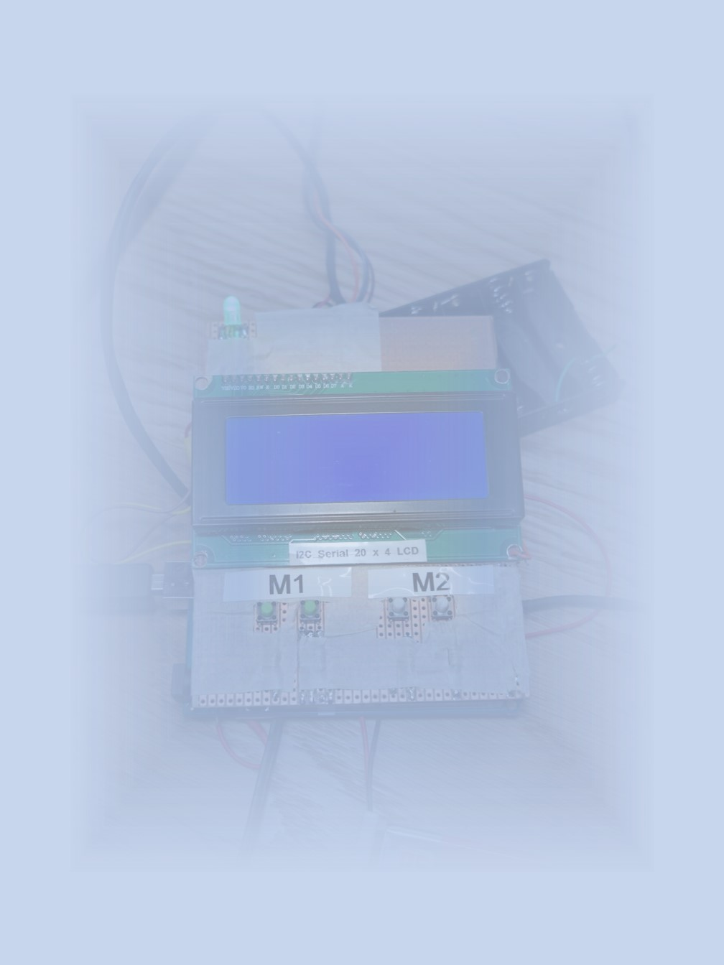
Group Research (Group C)
Jelly Jinzhe Liu – Hardware part
AB20328
Introduction
This project is to use the camera above the maze to capture the map of the maze and the ball for image recognition and path planning, and send the data to the motor connected to the maze to achieve automatic walking from the starting point to the end point without falling into the hole
Objective
In the hardware part, the main function is using the motor to drive two knobs in the maze, which can control the pitch and roll. This function is leading the ball running in the guided route in case of not dropping the hole and to the destination. It uses two servo motors to drive the maze by connecting to Arduino Mega. when the system turns on, Arduino will do a self-check to make sure every component is connected and working well.
After self-check, the user can choose two modes: auto mode and manual mode. It also includes auto trim, connect to pc and degree in auto mode. The benefit of this plan is to keep the original appearance and function of the maze, so people can still use it like the product itself.
Empirical Methodology
To use the motor as the maze driver, precise and fast motors are needed. Using servo motors is a good option to consider. Adding a gyro sensor can solve the problem of different ball speeds when the table is uneven. It's essential to establish simple, low-latency communication with the computer to reduce delay caused by turning the maze, which affects real-time performance. The manual mode is designed for users to adjust the maze angle themselves. The design mode selection function enables users or engineers to better use or debug the system.
Empirical Results
Reference

