Slide 1
Software Defined Networks (SDN)
Joel Sivanish
CSCD330-HW6
Eastern Washington University

Slide 2
What is Software Defined Networks?
SDN separates a network’s control plane from its data plane.
A centralized controller makes routing decisions instead of individual routers.
Switches act as simple forwarding devices using rules installed by the controller.
SDN introduces programmability, automation, and flexible policy management.

Slide 3
Why does SDN Exist?
Traditional networks require manual configuration on each device.
Scaling a network becomes difficult as the number of routers grows.
Policies can be inconsistent because each router runs local protocols.
SDN enables centralized control, network-wide visibility, and quick reconfiguration.

Slide 4
Core Components of SDN Architecture
SDN Controller: the “brain” that maintains a global network view and computes decisions.
SDN Switches: hardware devices that forward packets according to controller-installed rules.
Network Applications: software that automates tasks like traffic engineering and security.
APIs: northbound APIs connect apps to the controller, and southbound APIs connect the controller to switches.

Slide 5
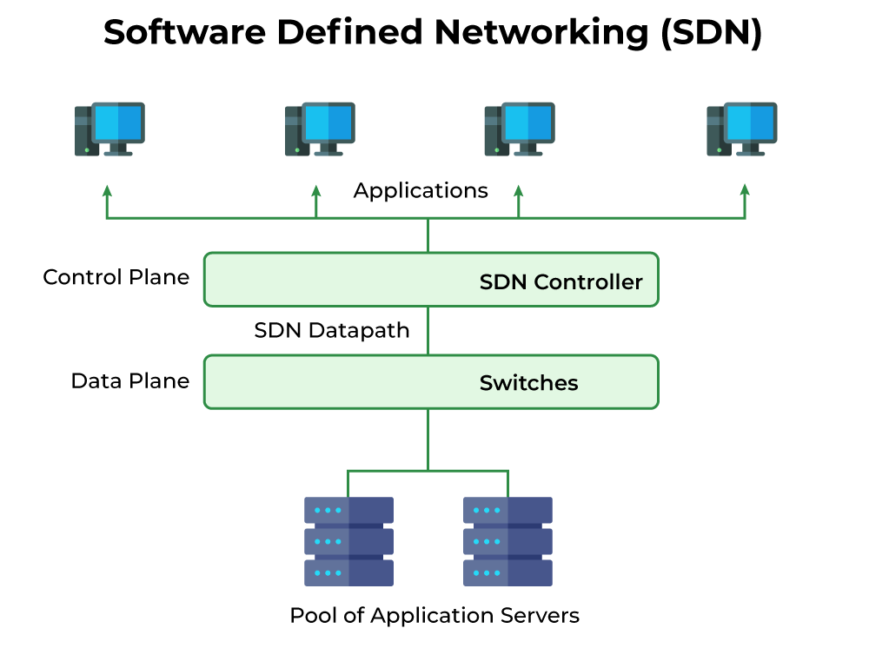

Slide 6
SDN Diagram Explanation
The SDN controller sits in the middle and acts like the “brain” of the network, making decisions about how traffic should be forwarded.
Applications communicate upward with the controller to request information or apply network policies.
The controller communicates downward to the switches, telling them exactly how to forward packets by installing flow rules in their forwarding tables.
Switches in the data plane don’t make any decisions, they simply follow the rules set by the controller.

Slide 7
How Does SDN Operate?
When a switch receives a packet without a matching rule, it forwards metadata to the controller.
The controller analyzes the packet and determines what forwarding behavior should be applied.
It installs a new flow rule onto the switch for future matching.
Subsequent packets in the same flow are forwarded locally without controller involvement.

Slide 8
SDN Product Example: Cisco Meraki
Cisco Meraki is a cloud-managed networking platform that applies SDN principles to real deployments.
A centralized cloud controller manages switches, access points, security appliances, and IoT devices.
Meraki exposes APIs for automation, integrations, and programmable network workflows.
Provides analytics tools for monitoring LAN, WAN, and application performance across sites.

Slide 9
Sources
Kurose, James, and Keith Ross. Computer Networking: A Top-Down Approach, 7th Edition.
Spiceworks. “15 Best Software-Defined Networking (SDN) Solutions.”
https://www.spiceworks.com/tech/networking/articles/best-sdn-solutions/
GeeksforGeeks. “Software Defined Networking (SDN).”
https://www.geeksforgeeks.org/computer-networks/software-defined-networking/

