Slide 1

MIT 6.S081 2021 Labs Report
软件工程 2253406 李跃跃
仓库地址：git@github.com:JellyYuey/MIT-6.S081.git

Slide 2
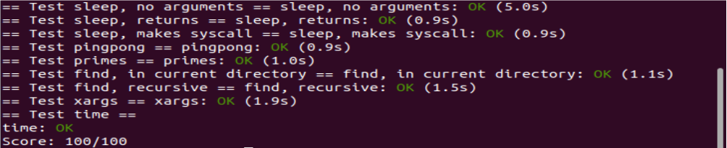
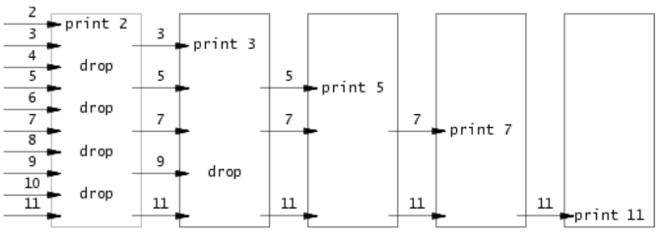
Lab1：Xv6 and Unix Utilities
Boot xv6
sleep
pingpong
primes
find
xargs

Slide 3
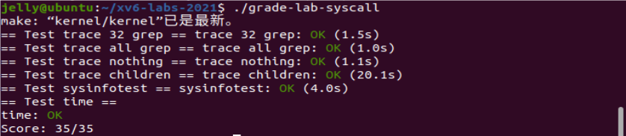
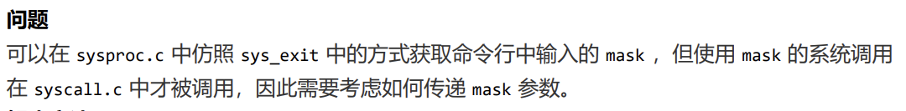
Lab2：System Calls
System call tracking
Sysinfo

Slide 4
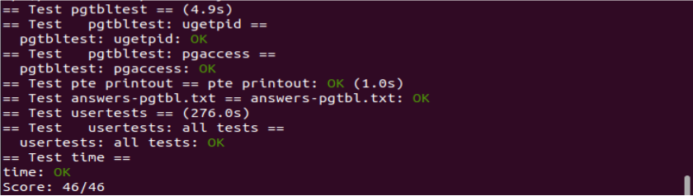
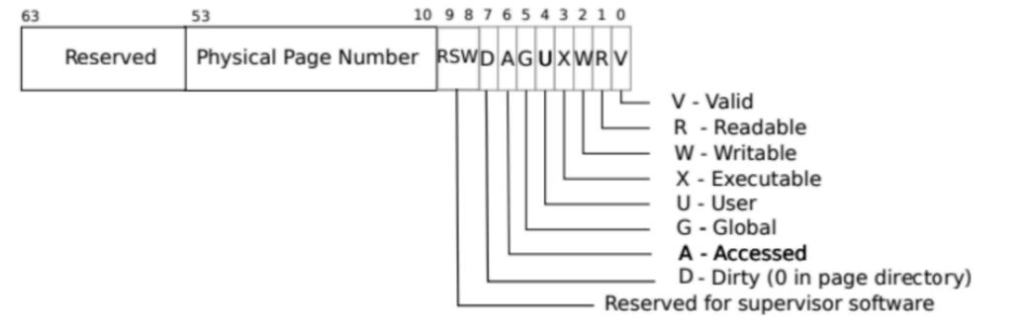
Lab3：Page Tables
Speed up system calls
Print a page table
Detecting which pages have been accessed

Slide 5
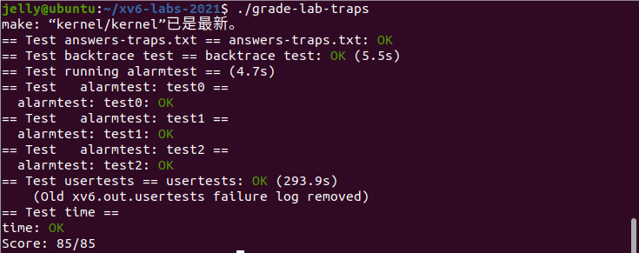

Lab4：Traps
RISC-V assembly
Backtrace
Alarm

Slide 6
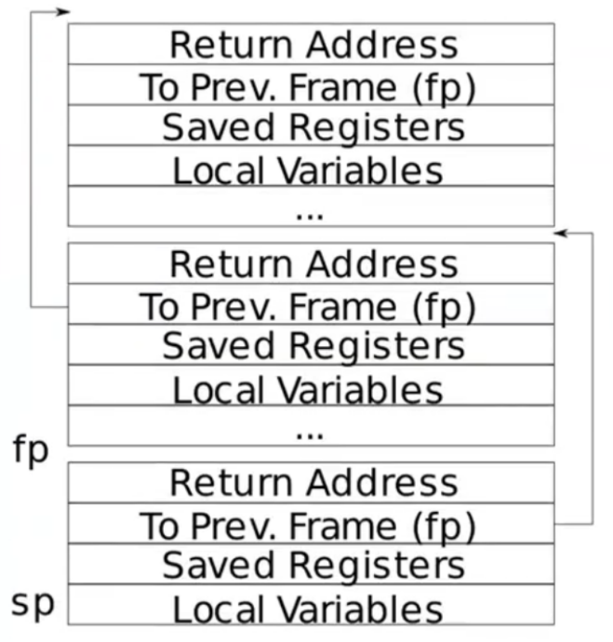
Lab4：Traps
RISC-V assembly
Backtrace
Alarm

Slide 7
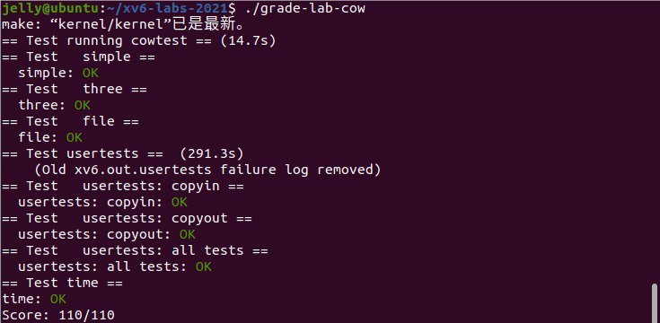
Lab5：Copy-on-Write Fork for xv6

Slide 8
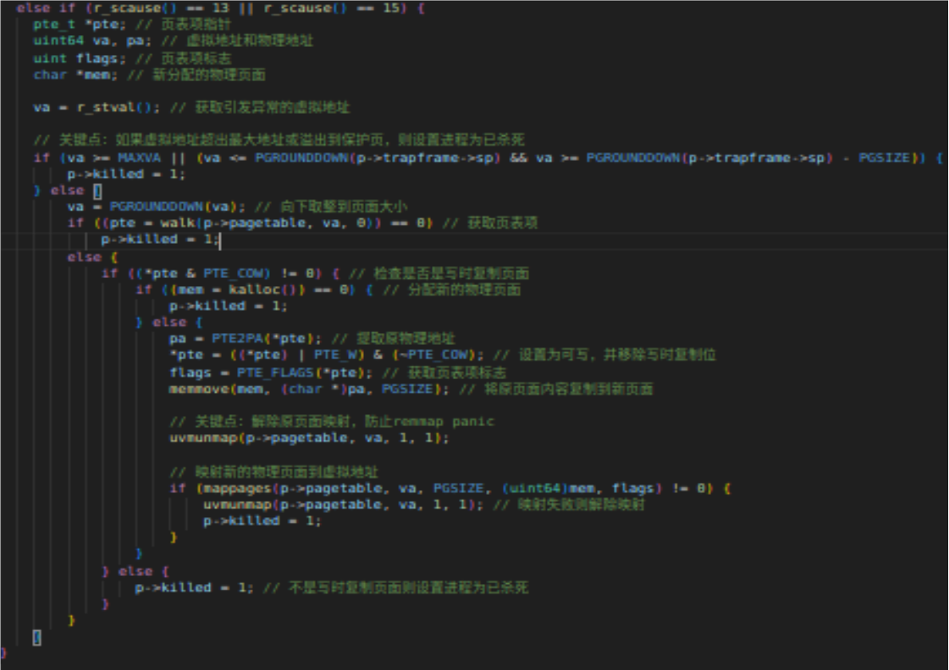
Lab5：Copy-on-Write Fork for xv6

Slide 9
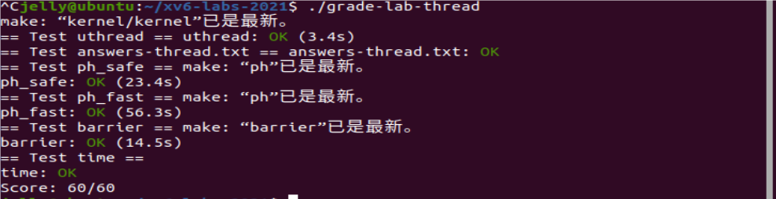
Lab6：Multithreading
Uthread: switching between threads
Using threads
Barrier
为什么RISC-V中有32个寄存器，但是swtch函数中只保存并恢复了14个寄存器？

Slide 10
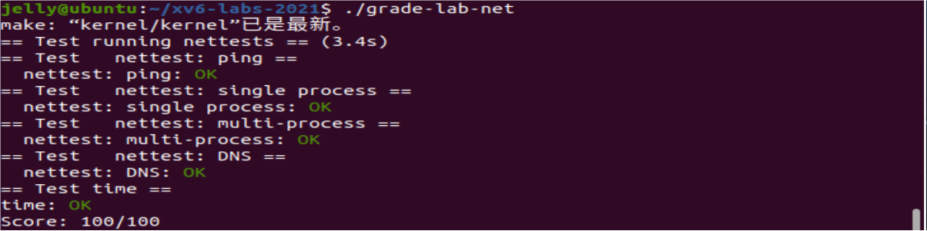
Lab7：Networking
_{E1000 硬件的数据包接受与传输机制}

Slide 11
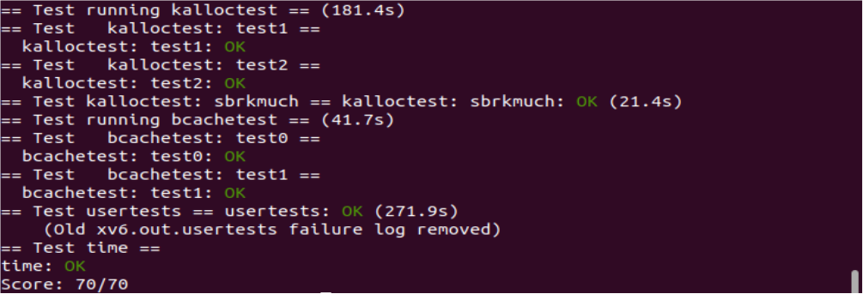
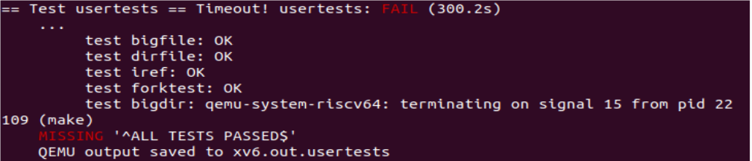
Lab8：Locks
Memory allocator
Buffer cache

Slide 12
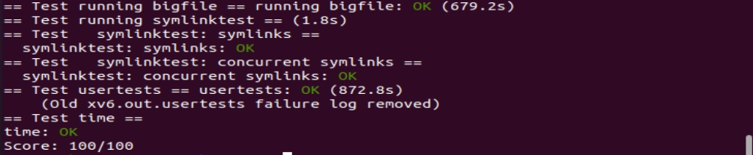
Lab9：File System
Large files
Symbolic links
在实验指南里有提到“别忘了把你 bread() 的每一个块都 brelse()” ，为什么？

Slide 13
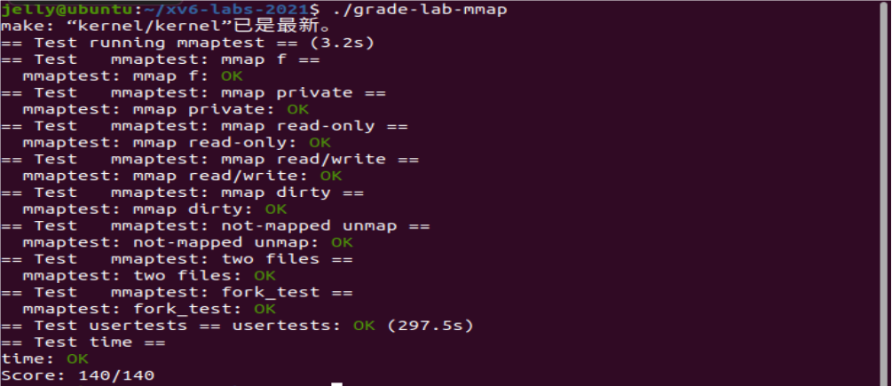
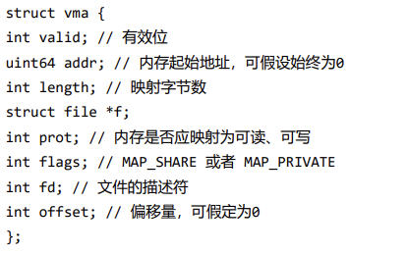
Lab10：Mmap
_{VMA 结构体的设计}

Slide 14
参考代码
https://github.com/PKUFlyingPig/MIT6.S081-2020fall
https://github.com/jlu-xiurui/MIT6.S081-2021-FALL/blob/master/lab8-net
https://github.com/Pikachudy/xv6-labs-2021
https://github.com/onevfall/MIT-6.S081
https://github.com/Baokker/my_xv6_lab
参考教程
官网：https://pdos.csail.mit.edu/6.828/2021
汉化：http://xv6.dgs.zone
笔记：https://fanxiao.tech/posts/2021-03-02-mit-6s081-notes/
课程翻译：https://mit-public-courses-cn-translatio.gitbook.io/mit6-s081/
视频教程：https://www.bilibili.com/video/BV1Qi4y1o7tN/?spm_id_from=333.788&vd_source=54848bbaacc95a6670b0f8ac0228b019
我的仓库地址：git@github.com:JellyYuey/MIT-6.S081.git

Slide 15
感谢观看
软件工程 2253406 李跃跃
2024/07/26
仓库地址：git@github.com:JellyYuey/MIT-6.S081.git

