Slide 1
UNIT-2
Introduction to
Embedded Systems

Slide 2
Embedded System
An Electronic/Electro mechanical system which is designed to perform a specific function and is a combination of both hardware and firmware (Software)
EXAMPLES:
Electronic Toys,
Mobile Handsets,
Washing Machines, Air Conditioners,
Automotive Control Units,
Set Top Box, DVD Player etc…
Embedded Systems are:
  Unique in character and behavior
  With specialized hardware and software

Slide 3
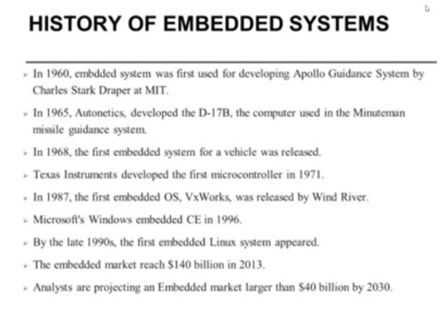

Slide 4
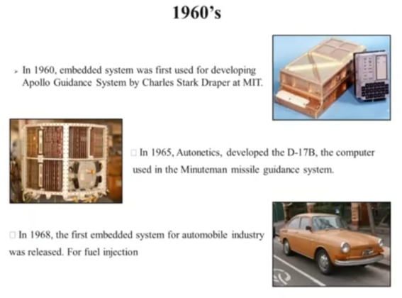

Slide 5
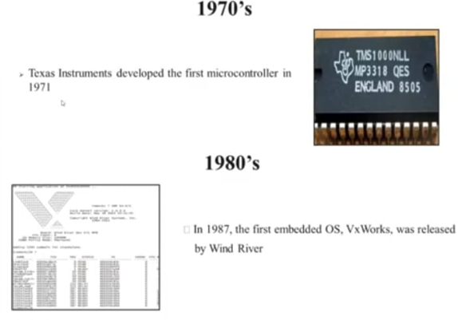

Slide 6
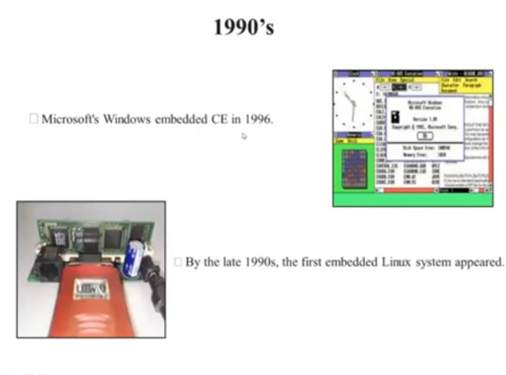

Slide 7
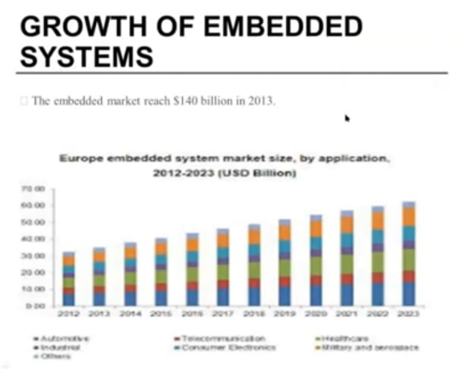

Slide 8
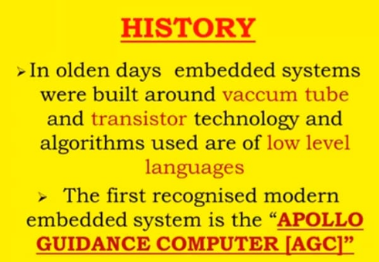

Slide 9
History of Embedded Systems:
First Recognized Modern Embedded System: Apollo Guidance Computer (AGC) developed by Charles Stark Draper at the MIT Instrumentation Laboratory.
  It has two modules
  1.Command module(CM) 2.Lunar Excursion module(LEM)
  RAM size 256 , 1K ,2K words
  ROM size 4K,10K,36K words
  Clock frequency is 1.024MHz
  5000 ,3-input RTL NOR gates are used
  User interface is DSKY(display/Keyboard)
First Mass Produced Embedded System: Autonetics D-17 Guidance computer for Minuteman-I missile

Slide 10
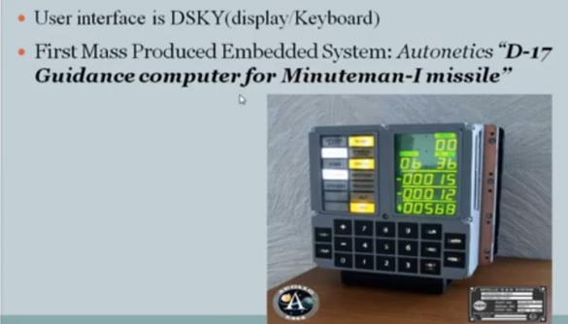

Slide 11
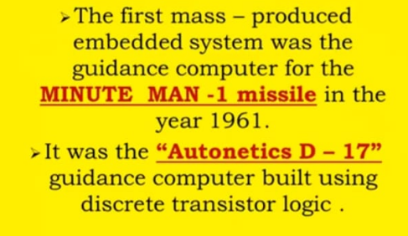
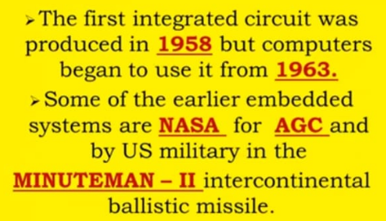

Slide 12
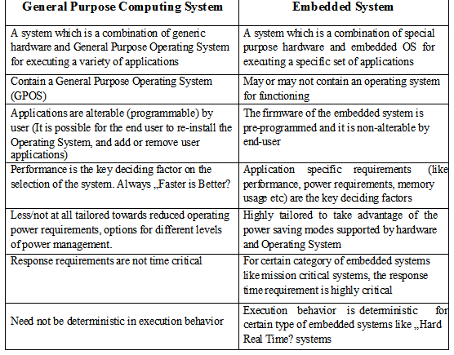
Embedded Systems Vs General Computing Systems:

Slide 13
Classification of Embedded Systems:
  Based on Generation
  Based on Complexity & Performance Requirements
  Based on deterministic behavior
  Based on Triggering

Slide 14
Embedded Systems - Classification based on Generation
First Generation: The early embedded systems built around 8-bit microprocessors like 8085 and Z80 and 4-bit microcontrollers with simple hardware and firmware.
EX. stepper motor control units, Digital Telephone Keypads etc.
Second Generation: Embedded Systems built around 16-bit microprocessors and 8 or 16-bit microcontrollers, following the first generation embedded systems
EX.SCADA, Data Acquisition Systems etc.

Slide 15
Third Generation: Embedded Systems built around high performance 16/32 bit Microprocessors/controllers, Application Specific Instruction set processors like Digital Signal Processors (DSPs), and Application Specific Integrated Circuits (ASICs).The instruction set is complex and powerful.
EX. Robotics, industrial process control, networking etc.
Fourth Generation: Embedded Systems built around System on Chips (SoC’s), Re- configurable processors and multicore processors. It brings high performance, tight integration and miniaturization into the embedded device market
EX Smart phone devices, MIDs etc.

Slide 16
Embedded Systems - Classification based on Complexity & Performance
Small Scale:
The embedded systems built around low performance and low cost 8 or 16 bit microprocessors/ microcontrollers.
It is suitable for simple applications and where performance is not time critical.
It may or may not contain OS.
Medium Scale:
Embedded Systems built around medium performance, low cost 16 or 32 bit microprocessors / microcontrollers or DSPs.
These are slightly complex in hardware and firmware. It may contain GPOS/RTOS.

Slide 17
Large Scale/Complex:
Embedded Systems built around high performance 32 or 64 bit RISC processors/controllers, RSoC or multi-core processors and PLD.
It requires complex hardware and software.
These system may contain multiple processors/controllers and co-units/hardware accelerators for offloading the processing requirements from the main processor.
It contains RTOS for scheduling, prioritization and management.

Slide 18
Embedded Systems - Classification Based on deterministic behavior:
It is applicable for Real Time systems. The application/task execution behavior for an embedded system can be either deterministic or non-deterministic
These are classified in to two types
  Soft Real time Systems: Missing a deadline may not be critical and can be tolerated to a certain degree
  Hard Real time systems: Missing a program/task execution time deadline can have catastrophic consequences (financial, human loss of life, etc.)

Slide 19
Embedded Systems - Classification Based on Triggering:
These are classified into two types
  Event Triggered : Activities within the system (e.g., task run-times) are dynamic and depend upon occurrence of different events .
  Time triggered: Activities within the system follow a statically computed schedule (i.e., they are allocated time slots during which they can take place) and thus by nature are predictable.

Slide 20
Major Application Areas of Embedded Systems:
Consumer Electronics: Camcorders, Cameras etc.
Household Appliances: Television, DVD players, washing machine, Fridge, Microwave Oven etc.
Home Automation and Security Systems: Air conditioners, sprinklers, Intruder detection alarms, Closed Circuit Television Cameras, Fire alarms etc.
Automotive Industry: Anti-lock breaking systems (ABS), Engine Control, Ignition Systems, Automatic Navigation Systems etc.
Telecom: Cellular Telephones, Telephone switches, Handset Multimedia Applications etc.

Slide 21
Computer Peripherals: Printers, Scanners, Fax machines etc.
Computer Networking Systems: Network Routers, Switches, Hubs, Firewalls etc.
Health Care: Different Kinds of Scanners, EEG, ECG Machines etc.
Measurement & Instrumentation: Digital multi meters, Digital CROs, Logic Analyzers PLC systems etc.
Banking & Retail: Automatic Teller Machines (ATM) and Currency counters, Point of Sales (POS)
Card Readers: Barcode, Smart Card Readers, Hand held Devices etc.

Slide 22
Purpose of Embedded Systems:
Each Embedded Systems is designed to serve the purpose of any one or a combination of the following tasks.
  Data Collection/Storage/Representation
  Data Communication
  Data (Signal) Processing
  Monitoring
  Control
  Application Specific User Interface

Slide 23
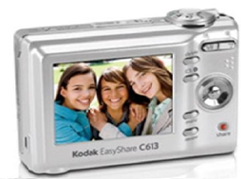
Data Collection/Storage/Representation
  Performs acquisition of data from the external world.
  The collected data can be either analog or digital
  Data collection is usually done for storage, analysis, manipulation and transmission
  The collected data may be stored directly in the system or may be transmitted to some other systems or it may be processed by the system or it may be deleted instantly after giving a meaningful representation

Slide 24
Data Communication:-
Embedded Data communication systems are deployed in applications ranging from complex satellite communication systems to simple home networking systems
Embedded Data communication systems are dedicated for data communication
The data communication can happen through a wired interface (like Ethernet, RS-232C/USB/IEEE1394 etc) or wireless interface (like Wi-Fi, GSM,/GPRS, Bluetooth, ZigBee etc)
Network hubs, Routers, switches, Modems etc are typical examples for dedicated data transmission embedded systems

Slide 25
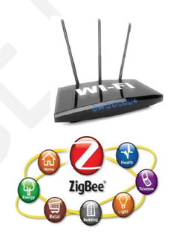

Slide 26
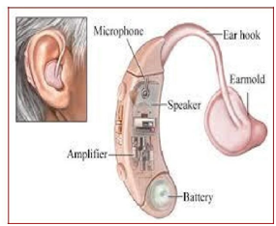
  Data (Signal) Processing
Embedded systems with Signal processing functionalities are employed in applications demanding signal processing like Speech coding, synthesis, audio video codec, transmission applications etc
Computational intensive systems Employs Digital Signal Processors (DSPs)

Slide 27
4.Monitoring:-
Embedded systems coming under this category are specifically designed for monitoring purpose
They are used for determining the state of some variables using input sensors
They cannot impose control over variables.
Measuring instruments like Digital CRO, Digital Multi meter, Logic Analyzer etc used in Control & Instrumentation applications are also examples of embedded systems for monitoring purpose

Slide 28
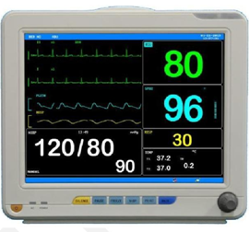
Electro Cardiogram (ECG) machine for monitoring the heart beat of a patient is a typical example for this
The sensors used in ECG are the different Electrodes connected to the patient’s body

Slide 29
5.Control:-
Embedded systems with control functionalities are used for imposing control over some variables according to the changes in input variables
Embedded system with control functionality contains both sensors and actuators
Sensors are connected to the input port for capturing the changes in environmental variable or measuring variable
The actuators connected to the output port are controlled according to the changes in input variable to put an impact on the controlling variable to bring the controlled variable to the specified range
Air conditioner for controlling room temperature is a typical example for embedded system with „Control‟ functionality

Slide 30
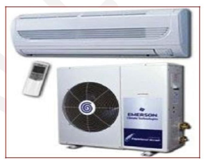
Air conditioner contains a room temperature sensing element (sensor) which may be a thermistor and a handheld unit for setting up (feeding) the desired temperature
The air compressor unit acts as the actuator. The compressor is controlled according to the current room temperature and the desired temperature set by the end user.

Slide 31
Application Specific User Interface:-
Embedded systems which are designed for a specific application
Contains Application Specific User interface (rather than general standard UI ) like key board, Display units etc
Aimed at a specific target group of users
Mobile handsets, Control units in industrial applications etc are examples

Slide 32
Characteristics of Embedded systems:
Embedded systems possess certain specific characteristics and these are unique to each Embedded system.
  Application and domain specific
  Reactive and Real Time
  Operates in harsh environments
  Distributed
  Small Size and weight
  Power concerns

Slide 33
1.Application and Domain Specific:-
  Each E.S has certain functions to perform and they are developed in such a manner to do the intended functions only.
  They cannot be used for any other purpose.
  Ex – The embedded control units of the microwave oven cannot be replaced with AC’s embedded control unit because the embedded control units of microwave oven and AC are specifically designed to perform certain specific tasks.

Slide 34
2.Reactive and Real Time:-
  E.S are in constant interaction with the real world through sensors and user-defined input devices which are connected to the input port of the system.
  Any changes in the real world are captured by the sensors or input devices in real time and the control algorithm running inside the unit reacts in a designed manner to bring the controlled output variables to the desired level.
  E.S produce changes in output in response to the changes in the input, so they are referred as reactive systems.
  Real Time system operation means the timing behavior of the system should be deterministic i.e the system should respond to requests in a known amount of time.
Example – E.S which are mission critical like flight control systems, Antilock Brake Systems (ABS) etc are Real Time systems.

Slide 35
3.Operates in Harsh Environment :–
  The design of E.S should take care of the operating conditions of the area where the system is going to implement.
  Ex – If the system needs to be deployed in a high temperature zone, then all the components used in the system should be of high temperature grade.
  Also proper shock absorption techniques should be provided to systems which are going to be commissioned in places subject to high shock.
4.Distributed: –
  It means that embedded systems may be a part of a larger system.
  Many numbers of such distributed embedded systems form a single large embedded control unit.
  Ex – Automatic vending machine. It contains a card reader, a vending unit etc. Each of them are independent embedded units but they work together to perform the overall vending function.

Slide 36
5.Small Size and Weight:-
  Product aesthetics (size, weight, shape, style, etc) is an important factor in choosing a product.
  It is convenient to handle a compact device than a bulky product.
6.Power Concerns:-
  Power management is another important factor that needs to be considered in designing embedded systems.
  E.S should be designed in such a way as to minimize the heat dissipation by the system.

Slide 37
Quality Attributes of Embedded System:
Quality attributes are the non-functional requirements that need to be documented properly in any system design
Quality attributes can be classified as
  1.Operational quality attributes
2.Non-operational quality attributes.
Operational Quality Attributes:
The operational quality attributes represent the quality attributes related to the embedded system when it is in the operational mode or online mode.

Slide 38
  1.Response :-
It is the measure of quickness of the system.
It tells how fast the system is tracking the changes in input variables. Most of the E.S demands fast response which should be almost real time.
Ex – Flight control application.
2.Throughput :-
It deals with the efficiency of a system.
It can be defined as the rate of production or operation of a defined process over a stated period of time.
The rates can be expressed in terms of products, batches produced or any other meaningful measurements.
Ex – In case of card reader throughput means how many transactions the reader can perform in a minute or in an hour or in a day.
Throughput is generally measured in terms of “Benchmark”.
A Benchmark is a reference point by which something can be measured

Slide 39
  3.Reliability :-
    It is a measure of how much we can rely upon the proper functioning of the system.
    Mean Time between Failure (MTBF) and Mean Time To Repair (MTTR) are the terms used in determining system reliability.
    MTBF gives the frequency of failures in hours/weeks/months.
    MTTR specifies how long the system is allowed to be out of order following a failure.
    For embedded system with critical application need, it should be of the order of minutes.
  4.Maintainability:-
  It deals with support and maintenance to the end user or client in case of technical issues and product failure or on the basis of a routine system checkup.
Reliability and maintainability are complementary to each other.
A more reliable system means a system with less corrective maintainability requirements and vice versa.
Maintainability can be broadly classified into two categories
Scheduled or Periodic maintenance (Preventive maintenance)
Corrective maintenance to unexpected failures

Slide 40
  5.Security:-
Confidentiality, Integrity and availability are the three major measures of information security.
Confidentiality deals with protection of data and application from unauthorized disclosure.
Integrity deals with the protection of data and application from unauthorized modification.
Availability deals with protection of data and application from unauthorized users.
  6.Safety :-
Safety deals with the possible damages that can happen to the operator, public and the environment due to the breakdown of an Embedded System.
The breakdown of an embedded system may occur due to a hardware failure or a firmware failure.
Safety analysis is a must in product engineering to evaluate the anticipated damages and determine the best course of action to bring down the consequences of damage to an acceptable level.

Slide 41
Non-Operational Quality Attributes:
The quality attributes that needs to be addressed for the product not on the basis of operational aspects are grouped under this category.
1.Testability and Debug-ability:-
Testability deals with how easily one can test the design, application and by which means it can be done.
For an E.S testability is applicable to both the embedded hardware and firmware.
Embedded hardware testing ensures that the peripherals and total hardware functions in the desired manner, whereas firmware testing ensures that the firmware is functioning in the expected way.
Debug-ability is a means of debugging the product from unexpected behavior in the system
Debug-ability is two level process
1.Hardware level 2.software level
1. Hardware level: It is used for finding the issues created by hardware problems.
2. Software level: It is employed for finding the errors created by the flaws in the software.

Slide 42
  2.Evolvability :-
It is a term which is closely related to Biology.
It is referred as the non-heritable variation.
For an embedded system evolvability refers to the ease with which the embedded product can be modified to take advantage of new firmware or hardware technologies.
  3.Portability:-
It is the measure of system independence.
An embedded product is said to be portable if the product is capable of functioning in various environments, target processors and embedded operating systems.
„Porting‟ represents the migration of embedded firmware written for one target processor to a different target processor.

Slide 43
  4.Time-to-Prototype and Market:-
It is the time elapsed between the conceptualization of a product and the time at which the product is ready for selling.
The commercial embedded product market is highly competitive and time to market the product is critical factor in the success of commercial embedded product.
There may be multiple players in embedded industry who develop products of the same category (like mobile phone).
  5.Per Unit Cost and Revenue:-
Cost is a factor which is closely monitored by both end user and product manufacturer.
Cost is highly sensitive factor for commercial products
Any failure to position the cost of a commercial product at a nominal rate may lead to the failure of the product in the market.
Proper market study and cost benefit analysis should be carried out before taking a decision on the per-unit cost of the embedded product.
The ultimate aim of the product is to generate marginal profit so the budget and total cost should be properly balanced to provide a marginal profit.

