Slide 1
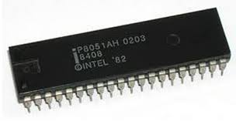

8051 Microcontroller
8051

Slide 2
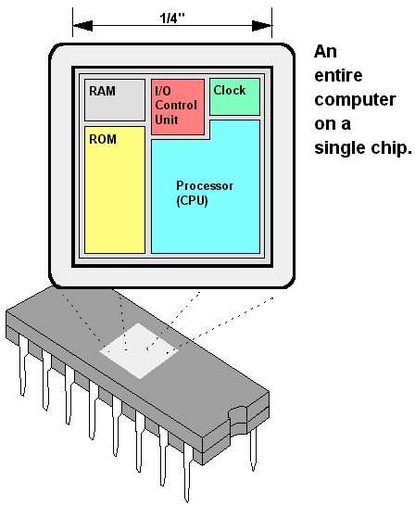
Definition: A single chip that contains the processor (the CPU), non-volatile memory for the program (ROM or flash), volatile memory for input and output (RAM), a clock and an I/O control unit. Also called a "computer on a chip,"

Slide 3
Microcontroller vs. Microprocessors

Slide 4
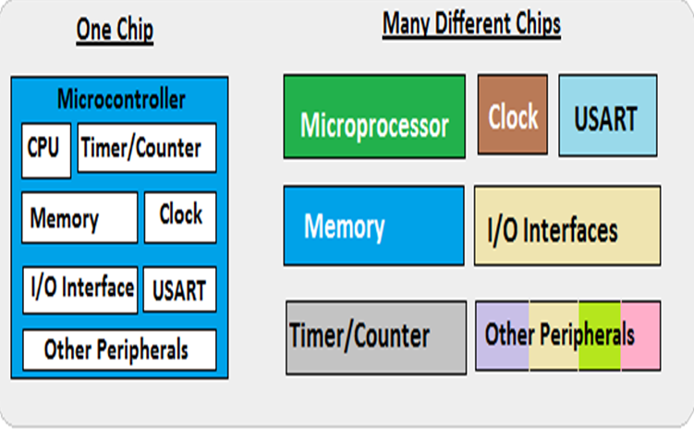
A smaller computer
On-chip RAM, ROM, I/O ports...
Example: Motorola’s 6811, Intel’s 8051, Zilog’s Z8 and PIC
CPU for Computers
No RAM, ROM, I/O on CPU chip itself
Example: Intel’s x86, Motorola’s 680x0

Slide 5
Microcontroller vs. Microprocessors
Microprocessor
CPU is stand-alone, RAM, ROM, I/O, timer are separate
Designer can decide on the amount of ROM, RAM and I/O ports.
Microprocessor based system requires More hardware
General-purpose Device
Microprocessor based system is more flexible
Access time for Memory and I/O is more
It has many Instructions to move data between memory and CPU
Microcontroller
CPU, RAM, ROM, I/O and timer are all on a single chip
Fixed amount of on-chip ROM, RAM, I/O ports
Microcontroller system requires less hardware
Single/Special purpose Device
Microcontroller based system is not flexible
Access time for Memory and I/O is less
It has less Instructions to move data between memory and CPU

Slide 6
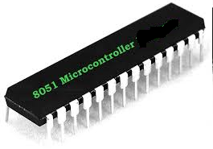
Applications of Microcontrollers

Slide 7
Embedded Products Using Microcontrollers
Home-Appliances , intercom, telephones, security systems, garage door openers, answering machines, fax machines, TVs, cable TV tuner, VCR, camcorder, remote controls, video games, cellular phones, musical instruments, sewing machines, lighting control, paging, camera, pinball machines, toys, exercise equipment

Slide 8
Features of 8051
1. 4 KB on chip program memory (ROM or EPROM)).
2. 128 bytes on chip data memory (RAM).
3. 8-bit data bus
4. 16-bit address bus
5. 32 general purpose registers each of 8bits
6. Two -16 bit timers T0 andT1
7. Five Interrupts (3 internal and 2external).
8. Four Parallel ports each of 8-bits (PORT0, PORT1, PORT2, PORT3) with a total of 32 I/O lines.
9. One 16-bit program counter and one 16-bit DPTR
10. One 8-bit stack pointer
Notes:
8

Slide 9

























General Block Diagram of 8051
External Interrupts
Interrupt Control
4K ROM
256 B RAM
Timer 0
Timer 1
Counter Inputs
8bit CPU
Bus Control
Serial Port
OSC
4 I/O Ports
TXD RXD
P0 P1 P2 P3

Slide 10
Components of 8051
1. Bus control
Data Bus: 8 bit data bus for carrying data
Address bus: 16 bit address bus used to carry address
2. Four (8 bit each) general purpose parallel I/O ports:
Port0: When no external memory is connected it acts as general-purpose I/O port
If external memory applied then it acts as multiplexed add and data bus
Can operate in dual mode

Slide 11
Port1: Normal I/O port
Port2: Same as port0 (GPIO and address line)
Port3: Dedicated I/O port
3. Timers and Counters: Used for synchronization of clock circuits in the internal operation by XTAL1 and XTAL2
4 additional pins are:
EA (External Enable)
PSEN (Program store enable)
ALE (Address latch enable)
RST (Reset)

Slide 12
4. Memory:
ROM – A program of 4k memory can be stored (requires 12bit address line)
RAM – 128 bytes internal RAM divided into 32 working registers. Each register has 4 register bank of 8 registers each
5. Serial port – for communication
SBUF: Serial port data buffer holds the data
SCON: Serial control for managing communication
PCON: Parallel control manages data transfer rates

Slide 13
RXD and TXD
4 programmable modes
Serial data mode0 (shift register mode)
Serial data mode1 (standard UART)
Serial data mode2 (multiprocessor mode)
Serial data mode3
6. Interrupt control (software or hardware)
5 sources are present
2 external interrupt sources connected through INT0 and INT1
3 external interrupt sources through serial port interrupt, timer flag0, and timer flag1
7. CPU: 8051 system bus connects all the support devices to CPU

Slide 14
Intel 8051 Micro Architecture

Slide 15
8051 pin diagram
P1.0
1
40
Vcc
P1.1
2
39
P0.0(AD0)
P1.2
3
38
P0.1(AD1)
P1.3
4
37
P0.2(AD2)
P1.4
5
8051
36
P0.3(AD3)
P1.5
6
35
P0.4(AD4)
P1.6
7
34
P0.5(AD5)
P1.7
8
33
P0.6(AD6)
RST
9
32
P0.7(AD7)
(RXD)P3.0
10
31
EA/VPP
(TXD)P3.1
11
30
ALE/PROG
(INT0)P3.2
12
29
PSEN
(INT1)P3.3
13
28
P2.7(A15)
(T0)P3.4
14
27
P2.6(A14)
(T1)P3.5
15
26
P2.5(A13)
(WR)P3.6
16
25
P2.4(A12)
(RD)P3.7
17
24
P2.3(A11)
XTAL2
18
23
P2.2(A10)
XTAL1
19
22
P2.1(A9)
GND
20
21
P2.0(A8)

Slide 16
Pin Description Summary
PIN | TYPE | NAME AND FUNCTION
Vss (GND) | I | Ground: 0 V reference.
Vcc | I | Power Supply + 5V.
P0.0 - P0.7 | I/O | Port 0: Port 0 is also the multiplexed low-order address and data bus during accesses to external program and data memory.
P1.0 - P1.7 | I/O | Port 1: Port 1 is an 8-bit bi-directional simple I/O port.
P2.0 - P2.7 | I/O | Port 2: Port 2 is an 8-bit bidirectional I/O. Port 2 emits the high order address byte
P3.0 - P3.7 | I/O | Port 3: Port 3 is an 8 bit bidirectional I/O port. Port 3 also serves special features as explained. 51
1

Slide 17
Pin Description Summary
PIN | TYPE | NAME AND FUNCTION
RST | I | Reset: resets the device.
ALE | O | Address Latch Enable:When ALE=0, it provides data D0-D7 When ALE=1, it has address A0-A7
PSEN* | O | Program Store Enable: acts as read strobe to external program memory For External Code Memory, PSEN = 0 For External Data Memory, PSEN = 1
EA*/VPP | I | External Access Enable/Programming Supply Voltage: EA = 0, 8051 microcontroller fetches from external program memory (ROM) only. EA = 1, then it fetches from internal and external program memories (ROMS).
XTAL1 and XTAL2 | 1 | Oscillator pins for generating an internal clock. External oscillator is connected to these pins.
512

Slide 18
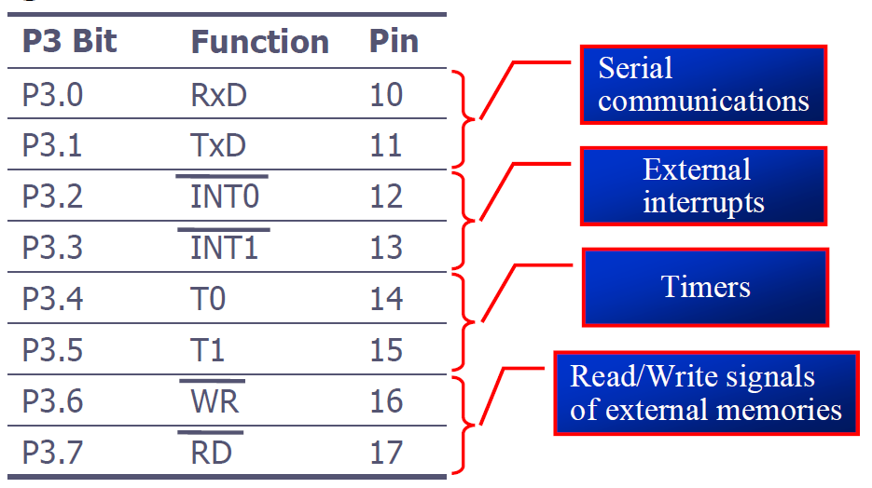
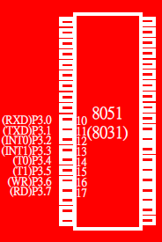
Port 3
• Port 3 can be used as input or output.
• Port 3 has the additional function of providing some extremely important signals
18

Slide 19
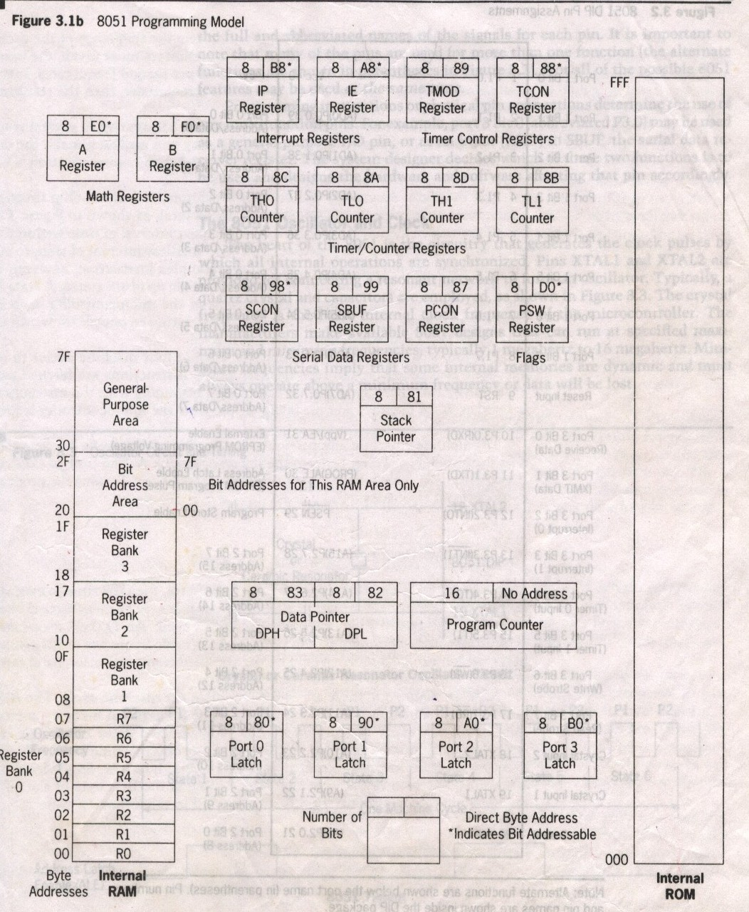
8051 Programming Model

Slide 20
A and B CPU registers
Totally 34 general purpose registers or working registers.
Two of these A and B hold results of many instructions, particularly math and logical operations of 8051.
The other 32 are in four banks,B0 – B3 of eight registers each.
A(accumulator) is used for addition, subtraction, mul, div, boolean bit manipulation and for data transfers.
But B register can only be used for mul and div operations.

Slide 21
Program Counter
16 bit register to hold the address of a byte in memory
PC contains the address of the next instruction to be executed.
Data Pointer
DPTR is made up of two 8 bit register DPH and DPL;
DPTR contains the address of internal & external code and data that has to be accessed.
DPTR Register is usually used for storing address of data and intermediate results.
Stack Pointer
It is an 8-bit register which stores the address of the stack top.

Slide 22
Program Status Word Register (PSW)/ Flag Register
CY
AC
F0
RS1
RS0
OV
--
P
CY PSW.7 Carry flag
AC PSW.6 Auxiliary carry flag
-- PSW.5 Available to the user for general purpose
RS1 PSW.4 Register Bank selector bit 1
RS0 PSW.3 Register Bank selector bit 0
OV PSW.2 Overflow flag
-- PSW.1 User define bit
P PSW.0 Parity flag Set/Reset odd/even parity
RS1 RS0 Register Bank Address
0 0 0 00H-07H
0 1 1 08H-0FH
1 0 2 10H-17H
1 1 3 18H-1FH

Slide 23
Special Function Registers(SFR)
Name | Function | Name | Function
A | Accumulator | SBUF | Serial Port data buffer
B | Arithmetic | SP | Stack Pointer
DPH | Addressing Ext Memory | TMOD | Timer/Counter mode control
DPL | Addressing Ext Memory | TCON | Timer/Counter control
IE | Interrupt enable | TL0 | Timer0 lower byte
IP | Interrupt Priority | TH0 | Timer0 higher byte
P0 | I/O Port Latch | TL1 | Timer1 lower byte
P1 | I/O Port Latch | TH1 | Timer1 higher byte
P2 | I/O Port Latch
P3 | I/O Port Latch
PCON | Power Control
PSW | Program Status Word
SCON | Serial Port Control

Slide 24
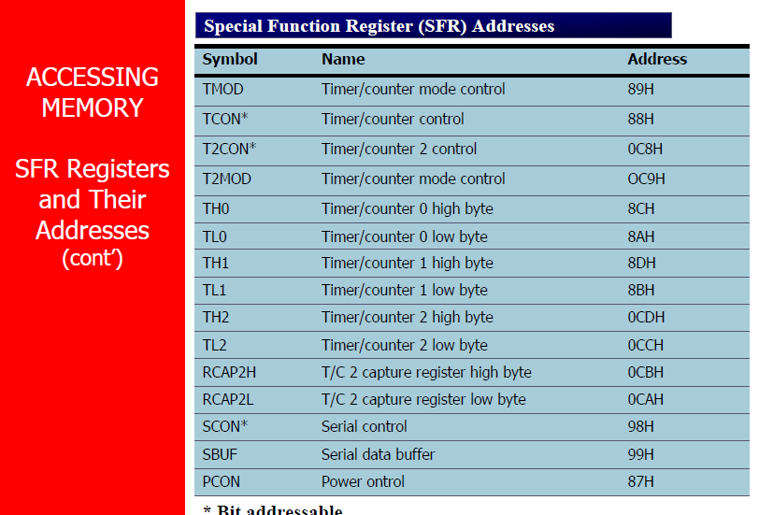

Slide 25
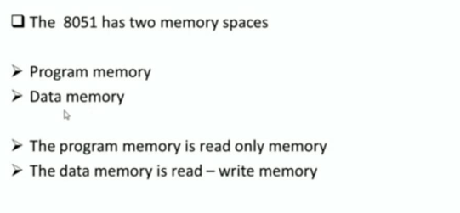
8051 Memory Organization

Slide 26
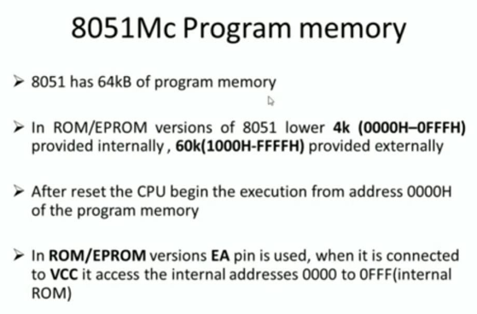

Slide 27
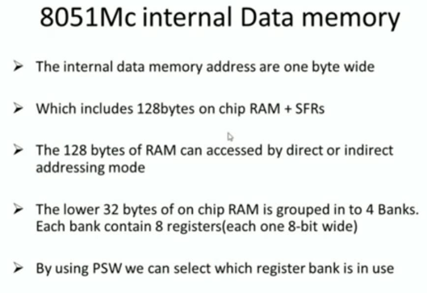

Slide 28
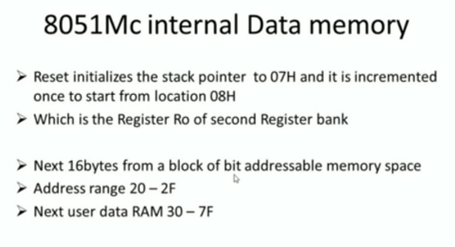

Slide 29
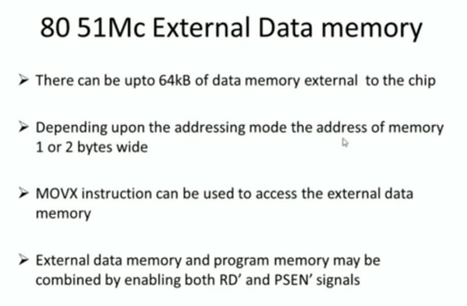

Slide 30
8051 Memory Organization
60K
64K
64K
4K

Slide 31
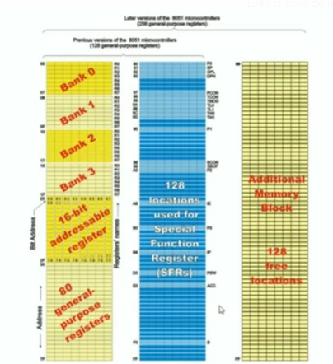

Slide 32
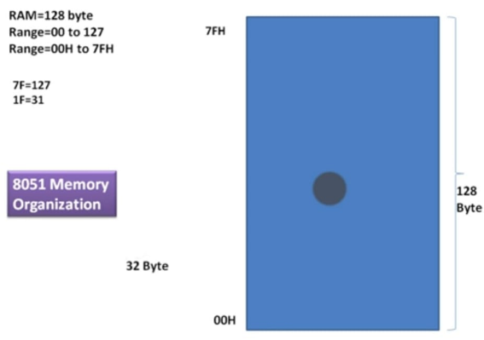

Slide 33
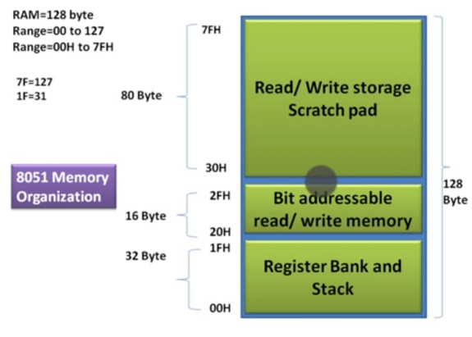

Slide 34
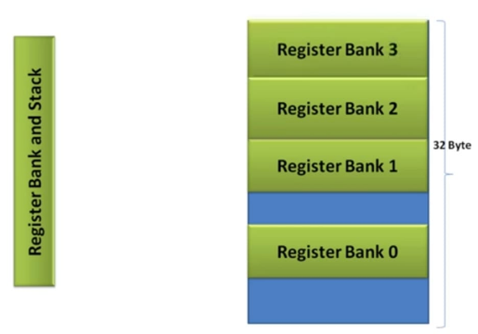
Register banks and stacks

Slide 35
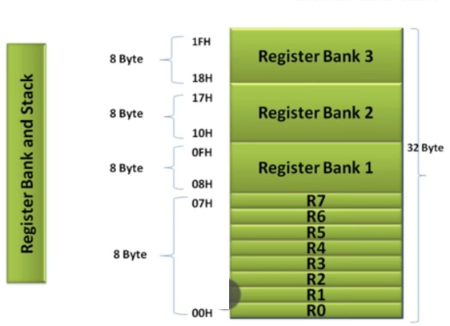

Slide 36
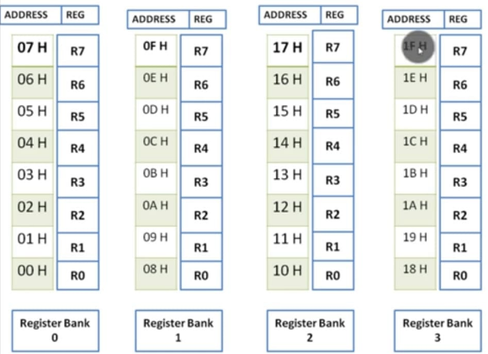

Slide 37
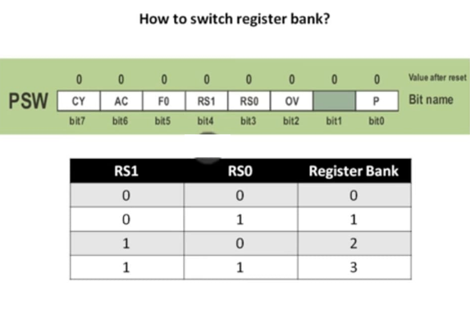

Slide 38
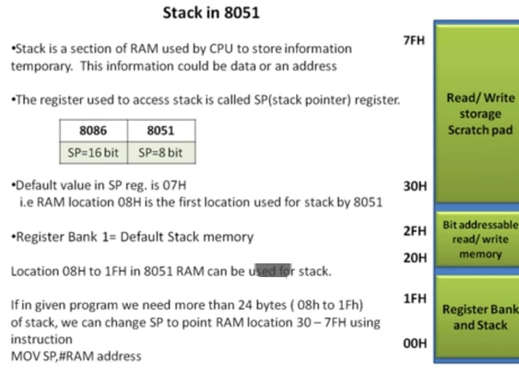

Slide 39
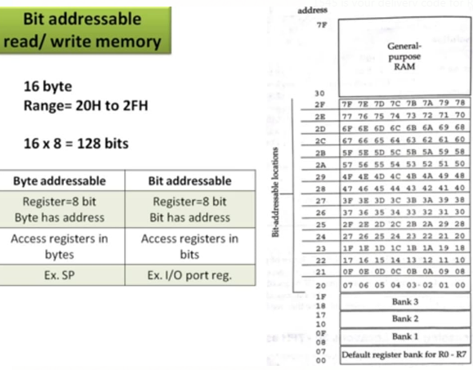

Slide 40
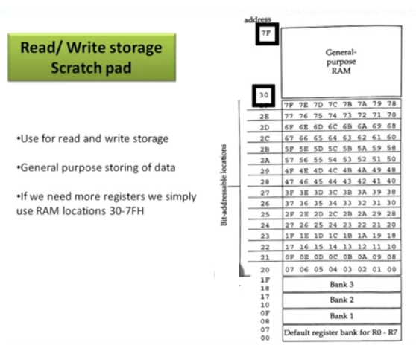

Slide 41
Accessing External Memory

Slide 42
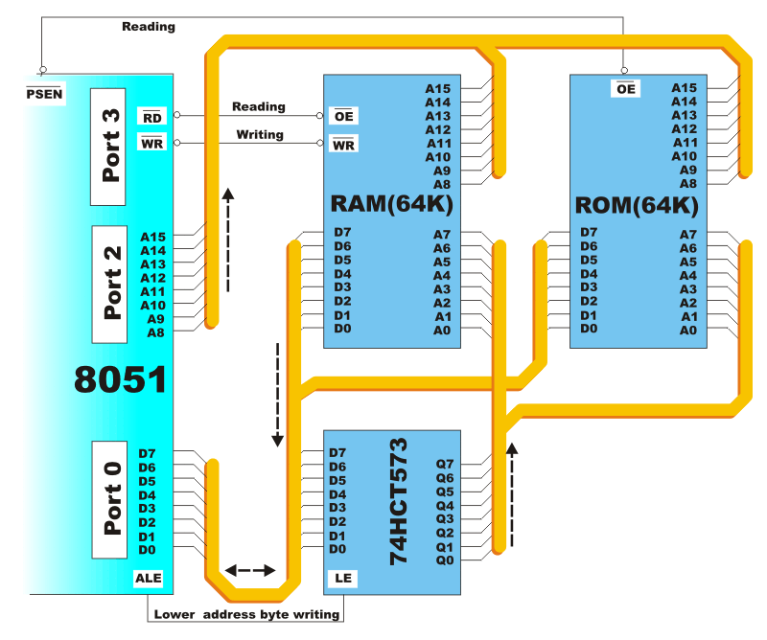

Slide 43
Accessing External Program Memory

Slide 44
Accessing External Data Memory

Slide 45
Addressing Modes
The way in which the instruction is specified.
Immediate
Register
Direct
Register Indirect
Indexed

Slide 46
Immediate Addressing Mode
Immediate Data is specified in the instruction itself
The immediate data sign, “#”
Eg:
MOV A,#65H
MOV A,#’A’
MOV R6,#65H
MOV DPTR,#2343H

Slide 47
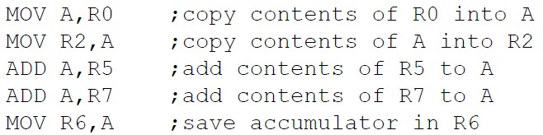
Register Addressing Mode
In the Register Addressing mode, the instruction involves transfer of information between registers.
MOV Rn, A ;n=0,..,7
ADD A, Rn
MOV DPL, R6
MOV DPTR, A

Slide 48

Direct Addressing Mode
The entire of 128 bytes of RAM can be accessed using direct addressing mode, it is most often used to access RAM loc. 30 – 7FH.
Only internal Data RAM and SFRs can be directly addressed
This mode allows you to specify the operand by giving its actual memory address
MOV R0, 40H
MOV 56H, A

Slide 49
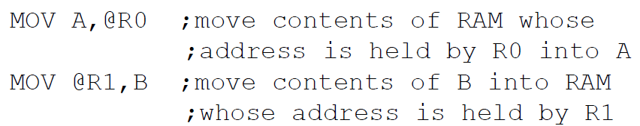
Register Indirect Addressing Mode
In this mode, register is used as a pointer to the data.
The operands are specified using the 8-bit address
The address register for 16-bit addresses can only be Data pointer (DPTR)
Only register R0 and R1 are used for this purpose.
R2-R7 cannot be used to hold the address of an operand located in RAM.
When R0 and R1 hold the addresses of RAM locations, they must be preceded by the “@” sign.
MOV A , @Ri
; move content of RAM loc. Where address is held by Ri into A
( i=0 or 1 )
MOV @R1,B
MOVX
A, @DPTR
Moves contents of DPTR to A

Slide 50
Indexed Addressing Mode for ROM Access
This mode is widely used in accessing data elements of look-up table entries located in the program (code) space ROM at the 8051
MOVC A,@A+DPTR
A= content of address A +DPTR from ROM
Note:
Because the data elements are stored in the program (code ) space ROM of the 8051, it uses the instruction MOVC instead of MOV. The “C” means code.

Slide 51
8051 Instruction Set

Slide 52
The first part of each instruction, called MNEMONIC refers to the operation an instruction performs Mnemonics are abbreviations of the name of operation being executed.
Eg: INC R1 - Increment register R1 (increment register R1);
LJMP LAB5 - Long Jump LAB5 (long jump to the address marked as LAB5);
JNZ LOOP - Jump if Not Zero LOOP (if the number in the accumulator is not 0, jump to the address marked as LOOP);
The other part of instruction, called OPERAND is separated from mnemonic by at least one whitespace and defines data being processed by instructions.
If there is more than one operand in an instruction, they are separated by a comma.
Eg: RET - return from a subroutine; no operand
JZ TEMP - if the number in the accumulator is 0, jump to the address marked as TEMP;
ADD A,R3 - add R3 and accumulator;
CJNE A,#20,LOOP - compare accumulator with 20. If they are not equal, jump to the address marked as LOOP;

Slide 53
The following nomenclatures for register, data, address and variables are used while write instructions.
A: Accumulator
B: "B" register
C: Carry bit
Rn: Register R0 - R7 of the currently selected register bank
Direct: 8-bit internal direct address for data. The data could be in lower 128bytes of RAM (00 - 7FH) or it could be in the special function register (80 - FFH).
@Ri: 8-bit external or internal RAM address available in register R0 or R1. This is used for indirect addressing mode.
#data8: Immediate 8-bit data available in the instruction.
#data16: Immediate 16-bit data available in the instruction.
Addr11: 11-bit destination address for short absolute jump. Used by instructions AJMP & ACALL. Jump range is 2 kbyte (one page).
Addr16: 16-bit destination address for long call or long jump.
Rel: 2's complement 8-bit offset (one - byte) used for short jump (SJMP) and all conditional jumps.
bit: Directly addressed bit in internal RAM or SFR

Slide 54
Instruction Groups
The 8051 instructions are grouped into 5 groups
  Arithmetic Instructions
  Logic Instructions
  Data Transfer Instructions
  Boolean Instructions
  Program Branching Instructions

Slide 55
Arithmetic Instructions
Arithmetic instructions perform several basic operations such as addition, subtraction, division, multiplication etc. After execution, the result is stored in the first operand.
ADD
  8-bit addition between the accumulator (A) and a second operand.
    The result is always in the accumulator.
    The CY flag is set/reset appropriately.
    Eg: ADD A, R1
ADDC
  8-bit addition between the accumulator, a second operand and the previous value of the CY flag.
    Useful for 16-bit addition in two steps.
    The CY flag is set/reset appropriately.
    Eg: ADDC A, R1

Slide 56
DAA
  Decimal adjust the accumulator.
    Format the accumulator into a proper 2 digit packed BCD number.
    Operates only on the accumulator.
    Works only after the ADD instruction.
SUBB
  Subtract with Borrow.
    Subtract an operand and the previous value of the borrow (carry) flag from the accumulator.
      A ← A - <operand> - CY.
      The result is always saved in the accumulator.
      The CY flag is set/reset appropriately.
      Eg: SUBB A, R1

Slide 57
MUL AB
  Multiply A by B and place result in A:B.
  lower byte of result stored in A, higher byte in B
  DIV AB
  Divide A by B and place result quotient in A and remainder in B.
INC
  Increment the operand by one.
    The operand can be a register, a direct address, an indirect address, the data pointer.
    Eg: INC A
DEC
  Decrement the operand by one.
    The operand can be a register, a direct address, an indirect address.
    Eg: DEC A

Slide 58
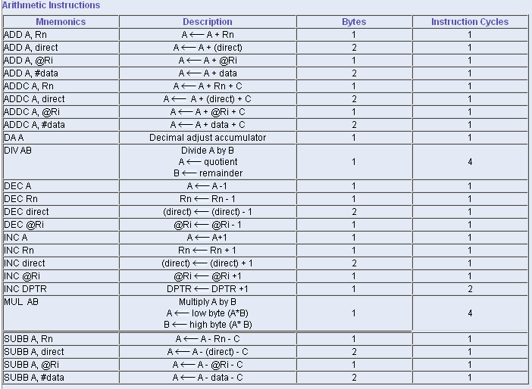

Slide 59
Logical Operations
Logic instructions perform logic operations upon corresponding bits of two registers. After execution, the result is stored in the first operand.
ANL (Logical AND) / ORL (Logical OR)
  Work on byte sized operands or the CY flag.
    Eg: ANL A, Rn
    ANL A, direct
    ORL A, Rn
XRL (Exclusive-OR)
  Works on bytes only.
  Eg: XRL A, Rn

Slide 60
CPL / CLR
  Complement / Clear.
  Work on the accumulator or a bit.
    Eg: CPL P1.2, CLR A
RL / RLC / RR / RRC
  Rotate the accumulator.
    RL and RR without the carry
    RLC and RRC rotate through the carry.
    Eg: RL A, RRC A
SWAP A
  Swap the upper and lower nibbles of the accumulator.

Slide 61
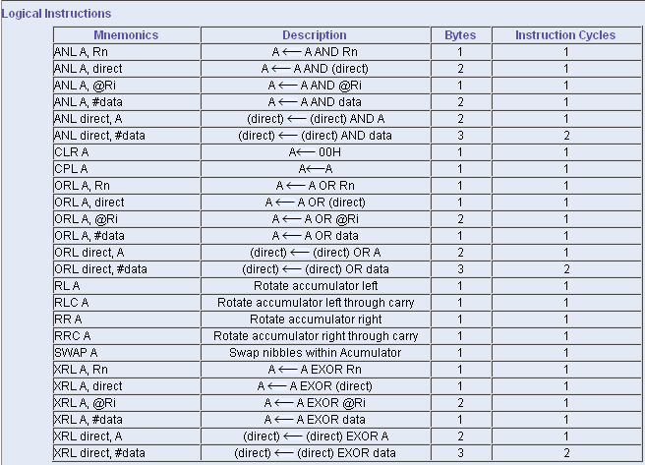

Slide 62
Data Transfer Instructions
Data transfer instructions move the content of one register to another. The register the content of which is moved remains unchanged.
MOV
  8-bit data transfer for internal RAM and the SFR.
    Eg: MOV A, Rn
MOV
  1-bit data transfer involving the CY flag
    Eg: MOV C, bit
    MOV bit, C
MOV
  16-bit data transfer involving the DPTR
    Eg: MOV DPTR, #data

Slide 63
MOVC
  Move Code Byte
    Load the accumulator with a code byte from external program memory.
    Must use indexed addressing
    Eg: MOVC A, @A+DPTR
      MOVC A, @A+PC
MOVX
  Data transfer between the accumulator and a byte from external data memory.
    Eg: MOVX A, @Ri
    MOVX A, @DPTR
    MOVX @Ri, A
    MOVX @DPTR, A

Slide 64
PUSH / POP
  Push and Pop a data byte onto the stack.
  The data byte is identified by a direct address from the internal RAM locations.
  Eg: PUSH DPL
    POP 40H
XCH
  Exchange accumulator and a byte variable
    XCH A, Rn
XCHD
  Exchange lower digit of accumulator with the lower digit of the memory location specified.
    XCHD A, @Ri
    The lower 4-bits of the accumulator are exchanged with the lower 4-bits of the internal memory location identified indirectly by the index register.
    The upper 4-bits of each are not modified.

Slide 65
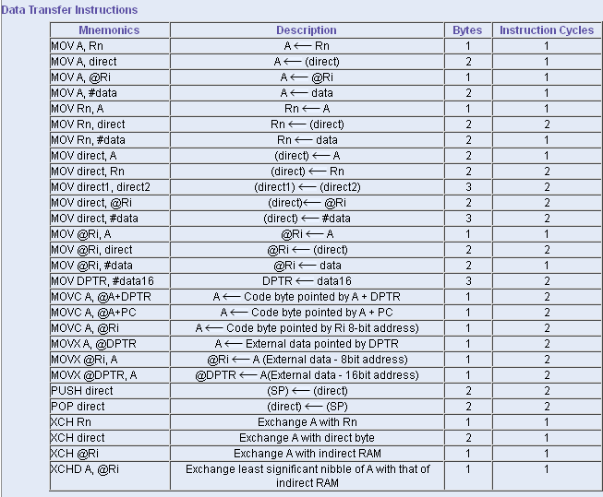

Slide 66
Boolean Variable Instructions
This group of instructions is associated with the single-bit operations of the 8051.
This group allows manipulating the individual bits of bit addressable registers and memory locations as well as the CY flag.
  The P, OV, and AC flags cannot be directly altered.
CLR
  Clear a bit or the CY flag.
    CLR P1.1
    CLR C
CPL
  Complement a bit or the CY flag.
    CPL 40H ; Complement bit 40 of the bit addressable memory

Slide 67
SETB
  Set a bit or the CY flag.
    SETB A.2
    SETB C
ORL / ANL
  OR / AND a bit with the CY flag.
    ORL C, 20H ; OR bit of bit address 20h in bit addressable memory with the CY flag
    ANL C, /34H ; AND complement of bit of bit address 34h in bit addressable memory with the CY flag.
MOV
  Data transfer between a bit and the CY flag.
    MOV C, 3FH ; Copy the CY flag to bit of bit address 3Fh of the bit addressable memory.
    MOV P1.2, C ; Copy the CY flag to bit 2 of P1.

Slide 68
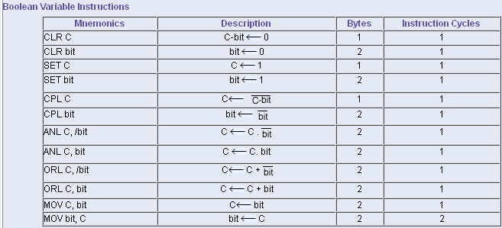

Slide 69
Program Branching Instructions
These instructions control the flow of program logic.
Some of these instructions has decision making capability before transferring control to other part of the program.
There are two kinds of branch instructions:
  Unconditional jump instructions:
  Upon their execution a jump to a new location from where the program continues execution is executed.
  Conditional jump instructions:
  A jump to a new program location is executed only if a specified condition is met. Otherwise, the program normally proceeds with the next instruction.

Slide 70
The 8051 provides four different types of unconditional jump instructions:
  Short Jump – SJMP
    Uses an 8-bit signed offset relative to the 1st byte of the next instruction.
    Eg: SJMP rel ; Short jump from -128 to +127 locations
  Long Jump – LJMP
    Uses a 16-bit address.
    3 byte instruction capable of referencing any location in the entire 64K of program memory.
    Eg: LJMP addr16 ; range : 0000H to FFFFH

Slide 71
  Absolute Jump – AJMP
    Uses an 11-bit address.
    The upper 3-bits of the address combine with the 5-bit opcode to form the 1st byte and the lower 8-bits of the address form the 2nd byte.
    The 11-bit address is substituted for the lower 11-bits of the PC to calculate the 16-bit address of the target.
    Absolute jump is within 2K byte memory.
    Eg: AJMP addr11 ; range : 0000H to 07FFH
  Indirect Jump –
    Makes an indirect jump to the specified location.
    Eg: JMP @A + DPTR

Slide 72
The 8051 provides 2 forms for the CALL instruction:
  Absolute Call – ACALL
    Uses a 11-bit address similar to AJMP
    The subroutine must be within the same 2K block.
    Eg: ACALL addr11
  Long Call – LCALL
    Uses a 16-bit address similar to LJMP
    The subroutine can be anywhere.
    Eg: LCALL addr16
  Both forms push the 16-bit address of the next instruction on the stack and update the stack pointer.

Slide 73
The 8051 provides 2 forms for the return instruction:
  Return from subroutine – RET
    Pops the return address from the stack, updates stack pointer and continues execution at the previously pushed address.
  Return from Interrupt – RETI
    Pops the return address from the stack.
    Restores the interrupt logic to accept additional interrupts at the same priority level as the one just processed.
    The PSW is not automatically restored to its pre-interrupt status.
    Continues execution at the address retrieved from the stack.

Slide 74
The 8051 supports 5 different conditional jump instructions.
  ALL conditional jump instructions use an 8-bit signed offset.
  Jump on Zero – JZ / JNZ
    JZ rel ; Jump if accumulator is zero.
    JNZ rel ; Jump if accumulator is not zero.
      The check is done at the time of the instruction execution.
  Jump on Carry – JC / JNC
    JC rel ; Jump if the C flag is set.
    JNC rel ; Jump if no carry flag.
  Jump on Bit – JB / JNB
    JB bit,rel ; Jump if the specified bit is set
    JNB bit, rel ; Jump if specified bit not set.
    Any addressable bit can be specified.

Slide 75
  Jump if the Bit is set then Clear the bit – JBC
    JBC bit, rel ; Jump if the specified bit is set.
    Then clear the bit.
Compare and Jump if Not Equal – CJNE
  Compare the magnitude of the two operands and jump if they are not equal.
    The values are considered to be unsigned.
    CJNE <dest-byte>, <src-byte>, rel
    The Carry flag is set if <dest-byte> is less than <src-byte> otherwise cleared.
      CJNE A, direct, rel
      CJNE A, #data, rel

Slide 76
Decrement and Jump if Not Zero – DJNZ
  Decrement the first operand by 1 and jump to the location identified by the second operand if the resulting value is not zero.
  DJNZ <byte>, <rel-addr>
      DJNZ Rn, rel
      DJNZ direct, rel
No Operation
  NOP

Slide 77
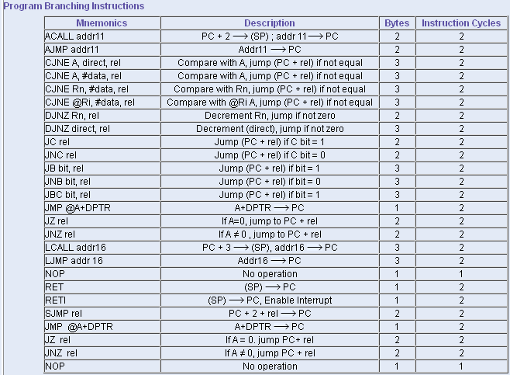

Slide 78
8051 Data types and Directives
Data Types:
8051 supports only one data type. It is 8-bits (byte).
The data type used by 8051 can be positive or negative.
The MSB bit of 8-bit data indicates the sign of the data.
Directives:
Commonly used assembler directives:
EQU, ORG, DB, END
CODE: It assigns a name to the specified memory location in program memory.
Eg: LIST CODE 1020H ; Memory location 1020H is referred as LIST

Slide 79
DATA: assigns a name to specified location in internal RAM.
Eg: TEMP DATA 52H ; Register at address 52H is referred to as TEMP
IDATA: assigns a name to specified location whose address is located in specified register.
Eg: MARKS IDATA 80H ; Register whose address is in register at address 80H is referred to as MARKS
XDATA: assigns a name to specified location in external RAM.
Eg: RESULT XDATA 1000H ; Memory location 1000H in external RAM is referred to as TEMP

