Slide 1
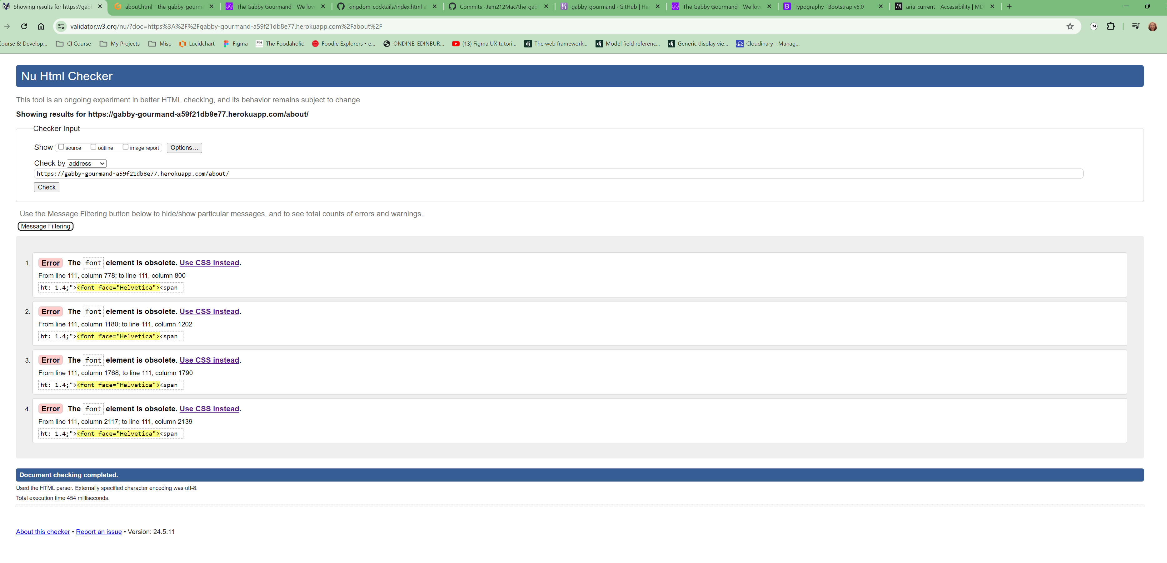
About Page
By URI

Slide 2
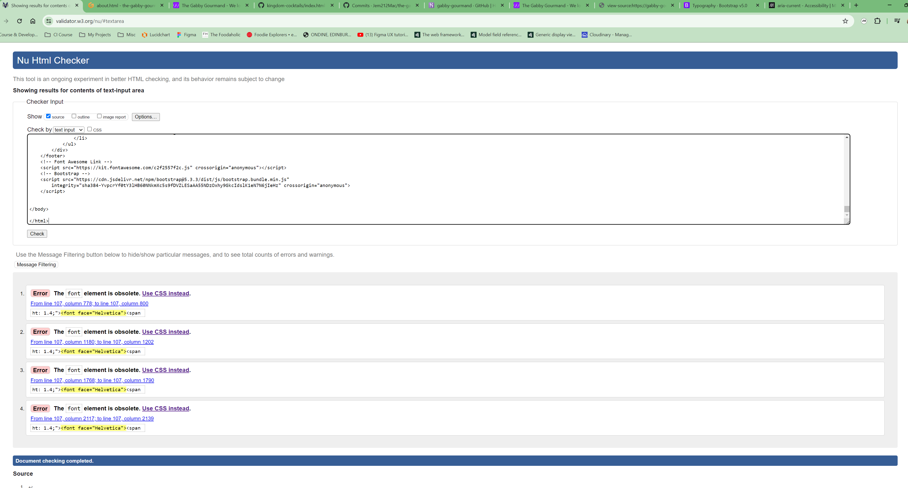
About Page
By Direct Input

Slide 3
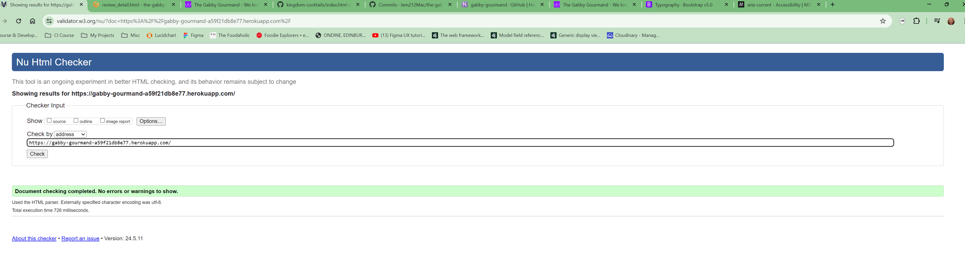
Home Page
By URI

