Slide 1
Exploring NIRS Application:
Fundamentals of Phenomic Prediction and Linear Mixed Models with R
Jemay SALOMON
PhD candidate
jemay.salomon@inrae.fr
Université Paris-Saclay
Phenomic Selection Workshop – April 11, 2024

Slide 2
Linear Mixed Models
Extension of linear models
Allows incorporation of both random and fixed effects
Used to assess genetic values
…

Slide 3

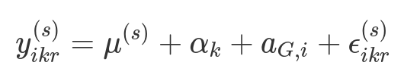
The linear mixed model
…...
Expériemental design :
250 sorghum genotypes
X2 blocks
Scalar form :
Yikr : Yield of genotype i (sorghum) in block k and repetition r
μ: intercept (mean yield of the population)
αk: block effects modeled as fixed
aG,i: genotype effects modeled as random
ϵikr: residuals

Slide 4


The linear mixed model
…...
Matrix form :
y: vector of yield
X: Incidence matrix for fixed effects (intercept μμ, blocks)
b: vector of fixed effects
Z: Incidence matrix for random effects
aG: vector of random effects (genetic values)
e: vector of residuals
H0 : = 0
Tests :
With :
H1 : > 0

Slide 5
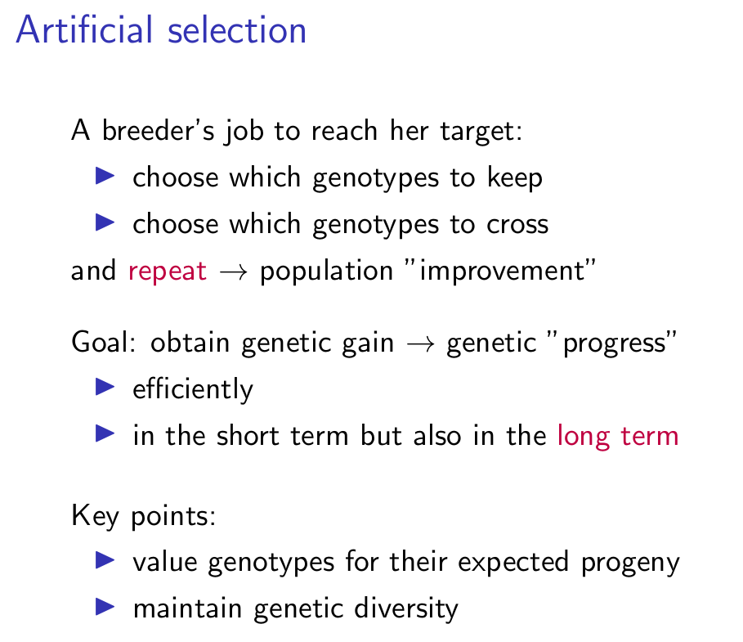
What interest ?????
…...
(Timothée Flutre/INRAE)

Slide 6
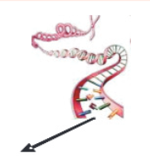
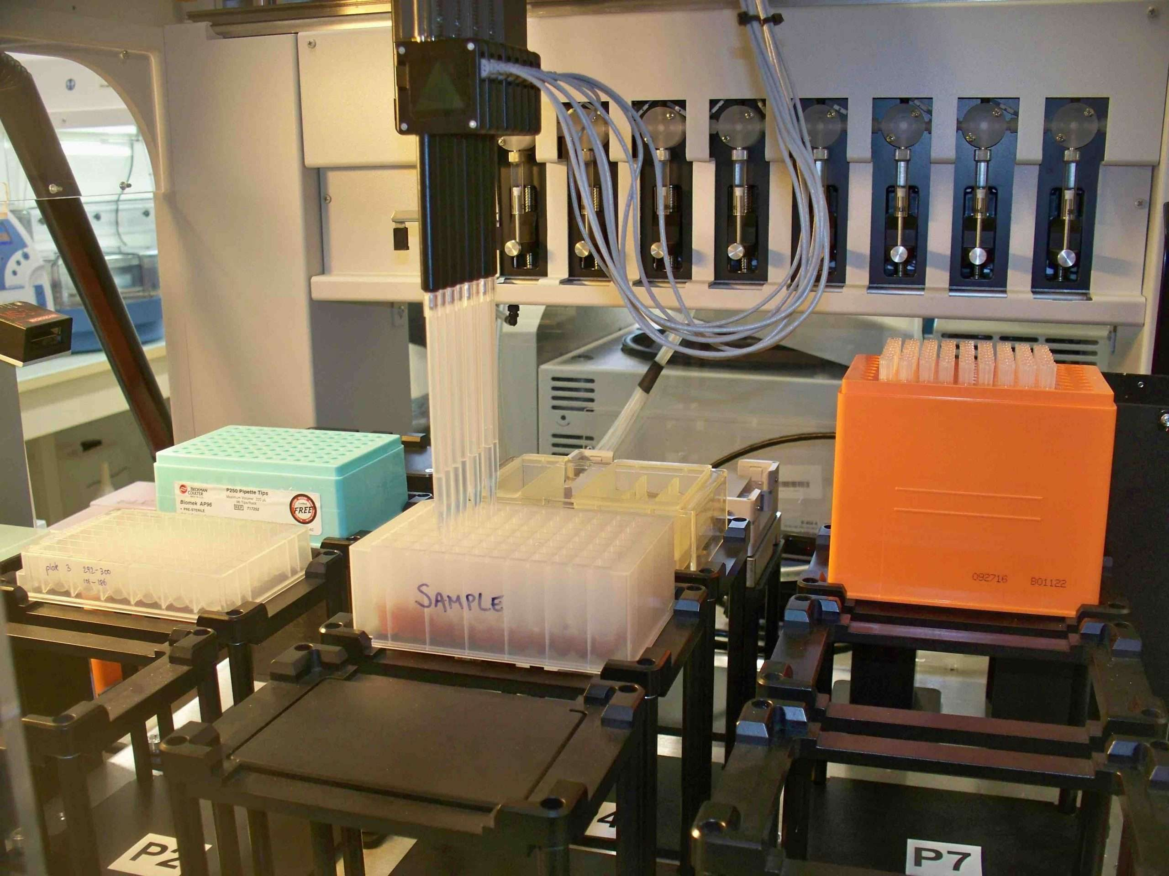
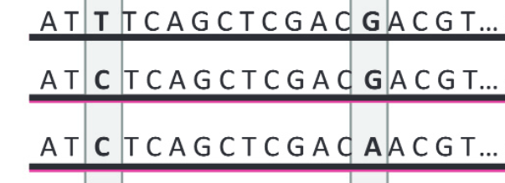
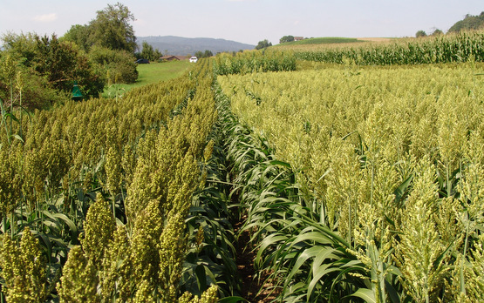
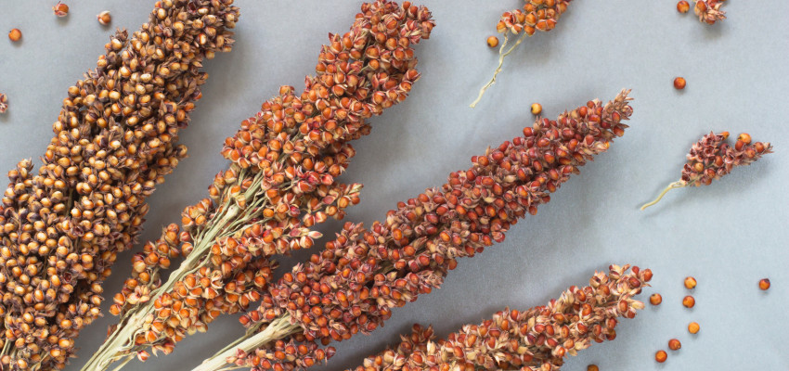
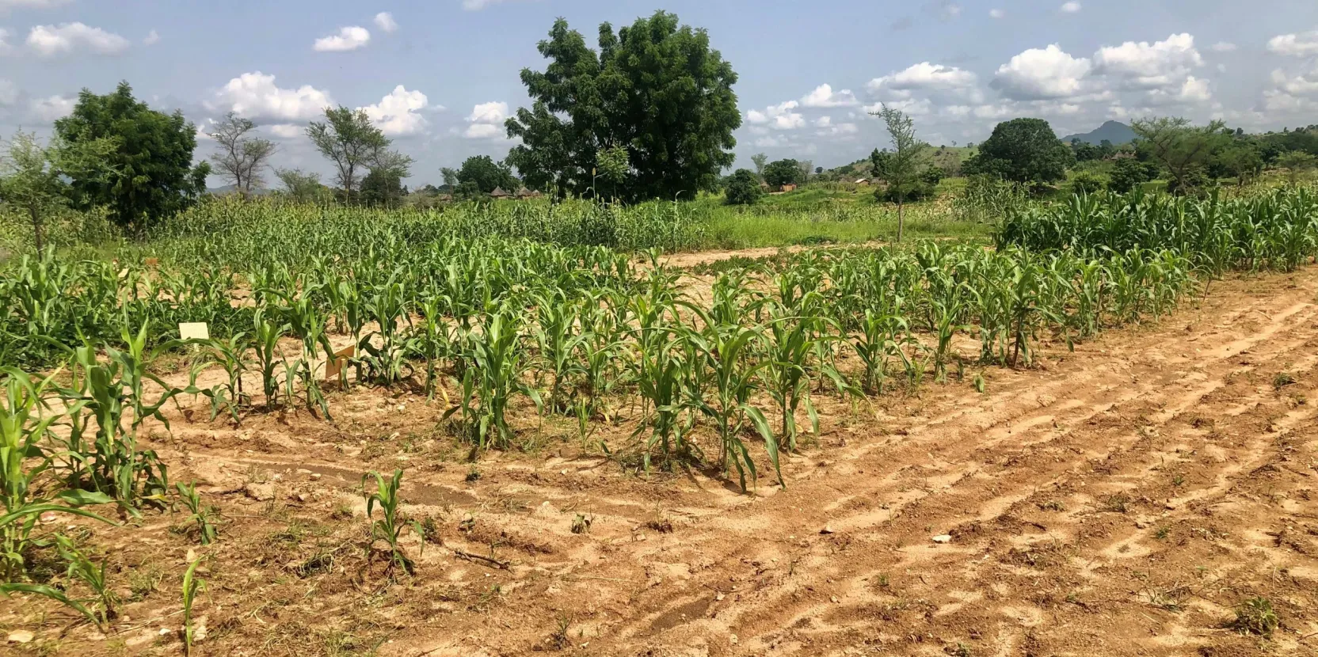
Used of mixed models in Genomic Prediction
Principle of genomic prediction or selection
Genotyping
Reference population
candidate population
Statistical models for genomic prediction
Genotyping

Slide 7
Used of mixed models in Genomic Prediction
Principle of genomic prediction or selection
Statistical models for genomic prediction
Genotyping
SNPs
d
+a
-a
A1A1
A1A2
A2A2
0
1
2

Slide 8
Used of mixed models in Genomic Prediction
Principle of genomic prediction or selection
Model :
(mod1)
(mod2)
(mod3)
(mod4)
y : vector of genotype yield
1µ : fixed parameter representing the global mean yield of génotypes
a : breeding values
e :residuals
With :

Slide 9
Used of mixed models in Genomic Prediction
Principle of genomic prediction or selection
Then :
Suppose cov(Xβ, ϵ) = 0
Variance-covariance matrix incorporating the relatedness between individuals
genetically related individuals are more likely to share alleles at causal loci, and thus have similar phenotypes.

Slide 10
Used of mixed models in Genomic Prediction
Principle of genomic prediction or selection
Keys point of this model (GBLUP) :
Primarily applied in scenarios with a polygenic architecture.
Assumes all markers have non-null effects with equal variance.
Facilitates accurate estimation of marker effects and variance (var(β)).
Predicts additive genotypic values (â).
Estimates the additive genetic component of variance (var(a)).
Estimates narrow-sense heritability. :

Slide 11
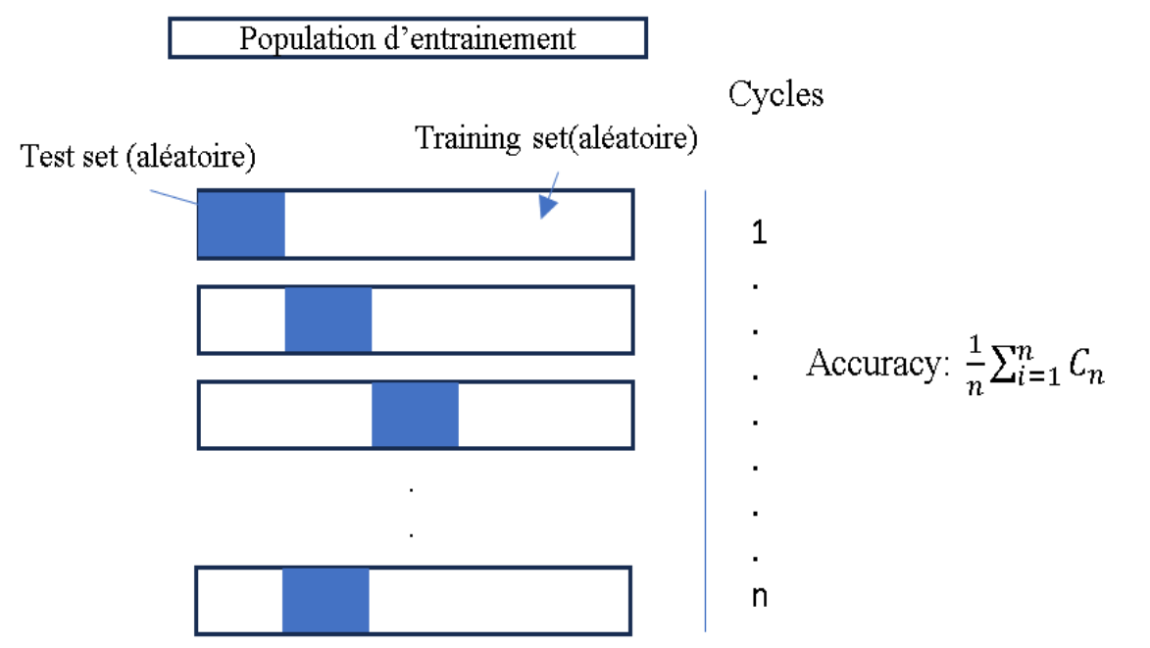
Used of mixed models in Genomic Prediction
Principle of genomic prediction or selection : Training models

Slide 12

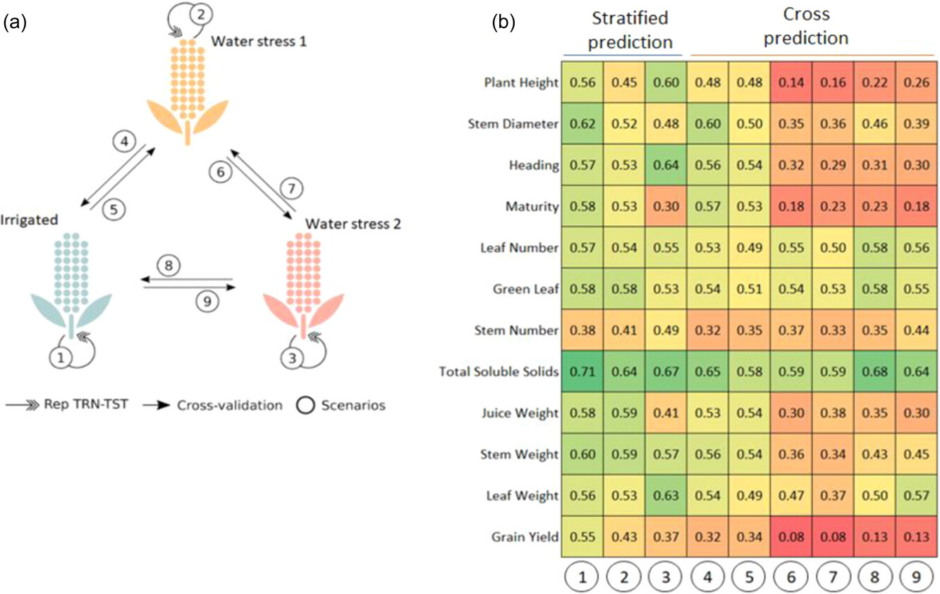
What it looks like in real-world applications :
Overall, stratified prediction demonstrated higher predictive performance than cross-prediction.

Slide 13
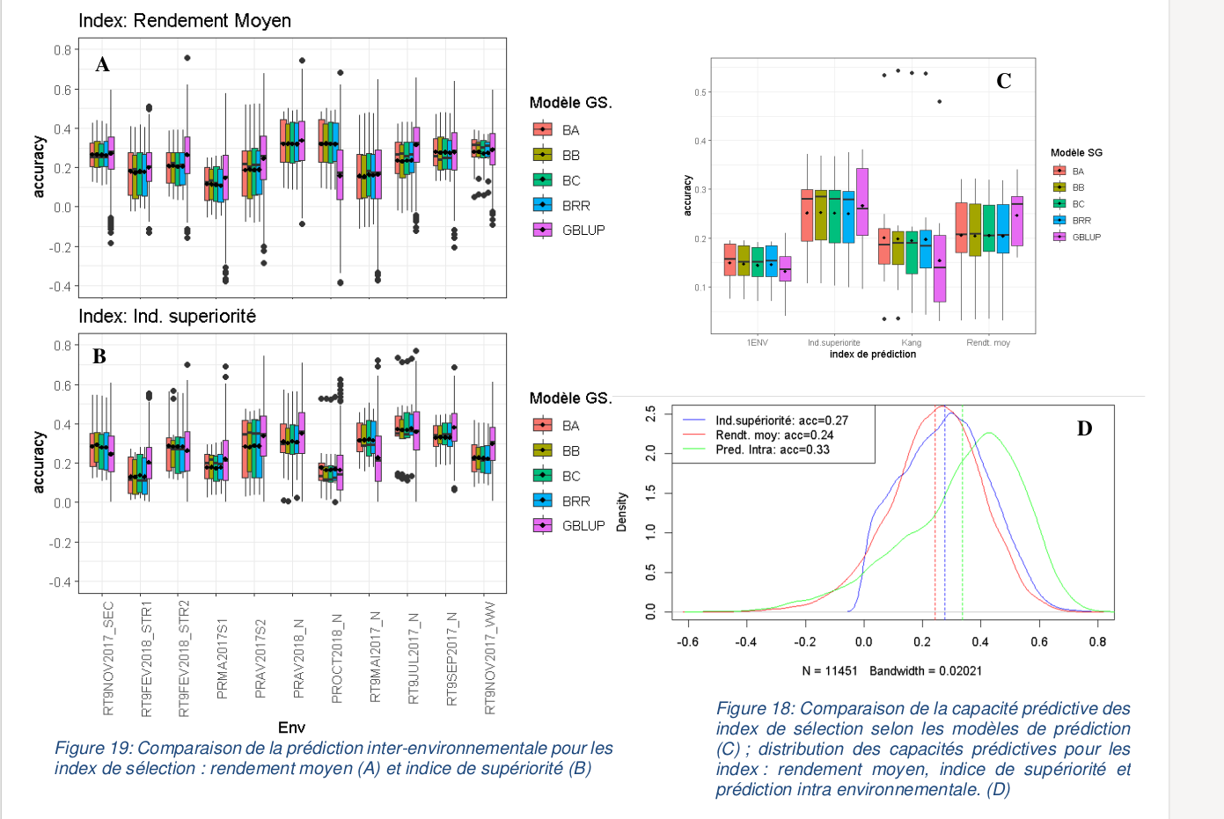
What it looks like in real-world applications :
Optimisation des modèles de prédiction génomique de la performance du sorgho (Sorghum bicolor) pour de nouveaux environnements : analyse destabilité et facteurs physiologiques influents, prédiction inter et intra environnementale, intégration de la composante GXE, et approche phénomique. (Jemay SALOMON – Memoire- M2)

Slide 14
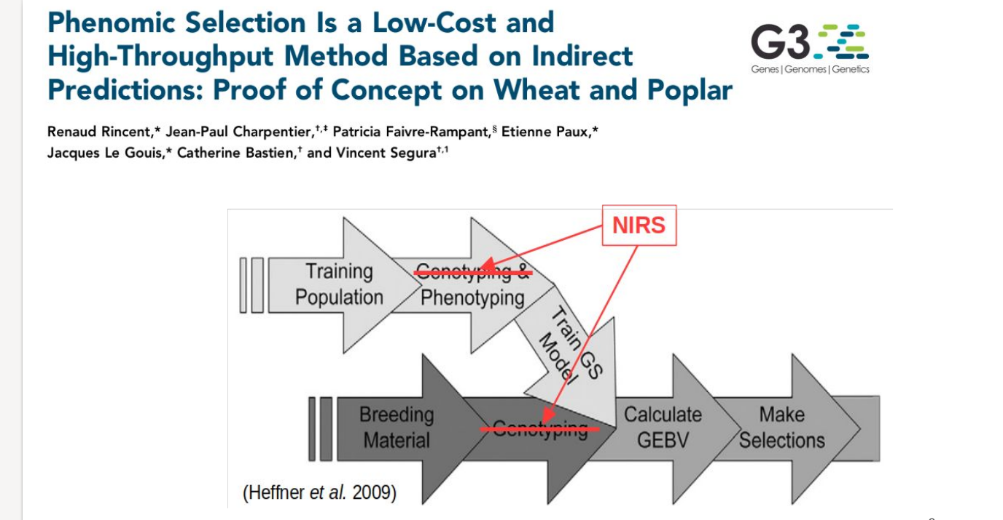
Phenomic Selection :
Diapos from : atelier – prédiction-génomique
https://github.com/timflutre/atelier-prediction-genomique

Slide 15
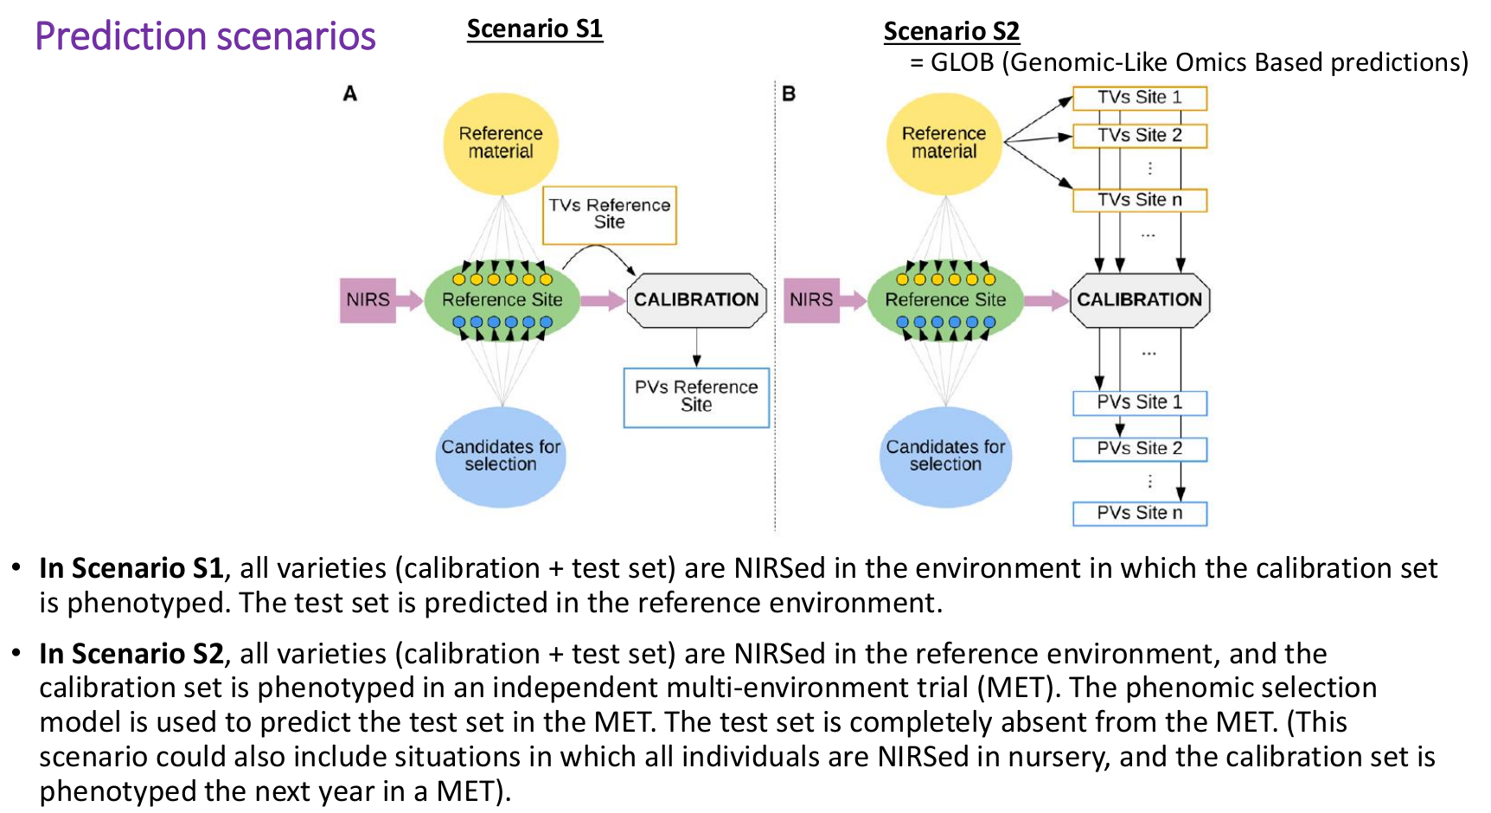
Phenomic Selection :
Diapos from : atelier – prédiction-génomique
https://github.com/timflutre/atelier-prediction-genomique

Slide 16
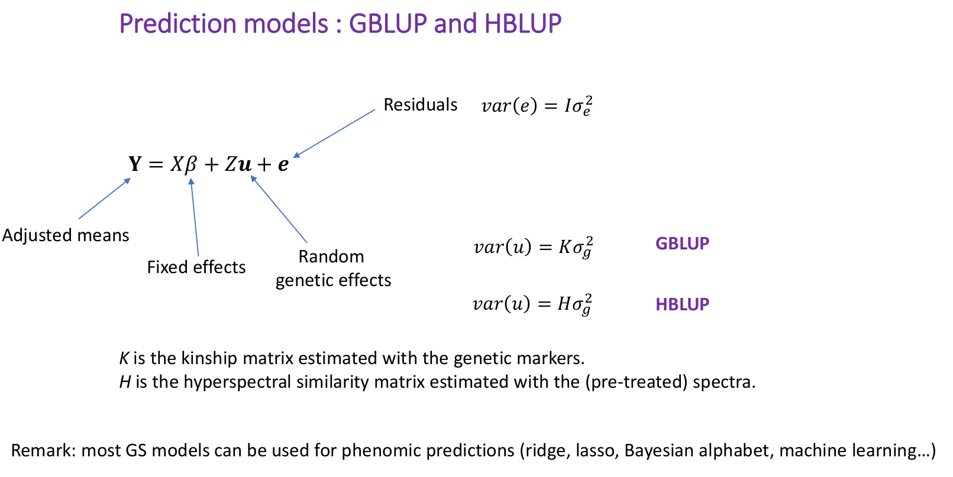
Phenomic Selection :
Diapos from : atelier – prédiction-génomique
https://github.com/timflutre/atelier-prediction-genomique

Slide 17
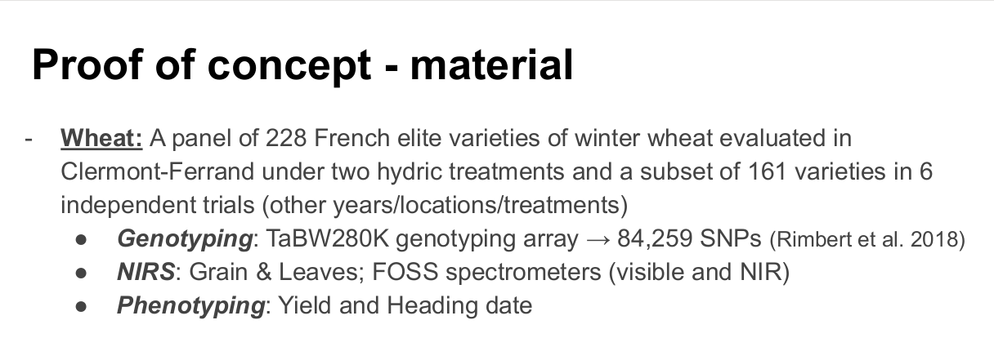
Phenomic Selection :
Diapos from : atelier – prédiction-génomique
https://github.com/timflutre/atelier-prediction-genomique

Slide 18
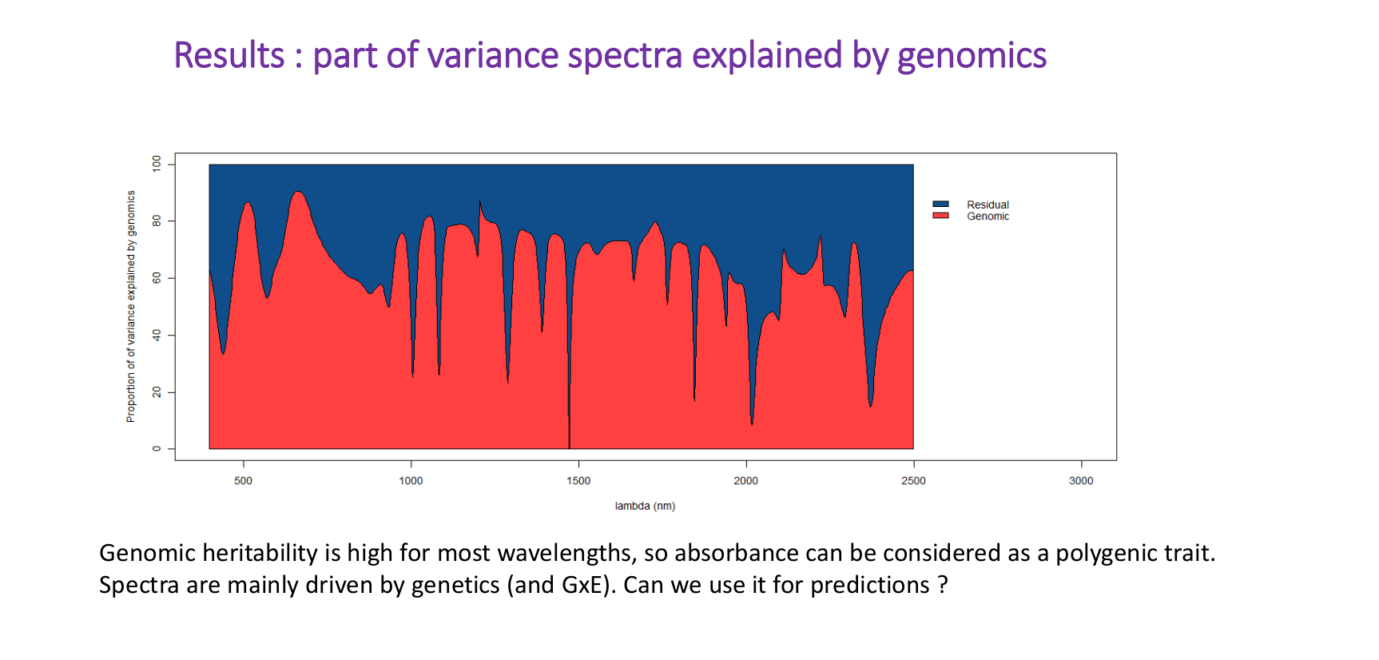
Phenomic Selection :
Diapos from : atelier – prédiction-génomique
https://github.com/timflutre/atelier-prediction-genomique

Slide 19
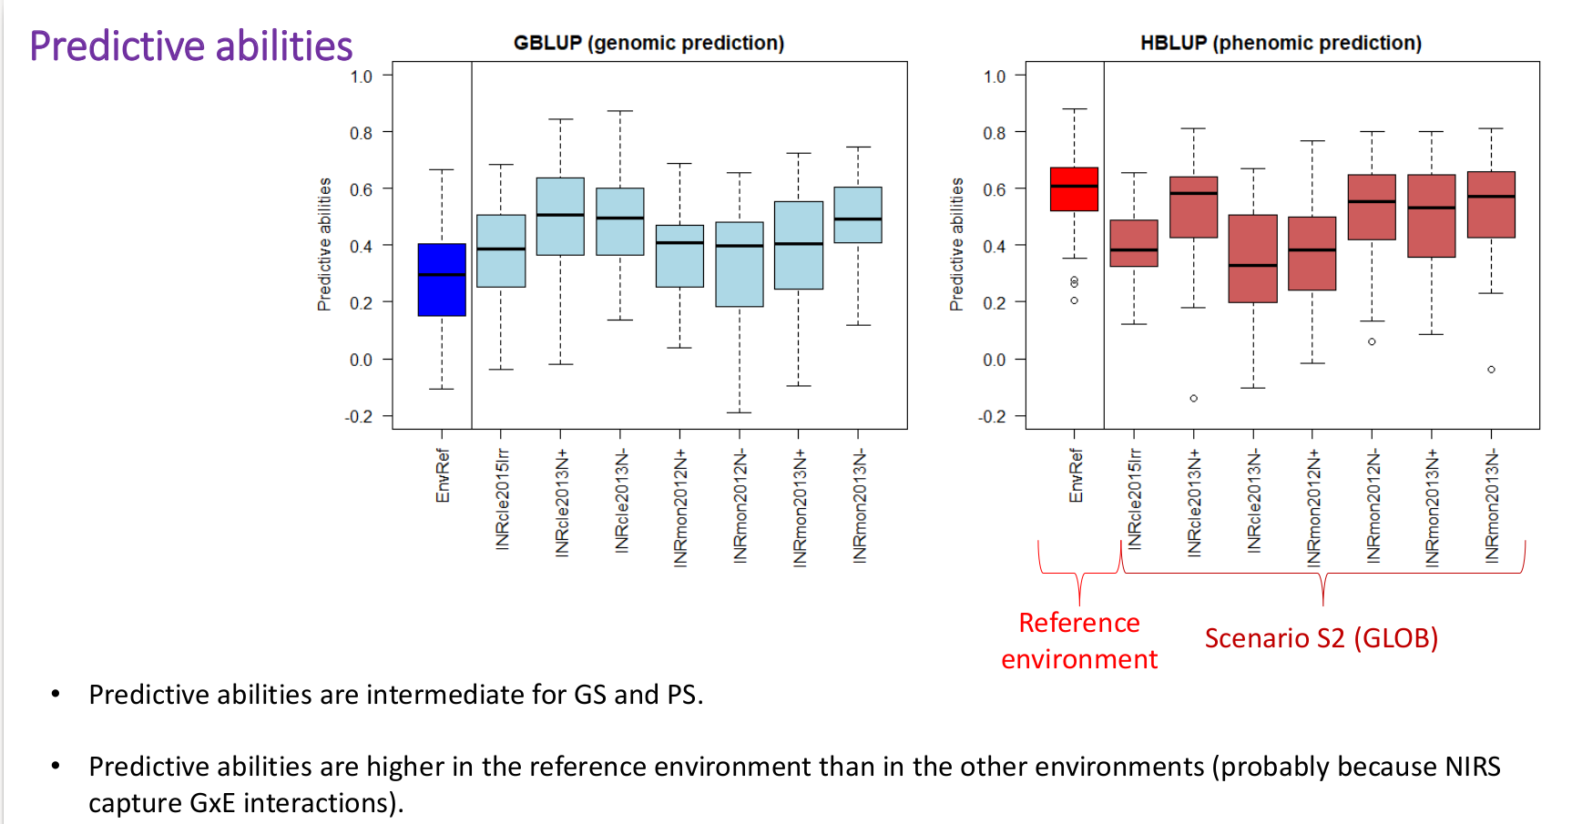
Phenomic Selection :
Diapos from : atelier – prédiction-génomique
https://github.com/timflutre/atelier-prediction-genomique

Slide 20
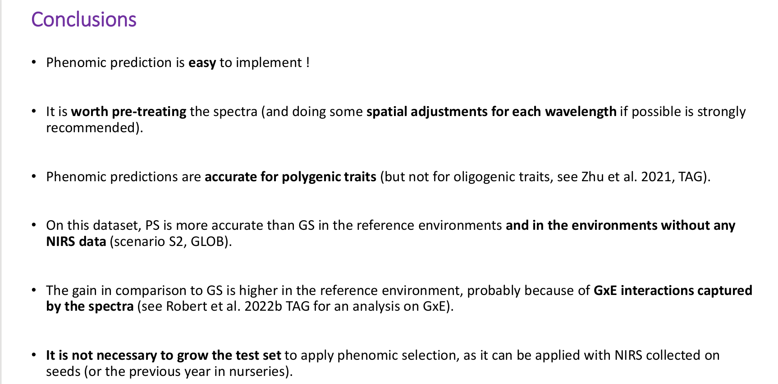
Phenomic Selection :
Diapos from : atelier – prédiction-génomique
https://github.com/timflutre/atelier-prediction-genomique

Slide 21
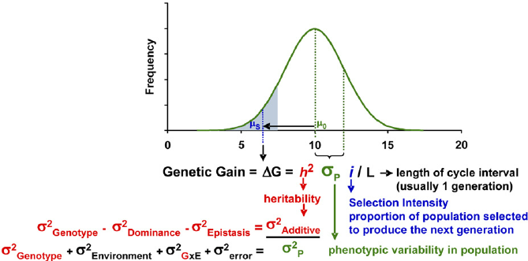
Breeder’s GOAL

Slide 22
THANKS !

