Slide 1
HTML

Slide 2
HTML (Hyper Text Markup Language)
is a markup language (markup -instructions for layout and style)
  is used to tell a Web browser
    where the heading is for a Web page,
    what is a paragraph,
    what is part of a table and so on, so it can structure your document and render it properly.
is not programing
Syntax:
<element name> Content here </element name>

Slide 3
The structure of an HTML element
<element name> Content here </element name>
It is recommended to use lowercase in all elements since required for XHTML documents.
Content
(may be text and/or other HTML elements)
Opening tag
Closing tag

Slide 4
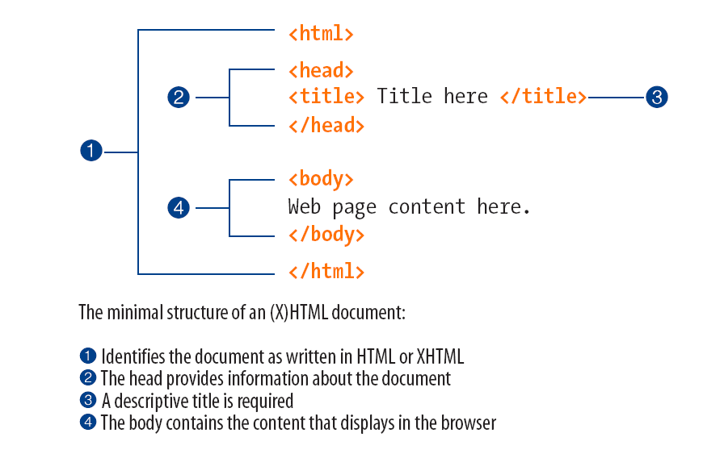
The structure of an HTML element

Slide 5
Simple page
<html>
<head>
<title> GuZo Ethiopia Travel and Tour PLC : About us </title>
</head>
<body>
<h1>About Guzo Ethiopia Travel and Tour PLC</h1>
<p>GuZo Ethiopia Travel and Tour PLC have been serving in Ethiopia for the last three decades with honesty, great hospitality and professional ethics. <p>
</body>
</html>

Slide 6
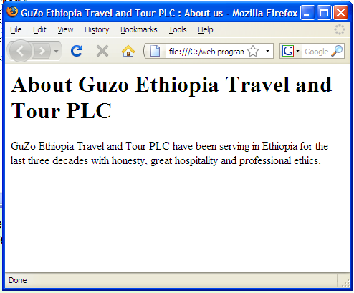
Simple page

Slide 7
Looking at the code
Html opening tag
<html>
<head>
<title> GuZo Ethiopia Travel and Tour PLC : About us </title>
</head>
<body>
<h1>About Guzo Ethiopia Travel and Tour PLC</h1>
<p>GuZo Ethiopia Travel and Tour PLC have been serving in Ethiopia for the last three decades with honesty, great hospitality and professional ethics. <p>
</body>
</html>
element
Html closing tag

Slide 8
Looking at the code
This is the beginning of a heading
<html>
<head>
<title> GuZo Ethiopia Travel and Tour PLC : About us </title>
</head>
<body>
<h1>About Guzo Ethiopia Travel and Tour PLC</h1>
<p>GuZo Ethiopia Travel and Tour PLC have been serving in Ethiopia for the last three decades with honesty, great hospitality and professional ethics. <p>
</body>
</html>
element
This is the end of a heading

Slide 9
Looking at the code
The main body starts here
<html>
<head>
<title> GuZo Ethiopia Travel and Tour PLC : About us </title>
</head>
<body>
<h1>About Guzo Ethiopia Travel and Tour PLC</h1>
<p>GuZo Ethiopia Travel and Tour PLC have been serving in Ethiopia for the last three decades with honesty, great hospitality and professional ethics. <p>
</body>
</html>
element
The main body ends here

Slide 10
Looking at the code
Header one starts here
<html>
<head>
<title> GuZo Ethiopia Travel and Tour PLC : About us </title>
</head>
<body>
<h1>About Guzo Ethiopia Travel and Tour PLC</h1>
<p>GuZo Ethiopia Travel and Tour PLC have been serving in Ethiopia for the last three decades with honesty, great hospitality and professional ethics. <p>
</body>
</html>
In HTML and XHTML there are
six levels of headings.
Header one ends here

Slide 11
Looking at the code
<html>
<head>
<title> GuZo Ethiopia Travel and Tour PLC : About us </title>
</head>
<body>
<h1>About Guzo Ethiopia Travel and Tour PLC</h1>
<p>GuZo Ethiopia Travel and Tour PLC have been serving in Ethiopia for the last three decades with honesty, great hospitality and professional ethics. <p>
</body>
</html>
paragraph starts here
paragraph ends here

Slide 12
Tags
<html> . . . </html>
    contains the whole page
<head> . . . </head>
    the head of the page
    contains information about the page which is not displayed
      Title
      Description of the page
      Keywords that search engines can use to index the page (Meta )

Slide 13
Cont'd . . . Tags
<body> . . . </body>
    the body of the page, main content
    the information seen in the main browser window

Slide 14
Adding style
Adding styles include:
  Adding font types
  Making fonts Blod , italic or underline
  Colors
  Alignment
  Change background color or picture
  etc

Slide 15
Cont'd . . . Adding styles
Colors are identified by six digit number
Specifies the back ground color of the whole page (green)
<html>
<head>
<title> GuZo Ethiopia Travel and Tour PLC : About us </title>
</head>
<body bgcolor="#71ec90">
<font face="arial">
<h1>About Guzo Ethiopia Travel and Tour PLC</h1>
</font>
<font face="arial" color="cc2400">
<p>GuZo Ethiopia Travel and Tour PLC have been serving in Ethiopia for the last three decades with honesty, great hospitality and professional ethics.<p>
</font>
</body>
</html>
Specifies the type of font for the heading
Specifies the type of font for the body

Slide 16
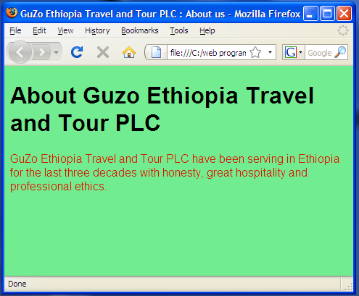
The output of the style
Title displayed here

Slide 17
Elements and their Attributes
<font> - element
    face – attribute
    color – attribute
Attributes say something about elements.
Attributes have two parts
  Name – the property to be set eg. face, color
  Value – is the value of the property eg. Arial, 71ec90
<font face="arial" color="cc2400">
An element should never have two attributes of the same name!! it will ignore the second one.

Slide 18
Keeping Style Separate from Structure and Semantics
Structural markup
  indicating the structure of a document
  the paragraphs and headings
Semantic markup
  telling us something about the content of the data,
  like the <title> element.
Stylistic markup
  indicates how the document should look
  Eg <font>, <b>, and <i>

Slide 19
The Structure of a Page

Slide 20
Structure of A page
XHTML documents are contained between the opening <html> and closing </html> called root element
Inside the root element the document is divided in to two
  The <head> element, which contains information about the document
    such as a title or a link to a style sheet
  The <body> element, which contains the real content of the document that you see.

Slide 21
The <html> Element
It comes after optional XML declaration and required DOCTYPE declaration
If you are writing Strict XHTML 1.0,the opening tag must also include something known as a namespace identifier (this indicates that the markup in the document belongs to the XHTML 1.0 namespace).
<html xmlns="http://www.w3.org/1999/xhtml">

Slide 22
The <head> Element
The <head> Element can contain one of the following in any order
<title> - to display the title of the page
<object>, which is designed to include images, JavaScript objects, Flash animations, MP3 files,QuickTime movies and other components of a page.
<link> to link to an external file, such as a style sheet or JavaScript file
<style> to include CSS rules inside the document
<script> for including script in the document
<meta>, which includes information about the document such as keywords and a description,which are particularly helpful for search applications;

Slide 23
The <title> Element
a title is needed for every page that you write inside the <title> element
The title of a web page is used for
  At the very top of a browser window
  As the default name for a bookmark
  By search engines that use its content to help index pages
So it is important to write the title of the page which can describe it well.
  Eg. “Guzo Ethiopia Travel and Tour : Contact us” describes the page more than just “Contact us”

Slide 24
Basic text formatting
Whitespace and Flow
  several consecutive spaces between two words
  a new line in your source document
  consecutive empty lines,
  Tab characters
  These all will be ignored and simply treated as one space
Useful to indent the code for better readability
example on the next slide

Slide 25
Example:
<html>
<body>
<p> Several consecutive spaces between two words
, a new line in the source document
,consecutive empty lines,
and tab characters are all ignored and simply treated as one space </p>
</body>
</html>

Slide 26
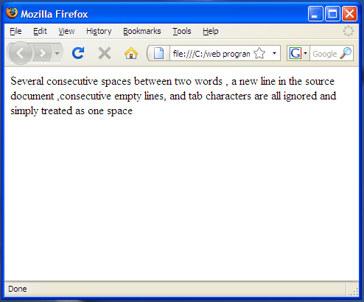
Cont'd . . . Example

Slide 27
Creating Headings using Hn Element
In XHTML you have six levels of headings, which use the elements <h1>, <h2>, <h3>, <h4>, <h5>, and <h6>. Example:
<html>
<body>
<h1> Heading 1 </h1>
<p> The content under heading one goes here. </p>
<h2> Heading 2 </h2>
<p> The content under heading two goes here. </p>
<h3> Heading 3 </h3>
<p> the content under heading three goes here. </p>
<h4> Heading 4 </h4>
<p> The content under heading four goes here. </p>
<h5> Heading 5 </h5>
<p> The content under heading five goes here. </p>
<h6> Heading 6 </h6>
<p> The content under heading six goes here. </p>
</body>
</html>

Slide 28
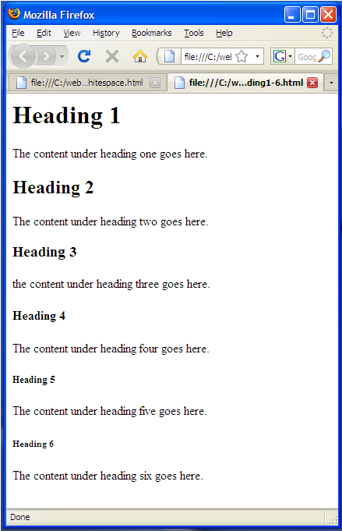
Example

Slide 29
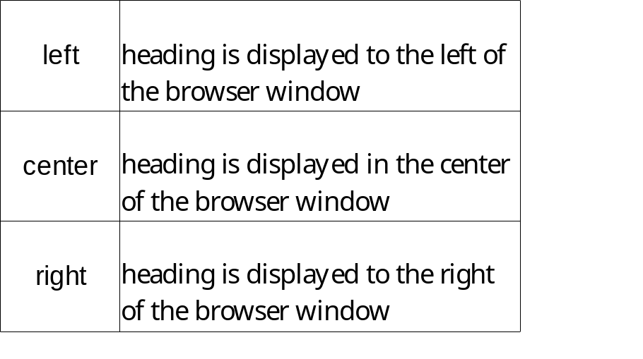
Heading
The six heading elements can all carry the universal attributes as well as a deprecated attribute called align.
  align, class, id, style, title, dir
The align Attribute (deprecated)
  <h1 align="left">Left-Aligned Heading</h1>

Slide 30
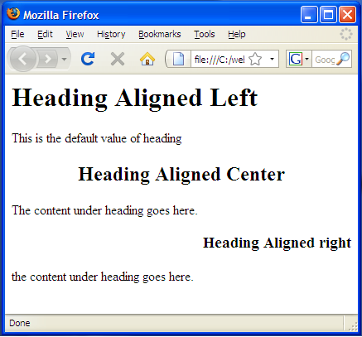
Example
<html>
<body>
<h1 align="left"> Heading Aligned Left </h1>
<p> This is the default value of heading </p>
<h2 align="center"> Heading Aligned Center </h2>
<p> The content under heading goes here. </p>
<h3 align="right"> Heading Aligned right</h3>
<p> the content under heading goes here. </p>
</body>
</html>

Slide 31
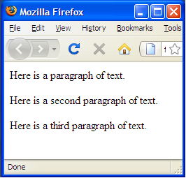
Paragraph <p> . . . </p>
When a browser displays a paragraph it usually inserts a
  new line before the next paragraph and
  adds a little bit of extra vertical space
eg.
. . .
<p>Here is a paragraph of text.</p>
<p>Here is a second paragraph of text.</p>
<p>Here is a third paragraph of text.</p>
. . .

Slide 32
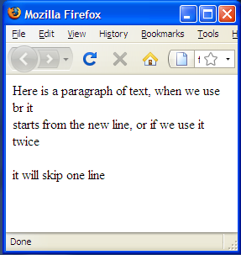
Creating Line Breaks
Whenever you use the <br /> element, anything following it starts on the next line.
<br /> (XHTML)
<br> (HTML)
It does not need opening and closing tags
eg.
<br/> used once
<html>
<body>
<p>Here is a paragraph of text, when we use br it <br/>starts from the new line, or if we use it twice <br/> <br/> it will skip one line </p>
</body>
</html>
<br/> used twice

Slide 33
Creating Preformatted Text
It will display the content as it is formated in the source document
<pre> . . . </pre>
most browsers would display this text in a monospaced font by default
  Used to display tabular data without the use of a table(in which case you must use the monospaced font or columns will not align correctly) and
  to represent computer source code.
Example on the next slide

Slide 34
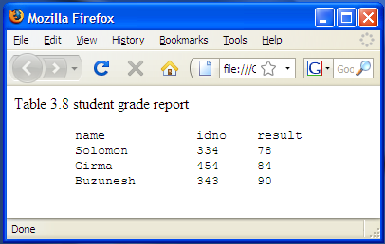
Example: tabular data using <pre> tag
<html>
<body>
<p> Table 3.8 student grade report
<pre>
name idno result
Solomon 334 78
Girma 454 84
Buzunesh 343 90
</pre>
</p>
</body>
</html>

Slide 35
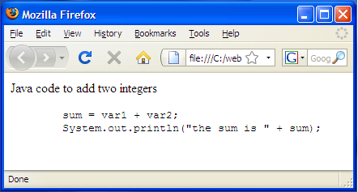
Example: using <pre> tag to display souce code
<html>
<body>
<p> Java code to add two integers
<pre>
sum = var1 + var2;
System.out.println("the sum is " + sum);
</pre>
</p>
</body>
</html>

Slide 36
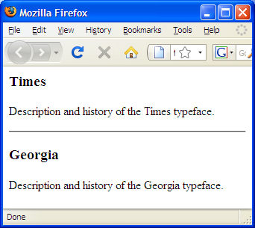
Horizontal Rules
Is a divider between sections
Use <hr> html or <hr /> xhtml
eg.
<body>
<h3>Times</h3>
<p>Description and history of the Times typeface.</p>
<hr />
<h3>Georgia</h3>
<p>Description and history of the Georgia typeface.</p>
</body>

Slide 37
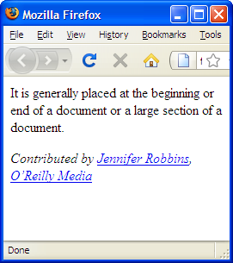
Address
the address element that is used to provide contact information for the author or maintainer of the document.
<address>
Contributed by <a href="../authors/robbins/">Jennifer Robbins</a>,
<a href="http://www.oreilly.com/">O’Reilly Media</a>
</address>

Slide 38

Lists
You can create three types of lists in XHTML:
  Unordered lists, which are like lists of bullet points
  Ordered lists, which use a sequence of numbers or letters instead of bullet points
  Definition lists, which allow you to specify a term and its definition

Slide 39
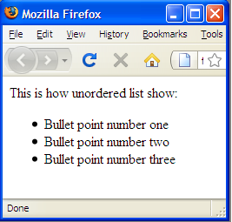
Unordered lists
syntax:
<ul>
<li> . . . </li>
<li> . . . </li>
</ul>
eg.
<p>This is how unordered list show:
<ul>
<li>Bullet point number one</li>
<li>Bullet point number two</li>
<li>Bullet point number three</li>
</ul>
</p>

Slide 40
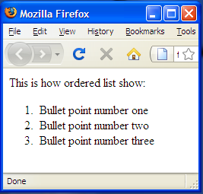
Ordered lists
syntax:
<ol>
<li> . . . </li>
<li> . . . </li>
</ol>
eg.
<p>This is how unordered list show:
<ol>
<li>Bullet point number one</li>
<li>Bullet point number two</li>
<li>Bullet point number three</li>
</ol>
</p>
For letters or Roman numerals , it is better to use CSS list-style-type property which will be discussed later

Slide 41
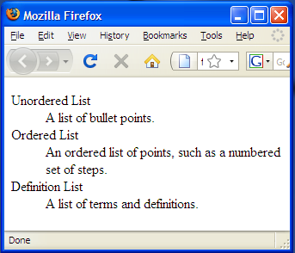
Definition lists
Definition list
is a special kind of list for providing terms followed by a short text definition or description for them.
eg.
<dl>
<dt>Unordered List</dt>
<dd>A list of bullet points.</dd>
<dt>Ordered List</dt>
<dd>An ordered list of points, such as a
numbered set of steps.</dd>
<dt>Definition List</dt>
<dd>A list of terms and definitions.</dd>
</dl>
Defined term
Definition

Slide 42
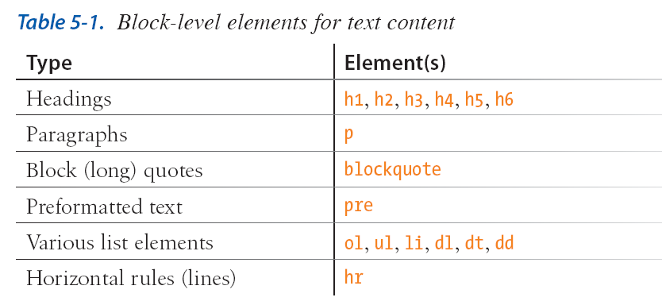
Summary

Slide 43
Inline Text Element
Most (X)HTML text elements are inline elements, which means they just stay in the flow of text and do not cause line breaks.
Inline text elements fall into two general categories:
  semantic elements and
  presentational elements.
semantic elements describe the meaning of the text; for example, an acronym or emphasized text.
presentational inline elements are discouraged from use in contemporary web design where style information should kept be separate from the markup.

Slide 44
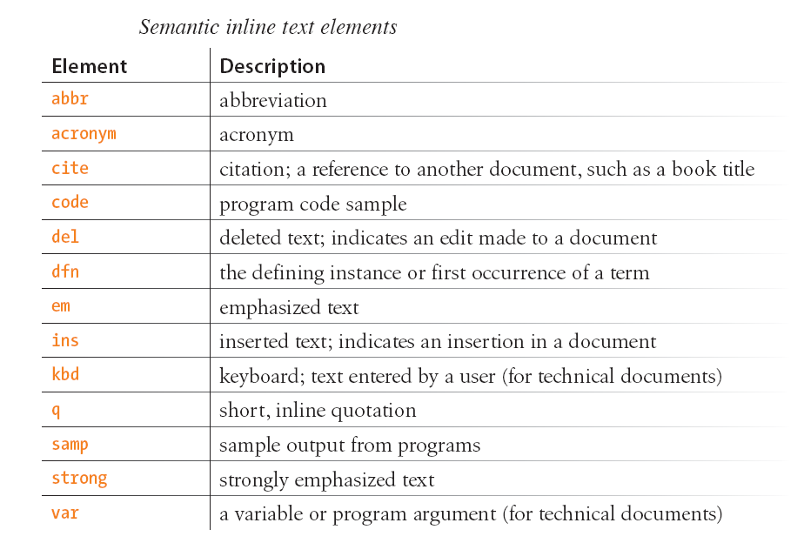
Semantic inline elements

Slide 45
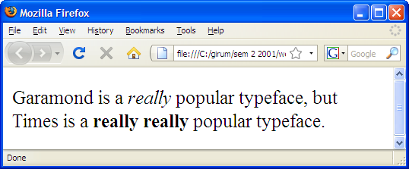
Adding emphasis to text
There are two elements that indicate that text should be emphasized:
em for emphasized text and
<em>...</em>
strong for strongly emphasized text.
<strong>...</strong>
Screen readers may use a different tone of voice to deliver emphasized text, which is why you should use an em or strong element only when it makes sense semantically, not just to achieve italic or bold text.
<p>Garamond is a <em>really</em> popular typeface, but Times is a
<strong>really really</strong> popular typeface.</p>
</p>

Slide 46
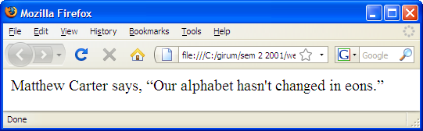
Short quotations
The quotation (q) element is used to mark up short quotations,
Matthew Carter says, <q>Our alphabet hasn't changed in eons.</q>

Slide 47
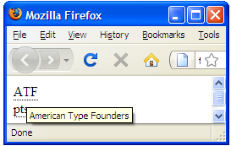
Abbreviations and acronyms
Marking up shorthand terms as acronyms and abbreviations provides useful information for search engines, screen readers, and other devices.
Abbreviations, indicated by the abbr element, are shortened versions of a word ending in a period (Conn. for Connection, for example).
<acronym title="American Type Founders">ATF</acronym>
Acronyms,indicated by the acronym element, are abbreviations formed by the first letters of the words in a phrase (such as WWW or USA).
<abbr title="Points">pts.</abbr>
Both elements use the title attribute to
provide the long version of the shortened term

Slide 48
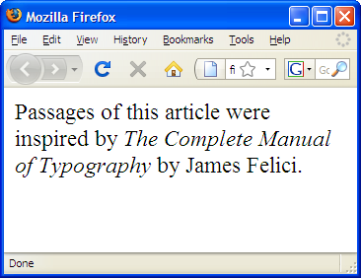
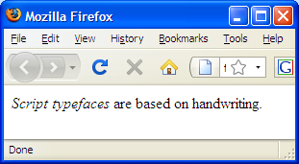
Citations
The cite element is used to identify a reference to another document, such as a book, magazine, article title, and so on.
Defining terms
Used when defining instance of a word
<p><dfn>Script typefaces</dfn>
are based on handwriting.</p>
<p>Passages of this article were inspired by
<cite>The Complete Manual of Typography</cite>
by James Felici.</p>

Slide 49
Program code elements
are used for describing the parts of technical documents, such as:
  code (code),
  variables (var),
  program samples (samp), and
  user-entered keyboard strokes (kbd).
Code, sample, and keyboard elements typically render in a constant-width (also called monospace) font such as Courier by default.
Variables usually render in italics.

Slide 50
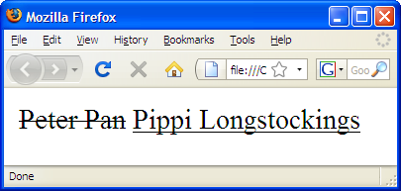
Inserted and deleted text
The ins and del elements are used to mark up changes to the text and indicate parts of a document that have been inserted or deleted
<p><Chief Executive Officer:
<del title="retired">Peter Pan</del>
<ins>Pippi Longstockings</ins></p>

Slide 51
Presentational inline elements
Be careful to keep style information like this out of the (X)HTML document.
Find alternate solutions - using CSS

Slide 52
Presentational Elements
Bold <b> . . . </b>
Italic <i> . . . </i>
Monospaced <tt> . . . </tt> teletype (constant width font )
Underlined <u> . . . </u>
strikethrough <s> . . . </s>
larger <big> . . . </big> makes the text one size bigger
Smaller <small> . . . </small> makes the text one size smaller
Superscripted <sup> . . . </sup>
subscripted text <sub> . . . </sub>
Font <font face="" color="" size=””>

Slide 53
Example: Presentational elements
<html>
<body>
<p>The following word uses a <b>bold</b> typeface.</p>
<p>The following word uses a <i>italic</i> typeface.</p>
<p>The following word uses a <tt>monospaced</tt> typeface.</p>
<p>The following word is <u>underlined</u> .</p>
<p>The following word uses a <s>strikethrough</s>.</p>
<p>The following word has <big>larger</big> fonts.</p>
<p>The following word has <small>smaller</small> fonts.</p>
<p>Alemu got the 1<sup>st</sup> prize in Maths club.<p>
<p>Addition of (1001)<sub>2</sub> and (0001)<sub>2</sub> ?.</p>
</body>
</html>

Slide 54
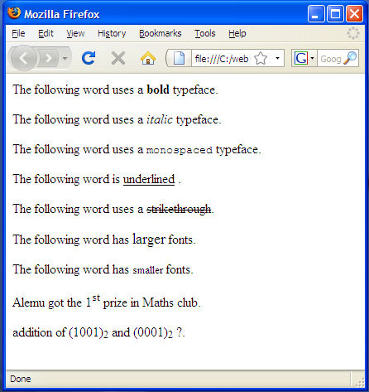
Cont'd . . . Example

Slide 55
Comments
You can put comments between any tags in your XHTML documents. Comments use the following syntax:
Syntax: <!-- comment goes here -->
<!-- This is a comment -->
<!-- This is a
multiple-line comment
that ends here. -->

Slide 56
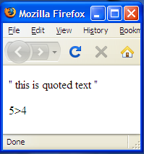
Special Characters
some characters that have special meaning in XHTML
use a set of different characters known as a character entity to represent these special characters
Character Numeric Entity Named Entity
” &#034; &quot;
& &#038; &amp;
< &#060; &lt;
> &#062; &gt;
® &#174; &reg;
© &#169; &copy;
eg. <p> &#034; this is quoted text &#034;</p>
<p>5&gt;4</p>

Slide 57
Attributes
id
  used to uniquely identify any element within a page or style sheet.
    to link to a specific point in a document,
    to select one specific element’s content,
    to associate a CSS style with a particular element,
    or identify that element using a script
  If you have two elements of the same name within a Web page or style sheet, you can use the id attribute to distinguish between elements
  Syntax : id=”idname”
<p id="faculty">This paragraph explains the role of the faculty.</p>
<p id="department">This paragraph explains the role of the department.</p>
It should be unique within the document
and should start with alphabet

Slide 58
Cont'd . . . Attributes
Title
  gives a suggested title for the element
  Syntax: title=”string”
class
  used to associate an element with a style sheet, and specifies the class of element
  Syntax: class="className"
Style
  attribute allows you to specify CSS rules within the element
  <p style="font-family:arial;color:#FF0000;">Some text...</p>
  The use of this attribute should be avoided since it mixes up the stylistic markup with structural and semantic markup

Slide 59
Generic Elements
The <div> and <span> elements allow you to group together several elements to create sections or subsections of a page.
Commonly used with CSS to allow you to attach a style to a section of a page
  <div> used to group block-level elements together.
  <span> is used to group inline elements only.
Both use id or class to give names to the generic div and span elements
<div class="footnotes">
<h2>Footnotes</h2>
<p><span class="inventor"><b>1</b> The World Wide Web was invented by Tim Berners Lee</span></p>
<p><b>2</b> The W3C is the World Wide Web Consortium who maintain many Web standards</p>
</div>
<div>...</div>
Generic block-level element
<span>...</span>
Generic inline element

Slide 60
Questions?
Links and Navigations

Slide 61
Links and Navigation
The average Web site is a group of pages users navigate between using hypertext links.
These pages often include links to
  other Web sites
  other pages in the same site.

Slide 62
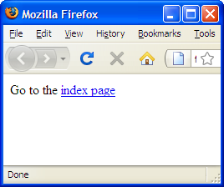
Basics
A link is specified using the anchor <a> element.
Anything between the opening <a> tag and the closing </a> tag becomes part of the link a user can click in a browser.
To link to another document, the opening <a> tag must carry an attribute called href, whose value is the page you are linking to.
<body>
Go to the <a href="index.html">index page </a>
</body>
The file index.html should be in the same folder

Slide 63
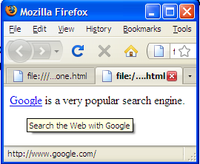
Linking to a website
to link to a different site you need to write the URL between the <a> and </a> tags - source anchor,
<body>
You can also <a href="http://www.google.com/">search Google</a>?
</body>
You can include title attribute to links – when the mouse is over the link additional information could be delivered to the user.
<body>
<a href="http://www.Google.com/" title="Search the Web with Google">Google</a>
is a very popular search engine.
</body>

Slide 64
Using an image as a link
put the img element in the anchor element:
<a href="http://www.oreilly.com"><img src="ora.gif" /></a>
Most browsers display linked text as blue and underlined, and linked images with a blue border.
Visited links generally display in purple.
One can change the color of links by using CSS and it is recommended that you keep them consistent throughout your site so as not to confuse your users.

Slide 65
Absolute and Relative URLs
No two files on the Internet share the same URL
An absolute URL uniquely identify a particular file on the Internet.
http://www.exampleNewsSite.com/Entertainment/Film/index.htm
A relative URL indicates where the resource is in relation to the current page.
If you are at the index page for the entertainment section you can link to film index page in the following way:
  Film/index.htm
the browser changes the relative URLs into full absolute URLs.

Slide 66
(Cont'd. . .) Absolute and Relative URLs
Another key of using relative URLs within your site is that it means you can change your .domain name
Same Directory
When you want to link to or include a resource from the same directory, you can just use the name of that file.
For example, to link from the home page (index.html) to the contact us page (contactUs.htm),
  contactUs.htm

Slide 67
Linking Within Your Own Site
Directories and Directory Structures
Directory is another name for a folder on the Web server
The main directory that holds the whole of your Website is known as the root folder of your Website.
A directory that is within another directory is known as a subdirectory.
A directory that contains another directory is known as the parent directory of the subdirectory.

Slide 68
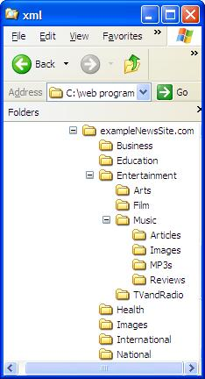
Example
Root directory : exampleNewSite.com
Film is a subdirectory of Entertainment
Entertainment is the parent directory of
  Film,
  Television and radio
  Arts, and
  Music.

Slide 69
Example
Linking within a directory
  <a href="about.html">About the site...</a>
Linking to a lower directory
  From root-directory(exampleNewSite.com) to index in Film directory
  <li><a href="Entertainment/Films/index.html">Visit Film's </a></li>
Linking to a higher directory
  Use ../ to link one level up in the directory
  Use ../ ../ to link two level up in the directory and so on
  To link from Film directory to the Entertainment's index page
  <li><a href="../index.html">Visit Film's </a></li>

Slide 70
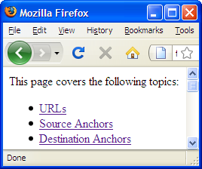
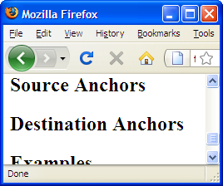
Linking to a specific part of a page
If you have a long Web page, you might want to link to a specific part of that page.
The destination anchor allows the page author to mark specific points in a page that a source link can point to.
<body>
<p>This page covers the following topics:
<ul>
<li><a href="#URL">URLs</a></li>
<li><a href="#SourceAnchors">Source Anchors</a></li>
<li><a href="#DestinationAnchors">Destination Anchors</a></li>
<li><a href="#Examples">Examples</a></li>
</ul>
</p>
<h1>Linking and Navigation</h1>
<h2><a name="URL">URLs</a></h2>
<h2><a name="SourceAnchors">Source Anchors</a></h2>
<h2><a name="DestinationAnchors">Destination Anchors</a></h2>
<h2><a name="Examples">Examples</a></h2>
</body>

Slide 71
Linking to a fragment in another document
You can link to a fragment in another document by adding the fragment name to the end of the URL (absolute or relative).
<a href="glossary.html#Examples">See the Examples</a>

Slide 72
Targeting a New Browser Window
Problem with putting links on your page is that when people click on them, they may never come back.
Solution to this Problem is to have the linked page open in a new browser window
To open a new window using (X)HTML markup,
  use the target attribute in the anchor (a) element ,
  Set the value of target to _blank ( target="_blank" )
For example:
<a href="http://www.oreilly.com" target="_blank">O'Reilly</a>
Or to open one window and to use it repeatedly:
<a href="http://www.oreilly.com" target="display">O'Reilly</a>
Opens a fresh window
to display the link
Could be any name

Slide 73
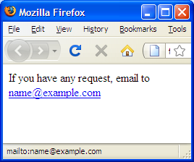
Linking to E-mail Addresses
To create a link to an e-mail address you need to use the following syntax with the <a> element:
<a href="mailto:name@example.com">name@example.com</a>
<a href="mailto:name@example.com">E-mail us</a>.

Slide 74
(Cont'd. . .) Linking to E-mail Addresses
You can also specify some other parts of the message, too, such as the
  subject,
  body, and
  people that it should be cc’d or blind cc’d to.
<a href="mailto:info@example.org?subject=XHTML">
<a href="mailto:info@example.org?subject=XHTML&cc=sales@example.org"></a>

Slide 75
Tables
Are used
  displaying tabular data
  to format whole pages and create visually attractive layouts ( recently CSS is becoming the standard for layout and tables are not recommended )
We use <table> . . . </table>

Slide 76
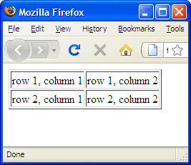
(Cont'd . . .) Tables
to create a table in XHTML use the <table> element.
A row is contained inside a <tr> element— table row
each cell is then written inside the row element using a <td> element for “table data” and <th> for “table headers,”
<table border="1">
<tr>
<td>row 1, column 1 </td>
<td>row 1, column 2 </td>
</tr>
<tr>
<td>row 2, column 1 </td>
<td>row 2, column 2 </td>
</tr>

Slide 77
Table Headers
the text marked up as headers (th elements) are displayed differently from the other cells in the table (td elements).
  Bold and
  Centric
~ are important because they provide information or context about the cells in the row or column

Slide 78
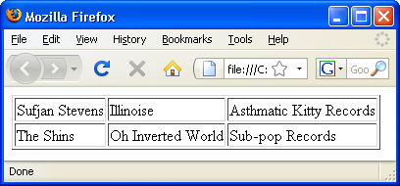
Exercise
In the code fragment below how many columns and rows are there?
<table>
<tr>
<td>Sufjan Stevens</td>
<td>Illinoise</td>
<td>Asthmatic Kitty Records</td>
</tr>
<tr>
<td>The Shins</td>
<td>Oh Inverted World</td>
<td>Sub-pop Records</td>
</tr>
</table>

Slide 79
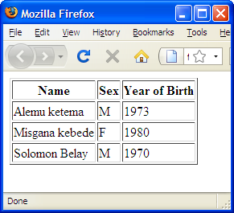
Exercise -1
write the markup for the table shown

Slide 80
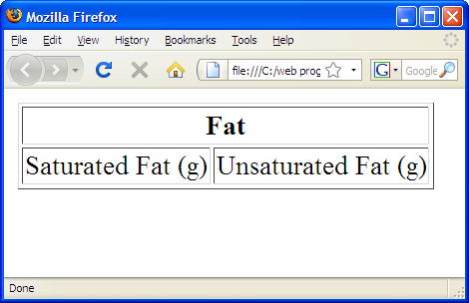
Spanning Cells
is the stretching of a cell to cover several rows or columns
You make a header or data cell span by adding the colspan or rowspan attributes
Column spans, created with the colspan attribute in the td or th element, stretch a cell to the right to span over the subsequent columns
  Example :
<table border="1">
<tr>
<th colspan="2">Fat</th>
</tr>
<tr>
<td>Saturated Fat (g)</td>
<td>Unsaturated Fat (g)</td>
</tr>
</table>

Slide 81
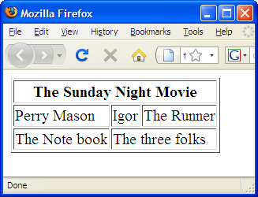
Exercise -2
  write the markup for the table shown

Slide 82
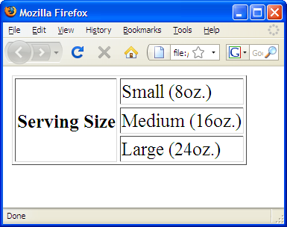
Row spans
Row spans, created with the rowspan attribute
  cause the cell to span downward over several rows.
  Example:
<table>
<tr>
<th rowspan="3">Serving Size</th>
<td>Small (8oz.)</td>
</tr>
<tr>
<td>Medium (16oz.)</td>
</tr>
<tr>
<td>Large (24oz.)</td>
</tr>
</table>

Slide 83
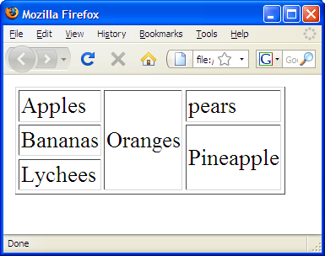
Exercise:
write the markup for the table shown

Slide 84
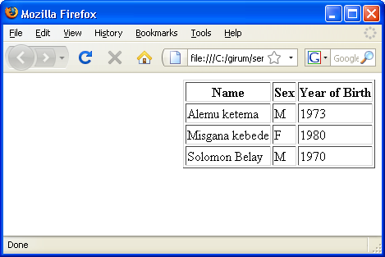
The align attribute (deprecated)
alignment of the table within the containing body-text flow
accepts a value of either left, right, or center,
<table align="right" , border="1">
Table aligned right

Slide 85
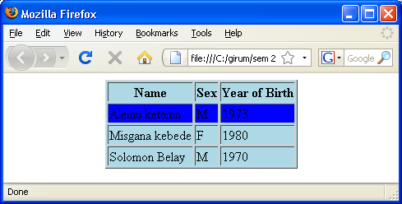
The bgcolor and background attributes
To make the background of a table a different color than the document's background
You may also set individual row and cell colors by providing the bgcolor attribute
<table align="center" , bgcolor ="lightblue" , border="1">
<tr bgcolor="blue">

Slide 86
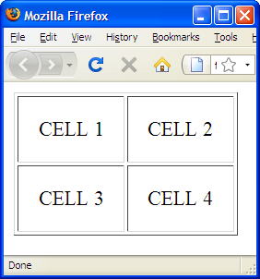
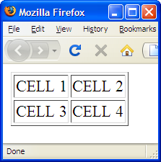
Cell Padding and Spacing
By default, cells are sized just large enough to fit their contents
Cell padding is the amount of space held between the contents of the cell and the cell border.
if you don’t specify any cell padding, the cells will have the default value of one pixel of padding.
  Example:
<table border="1" cellpadding="15">
<tr>
<td>CELL 1</td>
<td>CELL 2</td>
</tr>
<tr>
<td>CELL 3</td>
<td>CELL 4</td>
</tr>
</table>
With cellpadding
With out cellpadding

Slide 87
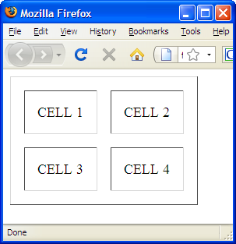
Cont'd ... Cell Padding and Spacing
cellpadding attribute may be used with the table element only, the cellpadding value applies to all the cells in the table.
Cell spacing is the amount of space held between cells, specified in number of pixels.
<table border="1" cellpadding="15" cellspacing="15">
<tr>
<td>CELL 1</td>
<td>CELL 2</td>
</tr>
<tr>
<td>CELL 3</td>
<td>CELL 4</td>
</tr>
</table>

Slide 88
The width and height attributes
the width attribute is either
  an integer number of pixels
<table width=400>
  a relative percentage of the screen width
<table width="50%">
height attribute to suggest a recommended height for the table

Slide 89
The align and valign attributes in <tr> tag
The align attribute for the <table> tag may be deprecated in the HTML and XHTML but not in <tr> tags
align attributes could be left, right, center, and justify
the valign attribute in the <tr> tag with a value of top, bottom, center, middle, or baseline (Internet Explorer only),
  Normally, browsers render cell contents centered vertically

Slide 90
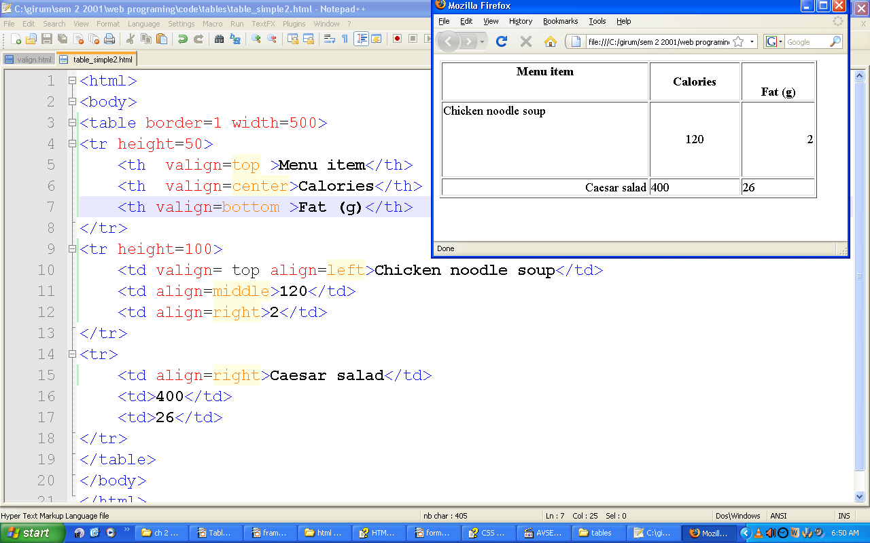
align example

Slide 91
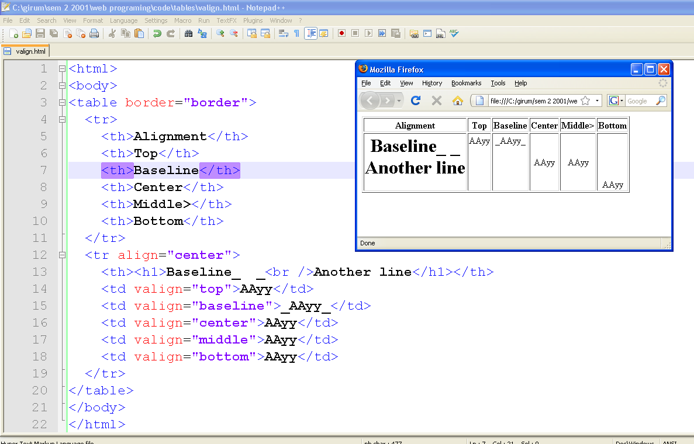
valign example

Slide 92
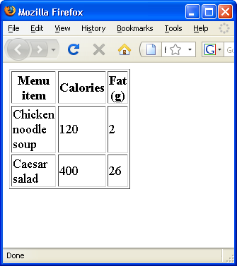
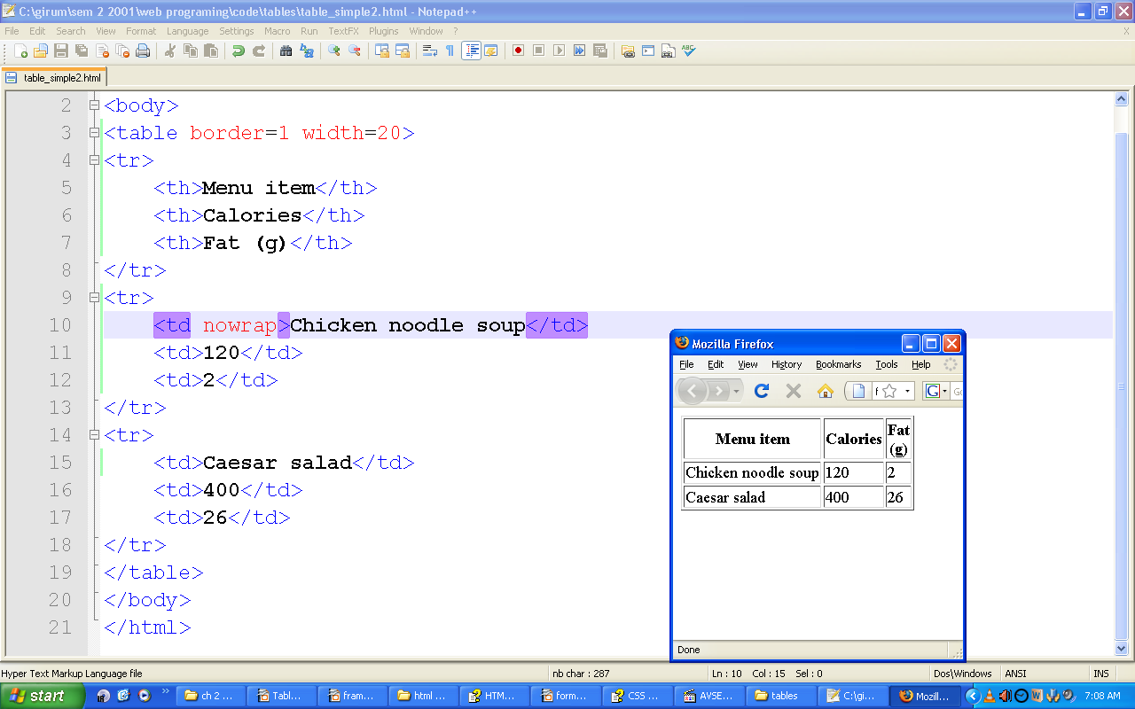
nowrap
stops that normal word wrapping
Without nowrap

Slide 93
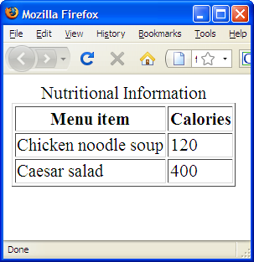
Captions and Summaries
are two methods for providing additional information about a table
caption is displayed with the table in visual browsers,
  is used to give a table a title or brief description
  Example:
<table>
<caption>Nutritional Information</caption>
<tr> <th>Menu item</th>
<th>Calories</th>
</tr>
<tr> <td>Chicken noodle soup</td>
<td>120</td>
</tr>
<tr> <td>Caesar salad</td>
<td>400</td>
</tr>
</table>

Slide 94
Cont'd . . . Captions and Summaries
Summary are used to provide a more lengthy description of the table and its contents.
They are added using the summary attribute in the table element, and they not displayed but may be used by assistive devices
<table summary="A listing of the calorie and fat content for each of the most popular menu items">
<caption>Nutritional Information</caption>
...table continues...
</table>

Slide 95
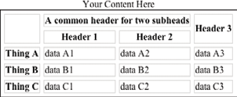
Exercise:
write the markup for the table shown

Slide 96
Questions ?

Slide 97

Colors, Images, and Objects

Slide 98
Adding Color to Your Site
In XHTML there are two key ways of specifying a color:
Hex codes: A six-digit code representing the amount of red, green, and blue that make up the color, preceded by a pound or hash sign # example, #333333.
Color names: A set of names that represent over 200 colors, such as red, blue
Color Hexadecimal Code
Black #000000
White #FFFFFF
Red #FF0000
Green #008000
Blue #0000FF
Purple #800080

Slide 99
Cont'd . . . Adding Color to Your Site
The numbers that follow the # sign is the amount of red, green, and blue that make up the color.
  The format for hex codes is: # rrggbb
  Each letter represent a hexadecimal number and
  each basic color has a value of 0 to 255 (00000000 – 11111111)or (00 – ff )
  If all values of red, green, and blue are 0 the color = black
  If all have 255 then the color would be white

Slide 100
Using Color Names to Specify Colors
you can also use color names such as red, green, and white to specify the color.
Example:
  aqua, beige, coral, darkcyan, firebrick, green, honeydew, indianred,
But usually it is better to use hex codes since it gives more color options.
Most graphic softwares also provide a color-picking tool

Slide 101
Choosing colors for website
In order to choose the colors you are going to use on the site you must have an understanding of the following:
  How colors are made up, and some key terms that describe colors
  What a color wheel is, and how it can help you choose your color schemes
  Different types of color scheme
  What the Web safe color palette is and why you can largely ignore it
  Factors that make colors look different on different computers
  Some issues regarding usability and color

Slide 102
Adding Images to Your Site
Adding images can really slow down the speed of a site—and slow sites frustrate users. Watch out!
Types of Image Formats
  There are two main ways in which graphics are created for computers:
    Bitmapped graphics divide a picture into a grid of pixels and specify the color of each pixel,
      Example: BMP, JPEG, GIF, TIFF,and PNG
    Vector graphics break the image into lines and shapes (like a wireframe drawing), and store the lines as coordinates,then fill the spaces between the lines with color.
      AI,SVG,Flash

Slide 103
Bitmap Images
Most static images on the Web will be bitmapped images.
GIF: Graphics Interchange format
  Uses one of one of the 256 colors
JPEG: Joint Photographic Experts Group format (pronounced “jay peg”)
PNG: Portable Network Graphics (pronounced “ping” )

Slide 104
Adding Images
use the <img /> (XHTML) and <img> (HTML)
<img src="logo.gif" alt="Wrox logo" /> -- works fine if logo.gif and the file are in the same folder.
<image> carry the following attributes:
  src - is required to specify the URL of the image to load. src="url" the url could be absolute or relative.
  alt - to specify a text alternative for the image in case the browser cannot display. alt="Company logo"
  align - used to align the image within the page or the element that contains the image(such as a table cell). Eg align="right" . The values could be: top, middle, bottom, left, right

Slide 105
Cont'd ... Adding Images
  border - specifies the width of the border around the image in pixels. Eg. border="2" , the default value is 0 unless it is a link.
  height and width - specify the height and width of the image: Eg. height="120" width="180"
    The values can either be pixels or a percentage (%)of the page or containing element.
    It is a good practice to specify the height and width of an image, becouse it will allow the browser to render the rest of the page before the image.
  hspace vspace - are used to control the amount of whitespace around an image. Eg. Hspace="10" vspace="14"
    helpful because text can flow around an image

Slide 106
Cont ... Adding Images
  ismap usemap – used with image maps (will be discussed later)
  Name- to specify a name for the image so that it can then be referenced from script code.to specify a name for the image so that it can then be referenced fromscript code. Now it is substituted by id.

Slide 107

Example
<h3>The first image </h3>
<img src="Winter.jpg" alt="Winter photo" width="130" height="130"/>
<h3>The second image</h3>
<img src="Blue hills.jpg" alt="Blue hills photo" width="300" height="300"/>
</body>

Slide 108
Using Images as Links
Images are often used to create graphical buttons or links to other pages.
place the <img /> element inside an <a> element:
<a href="../index.html" title="Click here to return to the home page">
<img src="images/banana.jpg" width="130" height="130" alt="Banana" border="0"/></a>

Slide 109
Image Maps
Image maps allow you to specify different areas of an image in your code, so that when users click different parts of the image, they get taken to different pages.
It uses two specific tags : map and area
<img src="imageMap.jpg" width="300" height="300" alt="Image map test " usemap="#color" />
<map name="color">
<area shape="rect" coords ="25,25,125,125" href="blueRectangle.html" alt="blue rectangle" title="Blue rectangle" />
</map>

Slide 110
Image Map Attributes
Attributes Value Description
shape rect,poly or circle defines the shape of the hot spot
coords rect: x1,y1,x2,y2 defined by upper-left and lower-right points
poly: x1,y1,x2,y2,x3,y3 . . . defined by each of their points
circle: x,y,z (x,y) center coordinates and the radius (r)
href filename.html defines the linked page
alt text string defines the alternate text
target target="_self" specifies window the page should be loaded into.

Slide 111
Example
<body>
<img src="imageMap.jpg" width="300" height="300" alt="Image map test " usemap="#color" />
<map name="color">
<area shape="rect" coords ="25,25,125,125" href="blueRectangle.html" alt="blue rectangle" title="Blue rectangle" />
<area shape="circle" coords="150,150,25" href="circle.html" alt="circle" title="circle" />
<area shape="poly" coords="95,300,85,165,200,265,300,161,300,300" href="poly.html" alt="green polygon" title="Green area"/>
</map>
</body>

Slide 112
Questions?

Slide 113
Frames

Slide 114
Frames
Frames divide a browser window into several pieces or panes, each pane containing a separate XHTML page.
One of the key advantages that frames offer is that you can then load and reload single panes without having to reload the entire contents of the browser window.
A collection of frames in the browser window is known as a frameset.

Slide 115
(Cont'd . . .) Frames
To create a frameset document,
  first you need the <frameset> element, which is used instead of the <body> element.
  The frameset defines the rows and columns your page is divided into, including where each individual frame will go.
  Each frame is then represented by a <frame> element.

Slide 116

Example
<?xml version="1.0" encoding="iso-8859-1"?>
<!DOCTYPE html PUBLIC "-//W3C//DTD XHTML 1.0 Frameset//EN"
"http://www.w3.org/TR/xhtml1/DTD/xhtml1-frameset.dtd">
<html>
<head>
<title>Frames example</title>
</head>
<frameset rows="150, *, 100">
<frame src="top_frame.html" />
<frame src="main_frame.html" />
<frame src="bottom_frame.html" />
<noframes><body>
This site uses a technology called frames. Unfortunately, your
browser does not support this technology. Please upgrade
your browser and visit us again!
</body></noframes>
</frameset>
</html>

Slide 117
The <frameset> Element
The <frameset> element replaces the <body> element in frameset documents.
the attributes of the <frameset> element
  cols specifies how many columns are in the frameset
  rows specifies how many rows are in the frameset
  <frame> element for each frame of the document
  <noframes> elements to indicate what should be displayed to the user if their browser does not load frames.

Slide 118
The cols Attribute
specifies
  how many columns are contained in the frameset and
  the size of each column.
  Eg cols="20%, 60%, 20%" – three columns and their relative size
If you do not specify a cols attribute then the default value is 100 percent
You can specify the width of each column in one of four ways:
  Absolute values in pixels
  A percentage of the browser window (or parent frame if you are nesting framesets)
  Using a wildcard symbol (*)
  As relative widths of the browser window (or parent frame)

Slide 119
Width of column
A Percentage of the Browser Window or Parent Frame
  use a number followed by the percent sign
  Cols="40%, 60%"
    The first frame takes 40% of the browser window
The second frame takes 60% of the browser window
The Wildcard Symbol (*)
  The asterisk, or wildcard symbol, indicates the “rest of the window,”
  Cols="400, *"
  <frameset cols="10%,3*,*,*"> - ??

Slide 120
Width of column
Relative Widths Between Columns
  Cols="3*, 2*, 1*"
    It is divided into six and the first frame takes half of it
Absolute Values in Pixels
  use a number
  Cols="100, 500, *" - - three columns 100, 500 and the rest
  Cols="100, 100, 100" – will produce three frames of size 100, but if the screen size is 600px it will produce three 200 px size frames
  Cols= “100,100,100,*” will produce three exactly 100px frames and one frame to fill the rest of the space

Slide 121
Additional <frameset> Element
The border Attribute
  specifies the width of the border of each frame in pixels.
  border="10"

Slide 122
Additional <frameset> Element
The frameborder Attribute
  Used to display a three-dimensional border between frames.
  frameborder="0" - the border will not show
  frameborder="1" - to display border
The framespacing Attribute
  specifies the amount of space between frames in a frameset
  should be given in pixels and the default value is 2

Slide 123
The <frame> Element
indicates what goes in each frame of the frameset.
The src Attribute
  indicates the file that should be used in the frame
  src="main_page.html"
The name Attribute
  it is used to indicate which frame a document should be loaded into.
  to create links in one frame that load pages into a second frame
  name="main_frame"

Slide 124
The <frame> Element
The marginwidth and marginheight Attributes
  Specifies the space between the three-dimensional border of a frame and its contents.
  marginheight="10" marginwidth="10"
The noresize Attribute
  prevents a user from being able to resize the frame
  noresize="noresize"

Slide 125
The <frame> Element
The scrolling Attribute
  scrolling="yes" - to always have the scrollbar
  or “no” - the frameset will not contain a set of scrollbars
  or “auto” - browser should include scrollbars when the content does not fit in the frame
The <noframes> Element
  If a user’s browser does not support frames the contents of the <noframes> element should be displayed to the user.
  place a <body> element inside the <noframes>

Slide 126
Creating Links Between Frames
The most popular uses of frames is to place navigation bars in one frame and then load the pages with the content into a separate frame. This is particularly helpful in three situations:
When your navigation bar is rather large in size (such as thumbnails of photographs in a gallery).By using frames, the user does not need to reload the navigation bar each time she views a new page.
When your main document is very long and the navigation bar provides shortcuts to parts of the main document.
When you do not want to reload the whole page.

Slide 127
Creating Links Between Frames
  In frame_link.html
<frameset cols="200, *"
<frame src="frames/linksNav.html" />
<frame src="frames/linksMain.html" name="main_page" />
</frameset>
  In linksNav.html
<body>
<h1> Navigation </h1>
<a href="http://www.wrox.com" target="main_page">Wrox Press</a><br />
<a href="http://www.google.com" target="main_page">Google</a><br />
<a href="http://www.microsoft.com" target="main_page">Microsoft</a><br />
<a href="http://news.bbc.co.uk/" target="main_page">BBC News</a><br />
</body>
  In linksMain.html
<body>
<h3> The links should display here </h3>
</body>

Slide 128


Slide 129

target
The target attribute can also take the attribute values

Slide 130
Default Target Frames
Setting a Default Target Frames Using the <base> Element
  You can set a default target frame using the <base> element in any page that contains links that should open in another frame.
  The <base> element should carry an attribute called target, whose value is the name for the frame you want the content to be loaded into.
So, you could add the following to linksNav.html to specify a default frame target:
<head>
<base target="main_page" />
</head>

Slide 131

Inline Frames
define a frame that exists within a conventional document, displayed as part of that document's text flow.
Uses <iframe> Tag
<h1> iFrame is used to show frames inside a document</h1>
<iframe src="main_frame.html", frameborder = "1",width=175 height=200 align=right>
Your browser does not support inline frames. To view this <a href="main_frame.html> document</a> correctly, you need to install a more recent browser on your computer.
</iframe>

Slide 132
When to Use Frames
use frames to compare a returned form with its original to verify the content the user submitted.
to hold a table of contents and various searching tools for the collection.

Slide 133
?

Slide 134
Animated Text
The <marquee> Tag
Function: Creates a scrolling text marquee
Attributes: align, behavior, bgcolor, class, controls, direction, height, hspace, loop, scrollamount, scrolldelay, style, vspace, width
End tag: </marquee>; never omitted
Contains: plain_text
Used in: body_content

Slide 135
Example

Slide 136
The behavior, direction, and loop attributes
The behavior attribute accepts three values:
  scroll (default)
  Slide
  Alternate
If you do not specify a marquee behavior, the default behavior is scroll.
  The direction attribute sets the direction for marquee text scrolling.
  The loop attribute determines how many times the marquee text scrolls.
  The bgcolor attribute lets you change the background color of the marquee area.

Slide 137
Example Slide

Slide 138
Example Alternate

Slide 139
The scrollamount and scrolldelay attributes
The scrollamount attribute value is the number of pixels needed to move text each successive movement during the scrolling process.
  Lower values mean smoother but slower scrolling;
  higher numbers create faster, jerkier text motion.
The scrolldelay attribute lets you set the number of milliseconds to wait between successive movements during the scrolling process.
  The smaller this value, the faster the scrolling.
<marquee scrollamount=1 scrolldelay=1>

Slide 140
example

Slide 141
?

Slide 142
Forms
There are two parts to a working form.
  The first part is the form , which are made up of buttons, text fields, and pull-down menus
    Forms are added to web pages using the form element.
  The other component of a web form is an application or script on the server that processes the information collected by the form and returns an appropriate response.(CGI, PHP, ASP etc )

Slide 143
Example
<html>
<head>
<title>Mailing List Signup</title>
</head>
<body>
<h1>Mailing List Signup</h1>
<form action="/cgi-bin/mailinglist.pl" method="post">
<fieldset>
<legend>Join our email list</legend>
<p>Get news about the band such as tour dates and special MP3
releases sent to your own in-box.</p>
<ol>
<li><label for="name">Name:</label>
<input type="text" name="name" id="name" /></li>
<li><label for="name">Email:</label>
<input type="text" name="email" id="email" /></li>
</ol>
<input type="submit" value="Submit" />
</fieldset>
</form>
</body>
</html>

Slide 144

Cont'd . . . Example

Slide 145
The action attribute
provides the location (URL) of the application or script that will be used to process the form.
<form action="/cgi-bin/mailinglist.pl" method="post">...</form>

Slide 146
Variables and Content
The name attribute
The name attribute identifies the variable name for the control.
<textarea name="comment" rows="4" cols="45">Would you like to add a comment?</textarea>
When a user enters a comment in the field (“This is the best band ever!”), it would be passed to the server as a name/value (variable/content) pair like this:
comment=This%20is%20the%20best%20band%20ever!

Slide 147
Labels
is used to associate descriptive text with its respective form field. This provides important context for users with speech-based browsers.
Each label element is associated with exactly one form control.
There are two ways to use it.
  implicit association, nests the control and its description within a label element:
<label>Male: <input type="radio" name="gender" value="M" /></label>
<label>Female: <input type="radio" name="gender" value="F" /></label>

Slide 148
Cont'd . . . Labels
  explicit association, matches the label with the control's id reference, The for attribute tells which control the label is for.
    useful when the control is not directly next to its descriptive text in the source
    and when we use CSS to align them
<label for="form-login-username">Login account:</label>
<input type="text" name="login" id="form-login-username" />
<label for="form-login-password">Password:</label>
<input type="password" name="password" id="form-login-password"/>

Slide 149

Fieldset and legend
fieldset element is used to indicate a logical group of form controls.
A fieldset may also include a legend element that provides a caption for the enclosed fields.
<fieldset>
<legend>Customer Information</legend>
<ol>
<li><label>Full name: <input type="text" name="name" /></label></li>
<li><label>Email: <input type="text" name="email" /></label></li>
<li><label>State: <input type="text" name="state" /></label></li>
</ol>
</fieldset>
<fieldset>
<legend>Mailing List Sign-up</legend>
<ul>
<li><label>Add me to your mailing list <input type="radio"
name="list" value="yes" checked="checked" /></label></li>
<li><label>No thanks <input type="radio" name="list" value="no" />
</label></li>
</ul>
</fieldset>

Slide 150
Text entry controls
There are three basic types:
  single-line text fields,
  password entry fields, and
  multiline text entry fields.

Slide 151

Single-line text field
used for entering a single word or line of text
syntax : <input type="text" />
Example:
<li><label for="form-city">City:</label>
<input type="text" name="city" value="Your Hometown" size="25" maxlength="50" id="form-city" /></li>
The value attribute specifies default text that appears in the field when the form is loaded. When you reset a form, it returns to this value.

Slide 152
Cont'd . . . Single-line text field
Size
By default, browsers display a text-entry box that is 20 characters wide, but you can change the number of characters using the size attribute. eg. size="25"
maxlength
By default, users can type an unlimited number of characters in a text field regardless of its size.
You can set a maximum character limit using the maxlength attribute. Eg maxlength="50"

Slide 153

Password text entry field
A password field works just like a text entry field, except the characters are obscured from view using asterisk (*) or bullet (•) characters,
Syntax: <input type="password" />
Example:
<li><label for="form-pswd">Log in:</label> <input type="password" name="pswd" size="8" maxlength="8" id="form-pswd" /></li>

Slide 154

Multiline text entry field
Syntax: <textarea>...</textarea>
Example:
<li><label for="form-entry">Official contest entry:</label> <br/><textarea name="contest_entry" rows="5" cols="100" id="form-entry">Tell us why you love the band in 50 words or less. Five winners will get backstage passes!</textarea></li>
rows
Specifies the number of lines of text the area should display. Scrollbars will be provided if the user types more text than fits in the allotted space.
cols
Specifies the width of the text area measured in number of characters

Slide 155
Submit and reset buttons
submit button immediately sends the collected form data to the server for processing.
reset button returns the form controls to the state they were in when the form loaded.
submit and reset buttons are added using the input element.
<input type="submit" />
<input type="reset" />
eg. <p><input type="submit" /> <input type="reset" value="Start over" /></p>

Slide 156

Radio and checkbox buttons
radio buttons is appropriate when only one option from the group is permitted
Syntax: <input type="radio" name="variable" />
Example:
<fieldset>
<legend>How old are you?</legend>
<ol>
<li><label><input type="radio" name="age" value="under24" checked="checked" /> under 24</label></li>
<li><label><input type="radio" name="age" value="25-34" /> 25 to 34 </label></li>
<li><label><input type="radio" name="age" value="35-44" /> 35 to 44 </label></li>
<li><label><input type="radio" name="age" value="over45" /> 45+
</label></li>
</ol>
</fieldset>

Slide 157

Cont'd . . . Radio and checkbox buttons
Checkboxes allow users to select as many or
as few from the group as desired.
Syntax: <input type="checkbox" />
Example:
<fieldset>
<legend>What type of music do you listen to?</legend>
<ul>
<li><label><input type="checkbox" name="genre" value="punk"
checked="checked" /> Punk rock</label></li>
<li><label><input type="checkbox" name="genre" value="indie"
checked="checked" /> Indie rock</label></li>
<li><label><input type="checkbox" name="genre" value="techno" /> Techno </label></li>
<li><label><input type="checkbox" name="genre" value="rockabilly" /> Rockabilly</label></li>
</ul>
</fieldset>

Slide 158
Menus
Menus tend to be more compact than groups of buttons and checkboxes.
  Pull-down
  scrolling menu
Menu control
<select>...</select>
An option within a menu
<option>...</option>
A logical grouping of options within a menu
<optgroup>...</optgroup>

Slide 159

Pull-down menus
only one item may be selected.
select element displays as a pull-down menu by default when
  no size is specified or
  if the size attribute is set to 1
Example:
<label for="form-fave">What is your favorite 80s band?<label><br />
<select name="EightiesFave" id="form-fave">
<option>The Cure</option>
<option>Cocteau Twins</option>
<option>Tears for Fears</option>
<option>Thompson Twins</option>
<option value="EBTG">Everything But the Girl</option>
</select>
Use the value attribute to provide an overriding value.

Slide 160

Scrolling menu
specify the number of lines you’d like to be visible using the size attribute.
The multiple attribute allows users to make more than one selection from the scrolling list.
<label for="EightiesBands">What 80s bands did you listen to?</label>
<select name="EightiesBands" size="6" multiple="multiple"
for="EightiesBands">
<option>The Cure</option>
<option>Cocteau Twins</option>
<option selected="selected">Tears for Fears</option>
<option selected="selected">Thompson Twins</option>
<option value="EBTG">Everything But the Girl</option>
<option>Depeche Mode</option>
<option>The Smiths</option>
<option>New Order</option>
</select>

Slide 161

Grouping menu options
You can use the optgroup element to create conceptual groups of options.
Example :
<select name="icecream" multiple="multiple">
<optgroup label="traditional">
<option>vanilla</option>
<option>chocolate</option>
</optgroup>
<optgroup label="fancy">
<option>Super praline</option>
<option>Nut surprise</option>
<option>Candy corn</option>
</optgroup>
</select>

Slide 162

File selection control
Forms can be used to transmit external documents from a user’s hard drive.
~ is used to select a document from the hard drive to be submitted with the form data.
Syntax: <input type="file" />
Eg:
<form action="/client.php" method="post" enctype="multipart/form-data">
<p><label for="form-photo">Send a photo to be used as your online
icon (optional):</label><br />
<input type="file" name="photo" size="28" id="form-photo" /></p>
</form>

Slide 163
?

