Slide 1
Approaches to System Development
Presented by
JIMMY DE VERA ROLDAN, MSIT

Slide 2
Specific Objectives
At the end of the topic session, the students should be able to:
Define Systems Development Life Cycle (SDLC).
Identify the steps in SDLC methodology.
Illustrate the SDLC.
Describe each phase in SDLC and identify its activities.
Differentiate traditional approach from object oriented approach.
Explain the variations of SDLC used by system developers.

Slide 3
Systems Development Life Cycle (SDLC)
The systems development life cycle (SDLC) is a conceptual model that describes the phases involved in an information system development project, from an initial feasibility study through maintenance of the completed application

Slide 4
Systems Development Life Cycle (SDLC)
The existing system is evaluated.
The new system requirements are defined.
The proposed system is designed.
The new system is developed.
The system is put into use.
The new system must be evaluated once it is up and running.

Slide 5
Systems Development Life Cycle (SDLC)
Business system is a collection of policies, procedures, methods, people, machines, and other elements that interact and enable the organization to achieve its goals.
Information system is a collection of interrelated components that collect, process, store, and provide as output the information needed to complete a business task.

Slide 6
Systems Development Life Cycle (SDLC)
Planning
Analysis
Design
Implementation
Maintenance

Slide 7
Planning Phase Objectives
Project planning is the process of defining clear, discrete activities, and the work needed to complete each activity within a single project.
The primary objectives of this phase are:
Identify the scope of the new system
Ensure that the project is feasible
Develop a schedule, resource plan, and budget for the remainder of the project

Slide 8
Planning Phase Activities
Define the problem
Confirm project feasibility
Produce the project schedule
Staff the project
Launch the project

Slide 9
Analysis Phase Objective
The primary objective of the analysis phase is to understand and document the business needs and the processing requirements of the new system. This phase is basically a discovery process.

Slide 10
Analysis Phase Activities
Gather information
Define system requirements
Build prototypes
Prioritize requirements
Generate and evaluate alternatives
Review recommendations with management

Slide 11
Design Phase Objective
This phase is where the technical blueprint of the system is created. The primary objective of the design phase is to design the solution system based on the requirements defined and decisions made during the analysis phase.

Slide 12
Design Phase Activities
Design and integrate the network
Design the application architecture
Design the user interfaces
Design the system interfaces
Design and integrate the database
Prototype the design details
Design and integrate the system controls

Slide 13
Implementation Phase Objective
In the implementation phase, the system is built, tested, and installed. The objective of the activities of this phase is not only to produce a reliable, fully functional information system, but also to ensure that the users are all trained and that the organization is ready to benefit as expected from use of the system.

Slide 14
Implementation Phase Activities
Construct software components
Verify and test
Convert data
Train users and document the system
Install the system

Slide 15
Maintenance Phase Objective
The objective of the maintenance phase is to keep the system running productively during the years following its initial installation. This phase begins only after the new system has been installed and put into use, and it lasts throughout the productive life of the system. At some stage in this phase, upgrades or enhancements may be carried out to expand the system’s capabilities.

Slide 16
Maintenance Phase Activities
Maintain the system
Enhance the system
Support the users

Slide 17
Approaches to System Development
There are two general approaches to system development and these are:
Traditional Approach. Also known as structured system development.
Object-Oriented Approach. It views an information system as a collection of interacting objects that work together to accomplish tasks.

Slide 18
The Waterfall Model
The waterfall model describes a development method that is linear and sequential. It is based on the metaphor that when one phase is finished, the development proceeds to the next phase with no turning back.

Slide 19
The Waterfall Model
Requirements
Design
Implementation
Verification
Maintenance

Slide 20
The Waterfall Model
A drawback in using the waterfall model is that it does not accept the expected changes and revisions that become necessary with most projects. Once an application is in the testing phase, it is very difficult to go back and change something that was not thought of in the concept stage. Some alternatives to the waterfall model include joint application development (JAD), rapid application development (RAD), and spiral model.

Slide 21
Prototyping Model
Prototyping is a systems development methodology in which a prototype is built, tested, and then reworked as necessary until an acceptable prototype is finally achieved from which the complete system or product can now be developed. In addition, this model is an iterative, trial-and-error process that takes place between the system developers and the end users.

Slide 22
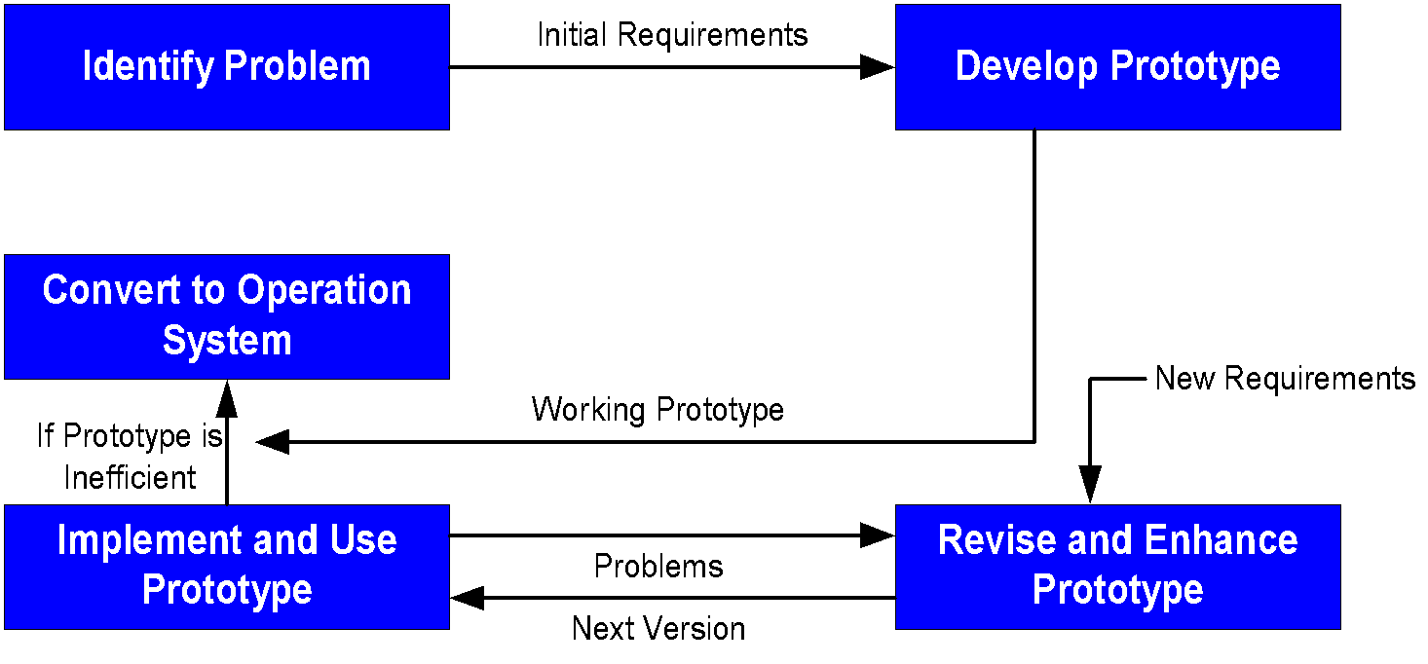
Prototyping Model

Slide 23
Prototyping Advantages
May provide the proof of concept necessary to attract funding
Early visibility of the prototype gives users an idea of what the final system looks like
Encourages active participation among users and producers
Enables a higher output for user
Cost effective

Slide 24
Prototyping Advantages
Increased system development speed
Assists to identify any problems with efficacy of earlier design, requirements analysis, and coding activities
Helps to refine the potential risks associated with the delivery of the system being developed

Slide 25
Prototyping Disadvantages
Possibility of causing systems to be left unfinished
Producer might produce a system inadequate for overall organization needs
User can get too involved whereas the program cannot be to a high standard
Structure of system can be damaged since many changes could be made
Not suitable for large applications

Slide 26
Spiral Model
The spiral model is an SDLC model used in information technology that combines the features of the prototyping model and the waterfall model. The model shows the life cycle as a spiral, starting from the center and works its way around, over and over again, until the project is complete.

Slide 27
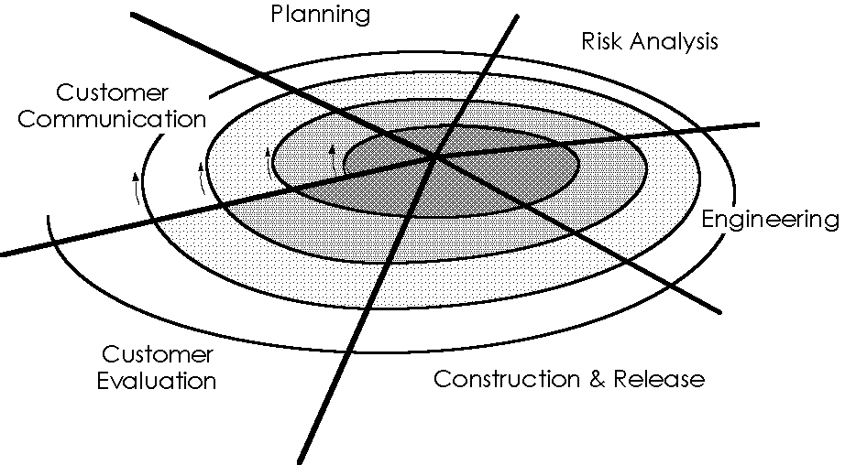
Spiral Model

Slide 28
Spiral Model Advantages
Estimates of the budget and schedule become more realistic as work progresses because of the questions that have been raised
Easier to cope with the changes inherent to software development
Software engineers can start working on the project earlier rather than wading through a lengthy early design process

Slide 29
Spiral Model Disadvantages
However, a drawback of the spiral model is that estimation of budget and time are harder to judge at the beginning of the project since the requirements evolve through the process.

Slide 30
Extreme Programming (XP)
Extreme programming is a discipline of system development that follows a specific structure that is designed to simplify and expedite the process of developing new software. This approach was developed by Kent Beck to be used with small teams of developers who need to develop software quickly in an environment of rapidly-changing requirements.

Slide 31
Unified Process
The unified process is an object-oriented system development methodology offered by Rational Software, which was recently acquired by IBM. In addition to providing several unique features, UP uses UML (a standard modelling notation for OO approach) for system models.

Slide 32
6 Best Practices in Unified Process
Develop iteratively
Define and manage system requirements
Use component architectures
Create visual models
Verify quality
Control changes

Slide 33
Phases in Unified Process
Inception – defines the scope of the project by specifying use cases.
Elaboration – focuses on several iterations that take part of the system and define the requirements, design the solution, and implement the solution.
Construction – continue to build the system using additional iterations that also include requirements, design, and implementation.
Transition – turn the system over to the end users and focus on end users training, installation, and support.

Slide 34
Agile Modelling
Popularized by Scott Ambler, agile modelling is a practice-based methodology for modelling and documentation of software-based systems. This is proposed to be a collection of values, principles, and practices for modelling software that can be applied on software development projects in a more flexible manner than traditional modelling methods.

Slide 35
Core Practices of Agile Modelling
Iterative and incremental modelling – apply the right models, create several models in parallel, and model in small increments.
Teamwork – model with others, get active stakeholder participation, encourage collective ownership, and display models publicly.
Simplicity – create simple content, illustrate models simple, and use the simplest modeling tools.
Validation – consider testability and then prove the model is right with the code.

Slide 36
Rapid Application Development (RAD)
RAD is a system development methodology that emphasizes speed of development through extensive user involvement in the rapid, iterative, and incremental construction of a series of functioning prototypes of a system that eventually evolves into the final system (or a version).

Slide 37
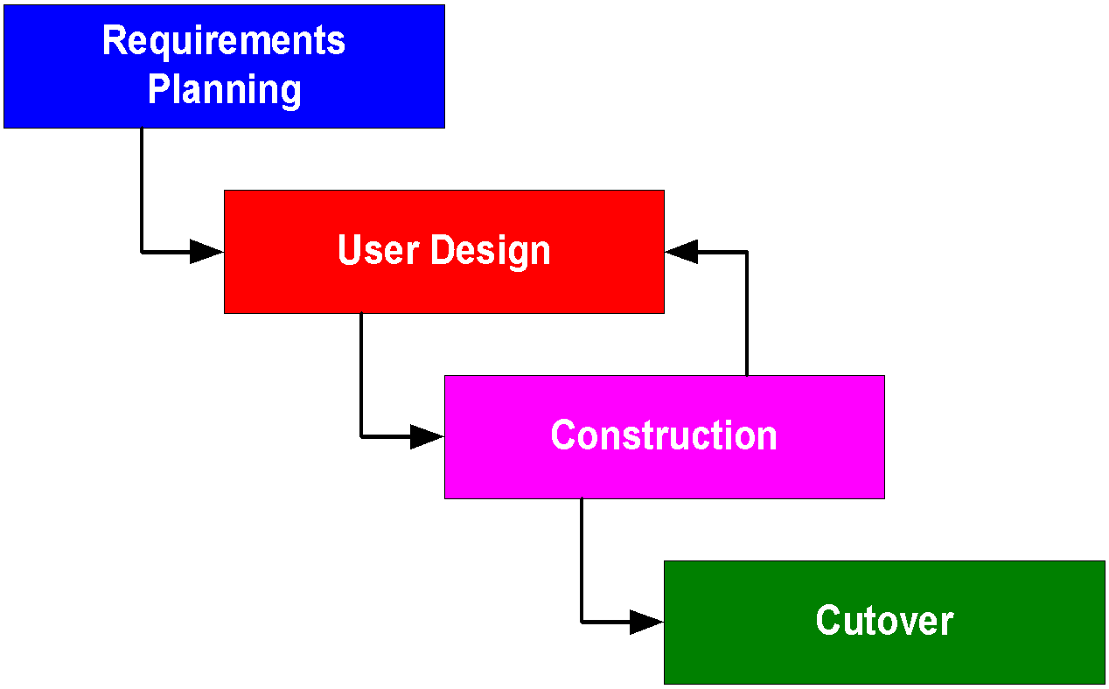
Rapid Application Development (RAD)

Slide 38
RAD Advantages
It is useful for projects in which the user requirements are uncertain and imprecise
It encourages active user and management participation, which increase end-user enthusiasm for the project
Projects have higher visibility and support because of the extensive user involvement throughout the process
Errors and omissions tend to be detected earlier in prototypes than in system models
The iterative approach is a more natural process because change is an expected factor during development

Slide 39
RAD Disadvantages
RAD prototypes can easily solve the wrong problems since problem analysis is abbreviated or ignored
A RAD-based prototype may discourage analysts from considering other, more useful technical alternatives
The emphases on speed can adversely impact quality because of ill-advised shortcuts through the methodology

Slide 40
Joint Application Development (JAD)
JAD is a systems development methodology that involves the client and end-users in the design and development of an application, through a succession of collaborative workshops called JAD sessions. Participants of these sessions would typically include a facilitator, end-users, developers, observers, mediators, and experts. This methodology was developed in the late 1970s by Chuck Morris and Tony Crawford, which were both from IBM.

Slide 41
Joint Application Development (JAD)
A variation on JAD is the RAD which attempts to create an application more quickly through strategies that include fewer formal methodologies and reusing software components. A major advantage of JAD is that it allows for the simultaneous gathering and consolidating of large amounts of information. However, a drawback of JAD is that it opens up a lot of scope of inter-personal conflict.

Slide 42
Approaches to System Development
Presented by
JIMMY DE VERA ROLDAN, MSIT

