Slide 1

Smart Exam Control System
Streamlining Academic Management at
Jahangirnagar University
PRESENTED BY ,
Name | Roll | Exam Roll
Najmul Islam Jesan | 363 | 220423
Aung Sing Marma | 377 | 220437
Jemima Rahman Appi | 389 | 220449
Jyoti Pal | 391 | 220451

Slide 2




Project Objectives: Enhancing Operational Efficiency
Digitalize Management
Fully digitalize the complex exam management process, moving away from paper-based systems to ensure accuracy and speed.
Streamline Financials
Integrate and simplify the fee payment process, providing transparent financial tracking and instant receipt generation.
Instant Information Access
Provide students and faculty with immediate, 24/7 access to results, schedules, and important academic announcements.
Boost Administrative Efficiency
Significantly enhance administrative operations by reducing manual data entry, minimizing errors, and accelerating workflows.

Slide 3



System Users & Core Capabilities
The Smart Exam Control System is designed with tailored functionalities for all key stakeholders, ensuring relevance and utility across the university.
Administrators
Students
Teachers
User management & system oversight
Fee payment & calculation
Result upload & management
Result viewing & analysis
Notice posting
Exam schedule coordination
Exam schedule access
Subject coordination
Financial monitoring
Personalized dashboard
Student performance tracking
Notice board management

Slide 4
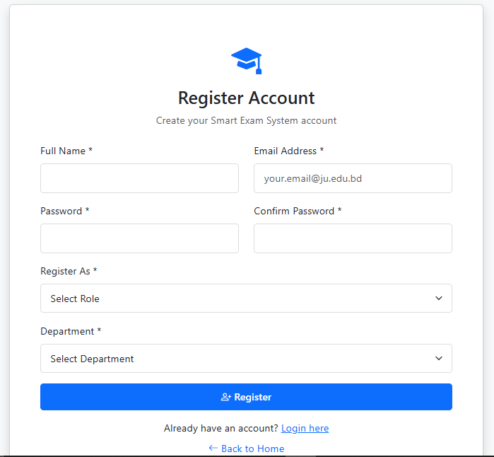
Secure & Simple User Registration Portal
Role-Based Access
The system ensures secure access through a structured registration process, automatically assigning permissions based on the user's role (Student or Teacher) within the university framework.
Role Selection: Mandatory selection of user type upon initial registration.
Departmental Setup: Accurate assignment to the correct department and semester for data segmentation.
Credential Security: Secure creation of login credentials with automated profile setup and verification.

Slide 5
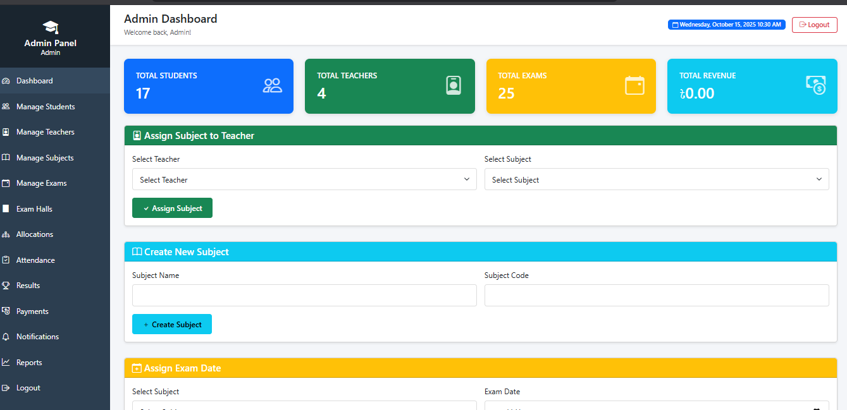
Administrative Control Panel

Slide 6
Administrative Control Panel: System-Wide Oversight
The Admin Portal serves as the central command center, offering deep insights and total control over all system operations and academic data.
User Management
Comprehensive tools for user account verification, status monitoring, and access control.
System Monitoring
Real-time oversight of system performance, usage logs, and security alerts.
Financial Oversight
Tracking and reporting on all fee collections, outstanding balances, and financial flows.
Academic Scheduling
Centralized management and coordination of all exam schedules, venues, and faculty assignments.

Slide 7
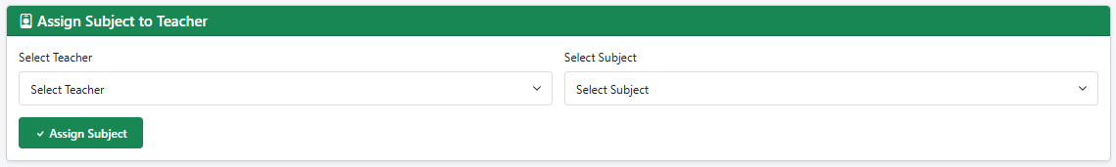
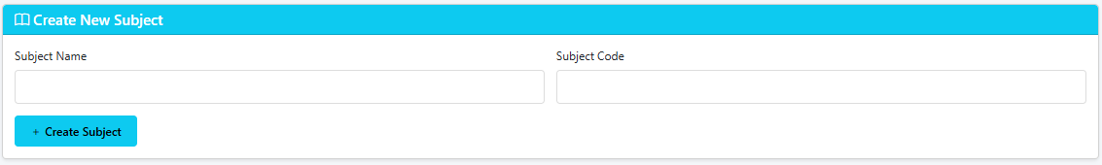
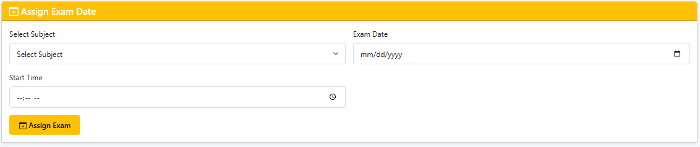
Advanced Administrative Controls
Assign Subjects to the teachers:
Create New Subjects:
Assign Exam Date

Slide 8
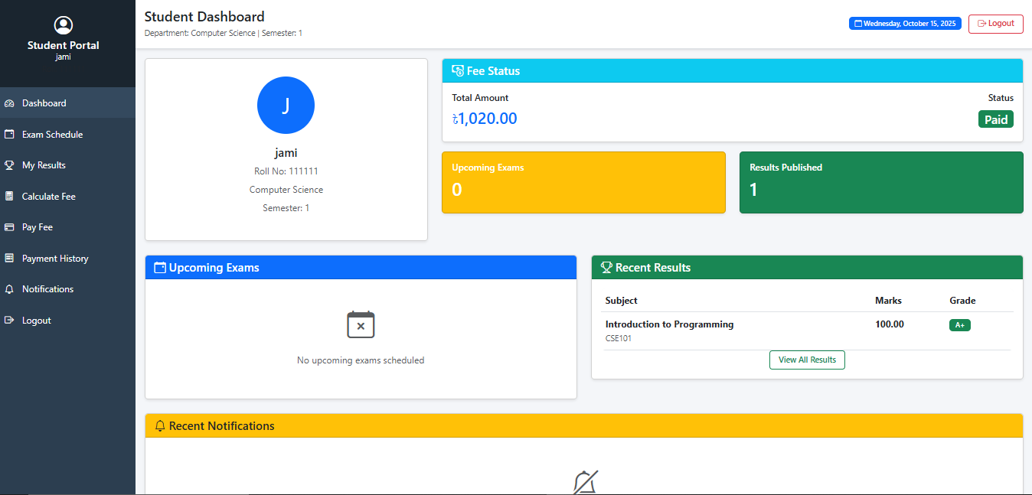
The Students Dashboard:

Slide 9
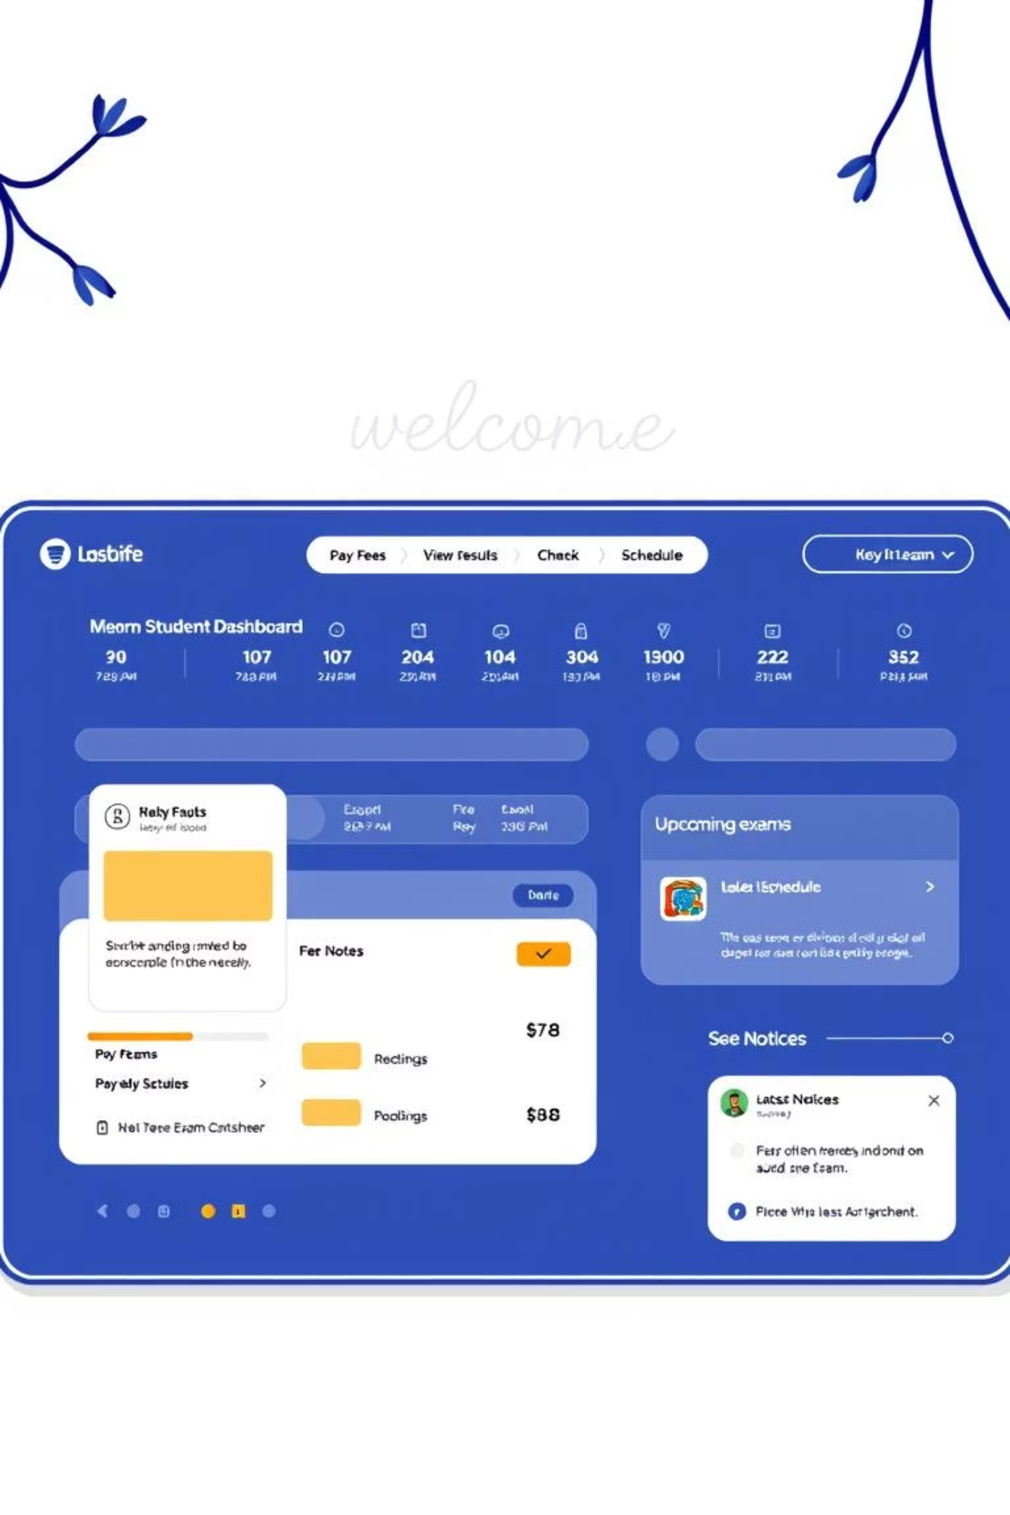
Student Academic Hub: The Personalized Dashboard
The Student Portal provides a personalized and user-friendly interface to manage all academic obligations and track progress.
Personalized Overview
A centralized dashboard offering a snapshot of current academic standing, personalized schedule, and payment status.
Quick Access
Intuitive quick action buttons enable students to navigate instantly to key functions like fee payment and result viewing.
Academic Calendar
Integrated calendar view for upcoming exams, deadlines, and university events.

Slide 10
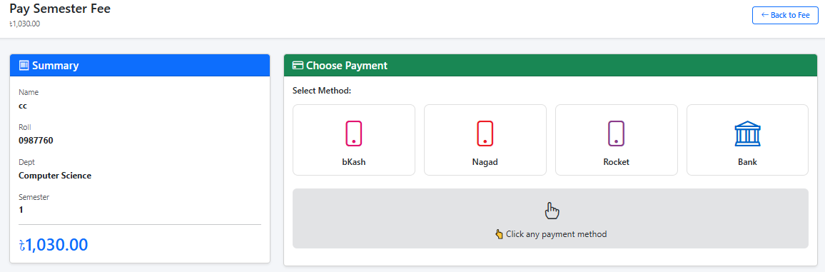
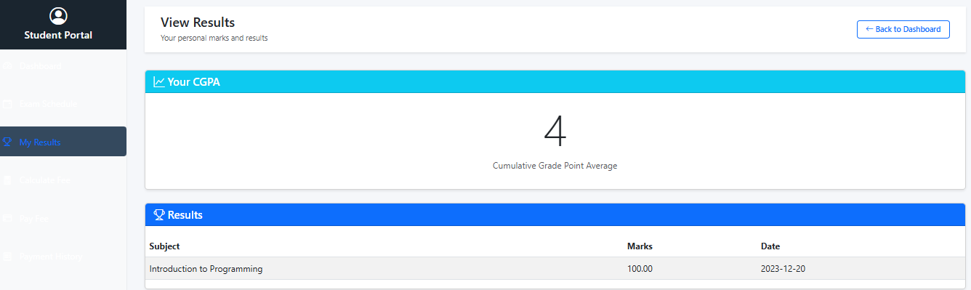
Comprehensive Student Features
Empowering students with essential tools for financial and academic management, accessible anytime, anywhere.
Fee Payment :
See Results:

Slide 11
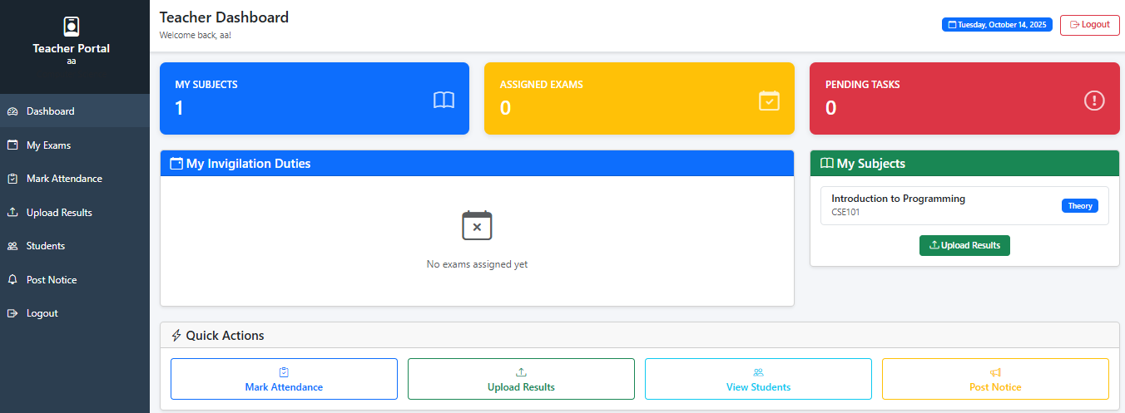
Teachers Dashboard:

Slide 12
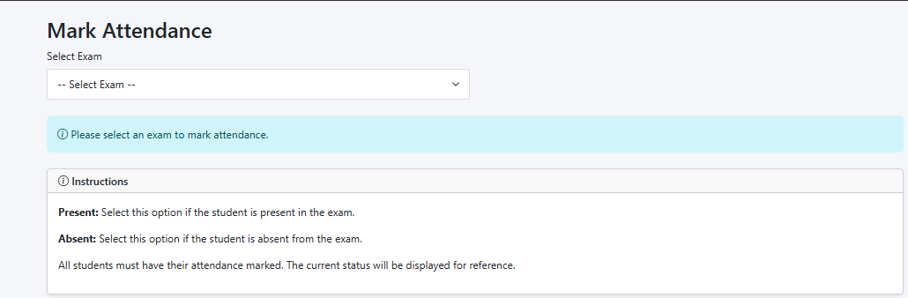
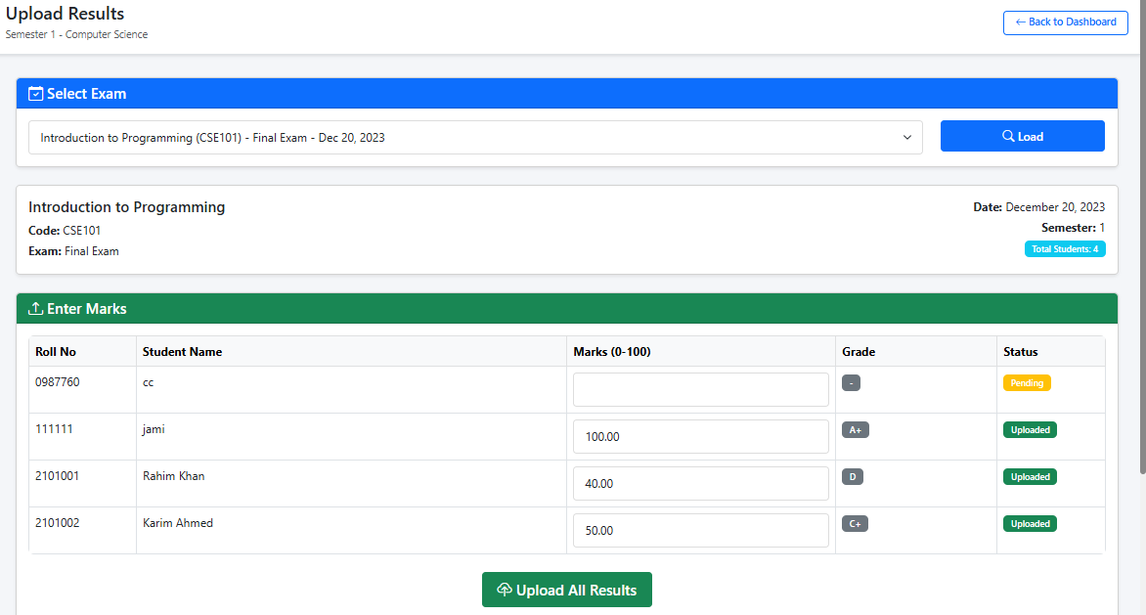

Teacher Control Center: Facilitating Academic Operations
Marks Attendence :
Upload Results:

Slide 13
THANK YOU

