Slide 1
AI POWERED STUDENT ASSISTANCE CHATBOT FOR DEPARTMENT OF TECHNICAL EDUCATION
CSE7101- Capstone Project
Review-1
Batch Number: CCS_12
Under the Supervision of,
Dr. Geetha A
Associate Professor
School of Computer Science and Engineering
Presidency University
Roll Number | Student Name
20221CCS0002 | VIPPARTI JEMIMAH
20221CCS0024 | ARCHANA NAYAK
20221CCS0042 | VAARUNI A R
Name of the Program: Computer Science & Engineering
Name of the HoD: Dr. Shanthi Pichandi Anandaraj
Name of the Program Project Coordinator: Dr. Sharmasth Vali Y.
Name of the School Project Coordinators: Dr. Sampath A K , Dr. Geetha A

Slide 2
Content
Problem Statement
Objectives
Existing Methods and Dra
Analysis of Problem Statement
Innovation or Novel Contributions
Git-hub Link
Timeline of the Project
References

Slide 3
Problem Statement Number:
Organization:
Category (Hardware / Software / Both) :Software
Problem Description:
During admission and academic processes in universities, students, parents, and stakeholders raise numerous queries about admission, eligibility criteria, courses, fee structure, scholarships, hostel facilities, previous academic year details, placement opportunities, and more.
Currently, these queries are addressed through phone calls, emails, or in-person visits, which is time-consuming, resource-intensive, and inefficient. With rising student strength, it becomes increasingly difficult for universities to handle enquiries promptly using traditional methods.

Slide 4
Analysis of Problem Statement (contd...)
To develop an AI-powered student assistance chatbot that acts as a virtual guide for university students.
To automate responses to frequently asked questions (FAQs) on admissions, academics, and placements.
To provide 24/7 accessible support for students, parents, and staff.
To reduce manual workload and allow staff to focus on more complex queries.
To personalize support by integrating syllabus, academic calendar, and course resources.

Slide 5
Gap Identification in Existing AIs
General-purpose vs. Domain-specific
Existing AIs are general-purpose; not syllabus-accurate.
Gap: No domain adaptation for technical education.
Data Reliability & Hallucination
LLMs may give confident but wrong answers.
Gap: No verified link to syllabus, textbooks, university docs.
Context Retention
Rule-based bots can’t handle multi-turn conversations.
Gap: No smooth dialogue flow.

Slide 6
Gap Identification in Existing AIs
Administrative Integration
Current bots can’t provide admissions, fees, hostel, placement info.
Gap: No connection with live university data.
Accessibility & Personalization
One-size-fits-all responses.
Gap: No role-based or student-specific support.
Multi-Modal & Multi-Language
Mostly text-only, English-only.
Gap: No support for regional languages, voice, or diagrams.
Deployment Challenges
Existing AIs are cloud-heavy & costly.
Gap: No lightweight, scalable, affordable solution for universities.

Slide 7
Proposed Method & Feasibility Study
Proposed Approach
Data Ingestion: Circulars, FAQs, notices, policies stored in a vector database.
Orchestration: Intent detection to route between Q&A and student services.
RAG Pipeline: Retrieval + LLM generation with citation of sources.
Guardrails: Domain glossary, PII redaction, fallback to human agent.
Evaluation: Accuracy, containment rate, student satisfaction scores.

Slide 8
Analysis of Problem Statement
Technology Stack Components:
Frontend: React.js / Flutter
Backend: Python (FastAPI/Flask)
AI/NLP: OpenAI GPT / LLaMA / Hugging Face + LangChain
Database: PostgreSQL / MongoDB + FAISS/Pinecone for vector search
Hosting: AWS / GCP / Azure, GitHub for version control

Slide 9
System Modules and Functionalities
User Module
Interface for students, parents, and staff
Accepts queries (text/voice), displays responses
Accessible via web & mobile
Chatbot Engine (AI/NLP Module)
Natural Language Understanding (LLMs)
LangChain for prompt handling & memory
Generates accurate, context-aware responses
Knowledge Base / Data Module
Stores syllabus, FAQs, admission & placement data
Vector DB (FAISS/Pinecone) for semantic search
Ensures verified, syllabus-based answers

Slide 10
System Modules and Functionalities
Backend/API Module
FastAPI/Flask for request handling
Manages data flow between UI & AI engine
Handles authentication & communication
Admin Module
Staff can update FAQs, syllabus & calendar
Dashboard to monitor queries & performance
Keeps data up-to-date
Deployment & Maintenance Module
Docker + Cloud (AWS/GCP/Azure) for deployment
GitHub for version control & collaboration
Ensures scalability & reliability

Slide 11
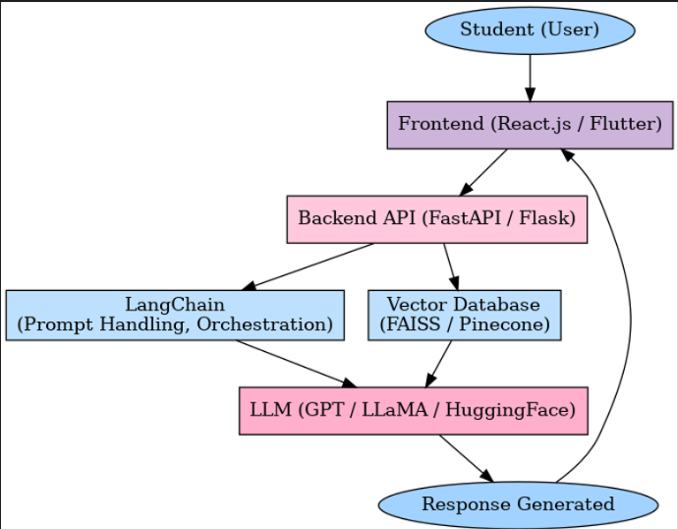
Architecture Diagram

Slide 12
Github Link
The Github link provided should have public access permission.
Github Link: https://github.com/Jemimah-Vipparti/Capstone-Project

Slide 13
Analysis of Problem Statement (contd...)
Software and Hardware Requirements:
Software: Python, Flask, React.js, LangChain, Git, Docker
Hardware: Laptop (8 GB RAM, i5+), Cloud GPU (if fine-tuning)

Slide 14
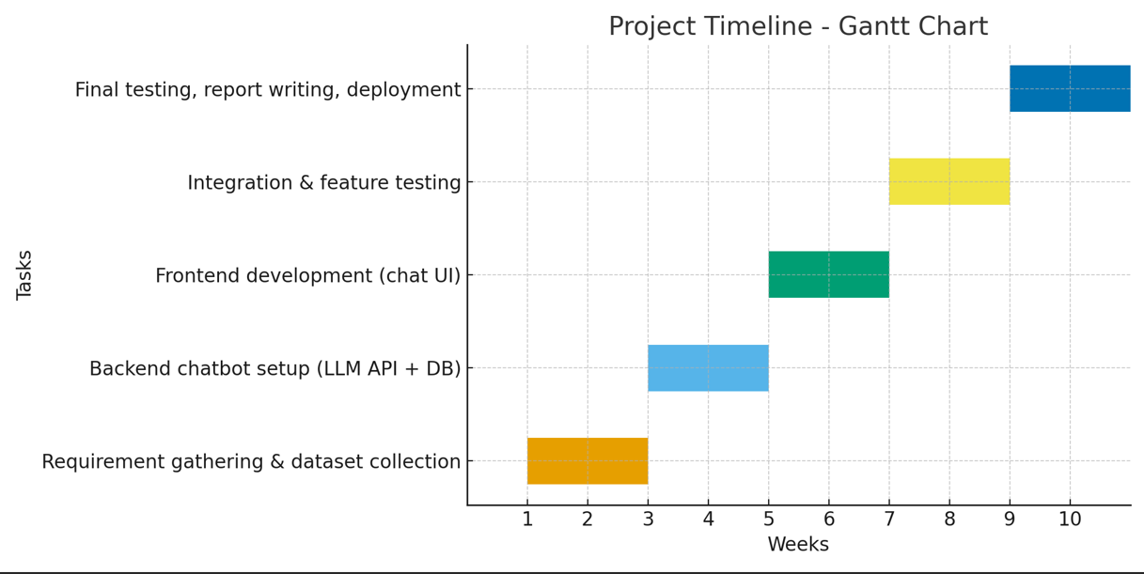
Timeline of the Project (Gantt Chart)
Week 1–2: Requirement gathering & dataset collection (university syllabus, FAQs)
Week 3–4: Backend chatbot setup with LLM API + database
Week 5–6: Frontend development (chat UI)
Week 7–8: Integration & feature testing
Week 9–10: Final testing, report writing, and deployment

Slide 15
References (IEEE Paper format)
[1] J. Gao, M. Galley, and L. Li, “Neural approaches to conversational AI,” Foundations and Trends in Information Retrieval, vol. 13, no. 2–3, pp. 127–298, 2019.
[2] McKinsey & Company, The State of AI Report 2023. [Online]. Available: https://www.mckinsey.com/featured-insights/mckinsey-technology-trends
[3] A. Vaswani et al., “Attention is all you need,” in Proc. Advances in Neural Information Processing Systems (NeurIPS), Long Beach, CA, USA, 2017.
[4] 2021 International Conference on Intelligent Technologies (CONIT) Conversational AI
Conversational AI: Chatbots | IEEE Conference Publication | IEEE Xplore
LINK for the 15 research papers

Slide 16


