Slide 1
CakGo
Finding everyday objects with a phone camera
and Korean voice guidance
Project progress and model results
17 October 2026 / Documentation: Thehxliday68
Notes:
CakGo is an accessibility-focused prototype. This update separates implemented code, benchmark findings and validation still pending. Source: https://github.com/Jeminana/CakGo_AI-powered-indoor-object-finding-assistant/blob/c3a4356a875bc4b41b052a4148cbd98133aa77b3/README.md

Slide 2
Target users and scope
Wallets, keys, glasses and TV remotes
People with visual difficulties and anyone who struggles to locate small belongings are the intended users.
The phone shows the detected object and speaks its screen position: left, center or right.
The MVP requires a visible target. It does not estimate physical distance or find fully hidden objects.
CakGo / 17 October 2026 / 2
Notes:
Intended benefit has not yet been validated with users. The system finds visible objects, not objects hidden completely or physical distances.
Sources:
https://github.com/Jeminana/CakGo_AI-powered-indoor-object-finding-assistant/blob/c3a4356a875bc4b41b052a4148cbd98133aa77b3/README.md
https://github.com/Jeminana/CakGo_AI-powered-indoor-object-finding-assistant/blob/c3a4356a875bc4b41b052a4148cbd98133aa77b3/docs/API_CONTRACT.md

Slide 3
Camera to Korean guidance
Stage | Responsibility
Phone camera | Capture a frame and send the selected target
FastAPI backend | Receive image, call detector and calculate direction
Detection model | Return matching boxes in original-image pixels
Phone feedback | Draw boxes, show Korean text and speak guidance
No detection means “not visible in this frame.”
CakGo / 17 October 2026 / 3
Notes:
Position uses the box horizontal center divided by original image width. The backend guides to the highest-confidence match and returns all matching boxes. Speech wiring is in PR #8.
Sources:
https://github.com/Jeminana/CakGo_AI-powered-indoor-object-finding-assistant/blob/c3a4356a875bc4b41b052a4148cbd98133aa77b3/docs/API_CONTRACT.md
https://github.com/Jeminana/CakGo_AI-powered-indoor-object-finding-assistant/blob/c3a4356a875bc4b41b052a4148cbd98133aa77b3/backend/app.py
https://github.com/Jeminana/CakGo_AI-powered-indoor-object-finding-assistant/pull/8

Slide 4
Implementation progress
Work | Recorded status
YOLO fine-tuning | PR #7 merged, training and evaluation saved
Camera and API display | PR #5 merged
DINO integration factory | PR #6 merged
Frontend speech wiring | PR #8 open, automated checks passed
Phone audio and the complete real-model flow still need device tests.
CakGo / 17 October 2026 / 4
Notes:
The team supplied this round of ownership: Najmi YOLO, Kim Cheolyeon frontend connection, Ogam DINO/voice integration, Sang Xingyu documentation. PR #8 was open when inspected. Coordinator reports success, but phone acceptance has no recorded evidence here.
Sources:
https://github.com/Jeminana/CakGo_AI-powered-indoor-object-finding-assistant/pull/7
https://github.com/Jeminana/CakGo_AI-powered-indoor-object-finding-assistant/pull/5
https://github.com/Jeminana/CakGo_AI-powered-indoor-object-finding-assistant/pull/6
https://github.com/Jeminana/CakGo_AI-powered-indoor-object-finding-assistant/pull/8

Slide 5
Baseline comparison on remote control
Model | AP50 | Precision | Recall | FP images
YOLO26s baseline | 0.870 | 1.000 | 0.833 | 0 / 10
DINO tiny | 0.941 | 0.198 | 1.000 | 9 / 10
DINO covers all four targets. Baseline YOLO covers only remote control.
DINO finds more objects, but its current threshold also produces many false alerts.
70 shared images. YOLO confidence 0.25, DINO 0.35. Matching IoU 0.5.
CakGo / 17 October 2026 / 5
Notes:
Only remote control is supported by COCO-pretrained YOLO among the four targets. Unsupported categories are not scored as zero. The YOLO baseline is a reference run made by the DINO evaluator on the same VM. Precision and recall are at different model operating thresholds.
Sources:
https://github.com/Jeminana/CakGo_AI-powered-indoor-object-finding-assistant/blob/c3a4356a875bc4b41b052a4148cbd98133aa77b3/tests/results/model_comparison_report.md

Slide 6
Fine-tuned YOLO now supports four classes
Category | Precision | Recall | AP50 | FP images
wallet | 0.6875 | 0.6471 | 0.8057 | 0 / 10
keys | 0.9688 | 0.9688 | 0.9678 | 0 / 10
glasses | 1.0000 | 0.9444 | 1.0000 | 0 / 10
remote control | 1.0000 | 0.9444 | 1.0000 | 0 / 10
Mean AP50: 0.9434. Wallet remains the weakest category.
Confidence 0.25. Same-source test set. Real-phone generalization remains untested.
CakGo / 17 October 2026 / 6
Notes:
Values come from metrics_conf0.25.json of the low-confidence inference run, not generic metrics.json, which reports confidence 0.5. Mean AP50 is computed across four class AP50 values. AP50 is not mAP@0.5:0.95. All values describe the existing 70-image source-dataset evaluation.
Sources:
https://github.com/Jeminana/CakGo_AI-powered-indoor-object-finding-assistant/blob/c3a4356a875bc4b41b052a4148cbd98133aa77b3/detection/experiments/yolo/results/ft_yolo26s_cakgo4_v1_conf0.001/metrics_conf0.25.json
https://github.com/Jeminana/CakGo_AI-powered-indoor-object-finding-assistant/blob/c3a4356a875bc4b41b052a4148cbd98133aa77b3/detection/experiments/yolo/training_runs/yolo26s_cakgo4_v1/training_info.json

Slide 7
False alerts on ten target-free images
DINO false alerts remain a concern for spoken directions.
A small negative sample cannot establish real-world reliability.
CakGo / 17 October 2026 / 7
Notes:
Counts are images with any false positive for the requested class. Different operating thresholds are explicit. Zero out of ten for fine-tuned YOLO does not establish zero false alarms in real scenes. Speech cooldown limits repetition, not recognition errors.
Sources:
https://github.com/Jeminana/CakGo_AI-powered-indoor-object-finding-assistant/blob/c3a4356a875bc4b41b052a4148cbd98133aa77b3/detection/experiments/yolo/results/ft_yolo26s_cakgo4_v1_conf0.001/metrics_conf0.25.json
https://github.com/Jeminana/CakGo_AI-powered-indoor-object-finding-assistant/blob/c3a4356a875bc4b41b052a4148cbd98133aa77b3/detection/experiments/grounding_dino/results/t4_gdino-tiny_box0.05/metrics.json
https://github.com/Jeminana/CakGo_AI-powered-indoor-object-finding-assistant/blob/c3a4356a875bc4b41b052a4148cbd98133aa77b3/tests/results/model_comparison_report.md

Slide 8
Model request time and hardware
Model | GPU | Mean request
Pretrained YOLO26s | Colab T4 | 15.25 ms
Grounding DINO tiny | Same Colab T4 | 333.88 ms
Fine-tuned YOLO26s | RTX 4050 Laptop | 15.22 ms
Only the first two rows share the same machine.
These measurements do not represent phone FPS or camera-to-speech latency.
CakGo / 17 October 2026 / 8
Notes:
The T4 baseline is a matched comparison, about 21.9 times DINO/YOLO request time. Fine-tuned YOLO ran on an RTX 4050 laptop and cannot support a direct speed ratio versus T4 DINO. Warmed-up model-call timings exclude file reading and camera, network and speech overhead.
Sources:
https://github.com/Jeminana/CakGo_AI-powered-indoor-object-finding-assistant/blob/c3a4356a875bc4b41b052a4148cbd98133aa77b3/tests/results/model_comparison_report.md
https://github.com/Jeminana/CakGo_AI-powered-indoor-object-finding-assistant/blob/c3a4356a875bc4b41b052a4148cbd98133aa77b3/detection/experiments/yolo/results/ft_yolo26s_cakgo4_v1_conf0.25/run_info.json
https://github.com/Jeminana/CakGo_AI-powered-indoor-object-finding-assistant/blob/c3a4356a875bc4b41b052a4148cbd98133aa77b3/detection/experiments/yolo/results/ft_yolo26s_cakgo4_v1_conf0.25/metrics.json

Slide 9
Real-phone testing plan
Collection | Per person | Team total
Wallet / keys / glasses / remote | 6 each | 72 object photos
No target item anywhere | 4 | 12 negative photos
Total, three collectors | 28 | 84 planned photos
Vary design, clutter, occlusion, distance and light.
Keep photos in the private team Drive and reserve them for testing.
CakGo / 17 October 2026 / 9
Notes:
Source: team collection instructions supplied on 17 October, due 19 October. The photos are planned, not confirmed uploaded. Three collectors each take six photos per category plus four none scenes. Two item designs per person, ideally six per category across the team. No training or tuning on the final test collection.
Sources:

Slide 10
Next milestones
18 October: review frontend voice PR #8 and test audible Korean on phones.
19 October: confirm all 84 photos, review labels and preserve the test-only set.
Then: compare both models on the same phone photos and deployment hardware.
The team selects the final model and thresholds after reviewing the evidence.
CakGo / 17 October 2026 / 10
Notes:
Frontend voice due 18 October. Photo collection due 19 October. Final model and thresholds require evidence and a team decision. Repeat timing on the same deployment machine. Maintain separate validation data for threshold selection.
Sources:
https://github.com/Jeminana/CakGo_AI-powered-indoor-object-finding-assistant/pull/8
https://github.com/Jeminana/CakGo_AI-powered-indoor-object-finding-assistant/blob/c3a4356a875bc4b41b052a4148cbd98133aa77b3/tests/results/model_comparison_report.md

Slide 11
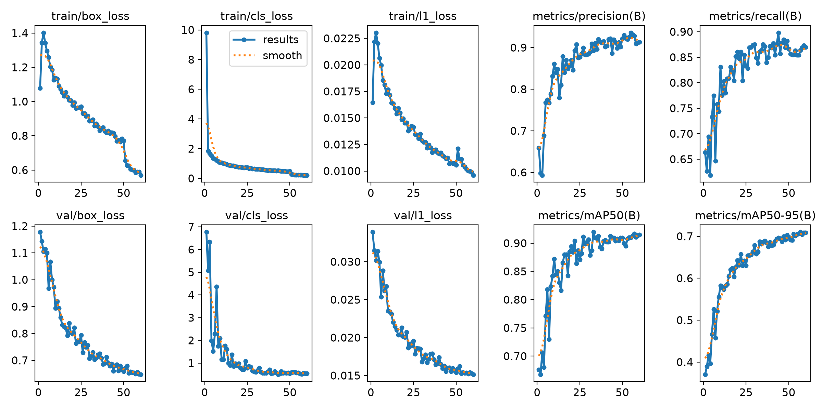
Appendix: the saved training run
6,514 train images and 1,536 validation images after filtering.
Validation curves describe the validation split, not the new phone test.
CakGo / 17 October 2026 / 11
Notes:
This is the original results.png from the 60-epoch fine-tuning run. It shows training and validation metrics, not held-out phone-test outcomes. The training set contains 6514 images after filtering and validation 1536. The test images and duplicates are removed by the preparation script.
Sources:
https://github.com/Jeminana/CakGo_AI-powered-indoor-object-finding-assistant/blob/c3a4356a875bc4b41b052a4148cbd98133aa77b3/detection/experiments/yolo/training_runs/yolo26s_cakgo4_v1/results.png
https://github.com/Jeminana/CakGo_AI-powered-indoor-object-finding-assistant/blob/c3a4356a875bc4b41b052a4148cbd98133aa77b3/detection/experiments/yolo/training_runs/yolo26s_cakgo4_v1/training_info.json

