Slide 1
MEMS Magnetic Field Sensors with Integrated Powder-Based Permanent Magnets
Jemish Naliyapara (18114)
Mayana Yousuf Ali Khan (2120702)
Under the guidance of
Dr. Santanu Talukder
ECS411 Introduction to MEMS
IISER Bhopal

Slide 2
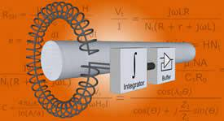
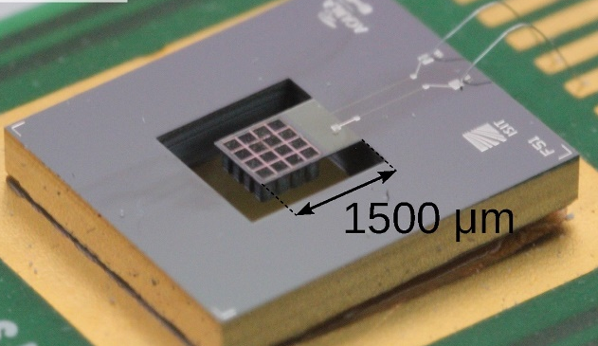
Introduction
MEMS has excellent feasibility in miniaturizing sensors because to its compact size, low power consumption, good performance, and batch manufacturing.
Electrical current measurement is essential for better performance in consumer electronics, power electronics and healthcare product.
Electrical current can be measure by magnetic field produced by current. There are two type of sensors can be used for current measurement.
Encircling based sensors
Rogowski coil
Sensors
Cantilever based MEMS sensor
Proximity based sensors

Slide 3
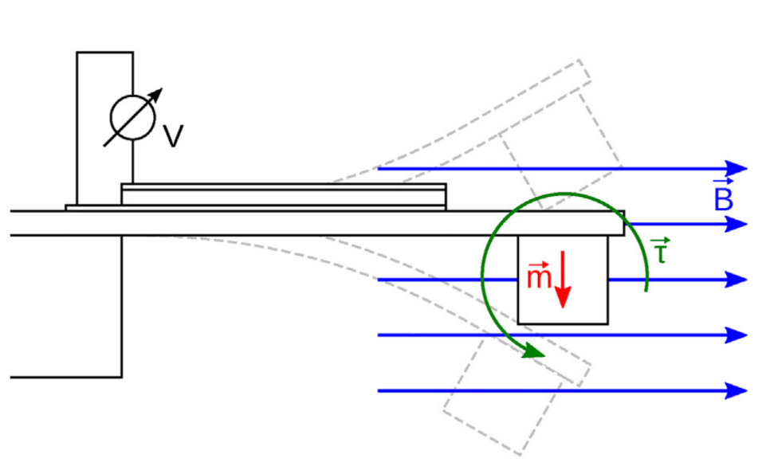
Theory
We worked on a proximity- based sensor that is based on a cantilever mounted permanent magnet by following F. Niekiel et al.’s paper [1].
Permeant magnet at cantilever tip
Torque due to magnetic field
Deflection due to torque
Electric signal generated by piezoelectric material

Slide 4
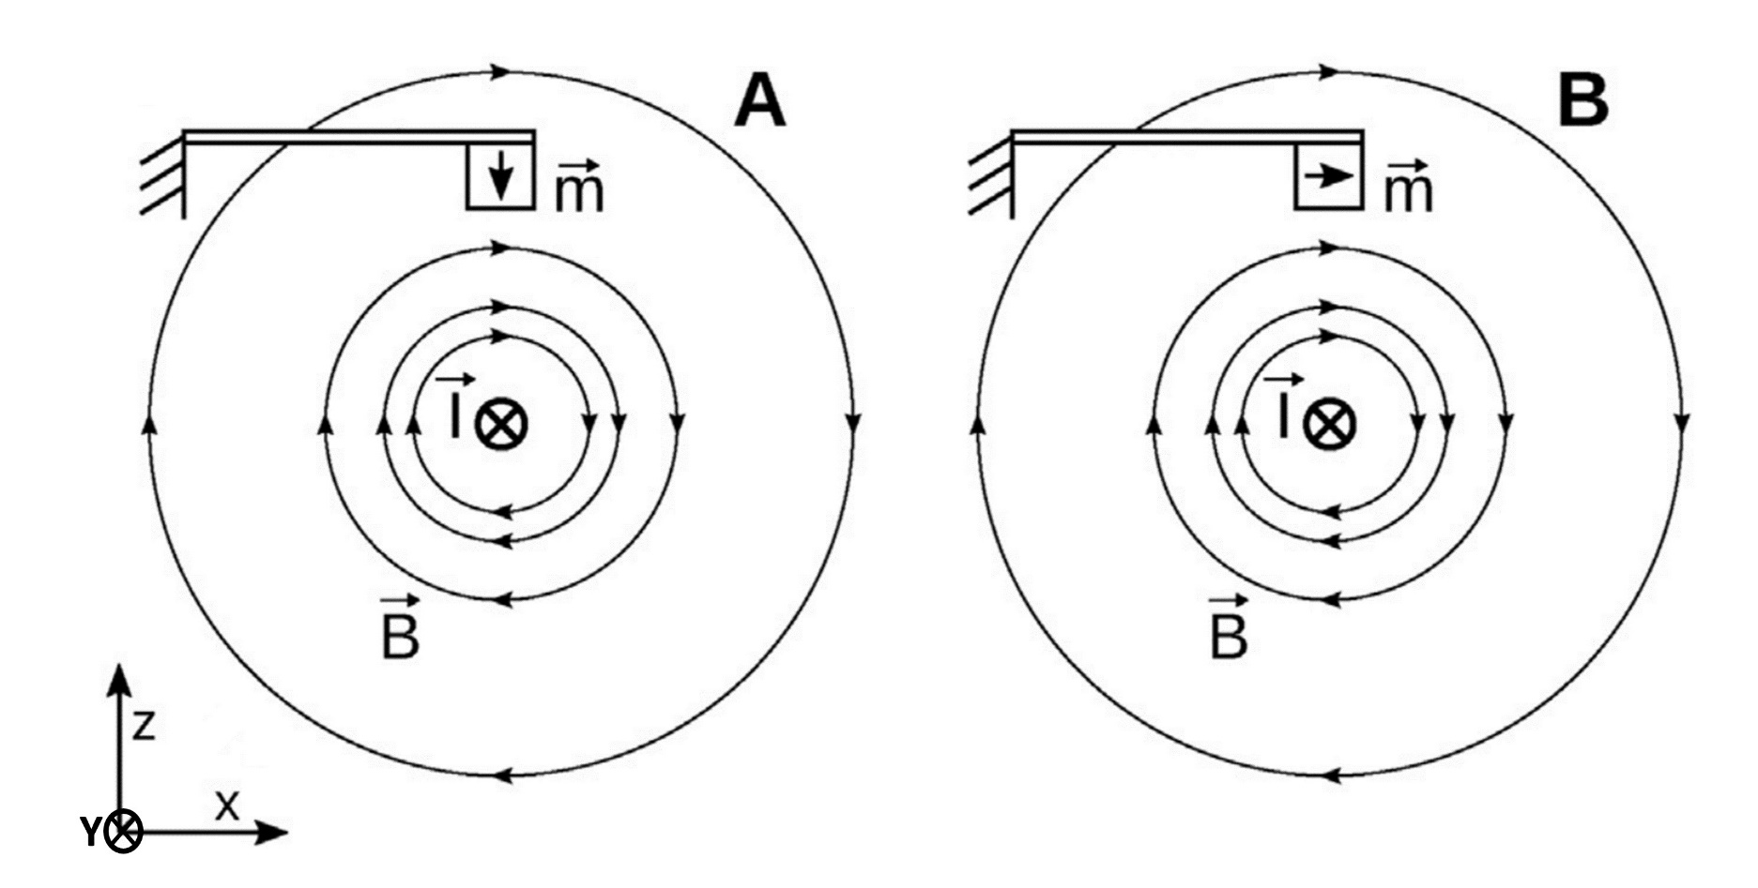
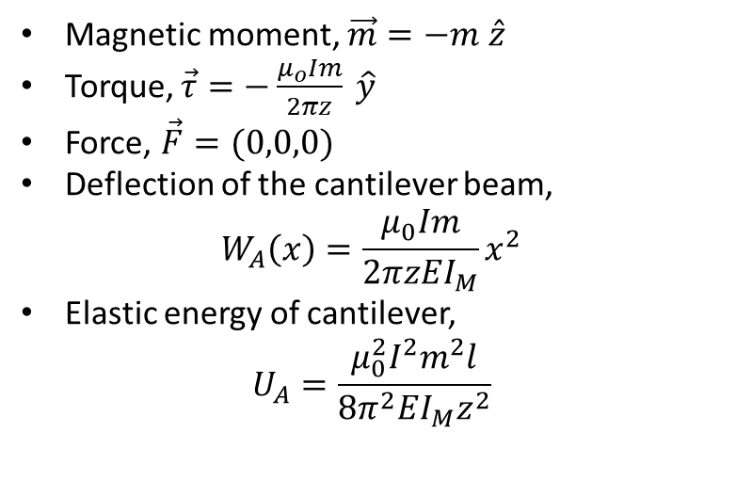
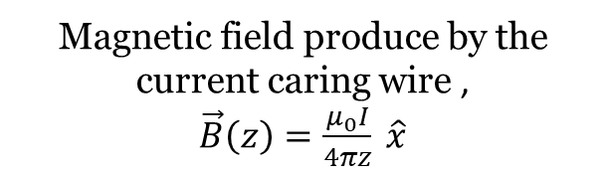
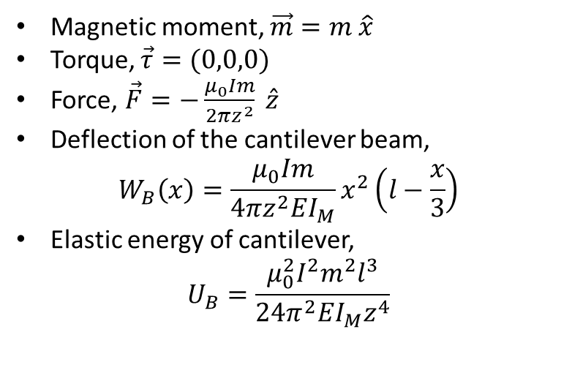
Case: A
Case: B
Magnetic field produce by the current caring wire ,
$\vec{B}\left(z\right)=\frac{μ_{0}I}{4πz} \hat{x}$
Magnetic moment, $\vec{m}=−m \hat{z}$
Torque, $\vec{τ}=−\frac{μ_{o}Im}{2πz} \hat{y}$
Force, $\vec{F}=(0,0,0)$
Deflection of the cantilever beam,
$$W_{A}\left(x\right)=\frac{μ_{0}Im}{2πzEI_{M}}x^{2}$$
Elastic energy of cantilever,
$$U_{A}=\frac{μ_{0}^{2}I^{2}m^{2}l}{8π^{2}EI_{M}z^{2}}$$
Magnetic moment, $\vec{m}=m \hat{x}$
Torque, $\vec{τ}=(0,0,0)$
Force, $\vec{F}=−\frac{μ_{0}Im}{2πz^{2}} \hat{z}$
Deflection of the cantilever beam,
$$W_{B}\left(x\right)=\frac{μ_{0}Im}{4πz^{2}EI_{M}}x^{2}\left(l−\frac{x}{3}\right)$$
Elastic energy of cantilever,
$$U_{B}=\frac{μ_{0}^{2}I^{2}m^{2}l^{3}}{24π^{2}EI_{M}z^{4}}$$

Slide 5
Febrication
MEMS has excellent feasibility in miniaturizing sensors because to its compact size, low power consumption, good performance, and batch manufacturing.
Electrical current measurement is essential for better performance in consumer electronics, power electronics and healthcare product.
Electrical current can be measure by magnetic field produced by current

