Slide 1
Deep-Learning Analysis of Longitudinal Alzheimer’s Data

Slide 2
NACC Dataset
Longitudinal neural-degenerative desease dataset
45,100 patients, 180,000+ samples
Includes clinical diagnosis of cognitive status at time of visit
Fertile ground for automated, time series analysis

Slide 3
TODO: Prior Work?

Slide 4
Today:
Masked transformer encoders can achieve state-of-the-art machine cognitive status prediction on NACC neuropsychological battery despite sparse feature signals
Fine-tuning trained current-visit diagnostic models on longitudinal data can yield comparable results for 3-year prognosis prediction
While patient history and lifestyle information does not significantly aid current-visit diagnostics, its inclusion significantly increases the accuracy of 3-year prognosis prediction

Slide 5
Today:
Masked transformer encoders can achieve state-of-the-art machine cognitive status prediction on NACC neuropsychological battery despite sparse feature signals
Fine-tuning trained current-visit diagnostic models on longitudinal data can yield comparable results for 3-year prognosis prediction
While patient history and lifestyle information does not significantly aid current-visit diagnostics, its inclusion significantly increases the accuracy of 3-year prognosis prediction

Slide 6
Clinician-Annotated Cognitive Status at Time of Visit
NACC Neural-Psychological Battery
MoCA
MMSE (and sub scores)
Boston Naming Test
Multilingual Naming Test
and others
…not actually
In total: 103 numerical features
Control | MCI | Dementia
78,117 | 57,625 | 51,563

Slide 7
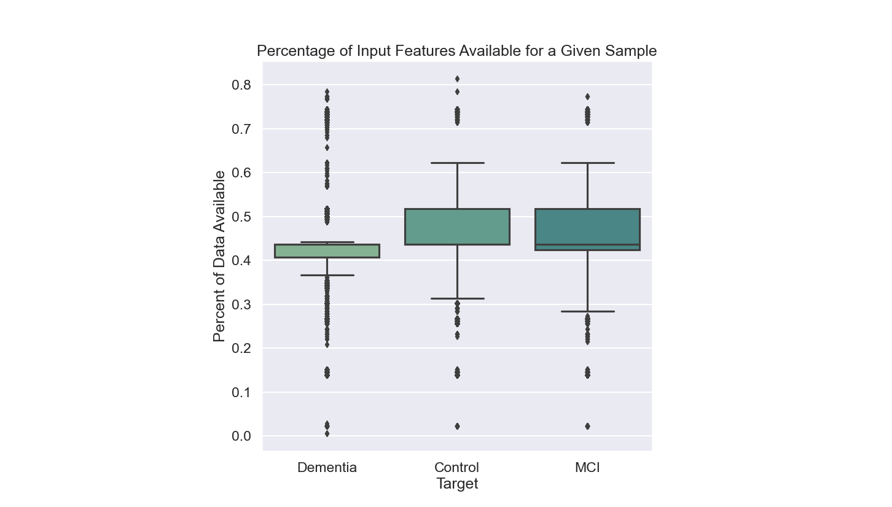
Most Samples in the NACC Has A Lot of the Available Neural-Psychological Features Not Reported
Over half of the available features are not reported (“-4”) across the battery
Which features are missing is inconsistent
Difficult to train a widely applicable model

Slide 8
Relationship Between Missing Data is Roughly Consistent
For instance—
The presence of one of:
Implies the likely absence of all of:
MMSE
Story Unit Recall (NACCMMSE)
Logical Memory IIA (LOGIMEM)
Benson Figure (UDSBENTC, UDSBENTD)
F-Word Generation (UDSVERFC, UDSVERFN, UDSVERNF)
L-Word Generation (UDSVERLC, UDSVERLR, UDSVERLN)
F+L-Word Generation (UDSVERTN,UDSVERTE, UDSVERTI)
MOCA (NACCMOCA, MOCA*)
Craft Story (CRAFT*)
Number Span Test (DIG*)
Multilingual Naming Test (MINT*)
p < 0.05, Pearson’s Correlation on Cov.

Slide 9
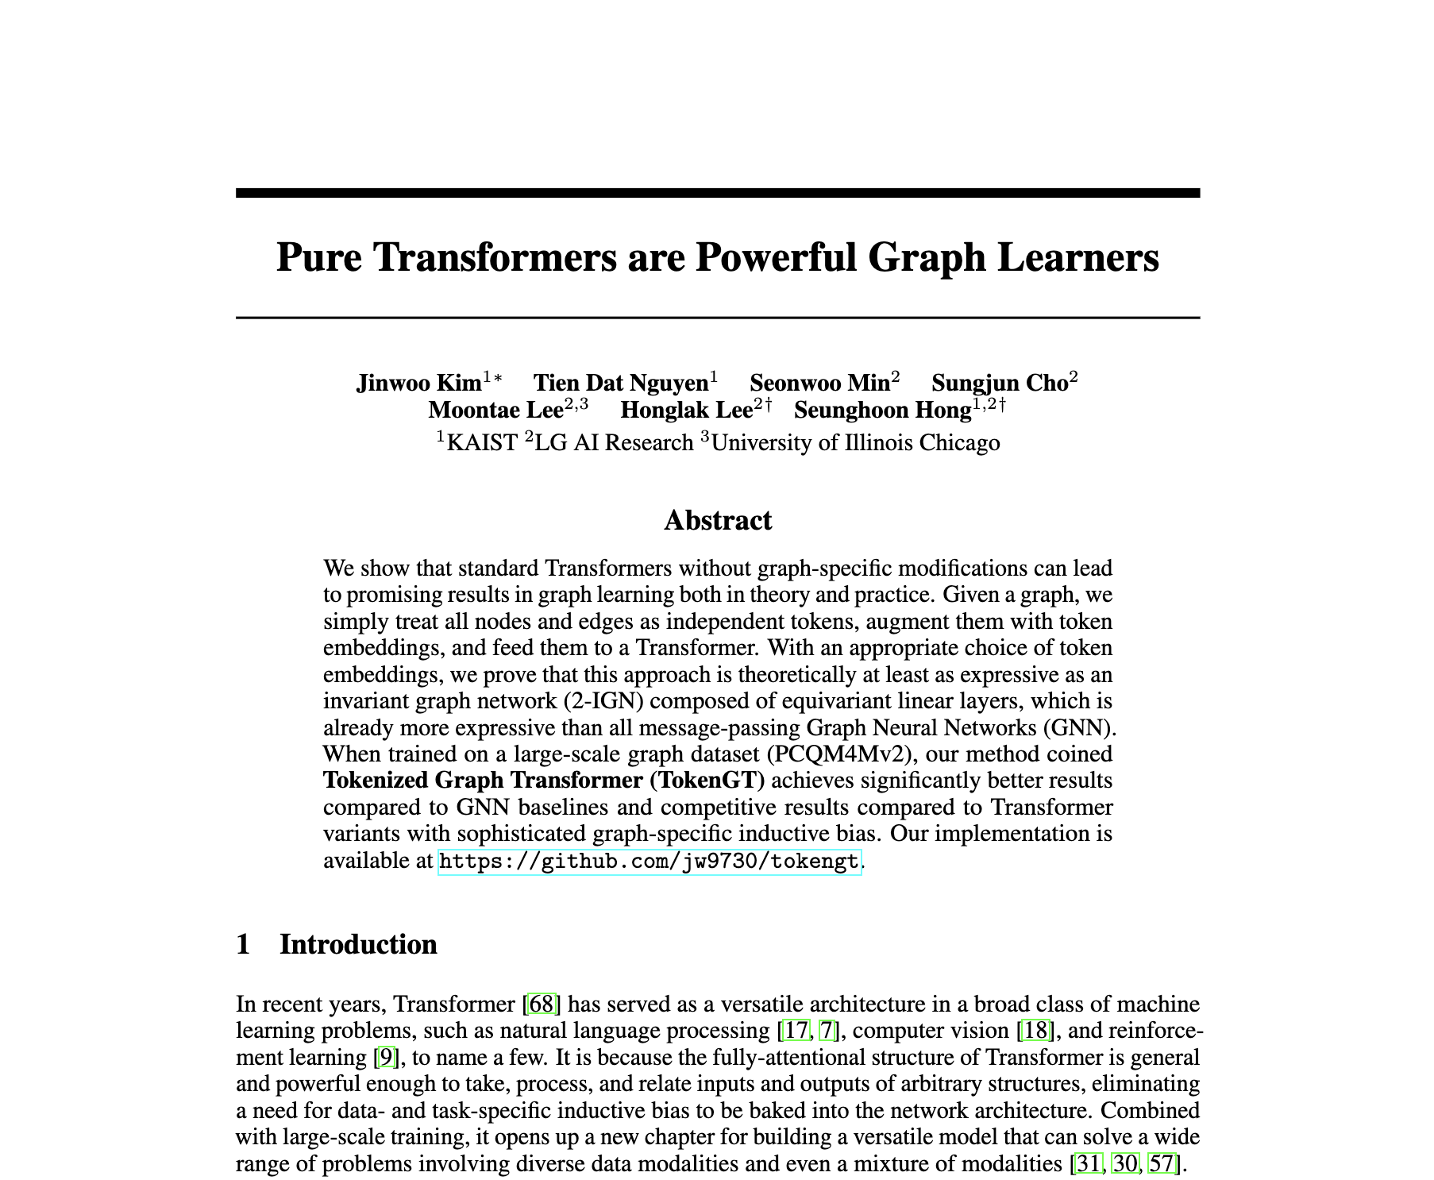
Proposal: Relationship Between Available Features Can Be Learned
Representation of graphical relationship (i.e. of available NACC features) between features via Classic Transformers
To vectorize each input: “Node ID Embeddings” traditional ID embeddings for each feature
Kim, J., Nguyen, D., Min, S., Cho, S., Lee, M., Lee, H., & Hong, S. (2022). Pure transformers are powerful graph learners. Advances in Neural Information Processing Systems, 35, 14582-14595.

Slide 10
Task 1: Predict Clinical Cognitive Status at Time-of-Visit
For each sample:
NACC Neural-Psychological Battery
Neural Classification
Control/MCI/Dementia

Slide 11
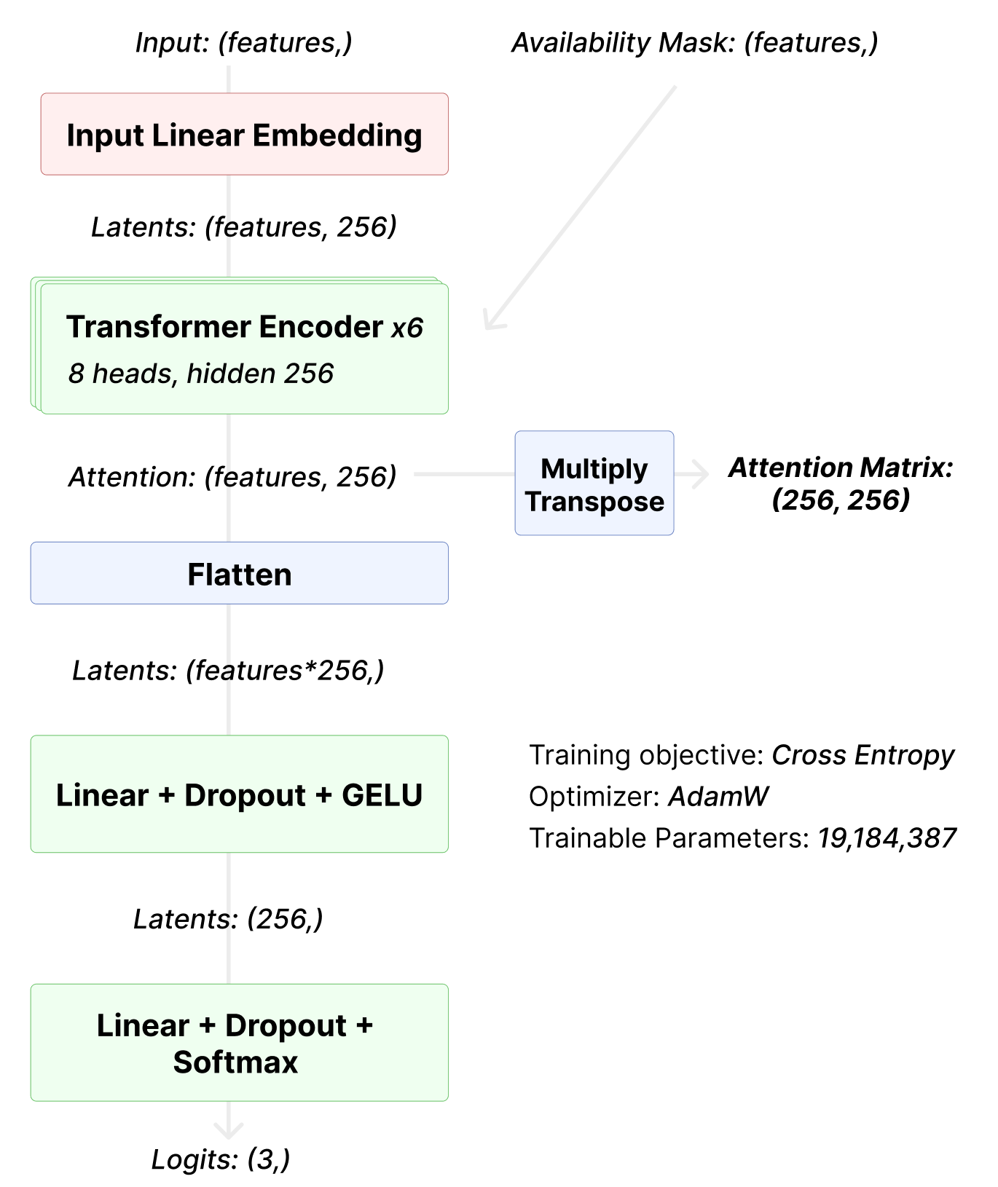
Input ID Embedding
(Kim, et al. 2022)
Mask attn. value to represent missing data

Slide 12
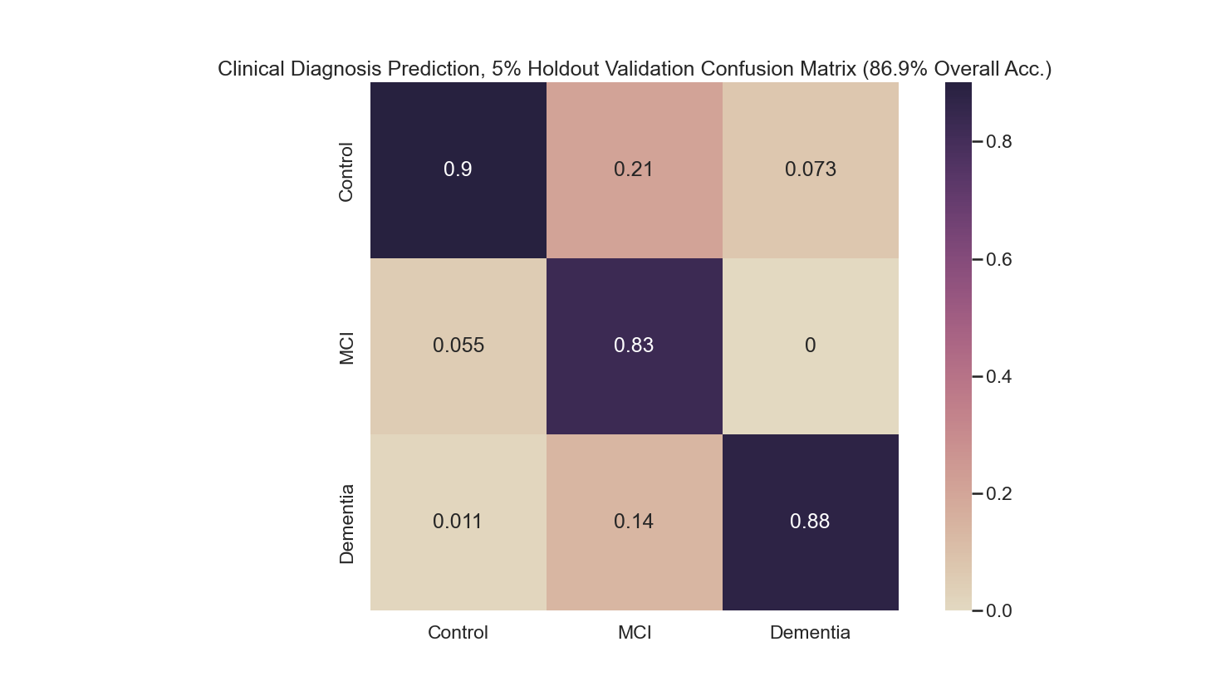
Yes: Classical Transformer Performs Positively to Current-Visit Cognitive Status Prediction
128 epochs,
5% holdout,
roughly 20 hours on RTX 2080
Even with sparse inputs with many, many missing features!

Slide 13
Today:
Masked transformer encoders can achieve state-of-the-art machine cognitive status prediction on NACC neuropsychological battery despite sparse feature signals
Fine-tuning trained current-visit diagnostic models on longitudinal data can yield comparable results for 3-year prognosis prediction
While patient history and lifestyle information does not significantly aid current-visit diagnostics, its inclusion significantly increases the accuracy of 3-year prognosis prediction

Slide 14
Today:
Masked transformer encoders can achieve state-of-the-art machine cognitive status prediction on NACC neuropsychological battery despite sparse feature signals
Fine-tuning trained current-visit diagnostic models on longitudinal data can yield comparable results for 3-year prognosis prediction
While patient history and lifestyle information does not significantly aid current-visit diagnostics, its inclusion significantly increases the accuracy of 3-year prognosis prediction

Slide 15
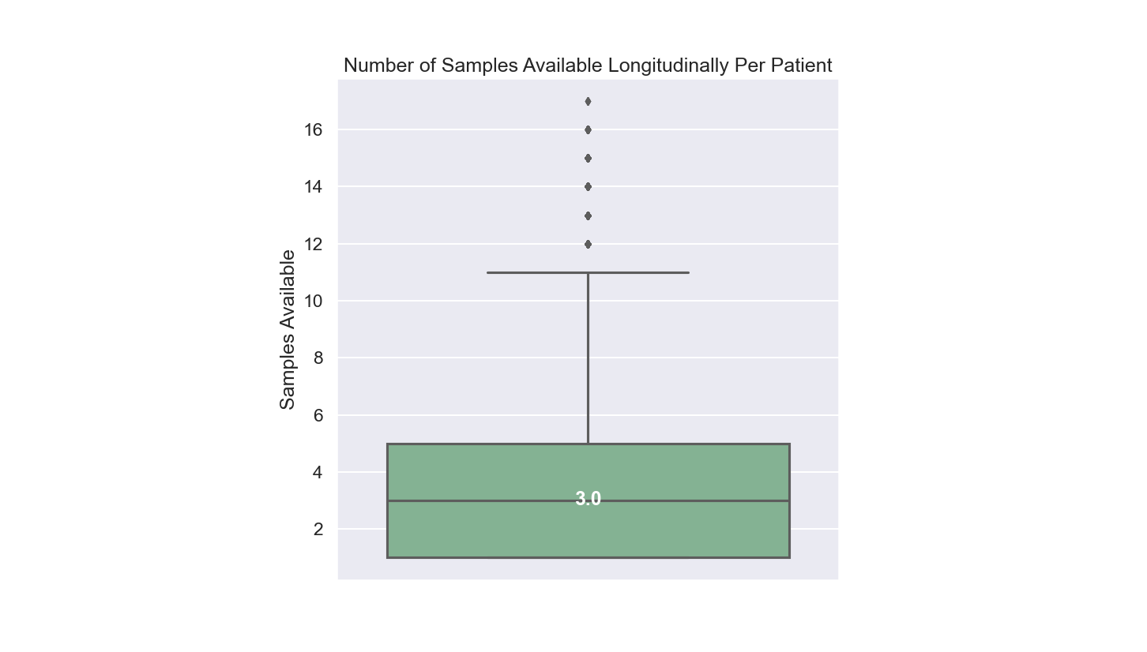
Lots of Longitudinal Data in the NACC!
Time Between Any Two Samples is Usually a Year+ Apart!

Slide 16
Task 2: 1-3 Year Prognosis Prediction
For each sample:
NACC Neural-Psychological Battery
Neural Classification
Control/MCI/Dementia status in 1-3 years

Slide 17
Task 2: 1-3 Year Prognosis Prediction
For each sample:
NACC Neural-Psychological Battery
Neural Classification
Control/MCI/Dementia status in 1-3 years
Number of sample pairs exactly 1-3 years apart:
Control | MCI | Dementia
2,396 | 2,386 | 2,385
A lot less data than current cognitive status
Just fine-tune the previous model!

Slide 18
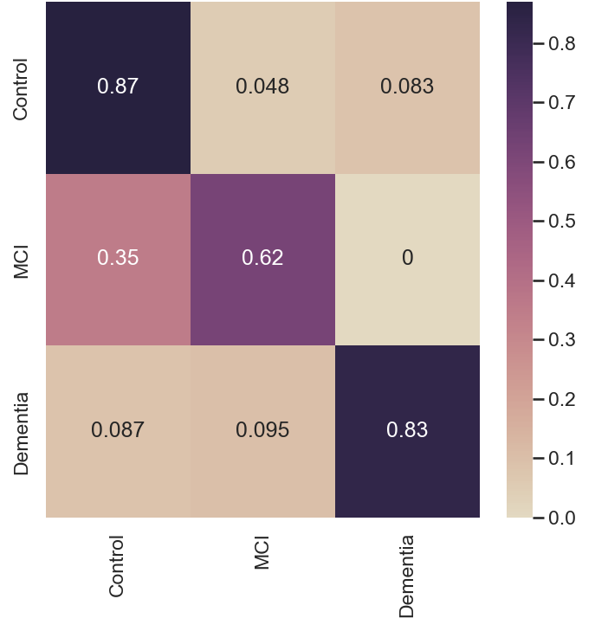

Directly Fine-Tuning Current-Visit Model for 1-3 Year Prognosis Task Yields Ambivalent Results
Current Visit (Base Model)
1-3 Year Prognosis (Fine Tuning)
128 epochs,
5% holdout,
roughly 3 hours on RTX 2080
“MCI now, Dementia later”

Slide 19
Today:
Masked transformer encoders can achieve state-of-the-art machine cognitive status prediction on NACC neuropsychological battery despite sparse feature signals
Fine-tuning trained current-visit diagnostic models on longitudinal data can yield comparable results for 3-year prognosis prediction
While patient history and lifestyle information does not significantly aid current-visit diagnostics, its inclusion significantly increases the accuracy of 3-year prognosis prediction

Slide 20
Today:
Masked transformer encoders can achieve state-of-the-art machine cognitive status prediction on NACC neuropsychological battery despite sparse feature signals
Fine-tuning trained current-visit diagnostic models on longitudinal data can yield comparable results for 3-year prognosis prediction
While patient history and lifestyle information does not significantly aid current-visit diagnostics, its inclusion significantly increases the accuracy of 3-year prognosis prediction

Slide 21
NACC Neural-Psychological Battery
MoCA
MMSE (and sub scores)
Boston Naming Test
Multilingual Naming Test
and others
dosen’t really capture risk factors
In total: 103 numerical features
NACC Patient History Features
Familial history of AD
Reported drug use
Tobacco and alcohol use
Heart and Circulatory Health
Comorbidities (Diabetes, Obesity, …)
Neurologoical Conditions (OCD, Anxiety, Bipolar, …)
Physical Exam
In total: 69 numerical features

Slide 22
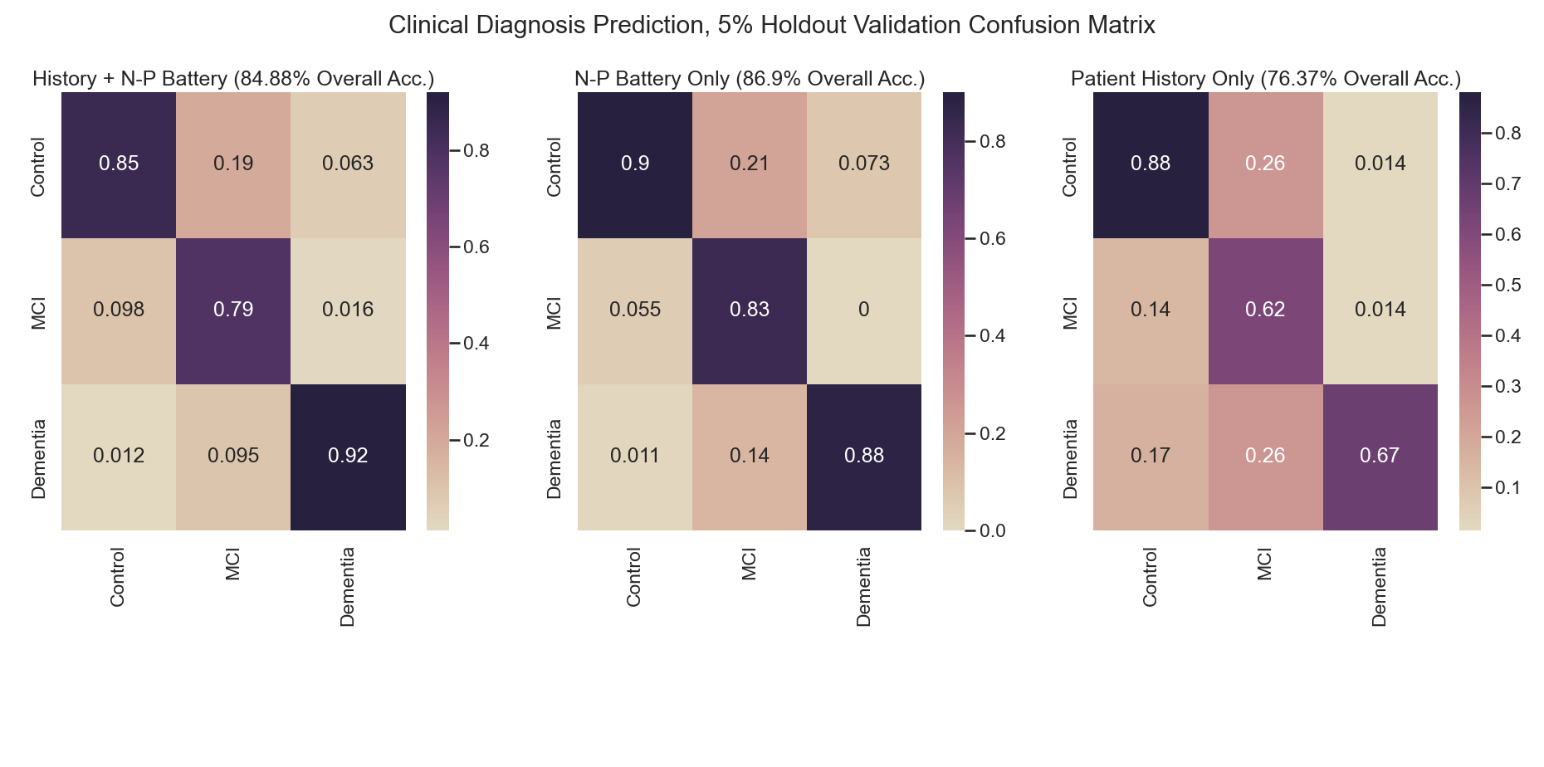
Patient History (Alone or Combined) Does Not Aid Current-Visit Diagnosis

Slide 23
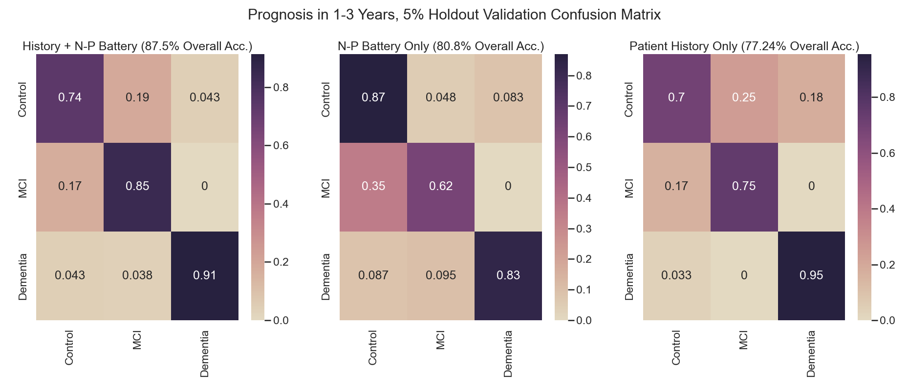
Yet, Combining Patient History and NP-Battery Features Achieves Significantly Higher Accuracy for 1-3 Year Prognosis
Highest Accuracy Combined!

Slide 24
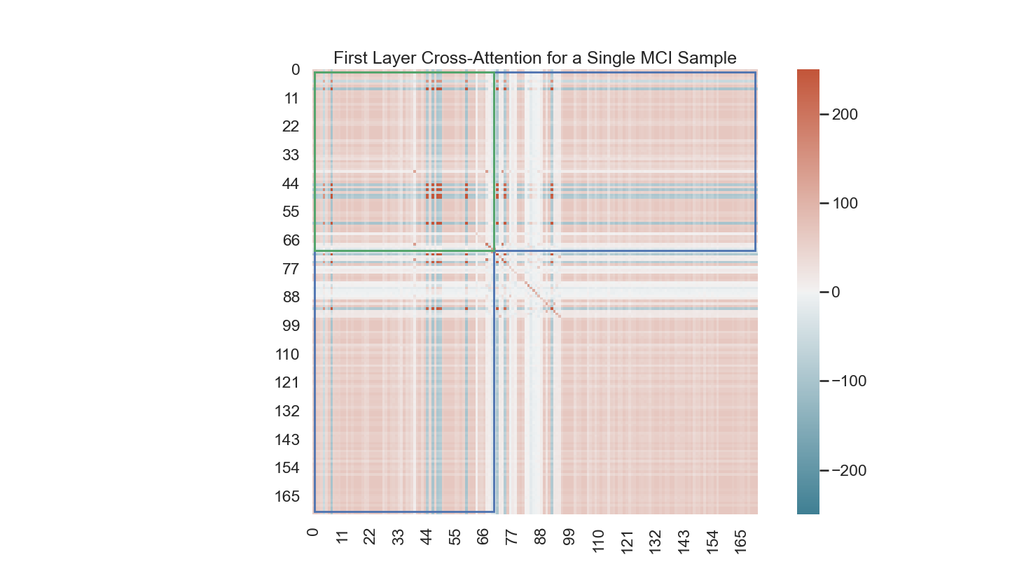
Trained Model Input Layer Attends More Readily to Patient History
For instance—
Legend
Patient History attends Patient History
Patient History attends NP-Battery
However: Non-trivial NP-Battery Only Activations!

Slide 25
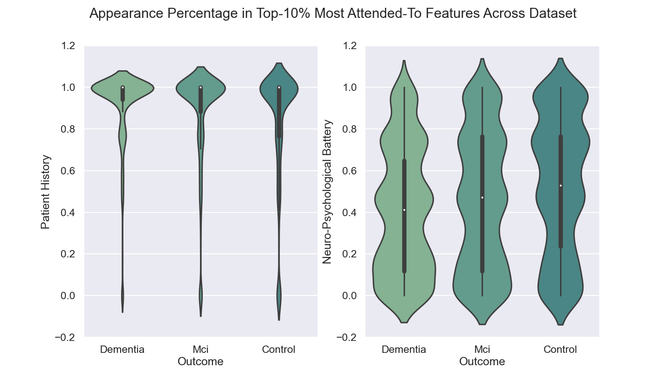
Patient History Features is More Readily Attended to Across Dataset

Slide 26
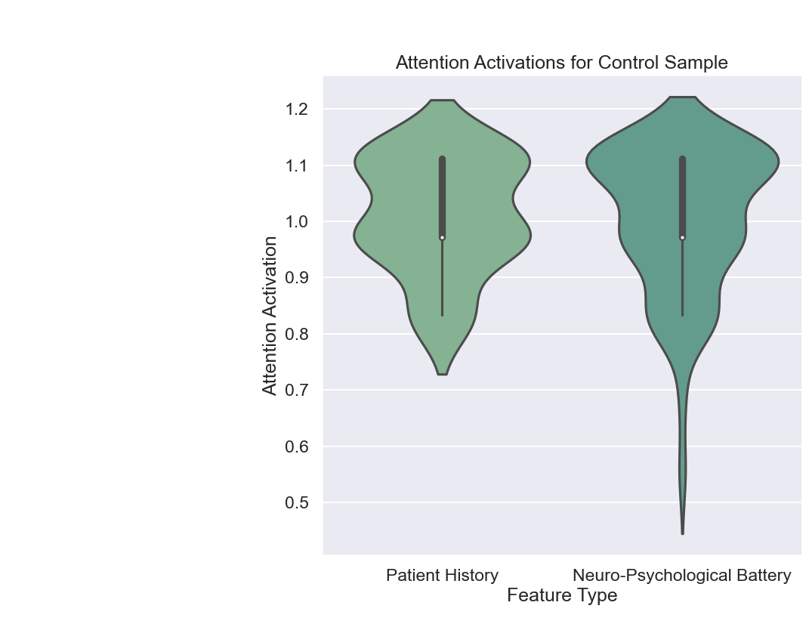
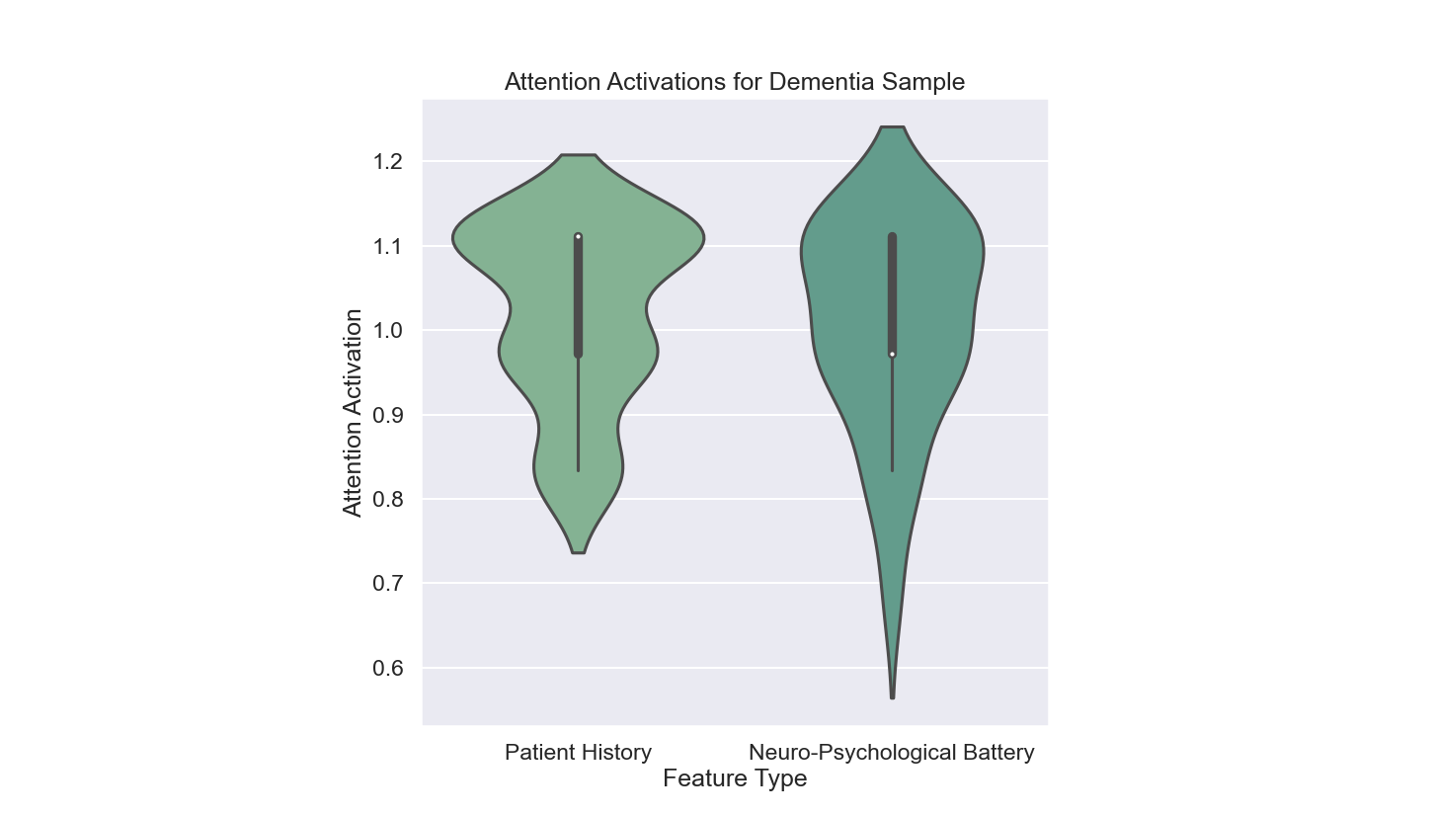
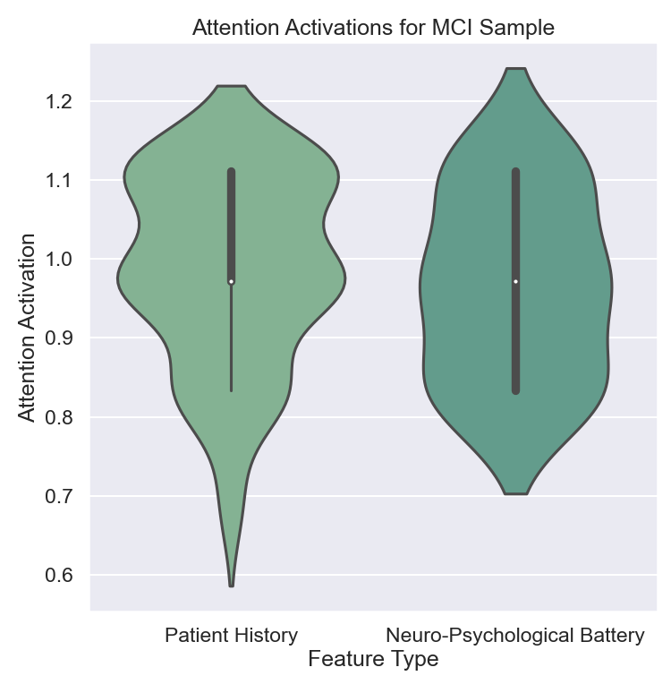
However: Mean Distribution of Attention Activation Between Patient History and NP-Battery Features is Similar

Slide 27
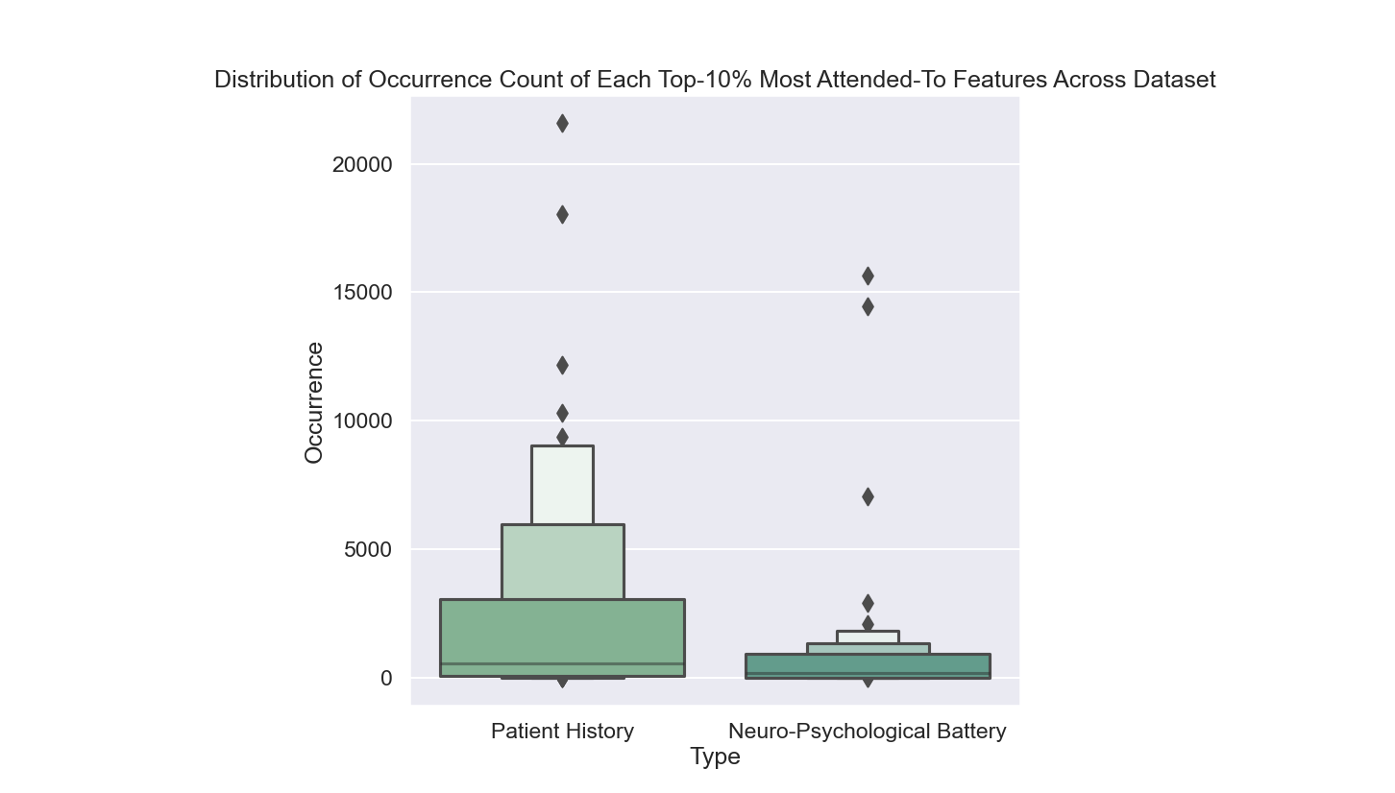
Top NP-Battery Features Attended to Just as Frequently as Patient History Features

Slide 28
Today:
Masked transformer encoders can achieve state-of-the-art machine cognitive status prediction on NACC neuropsychological battery despite sparse feature signals
Fine-tuning trained current-visit diagnostic models on longitudinal data can yield comparable results for 3-year prognosis prediction
While patient history and lifestyle information does not significantly aid current-visit diagnostics, its inclusion significantly increases the accuracy of 3-year prognosis prediction

Slide 29
Future Work:
More rigorous K-fold validation
Smaller, more focused feature groups and statistical comparisons of their performance
Interpreting attention activations to mine feature relation info and aid feature selection
Removing human-based metrics altogether (i.e. NP-battery)

