Slide 1
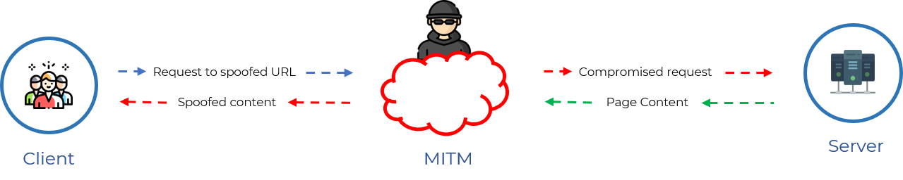
What is TLS Vulnerability?
A TLS vulnerability is a weak point or flaw in the TLS protocol that can be used by attackers to compromise the communication's security.
Vulnerabilities on TLS:
A)Conceptual Flaws Vulnerabilities:
1)Freak Attack:
An SSL/TLS implementation exploit called FREAK ("Factoring RSA Export Keys") occurs when RSA key exchange is used to safely negotiate pre-master-secret.
This vulnerability, which is currently known as "FREAK," allows attackers to intercept HTTPS connections between affected clients and servers and force them to utilise "export-grade" cryptography. Its CVE number is 2015-0204.
This high-security encryption uses outdated encryption key lengths that are simple to decrypt.

Slide 2
How to avoid this attack?
Server side:Turn off server support for all export-grade cypher suites. Also, we advise eliminating support for cyphers with 40- and 56-bit encryption, forward secrecy, and support for all known unsafe cyphers (not only RSA export ciphers).
Client side:Client software that utilises OpenSSL, Apple's Secure Transport, Windows Secure Channel/Schannel, Chrome, Safari, Opera, Android, and BlackBerry stock browsers are examples of vulnerable clients (i.e. Internet Explorer). The most recent releases of OpenSSL should be installed immediately on older versions.
B)Weak Cryptographic Primitives TLS Vulnerabilities:
Sweet32 (Birthday Attack):
Sweet 32 is a birthday attack against the Triple DES (3DES) encryption algorithm that exploits a weakness in the way 3DES handles blocks of data. It is called a "birthday attack" because the probability of a collision in a set of randomly chosen items increases as the number of items in the set grows closer to the square root of the number of possible values.
A symmetric encryption technique called Triple DES uses a 168-bit key and a block size of 64 bits. 3DES divides the data into 64-bit blocks and separately encrypts each block using the same key in order to encrypt bigger amounts of data. Sweet 32 takes advantage of the fact that 3DES can begin repeating blocks of ciphertext after encrypting roughly 232 blocks (or about 32GB of data). This enables an attacker to recover plaintext data via a birthday attack by looking for block collisions.
Key size determines how secure a block cipher is (k). The integral key search attack, which has a 2k complexity, is therefore the best defence against a block cipher. Despite the fact that block ciphers may encrypt large amounts of data using encryption techniques like CBC, the block size (n) also has a significant impact on the security of the encryption.

Slide 3
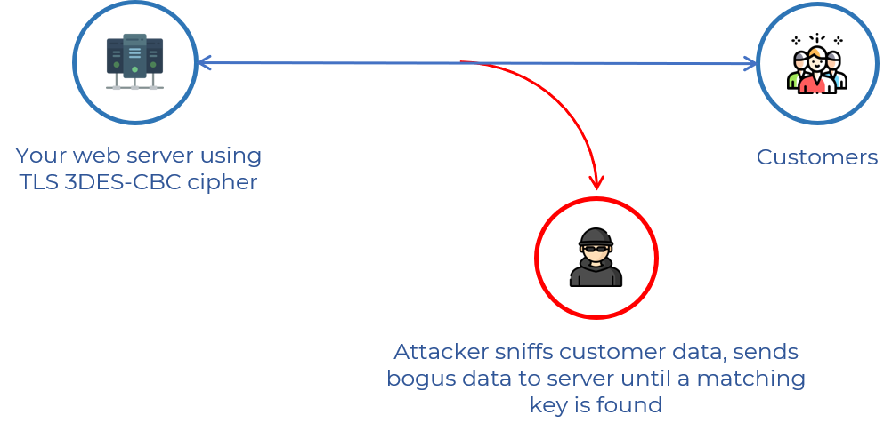
How to avoid this attack?
Prefer minimum 128-bit cipher suites.
By renegotiating the TLS agreement or by cutting off and re-establishing the connection, it is possible to set a 64-bit cipher time limit on TLS sessions.

Slide 4
C)TLS Implementation vulnerabilities:
1)Beast Attack:
"Browser Exploit Against SSL/TLS" is referred to as BEAST. Phillip Rogaway discovered the BEAST attack in 2002, but it was thought to be impossible to exploit since it took so many tries to get any relevant data.
The vulnerabilities initial POC was released in 2011. Most websites at the time were still using TLS 1.0 or an earlier version of SSL, both of which were deemed to be susceptible.
Data can be injected into TLS 1.0 transmission by an attacker who is sniffing it.
An attacker can insert a specially designed data block and check to see if the resulting encrypted block matches the corresponding block in the actual message stream if they are aware of the type of data being sent and where it is situated in the message. If so, the plaintext block has been found by the attacker. If not, they can attempt once more using several likely values.
How to avoid this attack?
Only permit TLS 1.1 or 1.2, as these versions fixed the underlying TLS 1.0 problem.
In reality, the TLS 1.1 protocol mitigated this in 2006. Sadly, TLS 1.0 is still supported by the majority of websites and modern browsers. TLS 1.0 was by default turned off in Windows Server 2008 R2, but it could be made active.
TLS 1.0 and 1.1 support will be turned off early in 2020 by Google Chrome, Microsoft Internet Explorer (IE) and Edge, Mozilla Firefox, and Opera.

Slide 5
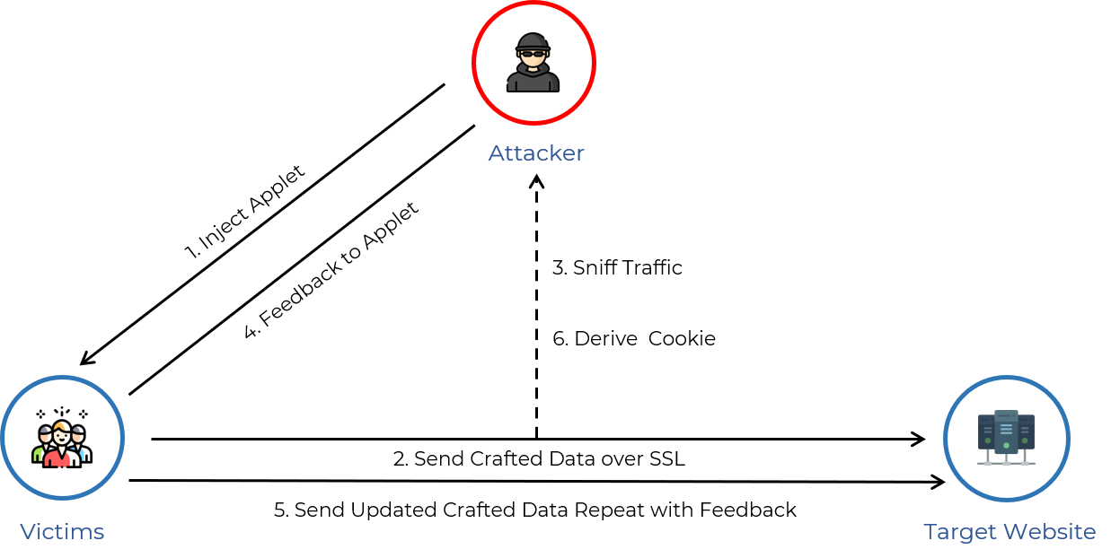
Figure of beast attack:

Slide 6
2)Crime Attack:
A security flaw known as CRIME (Compression Ratio Info-leak Made Easy) concerns the TLS (Transport Layer Security) protocol, which is used to ensure secure communication over the internet. It is a type of side-channel attack that was initially discovered in 2012 and may be used by an attacker to decode cookies and other sensitive data sent between a client and a server.
The CRIME attack takes advantage of the way TLS compression functions. To minimise the amount of data that must be communicated while using TLS, data can be compressed. Nevertheless, the TLS compression algorithm does not take into consideration the length of individual messages, which might be utilised by an attacker to decrypt encrypted messages by guessing their contents.
An attacker must have access to the network communication between a client and a server in order to conduct a CRIME attack. The attacker then makes a series of queries to the server that have been specifically prepared to elicit a predetermined response. The attacker can ascertain whether their assumptions regarding the contents of the encrypted messages are accurate by examining the size of the answers. Unless the attacker has successfully decrypted the sensitive data they are aiming for, such as session cookies or other authentication tokens, this process can be repeated.
CRIME makes use of SSL and TLS data compression capabilities. The SSL/TLS protocol uses compression, which affects both the header and the body.
SSL/TLS and SPDY use a compression algorithm called DEFLATE, the most common compression algorithm used, which compresses HTTP requests by eliminating duplicate strings.
CRIME takes advantage of the method in which duplicate strings are eliminated to guess session tokens by systematically brute-forcing them.

Slide 7
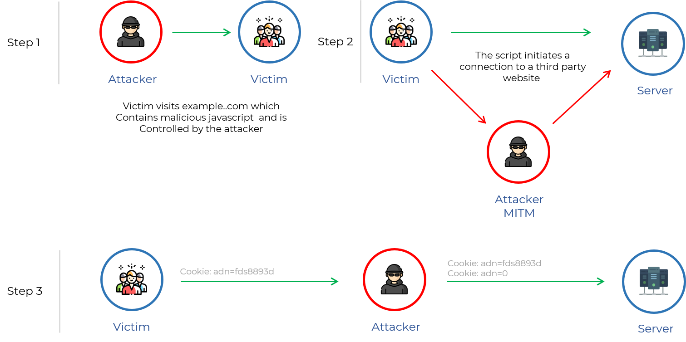
Figure of CRIME attack:

Slide 8
How to avoid this attack?
The majority of popular web browsers now either support SSL/TLS/SPDY compression in some form or have been patched.
Internet Explorer: No versions of IE support SSL/TLS Compression.
Chrome: 21.0.1180.89.
Firefox: 15.0.1.
Opera: 12.01.
Safari: 5.1.7
It is advised to turn off TLS compression or switch to safer compression methods. To reduce the danger of attacks, it's also crucial to maintain TLS libraries and software updated and configured securely.

Slide 9
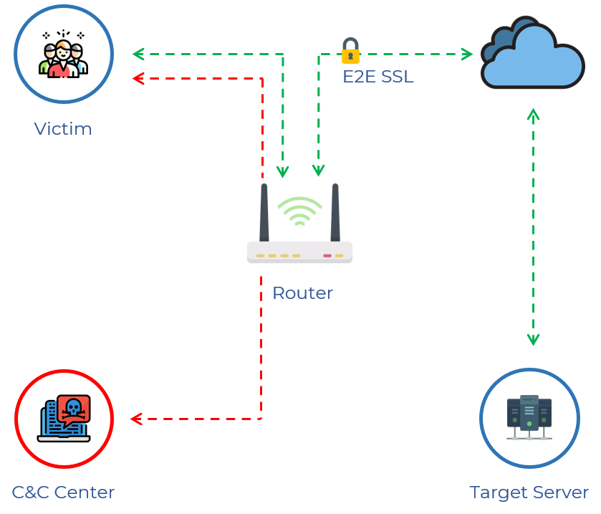
3)Breach Attack:
Attacks such as BREACH target HTTP answers that have been compressed with the more widespread HTTP compression, also known as content encoding and more frequently than TLS-level compression.
To be vulnerable to a BREACH attack, a web application must:
Be hosted on an HTTP-level compression-capable server.
User input is reflected in HTTP response bodies.
Reflect a secret (such as a CSRF token) in HTTP response bodies.

Slide 10
How to avoid this attack?
Secrets separation from user input.
Disabling Http compression.
Randomizing secrets per request.
Protecting vulnerable pages with CSRF.
Length Hiding(by adding a random number of bytes to the responses)
Rate-limiting the requests.
What is SSL attack?
An SSL attack targets the SSL handshake protocol by either abusing the SSL handshake protocol itself or by delivering invalid data to the SSL server, which will prevent legitimate users from connecting.
SSL Stripping attack:
A website requires an application protocol for each connection, which can be either HTTP or HTTPS. Due to the fact that HTTP sends data in plaintext, it is less secure than HTTPS, which encrypts all data. Via the use of SSL/TLS, which functions as a digital certificate and can both authenticate identities and encrypt data, HTTPS encrypts data.
When a hacker interferes with the connection between a user and a website, SSL stripping attacks take place. The hacker places themself in the midst of the connection, connecting to the HTTPS version of the website while the user is connected to the HTTP version. They can view anything the user says in an unencrypted form as a result.

Slide 11
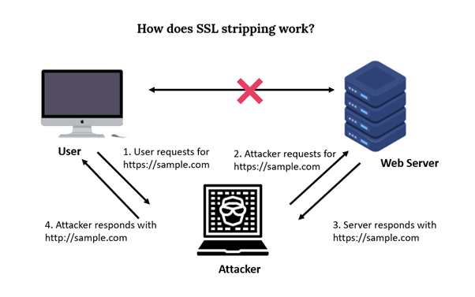
How to avoid this attack?
Use HTTP Strict Transport Security(HSTS):By requiring secure connections, the HSTS protocol, which encourages browsers to only connect to websites through HTTPS, can help prevent SSL stripping attacks.
Use certificate pinning:A website can define which SSL/TLS certificate(s) it should use using a technique called certificate pinning, which stops an attacker from using a bogus certificate.

