Slide 1
CRIME (CVE-2012-4929)
The CRIME attack is a vulnerability in the compression of the Secure Sockets Layer (SSL)/Transport Layer Security (TLS) protocols and the SPDY protocol.
The abbreviation stands for Compression Ratio Info-leak Made Easy.
It allowed attackers to decrypt encrypted cookies, which could contain sensitive information, such as session IDs and login credentials.
This vulnerability was caused by a flaw in the way compression was used in these protocols.

Slide 2
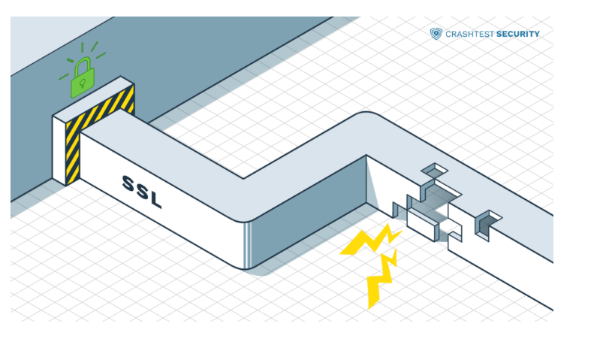
Working
The CRIME vulnerability works by exploiting the fact that the compression algorithm used in SSL/TLS does not differentiate between encrypted and unencrypted data.
This allows an attacker to manipulate the content of the requests sent by a client, causing them to include a known piece of information (such as a session cookie) and observe the resulting compressed size of the request.
By repeating this process with different pieces of information, an attacker can use statistical analysis to eventually recover the targeted information.

Slide 3
Mitigation
The CRIME vulnerability was first identified in 2012 and affects all versions of SSL/TLS that support the compression feature.
The vulnerability has since been addressed by disabling SSL/TLS compression
Using other mitigation techniques such as HTTP Strict Transport Security (HSTS) and Transport Layer Security (TLS) 1.2.

Slide 4
FREAK (CVE-2015-0204)
FREAK was a vulnerability in SSL and TLS protocols that allowed attackers to decrypt encrypted traffic between a client and a server.
The abbreviation stands for Factoring RSA Export Keys.
This vulnerability was caused by a flaw in the way these protocols negotiated the use of weak encryption algorithms.
The threat allows an attacker to make a vulnerable client use a weaker encryption cipher, weaker key exchange cipher, in this way, gain access to the data traffic. This is because when using 512 or fewer bits, the RSA encryption can be easily broken.

Slide 5
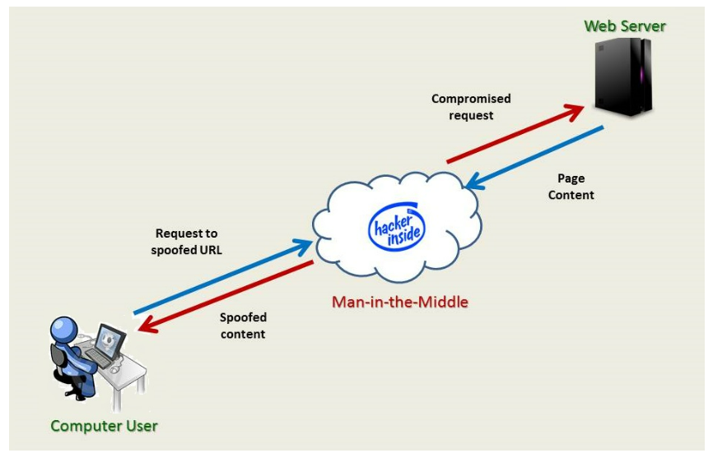
Working
The FREAK vulnerability works by exploiting the fact that some SSL/TLS implementations support weak, export-grade ciphers that were required by US law in the 1990s.
These ciphers use short, 512-bit RSA keys that can be factored relatively easily with modern computing power.
An attacker can intercept the initial SSL/TLS handshake between a client and server and force them to use an export-grade cipher, which the attacker can then use to factor the RSA key and potentially decrypt the traffic.

Slide 6
Mitigation
The FREAK vulnerability was discovered in 2015 and affects a wide range of SSL/TLS implementations, including web browsers, servers, and other software.
It is addressed by disabling support for export-grade ciphers in affected software and upgrading to stronger, more secure cryptographic ciphers.
It is recommended that website owners and administrators disable support for export-grade ciphers in their SSL/TLS configuration to prevent the FREAK vulnerability from being exploited.

Slide 7
DROWN (CVE-2016-0800)
DROWN was a vulnerability in SSL and TLS protocols that allowed attackers to decrypt encrypted traffic between a client and a server
The abbreviation stands for Decrypting RSA with Obsolete and Weakened eNcryption.
It is a cross-protocol attack that exploits a vulnerability in the SSLv2 protocol version.
Specifically, it is a version of the Bleichenbacher RSA padding oracle attack

Slide 8
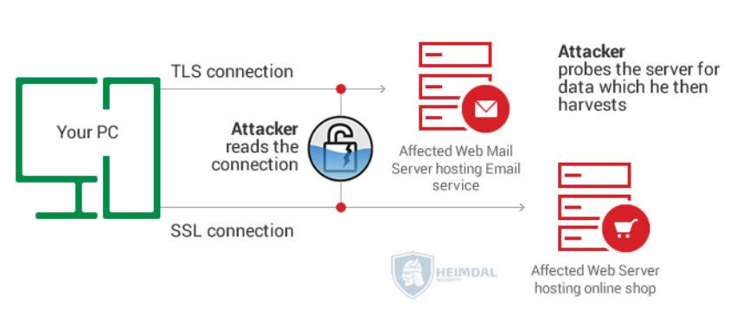
Working
The DROWN attack goes through several stages.
First, the attacker must observe and record sessions between the server and the client that use any version of SSL or TLS.
For DROWN to work, these sessions must also use RSA cipher suites. Eventually, one of these recorded sessions will be decrypted.

Slide 9
Working
At the second stage of the attack, the attacker has captured the usual client/server handshake.
They then create multiple connections to the server using the cross-protocol vulnerability.
They establish SSLv2 connections to the server, and since the server allows these connections, it is open to exposure.
These connections are modified handshake messages that target the RSA ciphertext because unpadded RSA, as used in SSLv2 can be changed.

Slide 10
Working
The attacker monitors the server’s responses which gradually provide hints about whether they are guessing the 40-bit encryption key correctly or not, and brute forces their way in through trial and error.
Once the master secret is revealed, the attacker obtains the session key, and they can use it to decrypt the previously recorded sessions.
This reveals sensitive data such as authentication credentials and, more, exposing clients.

Slide 11
Mitigation
To prevent the possibility of being exposed to a DROWN attack, server operators must make sure that their server does not support the use of SSLv2 cipher suites.
They must also ensure that the server’s private keys are not used anywhere else, such as in web servers, email servers such as SMTP, IMAP, or POP servers, etc., and server software that support SSLv2 connections.

