Slide 1
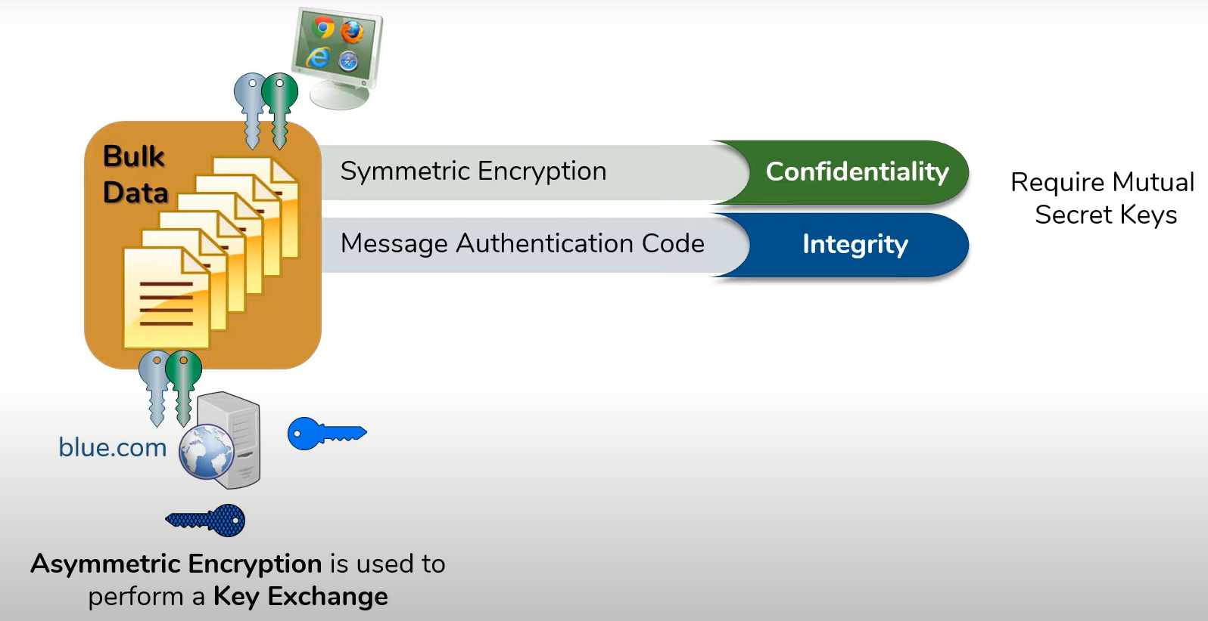
Working nature of TLS and SSL to secure data
TLS (Transport Layer Security) and SSL (Secure Sockets Layer) are cryptographic protocols that are used to secure data transmitted over the internet. They work by establishing an encrypted connection between two parties, such as a client and a server, in order to protect the confidentiality and integrity of the data being transmitted.

Slide 2
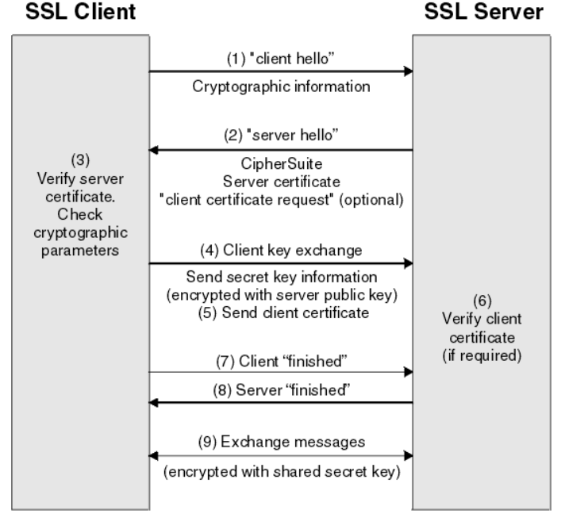
TLS/SSL Handshake Process
The TLS/SSL handshake process is the initial negotiation between a client (such as a web browser) and a server that establishes a secure communication channel. The handshake process involves the following steps between client and server.
Client Hello
Server Hello
Certificate
Client Key Exchange
Server Key Exchange
Certificate Request
Certificate Verify
Finished
Secure Data Transfer
Overall, the TLS/SSL handshake process ensures that both the client and server can authenticate each other, negotiate a secure encryption algorithm, and establish a secure channel for data transfer.

Slide 3
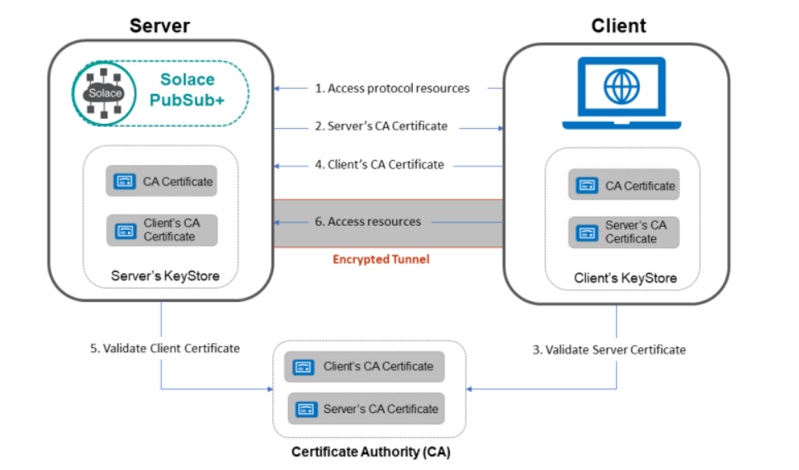
Certificate Validation
Certificate validation is the process of verifying the authenticity of a digital certificate presented by a server during a TLS/SSL handshake and involves checking the certificate chain, expiration date, revocation status, and certificate information
Certificate validation is a critical step in ensuring the security and integrity of TLS/SSL communications.
Failure to validate certificates can result in security breaches, which can be costly and damaging to an organization's reputation
Best practices for certificate validation include using trusted Certificate Authorities, regularly updating certificates, implementing certificate validation checks, and using modern TLS versions and encryption ciphers

Slide 4
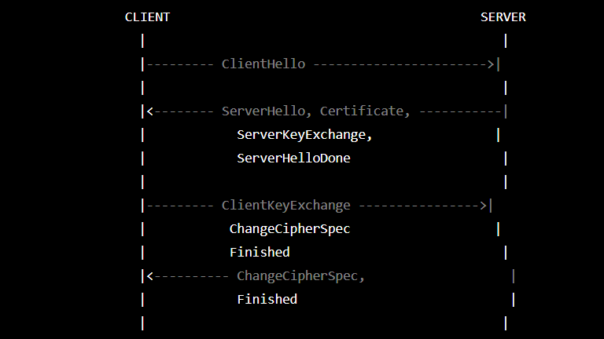
Key Exchange
Key exchange is the process of securely exchanging cryptographic keys between two parties to establish a secure communication channel and involves the use of public-key cryptography or key agreement protocols
Public-key cryptography involves the use of asymmetric encryption algorithms, where each party has a public and private key
Key agreement protocols, such as Diffie-Hellman, allow two parties to establish a shared secret key without transmitting it over the network
Key exchange is important because it ensures that the communication channel is secure and that the transmitted data is encrypted
Failure to properly perform key exchange can result in security breaches, where an attacker can intercept and read sensitive information
Best practices for key exchange include using strong encryption algorithms, implementing perfect forward secrecy, and regularly updating keys to prevent attacks

Slide 5
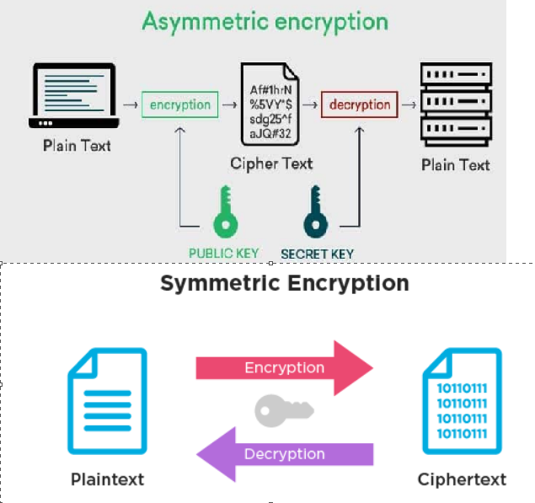
Data encryption
Data encryption is the process of transforming plaintext into ciphertext using an encryption algorithm and a secret key
Encryption algorithms can be symmetric, where the same key is used for both encryption and decryption, or asymmetric, where different keys are used for encryption and decryption
Data encryption is important because it ensures that the transmitted data is secure and cannot be read by unauthorized parties
Failure to properly encrypt data can result in security breaches and compromise of sensitive information
Best practices for data encryption include using strong encryption algorithms, implementing key management procedures, and regularly updating keys to prevent attacks

Slide 6
Session Termination
Session termination refers to the process of ending a TLS/SSL session between a client and a server. It is important because it allows for the secure exchange of information between the client and server. By properly terminating the session, the confidentiality, integrity, and authenticity of the data being exchanged is maintained.
In TLS/SSL, session termination occurs when either the client or server sends a "close_notify" message to the other party. This message signals the end of the session and ensures that any remaining data is properly transmitted.
One of the challenges in session termination is ensuring that all data has been transmitted and that the session is properly closed to prevent any unauthorized access.

