Slide 1
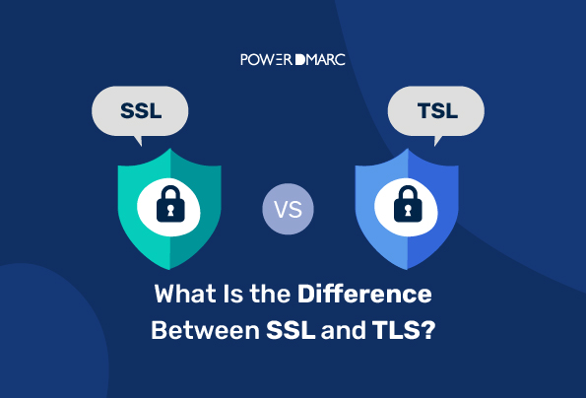

Slide 2
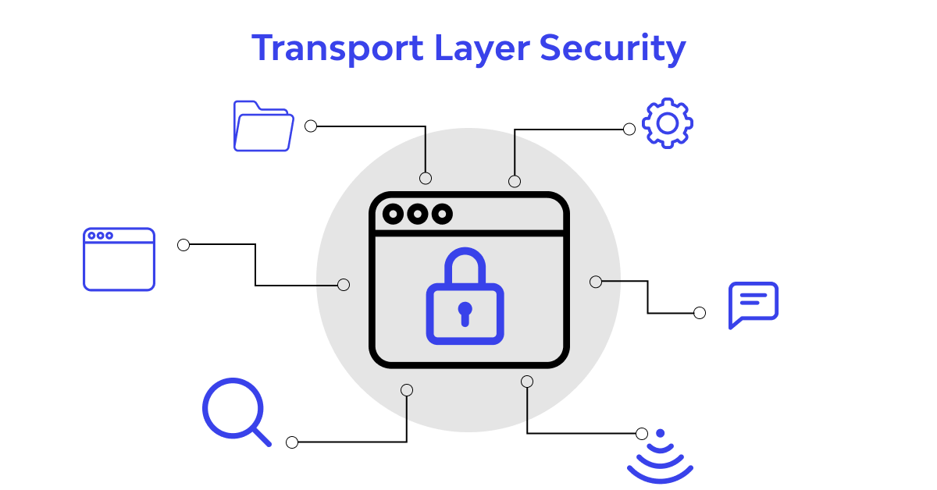
TLS:
TLS is a cryptographic protocol used to provide secure communication over the internet. It is designed to ensure the confidentiality and integrity of data exchanged between two applications or systems.
TLS 1.0 – It is now considered insecure due to several vulnerabilities, including POODLE and BEAST attacks.
TLS 1.1 – It addresses some of the vulnerabilities present in TLS 1.0, but it is also considered insecure due to certain vulnerabilities such as Lucky13.
TLS 1.2 – It is currently the most widely used and is considered secure. It has improved security features compared to TLS 1.1, such as stronger cipher suites, and support for authenticated encryption with associated data (AEAD).
TLS 1.3 – It is the latest and most secure version of TLS. It provides better security and performance compared to TLS 1.2, including faster handshakes and improved forward secrecy.

Slide 3
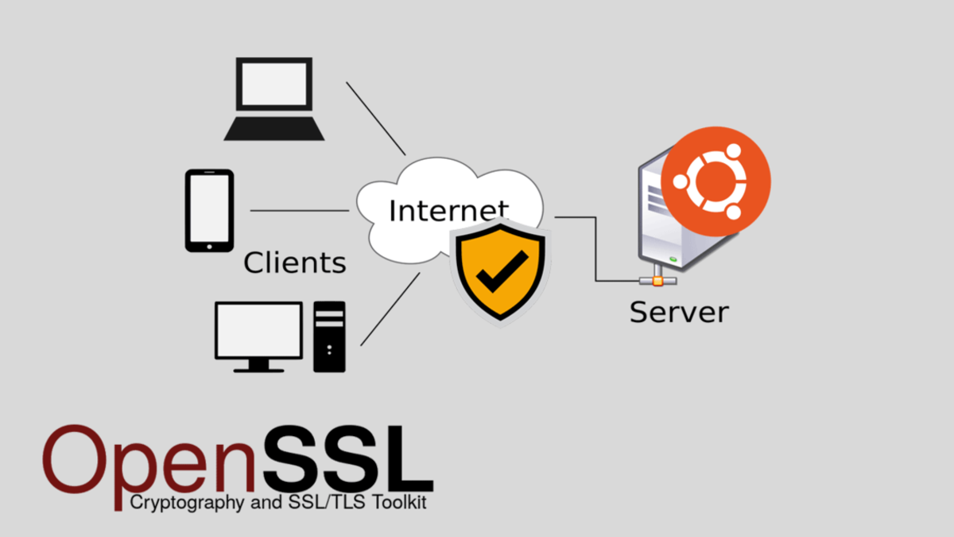
OPEN SSL:
OpenSSL also has different versions, and the latest version as of this writing is OpenSSL 3.0.0. Here are some of the differences between OpenSSL versions:
OpenSSL 1.0.2 - This version is no longer supported and has reached its end of life. It supports up to TLS 1.2.
OpenSSL 1.1.0 - This version introduced support for TLS 1.3 and Elliptic Curve Cryptography (ECC).
OpenSSL 1.1.1 - This version introduced several improvements, including support for TLS 1.3, ChaCha20-Poly1305 cipher suites, and Ed25519 and Ed448 elliptic curves.

Slide 4
COMPARISION of TLS versions and OpenSSL versions
Version | TLS 1.0 | TLS 1.1 | TLS 1.2 | TLS 1.3 | OpenSSL 0.9.8 | OpenSSL 1.0.1 | OpenSSL 1.1.1
Release Date | 1999 | 2006 | 2008 | 2018 | 2005 | 2012 | 2018
Security | Weak | Medium | Strong | Very Strong | Weak | Medium | Strong
Cipher Suites | Limited | Expanded | Expanded | Expanded | Limited | Expanded | Expanded
Handshake | Slow | Faster | Faster | Fastest | Slow | Faster | Fastest
Certificate Handling | Limited | Expanded | Expanded | Expanded | Limited | Expanded | Expanded
Support | Widely supported | Widely supported | Widely supported | Limited support | Widely supported | Limited support | Widely supported

