Slide 1
NuvoTon ISP_DFU sample
USB Device firmware upgrade

Slide 2
Instruction
Device Firmware Upgrade
USB class that allows upgrading the onchip firmware of a USB device.
The main requests are DNLOAD, UPLOAD.
DNLOAD
Host transfer data to device, device erase internal flash and load data into.
UPLOAD
Device transfer all data to host from internal flash.

Slide 3
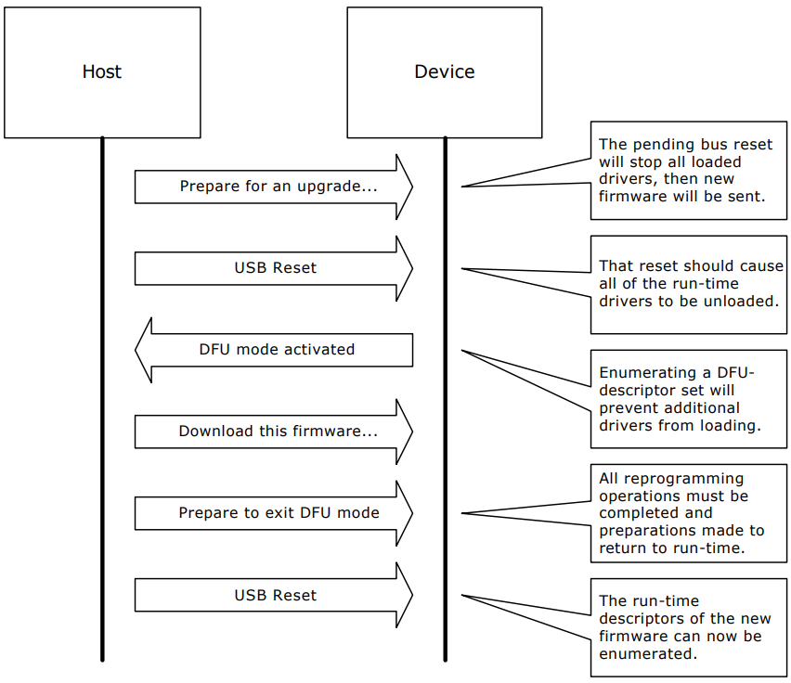
Stylized DFU session

Slide 4

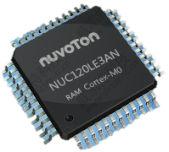
ISP_DFU Sample Environment
dfu_util command
Flash Control
USB DFU Class
USB DFU Class
USB Host
USB Host

Slide 5
ISP_DFU sample directory
ISP_DFU | Sample code folder
KEIL | KEIL project file and template files.
WindowsDriver | Windows DFU driver with Nuvoton digital signature
WindowsTool | Windows tool (dfu_util) and testing batch files.

Slide 6
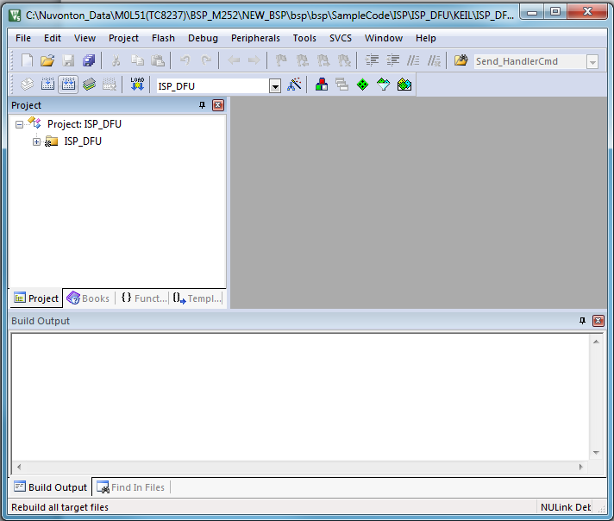
Build ISP_DFU project of KEIL
Rebuild

Slide 7
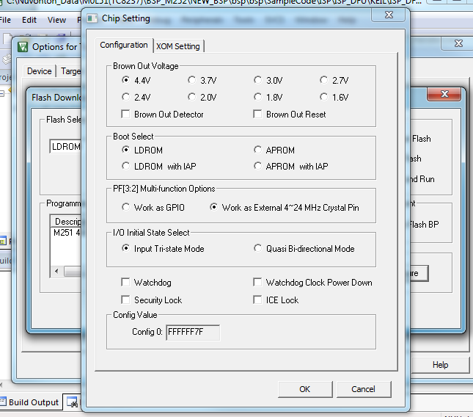
Setting chip boot from LDROM
Options for target
-> Utilities
-> Settings
-> Config0/1
-> Boot select (LDROM)
-> OK

Slide 8
Download
Download

Slide 9
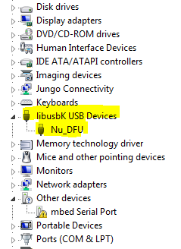

Windows DFU driver
Driver source from Zadig-2.3.exe.
Supported Win7 x86/64bit, Win8.1 64bit. Win10 64bit.

Slide 10
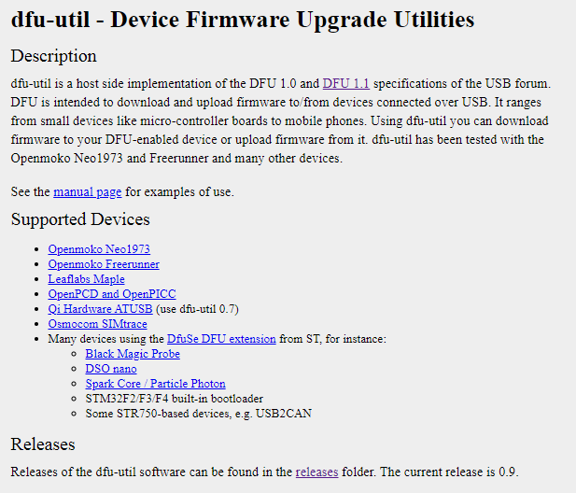
DFU host tool - dfu-util
http://dfu-util.sourceforge.net/

Slide 11
ISP_DFU sample demo steps
1. DFU_DNLOAD (ISP_DFU\WindowsTool\DFU_DNLOAD_FROM_FILE.bat)
– Program APROM 256kbyte of binary file.
2. DFU_UPLOAD
(ISP_DFU\WindowsTool\ DFU_UPLOAD_TO_FILE.bat)
– Read APROM 256kbyte to binary file.
3. Compare DNLOAD and UPLOAD binary file are identical.

Slide 12
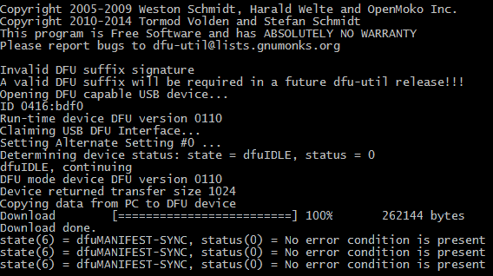
DFU_DNLOAD request demo result

Slide 13
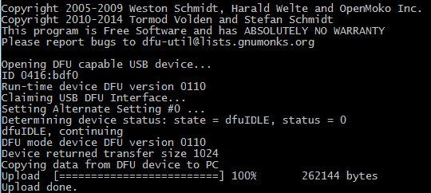
DFU_UPLOAD request demo result

Slide 14
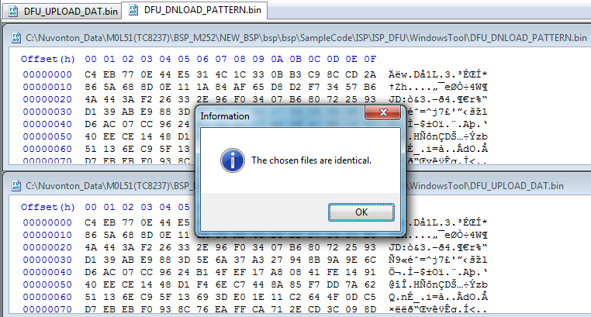
Compare DNLOAD and UPLOAD binary file

Slide 15
Applicable chips and BSP supported
ALL nuvoton supports USB MCU

