Slide 1
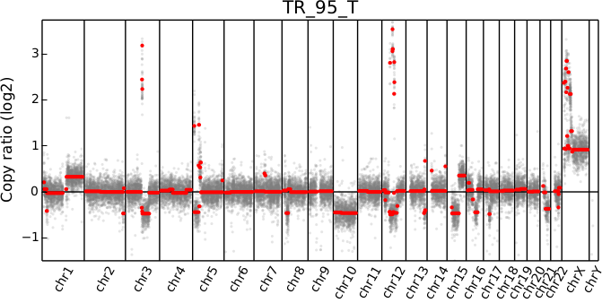
WES
CNV plot

