Slide 1
Aviation Risk Analysis
By Jeniffer Mbugua

Slide 2
Overview
This project focuses on analysing aviation accident data from the National Transportation Safety Board (NTSB), covering incidents between 1962 and 2023 across the United States and international waters. The primary goal is to gain actionable insights into aviation safety and identify patterns that can guide business decisions.

Slide 3
Business Understanding
The company is entering the aviation industry without prior expertise hence we lack a systematic, data-driven approach in assessing aircraft safety and operational risks. Misjudging the risk means making uninformed investment decisions that could jeopardize the success of venturing to the aviation industry and could lead to significant financial loss, operational disruptions, or reputational damage .
Approach: Clean and analyze data, compute trends, compare models & manufacturers, and produce business recommendations.
Goal: is to gain insights into aviation safety and identify patterns that will enable the company to identify low-risk aircraft options and confidently move forward with its aviation investments.

Slide 4
Data Understanding
Aviation accident data from the National Transportation Safety Board (NTSB), covering incidents between 1962 and 2023 across the United States and international waters was used.
It entails 90348 records of aircraft accident investigations.
Each record contains data on:
When & where accident happened ie country, airport, date .
Aircraft details e.g make,model, number of engines,.
Damages & Injuries fatal or non fatal
External factors that could affect or cause accident e.g weather conditions

Slide 5
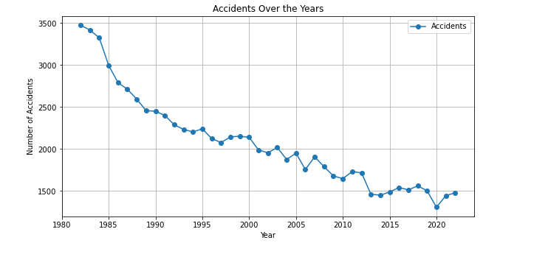
Trends Over The Years Accidents

Slide 6
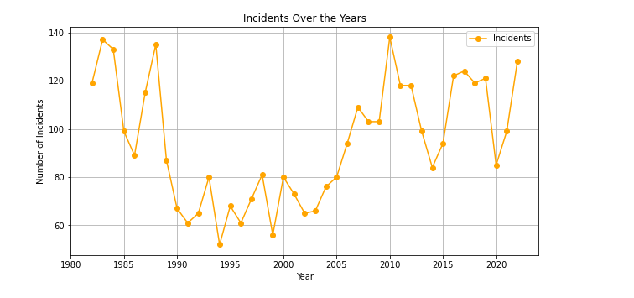
Trends Over The Years Incidents

Slide 7
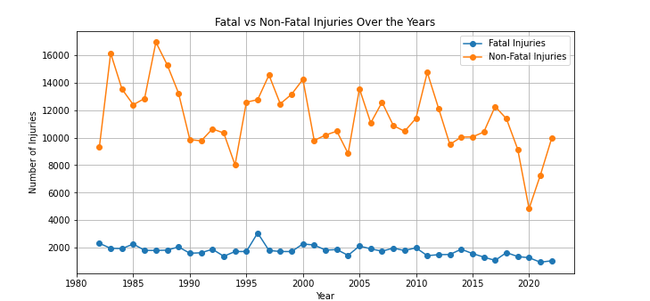
Trends Over The Years Injuries

Slide 8
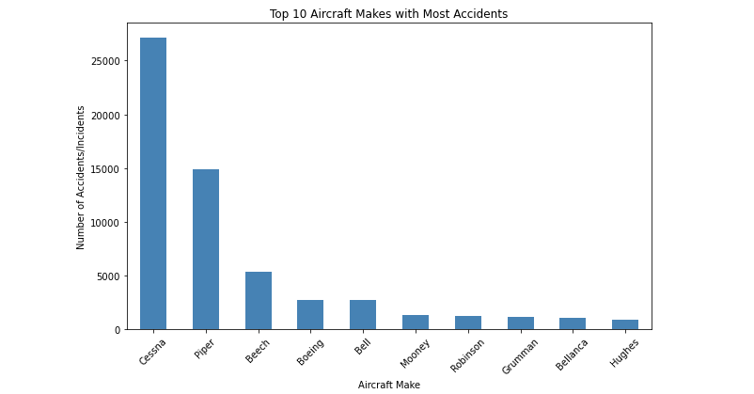
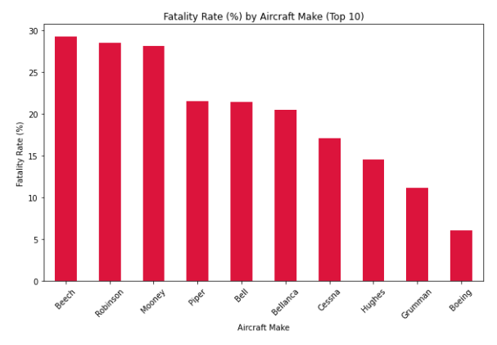
Aircraft Make &Model

Slide 9
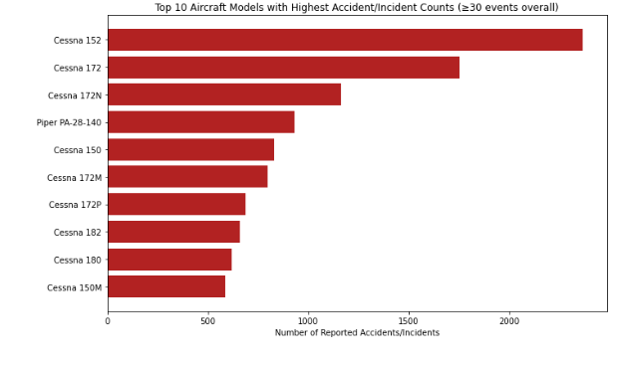
Models with highest Reported Cases

Slide 10
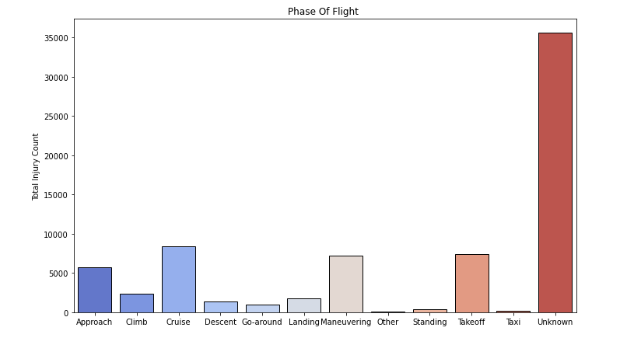
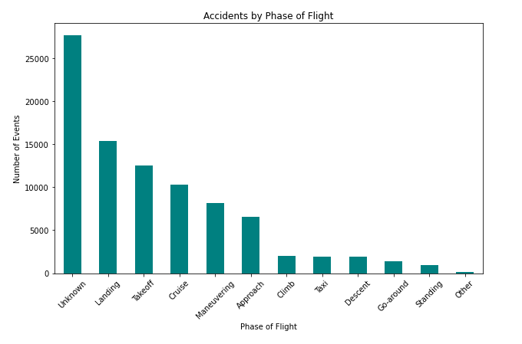
Flight Phases Analysis

Slide 11
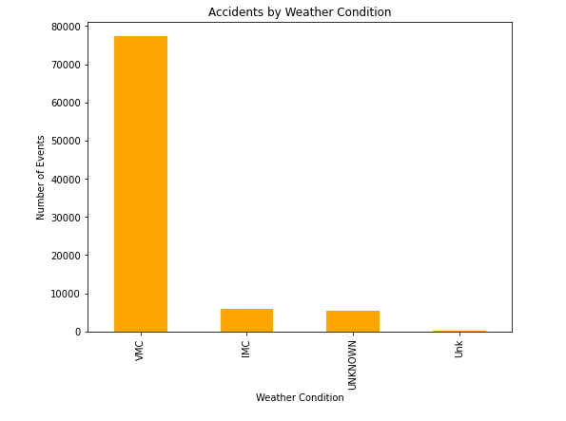
Weather Conditions

Slide 12
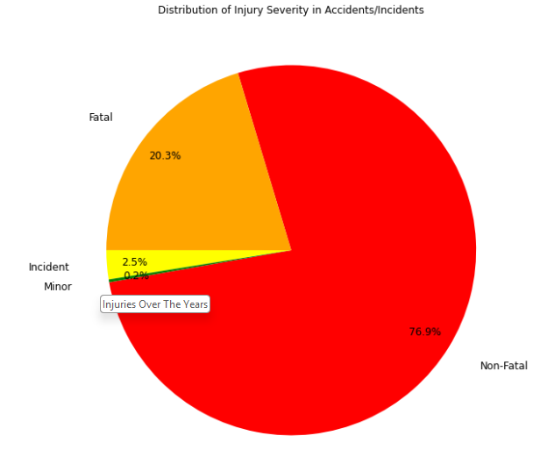
Injuries Severity

Slide 13
Insights
1. Accidents over the years
- Total aviation accidents/incidents peaked in earlier decades and have declined significantly since the 1980s.
- Fatal events follow the same downward trend, showing safety improvements over time.
2. Aircraft Make & Model Safety
- Some makes appear frequently in accidents, while others are rarely involved.
- Among the top makes, certain aircraft have much lower fatality rates compared to peers.
3. Phase of Flight Risk
- Most accidents occur during takeoff and landing phases, while cruise has far fewer incidents.Landing often has a higher share of fatal outcomes.

Slide 14
Insights cont…
4. Weather Conditions
- The majority of accidents occur in visual meteorological conditions (clear weather) simply because most flights occur in good weather.
- However, the fatality rate is higher in poor/Instrument Meteorological Conditions (IMC).
5. Injury Severity
- Many aviation accidents result in no injuries or minor injuries, but a notable share still leads to fatalities.
- Fatal accidents, while less frequent, are highly impactful.
6. Operator Type
- Private and general aviation operators account for a disproportionately higher number of accidents compared to commercial airlines.
- Commercial operators show lower accident and fatality rates due to stricter regulations and safety checks.

Slide 15
Conclusion
1. Modern aircraft (post-1990) are generally safer. The company should prioritize newer aircraft models instead of older ones with higher historical risks.
2. The company should invest in aircraft models with consistently low accident frequency and fatality rates. Avoid makes with disproportionately high fatal accidents.
3. Aircraft with advanced autopilot, landing assist, and navigation technologies should be prioritized. Training programs for pilots should emphasize takeoff and landing safety.
4. The company should purchase aircraft with enhanced weather resilience(navigation systems). Develop policies to limit risky flights in poor weather.
5. The company should invest in aircraft with strong safety records. Proactive risk management strategies (maintenance, inspections) can keep fatality rates low.
6. The company should adopt a commercial-grade operational model, even if entering private charter markets. Safety culture and compliance with airline-level standards will minimize risk.

Slide 16
Business Recommendations
1. Prioritize Aircraft Models with Lower Fatality Rates
- Some Makes & Models may have many incident/accidents events in the dataset, this mostly reflects fleet size but they have lower fatality rates than some of the other makes; selection should focus on specific models with lower fatality rates. Eg cessna
2. Favor Commercial Operations more than Private enterprise use
- Choose newer commercial jets models or modern aircraft for commercial operations from manufacturers with low accident and fatality rates in the dataset. Preferrably models with safety reputations and maintenance.
3. Mitigate Risks by Understanding Flight Conditions
- Invest in enhanced pilot training, strict maintenance audits, and data-driven safety monitoring like flight hours, incident reporting. This will reduce operational risk regardless of aircraft type.

