Slide 1
Team 3.4
Jennifer Paparelli, Kristina Pittman, Zac Osborne, Steven Mitchell, Anthony Micco

Slide 2

Is it time to upgrade?

Slide 3
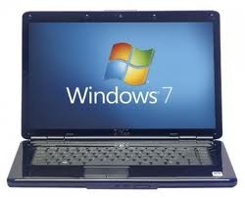
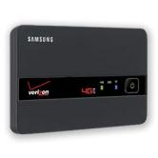
Laptops
HP g7-1255dx
Updated O.S. (Windows 7)
Improve Communication
Increase Productivity
Verizon 4G LTE Mobile Hotspot
Guaranteed Internet Access

Slide 4
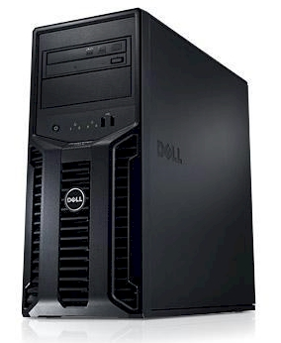
Dell Power Edge Server
Central Storage Location
Secure Storage
Back up
File Sharing
Print Server
Company “Cloud”
Customizable and Upgradable

Slide 5
Google Apps

Slide 6
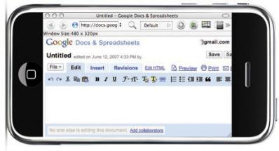
Apple iPhone
Direct Communication Lines with Employees
Mobile Access to Google Apps
Instant Access to the Internet

Slide 7
Netbeans, Mercural, and Bitbucket.org

Slide 8
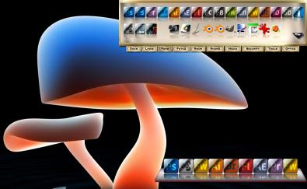
Adobe CS5
Photoshop
Illustrator
Fireworks
Dreamweaver
Acrobat X Pro

Slide 9

McAfee
Features
Hosted Management
Anti-Virus
Anti-Spyware
Safe Surfing
Desktop Firewall

Slide 10
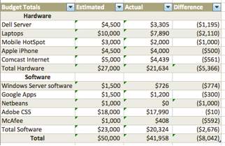
Budget

Slide 11
Thank you
In conclusion, our team collectively came together to propose the several items of software, hardware, and to maintain and manage a budget to effectively increase our companies overall productivity.

