Slide 1

TREAT
YO SELF
Alexa Skill Set Developed by:
John Williams
Nate Terry
Cole Christenson
Jennifer Guidotti
Cecil Hutchings

Slide 2
Treat Yo Self!

Slide 3

MOTIVATION
Over the past 10 years, the search topic of “motivation” has increased by over 40%
Google Trends 2017
Fitbit Tracker
TED Talks
Released in 2008. Comes with standard daily step goal of 10,000 steps.
First released in 2006. ”Ideas worth spreading” meant to inspire and motivate.

Slide 4
Voice Computing
Controlling the world through words alone
“Alexa”
“Ok, Google”
“Hey, Siri”
“Hey, Cortana”

Slide 5
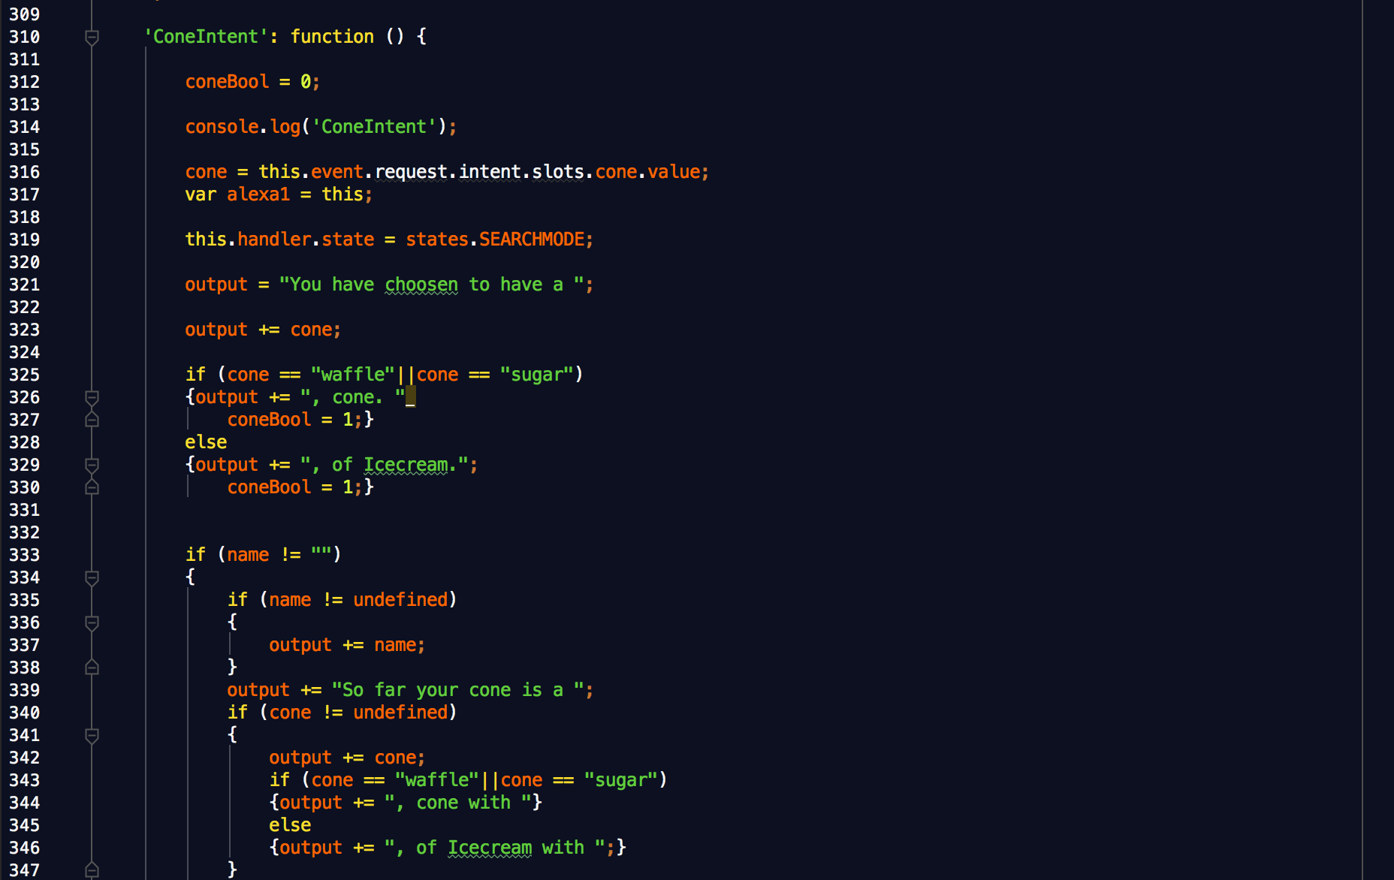
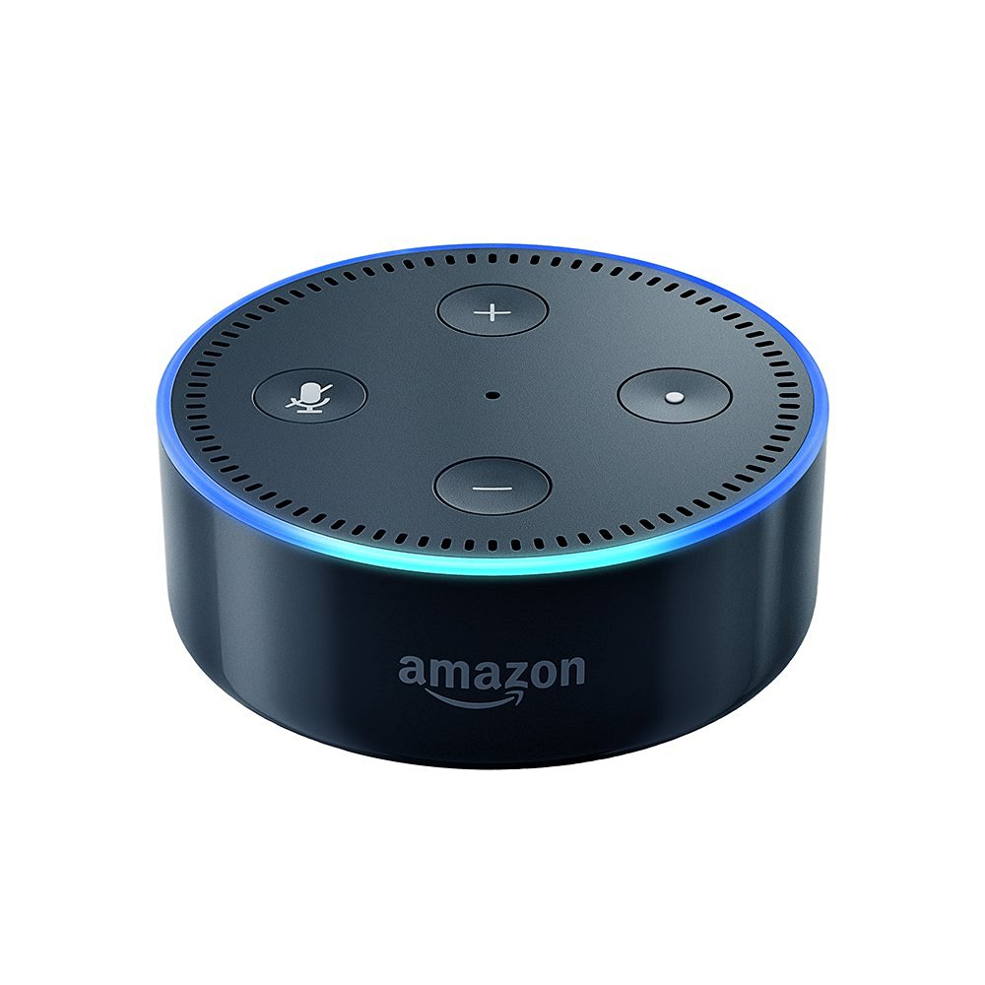
TREAT YO SELF
Alexa skill set that confirms your order of ice cream can be had as long as you have met your step goal.

Slide 6


SCHEMA
Alexa: this is how she runs
Start
Who Wrote This?
Sign into Account
Unknown Name - Return
Health Statistics
Build a Cone
Get last Cone
Can Have Ice Cream
Checks Steps
Can’t Have Ice Cream

Slide 7
DEMO

Slide 8









Slide 9
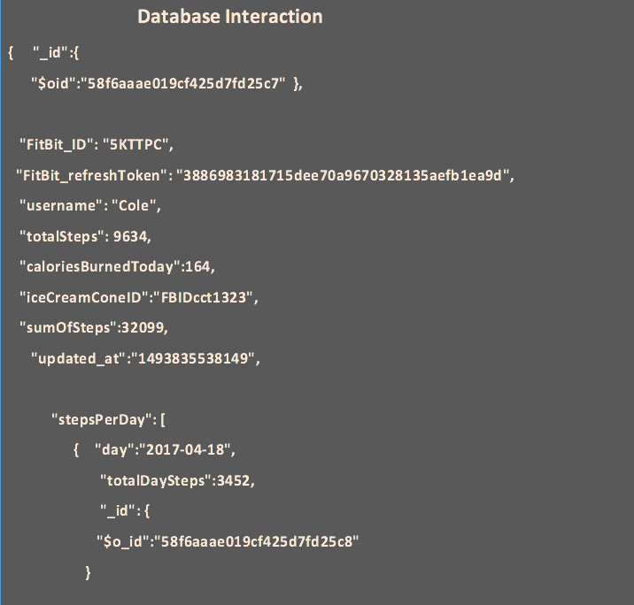
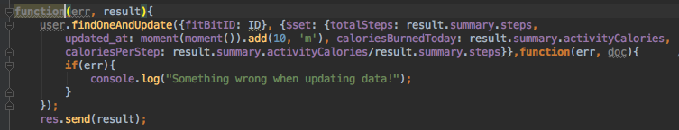
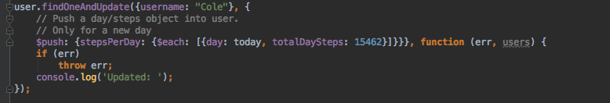
mLab User Profile

Slide 10
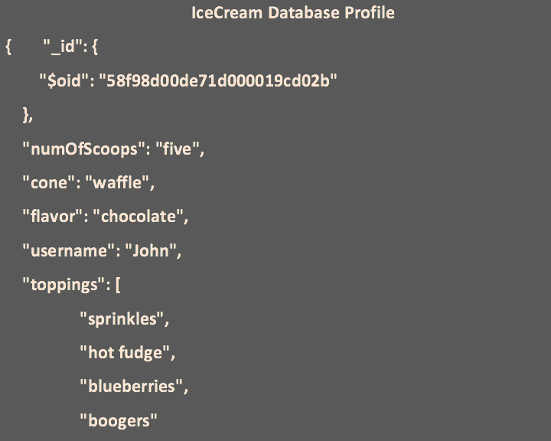
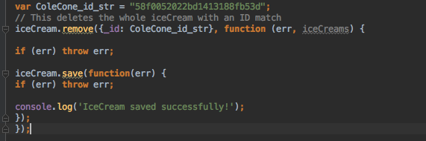
mLab IceCream Profile

Slide 11
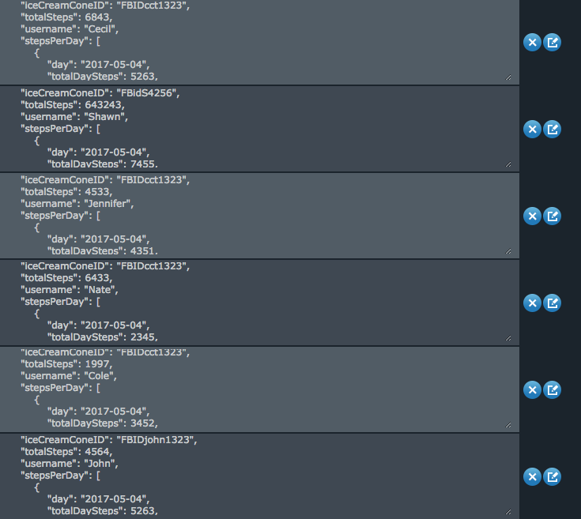
Database Profile Balance → Using JS to monitor and update mLab. → Maintain consistency: Alexa, Fitbit, Individual updates.

Slide 12
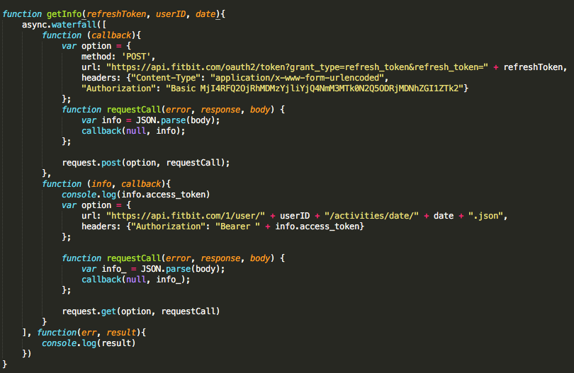
Code
Fitbit OAuth 2.0
Fitbit
Refresh Token
NodeJS
Fitbit APP
Restful call to Fitbit with APP info

Slide 13
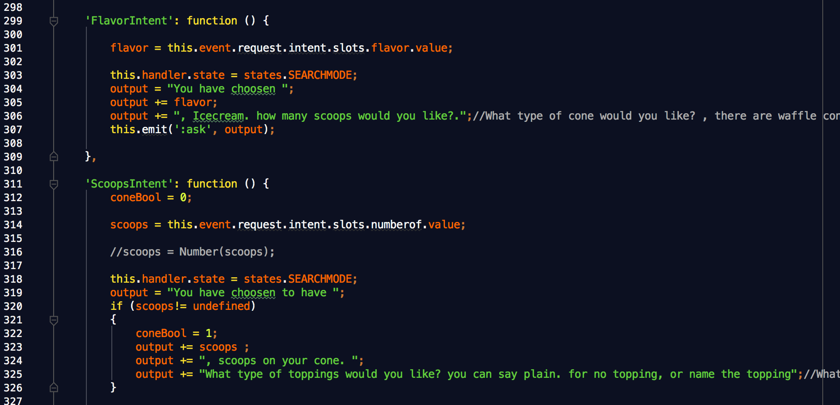
flavor = this.event.request.intent.slots.flavor.value;
scoops = this.event.request.intent.slots.numberof.value;

Slide 14
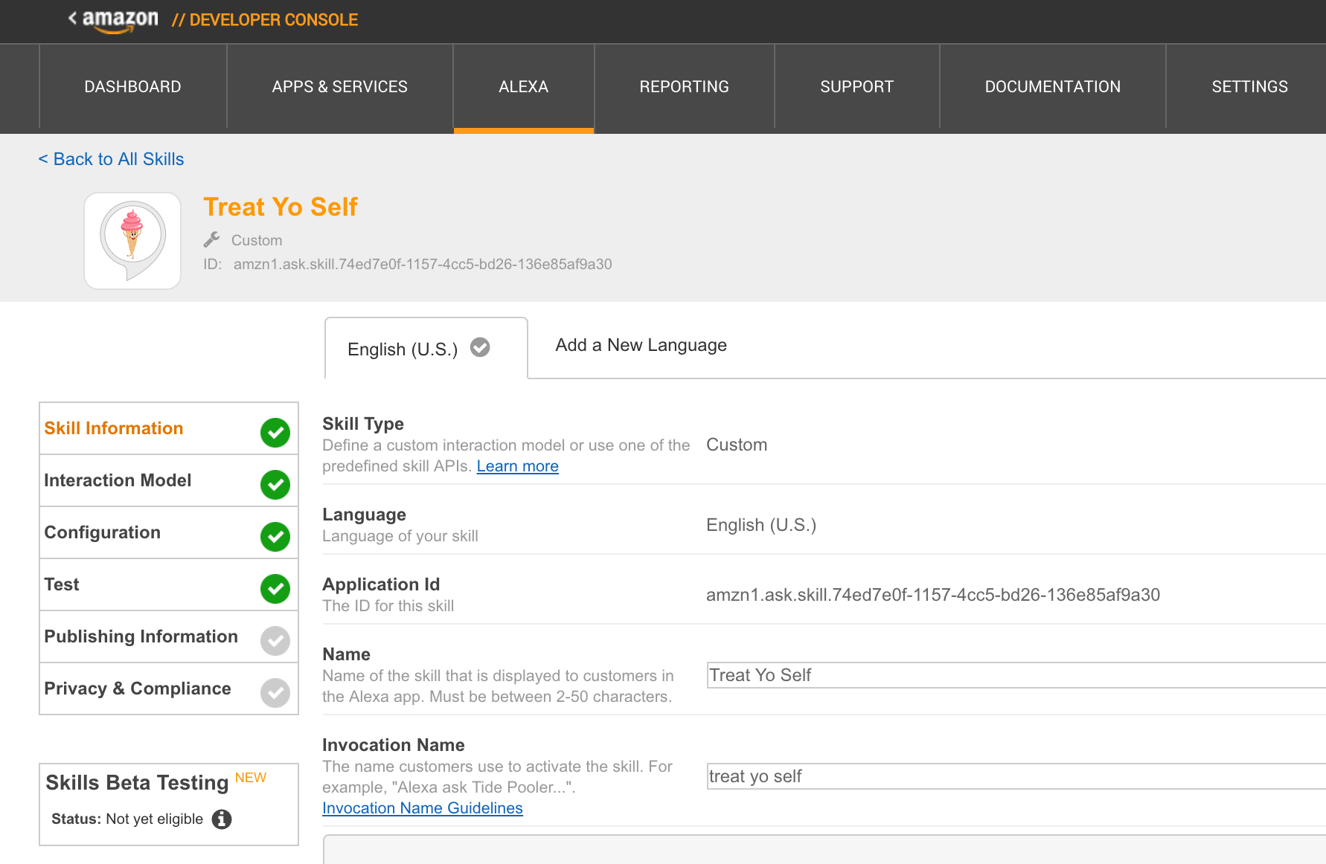
DEVELOPER CONSOLE
Registration and Management for your Skill Set
Defines the Interaction Model: intent schema, sample utterances, and any custom slot types
Basic Testing – “Open Treat Yo Self”
Connects your skill set to the AWS Lambda function

Slide 15
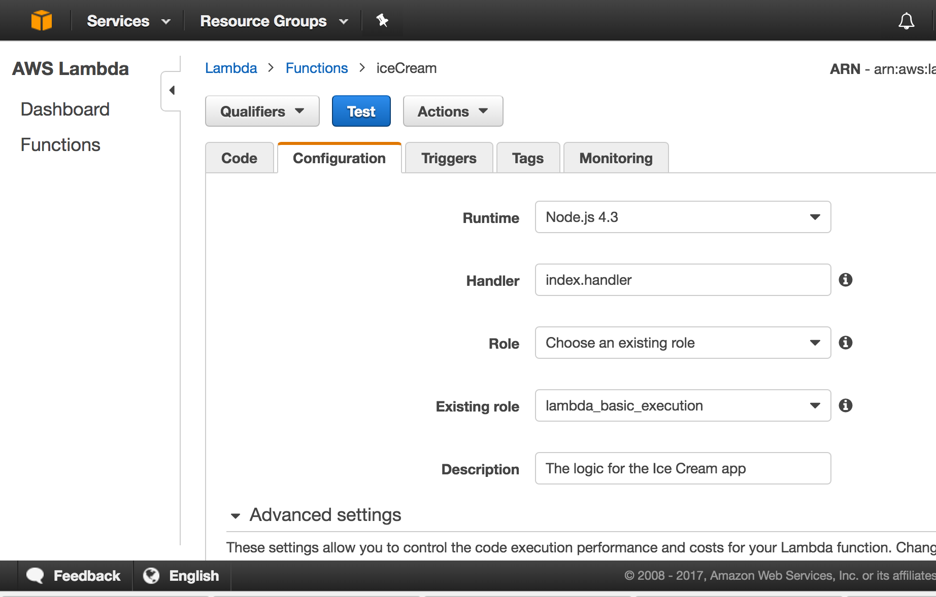
AWS LAMBDA
Amazon Web Services Computation Service
Upload that code!
Testing, CloudWatch – find out what went wrong

Slide 16

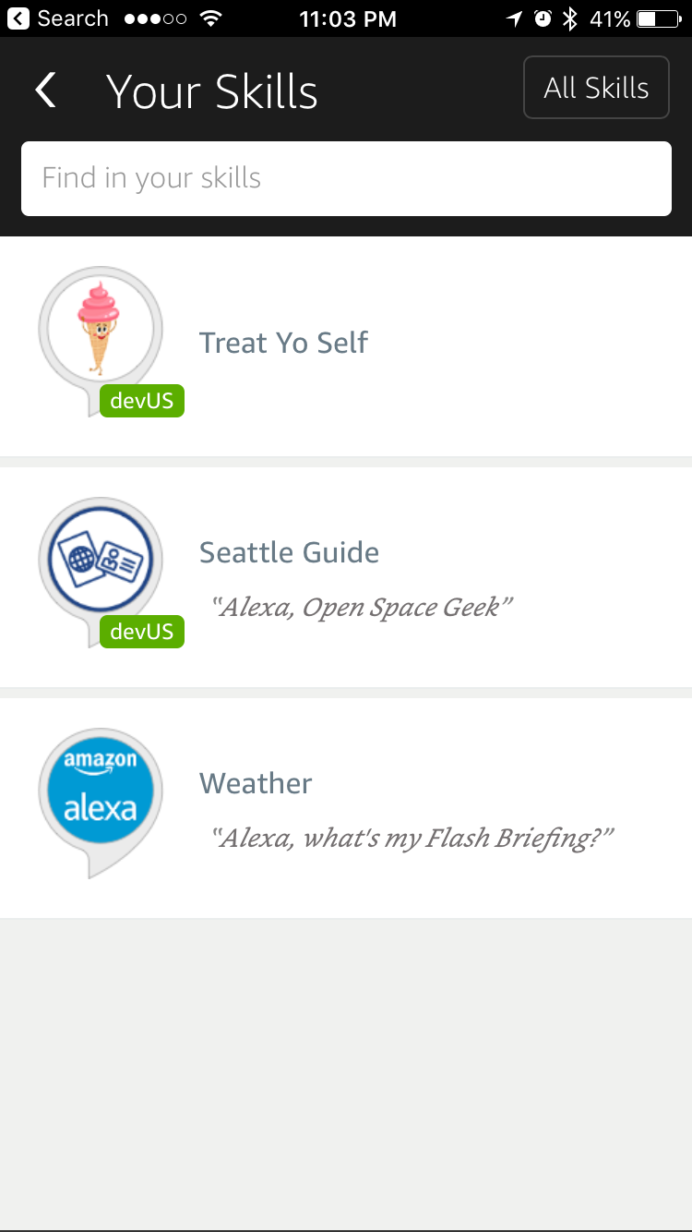
MOBILE
View the skills you built on your phone.

Slide 17
CHALLENGES
The struggle is real
λ
Fitbit
Alexa
Integration
OAuth 2.0
Issues with Refresh
Development
Finding Errors (Syntax)
Grabbing the data
01
02
03

Slide 18
Who Did What?
Together, everyone achieves more
John Williams
Nate Terry
Cole Christenson
Jennifer Guidotti
Cecil Hutchings
Alexa Main Developer
Database Development
Alexa Development
Fitbit
Alexa QA/QC
Graphic Design
Database Development

Slide 19
The End!
Questions?

