Slide 1

Kitsap County Healthcare Access Analysis
Identifying communities where healthcare resources may not align with population need.
Jen Fordham, RHIA Healthcare Analytics Portfolio July 2026
Notes:
Tthis project explores healthcare access equity across Kitsap County.
The goal was to identify communities where healthcare resource availability may not align with community need using publicly available data.
To answer that question, I built an end-to-end analytics workflow in Python, SQLite, and Power BI, culminating in an interactive dashboard for exploring healthcare access by ZIP code.

Slide 2






Project Workflow
Public Data → Python → SQLite → Scoring Model → Power BI
Business Question: Which communities should be prioritized for further investigation?
Notes:
This slide summarizes the overall analytical workflow.
I began by collecting public demographic and healthcare facility data. Using Python, I cleaned and transformed the datasets before storing them in a SQLite database.
I then developed a weighted scoring model that combined measures of healthcare supply and community need into a single Healthcare Access Priority Score.
Finally, I visualized the results in Power BI to make them easy to explore and interpret.

Slide 3




Data Sources
Census Data
Population
Income & Poverty
Insurance Coverage
Median Age
Healthcare Facilities
Primary Care Clinics
Hospitals
Provider Counts
Hospital Beds
Census ZCTAs
Zip Code Tabulation Areas
Kitsap County boundaries
Geospatial Analysis
19 Communities • 153 Providers • 311 Hospital Beds
Notes:
The project integrates three primary data sources.
Census data provided demographic characteristics such as population, income, poverty, insurance coverage, and age.
Healthcare facility data identified clinics, hospitals, provider counts, and hospital bed capacity.
Geographic boundary files allowed those datasets to be mapped to ZIP Code Tabulation Areas for spatial analysis.
In total, the project analyzed 19 communities containing 153 providers and 311 hospital beds.

Slide 4



Healthcare Access Priority Model
Community Need
Healthcare Supply
Poverty Rate
Uninsured Rate
Median Income
Age 65+
Providers per 10k
Clinics per 10k
Beds per 10k
Scoring Model
Healthcare Access Priority Score (0-100)
Notes:
Rather than relying on a single metric, I combined multiple indicators into a weighted scoring model.
The Community Need component included poverty rate, uninsured rate, median income, and the proportion of older adults.
Healthcare Supply measured provider availability, clinic density, and hospital bed capacity.
Together these generated a standardized Healthcare Access Priority Score ranging from 0 to 100, allowing communities to be ranked for further investigation.

Slide 5

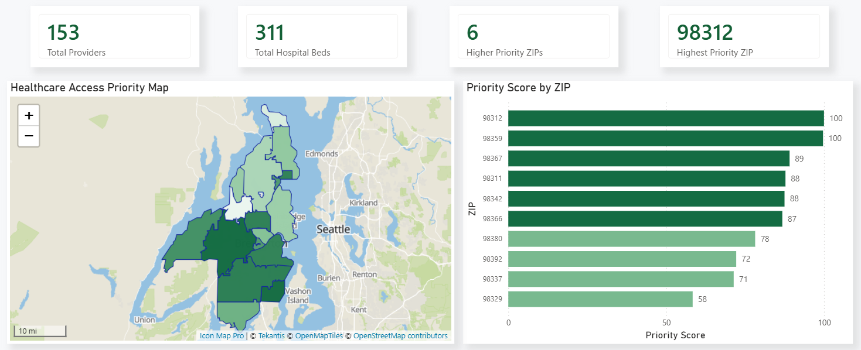
Executive Dashboard
Notes:
This dashboard provides a county-wide executive summary.
At the top are high-level KPIs, followed by a geographic map showing how priority scores vary across Kitsap County and a ranked comparison of all ZIP codes.
The purpose of this page is to help decision makers quickly identify where potential access challenges may exist before exploring individual communities in more detail.

Slide 6

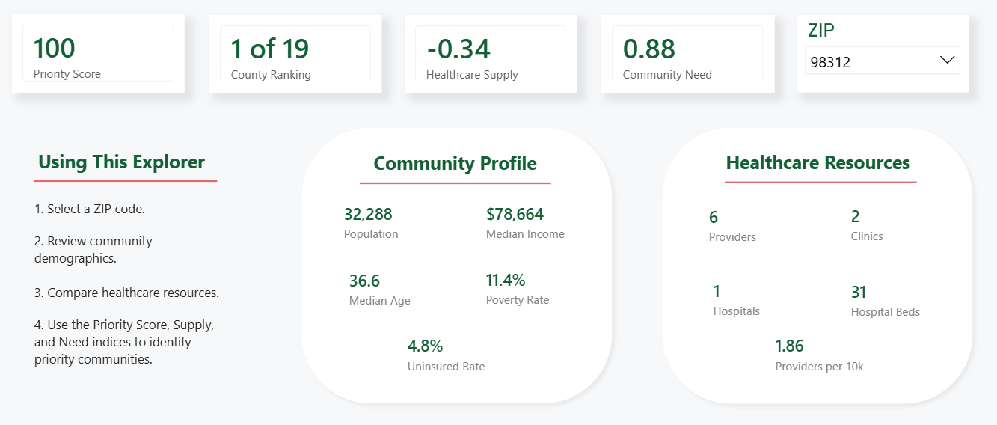
Community Explorer
Interactive exploration of healthcare access at the ZIP code level.
Notes:
The second dashboard page allows users to investigate individual communities.
Selecting a ZIP code automatically updates demographic information, healthcare resource metrics, and the community's priority ranking.
This transforms the dashboard from a high-level summary into an interactive exploration tool that supports deeper analysis of individual communities.

Slide 7
Highest Priority Communities
The Healthcare Access Priority Model identified these three communities as the highest priorities for further investigation based on healthcare supply relative to community need.
Although all three communities ranked among the highest priorities, each illustrates a different healthcare access challenge.
98312 (West Bremerton)
Large population with relatively limited provider availability
• Population: 32,288
• 1.86 providers per 10k
• 11.4% poverty rate
98359 (Olalla)
No local healthcare facilities identified
• Population: 4,889
• 0 providers
• 12.3% poverty rate
98637 (Port Orchard)
Growing residential community with no healthcare facilities identified despite serving more than 31,000 residents.
• Population: 31,186
• 0 providers
• 6.9% poverty rate
Recommendation: Further evaluate healthcare access by assessing travel time, provider capacity, transportation access, and other local barriers.
Notes:
The scoring model identified these three communities as the highest priorities for further investigation.
What's interesting is that they reached the top for different reasons.
West Bremerton is a large population center with relatively limited provider availability.
Olalla had no local healthcare facilities identified within the ZIP code despite moderate community need.
Brinnon is a small rural community with an older population and no local healthcare facilities identified.
These examples illustrate why combining healthcare supply and community need provides a more complete picture than examining either factor alone.
While the model highlights communities that may benefit from additional evaluation, further assessment should consider factors such as travel time, provider capacity, transportation access, and other local barriers.

Slide 8
Thank you / Questions
Thank you for your time and feedback.
Jen Fordham, RHIA Healthcare Analytics Portfolio July 2026
Notes:
Thank you for taking the time to review my project.
This analysis strengthened my skills in data engineering, SQL, geospatial analysis, dashboard development, and communicating analytical findings to a non-technical audience.
I'd be happy to answer any questions about the methodology, dashboard, or design decisions.

