Slide 1
Washington Hospital Quality Explorer
Analyzing CMS Hospital Quality Performance Across Washington
Jen Fordham, RHIA
July 2026
Microsoft Excel • PivotTables • Dashboard Development
Healthcare Analytics Portfolio Project

Slide 2
Business Problem
Healthcare leaders need reliable ways to compare hospital quality performance across Washington and identify opportunities for quality improvement.
CMS publishes extensive hospital quality data, but it can be difficult to interpret and compare across facilities.
Objective
Develop an executive Excel dashboard that transforms CMS hospital quality data into clear, actionable insights for statewide benchmarking and healthcare quality improvement.
Dataset: CMS Hospital Compare • 100 Washington Hospitals • 36 Counties
Notes:
Before building the dashboard, I wanted to clearly define the business problem I was trying to solve.
CMS publishes a large amount of hospital quality data, but it's spread across many measures and can be difficult to interpret at a statewide level. Healthcare leaders need a way to quickly compare hospital performance, identify patterns, and support quality improvement efforts.
My objective was to transform this public dataset into an executive Excel dashboard that summarizes statewide hospital quality performance and makes the information easier to understand. Rather than replacing the detailed CMS data, the dashboard provides a high-level view that supports benchmarking and data-informed decision making.
One thing I was careful about throughout the project was making sure my conclusions matched what the data could actually support. For example, many Critical Access and specialty hospitals aren't assigned CMS Overall Star Ratings, so I avoided making direct quality comparisons where the dataset didn't support them.

Slide 3
Business Question
How does hospital quality performance vary among Washington hospitals,
and what opportunities exist to support healthcare quality improvement?
Project Approach
Filtered CMS Hospital Compare data to Washington hospitals
Explored trends using Excel PivotTables
Calculated summary metrics and KPIs
Designed executive dashboards to communicate findings
Dataset: CMS Hospital Compare • Tools: Microsoft Excel, PivotTables, Dashboard Development
Notes:
This project began with a clear business question: how hospital quality performance varies across Washington and how the data can support healthcare quality improvement.
To answer that question, I first filtered the CMS Hospital Compare dataset to Washington hospitals. I then used PivotTables to explore the data, calculate summary metrics, and identify meaningful patterns. Finally, I designed executive dashboards to present the findings in a concise and accessible format.

Slide 4
From Data to Dashboard
📄 Import CMS Hospital Compare Data
↓
🧹 Filter & Prepare Washington Data
↓
📊 Analyze Using PivotTables
↓
📈 Calculate KPIs & Summary Metrics
↓
📋 Build Executive Dashboards
↓
💡 Communicate Business Conclusions
Filter & Prepare – Limited the dataset to Washington hospitals and validated records.
Analyze – Used PivotTables to identify patterns in hospital type, CMS Overall Star Ratings, and statewide quality performance.
Calculate – Created summary metrics to support dashboard KPIs.
Visualize – Designed executive dashboards to communicate findings to decision-makers.
Dataset: CMS Hospital Compare • Tools: Microsoft Excel, PivotTables, Dashboard Development
Notes:
After defining the business question, I followed a structured analytical workflow to transform the raw CMS dataset into executive dashboards.
I began by filtering the CMS Hospital Compare dataset to include only Washington hospitals and validating the records to ensure the analysis reflected the intended geographic scope.
Next, I used Excel PivotTables to explore patterns in hospital type, CMS Overall Star Ratings, and statewide quality performance. This exploratory analysis helped identify the most meaningful metrics to summarize in the dashboards.
I then calculated key performance indicators and summary metrics that would support the dashboard visualizations.
Finally, I designed two executive dashboards that present the findings in a concise, accessible format, allowing users to quickly understand statewide trends and supporting data-driven quality improvement efforts.
I intentionally used Excel because it's still one of the most common tools used for healthcare reporting. I wanted to demonstrate that I could take a public healthcare dataset, perform structured analysis with PivotTables, and create executive-ready dashboards using tools that many healthcare organizations rely on every day.
One challenge was making sure the business question matched what the data could actually support. For example, many Critical Access and specialty hospitals aren't assigned CMS Overall Star Ratings under CMS methodology. I adjusted both the business question and the conclusions to avoid making unsupported comparisons and to ensure the findings accurately reflected the dataset.

Slide 5
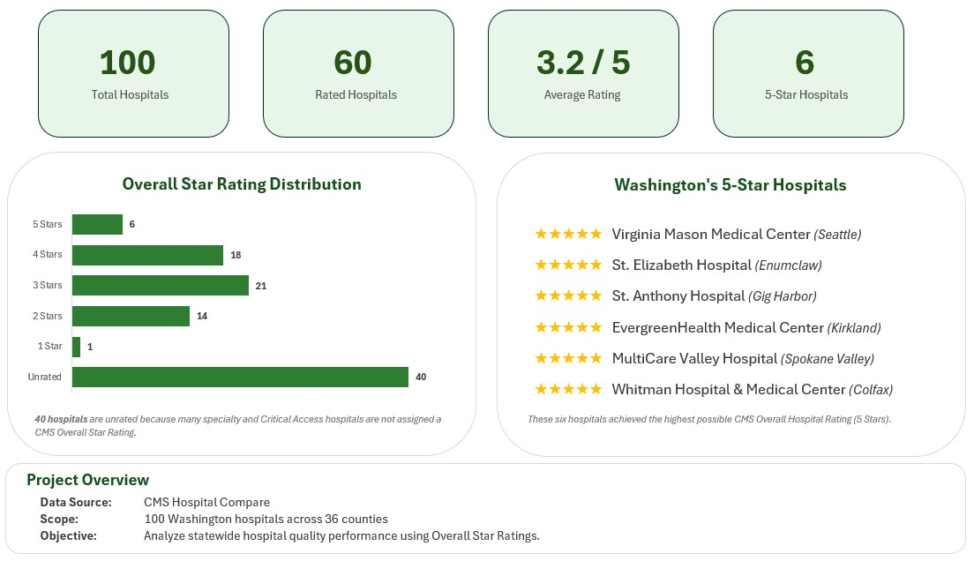
Executive Overview
High-level summary of statewide hospital quality performance and CMS Overall Star Ratings.
Figure 1. Executive dashboard summarizing statewide hospital quality performance.
Notes:
This executive dashboard provides a high-level summary of hospital quality performance across Washington.
The KPI cards highlight the scope of the analysis, including the total hospitals analyzed, the number receiving CMS Overall Star Ratings, the statewide average rating, and the number of hospitals achieving the highest 5-Star Rating.
The Overall Star Rating Distribution provides a quick view of how hospitals are distributed across CMS ratings, while also showing that many hospitals remain unrated because they are not eligible under CMS methodology.
Finally, the recognition panel highlights the six hospitals that achieved the highest Overall Star Rating, and the project overview summarizes the data source, geographic scope, and objective of the analysis.

Slide 6
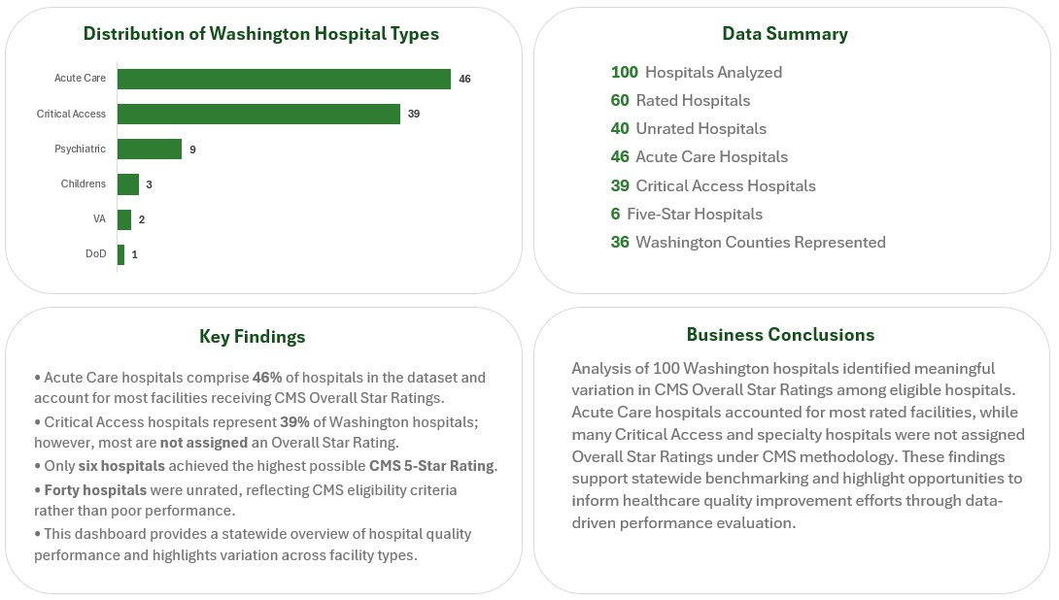
Performance Analysis
Supporting analysis highlighting hospital characteristics, statewide quality trends, and business conclusions.
Figure 2. Supporting analysis highlighting hospital characteristics and statewide quality performance.
Notes:
This dashboard expands on the executive overview by providing additional context behind the statewide results.
The hospital type distribution shows that Acute Care Hospitals and Critical Access Hospitals account for the majority of facilities included in the analysis.
The Data Summary provides quick reference metrics describing the dataset, including the number of hospitals analyzed, the number receiving CMS Overall Star Ratings, and the distribution of hospital types.
The Key Findings summarize the most important observations identified during the analysis, while the Business Conclusions explain how those findings can support statewide benchmarking and healthcare quality improvement efforts.
Together, these elements move beyond simply presenting data and help translate the analysis into actionable business insights.

Slide 7
Key Insights
Analytical Findings
Acute Care Hospitals accounted for nearly half (46%) of all facilities analyzed.
Critical Access Hospitals represented 39% of hospitals, though many were not assigned CMS Overall Star Ratings.
Only 6 hospitals achieved the highest possible 5-Star Rating.
40 hospitals were unrated because they were not eligible under CMS methodology.
Practical Applications
Executive dashboards simplify interpretation of complex CMS quality data.
Hospital type should be considered when comparing Overall Star Ratings.
Statewide benchmarking can help identify performance patterns and inform quality improvement efforts.
Executive dashboards enable faster, data-informed decision making.
Project Outcome: Developed an executive Excel dashboard that transforms complex public healthcare data into clear, actionable insights.
Notes:
The analysis identified several important statewide trends. Acute Care Hospitals represented nearly half of the facilities included in the dataset, while Critical Access Hospitals accounted for a significant portion but were frequently not assigned CMS Overall Star Ratings under CMS methodology.
One of the key takeaways is that hospital type should always be considered when interpreting statewide quality data. Comparing hospitals without considering CMS eligibility could lead to misleading conclusions.
Beyond the specific findings, this project demonstrates how executive dashboards can transform complex public healthcare data into information that is easier to interpret and supports benchmarking and quality improvement discussions.

Slide 8
Project Takeaways
Core Competencies
Excel Dashboard Design
PivotTables & PivotCharts
KPI Development
Data Visualization
Healthcare Data Analysis
Data Storytelling
Business Communication
Project Reflection
This project strengthened my ability to transform complex public healthcare data into executive-ready dashboards that communicate meaningful business insights. Throughout the project, I balanced analytical accuracy with clear visual communication while ensuring that conclusions remained aligned with the data. The experience reinforced the importance of thoughtful data exploration, stakeholder-focused reporting, and effective data storytelling.
Portfolio Project 3 • Excel • Healthcare Analytics • July 2026
Notes:
This project brought together many of the skills I've developed throughout my analytics portfolio, including dashboard design, KPI development, data visualization, and healthcare data analysis.
Beyond the technical work, one of my biggest takeaways was the importance of aligning business questions with what the data can legitimately support. Throughout the project, I refined both the analysis and the conclusions to ensure they accurately reflected CMS methodology and avoided unsupported comparisons.
Overall, this project reinforced that effective analytics isn't just about creating visualizations—it's about transforming complex data into information that decision-makers can understand and use with confidence.

