Slide 1

WHAT ARE THE BIGGEST FACTORS AFFECTING SLEEP IN ADULTS?
Charles Sisemseghan
Edgar A. Guevara
Jenny Friesenhahn
Kanwal Iftikhar
Pankaj Sethi
Notes:
Edgar

Slide 2
SOURCE & METHODOLOGY
SOURCE:
COLLECTION METHODOLOGY:
Dataset is downloaded from Kaggle.
The dataset provided was collected as part of a study conducted in the UK by a research team from The University of Oxfordshire.
The study aimed to investigate the impact of lifestyle factors such as caffeine, alcohol, and exercise on sleep patterns and sleep quality.
The research team recruited participants from the local community and collected data over a period of several months.
The data was collected using a combination of self-reported surveys, actigraphy, and polysomnography which is a sleep monitoring technique.
The data was then analyzed to understand the relationship between lifestyle factors and sleep patterns and to identify any potential areas for intervention to improve sleep.
Notes:
Edgar

Slide 3
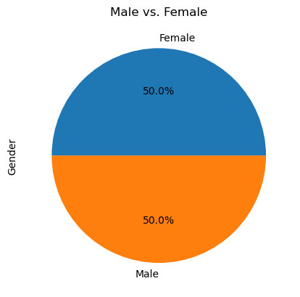
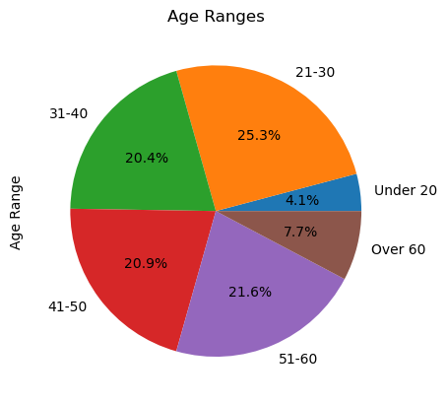
OVERVIEW OF POPULATION
Notes:
Jenny

Slide 4
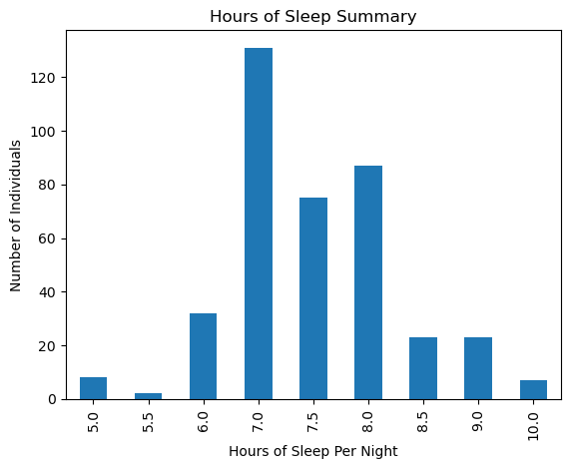
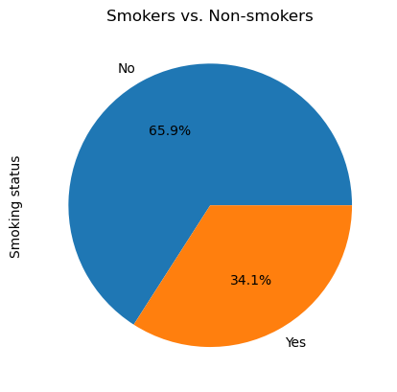
OVERVIEW OF POPULATION
Notes:
Jenny

Slide 5
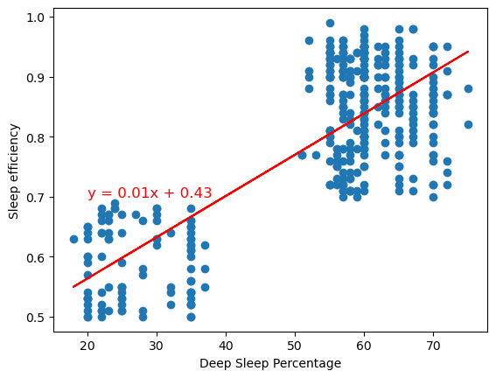
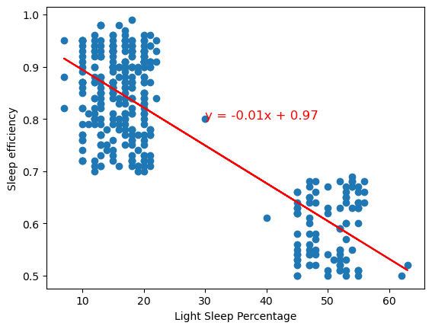
DEEP SLEEP VS. SLEEP EFFICIENCY VS. LIGHT SLEEP
Notes:
Pankaj
The correlation between Deep sleep and sleep efficiency is 0.79
The correlation between Light sleep and sleep efficiency is -0.82
Likely used deep sleep and light sleep percentage to calculate sleep efficiency

Slide 6
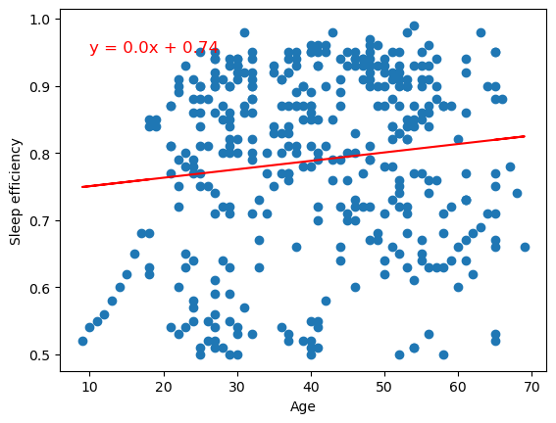
DOES AGE AFFECT SLEEP EFFICIENCY?
The correlation between age and sleep efficiency is 0.12
Notes:
Pankaj

Slide 7
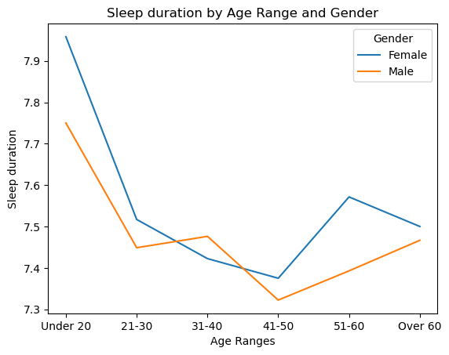
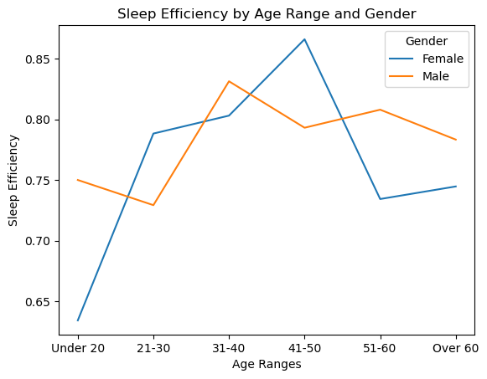
DO AGE & GENDER AFFECT SLEEP EFFICIENCY OR SLEEP DURATION ?
Notes:
Kanwal
41-50 has lowest duration but highest efficiency
After 41-50, women have higher sleep duration but lower sleep efficiency

Slide 8
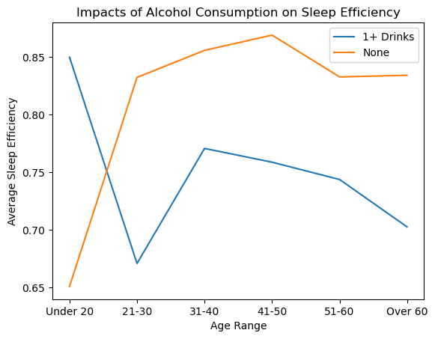
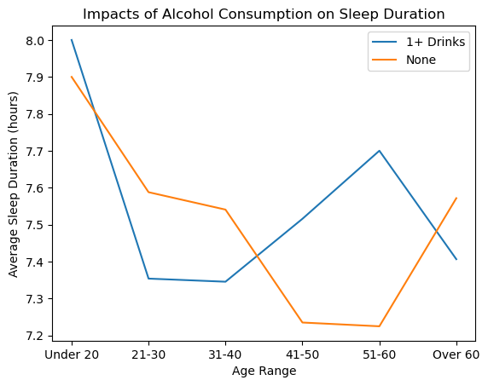
DOES ALCOHOL CONSUMPTION AFFECT SLEEP?
Notes:
Charles

Slide 9
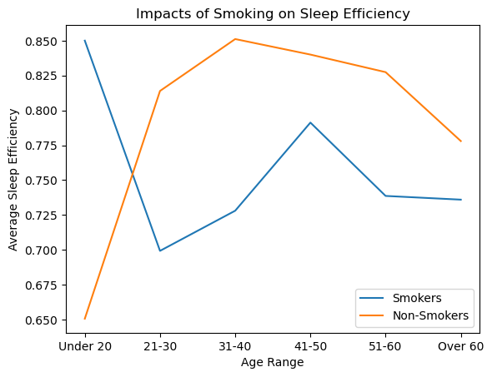
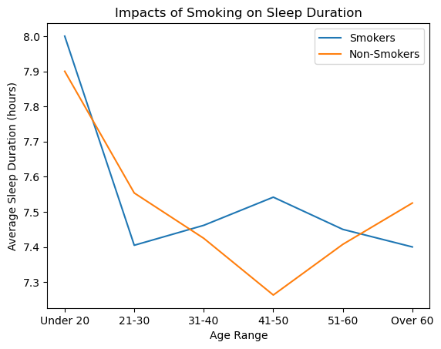
DOES SMOKING AFFECT SLEEP?
Notes:
Charles

Slide 10
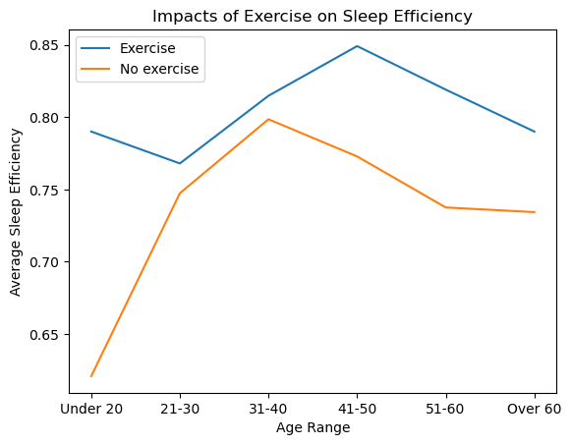
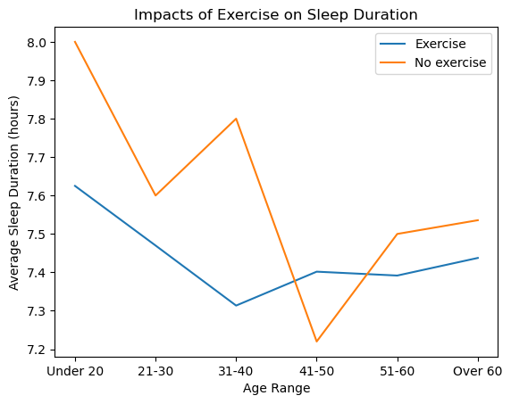
DOES EXERCISING AFFECT SLEEP?
Notes:
Charles

Slide 11
POSSIBLE BIAS IN DATASET
Small sample size
Portions of information are survey-based
UK-based study, may find different results in other countries
Correlation does not equal causation
Notes:
Charles

Slide 12
QUESTIONS?

