Slide 1
Bootstrap
Twitter ~

Slide 2
Contents
Short description of bootstrap
Pro’s and Con’s
How to use
Grid system
Css samples
Comoponents samples
JavaScript samples
Exercise

Slide 3
What is Bootstrap?
front-end web framework for designing websites and web applications
free
open-source

Slide 4
Pro‘s and Con‘s
standardized platform
all the basic styles and components needed
saves a lot of time.
Support for all major browsers
Lightweight and customizable files
Mobiles first
Several javascript plugins
Good documentation and community support
Lots of free and professional templates, themes and plugins
Works with media-queries
Styles are verbose and can lead to lots of HTML output that's not perfectly semantic
Javascript is tied to jQuery
Can require lots of overriding styles or rewriting their files
Websites can start to look the same if you don't customize the styles and colors much
Pro‘s
Con‘s
Notes:
Great standardized platform with all the basic styles and components needed (layout grid, panels, tables, buttons, modals, form styles, etc) to build on which saves a lot of time.
Support for all major browsers and fixes CSS compatibility issues.
Consistent UI that looks good out of the box.
Lightweight and customizable (on their site or via less and sass) files so you can include only what you use.
Designed with responsive structures and styles for mobile devices.
Several javascript plugins included using jQuery.
Icons included (now as a font file for infinite scaling).
Good documentation and community support.
Lots of free and professional templates, themes and plugins.

Slide 5
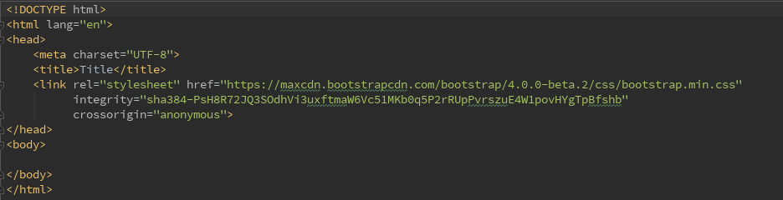
How to use
Download it on website
Or use CDN

Slide 6
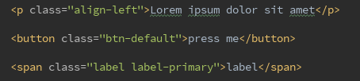
How to use
Download it on website
Or use CDN
Add classes

Slide 7
Grid system
creating page layouts through a series of rows and columns
scales up to 12 columns as the device or viewport size increases

Slide 8
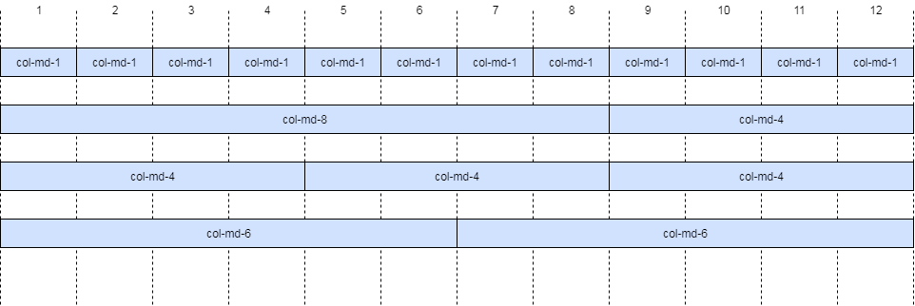

Grid system

Slide 9
Grid system
used for creating page layouts through a series of rows and columns
scales up to 12 columns as the device or viewport size increases
Different breakpoints for different devices

Slide 10
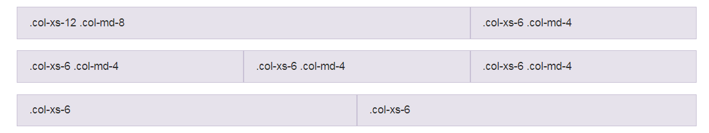
Grid system ~ breakpoints
col-xs: phones, less than 768px
col-sm: tablets, 768px and up
col-md: desktops, 992px and up
col-lg: large desktops, 1200px and up

Slide 11
Grid system
used for creating page layouts through a series of rows and columns
scales up to 12 columns as the device or viewport size increases
Different breakpoints for different devices
Can be nested

Slide 12
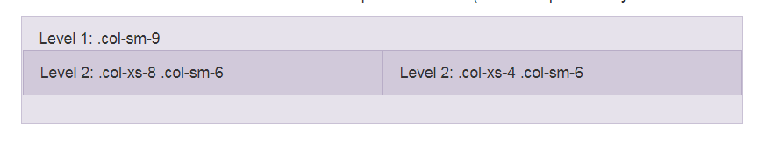
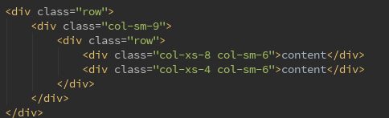
Grid system ~ nesting

Slide 13
Grid system
used for creating page layouts through a series of rows and columns
scales up to 12 columns as the device or viewport size increases
Different breakpoints for different devices
Can be nested
Offsets can be set

Slide 14
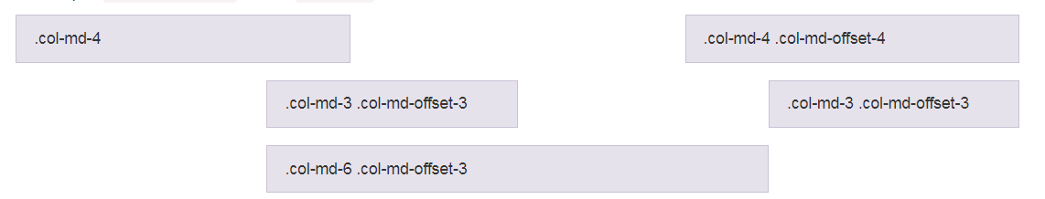

Grid system

Slide 15
Css ~Samples
Tables

Slide 16
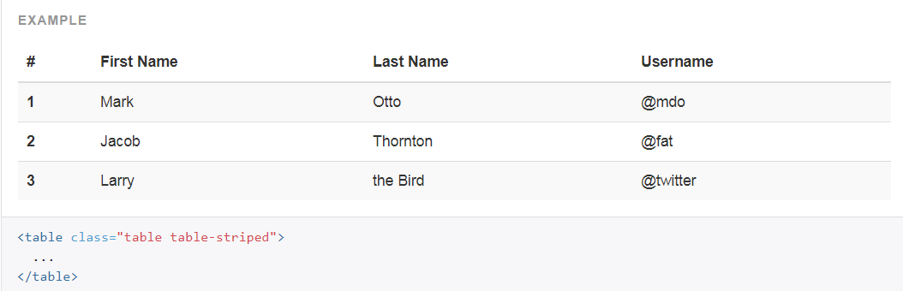
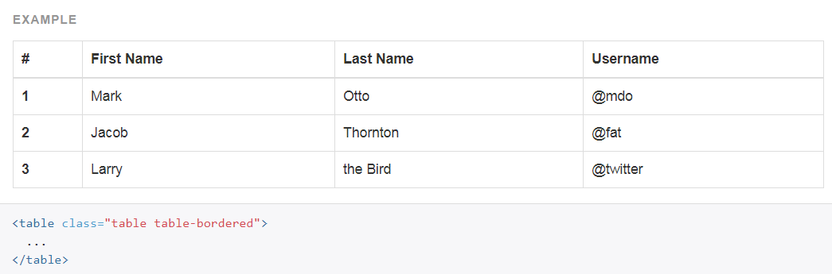
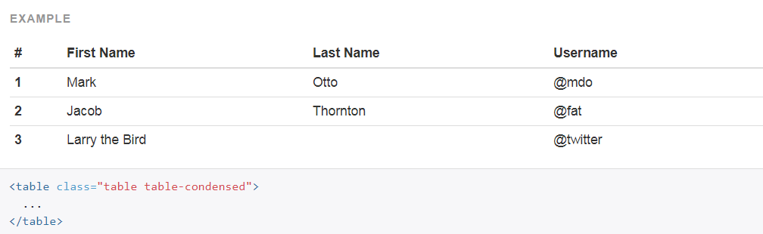
Css ~Samples: tables

Slide 17
Css ~Samples
Tables
Buttons

Slide 18
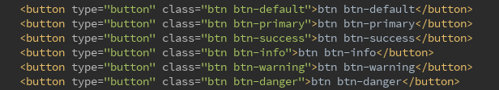
Css ~Samples: buttons

Slide 19
Css ~Samples
Tables
Buttons
Forms

Slide 20
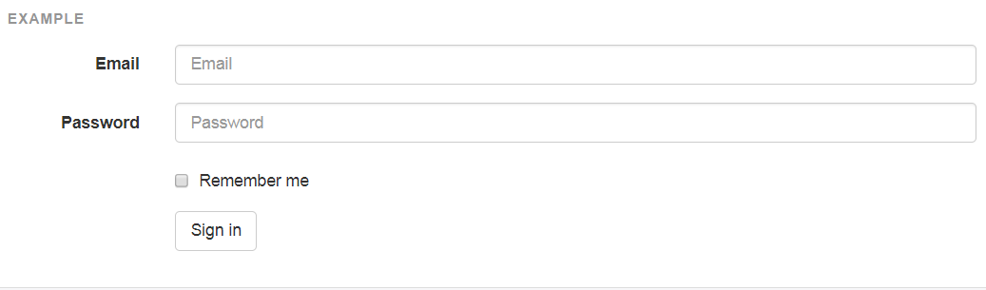
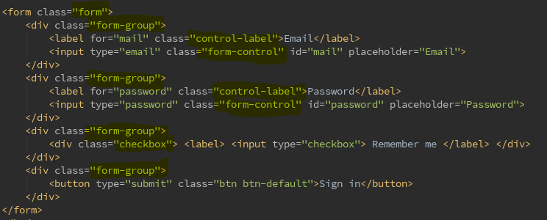
Css ~Samples: forms

Slide 21
Components ~Samples
Navbars

Slide 22

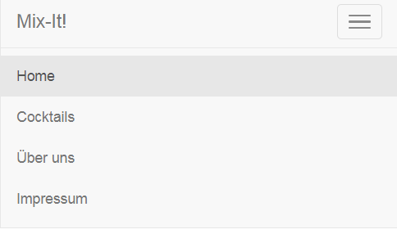
Components ~Samples
Navbars

Slide 23
Components ~Samples
Navbars
Alerts

Slide 24
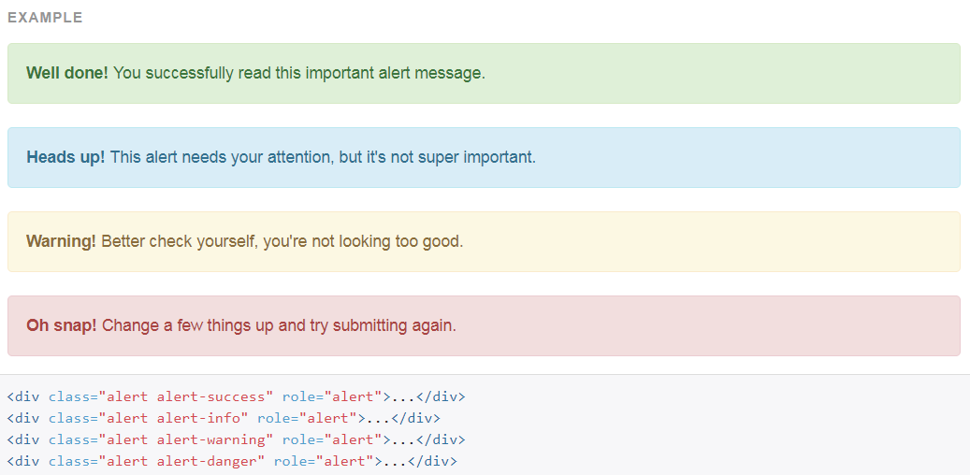
Components ~Samples: alerts

Slide 25
Components ~Samples
Navbars
Alerts
Navs

Slide 26
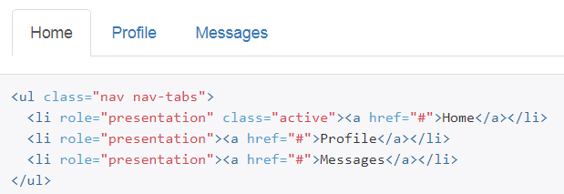
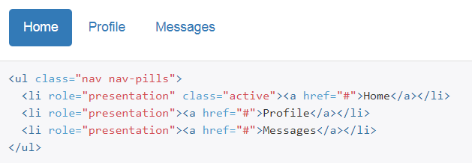
Components ~Samples: navs
Tabs
Pills

Slide 27
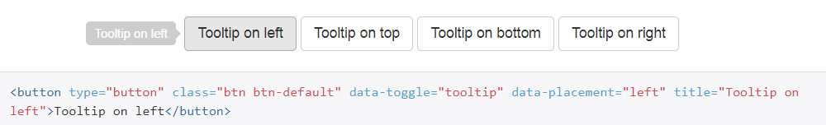
JavaScript ~Samples
Tooltip

Slide 28
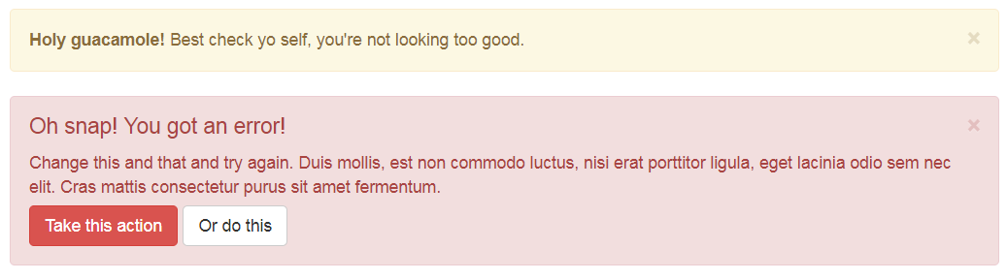

JavaScript ~Samples
Tooltip
Carousel
Alerts

Slide 29
JavaScript ~Samples
Tooltip
Carousel
Alerts
Tabs

Slide 30
Exercise
http://getbootstrap.com/docs/3.3/
https://github.com/JenHa/Bootstrap-presentation

Slide 31
Sources
https://www.quora.com/What-are-the-pros-and-cons-of-using-Bootstrap-in-web-development
https://getbootstrap.com/docs/3.3/

