Slide 1
Developer Exchange Group
深入淺出設計模式#1:
策略模式
Prepare by Sean Hsieh

Slide 2
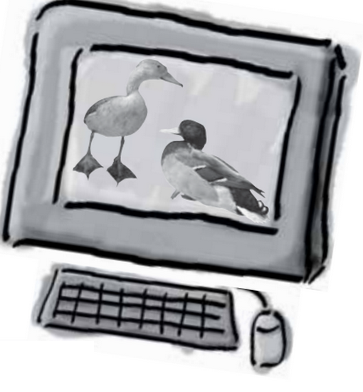
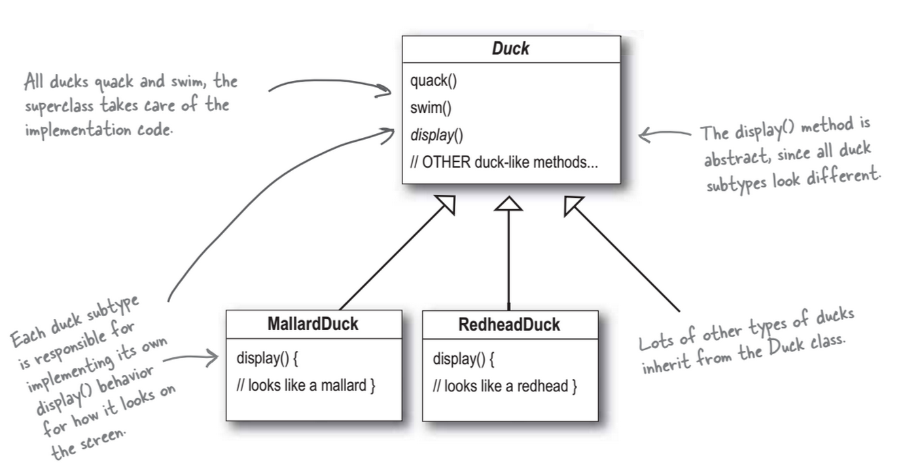
Scene
The story started from…

Slide 3
New requirement
New requirement: simulate a flying duck
So we add a fly function in Duck class
Add a fuction
Fly()
Fly()
Fly()
Override the fuction
Override the fuction

Slide 4
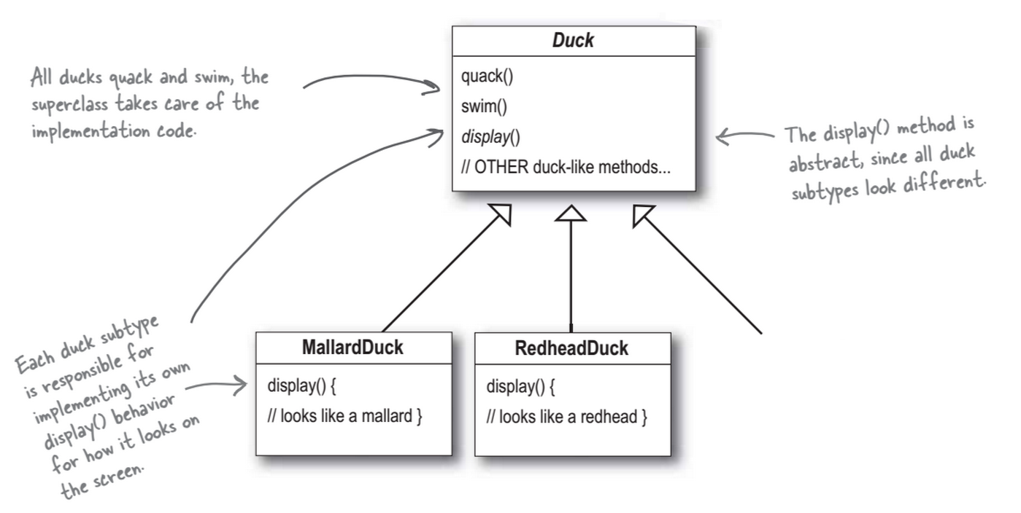
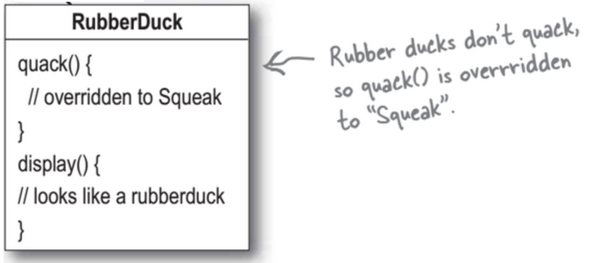
Look good, but…
Now we has another requirement, we need a rubber duck
Add a fuction
Fly()
However, the rubber duck can’t fly
Fly()
Fly()
Fly()
Override the fuction
Override the fuction

Slide 5
Now we know that…
Disadvantage of using Inheritance:
Code is duplicate accoss subclasses
Runtime behavior change is difficult
We can’t make duck dance
Hard to gain knowledge of all duck behaviors
Ducks can’t fly and quack at same time
Change can unintentionally affect other ducks

Slide 6
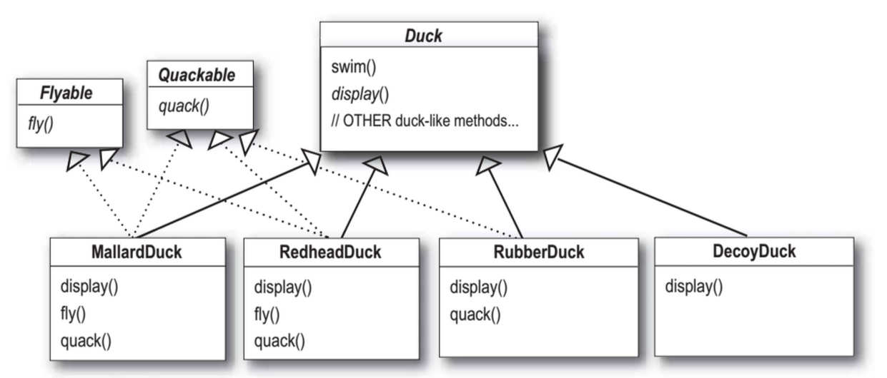
If We using Interface?
If we using interface to define every action
There will be thousands of classes in a program

Slide 7
So, How do you think?

Slide 8
Try Strategy Pattern

Slide 9
Design principle 1
Identify the aspects of your application that vary and
separate them from what stays the same.
For eample:
 | MallardDuck | RedheadDuck | RubberDuck | DescoyDuck | Duck
Display |  |  |  |  | 
Fly |  | 
Quack |  |  | 
Take the parts that vary and encapsulate them to extend them

Slide 10
More detail…
Fly
Display
Quack
Duck class
Duck action that vary
Take the parts that vary and encapsulate them to extend them

Slide 11
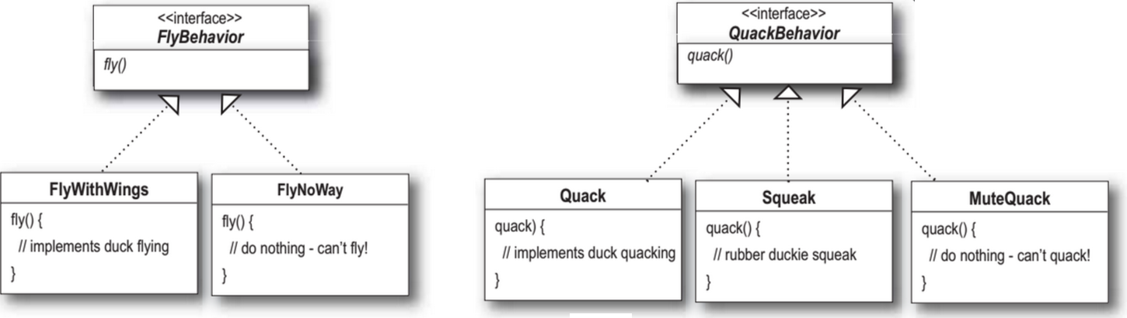
Design principle 2(1/2)
Program to interface/supertype, not an
implementation.
1.Interface:
Ex. Use FlyBehavior (interface) define Fly()

Slide 12
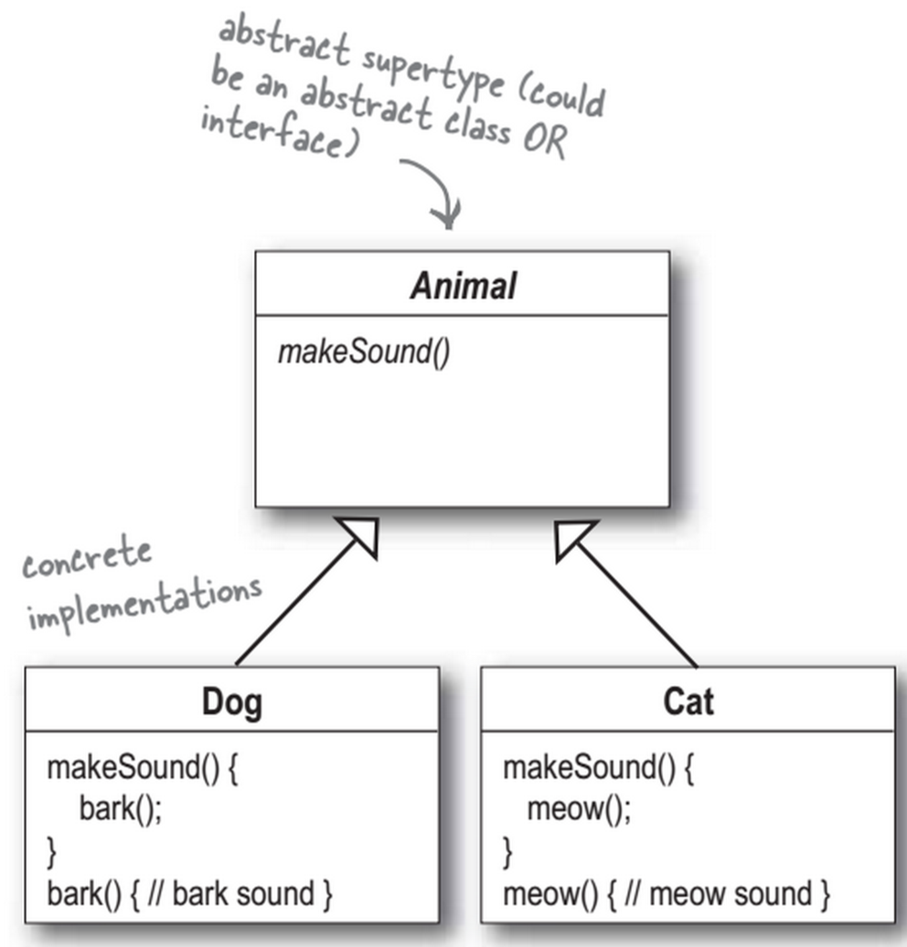
Design principle 2(2/2)
X Locked in the code
2. SuperType
Ex. Dog d = new Dog(); d.bark();
Animal animal = new Dog(); animal.makesound();

Slide 13
Design principle 3
Favor composition over inheritance

Slide 14
Do you remember?
Disadvantage of using Inheritance:
Code is duplicate accoss subclasses
Runtime behavior change is difficult
We can’t make duck dance
Hard to gain knowledge of all duck behaviors
Ducks can’t fly and quack at same time
Change can unintentionally affect other ducks

Slide 15
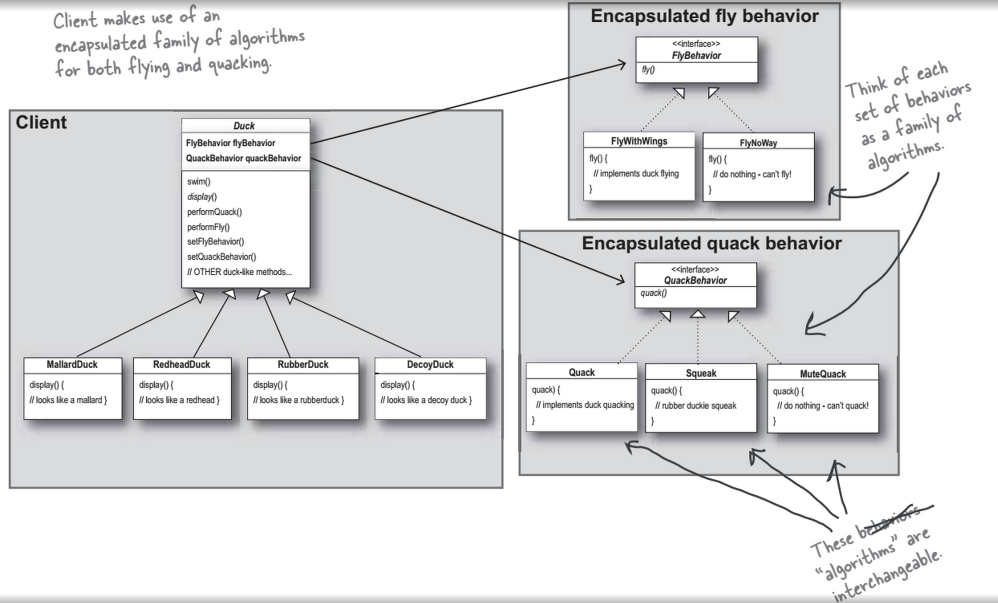

Slide 16
More

Slide 17
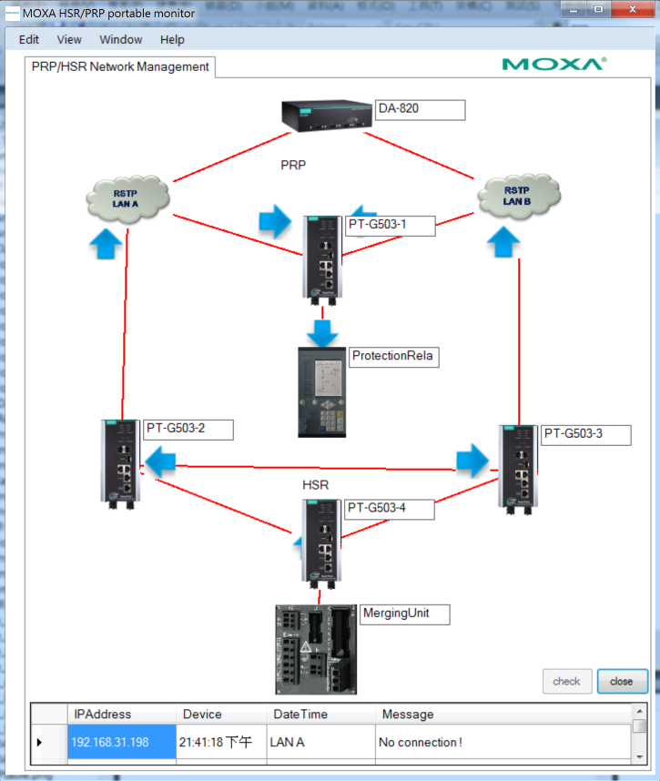
A Case of Portable Monitor prototype

Slide 18
But it has some requirement before shipping…
PM:
The different type packages must to be different colors.
The different type packages must to be different directions.
The user can switch different type package flow.

Slide 19
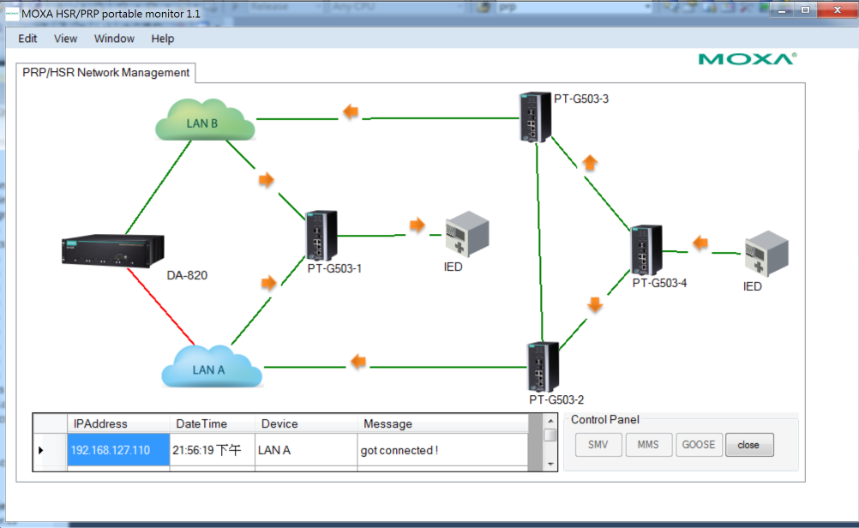
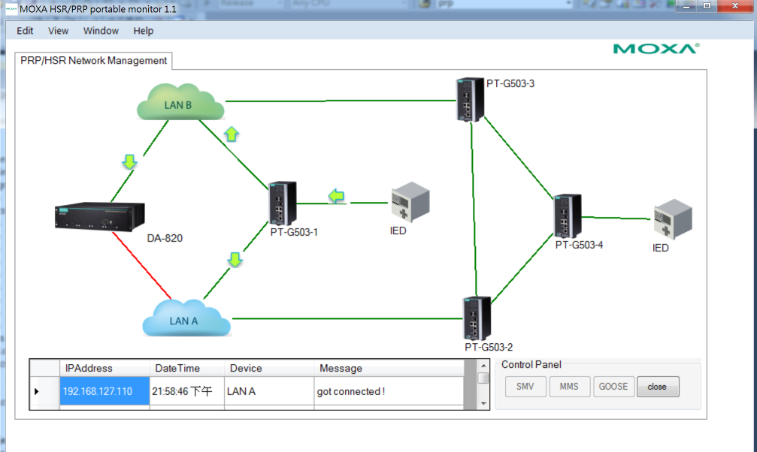
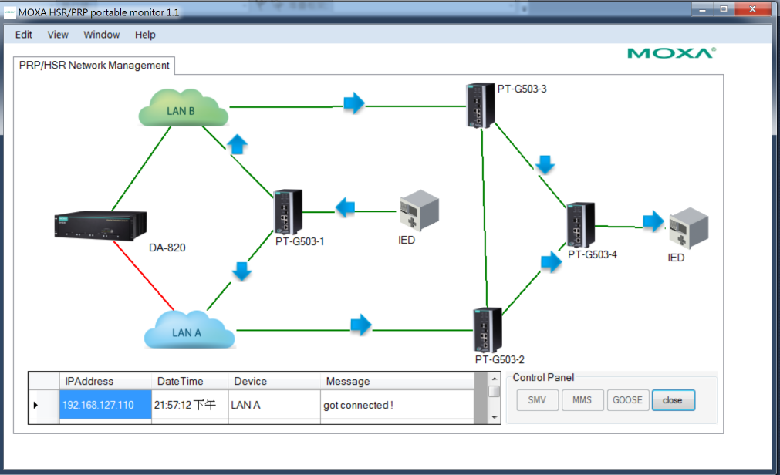
Let’s trying strategy pattern

Slide 20
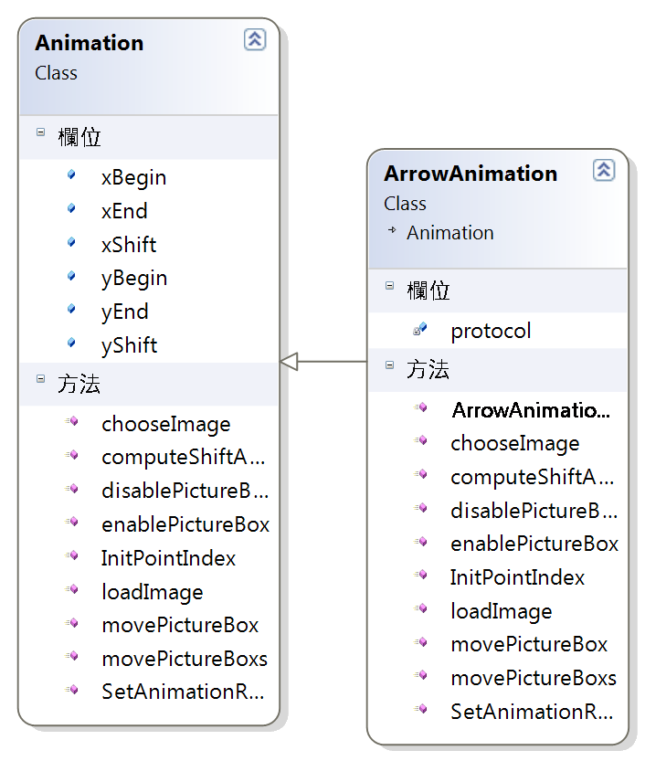
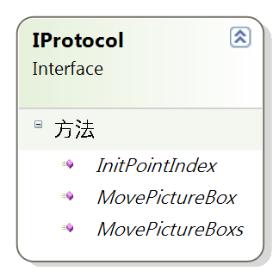
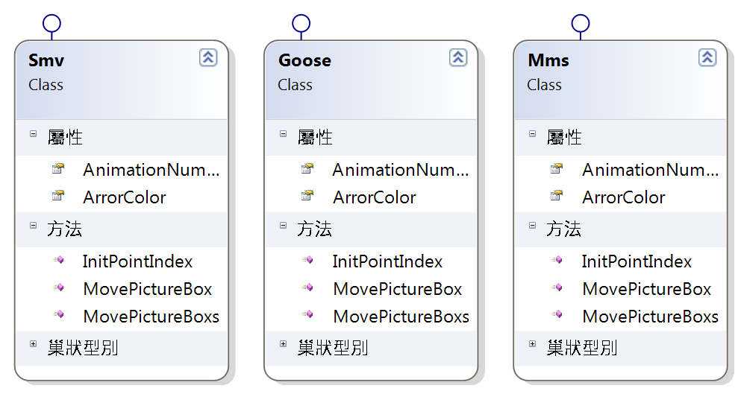
Design Architecture

