Slide 1
Developer Exchange Group
深入淺出設計模式#10:
獨體模式
Prepare by Sean Hsieh

Slide 2
Scene

Slide 3
Question
Some object we only need one of it
EX: thread pools, caches, dialog boxes,
objects that handle peferences and registry settings, object used for logging …etc
Use static variable in JAVA
What if this object is resource intensive and your application never ends up using it?
3 Advantage: 1.Ensure only one object gets created.
2.Give a global point to access
3.Just like a global variable without
downsides
Classic Singleton Pattern

Slide 4
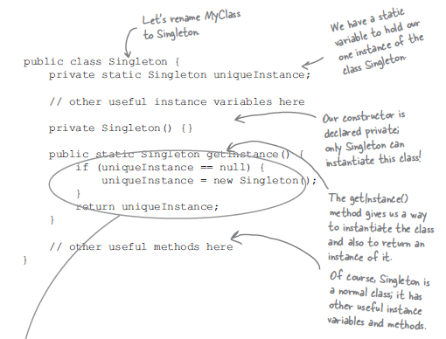
Classic Singleton Pattern
Key point:
1.Have a static variable to our one instance of the class Singleton
2.Constructor is declared private only Singleton can instantiate this class
3.The getInstance() method gives us a way to instantiate the class
Lazy instanliaze

Slide 5
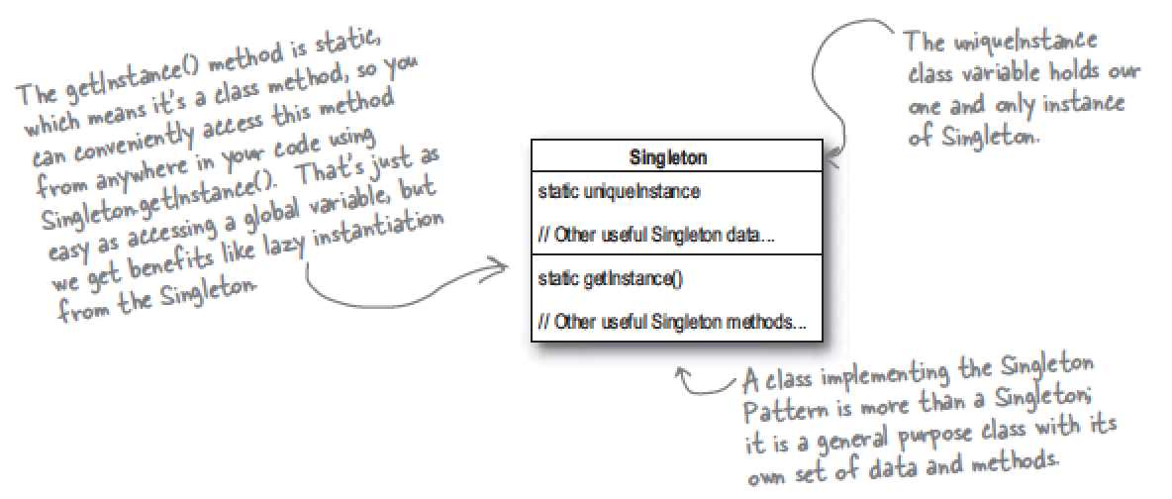
Define Singleton Pattern
The Singleton Pattern ensures a class has a only one instance, and provides global point of access it
1.Preventing any other class from creating a new instance on its own
2.Providing a global access point to the instance

Slide 6
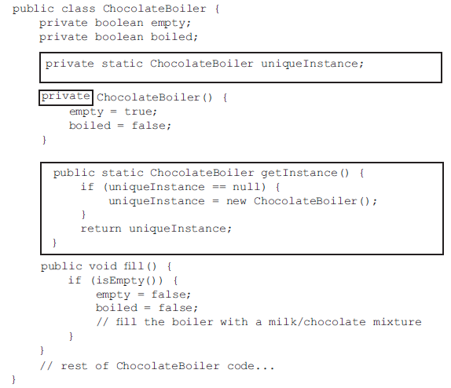
Scene - chocolate boiler
Is the classic Singleton pattern perfect enough?

Slide 7
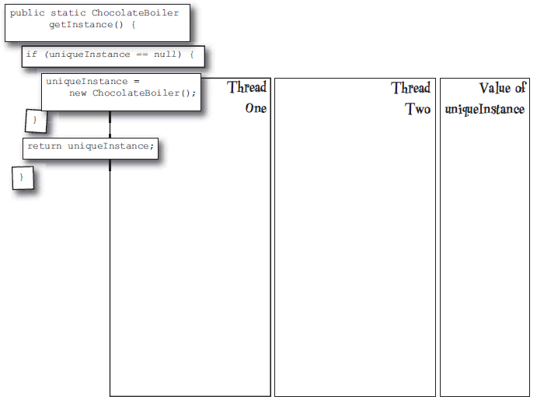
Scene - chocolate boiler
We have 2 threads to execute, what we should consider?

Slide 8
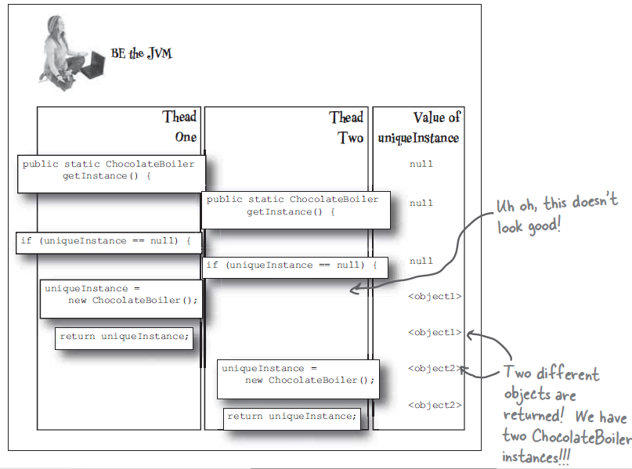
Scene - chocolate boiler
We will have 2 chocolate boiler instances!

Slide 9
We must handle multi-thread program

Slide 10
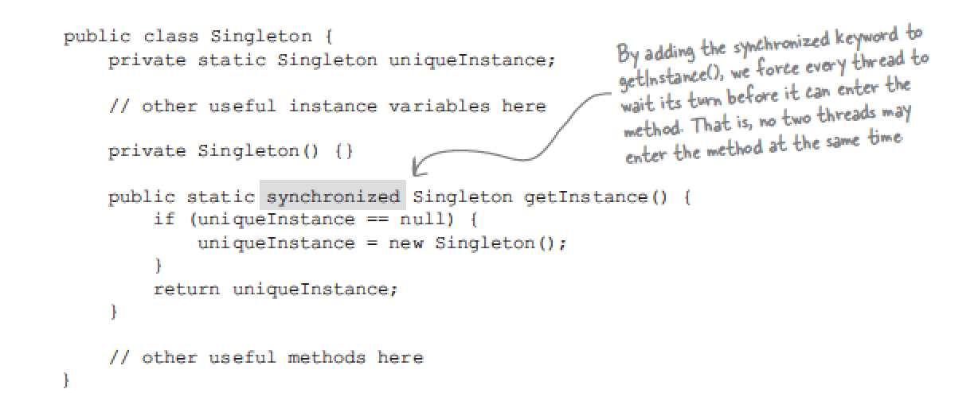
Use synchronization
But the synchronization is expensive
Any other choice?

Slide 11
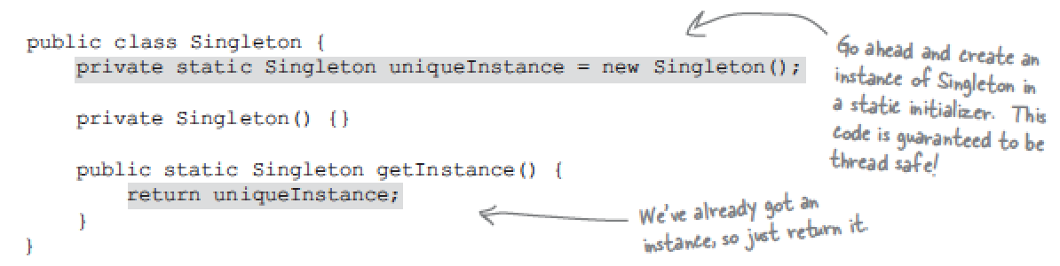
Method 1.
Move to an eagerly created instance rather than a lazily created one
JVM will create the instance before any thread accesses the static unique variable

Slide 12
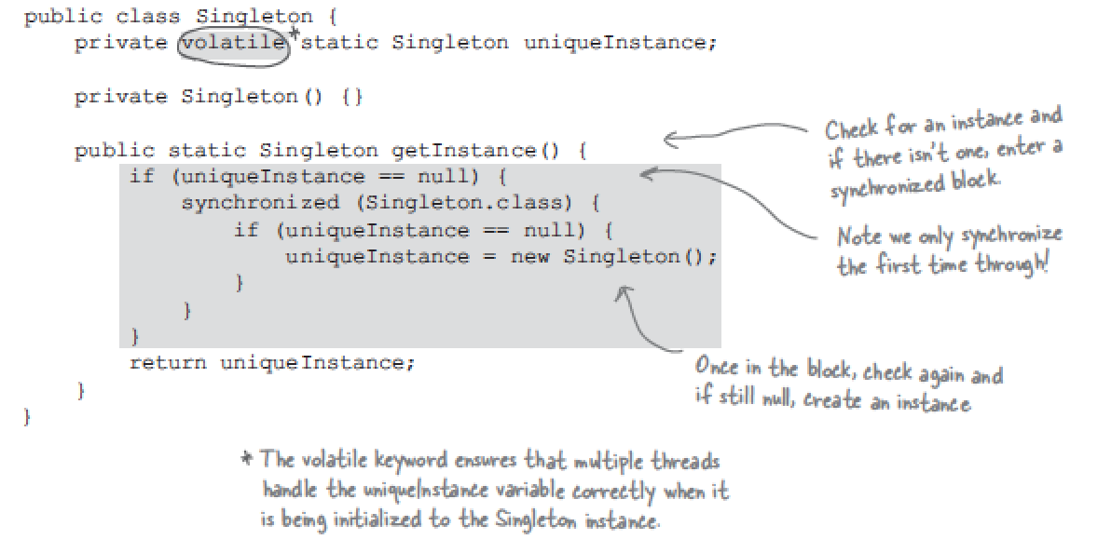
Method 2.
Use “double-checked locking” to reduce the use of synchronization

Slide 13
Analysis
Method | Advantage | Disavantage
1.Synchronize the getInstance() | Guaranteed to work | Performance concern
2.Use eager instantialization | Guaranteed to work | Less familar
3.Double-checked locking | No performance concern | JVM version concern

