Slide 1
Developer Exchange Group
深入淺出設計模式#2:
觀察者模式
Prepare by Sean Hsieh

Slide 2
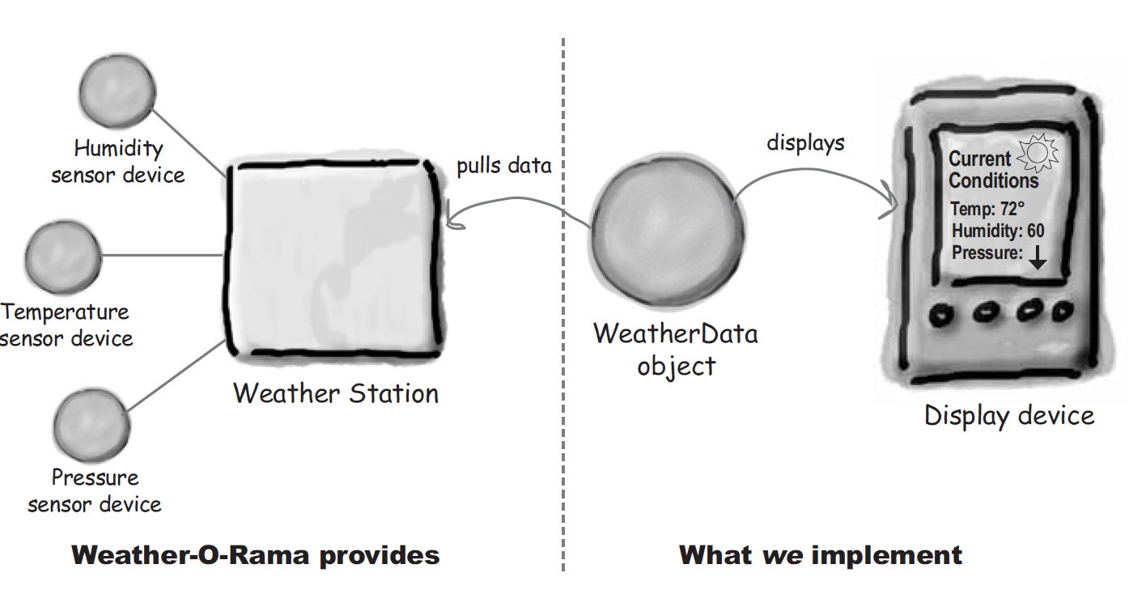
Scene
A monitoring application scene
The weather data from weather station must be showed on devices.

Slide 3
Let’s checking the requirements
1. Implement 3 display elements that use weather data:
Displays must be updated each time weather data has new measurement.
2.Expandable:
Other developers can create new custom display elements and users can add or remove as many display elements as they want to.

Slide 4
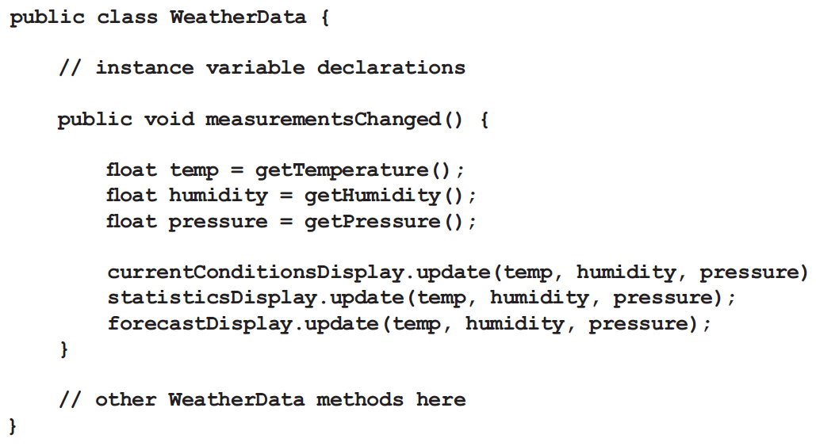
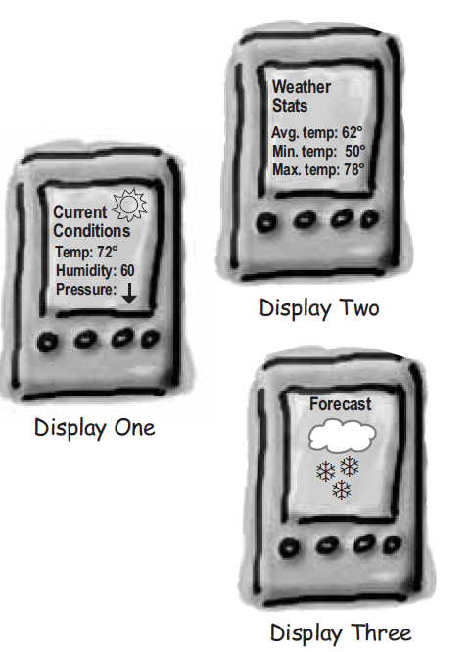
Taking a first implement
1.Coding to concrete implement, not interfaces.
2.For every new display element we need to alter code.
3.It has no way to add (or remove) display elements at run time.
4. The display elements don’t implement a common interface.
5.Not encapsulated the part that changes.
6. Violating encapsulation of the weather data class.
What’s difference between this implement and disign principle?

Slide 5
So how to design better?

Slide 6
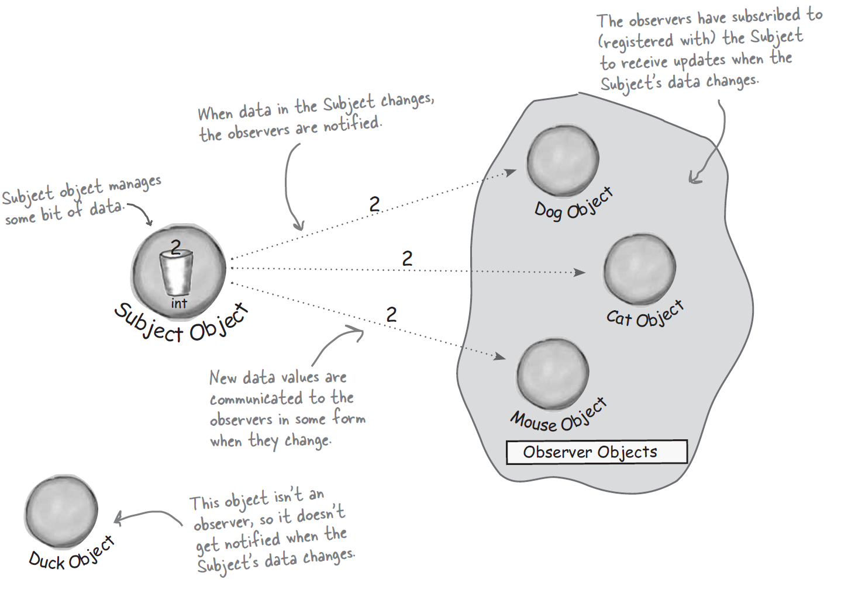
Use Observer pattern
Publishers + Subscribers

Slide 7
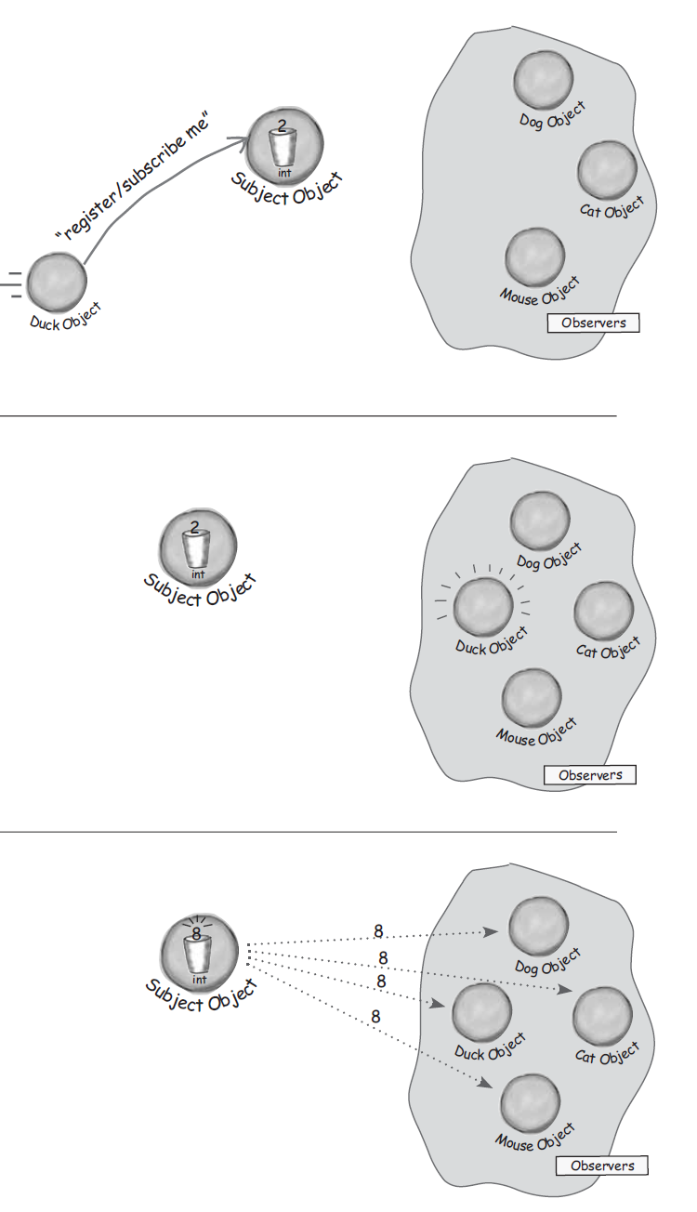
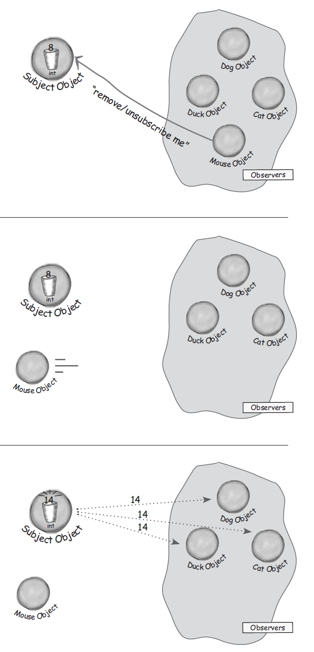
About Observer pattern
1. An observer subscribe to subject object.
3. The subject object remove an observer.
2. The subject object notify observers.
4. The subject object notify observers.

Slide 8
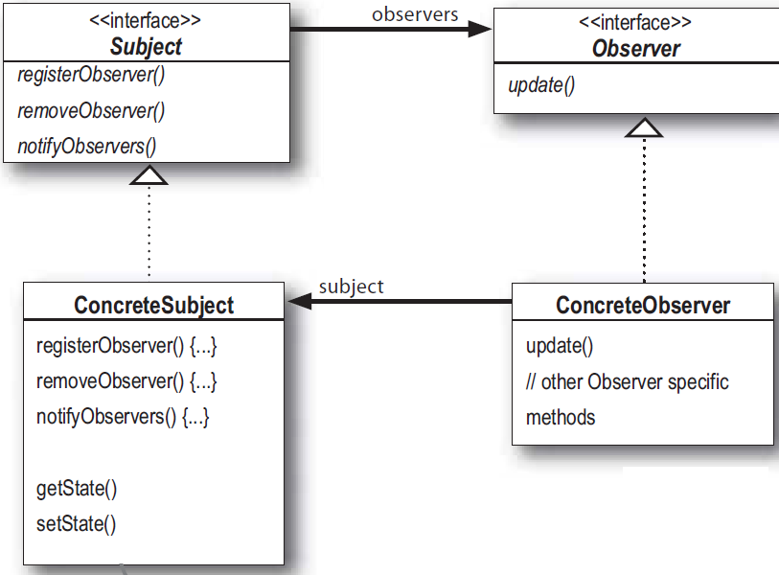
Class diagram of Observer pattern
Observer pattern define
A one-to-many dependency between objects so that when one object changes state, all dependents are notified and updated automatically.

Slide 9
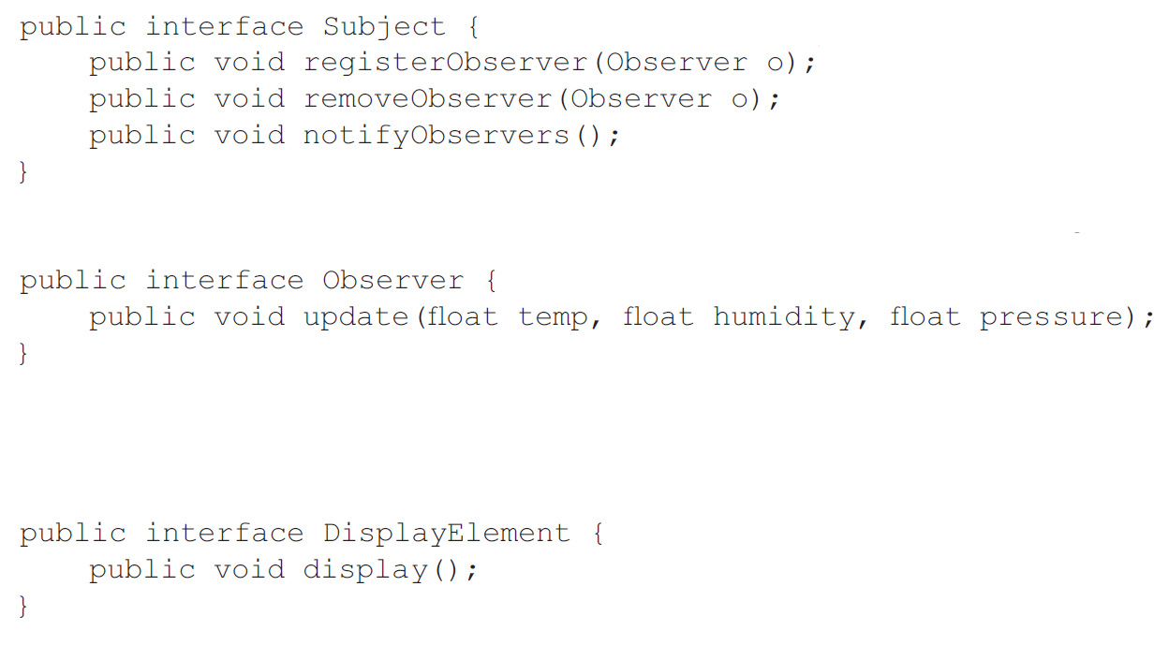
Example of each interfaces

Slide 10
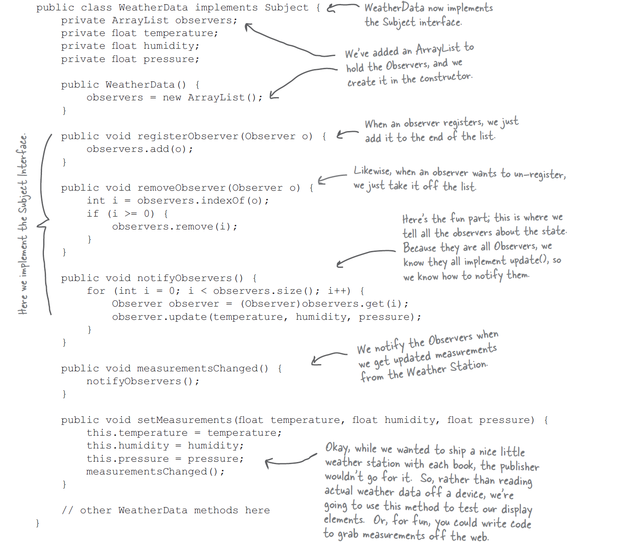
Example of subject object

Slide 11
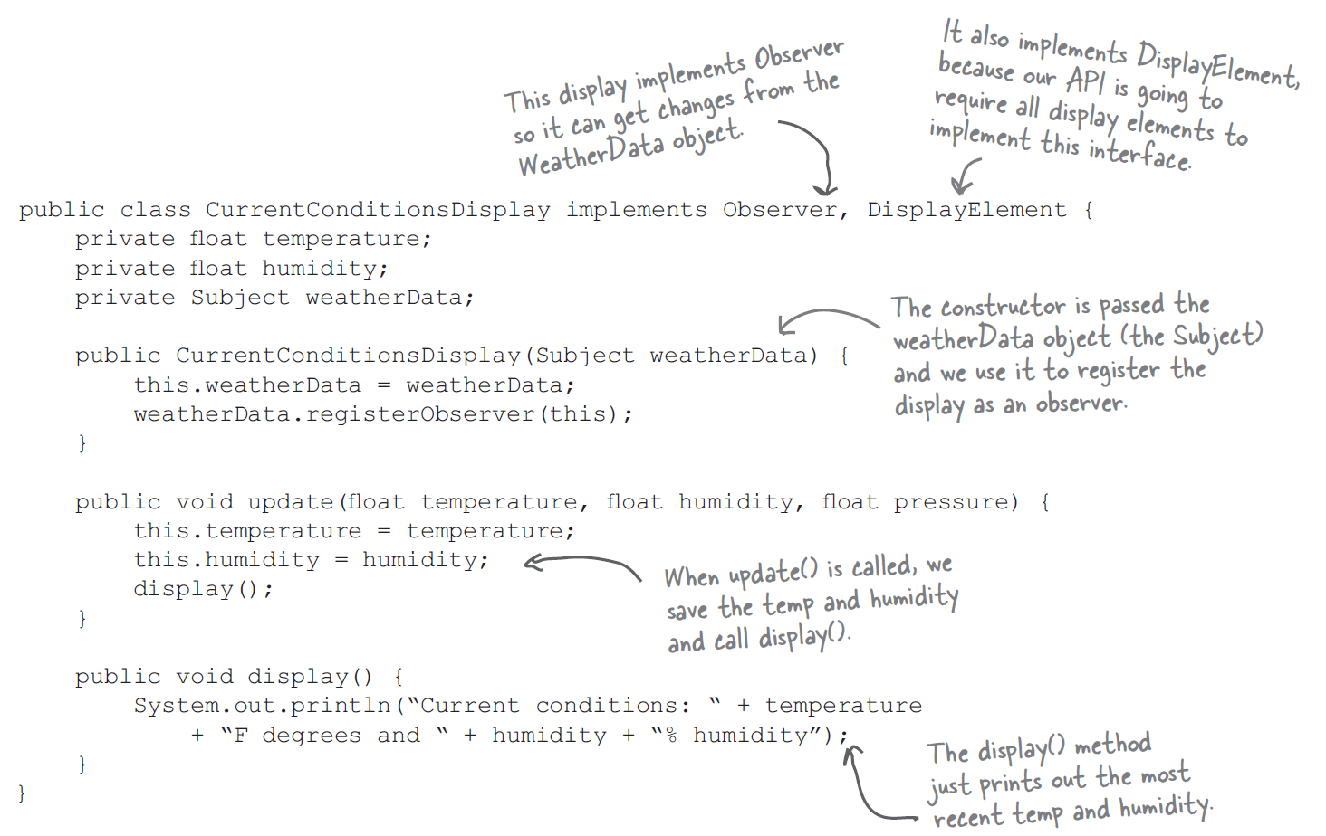
Example of Observers & Display

Slide 12
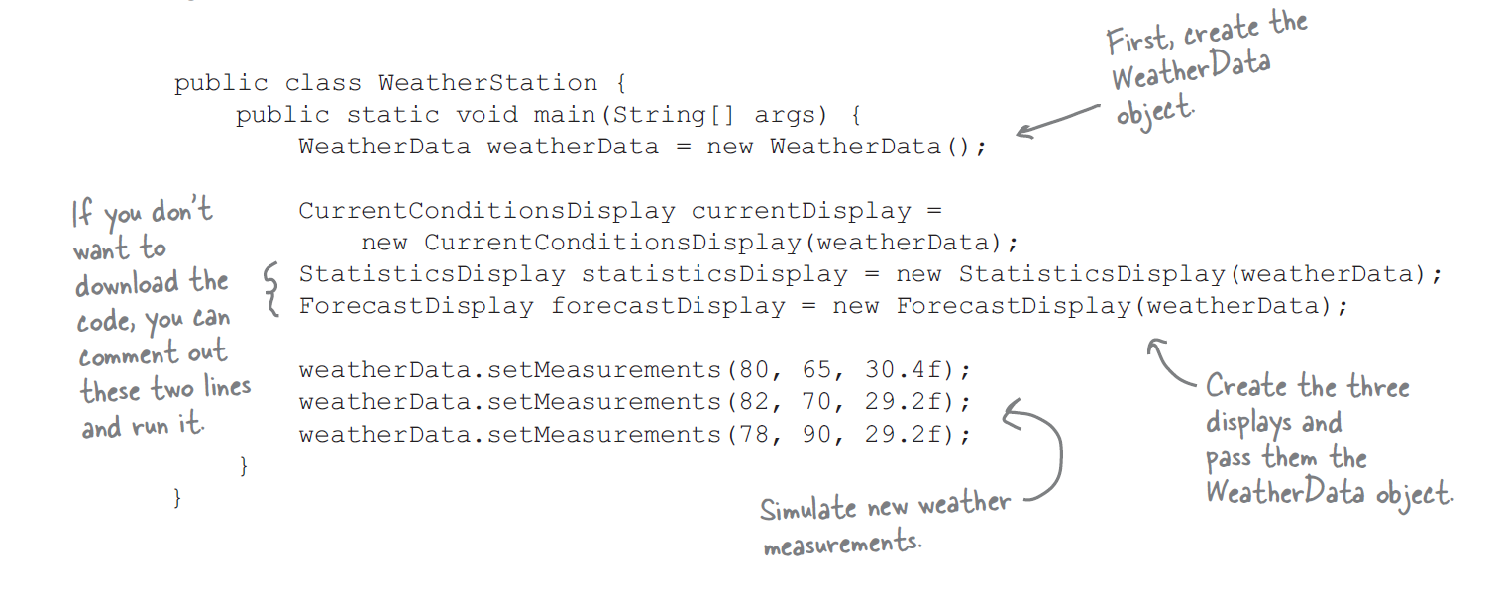
Example of main function

Slide 13
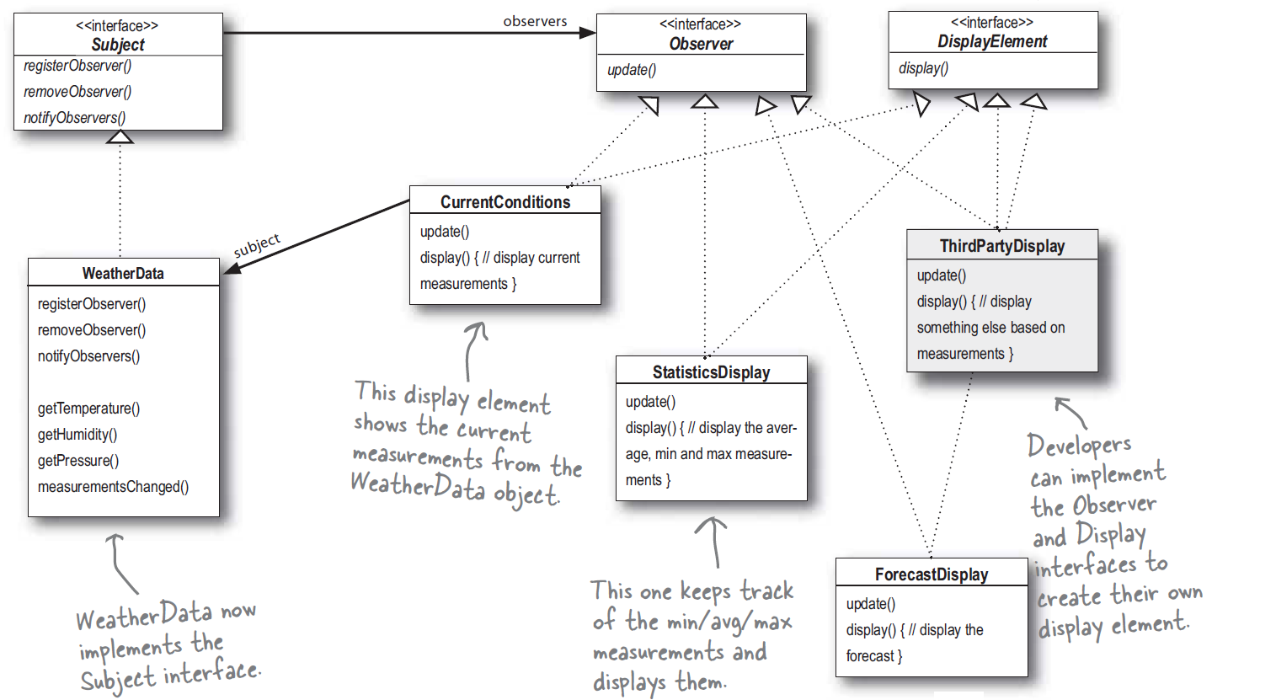
Class diagram (using Observer design pattern)

Slide 14
Advantage of Observer pattern
Loose coupling
We can add new observers at any time.
We never need to modify the subject to add new types of observers
We can reuse subject or observers independently.
Changes to either the subject or an observer will not affect the other.

Slide 15
More

Slide 16
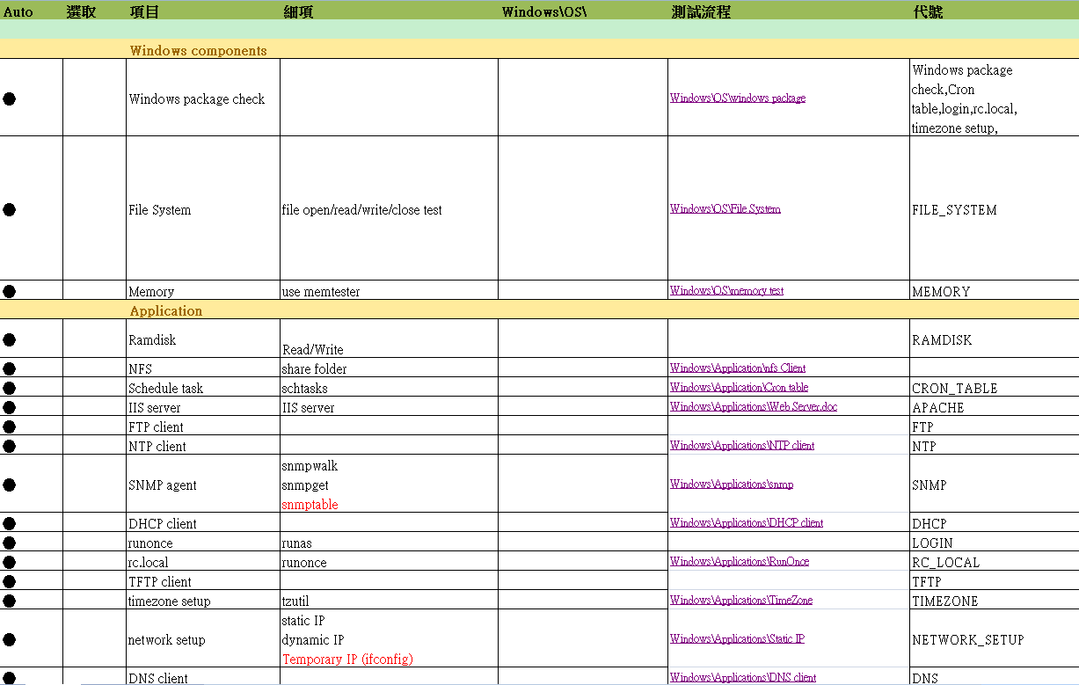
Auto E-test items

Slide 17
Auto E-test program
Main program on server side:
1. Get all users and test items for config files.
2.(1) Create a share folder to all client sides.
(2) Copy files to client sides that each E-test
item needs.
3.(1) Launch each E-test programs on client
sides and the server side.
(2) Pipe and reorganize log.
4. Retrieve log from client-side after
testing.

Slide 18



Design Architecture (before testing)
server
config
ItemController.exe
Share folder
Step 1
Retrieve data
Step 2
parameters.ini
client
remote control
(create folder, share)
Share folder

Slide 19


Design Architecture(testing)
server
remote control
config
ItemController.exe
testItem.bat
partialLog.txt
finalLog.ps1
finalLog.txt
parameters.ini
client
testItem.bat
partialLog.txt
remote control
finalLog.ps1
finalLog.txt

Slide 20
Design Architecture (after testing)
server
config
ItemController.exe
Share folder
Send Log
parameters.ini
client
Share folder

Slide 21
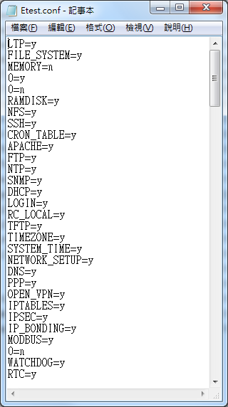
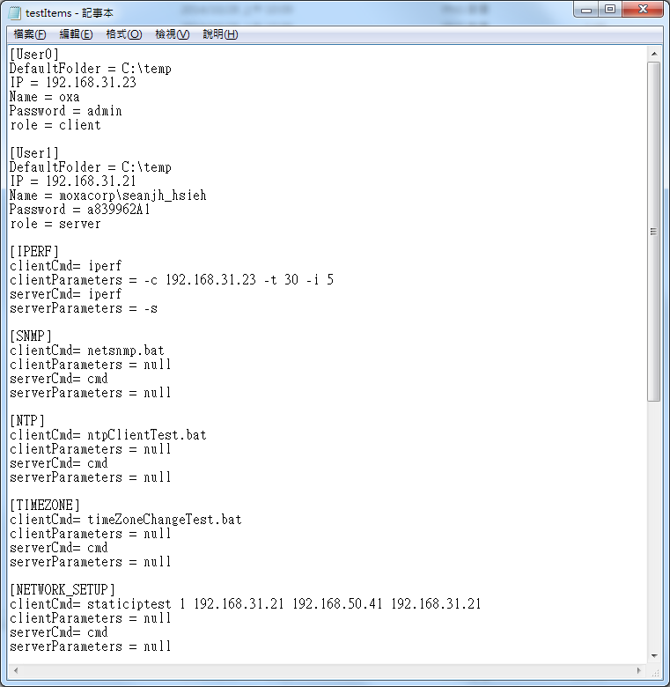
Design Architecture(old)

Slide 22
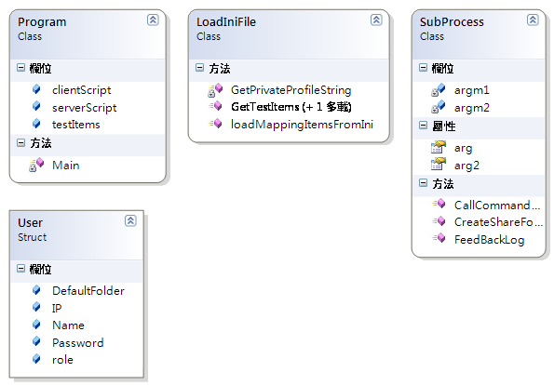
Class diagram (old)

Slide 23
Advantage and Disadvantage
Advantage:
Design is not complicated and easy to read
Disadvantage:
1.Coding to concrete implement, not interfaces.
2.It has no way to add (or remove) servers, clients and observers at run time.
3. The servers, clients and observers don’t implement a common interface.
4.Servers IP and clients IP must to be wrote again when they have to be used.
5.There is no Observer’s role in config file and design architecture.

Slide 24
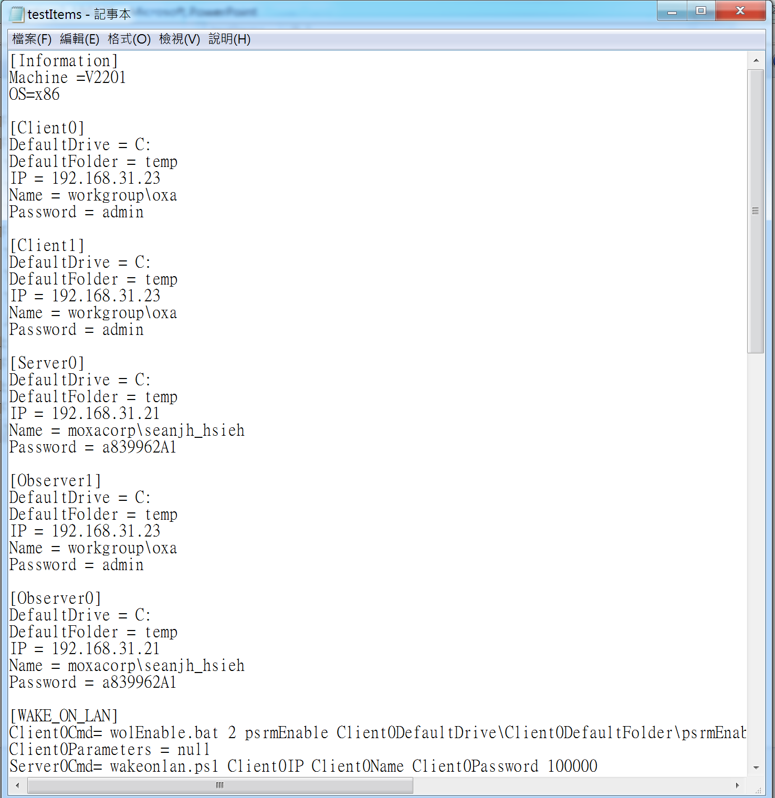
Design Architecture(new)
Subject Object
Observer

Slide 25
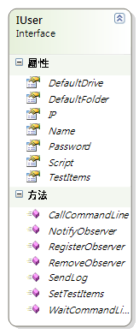
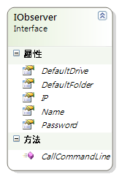
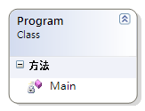
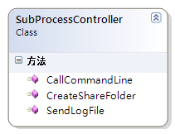
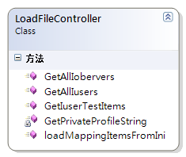
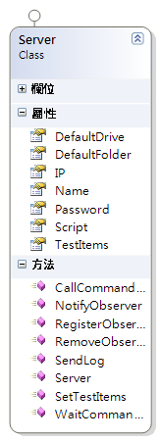
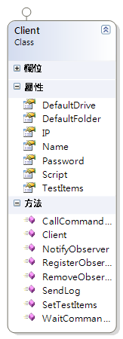
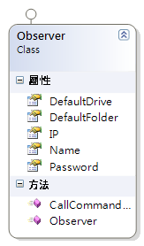
Class diagram (new)
observer
subject

