Slide 1
Developer Exchange Group
深入淺出設計模式#8:
狀態模式
Prepare by Sean Hsieh

Slide 2
State pattern

Slide 3
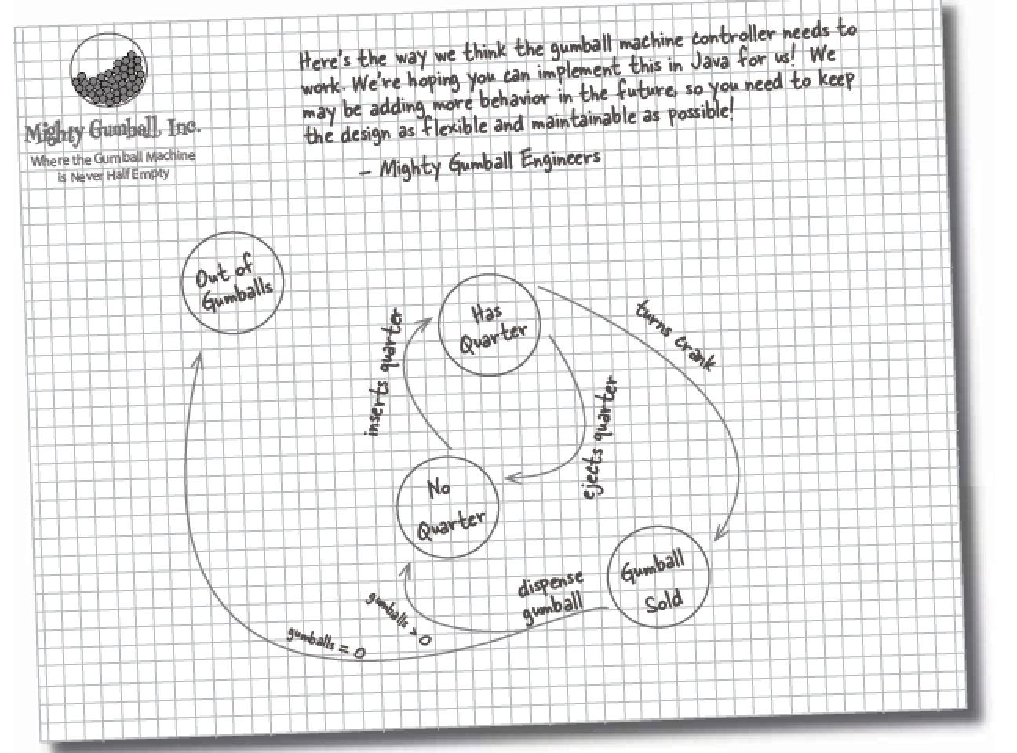
Scene
Status machine
All states need some action to take them to another state.

Slide 4
Procedure to implement status machine
Action
Insert quarter
Eject quarter
Turn crank
Dispense
Status
No quarter
Has quarter
Out of Gumballs
Gumball sold
x

Slide 5
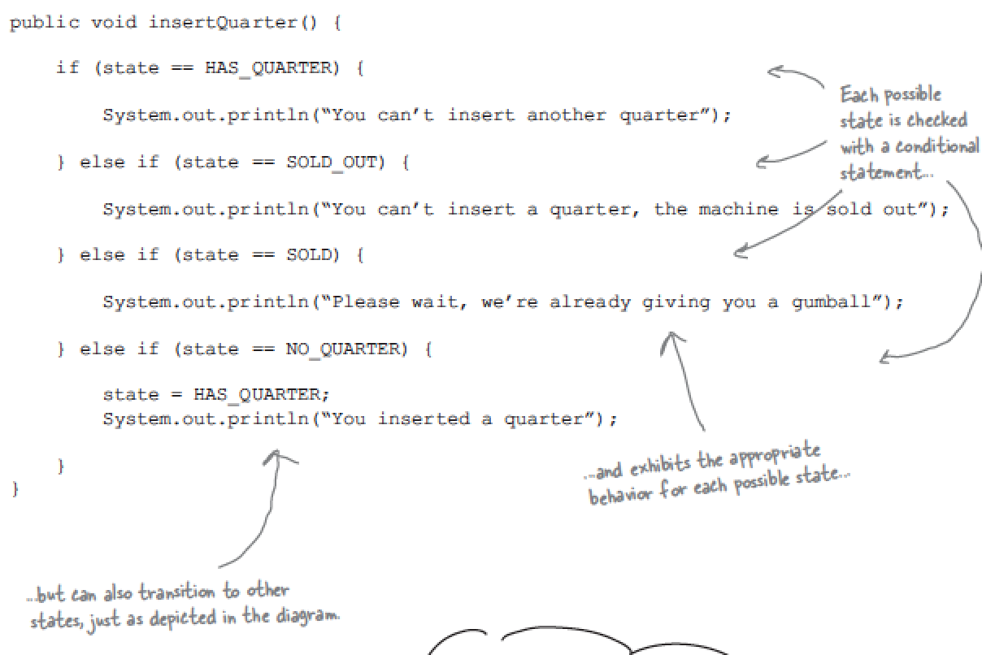
implement Action
For example

Slide 6
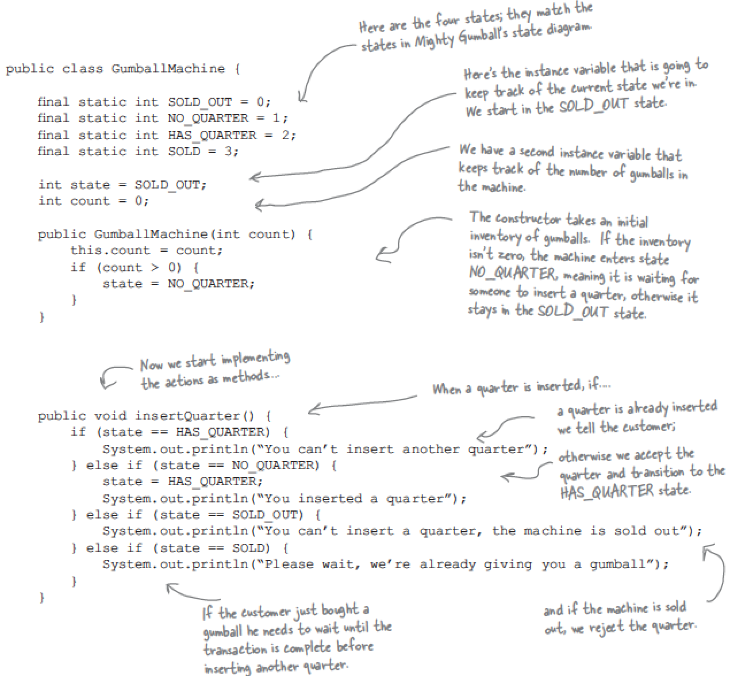
Implement status machine

Slide 7
However… The new request comes
We were asked to add 1 status
Action
Insert quarter
Eject quarter
Turn crank
Dispense
Status
No quarter
Has quarter
Out of Gumballs
Gumball sold
Winner state
x

Slide 8
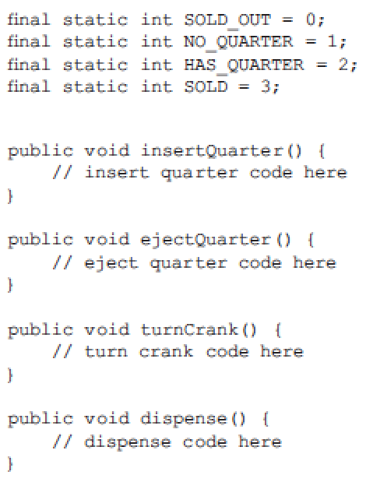
What’s wrong?
1.The code isn’t adhering to the Open Closed Principle.
2.We haven’t encapsulated anything that varies here.
3.Further additions additions are likely to cause bugs in working code.

Slide 9
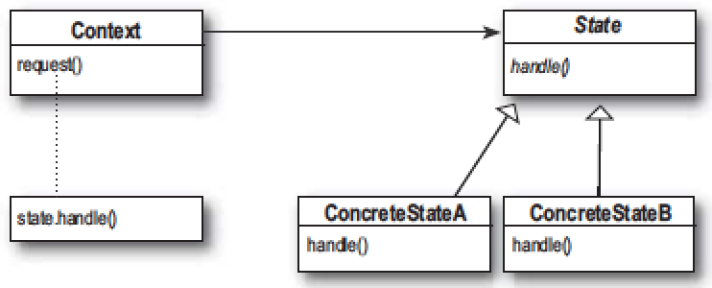
Rework the status machine
Status
No quarter
Has quarter
Out of Gumballs
Gumball sold
Winner status
Action
Insert quarter
Eject quarter
Turn crank
Dispense
x

Slide 10
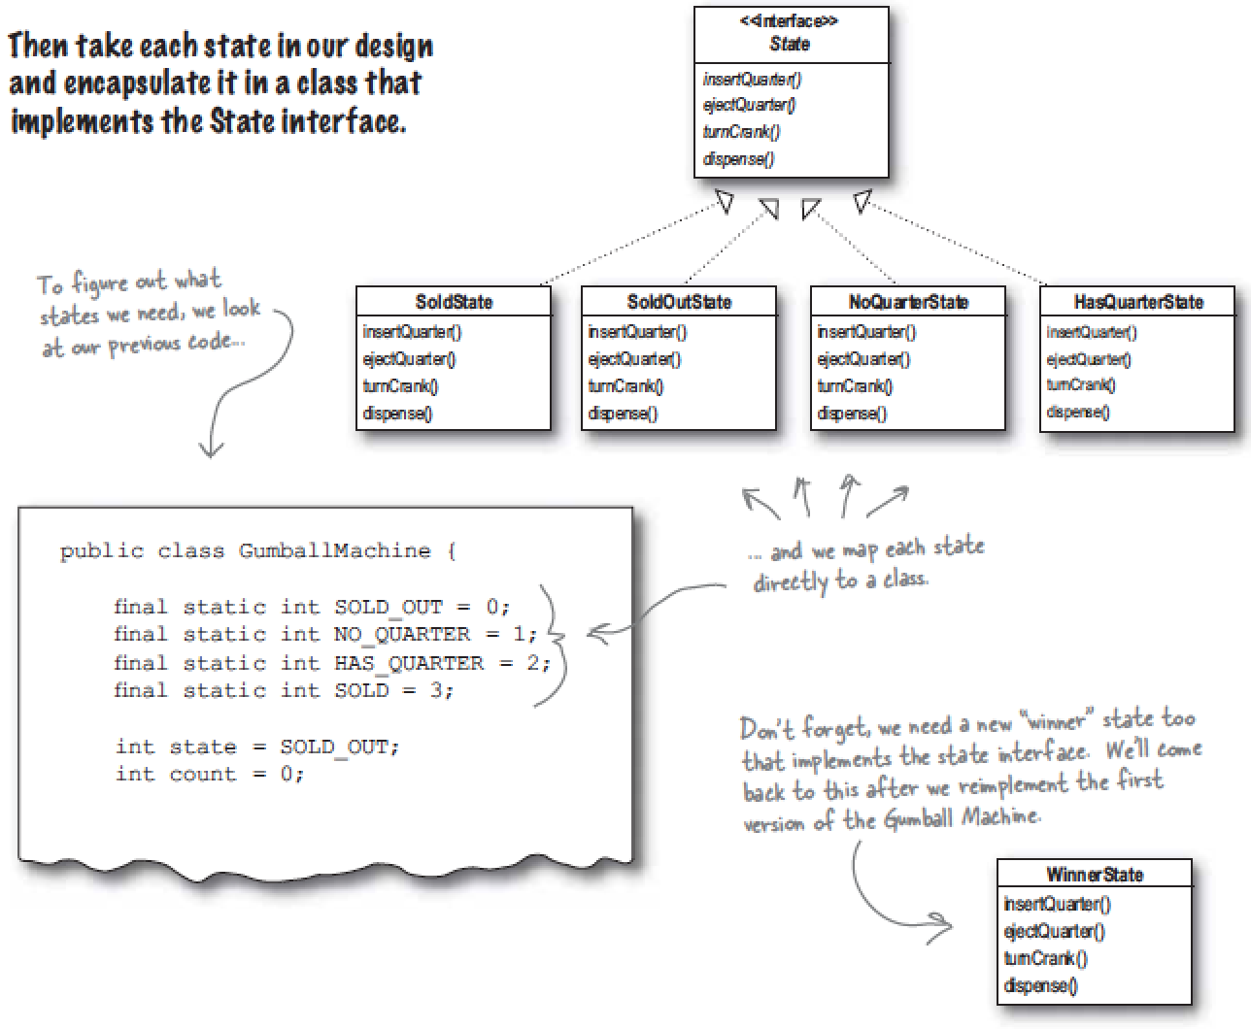
Status interface

Slide 11
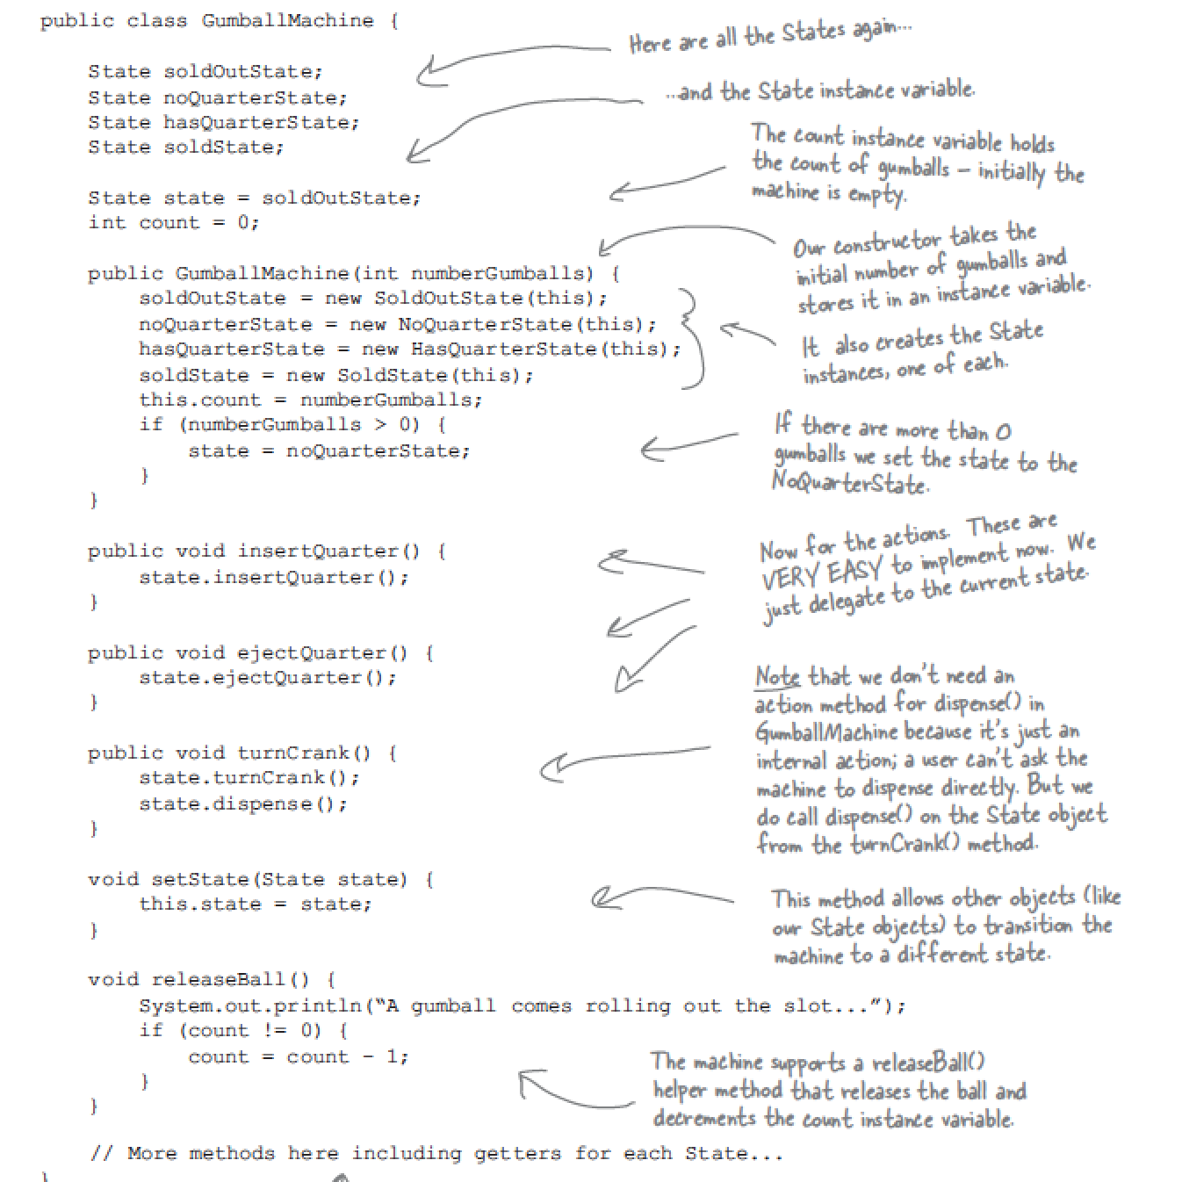
Implement status machine (After rework)

Slide 12
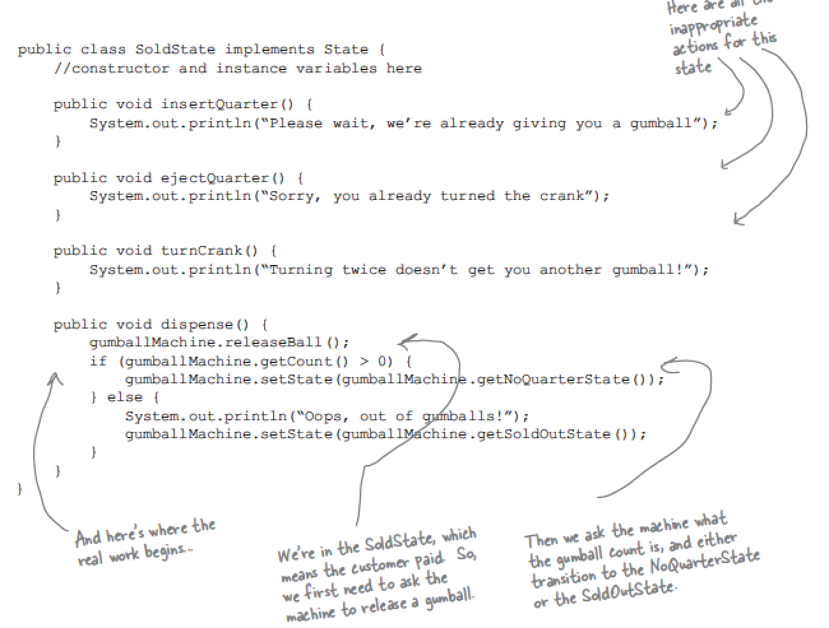
Implement Action (After rework)
For example:

Slide 13
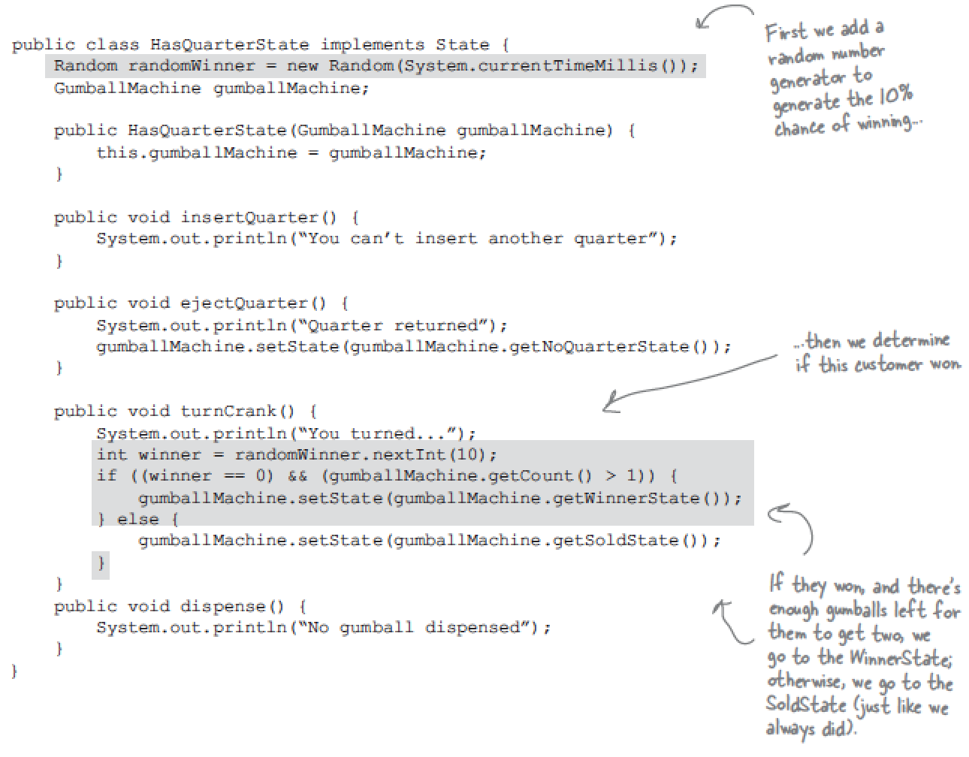
Implement Action (Add winner condition)

Slide 14
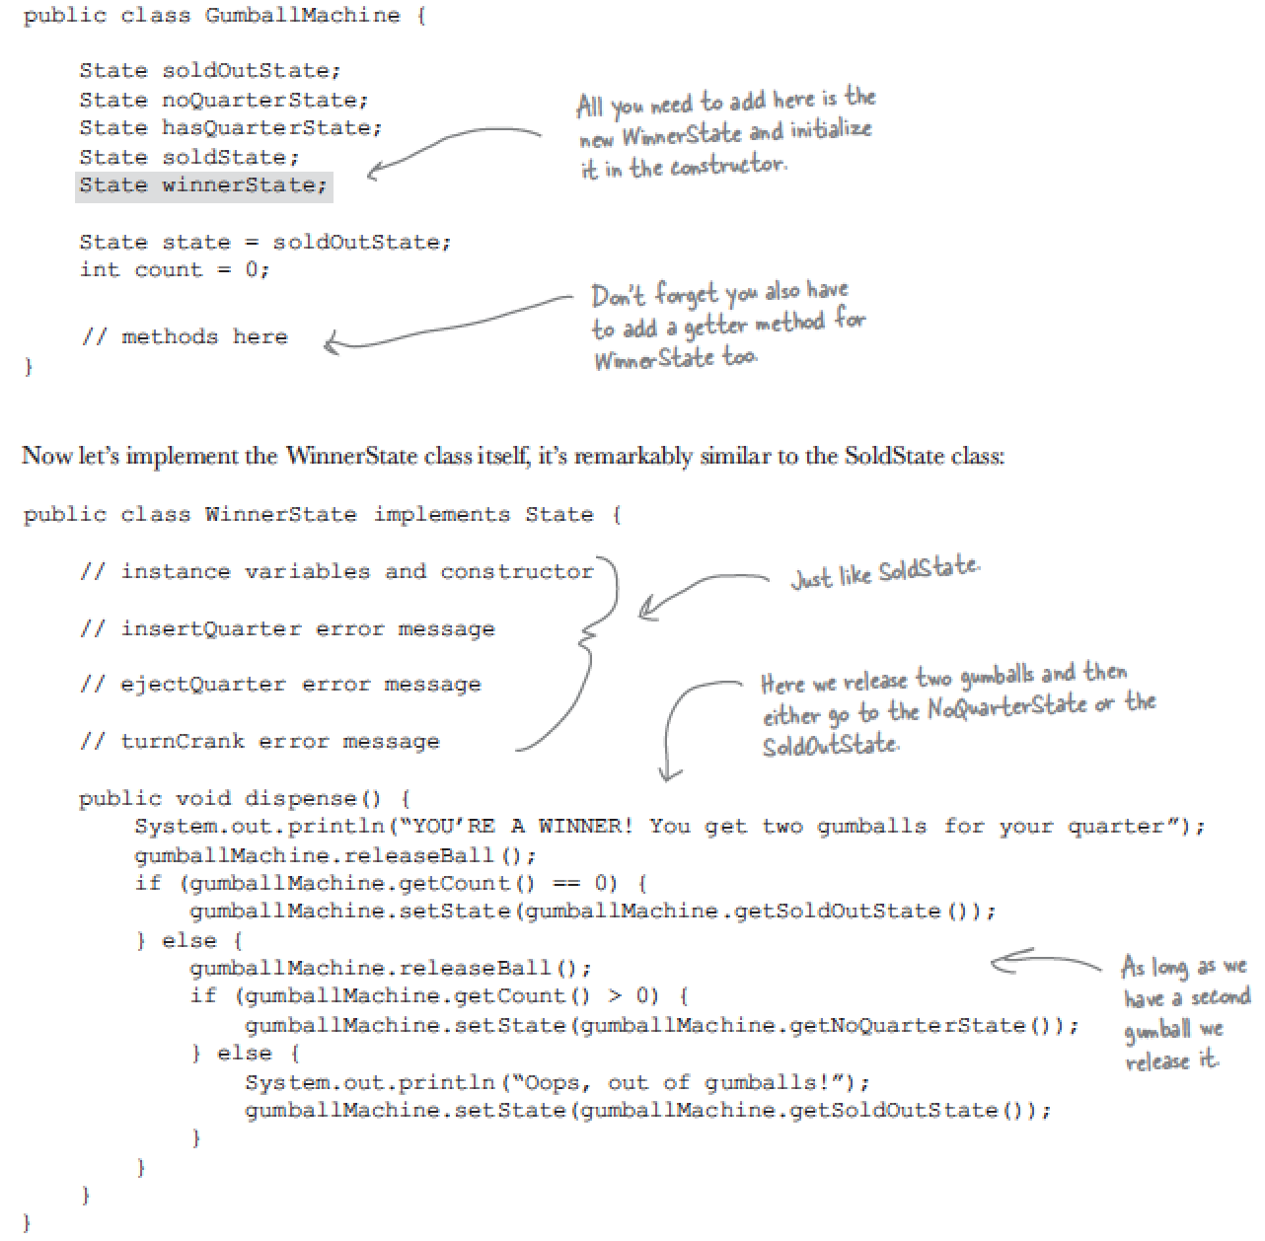
Implement status machine (Add winner condition)

Slide 15
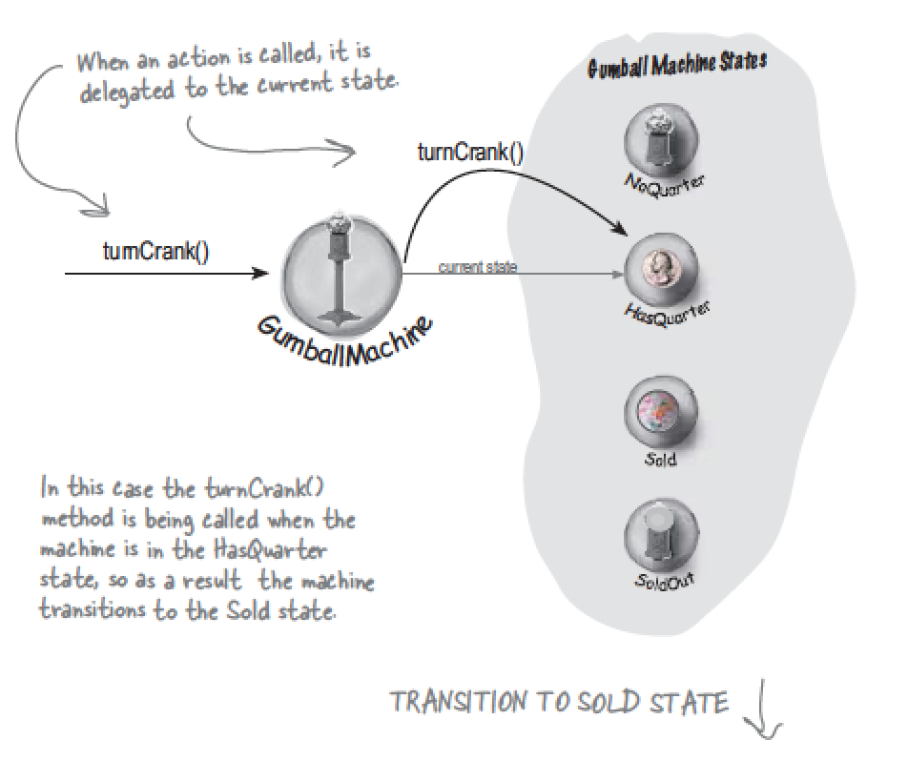
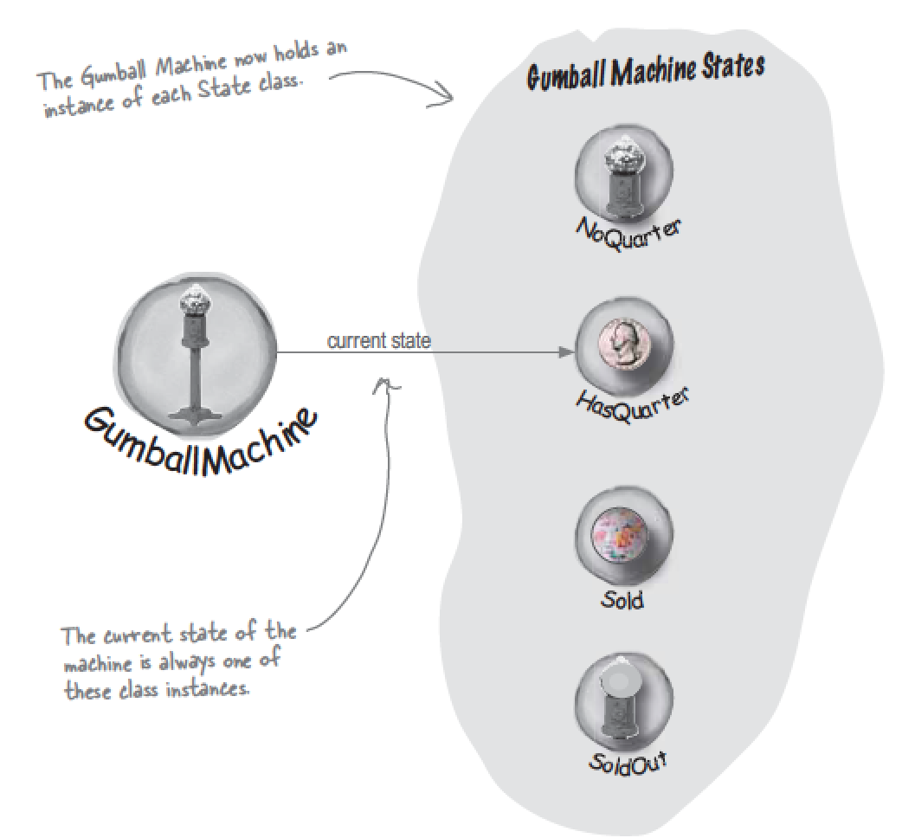
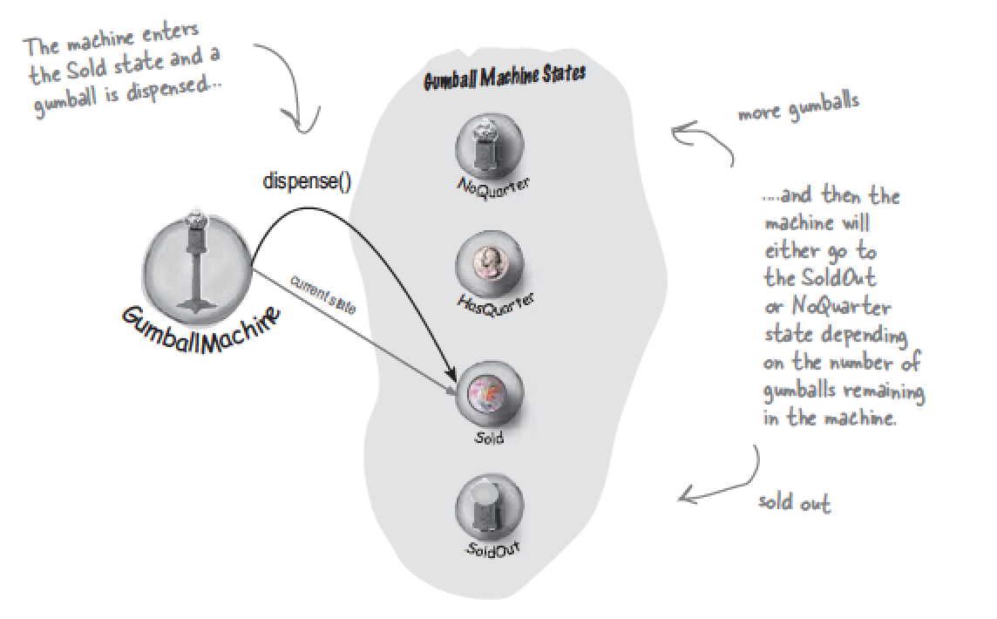
Overview

Slide 16
Define State Pattern
The state pattern allows an object to alter its behavior when its internal changes.
1.The disadvantage of having state transitions in the state classes in that we create dependencies between status class.
2.All requests to the states come from the context, clients don’t directly change the state of the context.

Slide 17
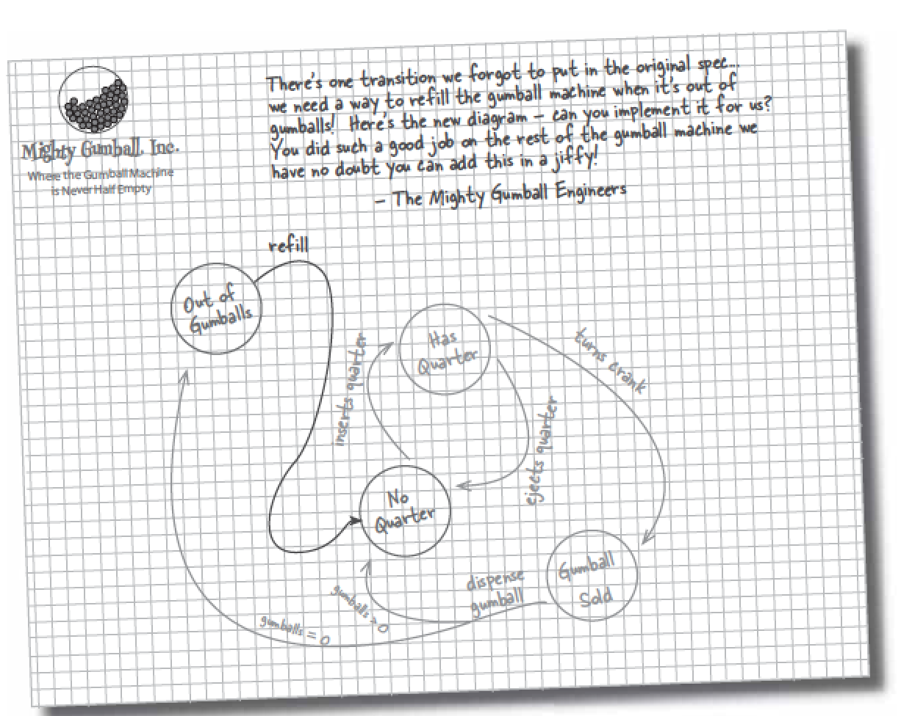
Operation of state pattern

Slide 18
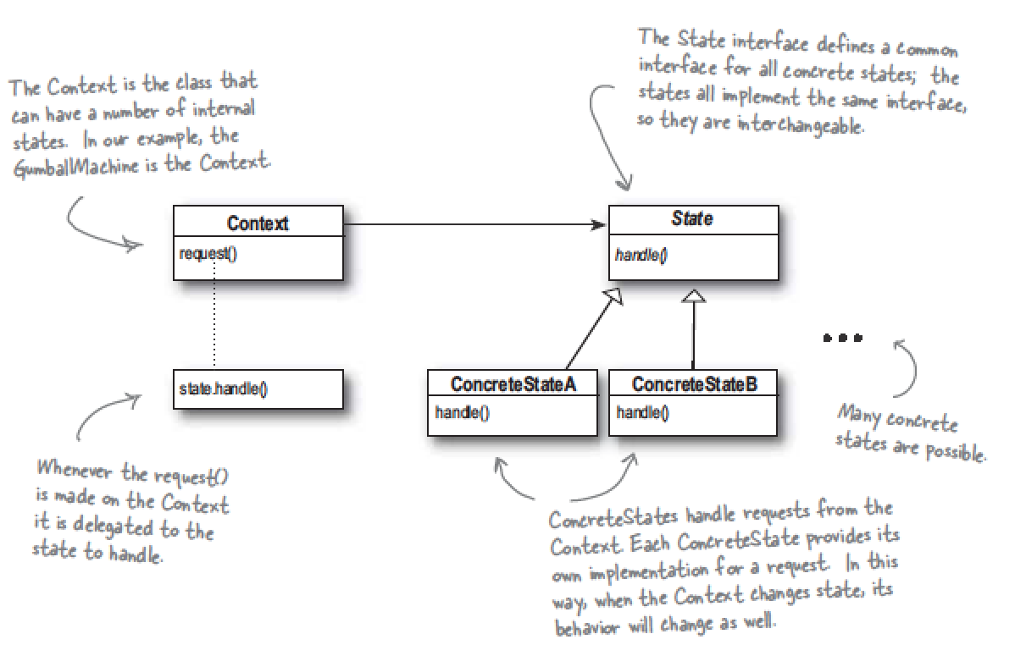
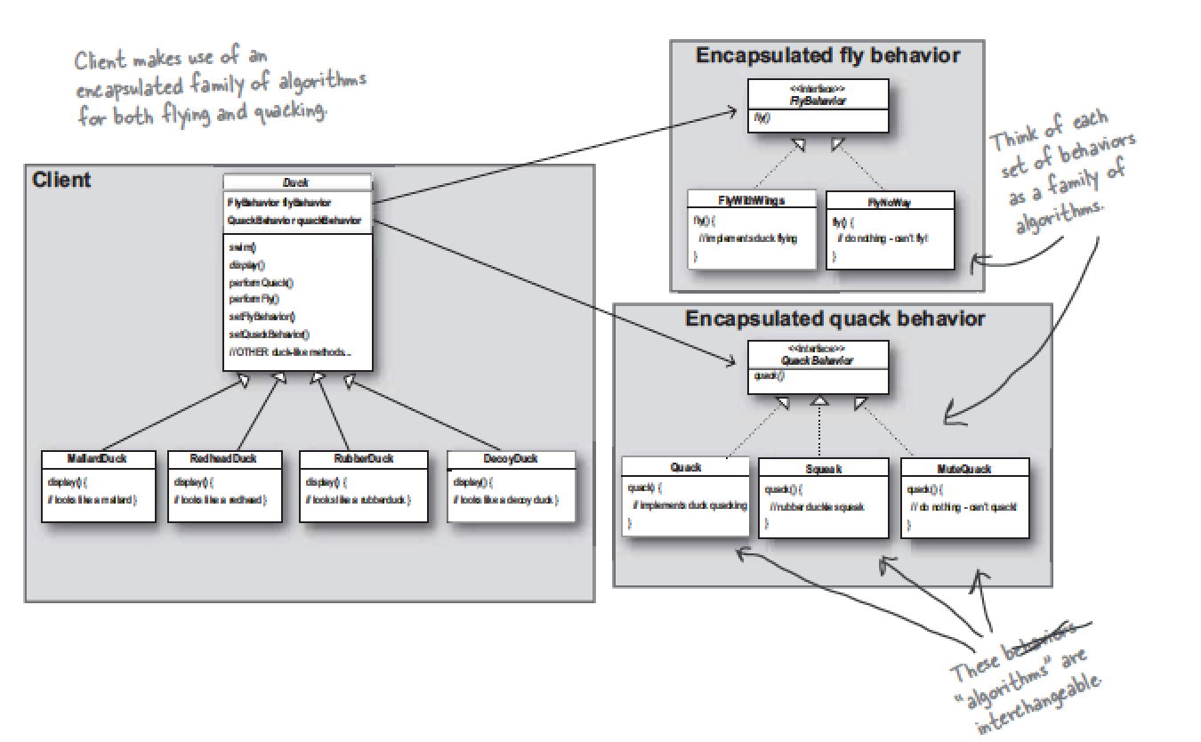
Compare with Strategy Pattern

Slide 19
More
A location recorder

