Slide 1
Developer Exchange Group
深入淺出設計模式#9:
命令模式
Prepare by Sean Hsieh

Slide 2
Scene

Slide 3
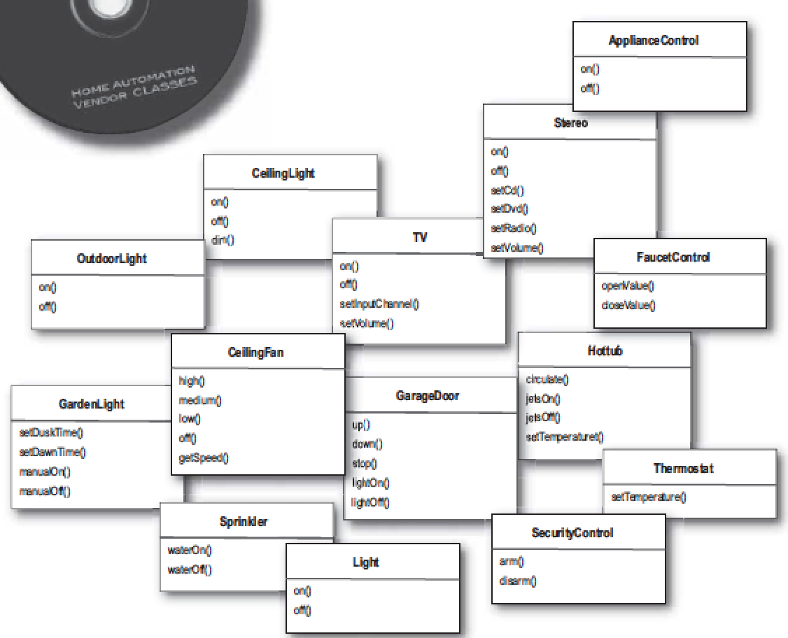
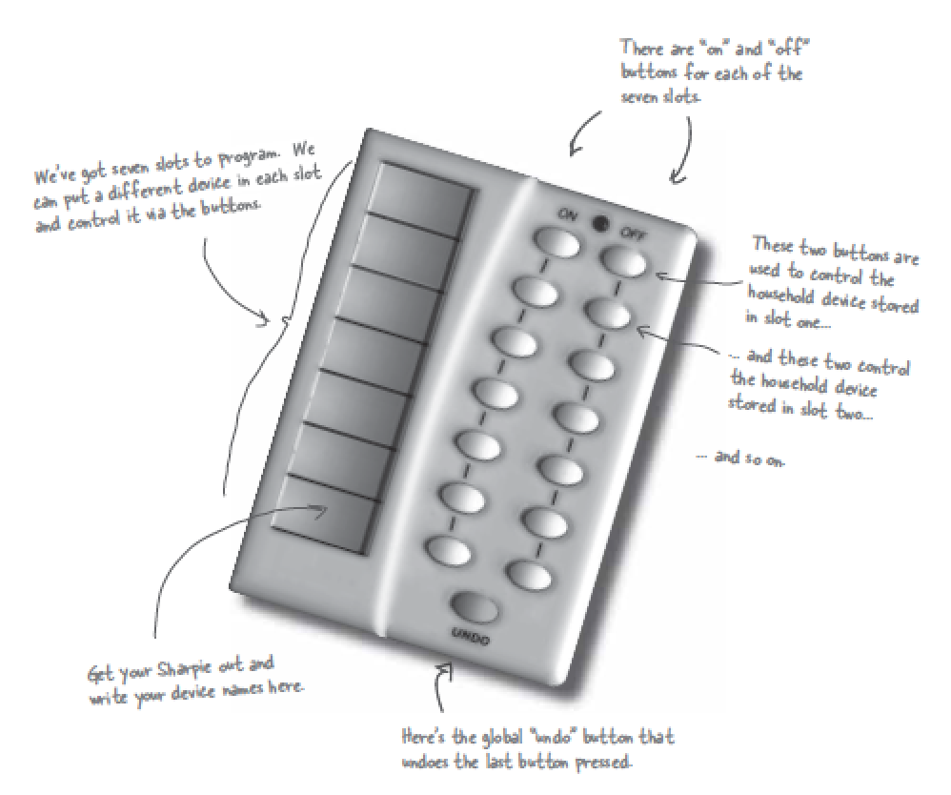
Scene
Remote controller
Many specific vendor waiting to be added.

Slide 4
What’s the problem?
We can expect more vendor classes in the future with just as diverse methods
Whenever a new vendor class comes out, we’d have to go and modify the code, potentially creating bugs and more works for ourselves.
Button 1
Light
on()
Button 2
TV
on()

Slide 5
The strategy to solve the problem
Separation
1.The remote should know how to interpret button press and make requests.
2.The remote shouldn’t know a lot about the specifics of the vendors classes.
Command
object
on()
SetCommand()
Button 1
(Client)
Action()
Invoker
object
Light
(Reciever)
execute()

Slide 6
Command pattern

Slide 7
What is command object
Definition
Encapsulates a request as an object
Letting you parameterize other objects with different requests, queue or log requests, and support undoable operations

Slide 8
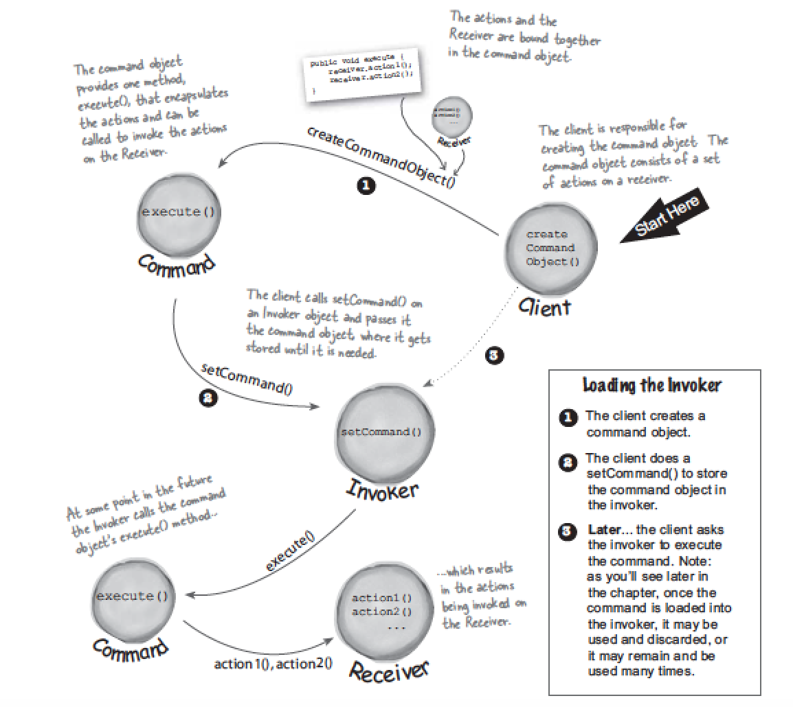
How to use command pattern?
Concept

Slide 9
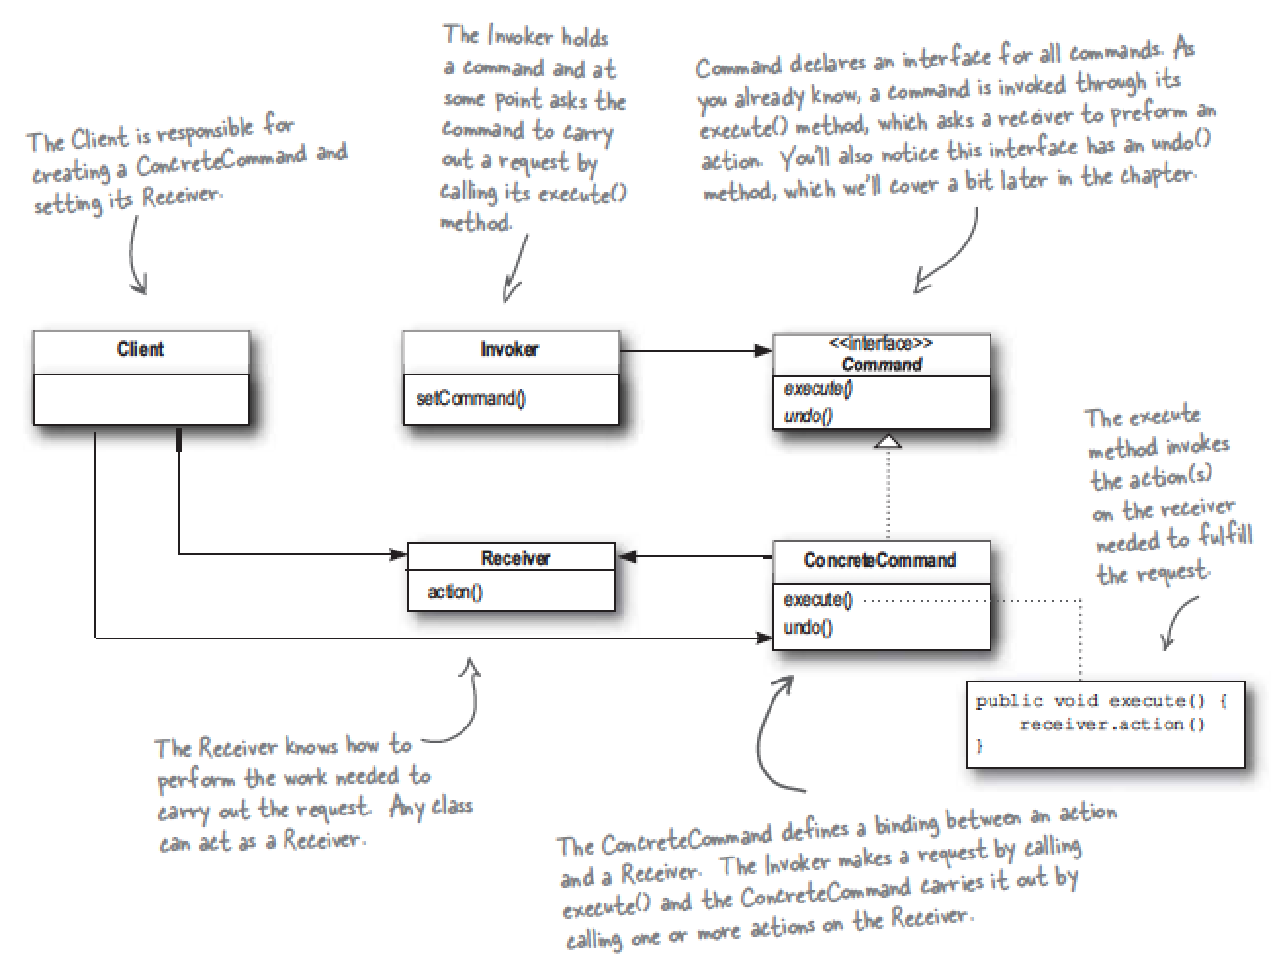
How to use command pattern?
Class diagram

Slide 10
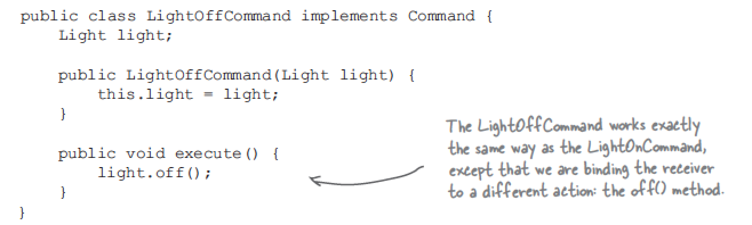
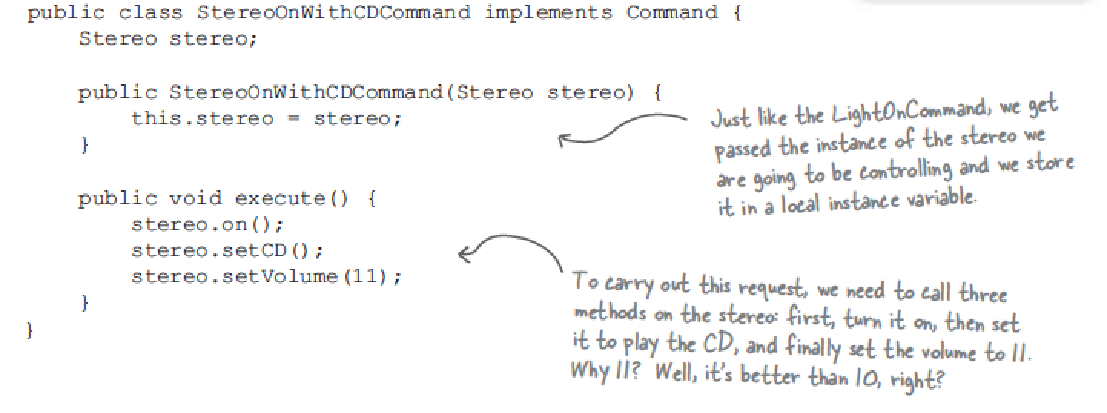
How to use command pattern?
Command object

Slide 11
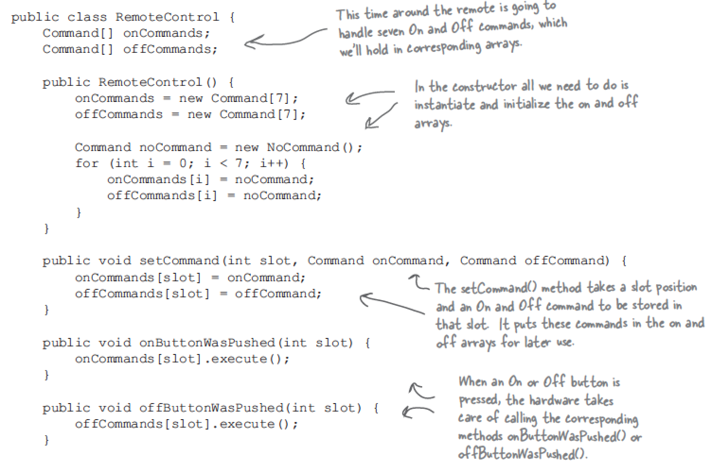
How to use command pattern?
Reciever

Slide 12
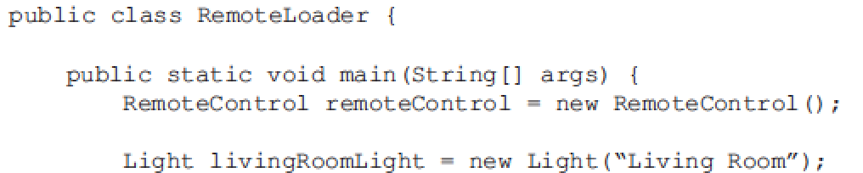


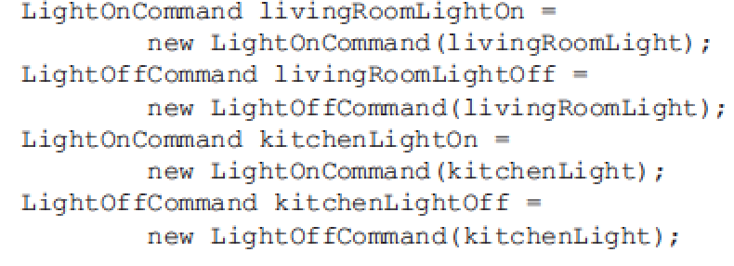
How to use command pattern?
Client

Slide 13
There are no dumb questions
1.Why can’t the command object implement the details of execute method?
You’ll no longer have the same level of decoupling between the invoker and reciever.
You’ll be unable to parameterize your commands with receivers.
2.How can I implement a history of undo operations?
3.Could I put the calls to execute the other commands in execute method?

Slide 14
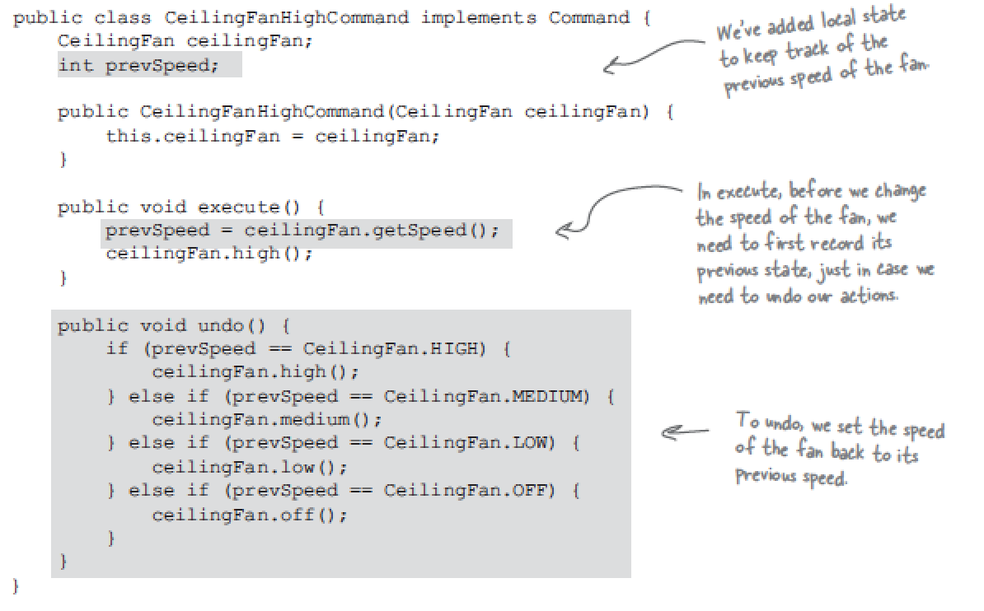
Undo operation in command object

Slide 15
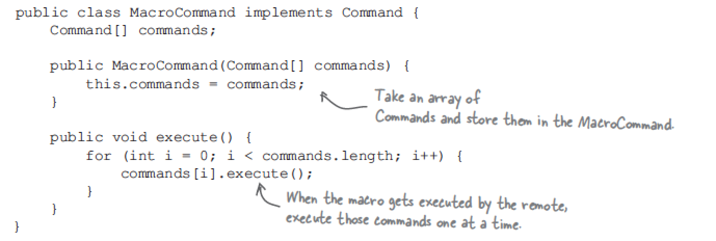
Using macro command(1/2)

Slide 16
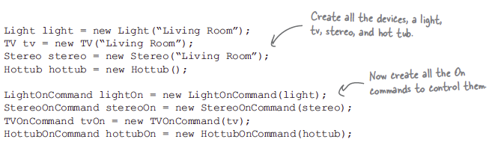
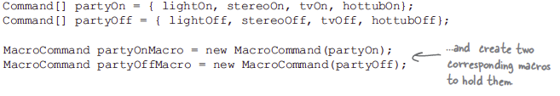


Using macro command(2/2)

Slide 17
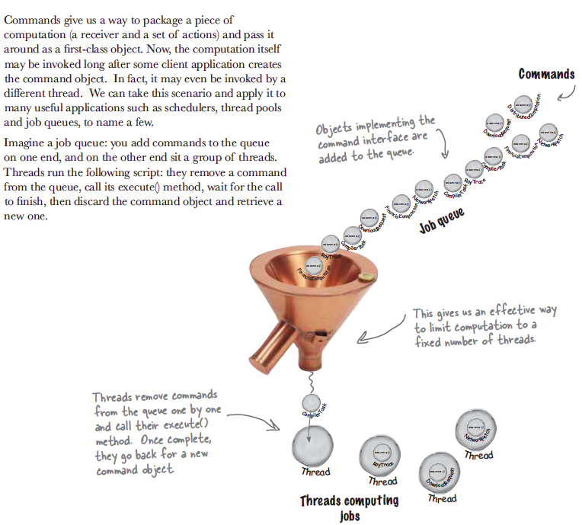
Queuing request

Slide 18
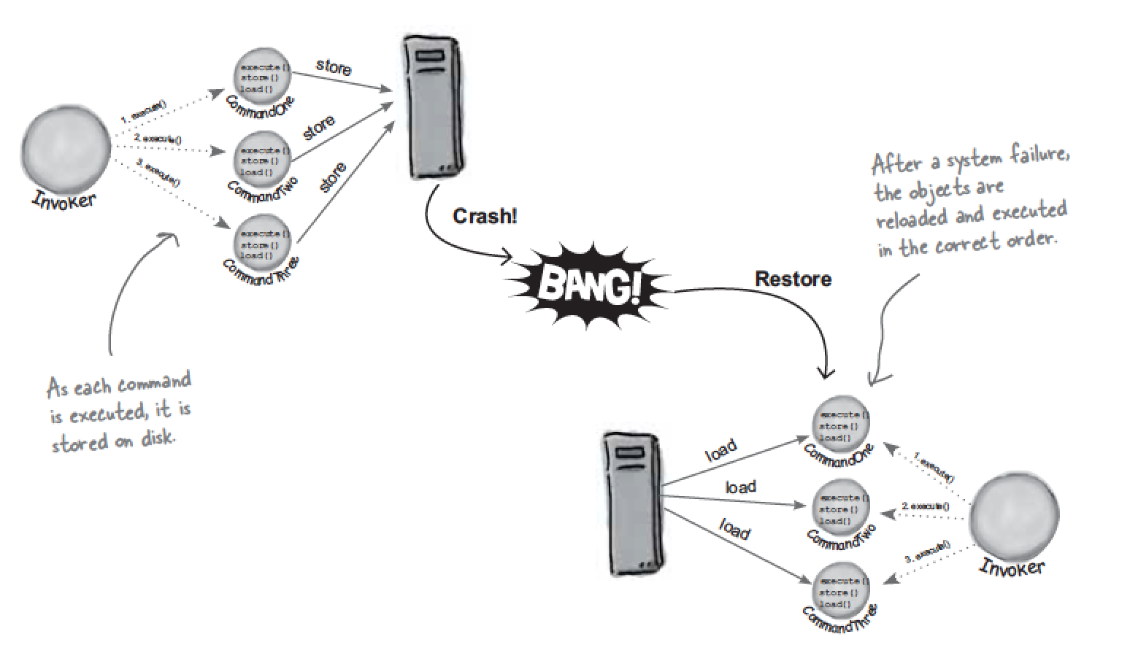
Logging request

Slide 19
More
Scheduler

