Slide 1



[Hands - On] Find Bad Loans Using R, Python, and Flow with H2O
Amy Wang
Avni Wadhwa
Megan Kurka

Slide 2
H2O Prerequisites
To Launch H2O and Flow the only prerequisite is:
64 bit Java 6+
Consequences of not having 64 bit version:
You will not be able to launch a cluster larger than 1 GB
Please install it from USB drive from the appropriate Windows or OSX Directory!

Slide 3
Flow Users
Web-based UI that comes prepackaged in H2O
To launch Flow you simply have to launch H2O either through the command line, R, or python
To launch via the command line:
Unpack the h2o-3.10.0.8.zip file in Windows/ or OSX/
In h2o-3.10.0.8 directory execute from a terminal or command prompt: java -Xmx4g -jar h2o.jar
Access flow at http://localhost:54321

Slide 4
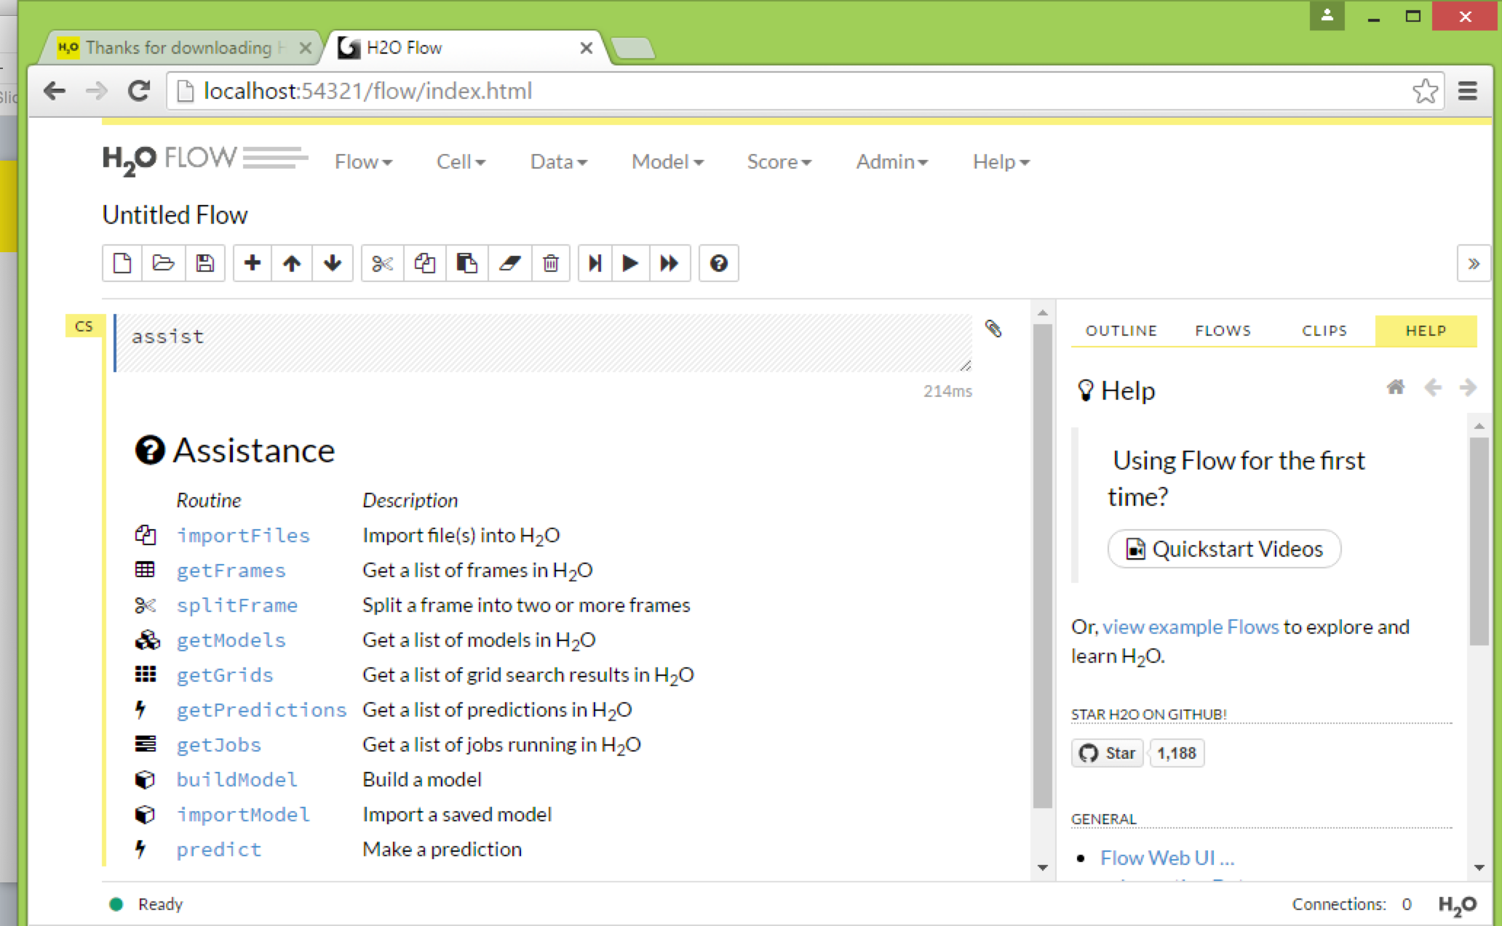

Slide 5
R Users
Prerequisite: R installed (for Windows Users please installed in a folder with no spaces e.g. Program Files)
Add R to your PATH
To quickly Install Dependent Packages:
R CMD INSTALL Windows/RPackages/*
R CMD INSTALL OSX/RPackages/mavericks/*
Install H2O package
Unzip the h2o-3.10.0.8.zip file either in Windows/ or OSX/
R CMD INSTALL h2o-3.10.0.8/R/*

Slide 6
R Users
To install from cran, please run:
install.packages(“statmod”)
install.packages(“RCurl”)
install.packages(“jsonlite”)
install.packages(“h2o”)
To check that it is properly installed run:
library(h2o)
h2o.init(nthreads = -1)

Slide 7
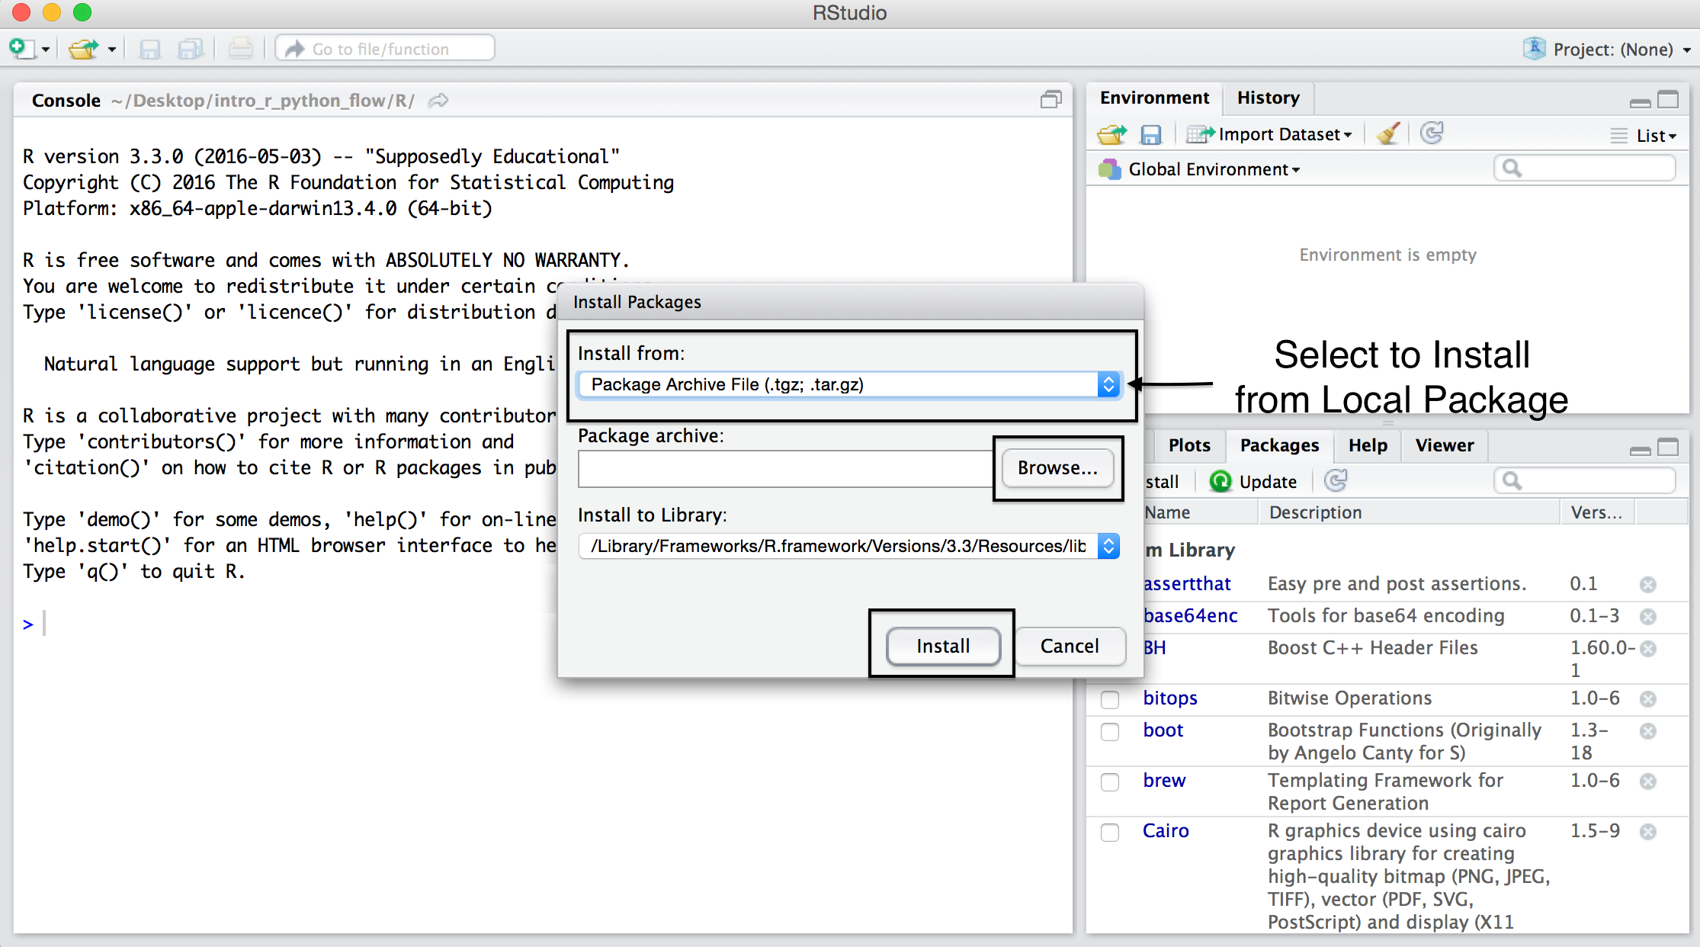
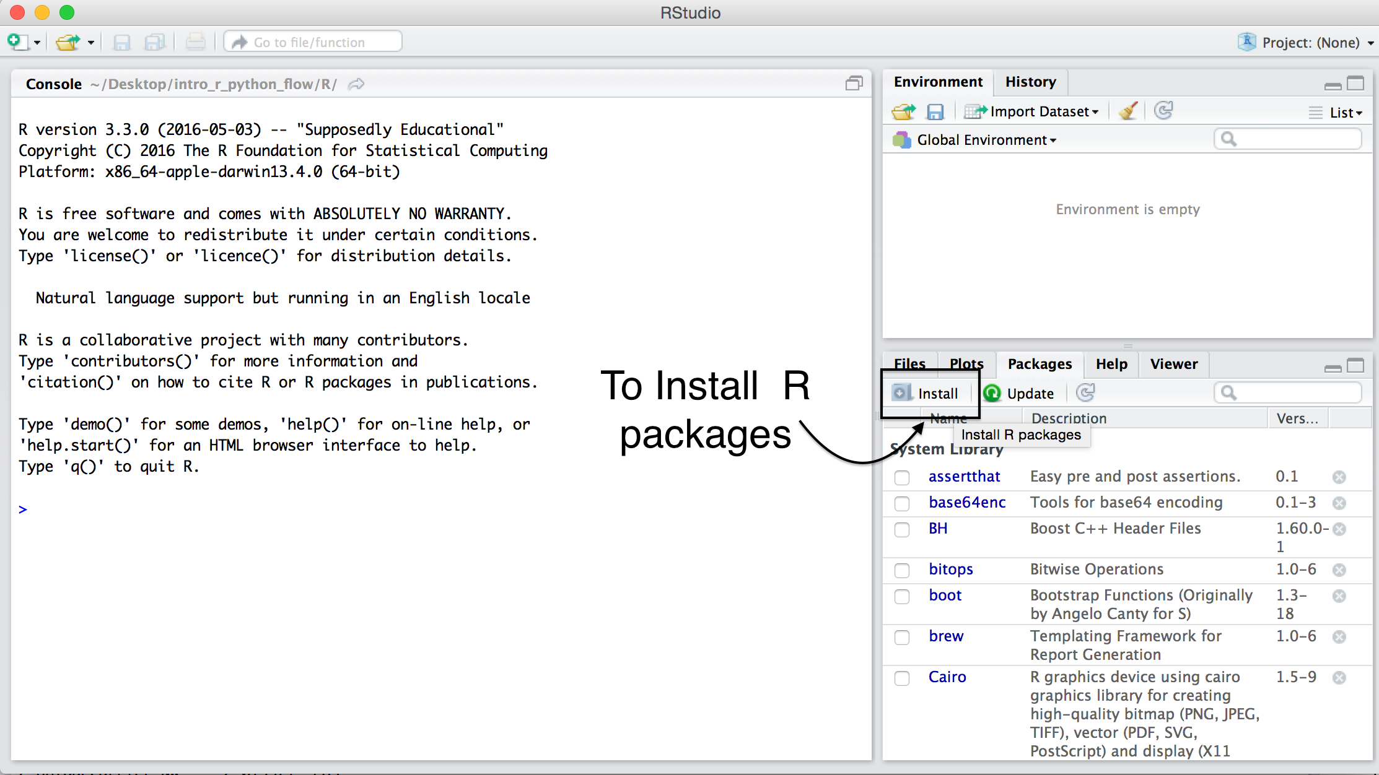
If you’re having difficulties installing from the terminal or command prompt, you can just as easily install from a R console or R Studio windows:

Slide 8
Python Users
Prerequisite: Python 2.7 or 3.3 installed
To Install Dependent modules:
pip install Windows/PythonModules/requests-2.8.1.tar.gz
pip install Windows/PythonModules/tabulate-0.7.5.tar.gz
pip install Windows/PythonModules/futures-3.0.5-py2-none-any.whl
Install H2O wheel
Unzip the h2o-3.10.0.8.zip file either in Windows/ or OSX/
pip install h2o-3.10.0.8-py2.py3-none-any.whl

Slide 9
Python Users
Prerequisite: Python 2.7 or 3.3 installed
To Install Dependent modules:
pip install requests
pip install tabulate
pip install futures
pip install six
Install H2O wheel
pip install h2o-3.10.0.8-py2.py3-none-any.whl

Slide 10
Debugging Installation Issues
To check to make sure you have the necessary modules installed, open a python interrupter and try to import them:
import requests
import tabulate
import futures
import six
Check to make sure h2o module is installed
import h2o
h2o.init(nthreads = -1)

Slide 11
Getting Started with H2O
Objective
Learn how R, Flow, and Python sends commands to compute in H2O
FAQ on writing R, Flow, and Python expressions
Hands on introduction into data processing and data science
Understanding model outputs
Note the limitations of the basic workflow to improve upon later

Slide 12

Reading Data into H2O with R
STEP 1
h2o_df = h2o.importFile(“../data/allyears2k.csv”)
R User

Slide 13
Reading Data into H2O with R
STEP 2
2.3
Initiate distributed ingest
H2O Cluster
2.2
R
HTTP REST API request to H₂O
carries the path argument
H₂O
H₂O
h2o.importFile()
H₂O
2.1
R function call
2.4
Request data
allyears2k.csv

Slide 14
Reading Data into H2O with R
STEP 3
3.2
Distributed H₂O
Frame in DKV
3.3
H2O Cluster
R
Return pointer to data in REST API JSON Response
H₂O
h2o_df
H₂O
H₂O
Frame
Cluster IP
Cluster Port
Pointer to Data
H₂O
3.4
h2o_df object created in R
3.1
Data Provided
allyears2k.csv

Slide 15
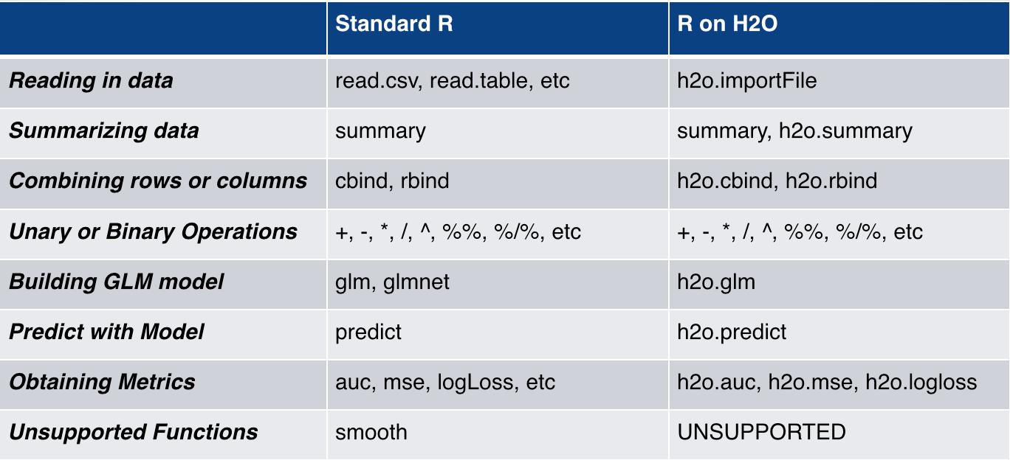
R Parity

Slide 16

Data Frame Types

Slide 17
as.h2o() vs. as.data.frame()
as.h2o()
as.data.frame()
Turns R data.frame into an H2OFrame
Saves data.frame to CSV and then performs h2o.upload() to H2O cluster
Turns H2OFrame to R data.frame
Does h2o.downloadCSV and then read.csv, and finally turns it into data.frame
Note: Be mindful of as.data.frame(), it is difficult to make a large H2OFrame into a R data.frame

Slide 18
Column Types: Enum, Numeric, Dates

Slide 19
Enum vs. Numeric vs. Dates
Enum: Also known as enumerated variable. Represents a categorical variable
Enum
Numeric: Variable that holds a numeric value
Numeric
Date: %M%D%Y is automatic format that H2O reads in
Dates

Slide 20
Enum vs. Numeric vs. Dates
Enum
Numeric
Dates
h2o.year(x)
Convert the entries of an H2OFrame object from milliseconds to years, indexed starting from 1900.
as.factor(x)
Used to convert given variable to an enumerated type variable
as.numeric(x)
Used to convert given variable to an numeric variable
h2o.month(x)
Converts the entries of an H2OFrame object from milliseconds to months (on a 1 to 12 scale).

Slide 21
Filters & Logics

Slide 22
Filters & Logics
h2o.ifelse(test, yes, no)
Arguments
Note: Only numeric values can be tested, and only numeric results can be returned.
test
yes
no
A logical description of the condition to be met (>, <, =, etc…)
The value to return if the condition is TRUE.
The value to return if the condition is FALSE.

Slide 23
Summary & Aggregation

Slide 24
Summary & Aggregation
h2o.group_by(data, by, ..., gb.control = list(na.methods = NULL, col.names = NULL))
Arguments
data
by
gb.control
. . .
an H2OFrame object.
a list of column names
a list of how to handle NA values in the dataset as well as how to name output columns
Any supported aggregated function: mean, min, max, sum, sd, nrow

Slide 25
Summary & Aggregation
h2o.table(x, y = NULL, dense = TRUE)
Arguments
x
y
dense
An H2OFrame object with at most two columns
An H2OFrame similar to x, or NULL
A logical for dense representation, which lists only non-zero counts, 1 combination per row. Set to FALSE to expand counts across all combinations.
Value: Returns a tabulated H2OFrame Object

Slide 26
String Munging

Slide 27
String Munging
Substitute pattern match w/replacement
h2o.gsub()
h2o.sub()
String Cleaning
h2o.substring()
h2o.strsplit()
h2o.trim()
h2o.rstrip() & h2o.lstrip()
h2o.interaction()

Slide 28
Hands on Introduction to Running H2O
Import & parse a small lending club dataset
Data cleaning and feature creation
Build a logistic regression model
Build a gradient boosting machine model
Review the model outputs

Slide 29
The Scripts
https://github.com/h2oai/dallas-tutorials
wget the script that you choose to work with:
Flow > Consumer_Loan_Demo.flow
Python > Consumer_Loan_Demo.ipynb
> Consumer_Loan_Demo.py
R > Consumer_Loan_Demo.R

Slide 30
The Dataset
Use case: To identify good loans based on consumer credit and debt history.
It is recommended to move the data to your desktop
For Python/R users:
Unzip H2OTour/Datasets/LoanStats.zip
Use unzipped LoanStats directory
For Flow users:
Use H2OTOUR/Datasets/loans.csv

Slide 31
The Dataset
Predictor Variable | Description | Units
loan_amnt | Requested loan amount | US dollars
term | Loan term length | months
emp_length | Employment length | years
home_ownership | Housing status | categorical
annual_inc | Annual income | US dollars
verification_status | Income verification status | categorical
purpose | Purpose for the loan | categorical
addr_state | State of residence | categorical
dti | Debt to income ratio | %
delinq_2yrs | Number of delinquencies in the past 2 years | integer
revol_util | Revolving credit line utilized | %
total_acc | Total accounts (number of credit lines) | integer
longest_credit_length | Age of oldest active account | years
Response Variable | Description | Model Category
bad_loan | Is this loan likely to be bad? | Binomial classification

Slide 32
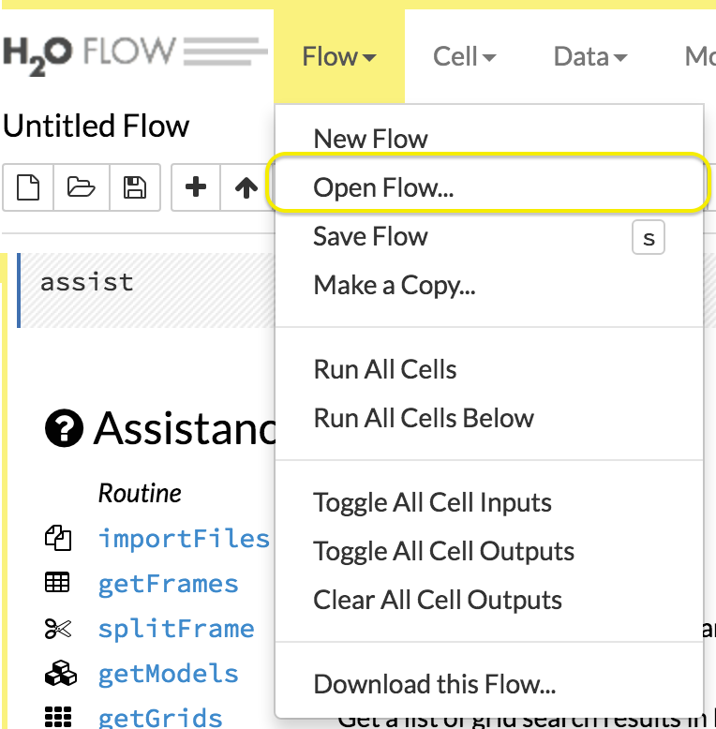
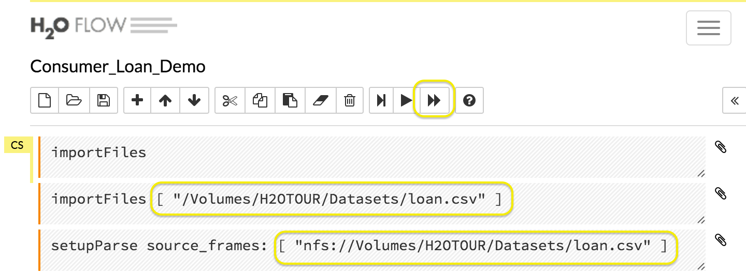
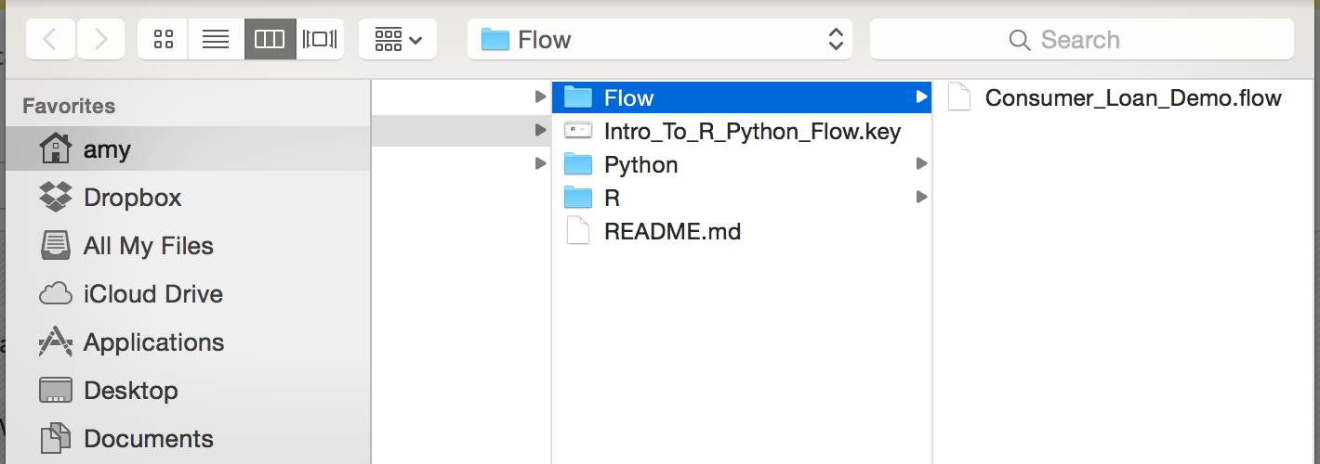
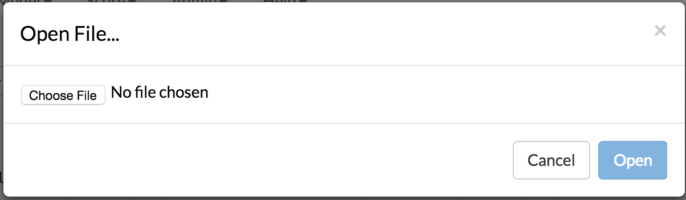
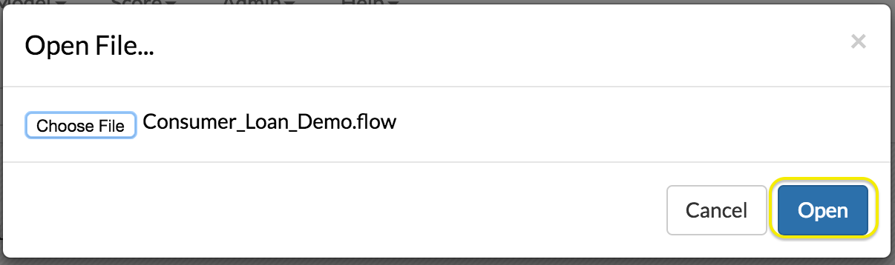
Load up an example Flow from Disk

Slide 33
Starting up H2O
Flow Users
From terminal, change the directory to where h2o.jar file is sitting and run:
> java -jar h2o.jar
Then access the Flow UI at:
https://localhost:54321
R Users
library(h2o)
h2o.init(nthreads = -1)
Python Users
import h2o
h2o.init()

Slide 34
Importing data into h2o
Flow Users
importFiles [ "/Volumes/H2OTOUR/Datasets/loan.csv" ]
setupParse source_frames: [ "nfs://Volumes/H2OTOUR/Datasets/loan.csv" ]
R Users
loan_stats = h2o.importFile(path = loans_path, destination_frame = “loan_stats")
Python Users
loan_stats = h2o.import_file(path = loans_path, destination_frame = “loan_stats”)

Slide 35
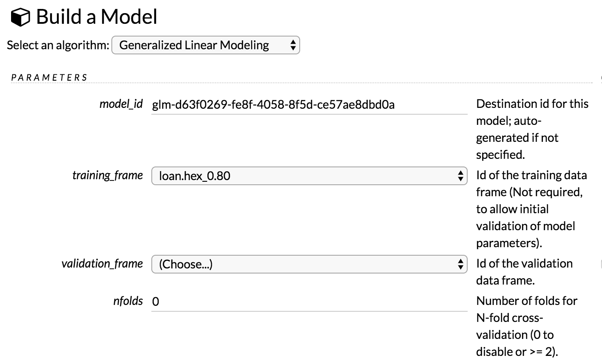
Build a Logistic Regression Model
Flow Users

Slide 36
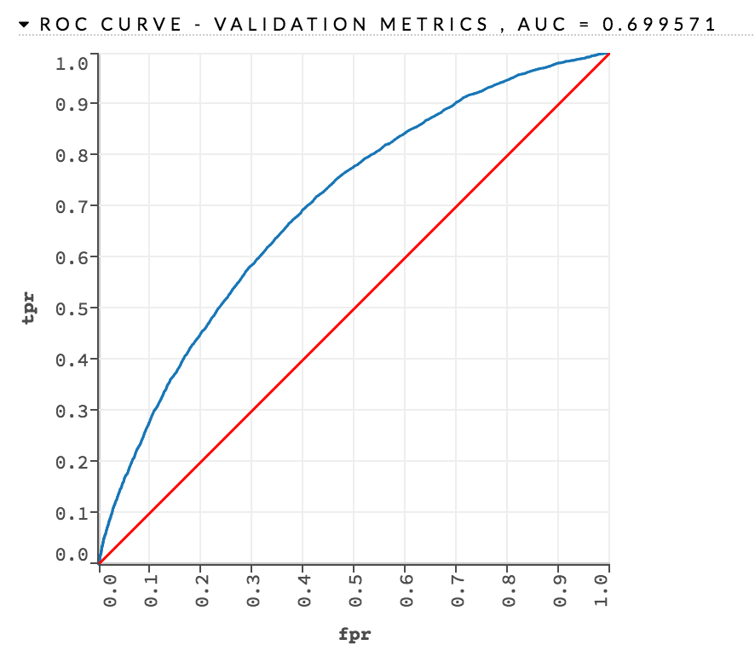
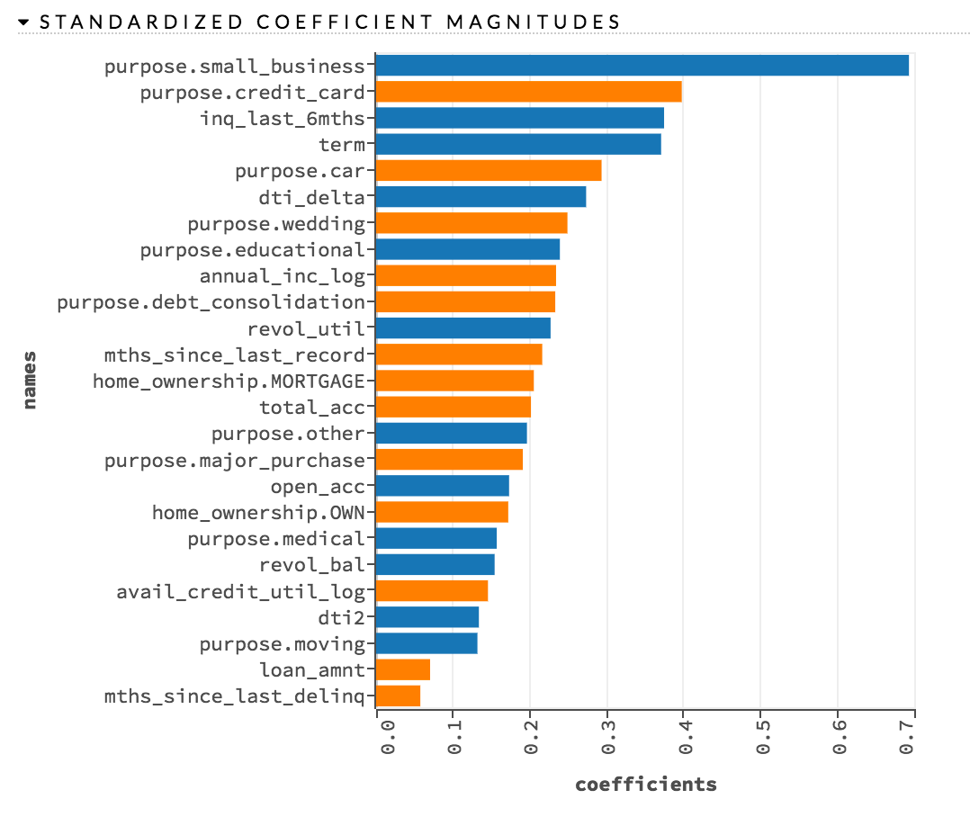
GLM Model Output

Slide 37
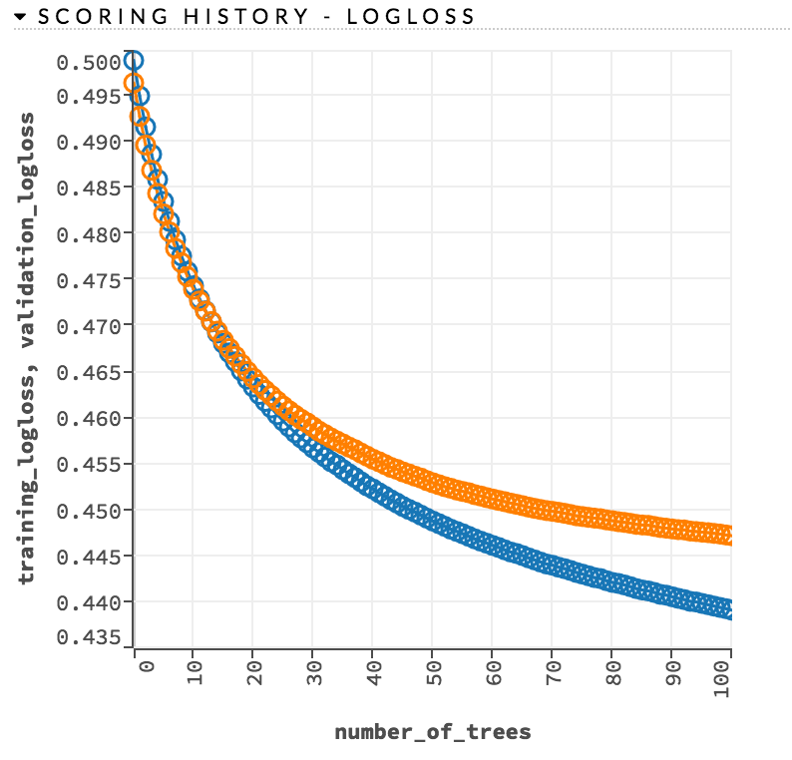
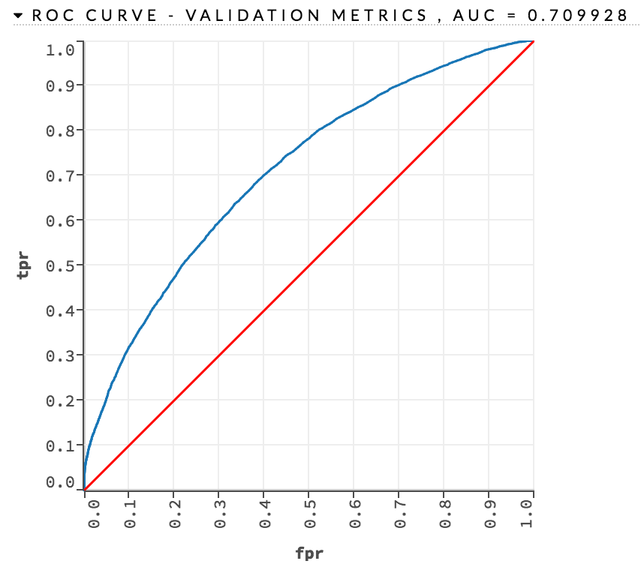
GBM Model Output

Slide 38
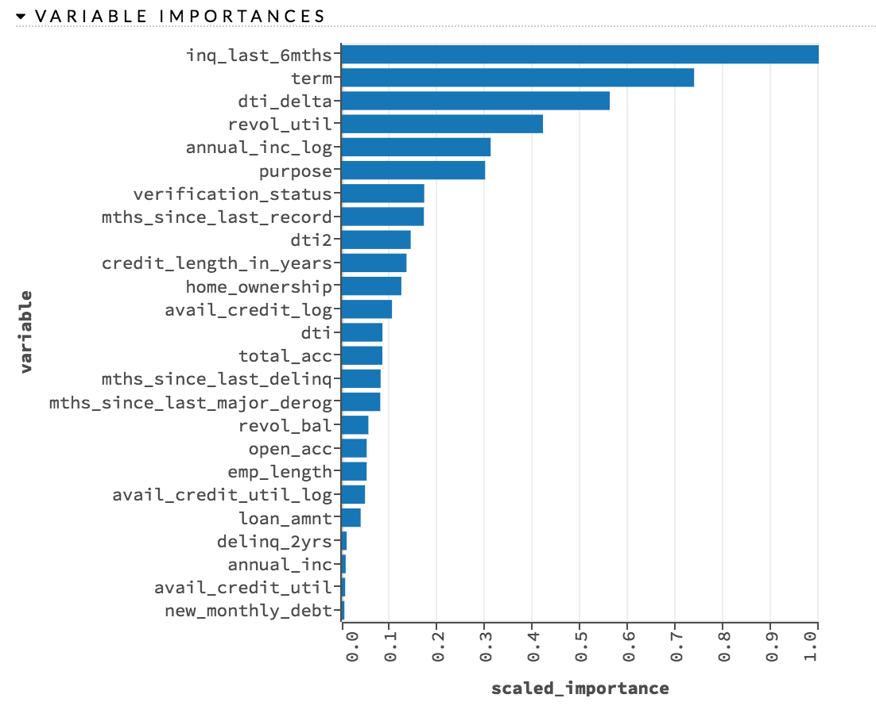
GBM - Variable Importance

Slide 39
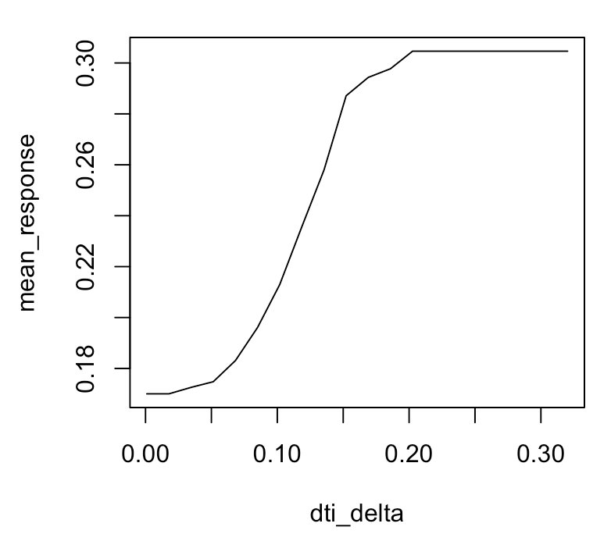
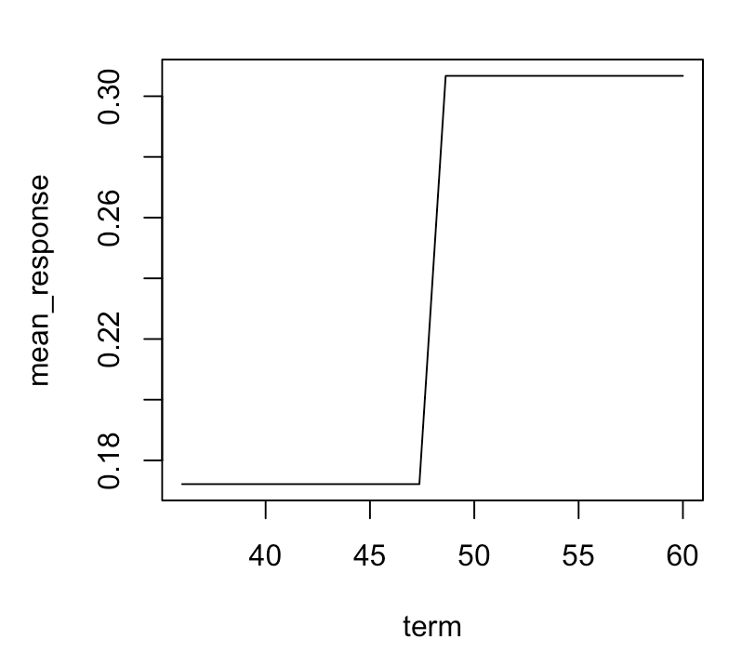
GBM - Partial Dependence Plots
dti_delta vs mean_response
term vs mean_response

Slide 40
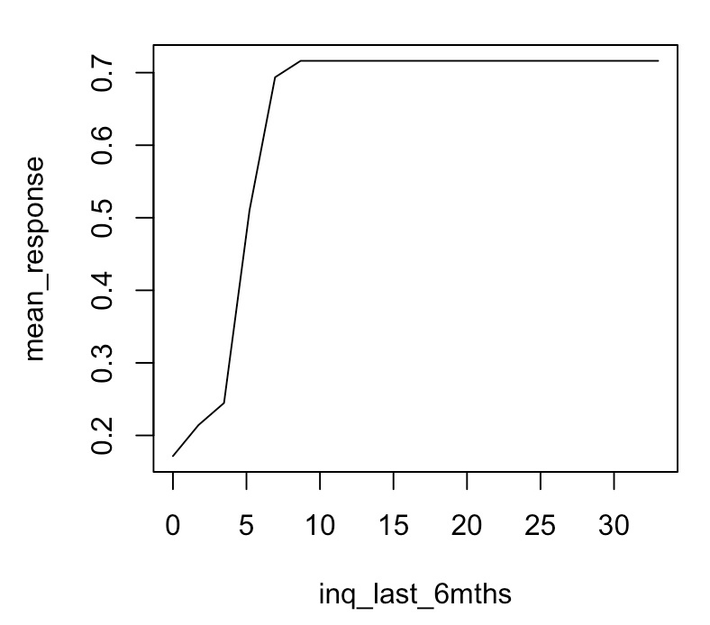
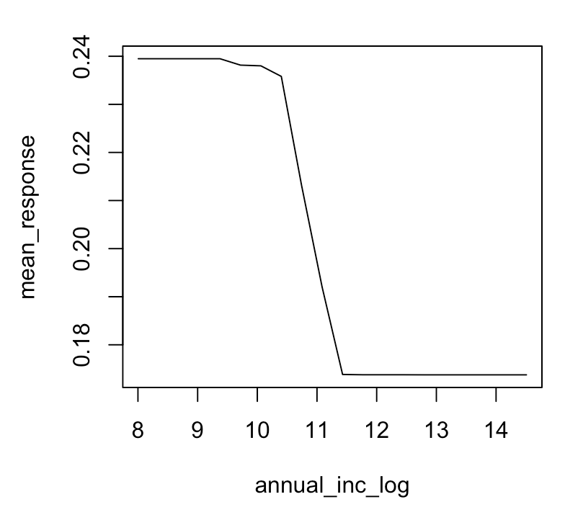
GBM - Partial Dependence Plots
inq_last_6mths vs mean_response
annual_inc_log vs mean_response

Slide 41
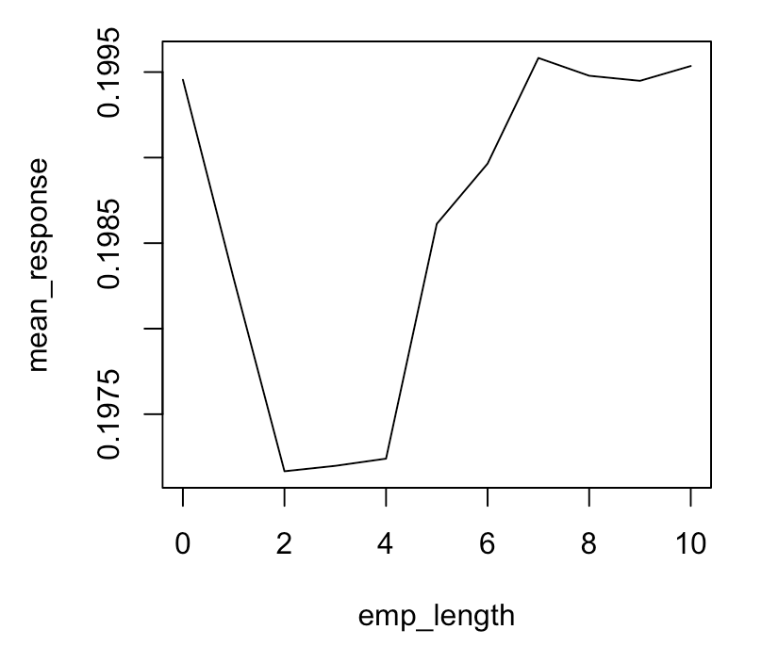
GBM - Partial Dependence Plots
emp_length vs mean_response

Slide 42
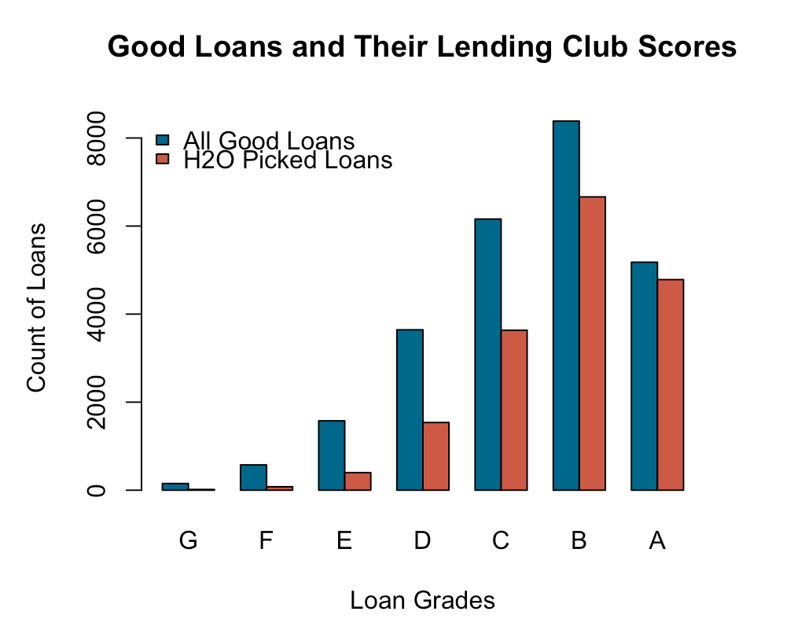
Portfolio Management

Slide 43
Overview
GLM
Faster to build than GBM models
Faster to score on new datasets
Beta coefficients directly relate each features, including expanded categorical levels, to the response variable
GBM
Outperforms GLM ever so slightly with the same feature sets
Able to use partial dependence plots to make general observation about the relationship between the predictors and response.
Can find non linear correlation between predictors and response

Slide 44
Overview
This was a subset of the available lending club data ranging from 2007 to 2014, new data updated with 2016 loan applications.
Lending Club policies might have since changed.
Credit score which is available in the secured version of the data was not used in this demo but available on LendingClub.com.
Misinformation reported by Lending Club: there were multiple entries of annual income exceeding $500k. If you look at the description, consumer corrected the changes in the description of the loan.
The text description supplied by borrowers were not used in the model and might be useful in generating new features.
Method of verification of income may not be reliable verification of STEADY income.

Slide 45
Overview
Write R and Python expression to clean and munge the data in a parallelized and distributed fashion in H2O.
Automate model builds by writing R and Python code and because all frames and models are generate in H2O, it is also accessible from the Flow UI.
From the Web UI, the user can readily access the POJO which is the H2O independent Java representation of the models.

