Slide 1
TAIPEI MRT CLUSTERING
Data Science w Python Final Project
Jen-Yin Chao

Slide 2
Agenda
Introduction
Approach
Result
Conclusion

Slide 3
Introduction
Taipei MRT – Mass Rapid Transit / Metro Service

Slide 4
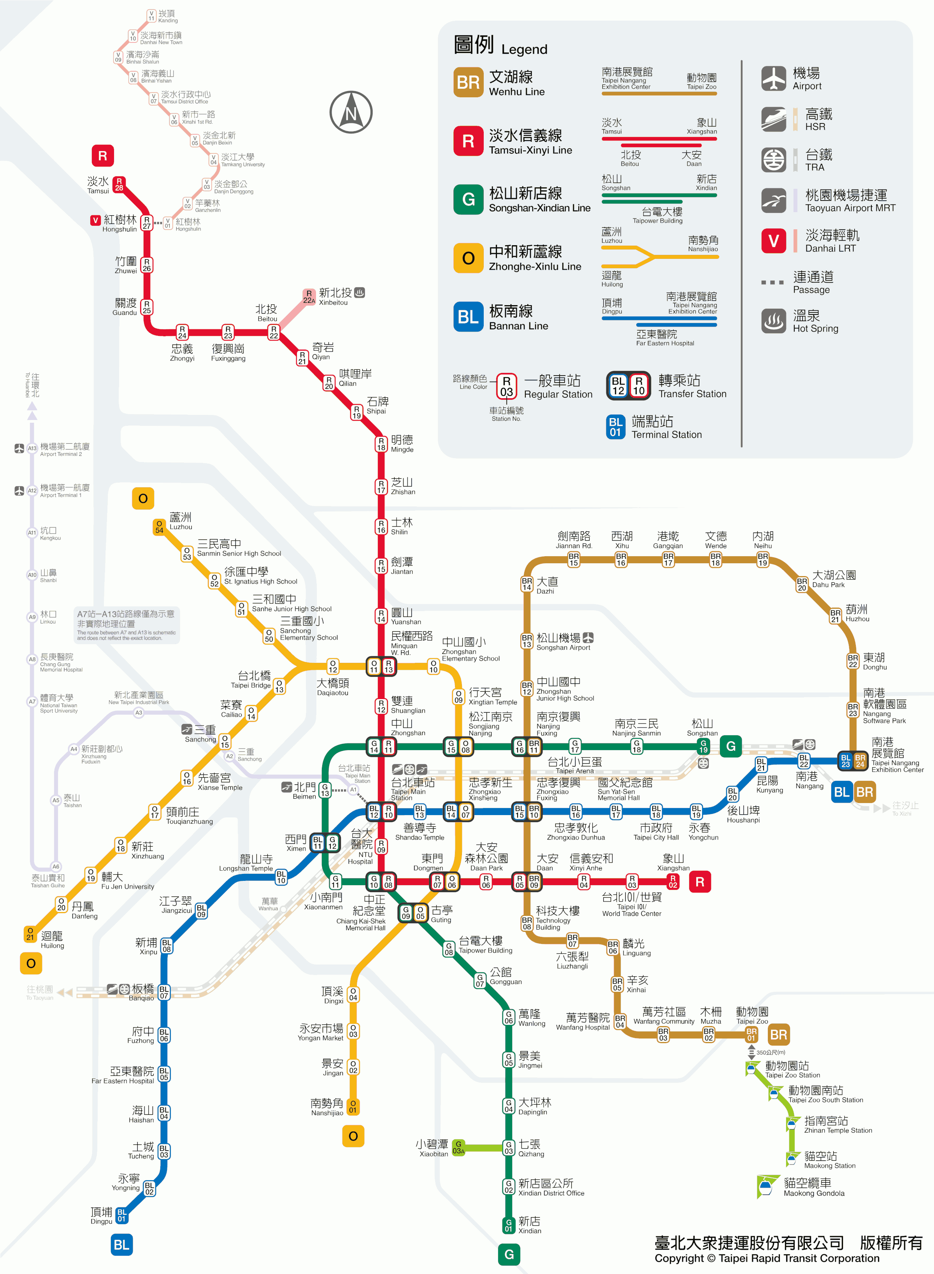
Tamsui
(Tourist Attraction)
Nanjing East Rd.
Songshan Airport
(Financial Center)
Nangang Software Park
Taipei Main Station
Xinyi District
Daan District
(Shopping Center)
(Expensive Block)
Taipei Zoo
Xindian
(Tourist Attraction)

Slide 5
Introduction
Taipei MRT – Mass Rapid Transit / Metro Service
Are there any weekly patterns of rider-ship?
Would patterns be different within stops?

Slide 6
Introduction (Pattern)
*Rider-ship
 | Sun | Mon | Tue | Wed | Thu | Fri | Sat
Taipei Main Station | H | H | H | H | H | H | H
Taipei Zoo | H | L | L | L | L | L | H
Nanjing East Rd. (Financial Center) | L | H | H | H | H | H | L
Can I separate MRT stops with their weekly rider-ship pattern?

Slide 7
Approach
Standardize rider-ship data of each stop
Choose # of clustering groups
Use k-means to separate stops with each weekly data
Compute the similarity within stops with all the clustering outcome

Slide 8
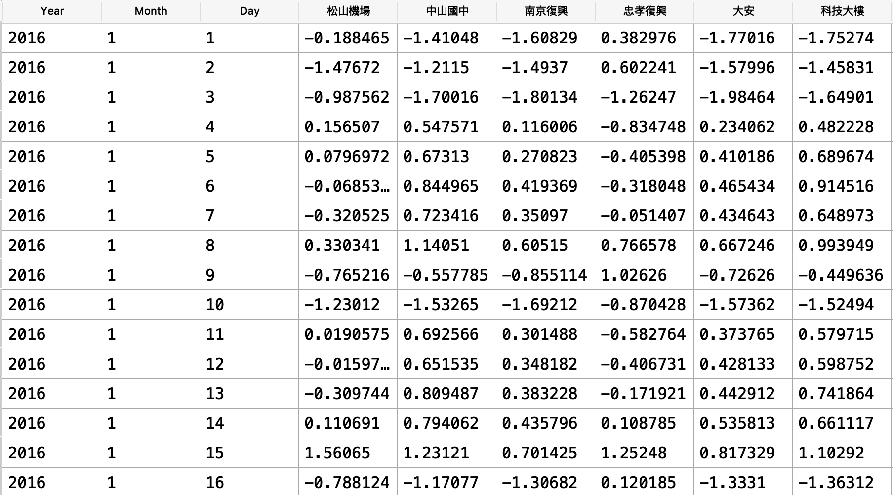
Data_1
Data_2
Data_3
Data_4
K-mean of week 1
K-mean of week 2

Slide 9
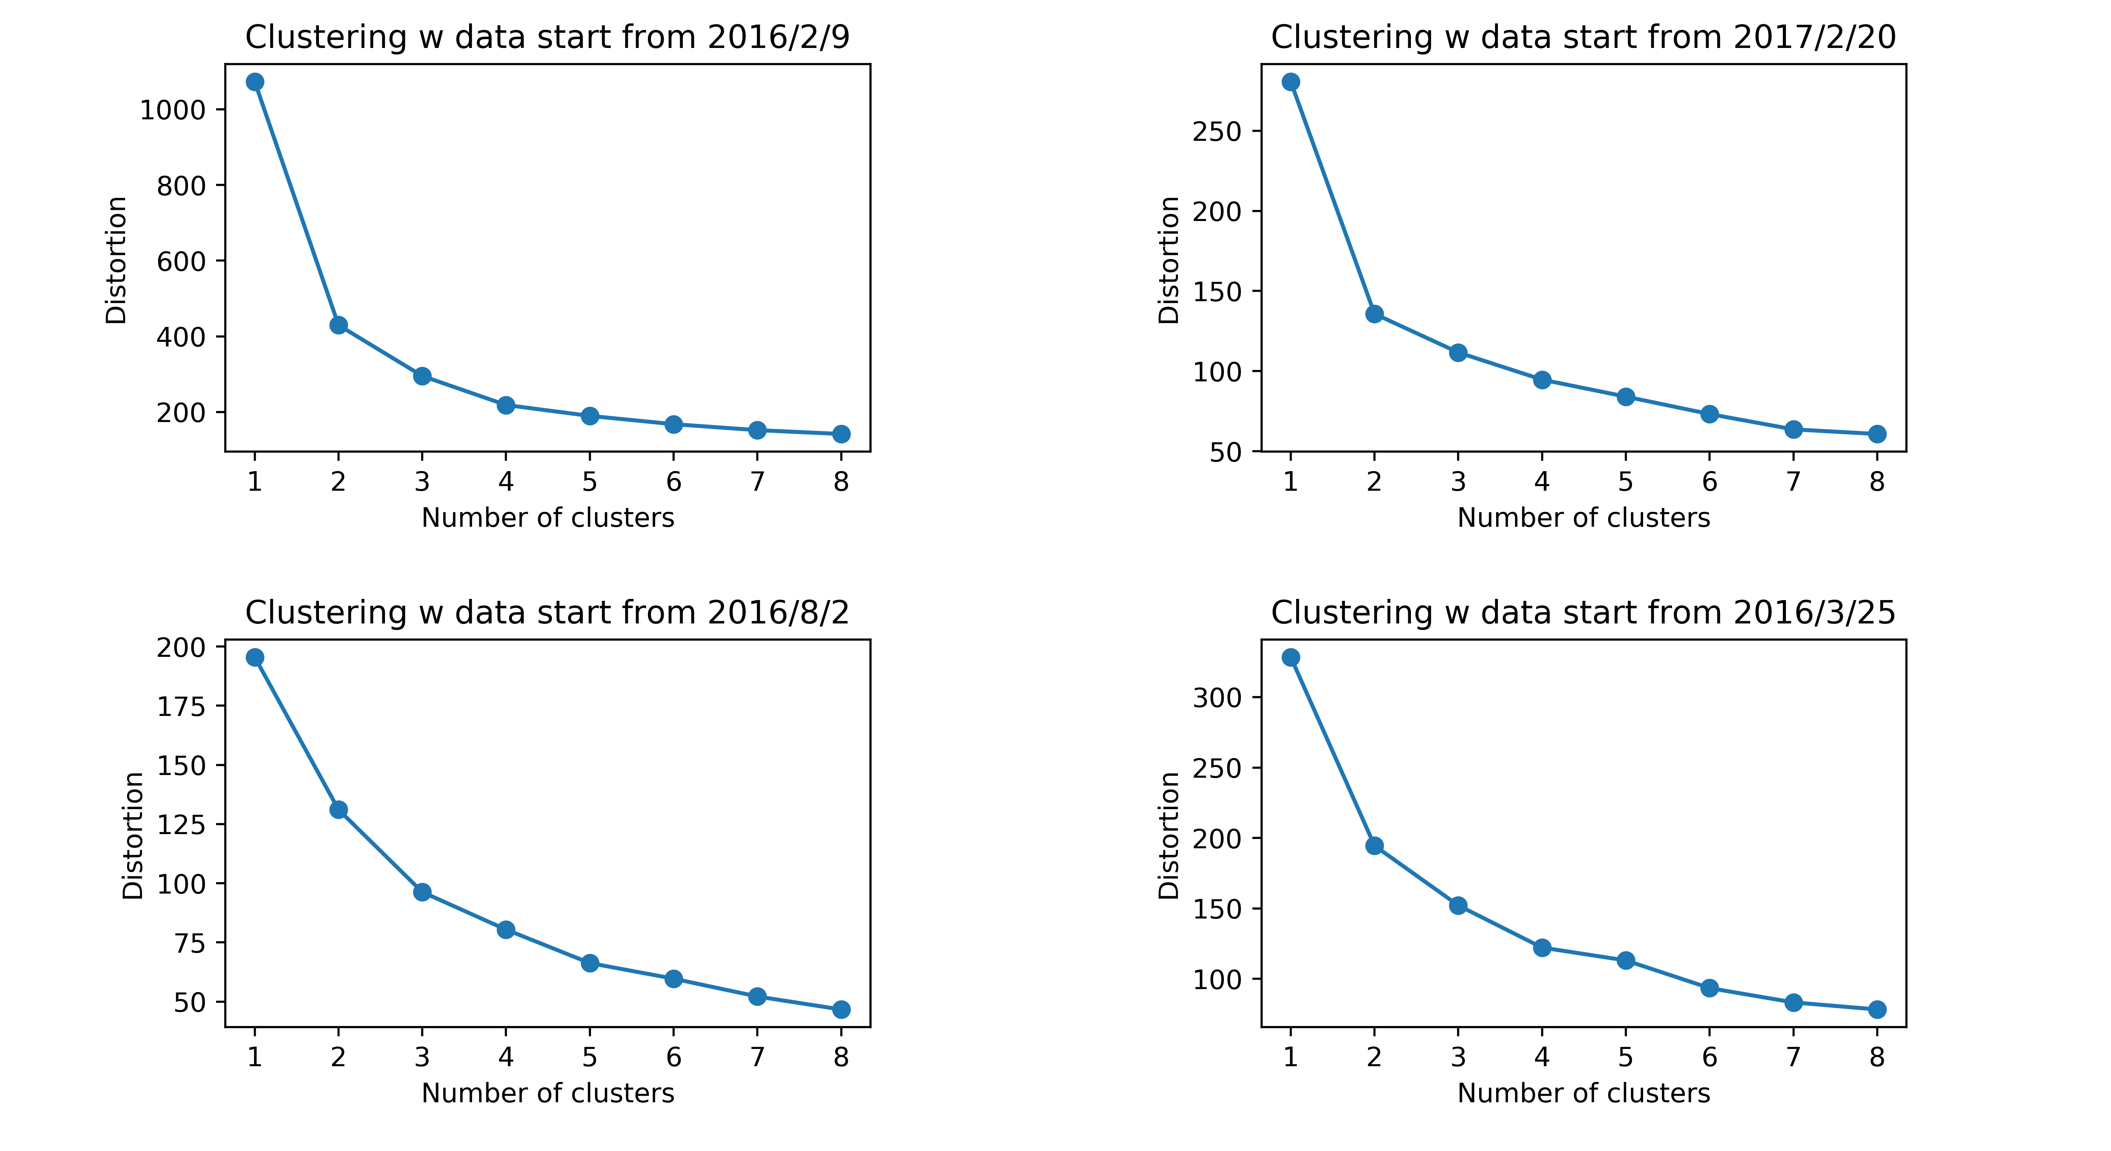
Approach
Distortion plot to choose # of clustering with entry data, n=3

Slide 10
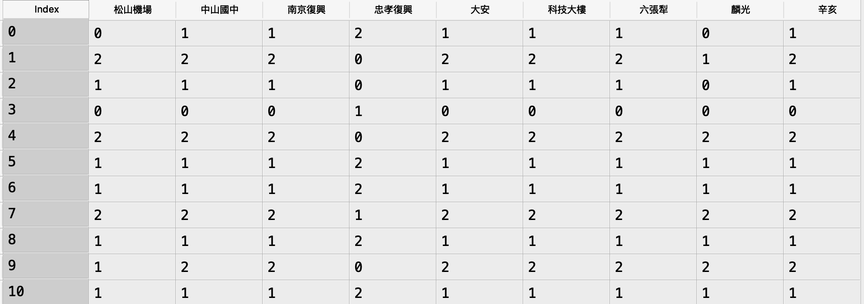
Approach
Clustering outcome of each week
Stop Name
Week #
which means this stop at week 2 is assigned to group 1
100% Similarity!

Slide 11
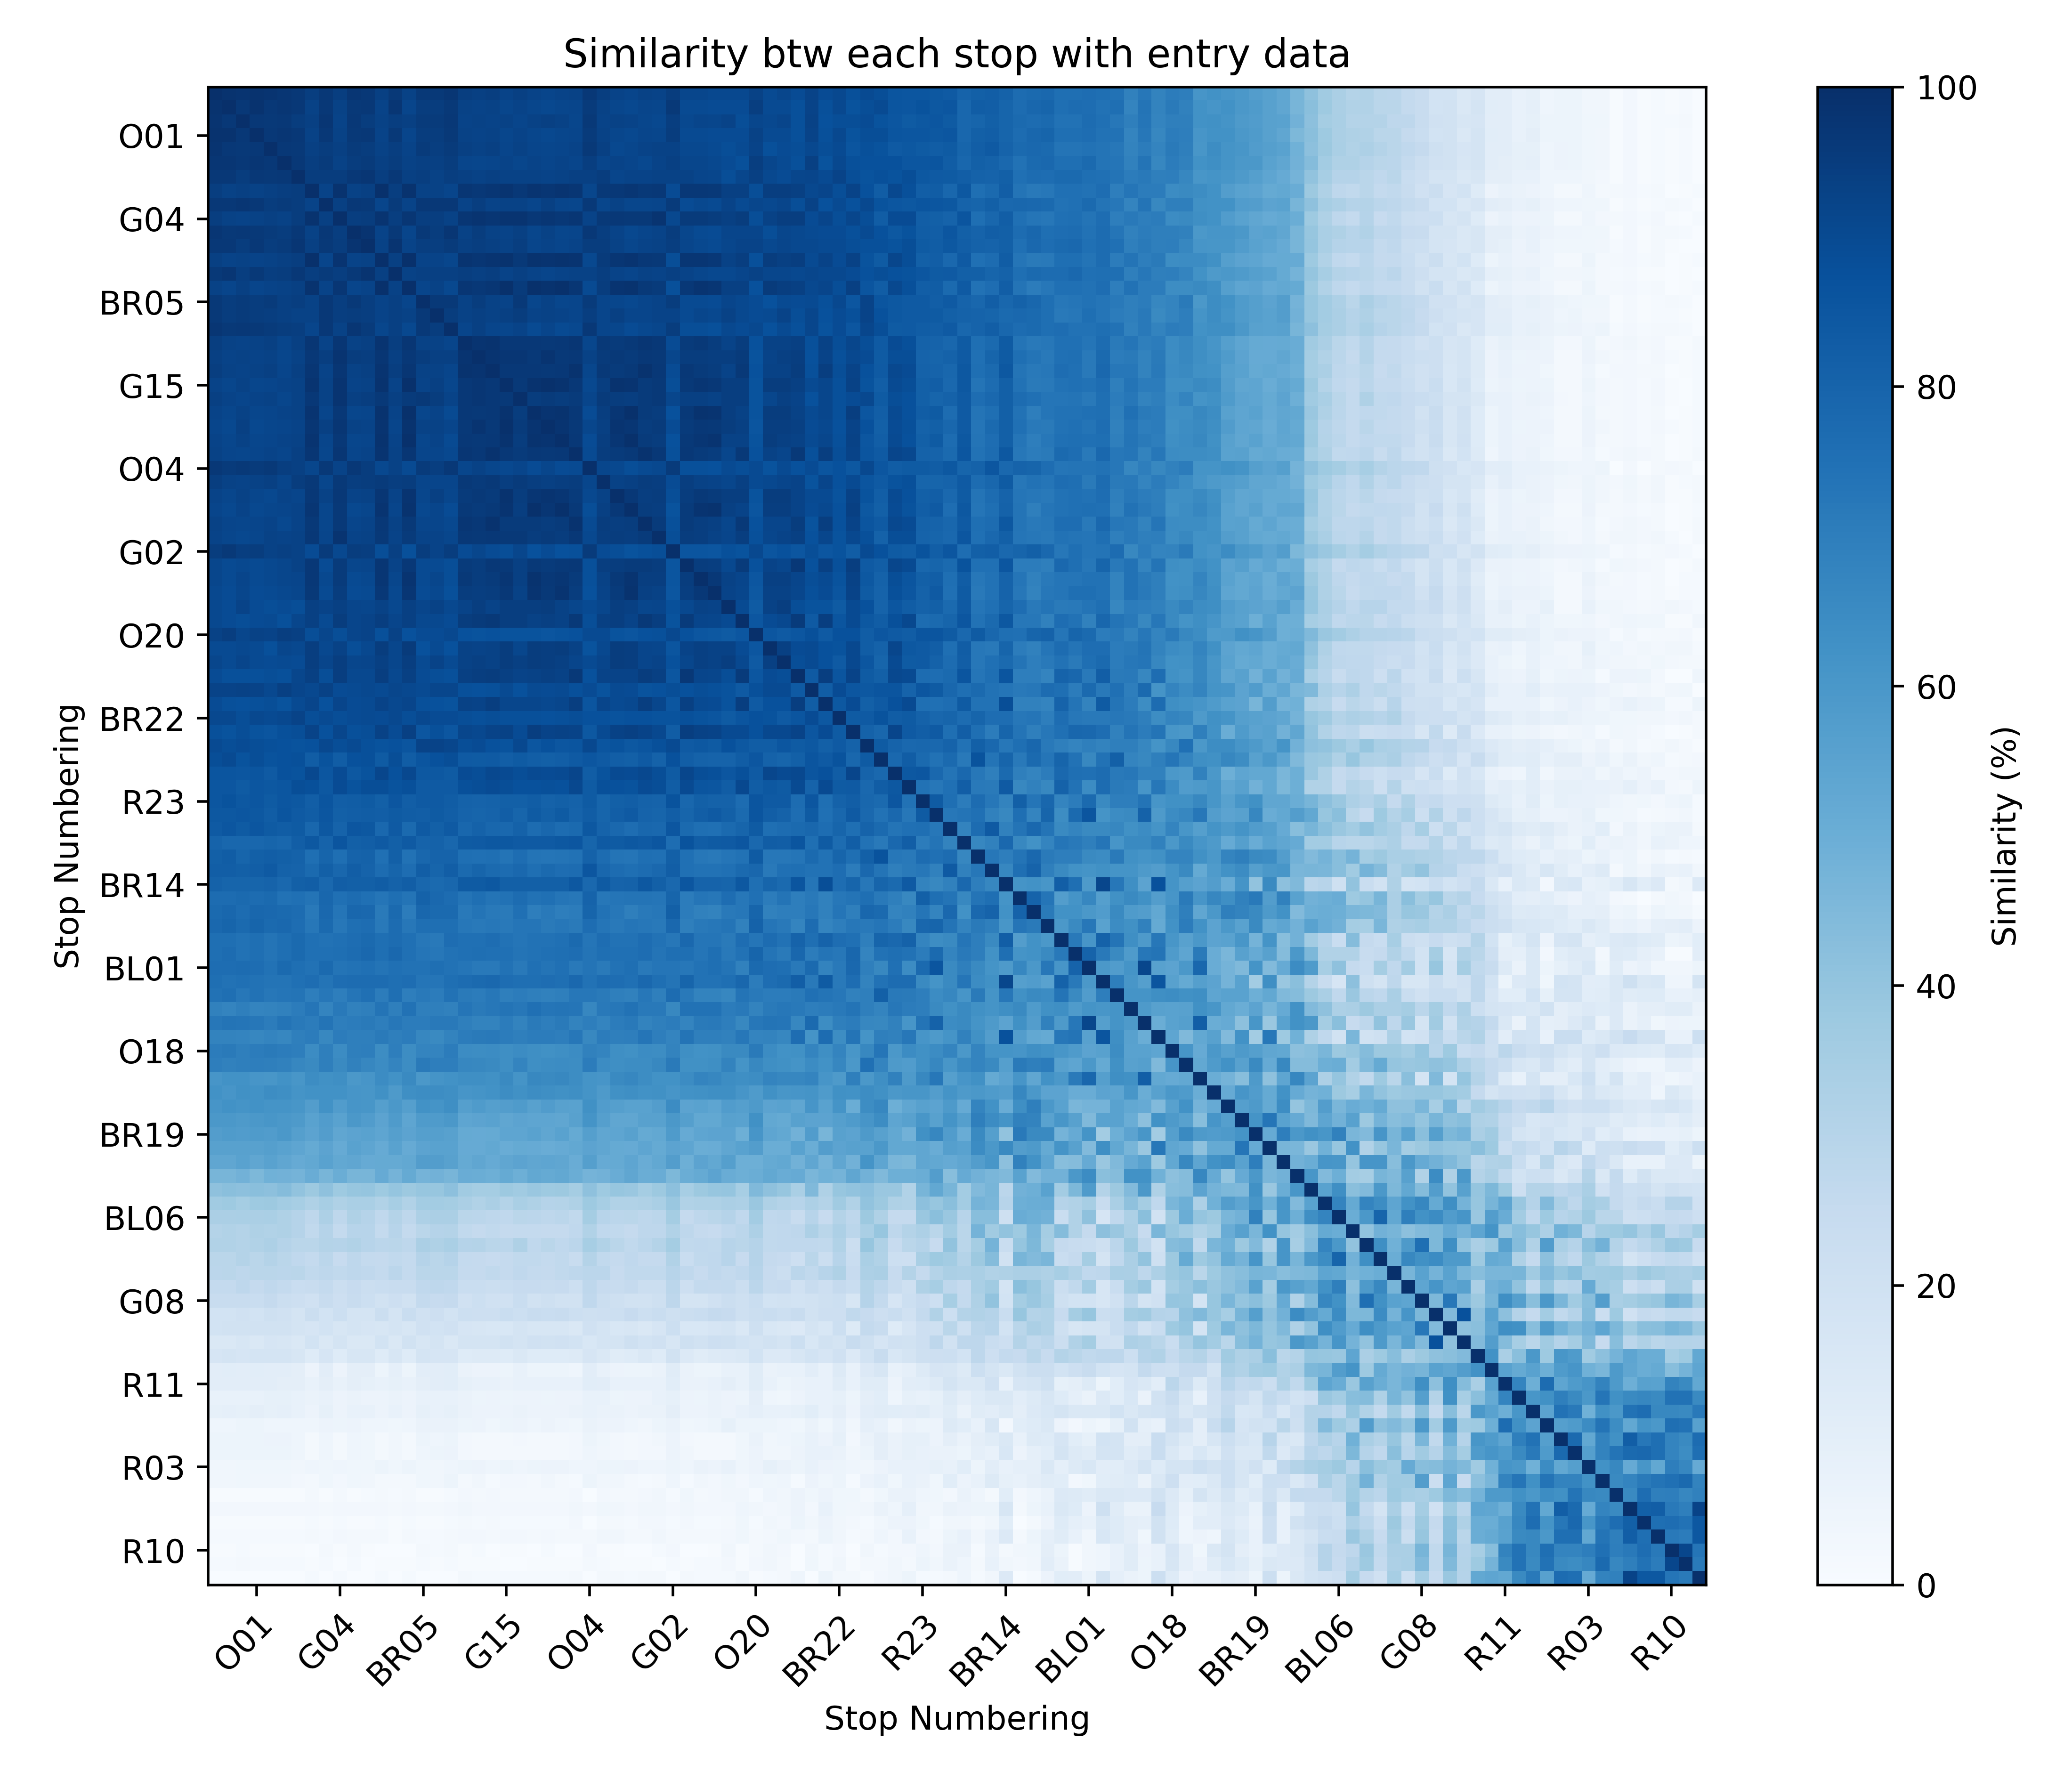
Approach
<Similarity Heat Map>
the probability of being assigned in the same group
Group 1
Group 2
Group 3

Slide 12
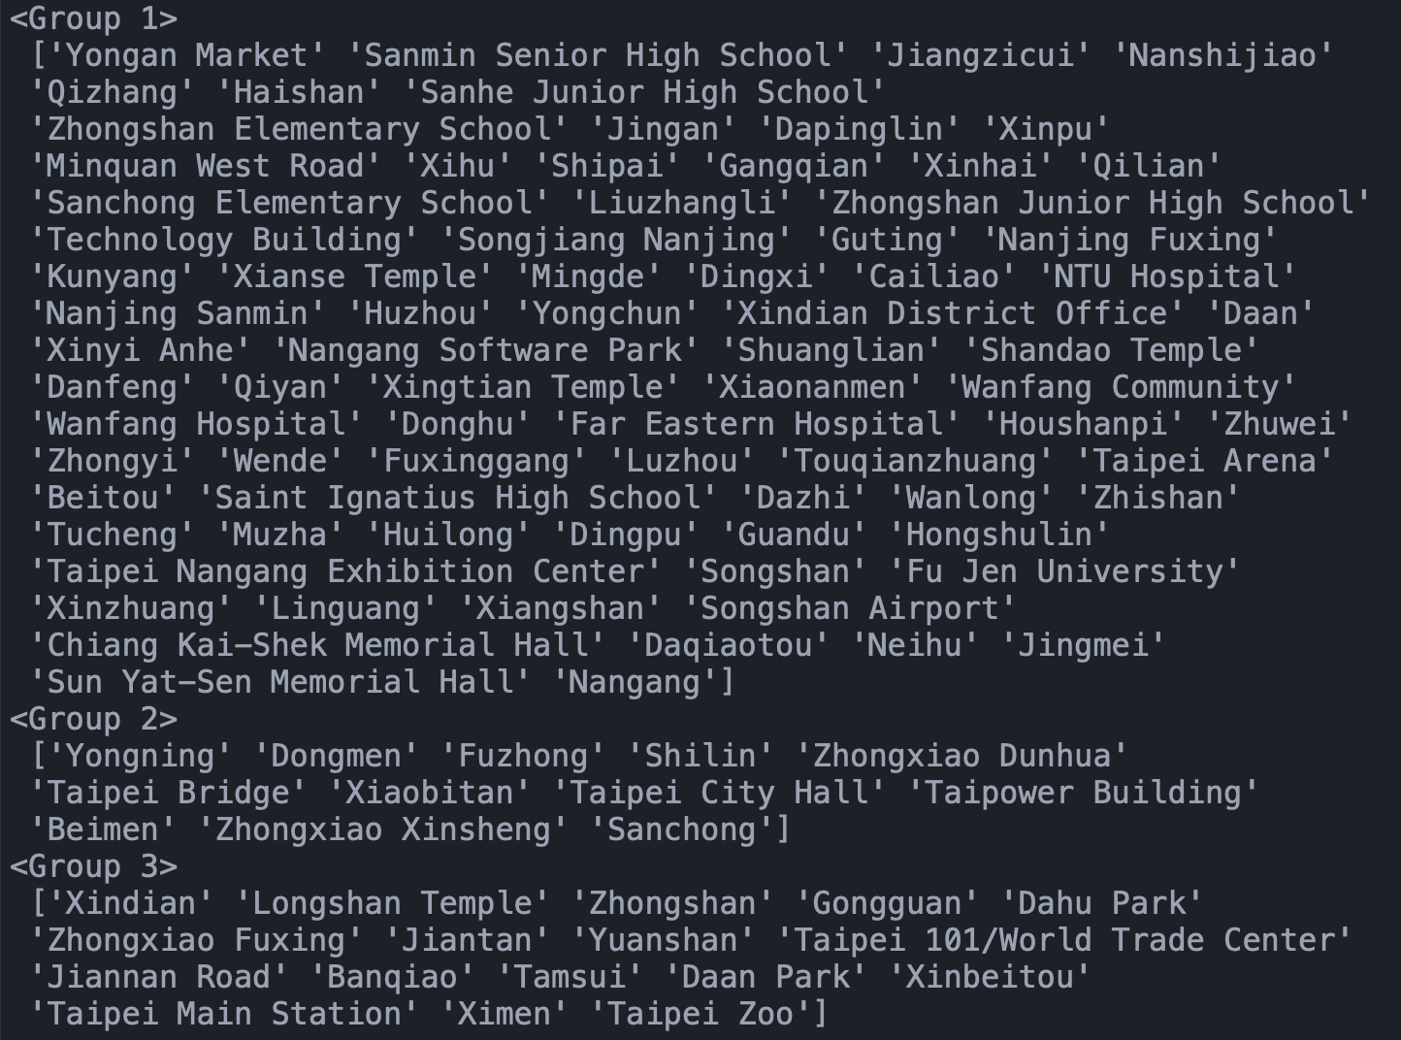
Result
Transit Station
Tourist Attraction
Shopping Center
Night Market
Financial Center
Expensive Block

Slide 13
Conclusion
Different kind of MRT stop do really have different weekly rider-ship pattern.
Most transit station, tourist attraction, and shopping center(night market) can be distinguished by the weekly rider-ship with k-means clustering method.

