Slide 1
LEAD SCORE CASE STUDY LOGISTIC REGRESSION
JAYASRI JENA

Slide 2
Problem Statement
An education company named X Education sells online courses to industry professionals. On any given day, many professionals who are interested in the courses land on their website and browse for courses.
The company markets its courses on several websites and search engines like Google. Once these people land on the website, they might browse the courses or fill up a form for the course or watch some videos. When these people fill up a form providing their email address or phone number, they are classified to be a lead. Moreover, the company also gets leads through past referrals. Once these leads are acquired, employees from the sales team start making calls, writing emails, etc. Through this process, some of the leads get converted while most do not. The typical lead conversion rate at X education is around 30%.
Now, although X Education gets a lot of leads, its lead conversion rate is very poor.

Slide 3
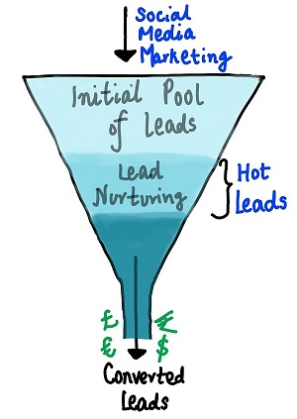

Slide 4
STEPS INVOLVED
Data Reading and Understanding:
Data Cleaning:
Data Visualization and Outliers Treatment
Data Visualization and Outliers Treatment
5. Model Building
Model Evaluation on Train Set -

Slide 5
DATA ANALYSIS

