Slide 1
CASCADING STYLE SHEETS : CSS 02 LAYOUT GRID and FLEXBOX
INFO 2302 WEB TECHNOLOGIES

Slide 2
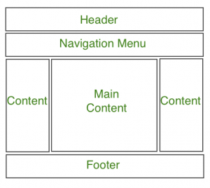
What is Web Layout...?
https://developer.mozilla.org/en-US/docs/Learn/Common_questions/Design_and_accessibility/Common_web_layouts

Slide 3
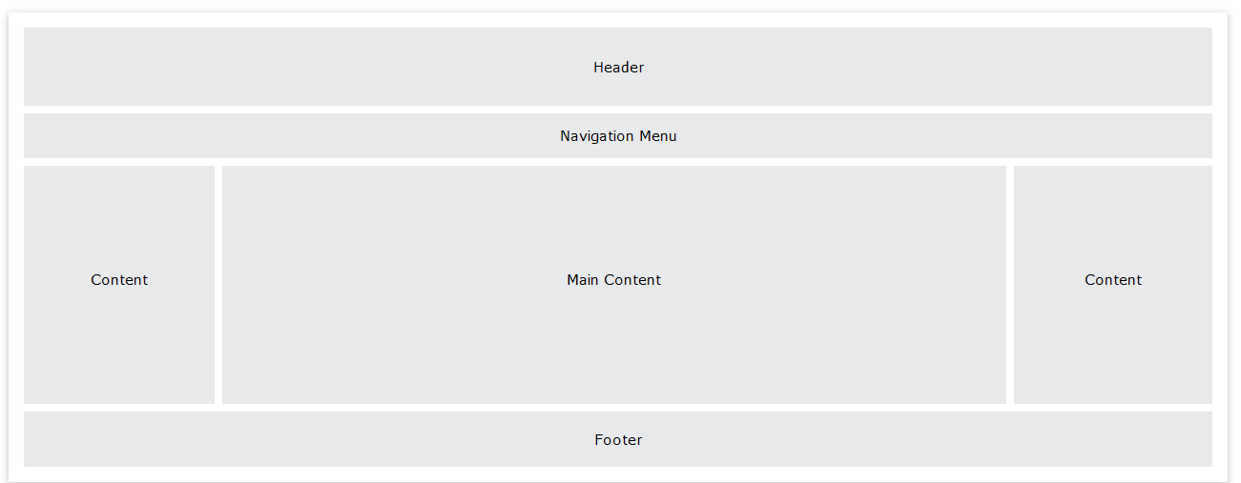
COMMON LAYOUT ELEMENT
Header 1
Visible at the top of every page on the site. Contains information relevant to all pages (like site name or logo) and an easy-to-use navigation system.
Main content A
The biggest region, containing content unique to the current page.
Stuff on the side B1/B2
1) Information complementing the main content; 2) information shared among a subset of pages; 3) alternative navigation system. In fact, everything not absolutely required by the page's main content.
Footer 2
Visible at the bottom of every page on the site. Like the header, contains less prominent global information like legal notices or contact info.

Slide 4

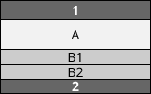
COLUMN LAYOUT – 1 column
1-column layout. Especially important for mobile browsers so you don't clutter the small screen up

Slide 5
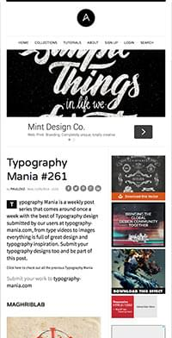
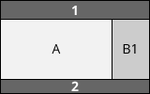
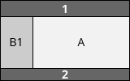
COLUMN LAYOUT – 2 column
2-column layout. Often used to target tablets, since they have medium-size screens

Slide 6
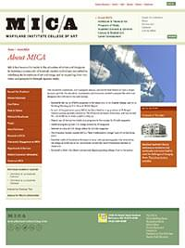
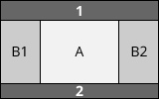
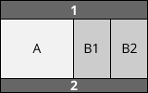
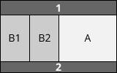
COLUMN LAYOUT – 3 column
3-column layouts. Only suitable for desktops with big screens. (Even many desktop-users prefer viewing things in small windows rather than fullscreen.)

Slide 7
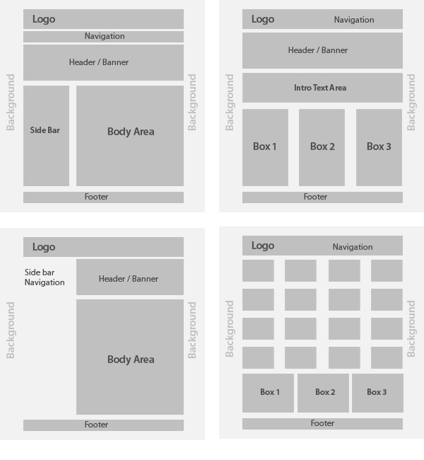
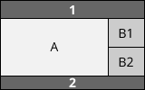
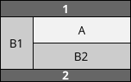
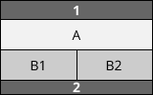
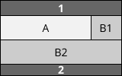
COLUMN LAYOUT – mix
FUN to mix

Slide 8
CSS Layout
CSS page layout techniques allow us to take elements contained in a web page and control where they're positioned relative to the following factors:
their default position in normal layout flow,
the other elements around them,
their parent container,
and the main viewport/window
.The page layout techniques are as follows
Normal flow
The display property
Flexbox
Grid
Floats
Positioning
Table layout
Multiple-column layout
Each technique has its uses, advantages, and disadvantages. No technique is designed to be used in isolation. By understanding what each layout method is designed for you'll be in a good position to understand which method is most appropriate for each task

Slide 9
NORMAL FLOW
Elements on webpages lay themselves out according to normal flow - until we do something to change that.
Flexbox
Flexbox is a one-dimensional layout method for laying out items in rows or columns
Grids
CSS Grid Layout is a two-dimensional layout system for the web. It lets you lay content out in rows and columns, and has many features that make building complex layouts straightforward
Floats
Originally for floating images inside blocks of text, the float property became one of the most commonly used tools for creating multiple column layouts on webpages. With the advent of Flexbox and Grid it has now returned to its original purpose, as this article explains.
Positioning
Multiple-column
Positioning allows you to take elements out of the normal document layout flow and make them behave differently, for example, by sitting on top of one another, or by always remaining in the same place inside the browser viewport.
The multiple-column layout specification gives you a method of laying content out in columns, as you might see in a newspaper

Slide 10
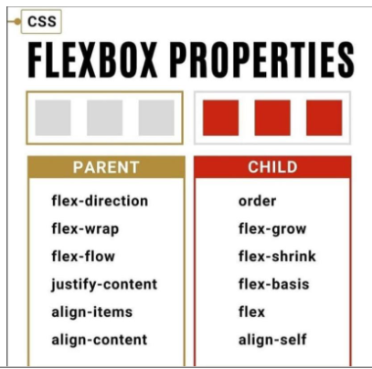
FLEX BOX
The CSS Flexbox is a one-dimensional layout. It is useful in allocating and aligning the space among items in a grid container.
It works with various kinds of display devices and screen sizes.
Flexbox layout makes it easier to design and build responsive web pages without using many float and position properties in the CSS code.

Slide 11
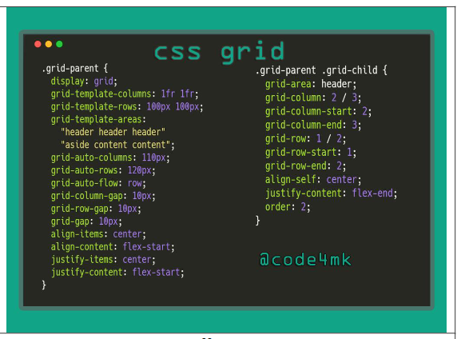
GRID A grid is a collection of horizontal and vertical lines creating a pattern against which we can line up our design elements.
They help us to create layouts in which our elements won't jump around or change width as we move from page to page, providing greater consistency on our websites.
A grid will typically have columns, rows, and then gaps between each row and column.
The gaps are commonly referred to as gutters.

Slide 12
When to use
Use Flexbox when you need to create simple, one-dimensional layouts where items flow in a single direction, such as navigation menus or aligning items in a row or column. | Use CSS Grid when you need to create more complex, two-dimensional layouts with precise control over both rows and columns, like grid-based page layouts, card-based designs, and complex grid structures.
In many cases, both Flexbox and Grid can complement each other, with Flexbox used within Grid items to handle their internal layout. It's essential to choose the layout technique that best suits your specific design requirements.

Slide 13
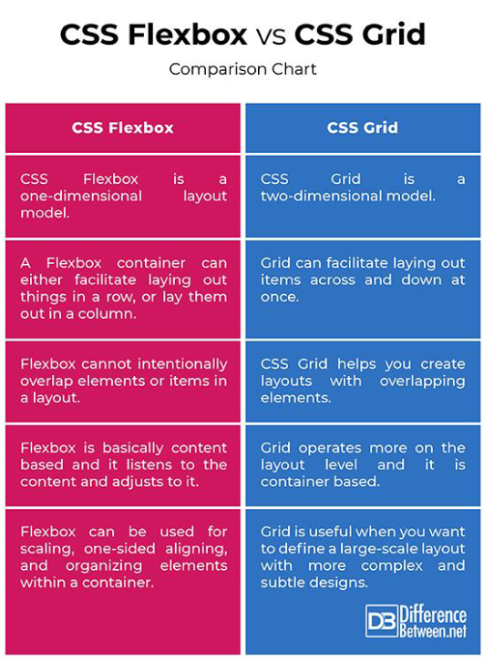

Slide 14
CLASS ACTIVITIES

Slide 15
CODE |  | Observe
1 | display: flex;
2 | flex-direction: row; Then Change the value row to: Row-reverse Column Colum-reverse
3 | flex-wrap: nowrap; Then change the value “nowrap” to “wrap” and resize your browser
FLEX exercise 01
Download flex01.html
Add the following code into .container {}

Slide 16
CODE |  | Observe
1 | Create the link to layout.css in flex02.html
2 | Insert display:flex; in the Parent flex
3 | Insert the following values in each of the Child flex:4; flex:1; flex:1; (play around with the numbers to get what layout you want
4 | Insert the following values in each of the Child order:1; order:2; order:3; (play around with the numbers to get what layout you want
FLEX exercise 02
Download flex02.html and layout.css
https://developer.mozilla.org/en-US/docs/Web/CSS/flex

Slide 17
CLASS ACTIVITIES

Slide 18
https://developer.mozilla.org/en-US/docs/Web/CSS/grid-column
CODE |  | Observe
1 | Create the link to mygrid.css in grid.html
2 | Insert the following in the Parent display: grid; grid-template-columns: 1fr 1fr 1fr 1fr; gap: 20px; * Then tick the Grid display setting in the inspector view
3 | header{ grid-column: 1/span 4; grid-row: 1; }
4 | nav{ grid-column: 1; grid-row: 2; } article{ grid-column: 2/span 2; } aside{ grid-column: 4; } footer{ grid-column: span 4; grid-row: 3; }
GRID 01 Exercise
Download grid.html and mygrid.css

Slide 19
https://developer.mozilla.org/en-US/docs/Web/CSS/grid-column
CODE |  | Observe
1 | Create the link to mygrid.css in grid.html
2 | Insert the following in the Parent display: grid; gap: 20px; grid-template-areas: "head head head head" "navi navi navi navi" "content content content side" "foot foot foot foot" ; grid-template-columns: 1fr 1fr 1fr 1fr;
3 | header{ grid-area: head; } article{ grid-area: content; } nav{ grid-area: navi; } aside{ grid-area: side ; } footer{ grid-area: foot; }
GRID 01 Exercise
Download grid.html and mygrid.css

