Slide 1
Automated Sample Preparation System
Supervisor:
Dr. Aladdin Masri
Students:
Jenan Abualrub
Yaqout Salameh

Slide 2
Outline
Introduction
Building process
Mechanism of action
Problems and constraints
Live demo
Notes & questions

Slide 3
Introduction
What does the study conducted in 2020 state?
Automated Sample Preparation System (ASPS) will solve those problems!
Improving reliability, safety, performance, and accuracy.
Facilitating the process through a mobile application.
Notes:
A study conducted in 2020 states that (61.9 - 68.2%) of the errors associated with laboratory tests occur within the pre-analytical phase of the test.

Slide 4
Building process
Components & hardware structure.
Needle & syringe movement.
Mobile application.
MQTT protocol.
Sensing circuit.

Slide 5
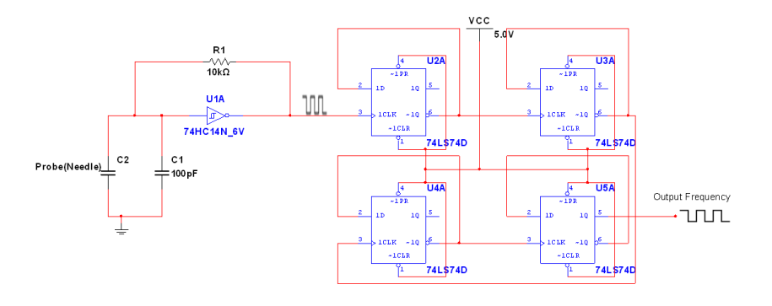
Sensing circuit
Circuit diagram:

Slide 6
Mechanism of action
System states:
Initialization
Cleaning
Substance selection

Slide 7
Problems and constraints
High frequencies in the sensing part and using a frequency divider circuit.
Building the wooden parts and designing them.
Special care is needed for the reagents.

Slide 8
Live demo ...

Slide 9
Discussion

Slide 10
Thank you!

