Slide 1
SEN3006 · SOFTWARE ARCHITECTURE
PROJECT PRESENTATION
Task Management System.
Factory Method and Strategy, built in pure Java.
Factory Method
Strategy
State
A task tracker for software teams, designed around two classic patterns and a zero-dependency Java core.
Abdul Rahman Malak
Mouhammad Houjeirat
Notes:
BOTH.
We're Abdul Rahman Malak and Mouhammad Houjeirat — our SEN3006 Task Management System, in pure Java. Two patterns, Factory Method + Strategy, plus State from the lifecycle. Zero dependencies, so the architecture is what's graded. Abdul Rahman Malak takes the contents.

Slide 2





CONTENTS
SECTION 1 / 5
What this presentation covers.
01
Introduction and problem definition
~3 min
02
The design patterns: Factory Method, Strategy, State
~5 min
03
Architecture and implementation
~4 min
04
Live demonstration
~3 min
05
Results, evaluation and conclusion
~2 min
Roughly sixteen minutes of talk and demo, then questions. We each take questions on the parts we led.
Task Management System · SEN3006 Software Architecture
02 / 32
Notes:
Abdul Rahman Malak.
Five sections: problem, patterns (the big one), architecture, live demo, evaluation. About sixteen minutes, then questions. Hold questions to the end unless something on screen is unclear. Section one is mine.

Slide 3

SECTION 01
SECTION 1 / 5
Introduction and problem definition.
The domain we chose, the objectives we set, and the two problems that drove every pattern choice.
Notes:
Abdul Rahman Malak.
Section one — define the problem first; it's graded. Domain and objectives, the requirements, then the two problems the patterns solve.

Slide 4



INTRODUCTION · BACKGROUND AND OBJECTIVES
SECTION 1 / 5
Why a task management system?
Software teams track many kinds of work. How that work gets created and ordered is where a tidy codebase usually starts to sprawl.
The domain
The motivation
A tracker for a software team: bug, feature, and documentation tasks, each moving through one shared lifecycle from open to done.
Two recurring causes of code sprawl in this kind of system line up cleanly with two patterns from the course.
Our objective
In one line
Support new task types and new orderings, and let them be added without editing code that already works.
One engine, three ways to run it, sixteen Java files, zero external dependencies.
Task Management System · SEN3006 Software Architecture
04 / 32
Notes:
Abdul Rahman Malak.
Domain: a task tracker for bugs, features, and docs on one lifecycle. Two recurring sources of code-sprawl match two course patterns. Objective, concrete and testable: add a new type or ordering without touching working code. One engine, three entry points, sixteen files, no libraries.

Slide 5


PROBLEM DEFINITION · REQUIREMENTS
SECTION 1 / 5
What the system must do.
FUNCTIONAL REQUIREMENTS
NON-FUNCTIONAL REQUIREMENTS
›
Create bug, feature, and documentation tasks.
›
Extensible: new types or orderings, no edits to old code.
›
Order the list by priority, deadline, or severity.
›
Pure Java 8+, zero external dependencies.
›
Move tasks through a validated lifecycle.
›
Runs from the terminal: tests, console, and a GUI.
›
Filter by status and summarise the list.
›
Explainable: the design has to survive a viva.
Two requirements drive the whole design: tasks are created in different ways, and the same list is ordered in different ways.
Task Management System · SEN3006 Software Architecture
05 / 32
Notes:
Abdul Rahman Malak.
Functional: create three task types, order three ways, validated lifecycle, filter and summarise. Non-functional, where the architecture lives: extensible with no edits to old code, pure Java, runs three ways, explainable. One line: different creation, different ordering. Next, why each is hard.

Slide 6



PROBLEM DEFINITION · PROBLEM 1
SECTION 1 / 5
Tasks have different creation logic.
Each task type has different fields and different defaults. Building them by hand ties every caller to the concrete classes.
new BugTask(title, priority, "MEDIUM", ""); // severity + steps
new FeatureTask(title, priority, 8, 5); // effort + value
new DocumentationTask(title, priority, "API", "Developers");
The flaw
The cost
What we need
Every entry point imports and names BugTask, FeatureTask, and DocumentationTask directly.
Adding a fourth type means hunting down and editing every place that builds a task.
We need to make a task from a type identifier, so the caller never names a concrete class.
Task Management System · SEN3006 Software Architecture
06 / 32
Notes:
Abdul Rahman Malak.
Creation. The three constructors are genuinely different — own fields and defaults. Flaw: every caller imports each concrete class. Cost: a fourth type means editing every call site. Need: build from an identifier like "BUG". That's Factory Method.

Slide 7
PROBLEM DEFINITION · PROBLEM 2
SECTION 1 / 5
Ordering depends on the moment.
The same task list is sorted differently at different times. The list never changes; only the rule does.
switch (sortMode) {
case DEADLINE: /* sort by due date */ break;
case SEVERITY: /* bugs first, by rank */ break;
case URGENT: /* sort by priority */ break;
}
The flaw
The cost
What we need
One switch statement inside the manager grows to carry every ordering rule.
Each new context edits tested code, which breaks the Open/Closed principle.
The ordering should swap at runtime, and new orderings should drop in without touching the manager.
Task Management System · SEN3006 Software Architecture
07 / 32
Notes:
Abdul Rahman Malak.
Ordering. Same list, three moments — deadline, severity, priority; only the rule changes. A switch inside the manager grows forever, and every new context edits tested code: an Open/Closed violation. Need: swap the ordering at runtime. That's Strategy. On to section two.

Slide 8

SECTION 02
SECTION 2 / 5
The design patterns.
Two patterns chosen to match the two problems, plus a third that the task lifecycle gave us at no extra cost.
Factory Method creational
Strategy behavioural
State behavioural
Notes:
Abdul Rahman Malak.
Section two — the patterns, and most of the grade. For each: definition, why it fits, advantage, how we built it. Map the problems to the patterns, then Factory, Strategy, and a State bonus. Colour code through the deck: clay Factory, teal Strategy, violet State.

Slide 9




PATTERN SELECTION
SECTION 2 / 5
Matching patterns to problems.
We did not start from the patterns. We started from the two problems, and each one maps cleanly to a single pattern.
Problem 1 · different creation logic
Factory Method
Creational pattern
Decouples the caller from the concrete task classes.
Problem 2 · context-dependent ordering
Strategy
Behavioural pattern
Makes each ordering a swappable object, chosen at runtime.
Bonus · the task lifecycle
State (in an enum)
Behavioural pattern
Each status declares its own legal transitions.
Task Management System · SEN3006 Software Architecture
09 / 32
Notes:
Abdul Rahman Malak.
The bridge. Problem 1, creation, maps to Factory Method (clay). Problem 2, ordering, maps to Strategy (teal). Bonus: the lifecycle is naturally a State machine in one enum (violet). Natural mappings, not forced. Starting with Factory Method.

Slide 10




PATTERN 1 · FACTORY METHOD
SECTION 2 / 5
Factory Method, and why it fits.
Definition
Why here
Define a method for making an object, and let each subclass decide which concrete class it produces.
Every task type has its own construction rules and defaults. The caller should not have to know them.
Advantage
Real world
A new task type is a new class. Code that creates tasks never changes when a type is added.
A document app that opens PDF, DOCX, and TXT files through one Open action, without naming a concrete reader.
Task Management System · SEN3006 Software Architecture
10 / 32
Notes:
Abdul Rahman Malak.
Factory Method: a method makes the object, each subclass decides the concrete class. We have an abstract TaskFactory and three subclasses. Why: each type has its own rules and defaults the caller shouldn't carry. Advantage: a new type is a new class, no creation code changes. Like an editor opening many formats through one Open. Next, the code.

Slide 11

PATTERN 1 · FACTORY METHOD
SECTION 2 / 5
How we built it.
The manager keeps a registry of factories keyed by a string. The caller asks for a type by name and never sees a concrete class.
manager.createTask("BUG", "Login broken", "OAuth callback fails", 8);
manager.createTask("FEATURE", "Dark mode", "Top user request", 5);
An abstract class, not an interface
A template method on the base
Each subclass owns its defaults: a bug is MEDIUM severity, a feature is 8h of effort at value 5, a doc targets developers.
createTaskWithDeadline wraps createTask and attaches a deadline once. Written once, reused by all three factories.
Task Management System · SEN3006 Software Architecture
11 / 32
Notes:
Abdul Rahman Malak.
The manager keeps a Map from a string key to a factory; createTask("BUG", ...) looks it up — the caller never imports BugTask. We added Documentation late and it just appeared in the menu. Two choices: an abstract class so each subclass owns its defaults, and createTaskWithDeadline as a Template Method on the base, written once. Now, Strategy.

Slide 12




PATTERN 2 · STRATEGY
SECTION 2 / 5
Strategy, and why it fits.
Definition
Why here
Define a family of interchangeable algorithms, wrap each one, and select between them at runtime.
The same task list must be ordered differently in different moments, while the app is running.
Advantage
Real world
Add or switch an ordering without touching the code that holds and manages the list.
Like picking a route in a maps app: fastest, shortest, or no tolls, over the same map.
Task Management System · SEN3006 Software Architecture
12 / 32
Notes:
Abdul Rahman Malak.
Strategy: a family of interchangeable algorithms behind one interface, chosen at runtime. Ours is PriorityStrategy, one sort method, three implementations. Why: the same list needs different orders while the app runs. Advantage: a new ordering is a new class; the manager never changes. Like routes in a maps app. Next, the code.

Slide 13

PATTERN 2 · STRATEGY
SECTION 2 / 5
How we built it.
Each ordering is a swappable object behind one interface. Changing the sort is a single setter call; the manager never learns which one is active.
manager.setPriorityStrategy(new SeverityFirstStrategy());
// the next call to getPrioritizedTasks() returns the new order
An interface, not a raw Comparator
A setter, not a constructor argument
PriorityStrategy names the role. SeverityFirst also lifts bugs to the top before sorting the rest, which a pairwise Comparator handles awkwardly.
Users change the sort mid-session. A setter avoids rebuilding the manager and copying every task into a fresh instance.
Task Management System · SEN3006 Software Architecture
13 / 32
Notes:
Abdul Rahman Malak.
Small implementation: the manager holds one PriorityStrategy; one setter call changes the order, no recompile. Two choices: a named interface, not a raw Comparator, because SeverityFirst lifts bugs first (stateful); and a setter, not constructor injection, because users swap mid-session. Next slide shows it live.

Slide 14
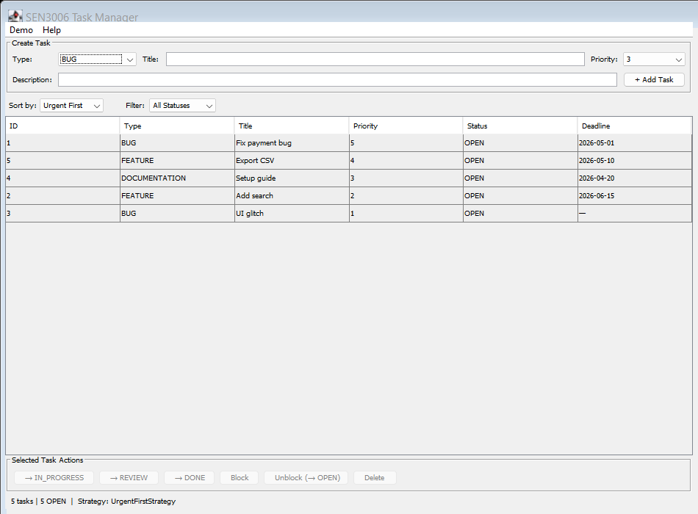
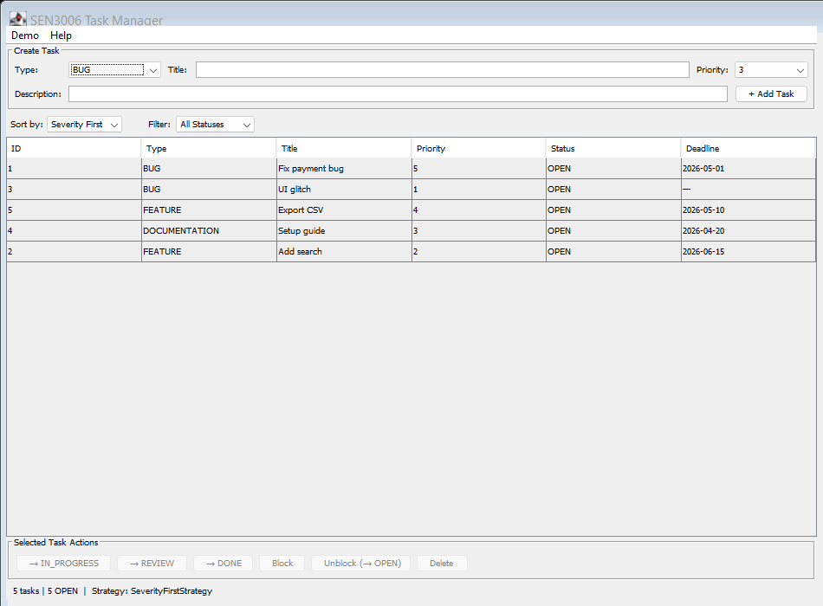
PATTERN 2 · STRATEGY · EVIDENCE
SECTION 2 / 5
The same list, reordered live.
Urgent First sort: priority 5 down to 1.
Severity First sort: both bugs rise to the top.
Task Management System · SEN3006 Software Architecture
14 / 32
Notes:
Abdul Rahman Malak.
Two real GUI screenshots, same five tasks. Left, Urgent First by priority; right, after switching to Severity First, both bugs jump to the top. Nothing recompiled — only the strategy object changed, via one setter on the dropdown. We'll do this live in the demo.

Slide 15
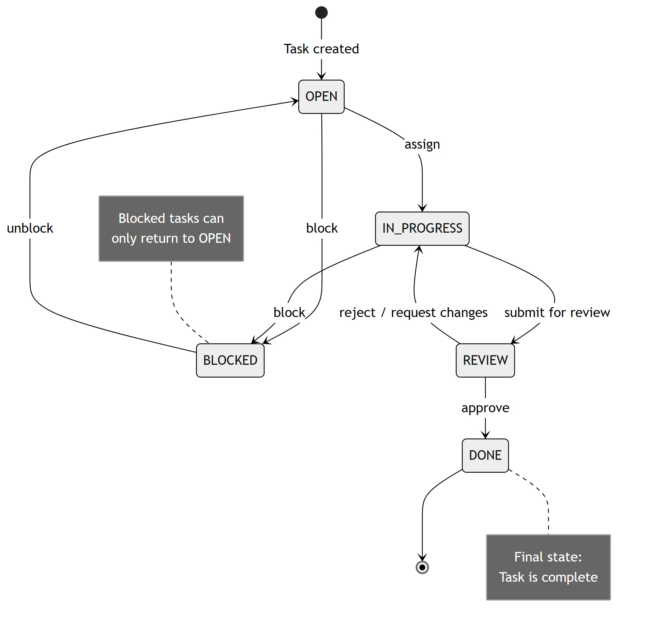
BONUS PATTERN · STATE
SECTION 2 / 5
The lifecycle is a state machine.
TaskStatus owns its transitions
Each enum constant declares its legal next states through canTransitionTo().
The base class enforces them
AbstractTask.setStatus() checks that table and throws on an illegal move.
No shortcuts
The engine refuses to jump OPEN straight to DONE; the cycle has to be walked.
State, for zero extra files
The whole pattern lives in one enum, with no extra classes.
Task Management System · SEN3006 Software Architecture
15 / 32
Notes:
Abdul Rahman Malak.
Bonus. The rubric needs one creational and one behavioural; the lifecycle is a free State machine. Path: OPEN, IN_PROGRESS, REVIEW, DONE, plus BLOCKED and reject-back. Each status declares its legal next states via canTransitionTo, and setStatus throws on an illegal jump like OPEN to DONE. One enum, no extra classes. Over to Mouhammad Houjeirat for the architecture.

Slide 16

SECTION 03
SECTION 3 / 5
Architecture and implementation.
How the design looks as classes, how one request flows through it, and how it satisfies all five SOLID principles.
Notes:
Mouhammad Houjeirat.
Section three — the system as a whole. The class diagram by pattern, one create-task call at runtime, the file layout, and SOLID.

Slide 17
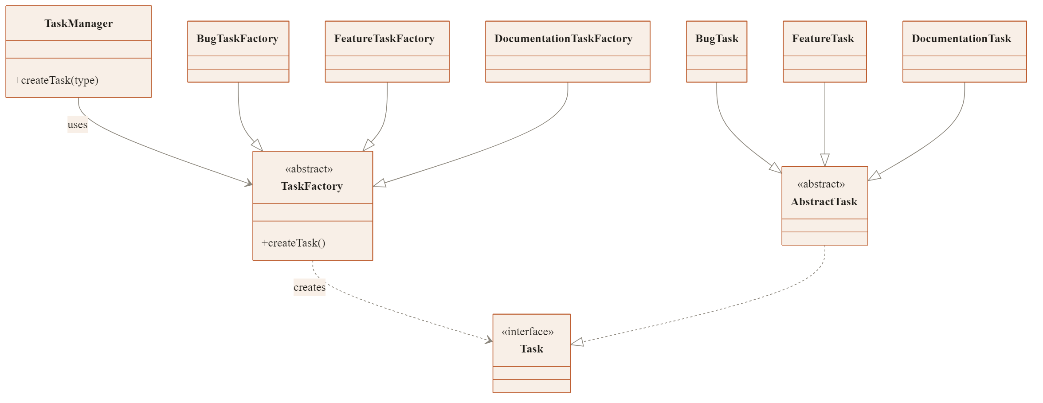
ARCHITECTURE · STRUCTURE · FACTORY METHOD
SECTION 3 / 5
Class view — the Factory Method side.
TaskManager talks only to the abstract TaskFactory, which creates a Task. Each concrete factory and each concrete task slots in underneath.
Task Management System · SEN3006 Software Architecture
17 / 32
Notes:
Mouhammad Houjeirat.
Factory side, split out for clarity. TaskManager depends only on the abstract TaskFactory; the three factories extend it; it creates a Task. Right is the product family. Every arrow points at an abstraction — Dependency Inversion — so a new type never touches the manager.

Slide 18
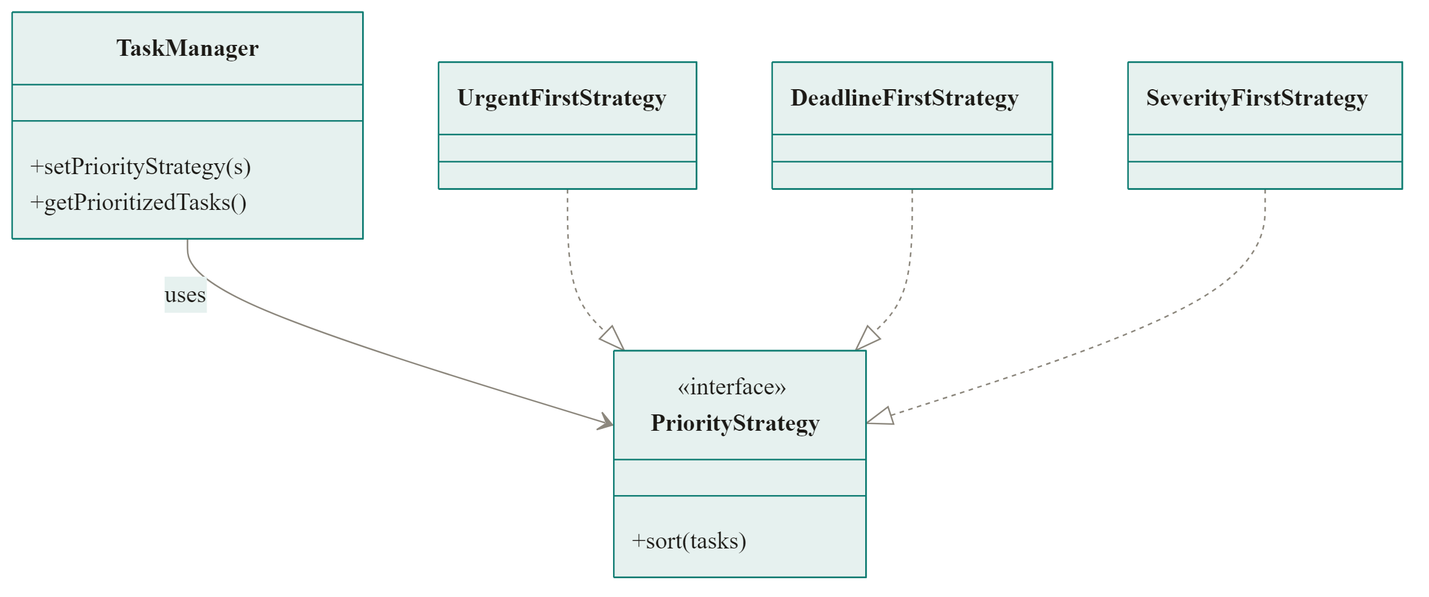
ARCHITECTURE · STRUCTURE · STRATEGY
SECTION 3 / 5
Class view — the Strategy side.
TaskManager holds one PriorityStrategy and can swap it at runtime. Each ordering is an interchangeable implementation of the same interface.
Task Management System · SEN3006 Software Architecture
18 / 32
Notes:
Mouhammad Houjeirat.
Strategy side, deliberately simple. The manager holds one PriorityStrategy through its two methods. The three orderings each implement one sort. Knowing only the interface, we add or swap an ordering with no edit to the manager — Open/Closed, straight from the pattern.

Slide 19
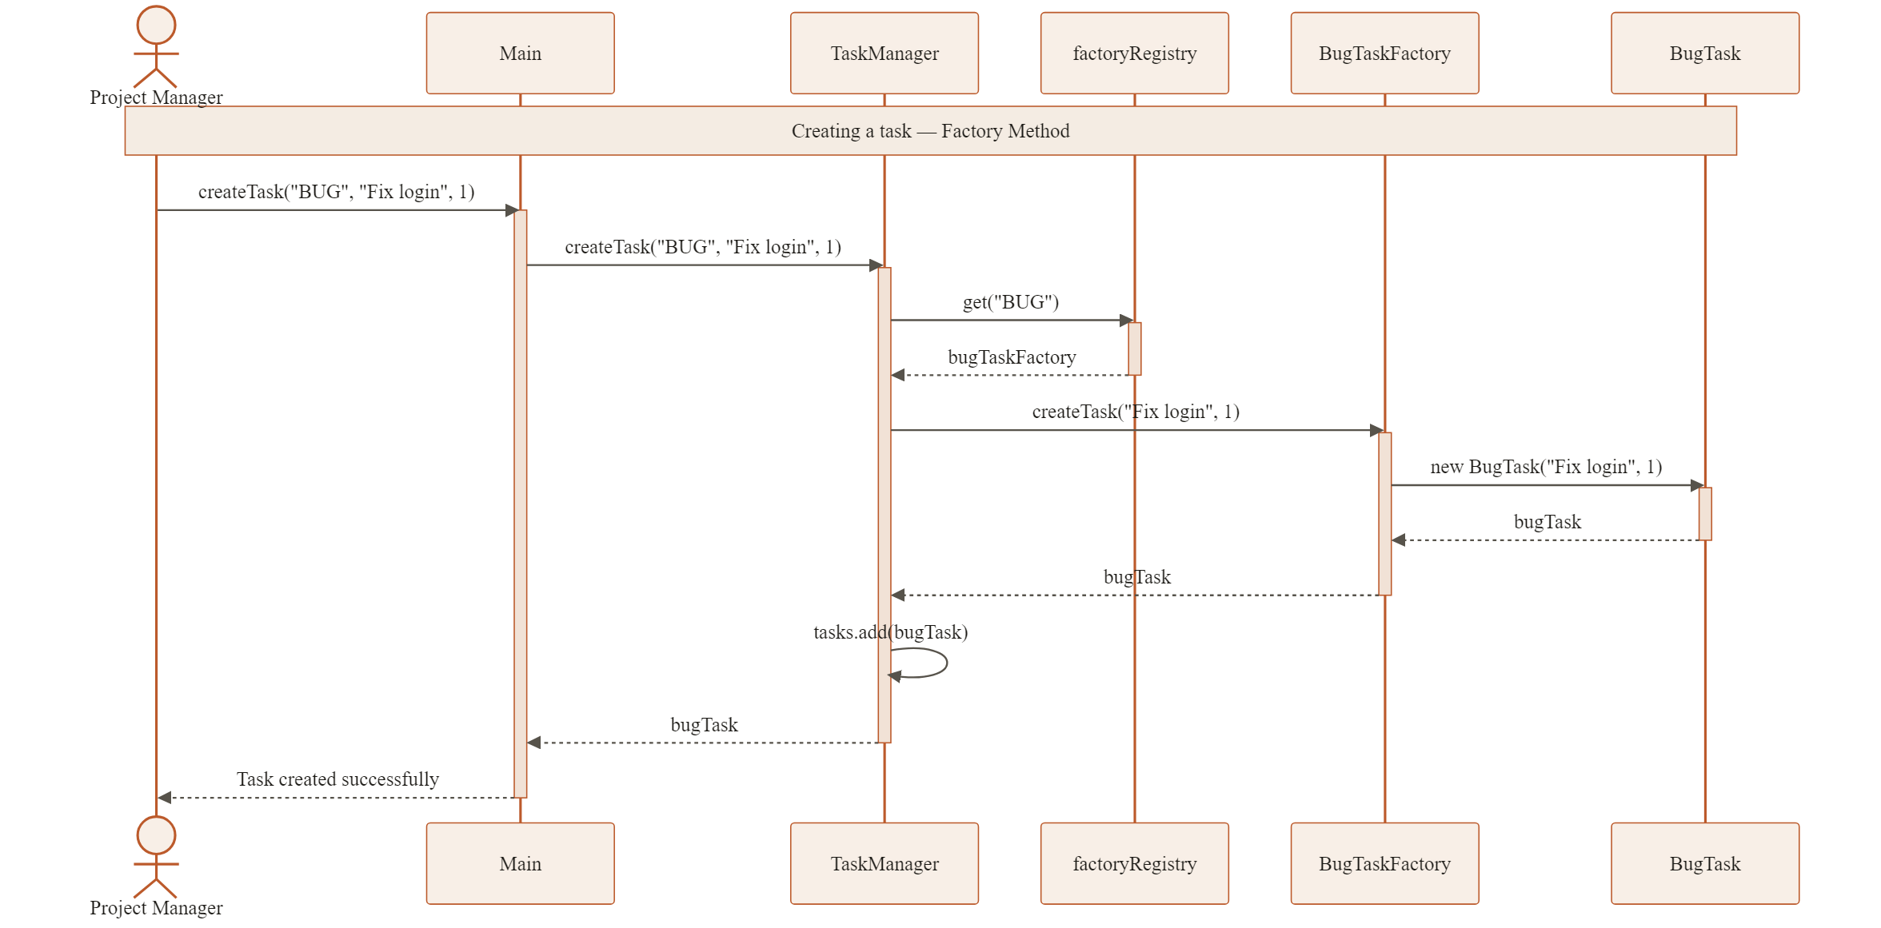
ARCHITECTURE · BEHAVIOUR · CREATION
SECTION 3 / 5
Creating a task, step by step.
The caller passes a type string; the manager looks up the registered factory and returns a Task. No concrete class is ever named by the caller.
Task Management System · SEN3006 Software Architecture
19 / 32
Notes:
Mouhammad Houjeirat.
Runtime view of Factory Method. Main asks the manager for a BUG; the manager looks up the registered factory, which builds a BugTask and returns it as a Task. The caller never writes new BugTask. The dynamic side of the class diagram.

Slide 20
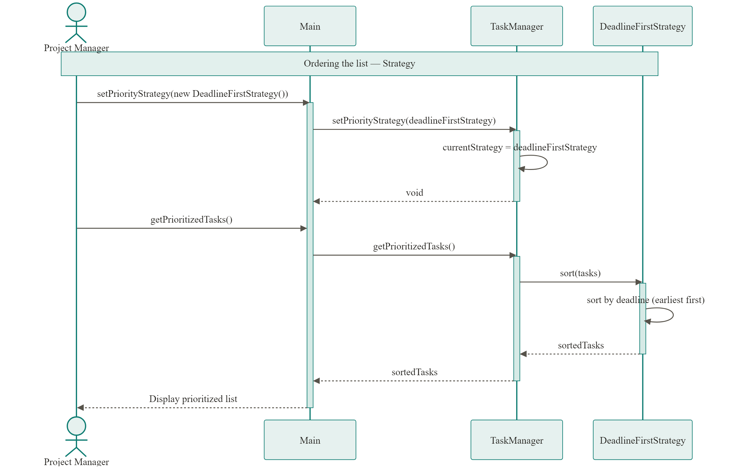
ARCHITECTURE · BEHAVIOUR · ORDERING
SECTION 3 / 5
Ordering the list, step by step.
Set a strategy, then ask for the prioritized list. The manager delegates the sort to whichever strategy is currently set.
Task Management System · SEN3006 Software Architecture
20 / 32
Notes:
Mouhammad Houjeirat.
Runtime view of Strategy. Set a strategy — DeadlineFirst — then ask for the prioritized list. The manager doesn't sort; it delegates to whichever strategy is set. Swap in SeverityFirst and the same call returns a new order, no recompile. The manager owns the list, the strategy owns the rule.

Slide 21
IMPLEMENTATION · STRUCTURE
SECTION 3 / 5
Sixteen files, three layers.
No package declarations, only java.util and java.time imported. The columns mirror the three layers of the class diagram.
PRODUCT LAYER
PATTERN LAYER
COORDINATION
›
Task (interface)
›
TaskFactory (abstract)
›
TaskManager (coordinator)
›
AbstractTask (base)
›
Bug / Feature / Doc factories
›
Main (automated tests)
›
BugTask, FeatureTask
›
PriorityStrategy (interface)
›
TaskManagementApp (console)
›
DocumentationTask
›
UrgentFirst, DeadlineFirst
›
gui.TaskManagerGUI (Swing)
›
TaskStatus (enum)
›
SeverityFirst
All three entry points drive the same engine through its public API. 2 interfaces · 1 enum · 1 abstract · 12 concrete classes.
Task Management System · SEN3006 Software Architecture
21 / 32
Notes:
Mouhammad Houjeirat.
Sixteen files, three layers: product (Task, AbstractTask, three tasks, the enum), pattern (the abstract factory and its three, the strategy interface and its three), coordination (one TaskManager plus three entry points). Only java.util and java.time. All three entry points drive the same engine, so GUI and console behave identically.

Slide 22





IMPLEMENTATION · PRINCIPLES
SECTION 3 / 5
How the design meets SOLID.
S · Single responsibility
O · Open / Closed
L · Liskov substitution
Factories build, strategies sort, the manager coordinates. One reason to change each.
A new task type or sort is a new file plus one line. Zero edits to existing classes.
Every factory works through the abstract reference; every strategy through the interface.
I · Interface segregation
D · Dependency inversion
The throughline
PriorityStrategy declares one method; the Task interface stays minimal.
The manager's fields are all interfaces and abstract types, never concretes.
Abstractions sit in the middle of the system; concrete classes live at the edges.
Task Management System · SEN3006 Software Architecture
22 / 32
Notes:
Mouhammad Houjeirat.
SOLID falls out of the two patterns. S: factories build, strategies sort, manager coordinates. O: a new type or sort is a new file, zero edits. L: every factory and strategy stands in for its abstraction. I: one-method strategy interface, minimal Task. D: the manager references only abstractions — no new BugTask anywhere inside it. On to the live demonstration.

Slide 23

SECTION 04
SECTION 4 / 5
Live demonstration.
The compiled system, run three ways: the automated test suite, the interactive console, and the Swing GUI.
Notes:
Mouhammad Houjeirat.
Section four, the live demo. Terminal first to prove the architecture, then the GUI. Rehearsed to about three minutes; screenshots as backup if the projector fails.

Slide 24
LIVE DEMONSTRATION · DEMO 1 · THE TERMINAL
SECTION 4 / 5
Demo 1 — the terminal.
Open a terminal in the project root folder, then paste the command for each step.
java -cp bin Main
STEP 1 · BUILD ONCE
$ java -cp bin Main
######## Task Management System ########
TEST 1 Factory Method Pattern
[PASS] correct types, no concretes
TEST 2 Strategy Pattern
[PASS] one list, three orderings
TEST 3 Lifecycle / State machine
[PASS] illegal moves are blocked
TEST 4-6 edge cases ........ 6 / 6
######## ALL TESTS PASSED ########
javac -d bin src/main/java/*.java src/main/java/gui/*.java
STEP 2 · RUN THE AUTOMATED TESTS
java -cp bin Main
STEP 3 · OPEN THE INTERACTIVE CONSOLE
java -cp bin TaskManagementApp
Inside the console menu:
1 create a task (Factory) · 4 change the sort (Strategy) · 3 view sorted · 5 change status (State)
Task Management System · SEN3006 Software Architecture
24 / 32
Notes:
Mouhammad Houjeirat.
Terminal first — it proves the architecture, not just the UI. Build once, then java -cp bin Main: six sections, ends ALL TESTS PASSED (the screen on the left). Then java -cp bin TaskManagementApp for the interactive console on the same engine — menu 1 creates via the factory, 4 then 3 swaps and re-lists, 5 walks the lifecycle. Then the GUI.

Slide 25


LIVE DEMONSTRATION · DEMO 2 · GRAPHICAL USER INTERFACE
SECTION 4 / 5
Demo 2 — the graphical interface.
From the same project root, one command launches the whole interface — the rest is clicks.
PASTE THIS TO LAUNCH THE GUI
java -jar TaskManagerGUI.jar
Load the demo data
Demo ▸ Load Strategy Demo seeds the table with tasks.
Strategy, live
Sort by: Urgent, Deadline, Severity — the table reorders, no recompile.
Factory, live
Add a task; the Type field picks which factory builds it.
State machine
Mark OPEN ▸ DONE: refused. OPEN ▸ IN_PROGRESS: allowed.
Task Management System · SEN3006 Software Architecture
25 / 32
Notes:
Mouhammad Houjeirat.
Same engine, Swing window. One command: java -jar TaskManagerGUI.jar, then load the demo data. Then clicks: cycle Sort by for Strategy; add a task, where Type picks the factory; mark OPEN to DONE — refused, OPEN to IN_PROGRESS — allowed, the State machine. On to the evaluation.

Slide 26

SECTION 05
SECTION 5 / 5
Results, evaluation and conclusion.
What the patterns delivered in practice, the honest limits of this build, and the main lesson.
Notes:
Mouhammad Houjeirat.
Final section — measure against the objective, the honest limits, and the conclusion.

Slide 27


RESULTS · WHAT THE PATTERNS DELIVERED
SECTION 5 / 5
New types and orderings, without editing existing code.
EXTENSION, IN NUMBERS
WHAT WORKED IN PRACTICE
›
New task type: 2 new files, 1 line of registration, 0 edits.
›
Documentation type was added late, with zero edits to existing code.
›
New ordering: 1 new file, 1 setter call, 0 edits.
›
The GUI dropdown proves the Strategy swap, live.
›
Test 5 in Main asserts this Open/Closed property at runtime.
›
The lifecycle enum makes every illegal transition unreachable.
›
Main doubles as the test harness, with no JUnit needed.
Task Management System · SEN3006 Software Architecture
27 / 32
Notes:
Mouhammad Houjeirat.
Did it work? A new type costs two files and one line; a new ordering, one file and one setter — zero edits either way, and Test 5 checks it at runtime. In practice: Documentation was added late with no edits, the GUI proves the live swap, the enum blocks illegal transitions, and Main was the test harness — no JUnit.

Slide 28



EVALUATION · LIMITATIONS AND ALTERNATIVES
SECTION 5 / 5
An honest look at the design.
Limitations
Alternatives we weighed
Future work
All data is in memory; nothing persists. Single user, no concurrency. Validation throws on the first error rather than collecting them all.
Abstract Factory: rejected, there is only one product family. A raw Comparator: loses the named role and the stateful sort.
Persistence via Repository, tags via Specification, async dispatch, and a small REST layer over the same engine.
Every limitation above is a scoping choice, not a structural one. The engine is decoupled enough that each item is an addition, not a rewrite.
Task Management System · SEN3006 Software Architecture
28 / 32
Notes:
Mouhammad Houjeirat.
Honest limits: in-memory only, single-user, validation throws on first error — deliberate scoping. Alternatives weighed: Abstract Factory (rejected — one product family), raw Comparator (loses the named role and the bugs-first sort). Future: persistence, tags, async, a REST layer. Each is an addition, not a rewrite.

Slide 29


CONCLUSION
SECTION 5 / 5
What we set out to do, and what we learned.
What we achieved
The patterns earned their place
A working task system where new types and new orderings cost no edits to existing, tested code.
Each was chosen to solve a concrete problem from section one, not to satisfy a checklist.
The lesson
The bigger point
Naming a role, a factory or a strategy, makes the codebase explain itself to the next reader.
Design patterns are a shared vocabulary that lets a team extend software without breaking what already works.
Task Management System · SEN3006 Software Architecture
29 / 32
Notes:
Mouhammad Houjeirat.
Achieved the objective: new types and orderings with no edits to working code. The patterns earned their place — each answered a real problem, not a checklist. The lesson: naming a factory or a strategy makes the code explain itself. The bigger point: patterns are a shared vocabulary for extending software safely. Thank you — questions welcome.

Slide 30
Thank you.
Questions welcome.
We can speak to any part: the problem, the patterns, the architecture, the code, or the demo.
Factory Method
Strategy
State
SEN3006 · SOFTWARE ARCHITECTURE
Notes:
Both.
Questions split by area: Abdul Rahman Malak takes the problem and the three patterns; Mouhammad Houjeirat takes the architecture, demo, SOLID, and evaluation. Likely asks: abstract class vs interface (per-subclass defaults + Template Method); strategy vs Comparator (named role + partition-then-sort); string registry (runtime lookup); no JUnit (zero-dependency rule, Main as harness).

Slide 31
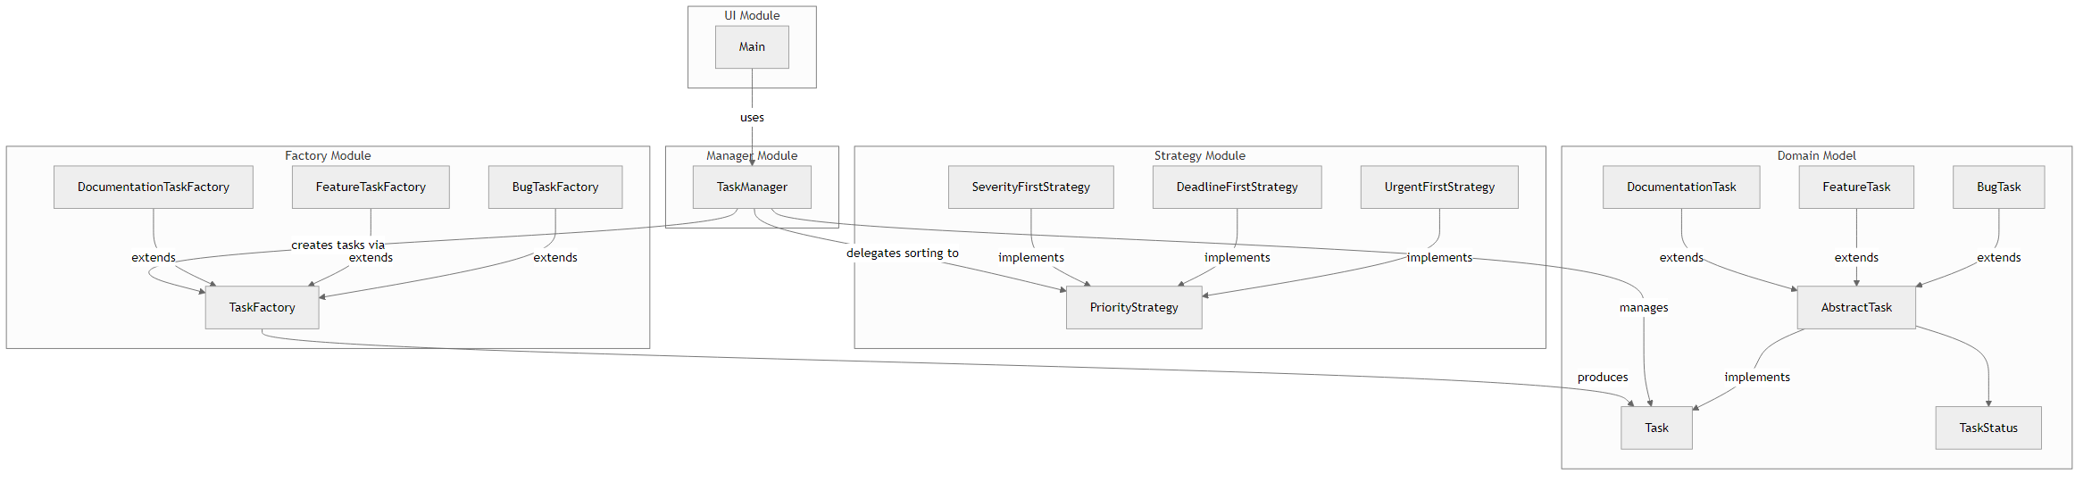
APPENDIX · SUPPORTING VIEW
SECTION 5 / 5
Component view.
The module structure: the UI depends on the manager, which delegates to the factory and strategy modules over the shared domain model.
Each box is a module; every arrow is a compile-time dependency pointing inward toward the manager and the abstractions.
Task Management System · SEN3006 Software Architecture
31 / 32
Notes:
Appendix, for questions.
Component view: UI, manager, factory, strategy, and domain modules. Every dependency points inward toward the manager and the abstractions — the module-level echo of the class diagram.

Slide 32
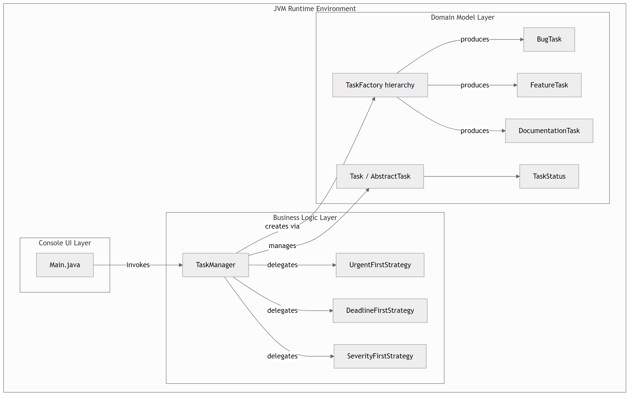
APPENDIX · SUPPORTING VIEW
SECTION 5 / 5
Deployment view.
One JVM, one shared engine, three entry points. No network, no database, no external services.
Task Management System · SEN3006 Software Architecture
32 / 32
Notes:
Appendix, for questions.
Deployment view: one JVM, one shared engine, three entry points. No network, no database — what zero dependencies means in practice.

