Slide 1


NextGen Central Sign-On
Overview for Clerk’s Office Staff
United States District Court, Southern District of California
Date, Time
Location
Presenter
United States District Court
Southern District of California

Slide 2
AGENDA
Key Terms
Central Sign-On for Court Users
Central Sign-On for Attorneys
Central Sign-On for Pro Se Litigants
Common Scenarios on Go Live Date
United States District Court
Southern District of California

Slide 3
Key Terms
CSO = Central Sign-On (One Set of Credentials)
JENIE = Judiciary Enterprise Network Information Exchange (Web-based portal for several AO hosted applications.)
Legacy (before August 11, 2014) vs. Upgraded
CurrentGen (old) vs. NextGen (new)
Exempt vs. Non-Exempt (PACER Payments)
United States District Court
Southern District of California

Slide 4
Central Sign-On for Court Users
United States District Court
Southern District of California

Slide 5
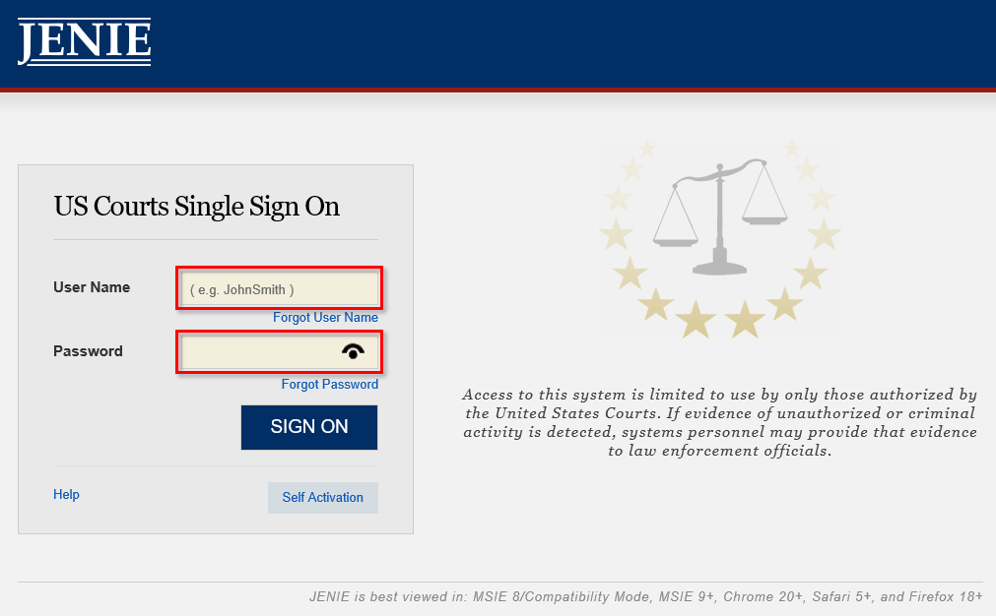
How do I log into NextGen CM/ECF?
Court users will now log in to CM/ECF through JENIE.
Navigate to https://jenie.ao.dcn.
Log in with your User Name and Password.
United States District Court
Southern District of California

Slide 6
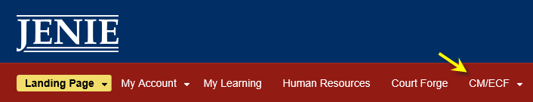
Once logged in, click on the ‘CMECF’ link on the toolbar.
Note: It may take a few minutes to load all menu options.
United States District Court
Southern District of California

Slide 7
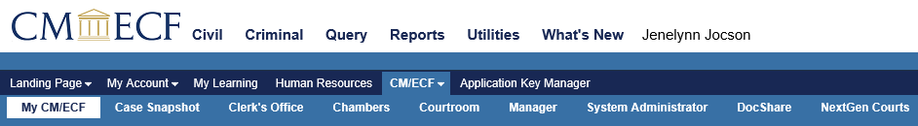
The legacy CM/ECF menu options will be shown on the top of the screen.
The NextGen menu items (My CM/ECF Workspace, NextGen Court links, etc.) are within the light blue bar. The NextGen menu will be different for each user, based on permissions.
You will access your HRMIS options through the Human Resources menu item within the dark blue bar.
United States District Court
Southern District of California

Slide 8
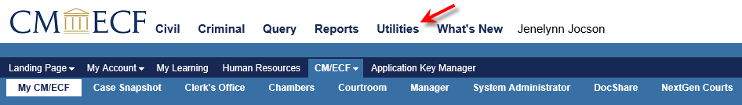
How do I log out?
Select an item from the legacy CM/ECF Menu (white menu bar)
Click Log Out
Please Note: For security purposes, please remember to close all browser windows and restart your PCs at the end of the day. Please lock your screens when stepping away from your desks throughout the day.
United States District Court
Southern District of California

Slide 9
NextGen CM/ECF FAQs for Court Users
Q: Why isn’t my CM/ECF username working?
A: You now log in through JENIE so your legacy
CM/ECF username will no longer work to allow access.
Q: What’s my username?
A: Your username is your JENIE username. This is
typically FirstnameLastname.
United States District Court
Southern District of California

Slide 10
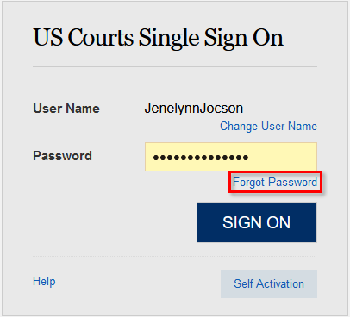
NextGen CM/ECF FAQs for Court Users
Q: What if I don’t know my password?
A: You can reset your password by clicking on the ‘Forgot Password’ link.
United States District Court
Southern District of California

Slide 11
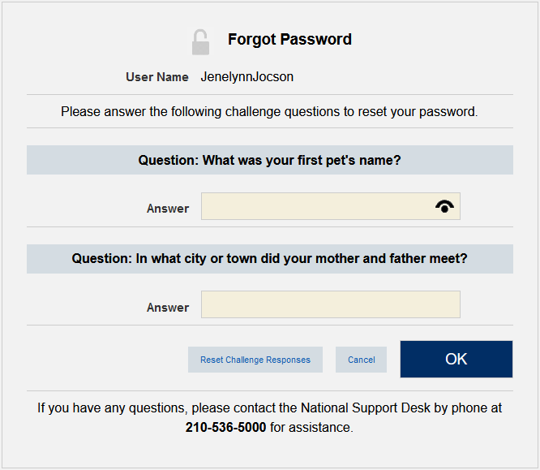
NextGen CM/ECF FAQs for Court Users - Forgot Password
You’ll be prompted to answer two security questions about your account.
If you can’t remember the answers to your security questions you can try the ‘Reset Challenge Response.’
If you still can’t access your account you’ll need to contact the JENIE help desk by phone or email. The JENIE contact information can be seen on screen as shown.
United States District Court
Southern District of California

Slide 12
Questions?
United States District Court
Southern District of California

Slide 13
Central Sign-On for Attorneys
United States District Court
Southern District of California

Slide 14
Overview - Central Sign-On for Attorneys
Central Sign-On allows attorneys to maintain one account across all NextGen courts (Appellate, District, Bankruptcy).
Attorneys can file and view documents, dockets sheets, and other PACER reports within this account.
Each Attorney must have his/her own PACER Account.
Attorneys with “legacy” PACER accounts must upgrade their accounts.
Once we are live on NextGen - 03/02/2020, PACER accounts must be linked with Attorney’s CM/ECF filing account.
United States District Court
Southern District of California

Slide 15
If Attorney… | Then Attorney…
HAS his/her own PACER account, established before August 11, 2014 and no recent changes… | Must UPGRADE the existing PACER account.
Does NOT have his/her own PACER account or uses a firm PACER account… | Must register for a PACER account (it will automatically be an upgraded account).
Has an upgraded individual PACER account and would like to file in CM/ECF (This step cannot be completed until we are live on NextGen - 03/02/2020; one-time procedure)… | Must LINK upgraded PACER Account to CM/ECF Account.
Is on the CJA panel and needs to Register for a new PACER Account or Upgrade a Legacy PACER Account… | Must take extra steps so that exempt privileges will be added to the account.
Is a CJA Attorney and needs to change to Exemption Status… | Must TOGGLE Between exempt and not exempt.
United States District Court
Southern District of California

Slide 16
Upgrading a PACER Account
If Attorney… | Then Attorney…
HAS his/her own PACER account, established before August 11, 2014 and not recently changed… | Must UPGRADE the existing PACER account.
This must be an individual PACER account (not a shared account).
United States District Court
Southern District of California

Slide 17

Upgrading a PACER Account
Navigate to www.pacer.gov.
Note: This can also be accessed through CM/ECF by clicking on Utilities > Manage your PACER Account.
Click on Manage My Account
Login with PACER username and password.
United States District Court
Southern District of California

Slide 18
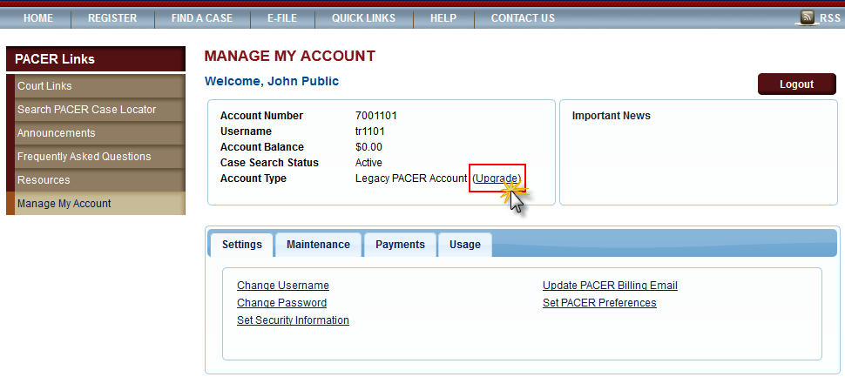
Upgrading a PACER Account
Click the Upgrade link next to the Account Type.
Please note: If the Account Type notes “Upgraded PACER Account” there is no need to upgrade.
United States District Court
Southern District of California

Slide 19
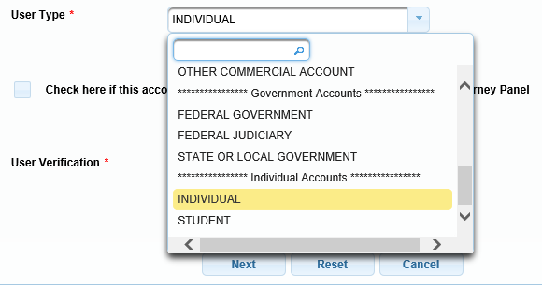
Upgrading a PACER Account
Follow prompts to update/enter all necessary information in each tab.
Select INDIVIDUAL as the User Type. Click Next.
Complete the Address section. Click Next.
Create a NEW username and password at the Security screen. Click Submit.
United States District Court
Southern District of California

Slide 20
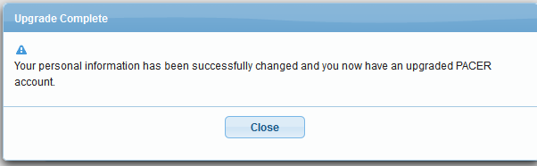
Upgrading a PACER Account
The PACER Account is now upgraded. The following confirmation screen will appear.
Note: They will no longer be able to use their old PACER username and password.
For questions, please contact PACER at 1-800-676-6856.
United States District Court
Southern District of California

Slide 21
Questions?
United States District Court
Southern District of California

Slide 22
Register for a New (Upgraded) PACER Account
If Attorney… | Then Attorney…
Does NOT have his/her own PACER account or uses a firm PACER account… | Must register for a PACER account (it will automatically be an upgraded account).
United States District Court
Southern District of California

Slide 23
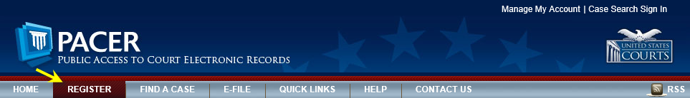
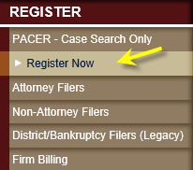
Register for a New (Upgraded) PACER Account
Navigate to www.pacer.gov.
Click on the REGISTER tab.
From the left menu options, select PACER - Case Search Only and Click the Register Now option.
Note: Do NOT click Start under the Registration Wizard
United States District Court
Southern District of California

Slide 24
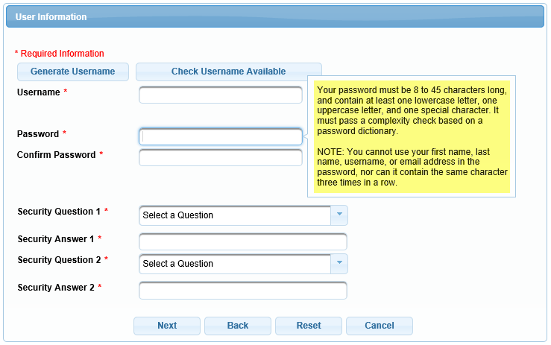
Register for a New (Upgraded) PACER Account
Complete the registration form. Select INDIVIDUAL as the user type. Click Next when finished.
Create a Username and Password, and select Security Questions. Click Next when finished.
United States District Court
Southern District of California

Slide 25
Register for a New (Upgraded) PACER Account
Enter payment information if desired.
Please Note: Providing a credit card is optional. If you would like to register without providing a credit card, click Next without entering any information on the screen. For instant access to PACER, we will validate the credit card information you provide. There is no registration charge; however, the credit card will be charged quarterly for any fees incurred. If you submit your registration request without providing credit card information, you will receive an activation code by U.S. mail in 7-10 business days.
Read and acknowledge the policies and procedures.
They will receive a confirmation page. For questions, please contact PACER at 1-800-676-6856.
United States District Court
Southern District of California

Slide 26
Questions?
United States District Court
Southern District of California

Slide 27
Link Upgraded PACER Account to CM/ECF Account
If Attorney… | Then Attorney…
Has an upgraded individual PACER account and would like to file in CM/ECF… | Must LINK upgraded PACER Account to CM/ECF Account.
Note: This step cannot be completed until we are live on NextGen on 03/02/2020 and is a one-time procedure.
United States District Court
Southern District of California

Slide 28

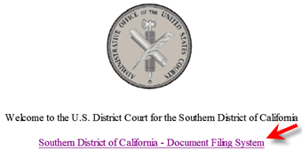
Link Upgraded PACER Account to CM/ECF Account
Please Note: These steps cannot be completed until the Southern District of California is LIVE on NextGen CM/ECF - March 02, 2020.
Navigate to the Southern District of California’s website: www.casd.uscourts.gov and click on the CM/ECF Electronic Case Filing System option.
Click on the Southern District of California - Document Filing System link.
United States District Court
Southern District of California

Slide 29
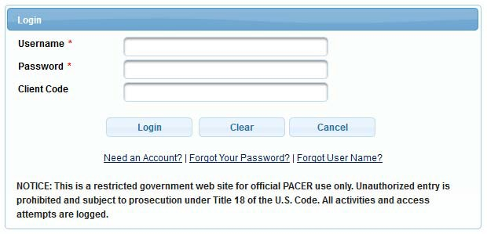
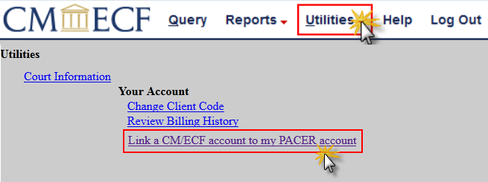
Link Upgraded PACER Account to CM/ECF Account
Login with the upgraded PACER username and password.
Click on Utilities and select Link a CM/ECF account to my PACER account.
United States District Court
Southern District of California

Slide 30
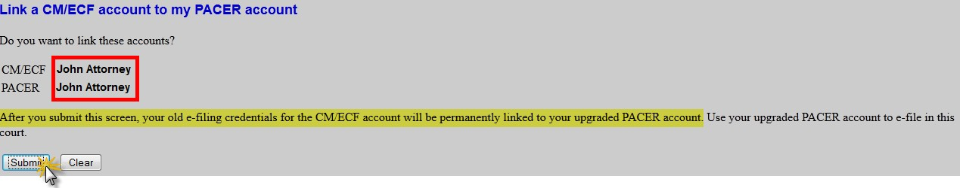
Link Upgraded PACER Account to CM/ECF Account
Enter current CM/ECF login and password. Click Submit.
Ensure that the CM/ECF account and PACER account listed are accurate. If so, click Submit.
Note: The individual PACER account should be listed. DO NOT link a shared firm PACER account to the CM/ECF account.
United States District Court
Southern District of California

Slide 31
Link Upgraded PACER Account to CM/ECF Account
They have successfully linked their account. The account is now ready for filings.
To have the Civil and Criminal menu items appear for filing…
> Refresh the screen (press F5)
> Click on one of the menu items.
Note: They will now only use their new
PACER username and password to login to
both PACER and CM/ECF.
United States District Court
Southern District of California

Slide 32
Questions?
United States District Court
Southern District of California

Slide 33
CJA Attorney PACER Accounts
If Attorney… | Then Attorney…
Is on the CJA panel and needs to Register for a new PACER Account or Upgrade a Legacy PACER Account… | Must take extra steps so that exempt privileges will be added to the account.
Note: CJA Attorneys will only need one PACER account for filing and viewing in CM/ECF NextGen. If they have a separate exempt CJA account now, those exempt privileges will be added to their individual upgraded PACER account.
United States District Court
Southern District of California

Slide 34
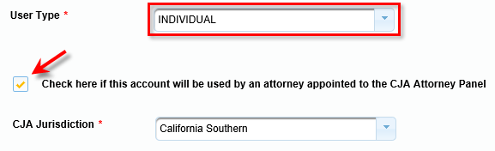
CJA Attorney PACER Accounts
Register for a new PACER Account
Follow the procedure to create a new PACER Account.
On the registration page, check the box to indicate that they are a member of the CJA Panel and select the CJA Jurisdiction.
Upgrade Legacy PACER Account
Follow the procedures to upgrade their Legacy Pacer Account.
Contact the PACER Service Center (PSC) by email at pacer@psc.uscourts.gov or by phone at 800-676-6856 and provide the following information to the PSC:
Name, PACER Username, Account number for upgraded PACER Account, List the Southern District of CA as the court in which they are appointed to the CJA Panel.
3. The PSC will send an email with instructions on how to proceed.
United States District Court
Southern District of California

Slide 35
Questions?
United States District Court
Southern District of California

Slide 36
Change PACER Exemption Status
If Attorney… | Then Attorney…
Is a CJA Attorney and needs to change to Exemption Status… | Must TOGGLE Between exempt and not exempt.
When viewing documents or docket sheets in a case in which attorneys are appointed as CJA counsel, they must change the PACER Exemption Status.
Each time they log into NextGen the status will default to Not Exempt.
United States District Court
Southern District of California

Slide 37
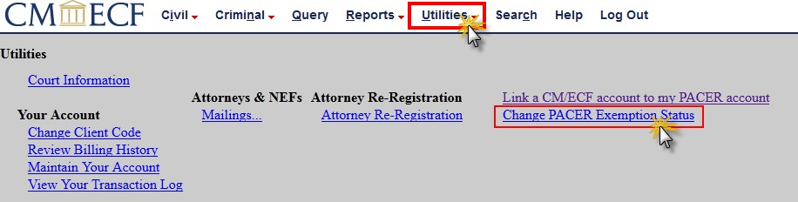
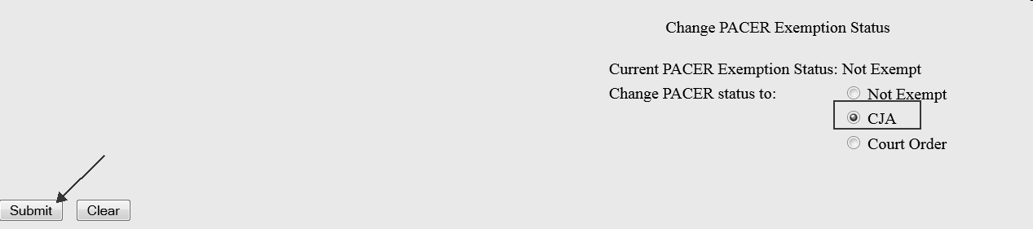
Change PACER Exemption Status
Log into CM/ECF NextGen
Click on Utilities
Select Change PACER Exemption Status
Select CJA and then Submit.
Note: The change to exempt is only good for the current session. The status will need to be changed each time they log in acting in their CJA capacity.
United States District Court
Southern District of California

Slide 38
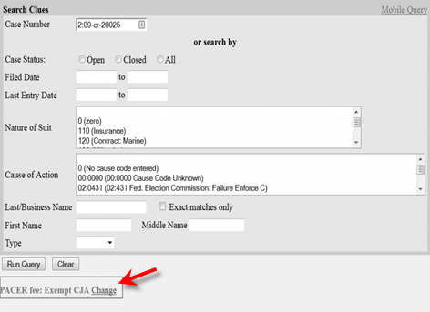
Change PACER Exemption Status
While using the Query option in CM/ECF, they can toggle between exempt and not exempt by clicking
on the link at the bottom of the page.
United States District Court
Southern District of California

Slide 39
Questions?
United States District Court
Southern District of California

Slide 40
Central Sign-On for Pro Se Litigants
United States District Court
Southern District of California

Slide 41
Central Sign-On for Pro Se Litigants
General Overview - Pro Se Litigants with leave to electronically file:
Must obtain their own individual upgraded PACER account
Will need to know their current CM/ECF login and password Can contact the Clerk’s Office to reset their password, if needed. ecfhelp@casd.uscourts.gov
Must link PACER and CM/ECF accounts once we are live on NextGen
United States District Court
Southern District of California

Slide 42
Questions?
United States District Court
Southern District of California

Slide 43
Common Scenarios on Go Live Date
United States District Court
Southern District of California

Slide 44
Common Scenarios on Go Live Date
Attorney: When I try to log into CM/ECF, I’m redirected to PACER.
Court Staff: Our court upgraded from Legacy CM/ECF to NextGen CM/ECF, which requires attorneys to log into CM/ECF with an upgraded PACER account. Your PACER login replaces your old (legacy) e-filing login.
Questions to ask:
Do you have a PACER account that is not shared with anyone?
Do you have the correct login credentials for your Legacy CM/ECF account?
United States District Court
Southern District of California

Slide 45
Common Scenarios on Go Live Date
Attorney: I logged in through PACER and have an upgraded account, but when I try to efile, I do not have the Civil and Criminal tabs on my menu bar.
Court Staff: It sounds like you may have not linked your PACER account to your CM/ECF Account.
What to do:
Direct them to the instructions for linking their accounts.
United States District Court
Southern District of California

Slide 46
Common Scenarios on Go Live Date
Attorney: I am a part of the CJA panel and I forgot to check the box on the registration form that allows me to have exempt privileges.
Court Staff: Unfortunately that is something that the Clerk’s Office does not have control over. Please send an email to pacer@psc.uscourts.gov to get the situation resolved.
United States District Court
Southern District of California

Slide 47
Common Scenarios on Go Live Date
Attorney: I don’t know the password to my account.
Court Staff: Which account are you looking to obtain your password for?
What to do:
For a CM/ECF password, please direct them to a member of the CASD CM/ECF Team (Attorney Admissions).
For a PACER password, please direct them to contact PACER at 1-800-676-6856.
United States District Court
Southern District of California

Slide 48
Common Scenarios on Go Live Date
Attorney: I need to update my address.
Court Staff: Go to www.pacer.gov. Select Manage my Account > Maintenance tab > Update Address.
United States District Court
Southern District of California

Slide 49
Questions?
United States District Court
Southern District of California

Slide 50
NextGen CM/ECF Support
CASD NextGen Implementation Team
Theodore Lewis, Chief Deputy - Operations Lead (x5344)
Jenelynn Jocson, CS Supervisor - Project Manager, WorkSpace Lead (x7356)
Daniel Nanula, CM/ECF Specialist - JENIE Lead (x7440)
Joseph Diaz, CM/ECF Training Coordinator - Central Sign-On Lead (x5601)
Robert Chapman, CM/ECF Specialist - Attorney Admissions Lead (x7355)
Brenda Tinker, IT Supervisor - IT Lead (x7646)
Robert Lopez, Systems Programmer - Citation Links Lead (x7866)
Laura Barkins, CRD Supervisor - Judge Review Packet Lead (x6416)
Attorney Admissions Line: 619-557-5329
CM/ECF Help Line: 866-233-7983
United States District Court
Southern District of California

