Slide 1
INDIVIDUAL IDEATION ASSIGNMENT
SAAS — A Student Absence & Academic Accommodation System
Replacing email-based absence with one policy-driven platform for universities
9 user roles
9 leave categories
5 instructor accommodations
3 routing cases
Johnny, Jeng-lin Li · HKUST(GZ)
Sept 2026 · ≈ 1,030 words + 1 figure + 6 references
For the SAAS design package: see /saas/index.html · Flask prototype: http://127.0.0.1:5055
Notes:
Hi, I'm Johnny — Jeng-lin Li — from HKUST(GZ). This is my Individual Ideation assignment. I'll propose a system that replaces today's email-based short-term leave with one policy-driven platform for universities.

Slide 2
1 · Problem
Today, asking for two days off is an email exercise
• A student emails every instructor separately, attaches the same certificate several times, and negotiates each quiz / lab individually.
• Each instructor improvises a reply — the programme office sees nothing; when a dispute arises, the Registry has no record of what was agreed.
• Students face unpredictable outcomes and repeat private disclosures to people they barely know.
• Instructors decide without context — they cannot see that the same student has already missed four sessions this term.
• Programme offices and the Registry have no visibility, no audit trail, and no way to notice a struggling student before the damage reaches their grades.
Why current tools do not help
• Form builders know nothing about timetables.
• LMS attendance modules cannot distribute accommodation decisions.
• Email creates no state anyone can audit.
An absence decision is an academic decision
• Unmanaged conflict → missed assessment, disputed grade, or quiet disengagement.
• The problem hits three groups at once: students, instructors, programme offices.
• It is a genuine, verifiable problem on my own programme and at most universities.
SAAS · Individual Ideation · Johnny, Jeng-lin Li
2 / 10
Notes:
Today, asking for two days off is an email exercise. Students email each instructor separately, attach the same medical certificate several times, and negotiate each assessment individually. The programme office sees nothing; when a dispute arises, the Registry has no record.

Slide 3
2 · Proposed Innovation
One submission replaces the whole email ritual
• Student selects category (medical, official activity, conference, family emergency, visa, bereavement, personal…), enters dates and reason, uploads evidence.
• System resolves enrolments × assessment calendar → one conflict record per affected quiz / midterm / final / workshop / laboratory.
• Routes by policy: A medical → instructor; B endorsed activity → roster auto-verified, instructors notified only; C > 7 days → programme office → Registry → instructors.
• Instructor selects one of 5 accommodations per conflict: excused, make-up, alternative, weight redistribution, rejection with reasons.
• Student sees outcome, deadline and make-up date in one timeline; notifications via email, Teams and push; every step audited.
What is new (not the technologies)
• The technologies are mature — cloud hosting, campus SSO, workflow engine, document storage, integrations with SIS / LMS / email / Teams.
• The new thing is the information design.
• Unit of work = consequence, not request. Every affected assessment is resolved explicitly rather than left to negotiation.
• Policy parameters live in Registry-owned configuration — rules change without a release.
• Privacy is structural: instructors receive the accommodation to apply, never the medical reason or certificate behind it.
SAAS · Individual Ideation · Johnny, Jeng-lin Li
3 / 10
Notes:
SAAS replaces the email ritual with one submission. The technologies are all mature; the new thing is the information design. Unit of work is not the request but its consequence. Policy lives in Registry-owned configuration. And privacy is structural — instructors see the accommodation to apply, never the medical reason or certificate behind it.

Slide 4
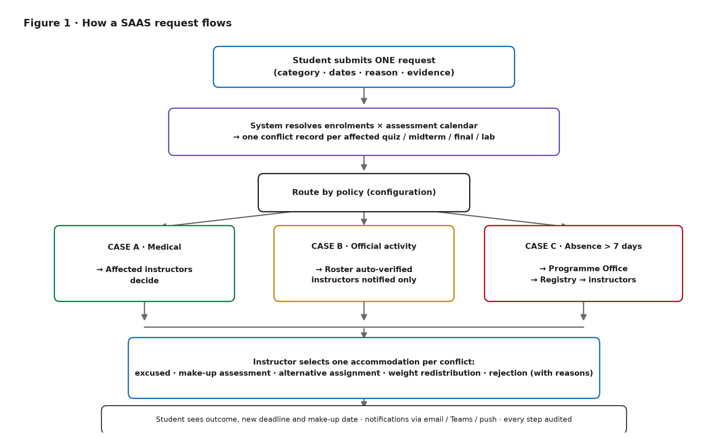
3 · How It Works
One request → resolved conflicts → policy routing → accommodation
SAAS · Individual Ideation · Johnny, Jeng-lin Li
4 / 10
Notes:
Walk through the diagram: student submits one form → the system resolves enrolments against the assessment calendar and creates one conflict record per affected assessment → the request routes by policy through Case A, B or C → instructor picks one of 5 accommodations per conflict → the student sees every outcome in one timeline. Every step is audited.

Slide 5
4 · Three Routing Cases
Configuration, not hard-coded logic
CASE A · Medical Leave
CASE B · Official Activity
CASE C · Absence > 7 days
Trigger
Trigger
Trigger
< 7 days
roster match
long absence
Route
Route
Route
→ affected instructors decide
→ auto-verified, instructors notified only
→ programme office → Registry → instructors
Each instructor picks an accommodation; if >3 days Registry countersigns.
No approval gate; students on the endorsed roster get the highest priority lane.
Registry may attach conditions (coursework plan, minimum attendance) before final approval.
Case B students: auto-verified, no document required, highest priority lane · Case C must pass Registry before instructors act
SAAS · Individual Ideation · Johnny, Jeng-lin Li
5 / 10
Notes:
Three routing cases, all driven by configuration rather than code. Case A: medical → affected instructors. Case B: official activity → roster auto-verified, instructors notified only — the highest priority lane and no document required. Case C: any absence over seven days must pass the programme office and the Registry before instructors act.

Slide 6
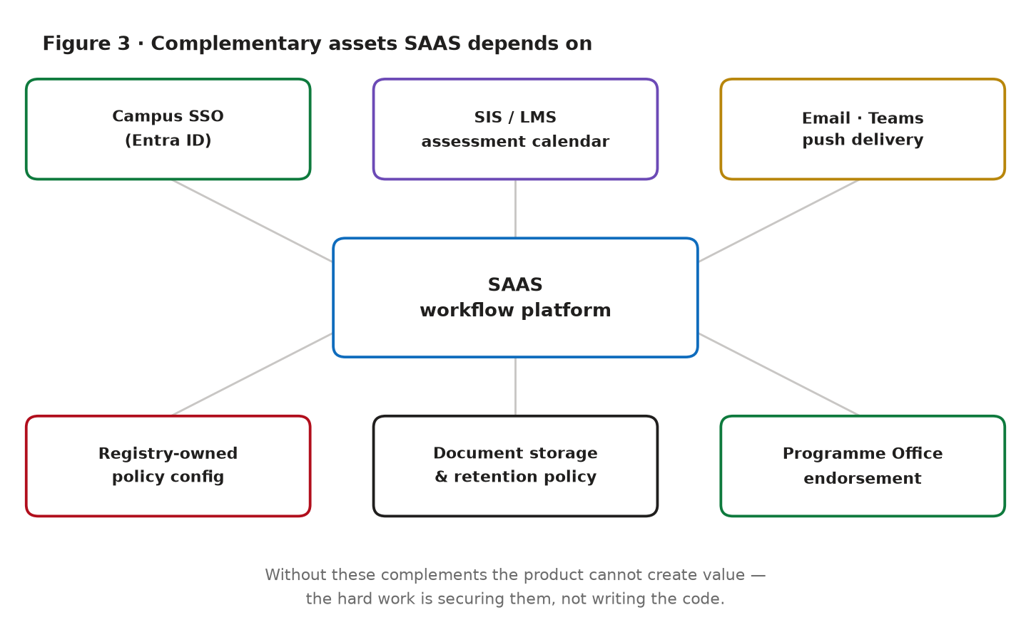
5 · Course Concept · Complements
Teece (1986): value is co-produced with the assets an innovator does not own
• SAAS value is almost entirely co-produced:
– without assessment calendar → conflict detection is guesswork
– without campus SSO → adoption collapses
– without email / Teams → decisions stall in a queue nobody opens
– without Registry-owned configuration → the system fossilises
• Hard work is securing the complements, not writing the application.
• Implication: prioritise integration contracts (SIS, LMS, IT) and policy ownership over feature scope in the first release.
SAAS · Individual Ideation · Johnny, Jeng-lin Li
6 / 10
Notes:
Apply Teece's complements argument. SAAS value is almost entirely co-produced. Without the assessment calendar, conflict detection is guesswork. Without campus SSO, adoption collapses. Without email and Teams delivery, decisions stall. Without Registry-owned configuration, the system fossilises. The hard work is securing the complements, not writing the application.

Slide 7
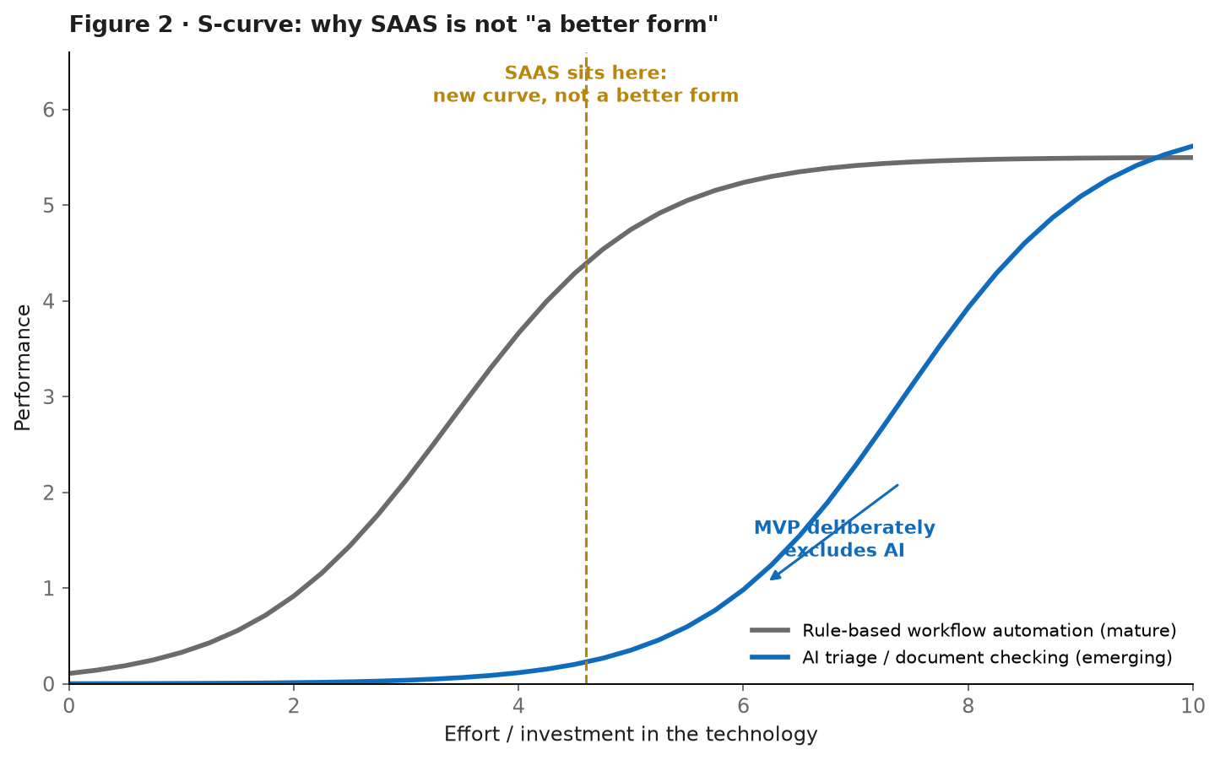
6 · Course Concept · S-curve
Why SAAS is not "a better form" — Utterback & Abernathy (1975); Foster (1986)
• Rule-based workflow automation sits on the flat, mature part of its curve — competing on form features yields diminishing returns.
• SAAS matters only by starting a new curve: joining academic-calendar data to a privacy-aware approval workflow.
• Same logic explains the deliberate omission: AI triage and certificate-authenticity checking sit on the steep part of the LLM curve.
• A wrong automated decision in a high-stakes academic process is unacceptable; these features wait until reliability crosses the threshold.
SAAS · Individual Ideation · Johnny, Jeng-lin Li
7 / 10
Notes:
Apply the S-curve. Rule-based workflow automation sits on the flat, mature part of its curve — competing on form features yields diminishing returns. SAAS matters only by starting a new curve. The same logic explains why MVP deliberately excludes AI triage: it sits on the steep part of the LLM curve, where reliability is still improving, and a wrong automated decision in a high-stakes academic process is unacceptable.

Slide 8
7 · Business Value
An institutional licence; measurable cost becomes visible
• Customer & payer: the university, not the student — Registry and IT office buy an annual licence sized by student population.
• Users (students, instructors) pay in time, not money.
• Value: makes an unmeasured cost measurable.
– Instructor hours on absence email
– Administrative effort on disputes
– Compliance risk of holding no record
• Differentiator: policy-configuration layer + portability — same product serves HKUST(GZ), HKUST, CUHK(SZ) and other institutions whose thresholds differ.
• Needed complements: campus SSO, SIS / LMS vendors, Microsoft for delivery, cross-campus policy owners willing to harmonise.
Why choose it over alternatives?
• Generic form tool → cannot see the timetable.
• LMS attendance module → records absence, but cannot distribute an accommodation decision.
• Building in-house → hard-codes one university's policy.
• SAAS → auditable decision history + configurable policy + portable across institutions.
SAAS · Individual Ideation · Johnny, Jeng-lin Li
8 / 10
Notes:
The customer and payer is the university, not the student — Registry and IT buying an annual licence sized by student population. The value is that it makes an unmeasured cost measurable: instructor hours, dispute effort, compliance risk. Differentiator is the policy-configuration layer plus portability — one product, multiple institutions, different thresholds.

Slide 9
8 · Social Impact & Risks
Equity gains are uneven; data is a double-edged good
Positive impact
Risks & mitigations
• Equity: outcome stops depending on which instructor you ask or how persuasive your email is.
• Recurring-need students (chronic illness, caregiving, visa, athletes) gain most — the system carries context instead of forcing retellings.
• Early-warning rules can reach a struggling student before failure appears in grades.
• Unavoidable date absences (visa appointments) cannot be rejected on grounds of date.
• Gains are uneven: well-connected students adopt earliest; need an assisted non-digital route.
• Surveillance: risk scoring may stigmatise; medical documents are among the most sensitive records a university holds.
• Automation bias: instructors may ratify whatever the queue presents.
• Employment effect: administrative staff shift from email triage to case management (a change in skills, not simply less work).
• Mitigations built in: instructors never see medical reasons; every decision stays human; retention periods fixed; AI is advisory, logged and refusable.
SAAS · Individual Ideation · Johnny, Jeng-lin Li
9 / 10
Notes:
The main positive impact is equity. Today the outcome depends on which instructor you ask and how persuasive your email is; a policy-driven process replaces discretion with consistent rules. But gains are uneven — need an assisted non-digital route. And a complete absence record is also a surveillance instrument. Mitigations are built in: instructors never see medical reasons; every decision stays human; AI is advisory, logged and refusable.

Slide 10
9 · Final Reflection
Worth developing — but narrowed
• Yes, develop further as a team project — the problem is real and bounded, the complements already exist on campus, and its hardest questions are organisational rather than technical, which makes it a genuine test of collaborative innovation.
• But narrow scope: the full system is too large for one term.
• Recommend scoping the team project to the assessment-conflict workflow, where both the value and the privacy tension are sharpest.
References
Foster (1986); Teece (1986); Utterback & Abernathy (1975); Microsoft Entra ID docs (2025); GDPR (2016); FERPA (US Dept. of Education).
SAAS · Individual Ideation · Johnny, Jeng-lin Li
10 / 10
Notes:
Yes, develop further as a team project, but narrowed. The problem is real and bounded, the complements already exist on campus, and its hardest questions are organisational rather than technical — a genuine test of collaborative innovation. I'd scope the team project to the assessment-conflict workflow, where both the value and the privacy tension are sharpest.

