Slide 1
ASP.Net Core 3.1
Mr. Sophon Jumpapang

Slide 2
Introduction myself
Company
Position
Job
Partner
: CODE-D 789 CO., LTD.
: Software Engineering
: Backend Developer
: Bank of Ayudhya (Krungsri)

Slide 3
LOL Wild Rift overview
01
02
03
04
Database
Table and Stored procedure
ASP.Net Core Web API
Postman HTTP protocol and
Authorization
ASP.Net Core Web Application
JavaScript jQuery and ajax
GitHub
Git Create repository
Checkout Commit etc.

Slide 4
01
Database

Slide 5

Notes:
0:00 - 3:00

Slide 6
Database structure
Stored procedure
Database
Client
Table

Slide 7
Step
1. Database
2. Table
3. Stored procedure
LOL_WILD_RIFT_DB
CHAMPIONS
RECOMMENDED_LANE
ROLE
CHAMPIONS
RECOMMENDED_LANE
ROLES
ADD/UPDATE/GET/DELETE

Slide 8
Table
CHAMPIONS
 | ID
 | NAME
 | HISTORY
 | STATS_DAMAGE
 | STATS_TOUGHNESS
 | STATS_UTILITY
 | STATS_DIFFICULITY
 | ROLE_ID
 | RECOMMENDED_LANE_ID
 | IMAGE_PATH
ROLES
 | ID
 | ROLE_NAME
RECOMMENDED_LANE
 | ID
 | NAME

Slide 9
Stored procedure
CHAMPIONS.SP_ADD_OR_UPDATE
ROLES.SP_ADD_OR_UPDATE
CHAMPIONS.SP_DELETE
ROLES.SP_DELETE
CHAMPIONS.SP_GET
ROLES.SP_LIST
CHAMPIONS.SP_LIST
RECOMMENDED_LANE.SP_ADD_OR_UPDATE
RECOMMENDED_LANE.SP_DELETE
RECOMMENDED_LANE.SP_LIST

Slide 10
02
ASP.Net Web API

Slide 11

Notes:
0:00 - 3:00

Slide 12
API overview
ChampionAddOrUpdate
RoleList
GetChampion
RoleAddOrUpdate
ChampionsList
RoleDelete
ChampionDelete
RecommendedLaneList
RecommendedLaneAddOrUpdate
RecommendedLaneDelete

Slide 13
Build an API and run tests

Slide 14
Postman
Postman
is a software development tool.
It enables people to test calls to APIs. Postman users enter data

Slide 15
Http
Hypertext Transfer Protocol
HTTP GET
HTTP POST
01
02
Requests using GET should only retrieve data.
A POST request is used to send data to the server.
HTTP PUT
HTTP DELETE
03
04
Replaces all the current representations of the target resource with the uploaded content.
Removes all the current representations of the target resource given by URI.
Notes:
Http method

Slide 16
03
ASP.Net Web Application

Slide 17
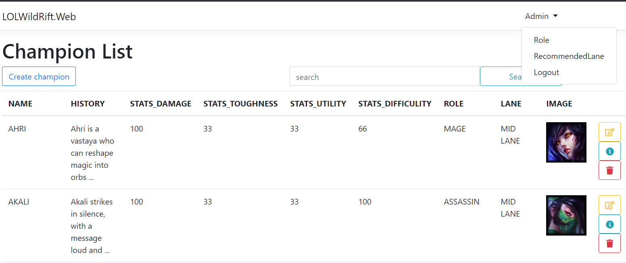
Overview

Slide 18
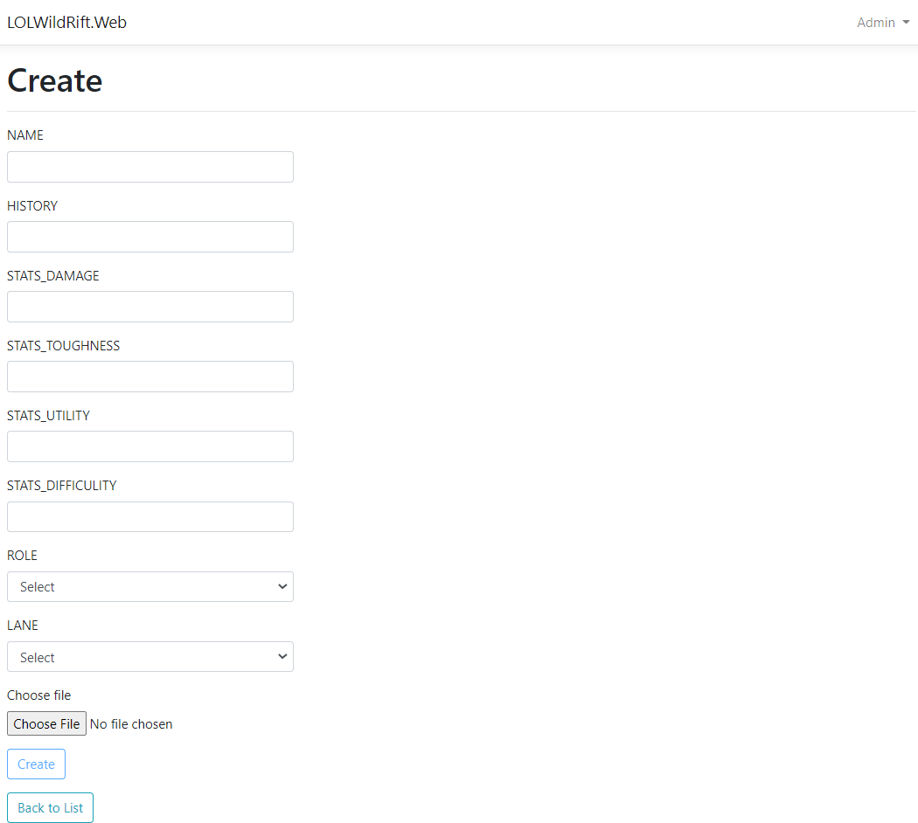

Slide 19
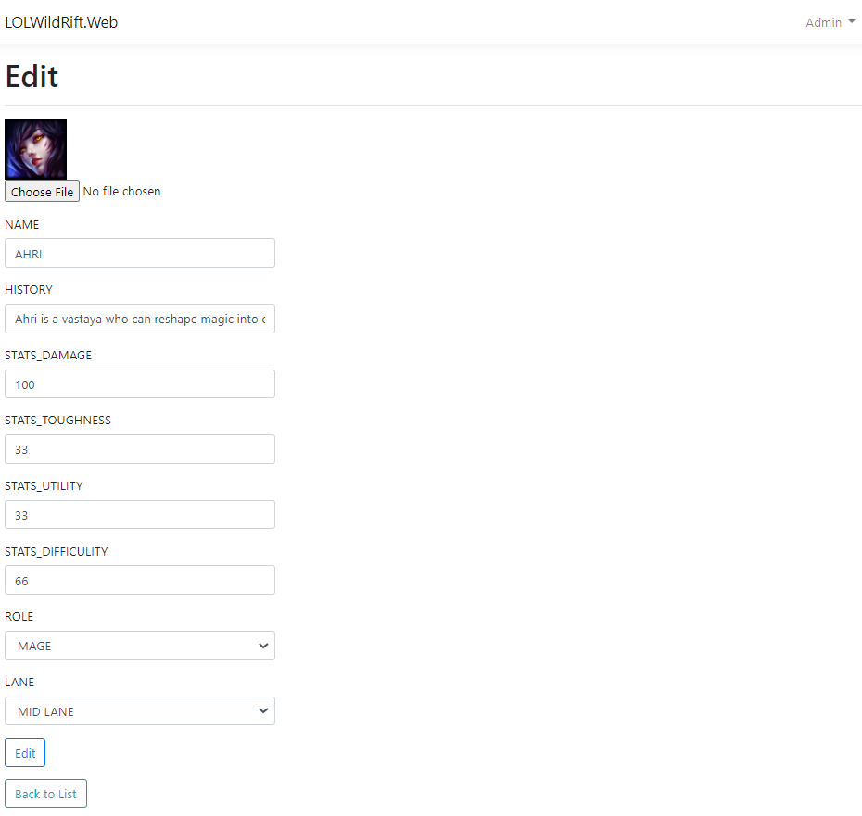

Slide 20
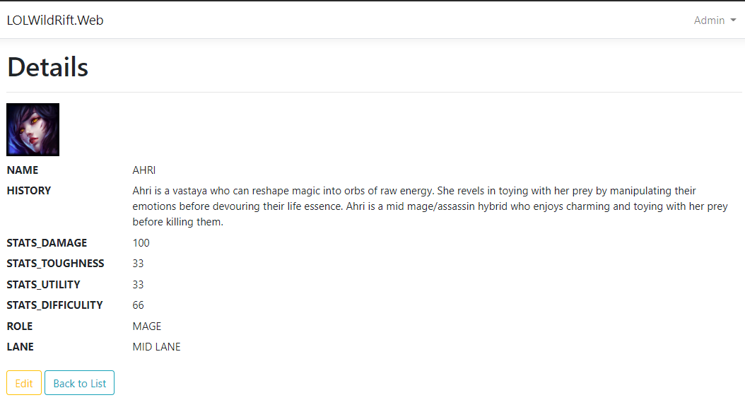

Slide 21
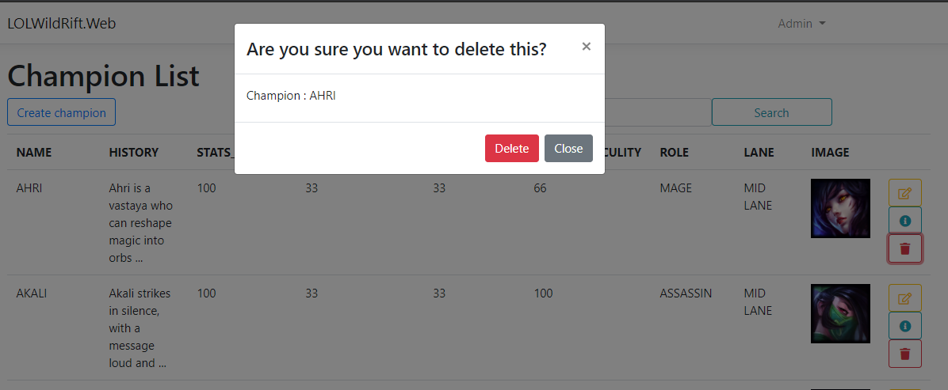

Slide 22
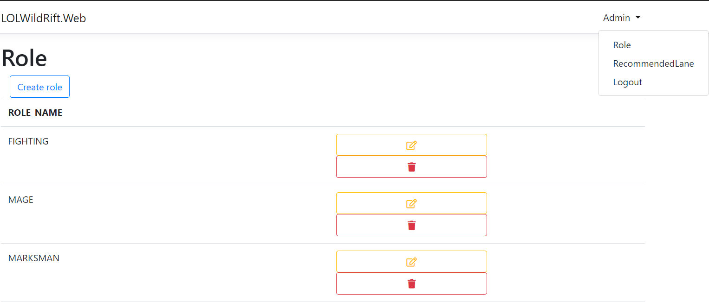

Slide 23
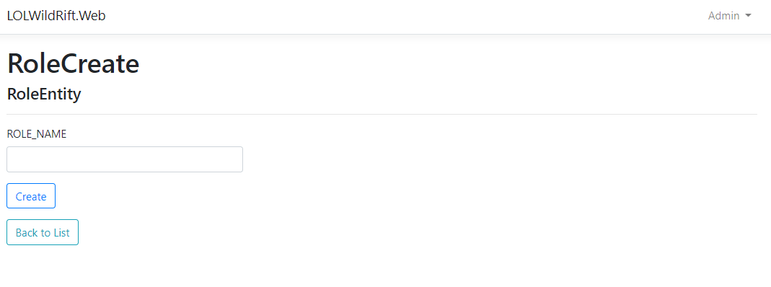

Slide 24
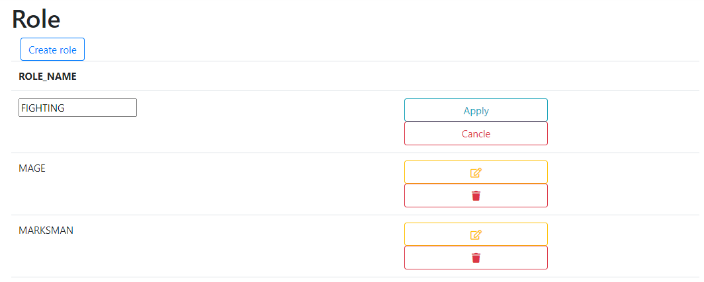

Slide 25
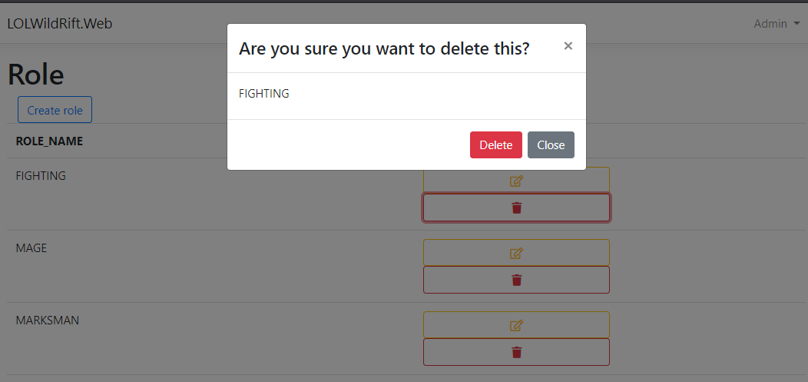

Slide 26
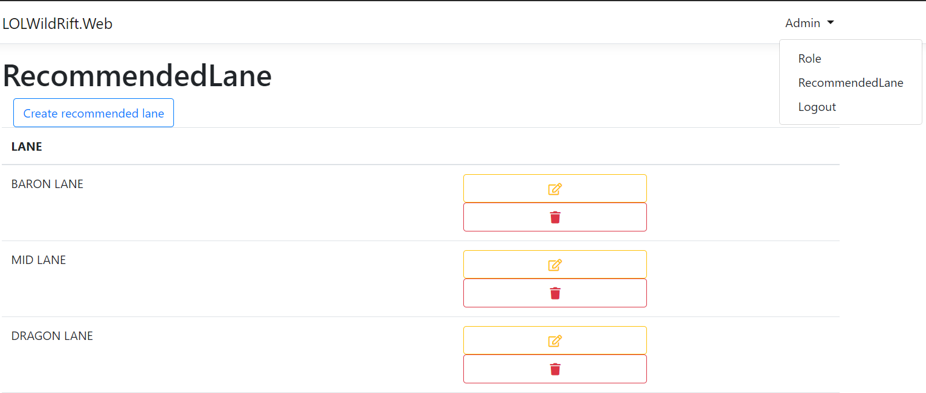

Slide 27
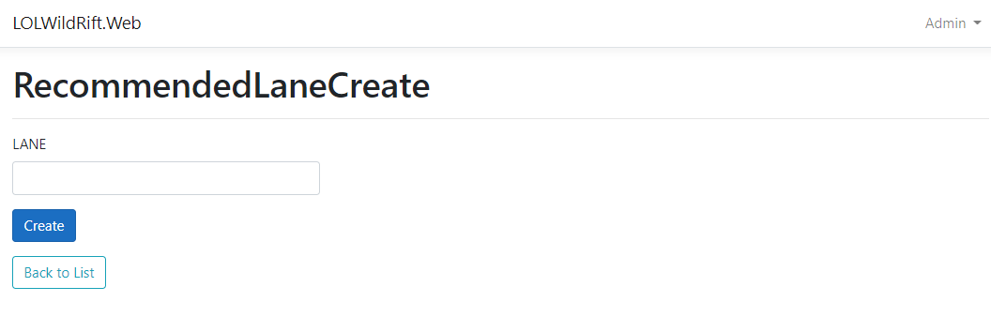

Slide 28
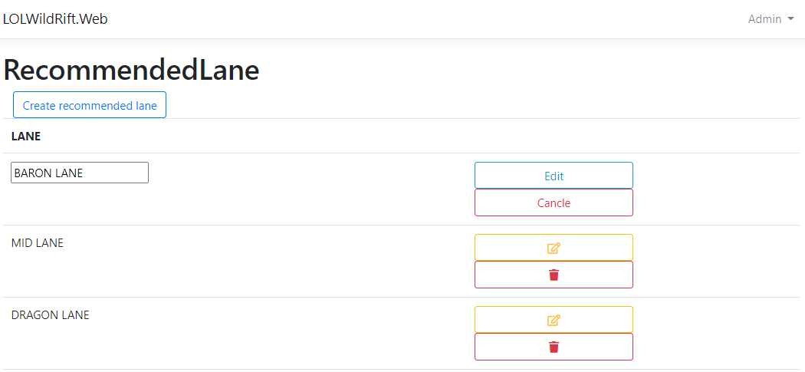

Slide 29
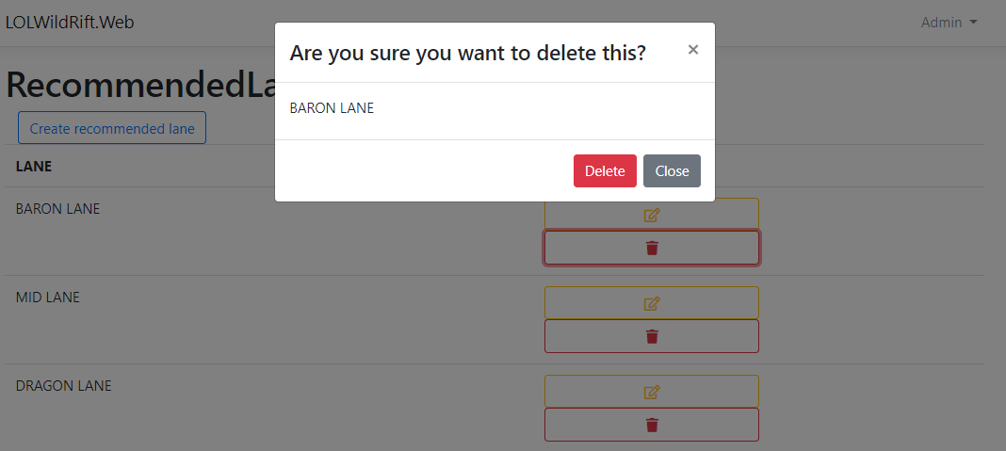

Slide 30
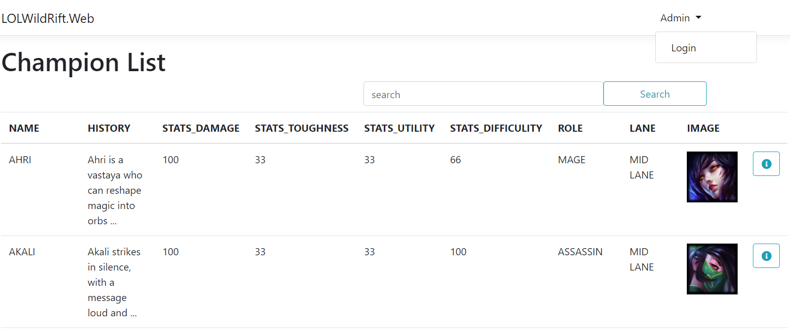
Login and Logout

Slide 31
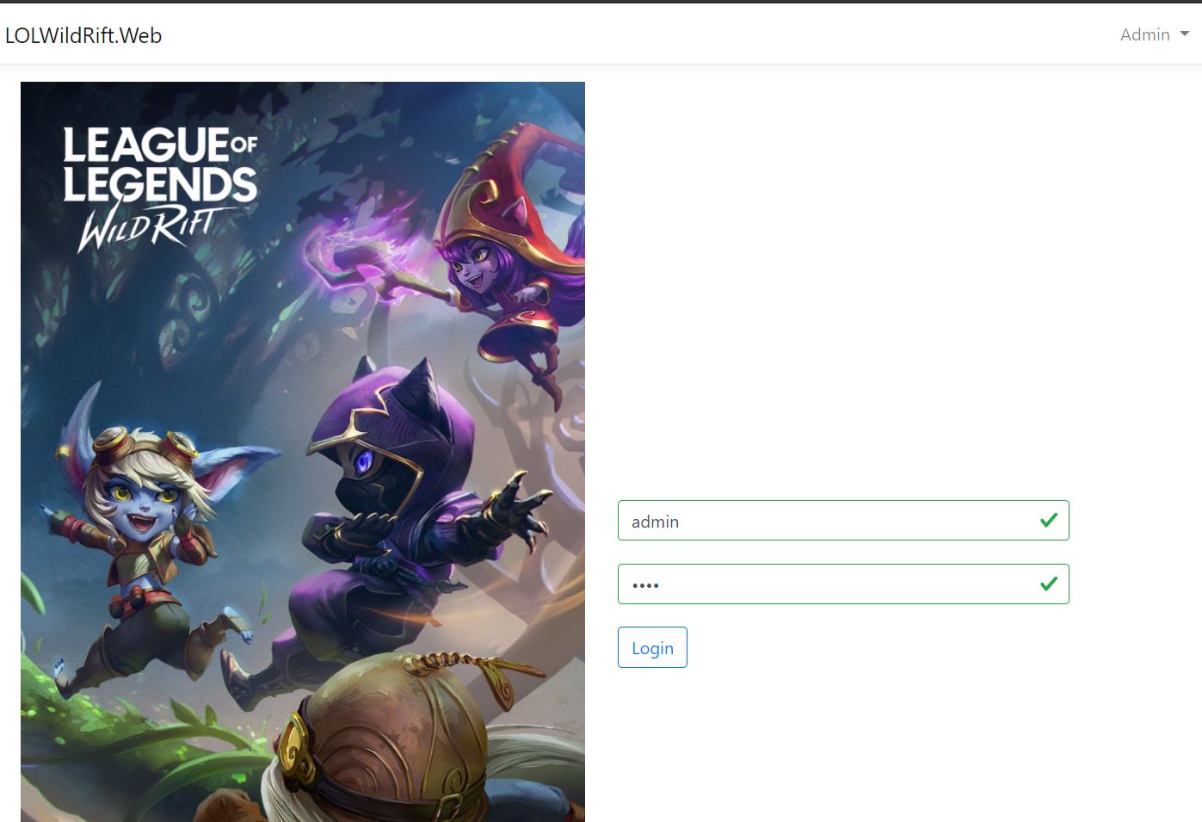
Login

Slide 32
Logout

Slide 33
API authorization
Client
API
Auth

Slide 34
Basic Authentication
Client
API
Basic ZGVtbzpwQDU1dzByZA==
a base64-encoded string username:password

Slide 35
Basic Authentication
Client
API
eaa3281b-8d31-4ae0-9696-3bc2c0536281
Generate UUID

Slide 36
04
Git Hub

Slide 37


Slide 38
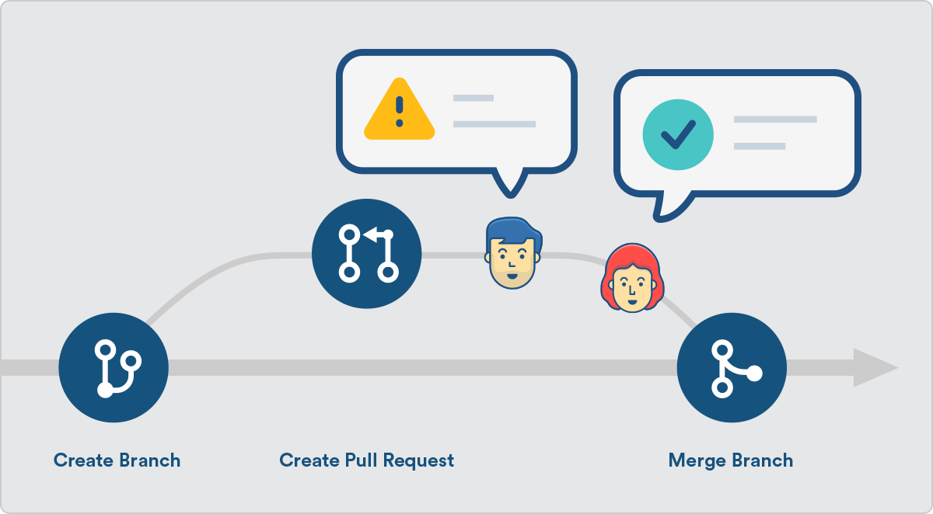

Slide 39
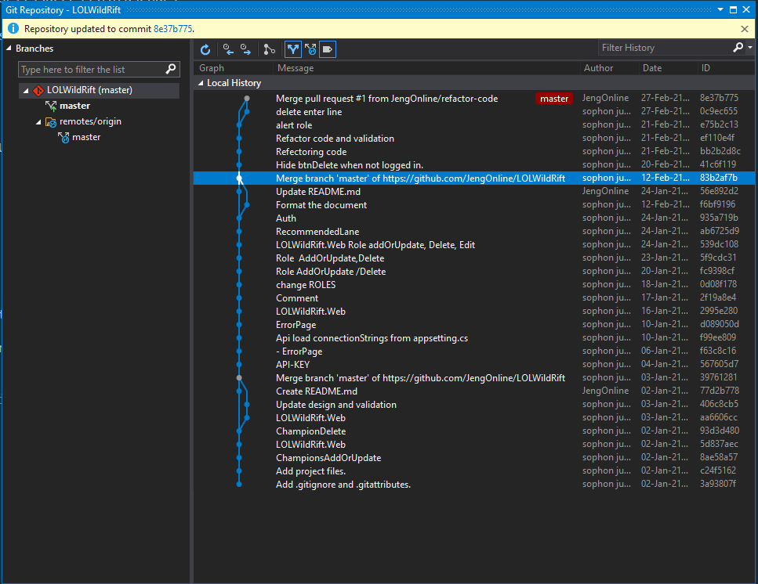

Slide 40
Thanks!
Do you have any questions?
Sophon Jumpapang

