Slide 1
Cancer Detection with Deep Learning Applied Deep Learning
Tallis Shih-Ying Jeng
sj2909

Slide 2
Outline
1
Introduction
2
Data Processing
3
Models & Experiments
4
Results & Analysis
5
Conclusion

Slide 3
1
Introduction

Slide 4
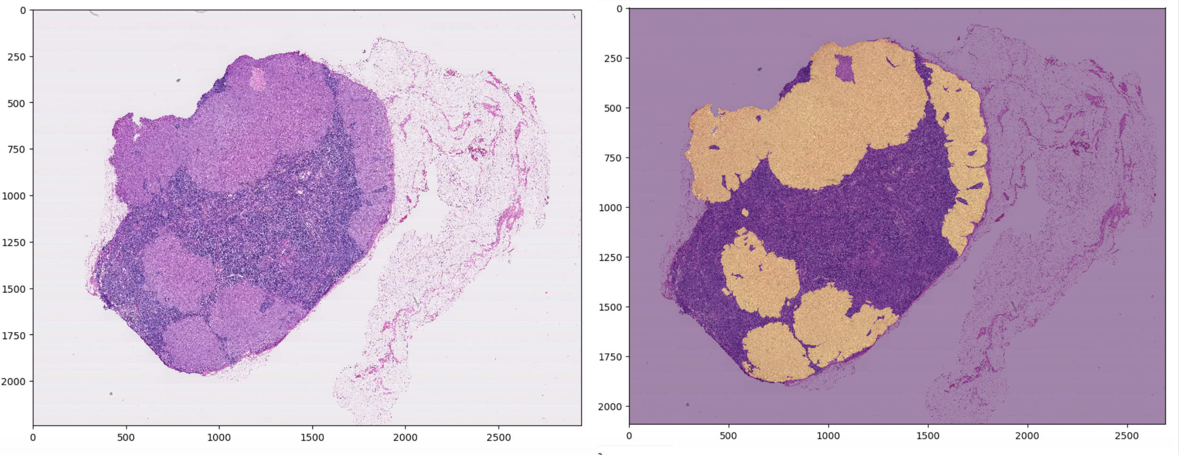
1. Introduction: What
A deep learning based system that automatically detect cancer region in pathology images

Slide 5
1. Introduction: Why
Manual annotation is costly and has low scalability
Deep learning system is potentially more accurate given the amount of training data the model can learn on in a relatively short period of time
Assistive diagnostic tool provides a second opinion and therefore lowers the risk of misdiagnosis

Slide 6
1. Introduction: Objectives
Build a Proof-of-concept prototype for cancer detection
Experiment multi-scale ensemble models
Based on the paper Detecting Cancer Metastases on Gigapixel Pathology Images
Design evaluation metrics and analyze experimental results

Slide 7
1. Introduction: Implementation
Models on slide level 5 (32x), models on slide level 7 (128x)
Models for different levels trained independently
Quantitative & Qualitative analysis
Heatmap on slide level 7

Slide 8
2
Data Processing

Slide 9
2. Data Processing: patch extraction
Extract patches (299 x 299) from the slides
Slides stored on GCS
Extracted patches stored in Google Drive
Target Label for binary classification
ROI: Center pixels
Sum pixels in ROI of the mask -> target class label

Slide 10
2. Data Processing: Train/Val/Test Split
Train & Validation set:
Randomly extract patches
Ensure class balanced by under-sampling majority (negative) classes (60 images from each class per slide)
slides '078', '084', '091', '094', '096', '101'
Test set:
Slide window across the slide
Maintain class ratio as it is
Slide ‘110'

Slide 11
3
Models

Slide 12
3. Model: Transfer Learning
Transfer Learning VGG16:
Based on results, better than the result of InceptionV3 and MobileNet
Neural Network
Dense layer with 512 units, relu activation, RMSprop optimizer
Dropout (0.5)
Random Forest
200 estimators, max_depth=8
https://www.fast.ai/2018/07/02/adam-weight-decay/

Slide 13
3. Model Transfer Learning + Dense Layer
CNN Transfer Learning Model
Layer | Component
Input (size x size x 3) | Input
(conv3-64) x2 | Block 1
maxpool-2
(conv3-128) x2 | Block 2
maxpool-2 *
(conv3-256) x3 | Block 3
maxpool-2 **
(conv3-512) x3 | Block 4
maxpool-2
(conv3-512) x3 | Block 5
maxpool-2
Dense-512 | Dense
Dropout-0.5
Softmax | Softmax

Slide 14
3. Experiments
 | Transfer VGG16 + Dense layer | Transfer VGG16 + Random Forest
Level 5 | Model nn5 | Model rf5
Level 7 | Model nn7 | Model rf7

Slide 15
4
Results

Slide 16
4. Results: Evaluation Metrics
Quantitative Evaluation
Accuracy
Precision, Recall, F1
AUROC
Average confidence on erroneous prediction
Qualitative Evaluation
Inspect test samples that causes erroneous prediction
Heatmap quality

Slide 17
5
Conclusion

Slide 18
5. Conclusion
Built proof-of-concept prototype
Multi-scale ensemble not helpful
Ensemble of different model types helpful

Slide 19
== THE END == THANK YOU VERY MUCH
GitHub Repository: https://github.com/JengTallis/adl-cancer-detection
YouTube Video: https://youtu.be/ITjs99j0P14

