Slide 1

C196 Mobile Application Development Story Board
Jared Engelkemier
Western Governors University
ID# 000347987

Slide 2
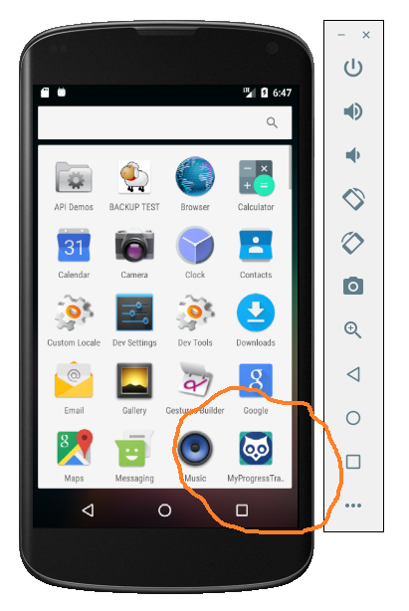
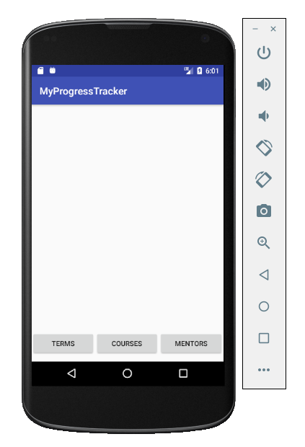


The “My Progress Tracker” application launches with the custom launcher icon.
The main screen consists of a welcome image and three navigational buttons located at the bottom of the layout.
For “Mentors” button see slide 3.
For “Courses” button see slides 4 – 8.
For “Terms” button see slides 9 – 11.

Slide 3
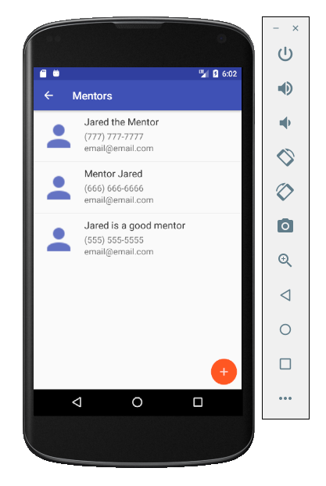
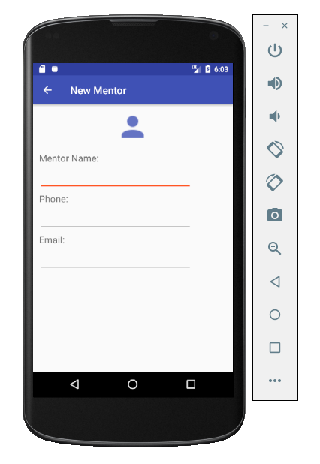
From the Main Screen, the “Mentors” button takes the user to the list of Mentors. This screen offers a view of the current Mentors and the option to add additional Mentors via the floating action button located in the bottom right corner or edit current Mentor information by clicking on the desired Mentor list item.
When inserting a new Mentor, the edit fields are blank.
When editing a current Mentor, the edit fields are populated with the existing data as well as a delete option.

Slide 4
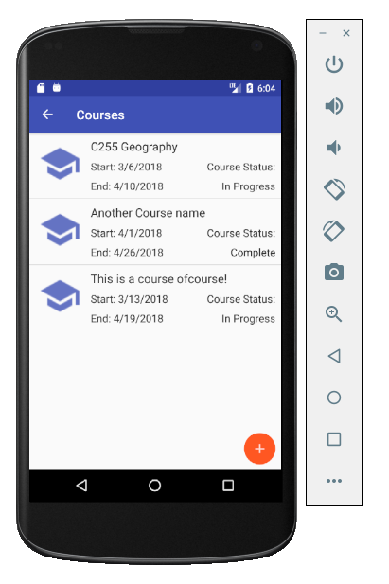
From the Main Screen, the “Courses” button takes the user to the list of Courses. This screen offers a view of the current Courses and the option to add additional Courses via the floating action button located in the bottom right corner or edit current Course information by clicking on the desired Course list item.
The Courses section of the application features tabbed navigation as shown in the following slides. The data fields in each tabbed section are either blank in the case of inserting a new course or are populated with the current course information.

Slide 5
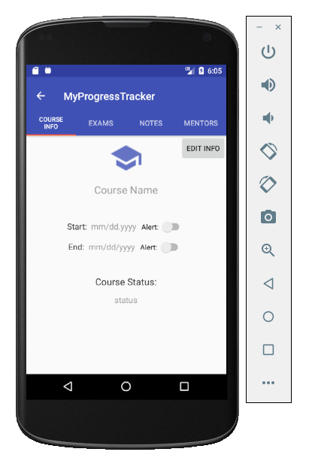
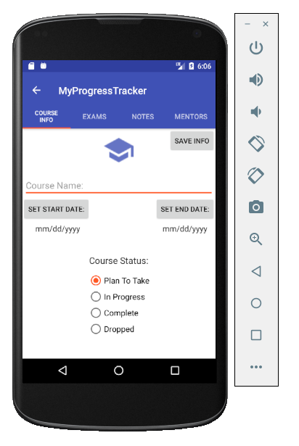
The “Course Info” tab of the Course section allows the user to enter Course data such as name, start and end dates, and current course status. This section also allows the user to set alerts in order to keep track of when a course begins and ends.

Slide 6
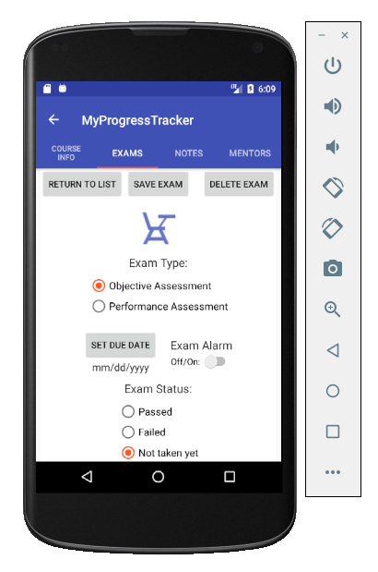
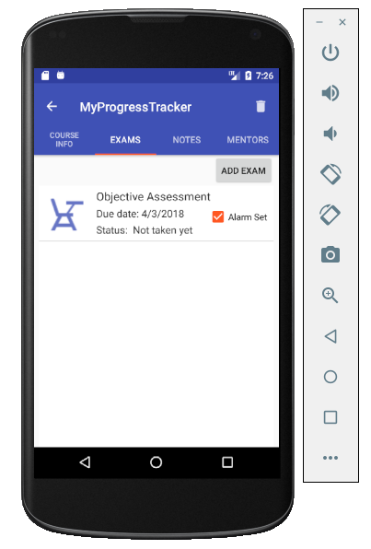
The “Exams” tab of the Course Section allows users to add, edit, or delete exams for a particular Course. When inserting a new Course, the list of Exams is blank. When editing an existing Course the list is populated with all of that Course’s existing Exams.
The edit screen of the “Exams” tab allows the user to enter all of the Exam information as well as set an alert in order to keep the user aware of the Exam due date.

Slide 7
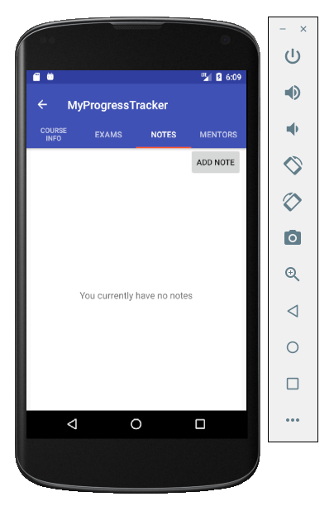
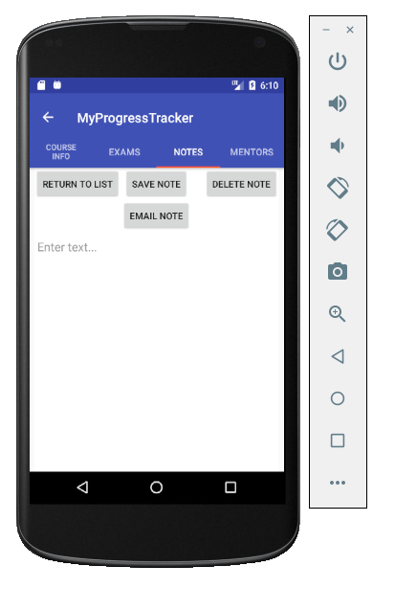
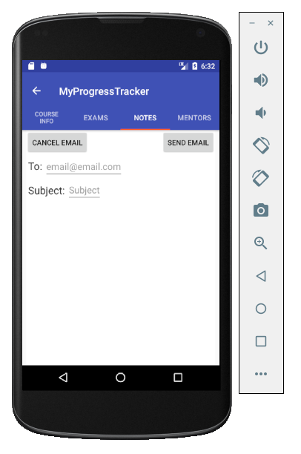
The “Notes” tab of the Course section begins by displaying a list of all the current notes associated with a particular Course. Notes can be added, edited, deleted, or emailed from these screens.

Slide 8
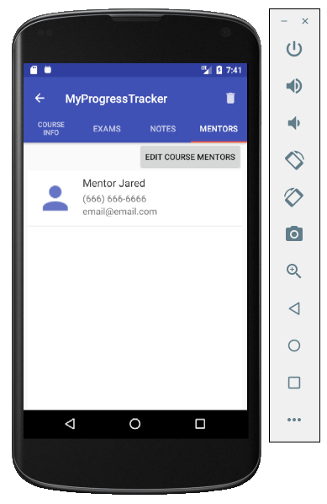
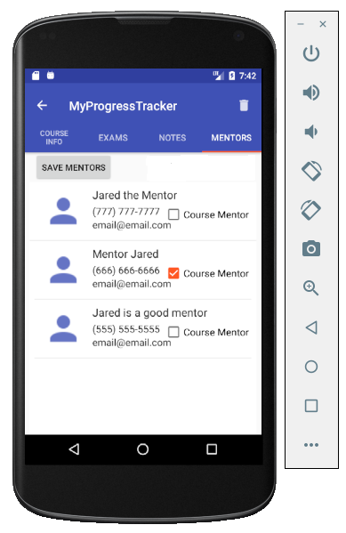
The “Mentors” tab of the Course section displays all of the Course Mentors for a particular Course. When creating a new Course this list is blank. When editing an existing Course, the list is populated with the current Course Mentors.
The edit screen consists of a list of all Mentors created from the “Mentors” section of the application. To add or remove a Mentor from a specific Course, a user can check or un-check the Course Mentor checkbox next to each Mentor list item.

Slide 9
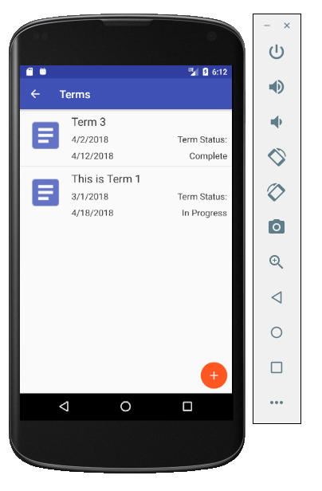
From the Main Screen, the “Terms” button takes the user to the list of Terms. This screen offers a view of the current Terms and the option to add additional Terms via the floating action button located in the bottom right corner or edit current Term information by clicking on the desired Term list item.
The Terms section of the application features tabbed navigation as shown in the following slides. The data fields in each tabbed section are either blank in the case of inserting a new Term or are populated with the current Term information.

Slide 10
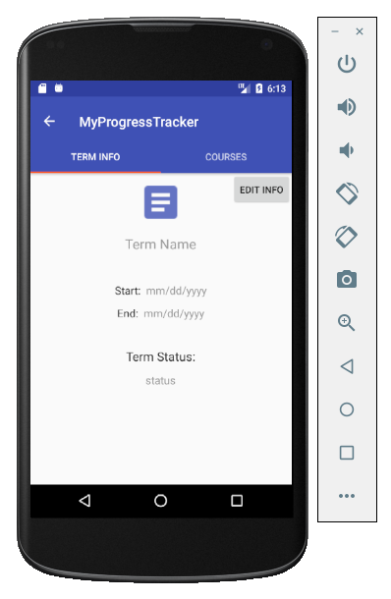
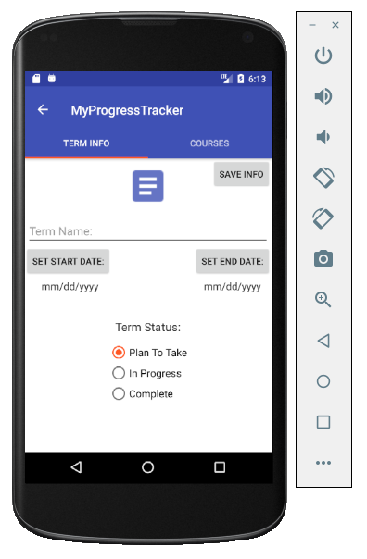
The “Term Info” tab of the Term section allows the user to enter Term data such as name, start and end dates, and current course status. The data fields are blank for new Terms and are populated with current data for existing Terms.

Slide 11
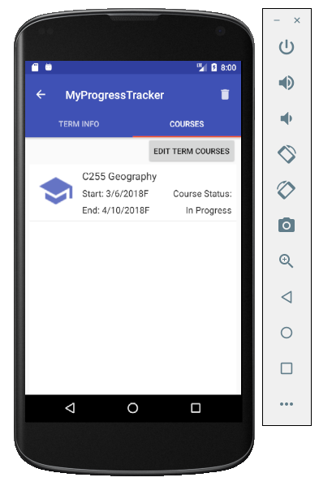
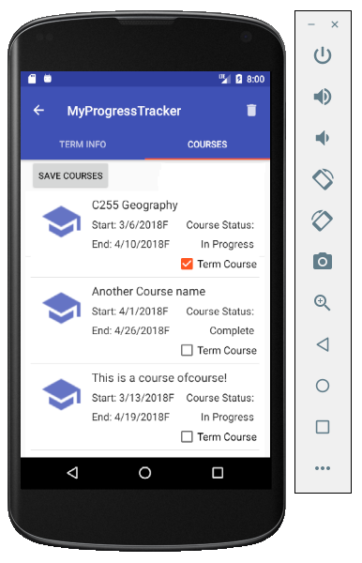
The “Courses” tab of the Term section displays all of the Term Courses for a particular Term. When creating a new Term this list is blank. When editing an existing Term, the list is populated with the current Term Courses.
The edit screen consists of a list of all Courses created from the “Courses” section of the application. To add or remove a Course from a specific Term, a user can check or un-check the Term Course checkbox next to each Course list item.

Slide 12
C196 Mobile Application Development Story Board
Jared Engelkemier
Western Governors University
ID# 000347987
End of Story Board

