Slide 1

gOGOGAGA Playlist Analysis
By: Jeni Lamoureux, Lenn Grayes, and Allison Palka

Slide 2
LADIES AND GENTLEMEN, THE PRESENTATION YOU ALL HAVE BEEN WAITING FOR…
HOPEFULLY…

Slide 3
AGENDA
The Goal
App/Visualization review & learning
If timed allowed and Questions

Slide 4

The Idea
We wanted to give music lovers deeper insight into their different playlists based on multiple musical attributes.

Slide 5
The Set Up
Jeni
Data clean up
Flask connection
Charts
Allison
Java for table
Flask set up
Lenn
Html design
Incorporating Anime js

Slide 6
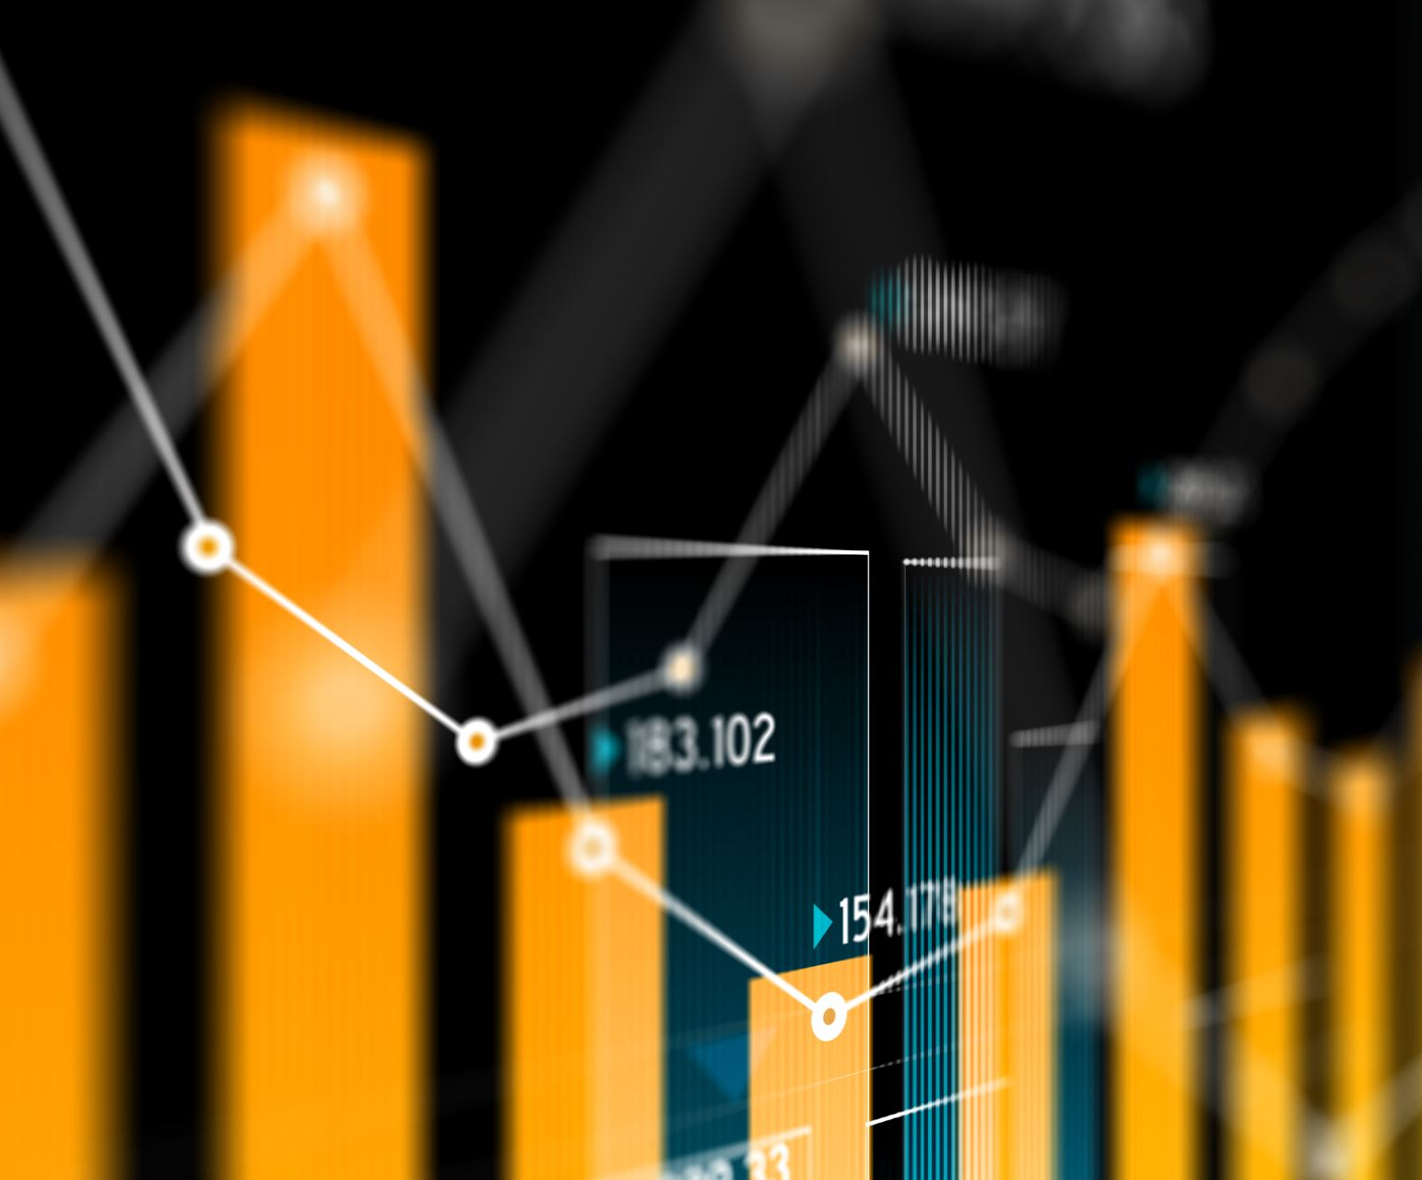
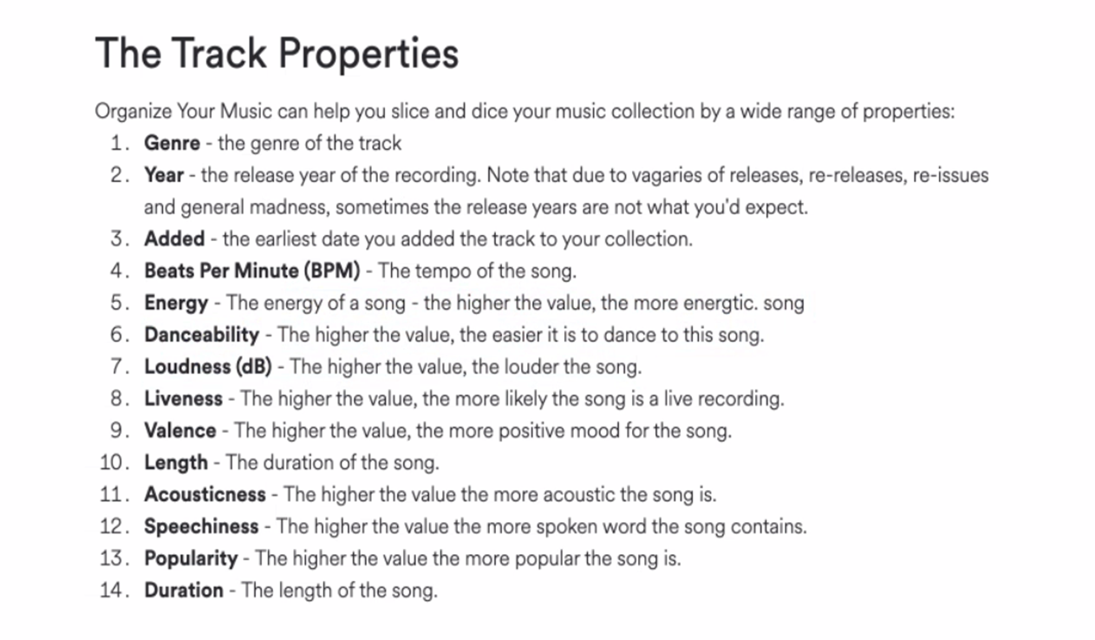
The Data
Kaggle
Clean
Sufficient Records
Reviewed several other Spotify datasets on Kaggle, but they were not as concise as the dataset we landed on
The additional information behind our data assisted with definitions of all columns

Slide 7
THE APP
Notes:
Lenn –
Review home page
Talk about the second javascript library we used
Walk through “app” pages
Jeni
Speak to charts
What conclusions were drawn
What questions do we still have
Allison
Walk through what user can do with table
Meaning of different columns
If we had more time – getting comparison to similar playlists?

Slide 8
If we had more time
API pull to get a more rounded data set
Use React JavaScript library for the ability to embed mp.3’s in the html to have songs auto-play
Creating this as an app to have users analyze their playlists and allowing more data entries to compare
Make the charts more interactive
Link tracks to YouTube
Web-scrape the album cover connected to each song
Questions?
Remember our brains are fried right now

Slide 9
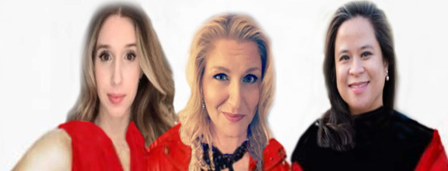
Thank you

