Slide 1

gOGOGAGA Playlist Analysis
By: Jeni Lamoureux, Lenn Grayes, and Allison Palka
Notes:
GOOD EVENING BOOTCAMP PEERS AND THANK YOU FOR TUNING IN FOR OUR PRESENTATION!
WE APPRECIATE YOUR ATTENDANCE, ALTHOUGH WE ACKNOWLEDGE IT IS REQUIRED.
WE ARE GROUP NUMBER FIVE AND THIS IS THE GOGOGAGA PLAYLIST ANALYSIS.
LET’S GET STARTED.

Slide 2
LADIES AND GENTLEMEN, THE PRESENTATION YOU ALL HAVE BEEN WAITING FOR…
Well one of them…

Slide 3
AGENDA
UNDERSTANDING THE GOAL
WALKING THROUGH THE APPLICATION
INSIGHTS AND OPPORTUNITES
Notes:
THIS EVENING WE WILL WALK YOU THROUGH THE FOLLWING:
OUR GOAL:
OUR APP:
OUR OPPORTUNITIES:

Slide 4
“Data that is loved tends to survive.”
KURT BOLLACKER, COMPUTER SCIENTIST

Slide 5

The Idea
WHAT SORT OF DATA CAN BE CAPTURED WITHIN A MUSIC PLAYLIST?
HOW CAN THE DATA BE USED?
HOW CAN WE IMPLEMENT A PIE CHART FOR MO?
Notes:
HOW MANY OF YOU STREAM MUSIC DAILY? WE FIGURED IT WOULD BE MOST EVERYONE. WE ARE ALL JAMMERS AND DREAMERS.
WHEN WE THINK OF THE TYPES OF DATA THAT IS COLLECTED IN OUR DAILY LIVES, WE OFTEN THINK OF SOCIAL MEDIA SITES AND REWARDS PROGRAMS
AT GROCERY STORES. WE SELDOM CONSIDER THE DATA THAT IS BEING COLLECTED FROM OUR MUSICAL PREFERENCES—OR HOW IT IS BEING ANALYZED AND USED BY BUSINESSES AND OUR FAVORITE ARTISTS/MUSICIANS.
YOU MIGHT KNOW EVERY WORD TO YOUR FAVORITE SONG, BUT WHAT ABOUT ITS RATING ON BPM, TEMPO, DANCEABILITY, OR DURATION?
THE IDEA? MUSIC IS DEFINITELY LOVED—THEREFORE SO IS ITS DATA.
LETS TAKE A LOOK.

Slide 6

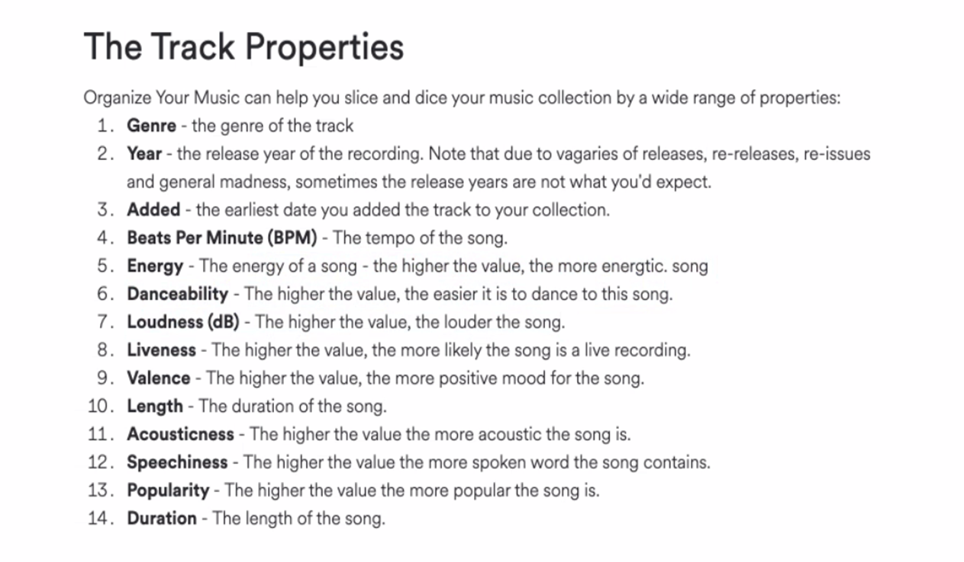
The Data
USER SPOTIFY PLAYLIST FOUND ON KAGGLE
TRACK PROPERTIES FALL UNDER BINS:
MOOD
AUDITORY PROPERTIES
CONTEXT
SEGMENT
Notes:
SPOTIFY IS ONE OF THE LARGEST ON DEMAND MUSIC SERVICES IN THE WORLD, WITH TENS OF MILLIONS OF PEOPLE LISTENING EVERYDAY.
THAT’S A LOT OF DATA TO MINE THROUGH. THEIR GROWING PLATFORM HAS SUCCESSFULLY “HUMANIZED DATA” BY EFFECTIVELY
TRAINING ALGORITHMS AND MACHINES TO LISTEN TO MUSIC AND EXTRAPOLATE INSIGHTS THAT IMPACT NOT ONLY BUSINESS, BUT THE USER EXPERIENCE.
BY REFINING COLLECTED DATA, THEY ARE ABLE TO ANALYZE WHAT SONGS GET THE MOST PLAYTIME, WHICH PLAYLISTS ARE GENERATING NEW FANS,
AND CURATE PERSONALIZED PLAYLISTS FOR USERS BASED OFF OF CATEGORIZED MUSICAL ATTRIBUTES.
OUR CHOSEN DATASET IS AN INDIVIDUAL USER’S SPOTIFY PLAYLIST FOUND ON KAGGLE. WHILE WE WOULD HAVE LOVED TO CREATE AN API CALL ON THE ACTUAL SPOTIFY WEBSITE, WE FOUND OUR KAGGLE DATASET TO BE CLEANER WHILE STILL SUPPLYING US WITH THE SUFFICIENT RECORD REQUIREMENTS.
BECAUSE OUR DATASET WAS CONFINED TO A SINGLE SPOTIFY USER—WE CHOSE TO ANALYZE MORE OF THE CONTEXTUAL PROPERTIES.
LET’S MOVE ON TO THE NEXT SLIDE TO GO OVER THE STEPS FOR OUR ANALYSIS.

Slide 7
The Set Up
Jeni – Clean up/Flask connection/Charts
Allison – Java for table/Flask set up
Lenn – Html design/Incorporating Anime js
Notes:
OUR COLLABORATION ON THIS PROJECT WAS INCREDIBLE. COMMUNICATION WAS FREQUENT AND WE VERY MUCH MADE A GREAT TEAM WHEN IT CAME TO DEBUGGING. WHILE THIS PROJECT WAS CHALLENGING—WE KEPT IT FUN!
JENI
DATA CLEAN UP
FLASK CONNECTION
INTERACTIVE CHARTS
ALLISON
TABLE JAVASCRIPT
FLASK SET UP
LENN
HTML CODE AND DESIGN
INCORPORATING ADDITIONAL JAVASCRIPT LIBRARIES

Slide 8
THE APP
Notes:
LENN
REVIEW HOME PAGE
DISCUSS JAVASCRIPT LIBRARY
WALK THROUGH “APP” PAGES
JENI
SPEAK TO CHARTS
WHAT CONCLUSIONS WERE DRAWN?
WHAT QUESTIONS DO WE STILL HAVE?
ALLISON
IN ADDITION TO OUR CHARTS, WE WANTED TO ATTACH A TABLE WITH THE PLAYLIST DATA SO THE USER CAN INTERACT THROUGH FILTERING AND SEARCHING SELCT PROPERTIES. WE DID OPT TO MAKE THIS TABLE A LITTLE MORE USER FRIENDLY BY ELMINATING SOME OF THE PROPERTIES THAT WEREN’T EASILY UNDERSTOOD, SUCH AS SPECHINESS.
THIS WAS DEFINITELY AN AREA THAT WE WOULD HAVE LOVED TO SPEND MORE TIME ON. THE IDEA BEING THAT WE COULD DEVELOP THIS FURTHER WHERE ANY SPOTIFY PLAYLIST COULD BE ADDED TO THIS TABLE AND COMPARED—CONTINUOUSLY COLLECTING DATA.

Slide 9
If we had more time
Spotify API pull to get a more rounded data set
Use React JavaScript library for the ability to embed mp.3’s in the html to have songs auto-play
Creating this as an app to have users analyze their playlists and allowing more data entries to compare
Link tracks to YouTube
Web-scrape the album cover connected to each song
Give all charts the ability to be filtered and interactive
Additional Styling
Questions?
Remember our brains are fried right now…throw us a few softballs

Slide 10
“getting information off the internet is like taking a drink from a firehose.”
MITCHELL KAPOR, CO-FOUNDER OF ELECTRONIC FRONTIER FOUNDATION

Slide 11
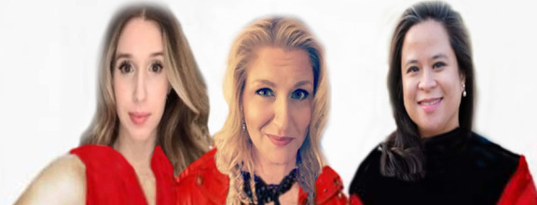
Thank you

