Slide 1


Species Distribution Models
Foundations and applied modelling in R
Photo by Stefan Els
Notes:
Open with SDM foundations; Aedes aegypti in Brazil is the applied example, not the starting point.
[Sources] University CERI template; workshop SDM materials.

Slide 2
What does a species distribution model do?
It links observed records to environmental conditions, then projects that relationship across space.
Records
Environment
Suitability
locations where the species was observed
temperature, rainfall, seasonality, habitat
a mapped hypothesis,
not proof of presence
Notes:
Foundation slide: define the SDM workflow before introducing a disease vector.
[Sources] Concept adapted from Lecture1_12Juin17.pdf pages 3 and 57-58.

Slide 3
Suitability is not the same as distribution
Species may fail to occupy all suitable habitat, and records may miss places where the species occurs.
Abiotic conditions can limit survival or reproduction.
Biotic interactions can shape realised distributions.
SDM output
Dispersal barriers can prevent occupation of suitable environments.
environmental suitability
Sampling effort changes what we observe.
a hypothesis for interpretation
Notes:
Clarifies the distinction between environmental suitability and observed distribution.
[Sources] Concept adapted from Lecture1_12Juin17.pdf pages 7-15.

Slide 4
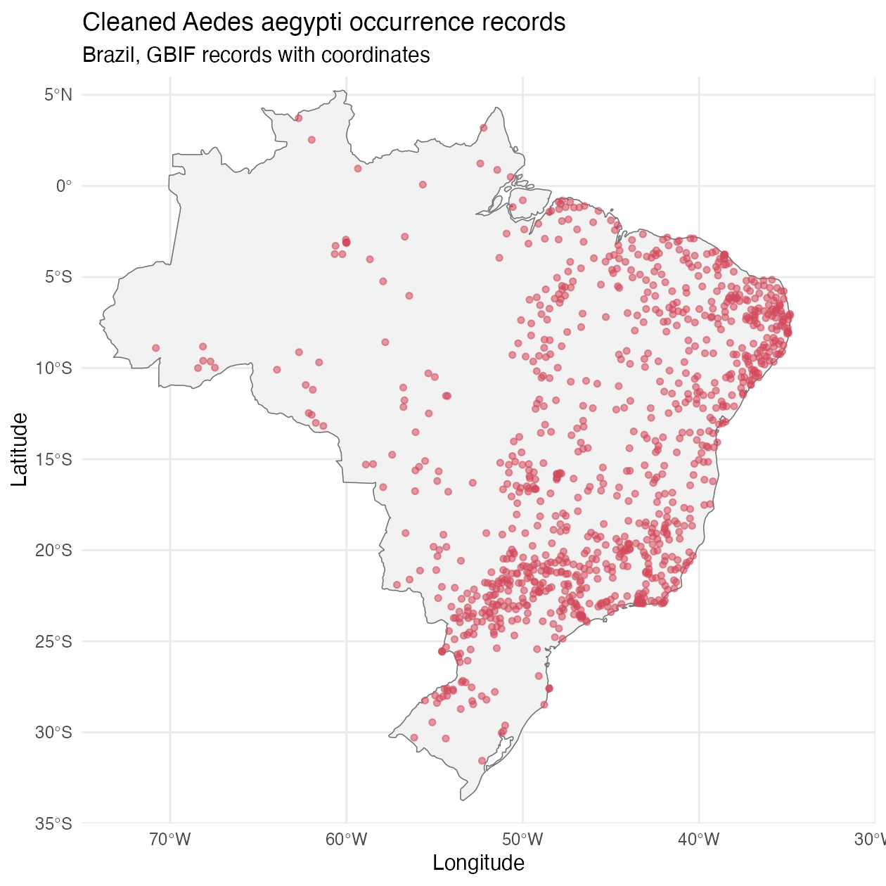
Worked example: Aedes aegypti in Brazil
After the foundation, the workshop uses a dengue vector as a practical modelling case.
GBIF gives reusable occurrence records.
Brazil provides a national-scale projection exercise.
The model estimates vector suitability, not dengue risk.
The same script can be adapted to other species.
Notes:
Introduce Aedes aegypti only after the method has been defined.
[Sources] Workshop GBIF occurrence map.

Slide 5
Occurrence data: useful, messy, teachable
The first modelling decision is whether the records are good enough for the question.
Before modelling
Remove records without coordinates.
Check the study boundary.
Thin duplicate raster cells.
Keep a clean backup for live teaching.
Notes:
Data cleaning slide for the GBIF part of the live script.
[Sources] Workshop GBIF occurrence map and script.

Slide 6
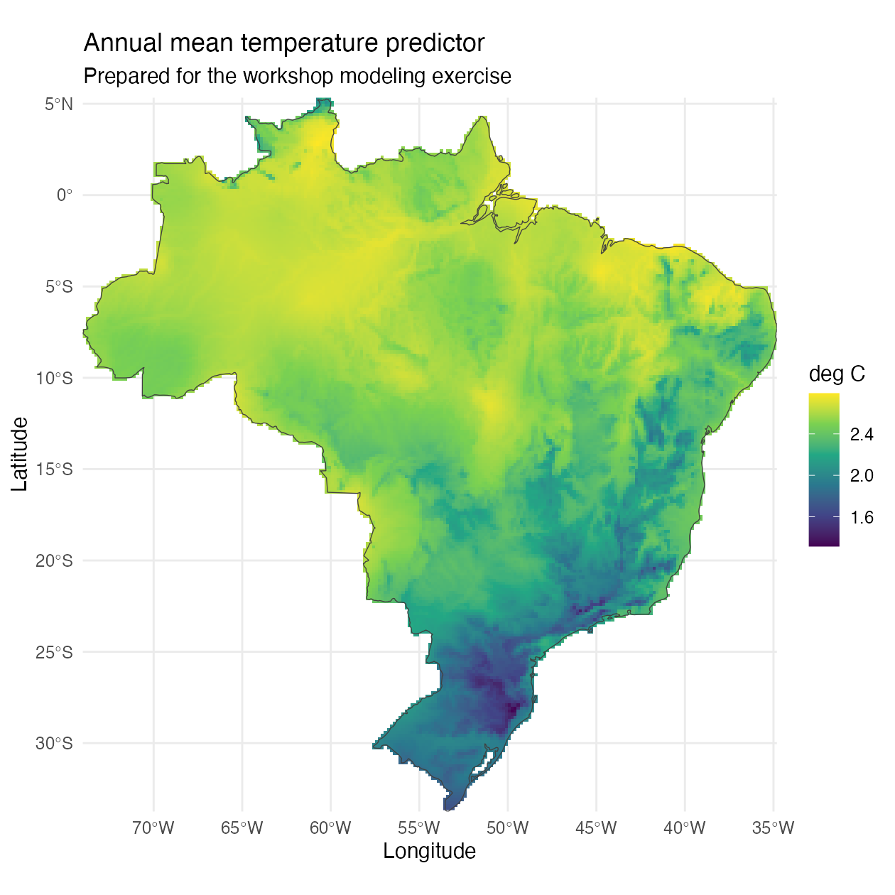
Predictors define the environmental lens
We keep four climate predictors so the first model is fast enough and interpretable enough for a 90-minute workshop.
Workshop predictors
Annual mean temperature
Temperature seasonality
Annual precipitation
Precipitation seasonality
Notes:
Predictor slide for the environmental raster section of the script.
[Sources] Workshop environmental raster derived from cached WorldClim predictors.

Slide 7
Presence-only data require pseudo-absences
Pseudo-absences are comparison points. They are not confirmed absences.
Presences
Pseudo-absences
Formatted
data
known occurrence records
background contrast
ready for biomod2
In the script: BIOMOD_FormatingData()
Notes:
Prepares participants for the biomod2 formatting call.
[Sources] Pseudo-absence concept adapted from Lecture1_12Juin17.pdf pages 106-109.

Slide 8
Three algorithms, three modelling assumptions
We use multiple algorithms to make model behaviour visible.
GLM
GBM
RF
transparent statistical trend
boosted sequence of trees
many trees voting together
simpler shape
flexible shape
robust shape
Notes:
Explains why the workshop runs GLM, GBM, and RF.
[Sources] Algorithm framing adapted from Lecture1_12Juin17.pdf pages 45-56.

Slide 9
Evaluation asks whether predictions generalise
Good scores make the model worth inspecting. They do not make the map true.
Training data
Model
Test data
TSS
AUCroc
threshold-based balance of sensitivity and specificity
threshold-independent ranking of presences above absences
Notes:
Connects to metric.eval in BIOMOD_Modeling().
[Sources] Evaluation concepts adapted from Lecture1_12Juin17.pdf pages 59-74.

Slide 10
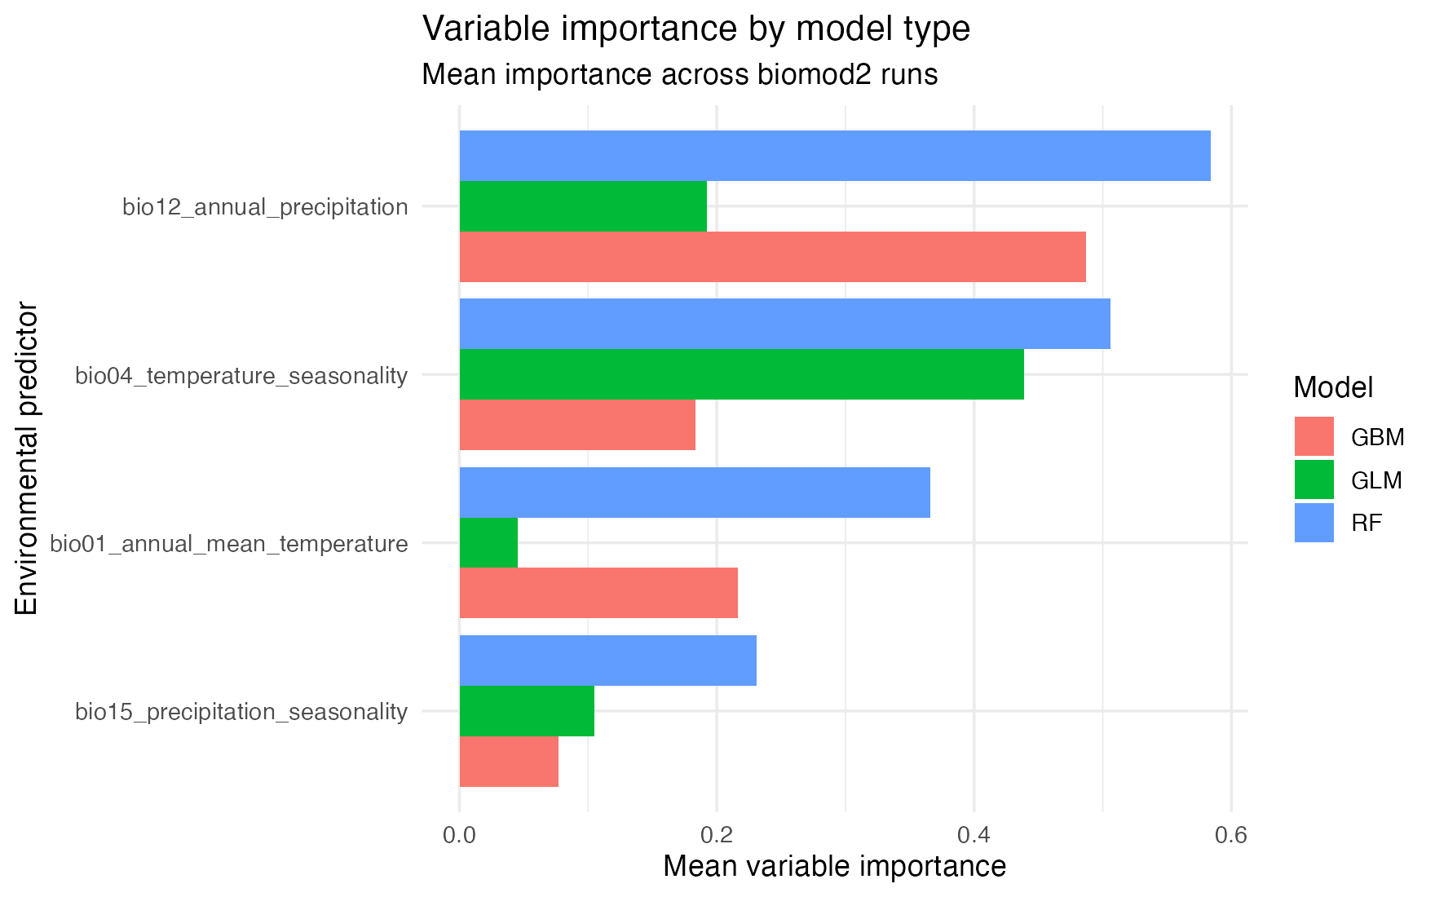
Variable importance: from output to questions
Importance is model sensitivity, not biological proof.
Ask
Which predictors changed predictions most?
Do GLM, GBM, and RF agree?
Could this be ecology, sampling, or correlation?
Notes:
Interpret variable importance from biomod2.
[Sources] Workshop-generated variable importance plot.

Slide 11
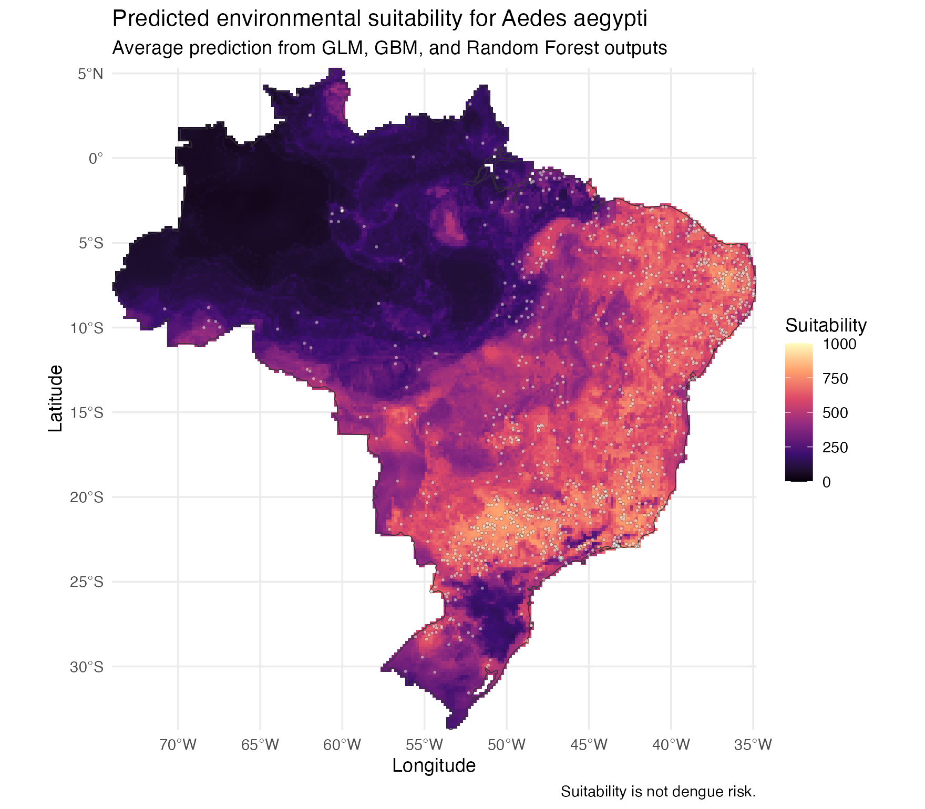
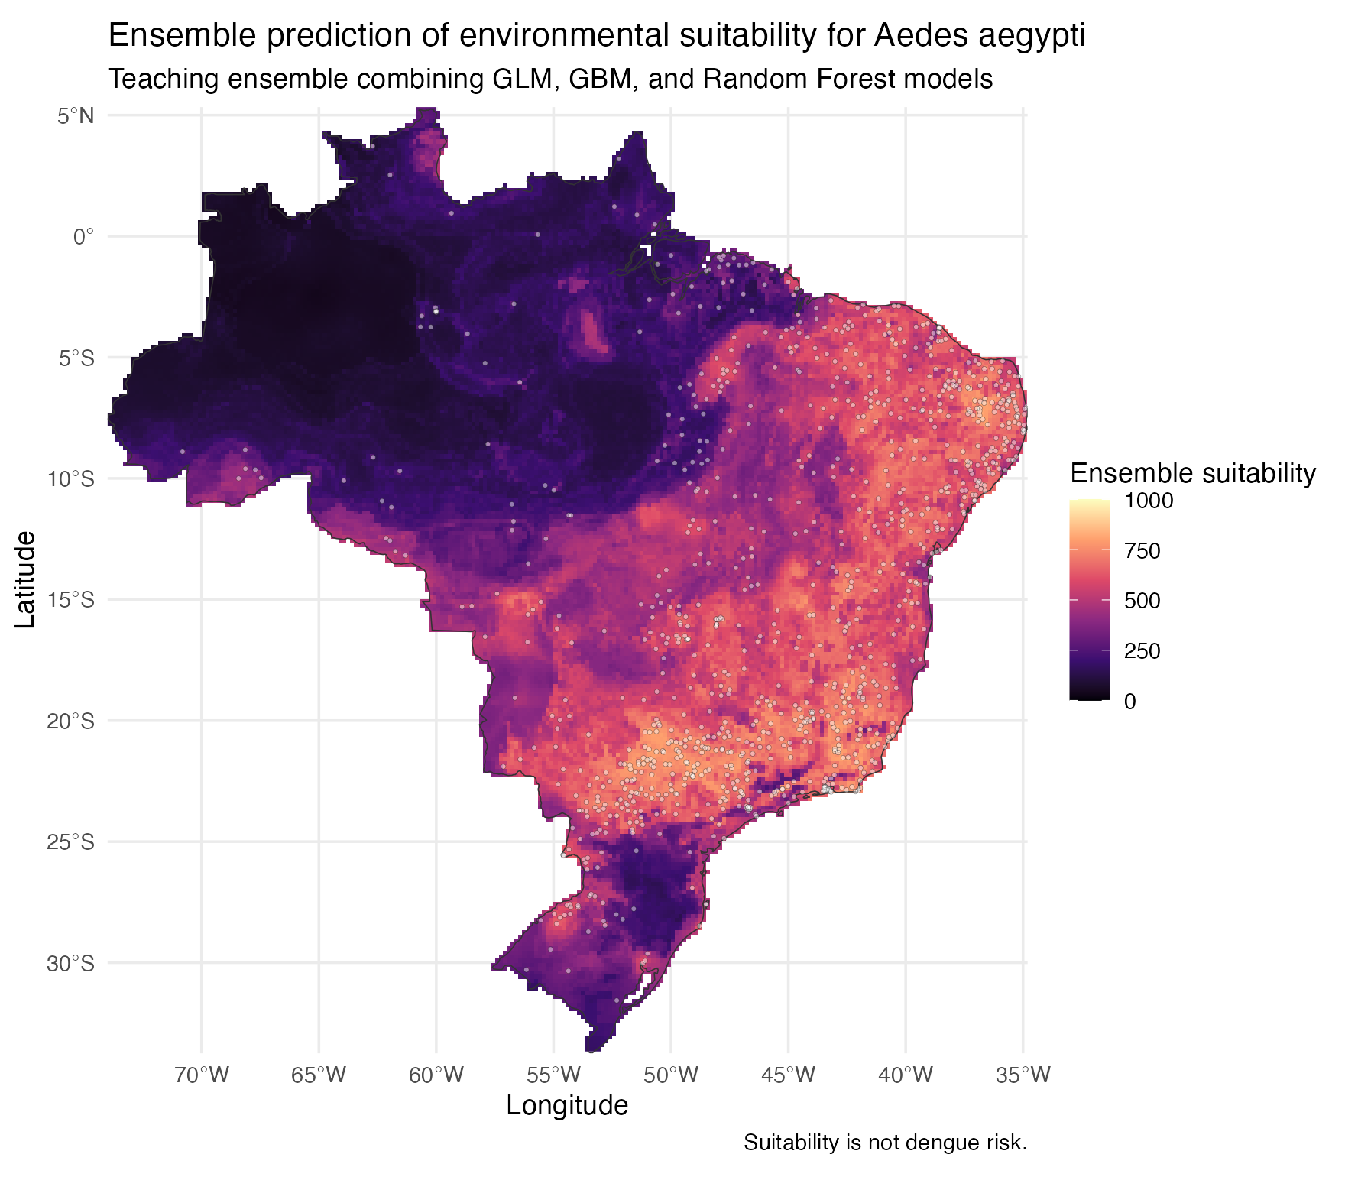
Ensembles and projections make choices visible
The map is a synthesis of model behaviour across Brazil.
individual model average
ensemble projection
Notes:
Connects BIOMOD_Projection and BIOMOD_EnsembleForecasting to the final maps.
[Sources] Workshop-generated suitability maps.

Slide 12
A good SDM should sharpen the next conversation
Now we build the model line by line in R.
Before acting on a map, ask:
Where is suitability high or low?
Where are the data thin?
What could be sampling bias?
Which predictor story is plausible?
What dengue surveillance data would you add?
Notes:
Closing slide before the live R tutorial.
[Sources] Workshop model output and interpretation prompts.

