Slide 1

From Confusion to Clarity
SMART CAMPUS
Registration Number
Full Name
2025JULJPGG0010
A Pujita
2025JULJPGG0037
Jenifa X
2025JULJPGI4001
Karthik Ps
2025JULJPGF1022
Lekshmi S Nair
2025JULJPG0102
Nandu Prasad
2025JULJPGG0053
Nikita Sara M
2025JULJPGF1026
Rejoice George
2025JULJPGG0011
Shreya Sen
2025JULJPGA3007
Sri Durga
2025JULJPGF1005
Yuvetha M

Slide 2

The Problem: 40+ Minutes Lost Every Day
Every day, thousands of students on large Indian university campuses lose over 40 minutes to a problem entirely unrelated to academics — the sheer chaos of fragmented information. No maps. No faculty availability. No single source of truth. Updates scattered across ERP, WhatsApp, e-mail, and notice boards. The result: anxiety, wasted time, and missed academic moments.
40+
Minutes wasted
Per cabin visit, navigating blind
5+
Platforms daily
ERP, LMS, email, WhatsApp, boards
3–5
Missed updates
Per student, every single month
2.8
Satisfaction score
Out of 5.0 before intervention

Slide 3

Understanding the Problem Space
Before designing any solution, the team mapped the problem rigorously using a 5W + H breakdown — grounding every assumption in real campus context across India.
Where
What
Large multi-block university campuses across India — sprawling, confusing, and under-signposted.
Fragmented information systems — ERP, LMS, e-mail, WhatsApp, and physical notice boards operating in silos.
When
Who
Peak friction moments: before class, during break, and in the stressful days leading up to exams.
UG and PG students — freshers to final-year, hostellers and day scholars alike, across departments and states.
How
How Often
Blindly walking to faculty cabins, physically checking boards, and relying on second-hand WhatsApp rumours.
Daily — thousands of students, multiple information-tracking rounds per day, every working day.
Initial Problem Statement
Reframed — Human-Centred
"The institute utilises multiple disconnected digital systems leading to excessive admin overload, repeated student queries, and inefficient faculty time utilisation."
"How might we reduce uncertainty and mental load for students during everyday academic tasks?" This shift from system-efficiency to human-experience was the critical turning point.

Slide 4


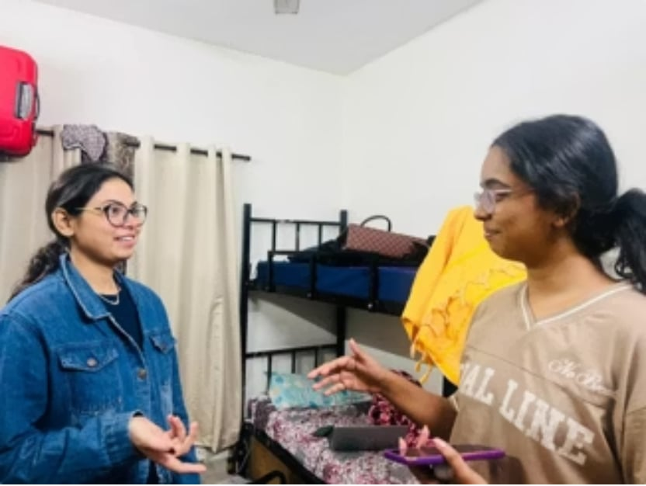
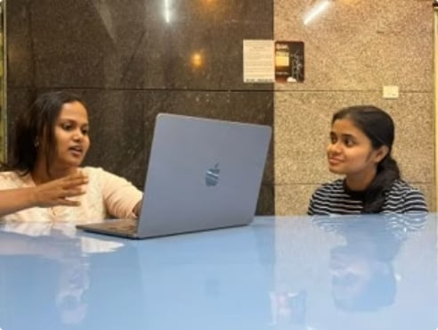
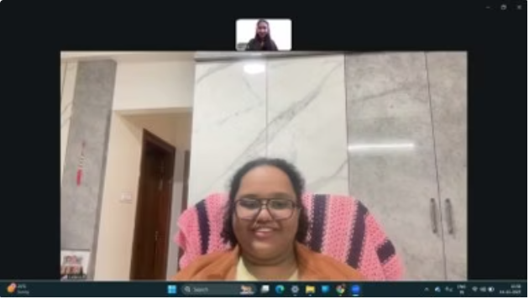
Empathy & User Research
The team conducted 5 in-depth interviews and 11 surveys spanning UG and PG students from Year 1 to final year, across multiple states and departments. Three verbatims cut through all the data and defined the direction.
"I waited outside a faculty cabin for almost 40 minutes and later found out they were in a meeting."
"Information was always scattered. I had to depend on WhatsApp groups instead of one proper system."
"Finding locations is the biggest problem. The campus is huge and there are no proper maps."
— 3rd Year UG Student
— 1st Year PG Student
— 1st Year UG Student
Empathy Map — Harshini (Composite Student)
Says
Thinks
I just ask my friend where the class is
WhatsApp groups are the only real update
I had no idea the room had changed
Why isn't this on one app?
What if the professor isn't available again?
I hope I'm in the right block
Does
Feels
Checks 3 platforms every morning
Walks to cabin and waits without confirmation
Uses landmarks — lift, canteen — to navigate
Frustrated by wasted time
Anxious before meeting faculty
Cognitively overloaded daily

Slide 5
Define — Personas, Journey & HMW
Harshini R. — Primary Persona
Prof. Vani — Secondary Stakeholder
2nd Year B.Tech · Day Scholar · Engineering Dept.
Assistant Professor · Computer Science
Navigation struggles on large campus
Misses announcements regularly
Entirely WhatsApp-dependent for updates
Flooded with unannounced student queries
Meeting disruptions affect research prep
Goal: Manage time efficiently, avoid unnecessary interruptions.
Pain: Students walk in unannounced; repeated queries clog cabin time and delay teaching and research.
Goal: Complete daily academic tasks without wasting time or energy.
Pain: No single trusted source; wastes 30–40 min every day piecing together fragmented information.
Point of View Statement
Harshini needs real-time contextual guidance because uncertainty creates stress and wastes valuable academic time.
As-Is Journey — Emotional Energy Drops at Every Stage
🌅 Morning Plan
🗺️ Find Class
Uncertain — doesn't know room or schedule changes
Frustrated — wanders campus using informal landmarks
🚪 Faculty Visit
📢 Check Updates
Exhausted — waits 40 min with no visibility on availability
Anxious — overwhelmed by messages yet misses critical ones
Top 3 How Might We Questions
1
HMW guide students through their day without them having to search?
2
HMW reduce wasted time using real-time faculty availability?
3
HMW deliver updates in context, not just as generic notifications?
Every student described scrambling reactively, never being guided proactively.
"Waited 40 min and they were in a meeting" — the single biggest time drain identified in research.
Students were overwhelmed by messages yet still missed what genuinely mattered.

Slide 6



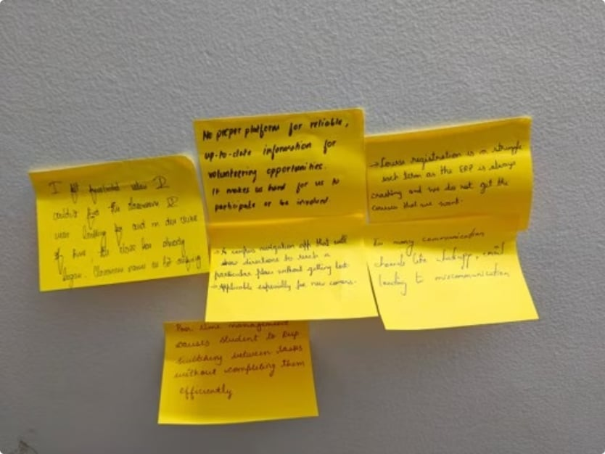

Ideation — Diverging & Converging
Using brainstorming, brainwriting, and SCAMPER, the team generated 10+ raw ideas across three themes, then used dot voting and an impact–effort matrix to filter down to three strong concept directions — which ultimately converged into one.
Connected Campus Navigation
Faculty Availability & Booking Hub
Centralised Academic Dashboard
Digital maps, QR-based anchors, and block/room guidance for large, confusing campuses.
Real-time faculty status, meeting availability slots, and structured appointment booking.
One platform for announcements, exams, events, library info, and admin contacts.
The Convergence Insight: Students don't think in features — they think in "What do I need to do next?" All three concepts merged into a single context-aware companion anchored by the flow: Timetable → Next Class → Navigate.

Slide 7
Prototyping — 4 Iterative Rounds
The team built and tested four successive prototypes — from paper sketches to a live, ERP-integrated app — using Lovable.dev, Replit AI, and Visual Studio Code. Each round sharpened the core insight: simplicity and context-awareness matter more than feature depth.
V1 — Paper Sketch
1
Feature-heavy navigation app. Identified core mental model but overwhelmed users with options.
2
V2 — Clickable Wireframe
Basic dashboard introduced. Interaction flows validated; visual hierarchy issues surfaced.
V3 — ERP/LMS Integration
3
Real data via Lovable.dev. Faculty availability module added; information overload identified.
4
V4 — Context-Aware Companion
Built on Replit + VS Code. "Next Class" as hero feature. Landmark-based navigation. Context-first principle applied throughout.
Home Dashboard (V4)
Faculty Availability Hub (V4)
Good morning, Harshini 👋
Next Class · in 12 min
Data Structures · Room B-304, Block B, Floor 3
↗ Navigate Now
📌 Mid-sem timetable released — check now
⚠️ Lab session moved to B-201 tomorrow
Prof. Sharma — Available · Cabin C-112 · Till 11 AM
Dr. Meena Iyer — In meeting · Back at 12:30 PM
Prof. Rajan — Available · Virtual appointments open
👉 Book an Appointment — structured, no more blind cabin visits.

Slide 8
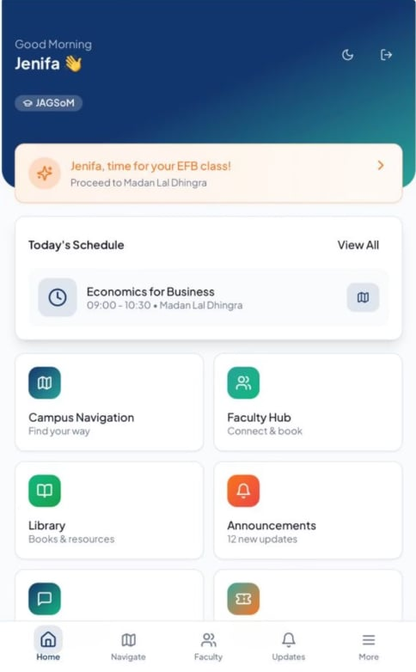
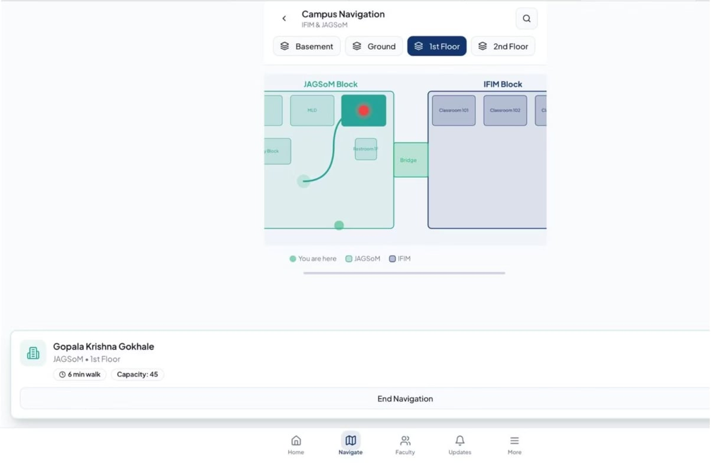
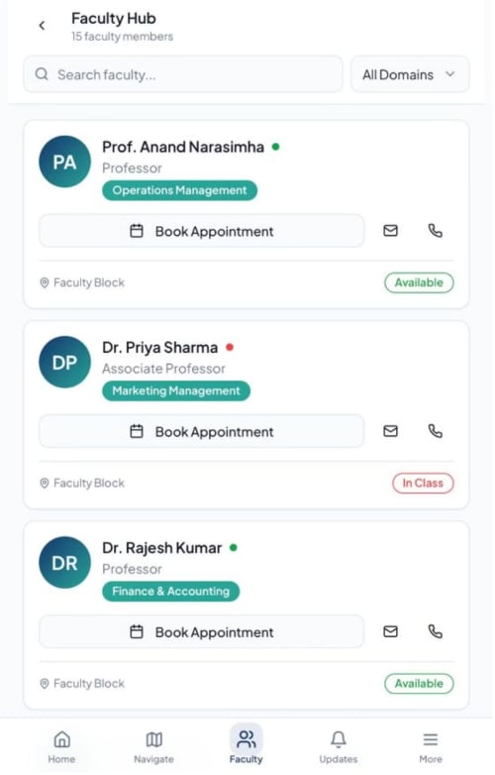
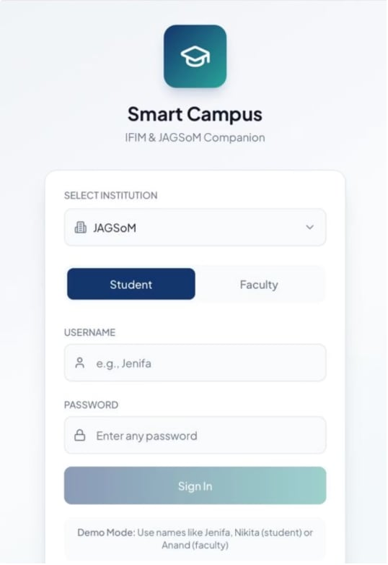
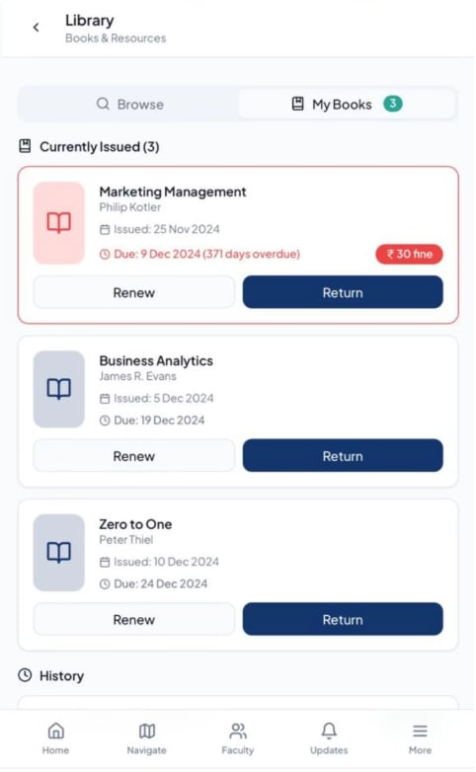
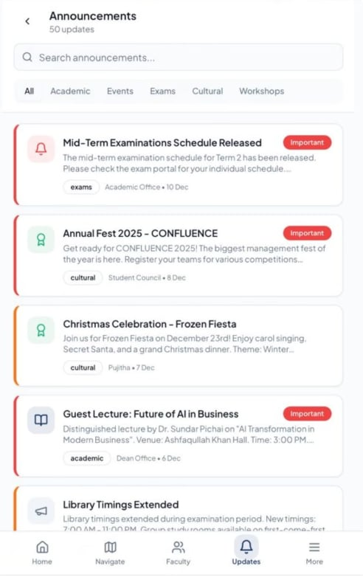

Slide 9
User Testing & Iteration Outcomes
Testing involved 8 participants across 3 rounds using think-aloud protocol and scenario-based tasks: find Room B-304 in 15 minutes; confirm Prof. Sharma's availability; check today's announcements. Feedback was decisive and actionable.
7/8
10s→3s
Said auto-navigation
Task-identification time
Was "exactly what they needed" — highest-rated feature
After making "Next Class" the hero feature on the dashboard
✓ What Worked
✗ What Failed (and Was Fixed)
Timetable-integrated navigation — felt intuitive, matched students' mental model perfectly
Contextual announcements — significantly reduced information overload
Faculty status visibility — eliminated the need for guesswork cabin visits entirely
Visual hierarchy — all features had equal weight; "Next Class" was buried → made it the hero
Navigation lacked landmarks — first-years still uncertain → added lifts, canteens, block entrances as wayfinding anchors
Feature overload → applied context-first principle: only show what matters right now

Slide 10

Final Solution & Viability
The Smart Campus Companion App (V4) is a timetable-driven, context-aware guide designed for large Indian university campuses. Pilot results: task-completion time reduced by 50%, cabin wait time cut by 70%, and satisfaction rose from 2.8 to 4.2/5.0.
2D Smart Navigation
Auto Class Navigation
Floor-wise indoor maps, QR anchor points, and room search with landmark-based wayfinding.
Timetable sync enables one-tap "Go to Next Class" — proactive, not reactive.
Faculty Availability Hub
Centralised Dashboard
Real-time status display plus structured appointment booking — no more blind visits.
Exam schedules, events, academic alerts, and admin contacts in one trusted platform.
Pilot
Full Rollout
Month 1: 1 dept, 50–100 students
Months 4–6: campus-wide integration
Expansion
Months 2–3: 5 depts, 500+ users

Slide 11
Reflections & Lessons
Biggest Surprise
"Real problems are frequently behavioural and emotional rather than merely technical or operational. Good design makes people feel supported, confident, and less stressed — not just better-informed."
Students trusted WhatsApp groups and seniors more than official institutional systems — revealing a deep confidence gap, not merely an information gap.
What We'd Do Differently
— Core Lesson, Smart Campus Design Thinking Project
Prototype earlier — even before defining. Recruit more hostellers and first-year students, who are most disoriented and have the most to gain.
Skills Developed
Deep active listening, bias reduction in research, and an iterative mindset — learning that adding features often worsens the experience.

Slide 12
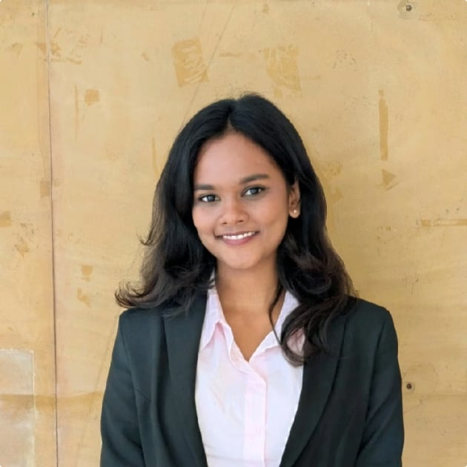
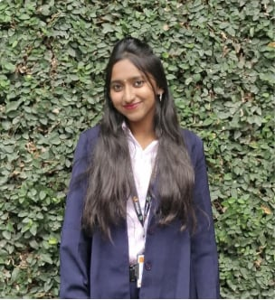
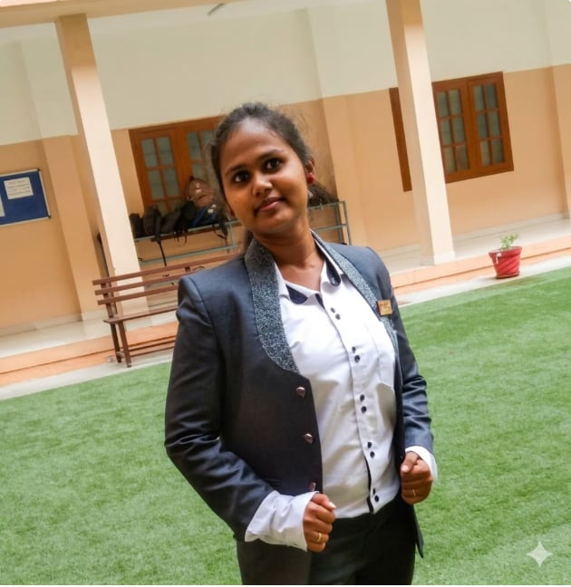
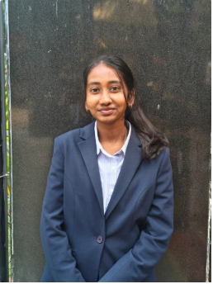
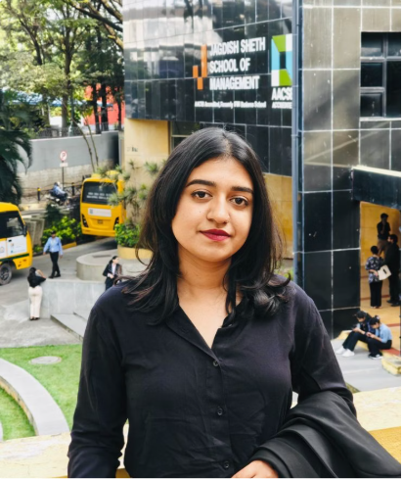
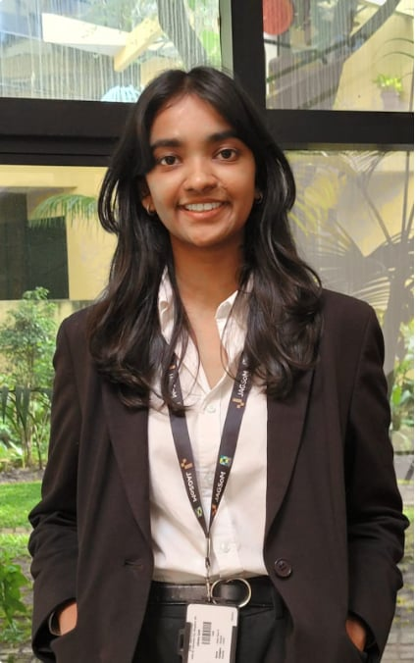
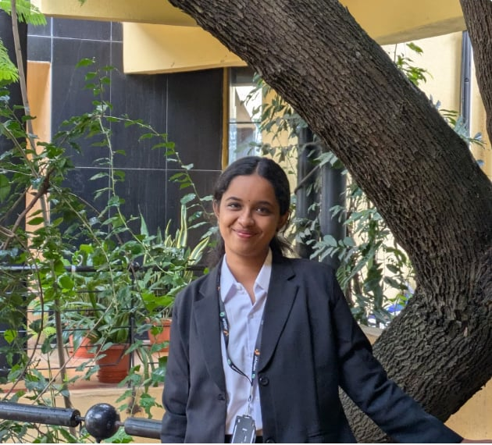

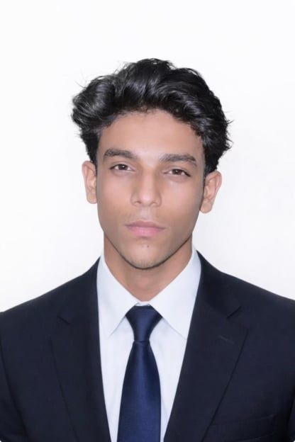
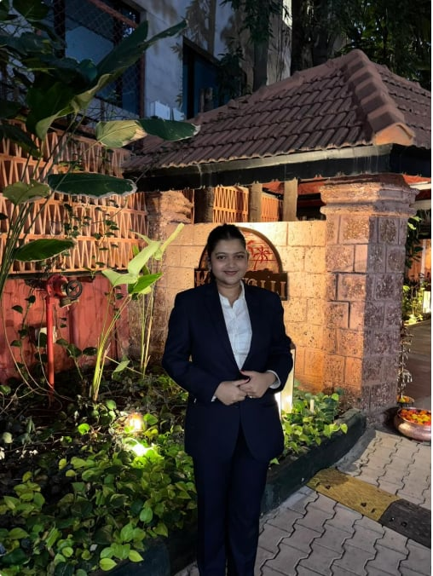
The Team
I’m Pujita — I enjoy working with people so much that I chose HR as both my career and personality.
I'm Jenifa, a PGDM student passionate about business intelligence, problem-solving, and leveraging data to drive growth and innovation.
I'm Nandu. Turning coffee and curiosity into finance and analytics skills while navigating presentations, deadlines, and continuous learning.
I'm Yuvetha - Just a girl passionate about valuation and private equity while pretending Excel doesn’t scare her sometimes.
I'm Sri Durga-Business Analytics student with experience in business development, customer service, data analytics, and passionate about analytics, strategy and innovation.
REJOICE here, PGDM Finance student with keen interest in Risk management. Creating a life worth living.
Lekshmi, PGDM Finance student passionate about numbers, analytics, and problem-solving balancing finance concepts, presentationsk, and continuous growth.
Myself Karthik , International Business student with a creative mindset and I'm pretty people centric !
I'm Nikita, a PGDM Business Analytics student. Into business, science, and figuring things out.
I’m Shreya Sen, currently pursuing my PGDM with a major in Analytics at Jagdish Sheth School of Management, with a background in Biotechnology.

