Slide 1
Morse-Code BOT
GROUP MEMBERS :- Ajinkya Gorad 140110033
Kewal S Bhat 14D110008
Jenil P Shah 14D170008
Shrenik S Jain 140110045

Slide 2
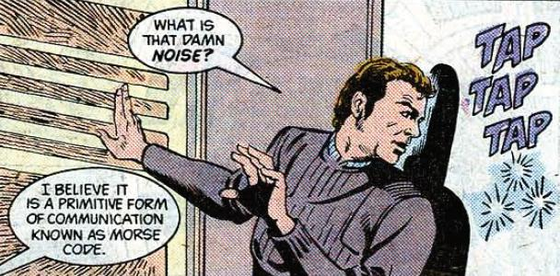

Slide 3
Problem statement
1: Audio Morse code signals will be sent to the bot from source. The signal should be received without attenuation, converted into a pulse signal, and it should then be expressed as a series of dits and dahs by the microcontroller.
2: The series of dits and dahs will be converted into letters of English language. Eg: ‘F’,’B’,’R’,’L’,etc.
Eg- (Dit,dit,dah,dit) ..-. Corresponds to ‘F'

Slide 4
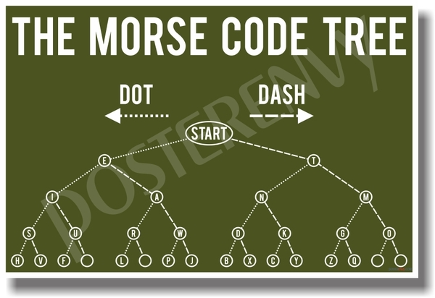

Slide 5
Problem statement
3: Based on the letters received, the bot performs multiple operations. This exercise is being done to show the bot has decoded the signal and has processed it in the required way. Eg: for the letter ‘F’ the bot performs forward motion.
4: After the bot receives the signal , the bot should be able to transmit Morse code , conveying that it has received the signal. Also, after completing the required task the bot should be able to transmit Morse code. The morse code transmission is using on board buzzer.

Slide 6
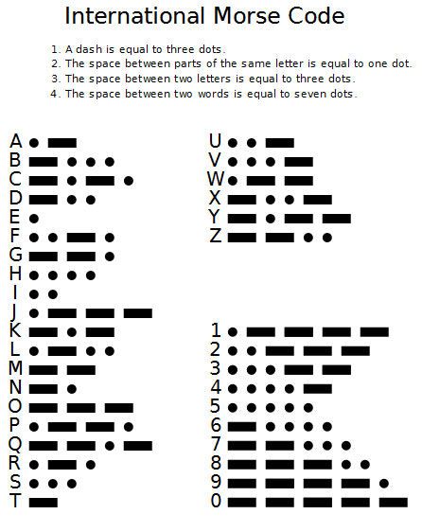

Slide 7
Challenge
Receiving morse code in the form of audio signals and providing it to the microcontroller, in such a way that it would be able to process it.
Solution
Converting the received audio signals to digital signals (as the following fig. suggests) using comparator .

Slide 8
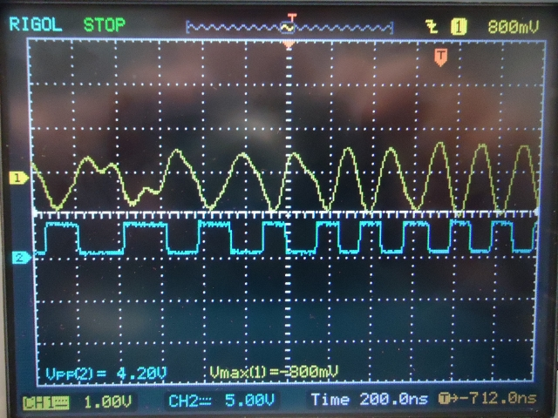

Slide 9
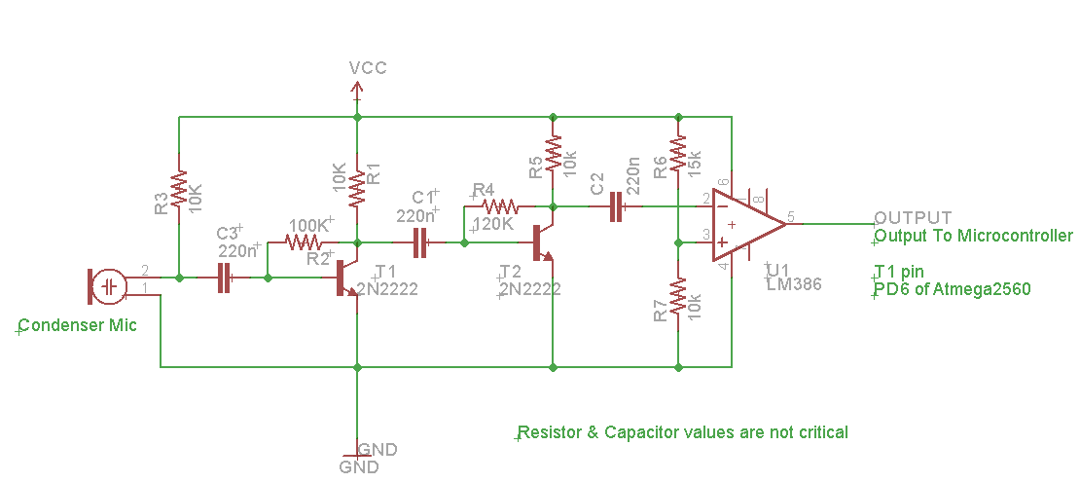
External Hardware
The circuit for the microphone receiver :

Slide 10
External Hardware
Audio signals amplified first using transistor amplifier.
Output of amplifier is fed to comparator (Compares voltages) .
Output is a series of square pulses dependent on audio input.
No ADC ( Analog To Digital Converter ) is used .
Uses only one pin of microcontroller.
Internal Counter is used for counting the pulses on T1 (PC6) pin on atmega.

Slide 11
Limitations
The surrounding noises should be minimal to avoid false decoding by bot. It should be ensured that the bot should be kept in a noise free zone for error free processing.
Can be overcome by advance audio processing techniques.
like DSP (Digital Signal Processing Techniques).

Slide 12
Future Work
1) One can introduce light sensors like LDR, and make the given project decode morse code transmitted as light. Flashing light Morse even from a flashlight may be read several miles away for a lost sailor or hunter. Countless snowstorm rescues have been recorded by stranded drivers flashing an SOS signal on a flashing light. Mirrors accomplish the same thing during the day. The user directs a mirrored sun reflection and then blocks it with his other hand or piece of cardboard flashing out the Morse code signal. The code for the program will still remain quite similar .

Slide 13
Future Work
2) Medical uses allow the severely handicapped person to tap or blink out a message that could be read by our decoder, giving new hope and meaning to life for sufferers.
3) A new method for using Morse code involves cell phones and text messages entered from an iambic keyer on the cell phone face. It seems that experienced Morse code operators can enter the text much faster than a normal keyboard operator and can do it without looking at the keyboard. Our decoder will play a role in converting the Morse code written to text and to display it on the screen.

Slide 14
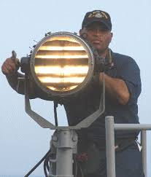
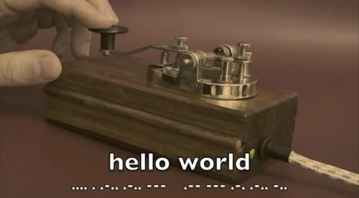
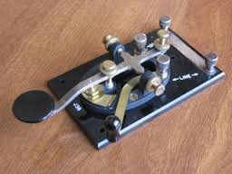
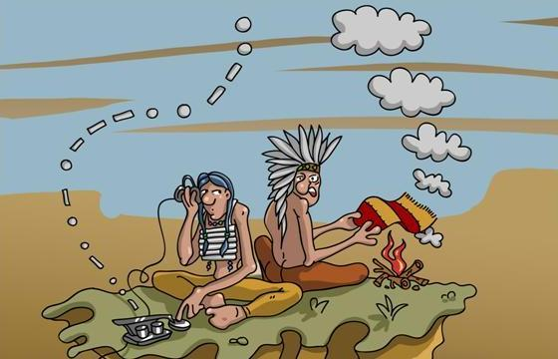
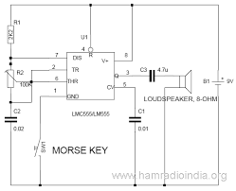
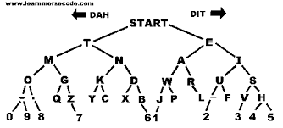

Slide 15


THANK YOU !!!

