Slide 1
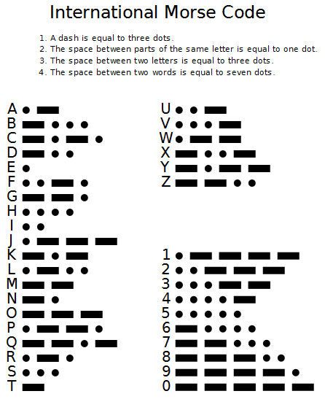
Morse-Code Decoder
GROUP MEMBERS :- Ajinkya Gorad 140110033
Kewal S Bhat 14D110008
Jenil P Shah 14D170008
Shrenik S Jain 140110045

Slide 2
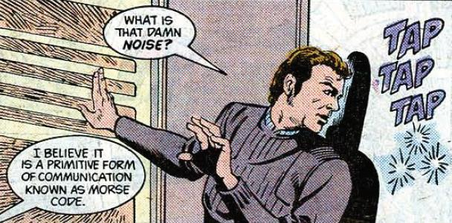

Slide 3
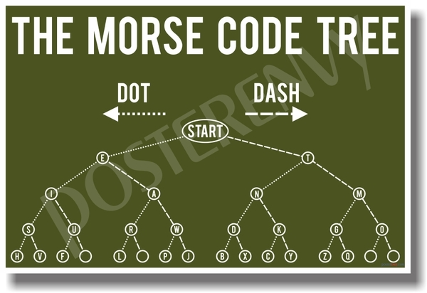

Slide 4
Problem statement
1. Goal 1: Audio Morse code signals will be sent to the bot from source. The signal should be received without attenuation, converted into a pulse signal, and it should then be expressed as a series of dits and dahs by the microcontroller.
2. Goal 2: The series of dits and dahs will be converted into letters of English language. Eg: ‘F’,’B’,’R’,’L’,etc.

Slide 5
Problem statement
3. Goal 3: Based on the letters received, the bot performs multiple operations. This exercise is being done to show the bot has decoded the signal and has processed it in the required way. Eg: for the letter ‘F’ the bot performs forward motion.
4. Goal 4: After the bot receives the signal , the bot should be able to transmit Morse code , conveying that it has received the signal. Also, after completing the required task the bot should be able to transmit Morse code. The morse code transmission to be done using on board buzzer.

Slide 6
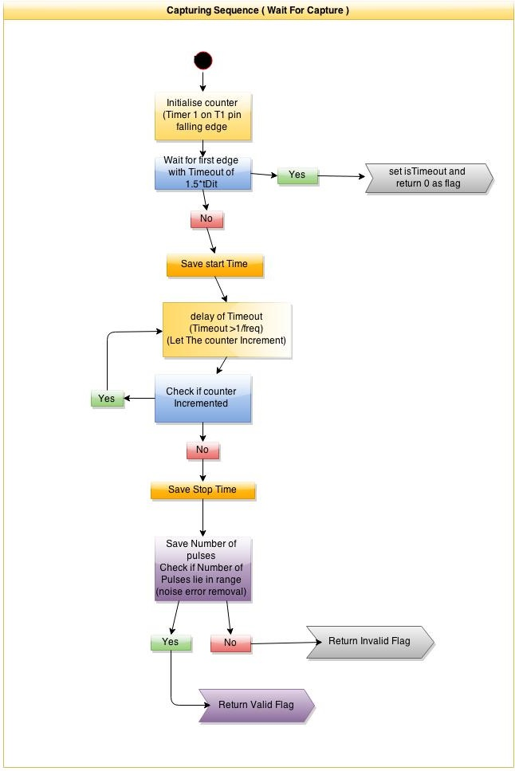
Project Screenshots/Video
Add screenshots or video describing project
(Ajinkya)

Slide 7
Challenge
The biggest challenge that we faced while making our Morse code decoder was that part of the project in which we had to first make the hardware for receiving signal from the microphone, and then, had to convert those received signals into dits and dahs,along with minimization of noise during receiving.

Slide 8
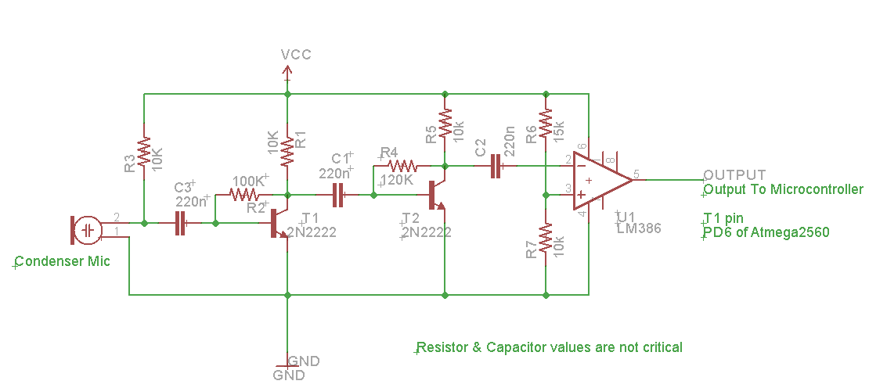
Solution To The Challenge
The circuit for the microphone receiver is as shown below :

Slide 9
Solution To The Challenge
The input to the circuit is of the form :
The output is:
The microcontroller does : (Ajinkya explain your part in detail . If possible, also put some pictures)
Thus, in this way we were able to tackle this challenge.

Slide 10
Future Work
1) One can introduce light sensors like LDR, and make the given project decode morse code transmitted as light.Flashing light Morse even from a flashlight may be read several miles away for a lost sailor or hunter. Countless snowstorm rescues have been recorded by stranded drivers flashing an SOS signal on a flashing light. Mirrors accomplish the same thing during the day. The user directs a mirrored sun reflection and then blocks it with his other hand or piece of cardboard flashing out the Morse code signal. The code for the program will still remain quite similar to what we have done.

Slide 11
Future Work
2) Medical uses allow the severely handicapped person to tap or blink out a message that could be read by our decoder, giving new hope and meaning to life for sufferers.
3) A new method for using Morse code involves cell phones and text messages entered from an iambic keyer on the cell phone face. It seems that experienced Morse code operators can enter the text much faster than a normal keyboard operator and can do it without looking at the keyboard. Our decoder will play a role in converting the Morse code written to text and to display it on the screen.

Slide 12
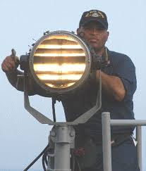
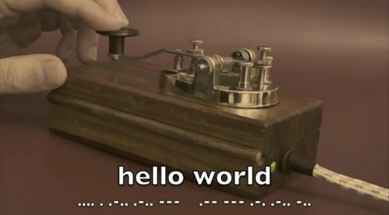
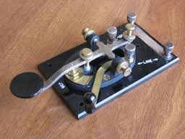
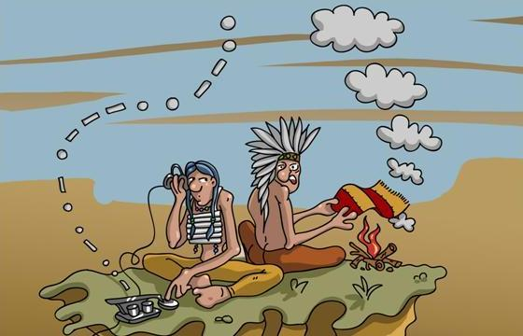
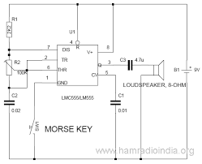
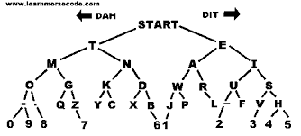

Slide 13


THANK YOU !!!

