Slide 1
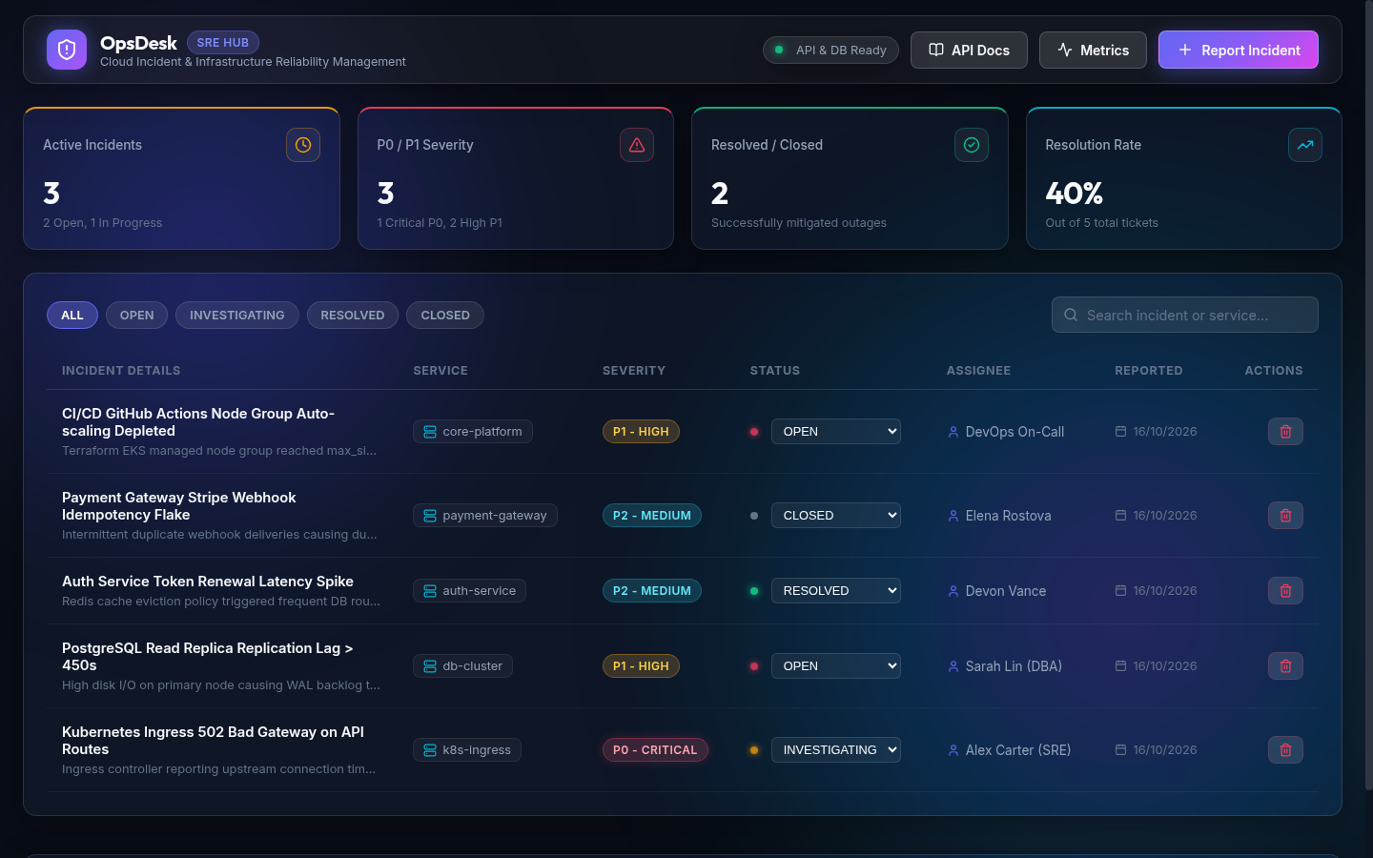
DEVOPS FINAL CAPSTONE PROJECT
OpsDesk
Enterprise Cloud Incident & Site Reliability Engineering (SRE) Hub
Objective: Demonstrate an end-to-end automated DevOps lifecycle, from workstation commit to an auto-scaling, monitored cloud infrastructure.
FastAPI · Python 3.12
React 18 · Glassmorphism UI
OpsDesk dashboard — React 18 glassmorphism UI
PostgreSQL 16
Docker
Kubernetes / Helm
AWS EKS
Terraform
Prometheus
Grafana
9
5
17
capstone modules
pipeline stages
AWS resources
Notes:
OpsDesk is a full-stack SRE platform demonstrating all 9 capstone modules with real automated pipelines and live AWS provisioning.

Slide 2
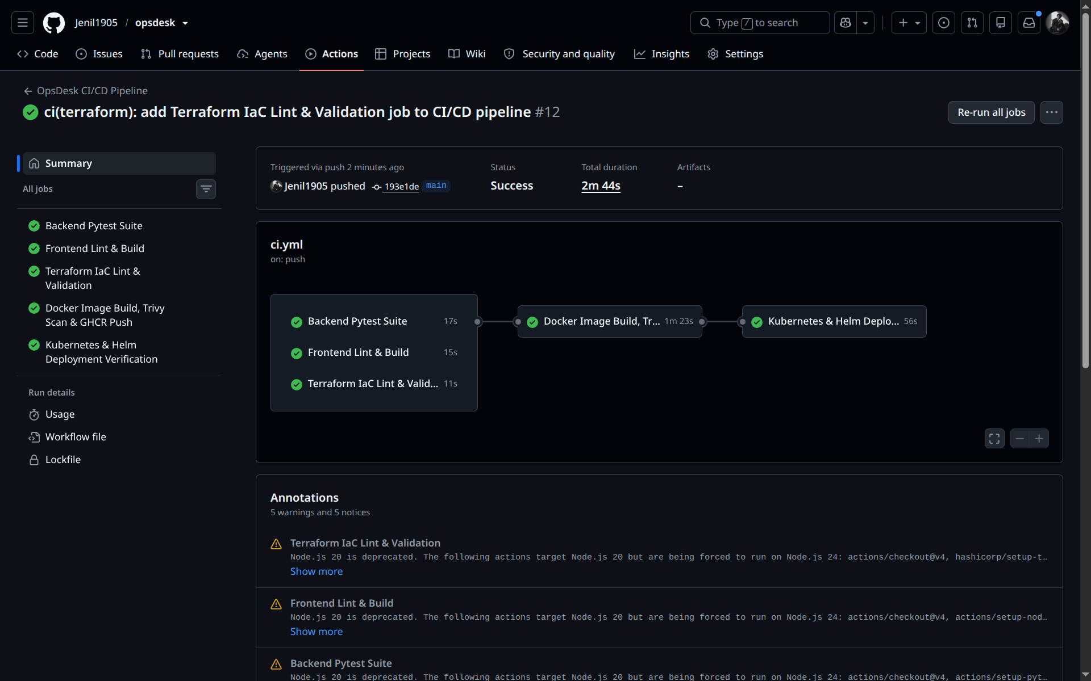
End-to-End System Architecture
ARCHITECTURE
1
2
3
4
5
6
7
Git Push
GitHub Actions CI/CD
Pytest & Vite Build
Terraform AWS IaC
Trivy Vulnerability Scan
Docker & GHCR
Kubernetes & Helm Deploy
Layering: Clean separation of UI, stateless REST API, persistent relational storage, and auto-scaling container workloads.
Infrastructure: Multi-AZ AWS VPC (10.0.0.0/16) powering a managed Kubernetes v1.30 cluster.
Quality gates: Tests and security scans must pass before any artifact reaches Kubernetes.
GitHub Actions — full CI/CD pipeline run
Notes:
This architecture represents production SRE best practices, enforcing automated quality gates before any artifact reaches Kubernetes.

Slide 3
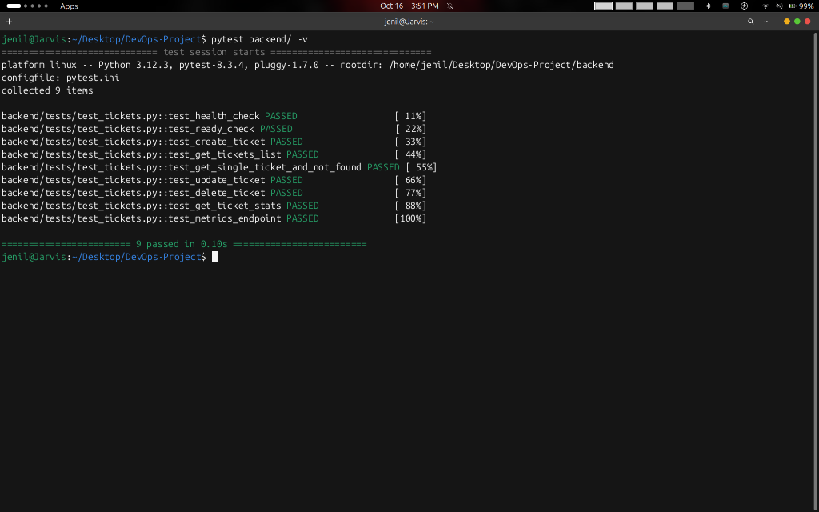
Automated Testing & Code Quality
QUALITY GATE 1
9/9
<0.15s
tests passing
full suite runtime
Framework: Pytest 8.3 with isolated, in-memory SQLite fixtures for hermetic runs.
Coverage: CRUD, health/readiness probes, metrics scrape, and SLA analytics.
Feedback loop: Sub-second execution gives developers near-instant results.
Pytest terminal — 9 passed
Notes:
Automated testing validates business logic and API contracts in CI before container packaging begins.

Slide 4



CI/CD Pipeline & DevSecOps
QUALITY GATES 2 & 3
Automation Engine
GitHub Actions workflow runs on every push to main and on pull requests.
DevSecOps Gate
Aqua Security Trivy scans backend and frontend images for CRITICAL/HIGH CVEs.
Immutable Artifacts
Docker Buildx builds non-root images, tagged with Git commit SHAs and pushed to GHCR.
All 5 pipeline stages passed
Notes:
All 5 stages passed with green checkmarks, ensuring zero security regressions and automated container publishing.

Slide 5
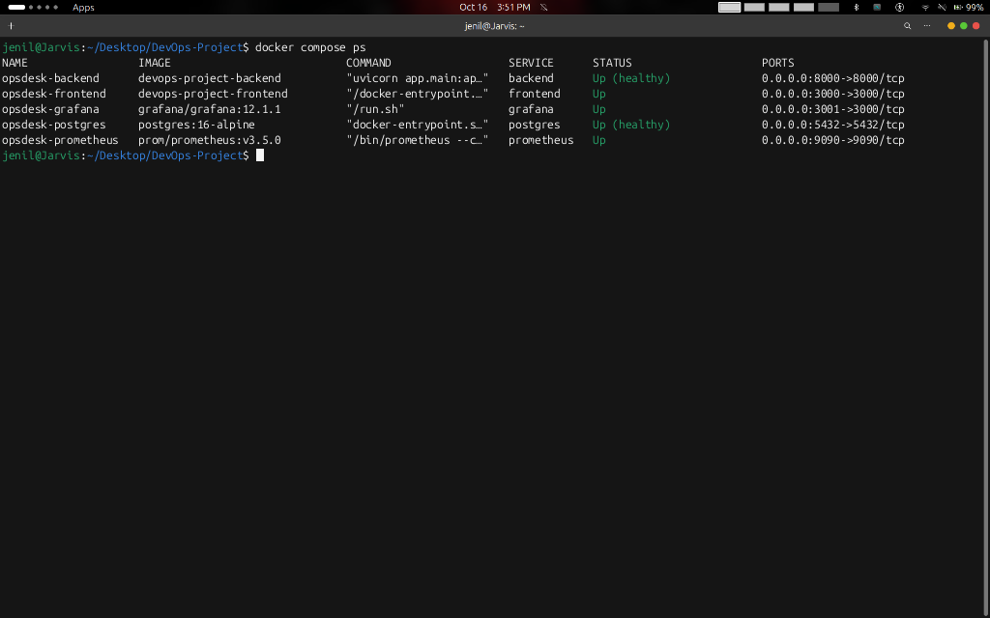
Containerization & Local Development
CONTAINERIZATION
Multi-service stack: 5 containers — PostgreSQL 16, FastAPI backend, React frontend, Prometheus v3, Grafana 12.
Production hardening: Non-root unprivileged user (appuser, UID 10001) for a minimal attack surface.
Environment parity: Standardized env variables keep Docker Compose and Kubernetes consistent.
$ docker compose up -d
Docker Compose — 5 services running
Notes:
Docker Compose allows developers to boot the entire ecosystem locally with a single command (docker compose up -d).

Slide 6
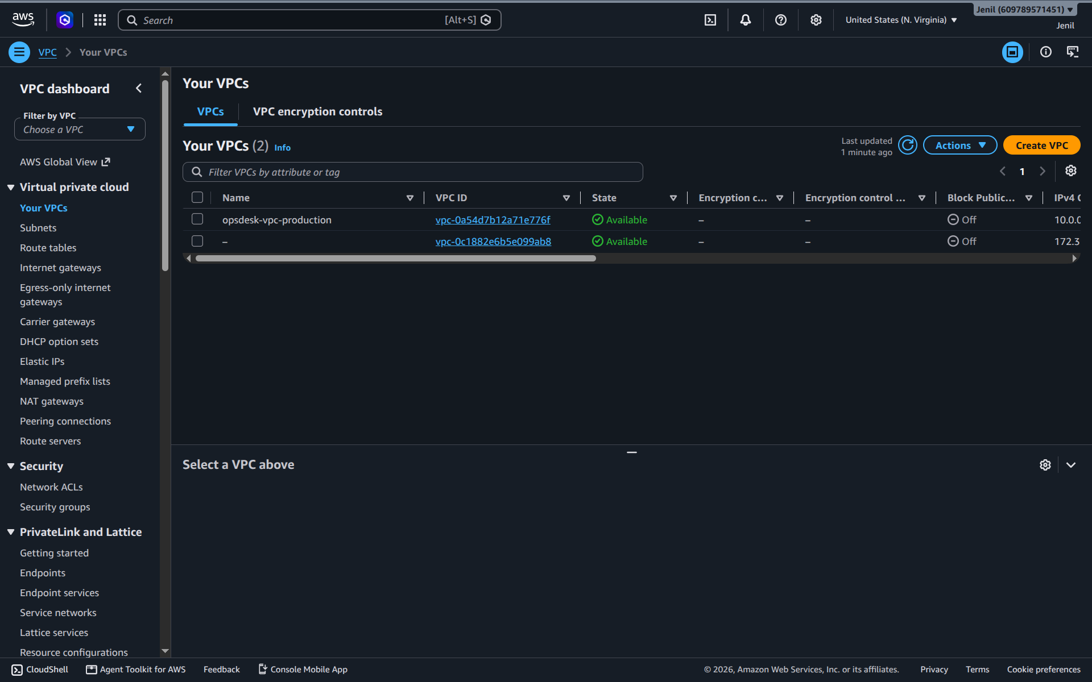
Infrastructure as Code with Terraform
INFRASTRUCTURE AS CODE
IaC engine: Modular Terraform using the HashiCorp AWS Provider ~> 5.0.
Network topology: Custom VPC, 2 public subnets with an Internet Gateway for ingress, 2 private subnets for worker nodes, and route tables.
Verification: A dry-run terraform plan validated 17 cloud resources before live execution.
17
10.0.0.0/16
2 + 2
resources planned
VPC CIDR
public / private subnets
AWS Console — production VPC, us-east-1
Notes:
Terraform codifies the entire cloud network deterministically across multiple availability zones in us-east-1.

Slide 7
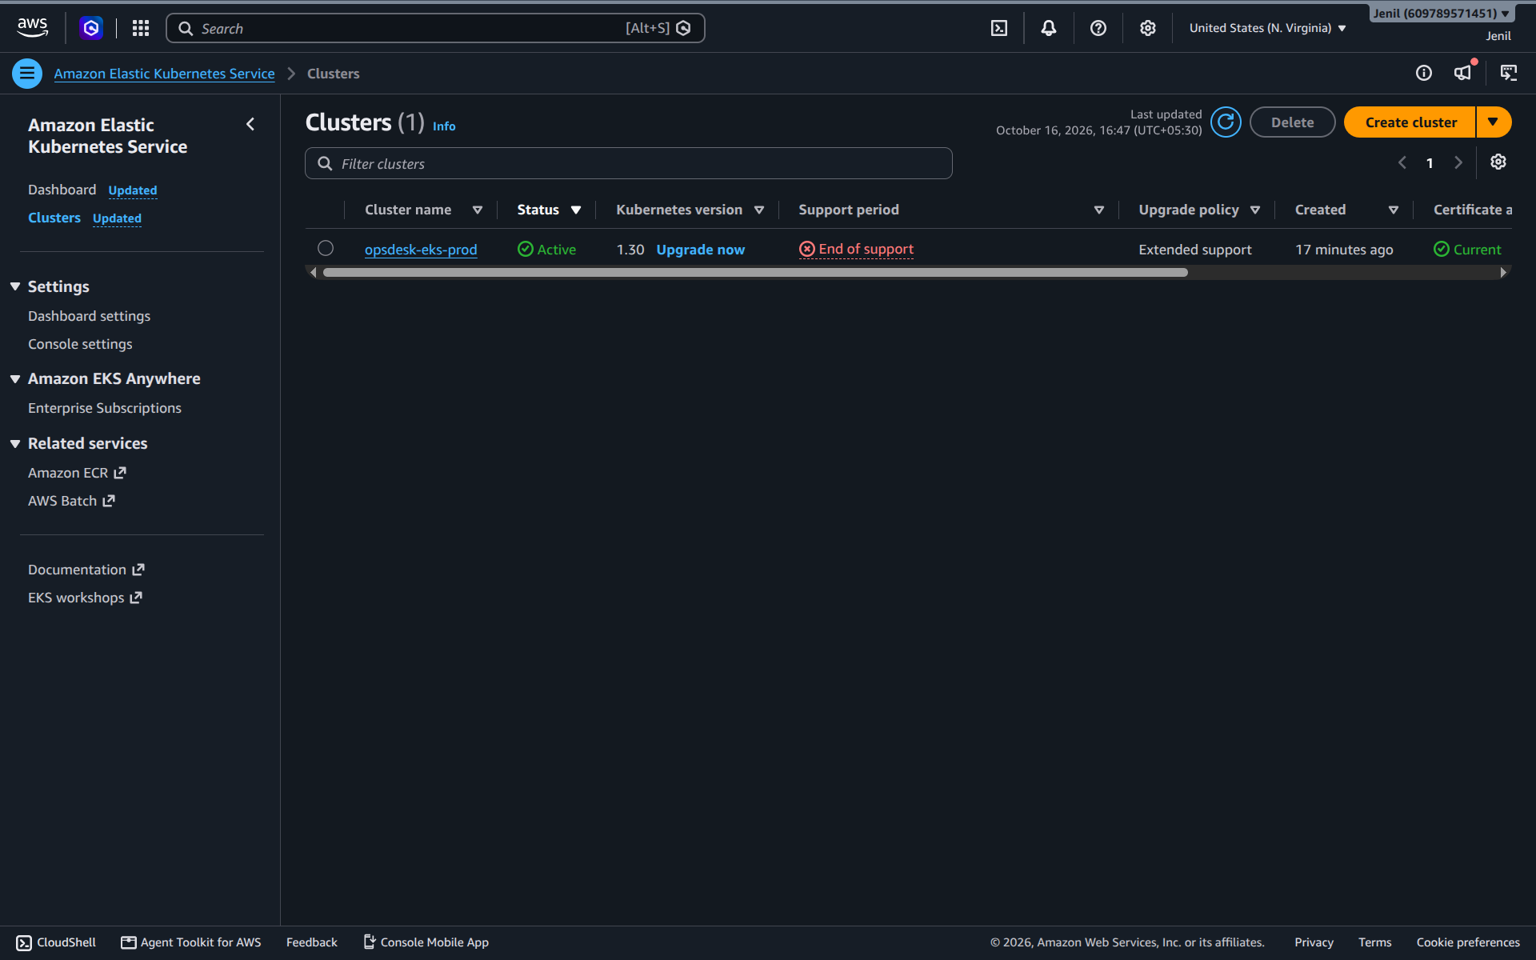
Live AWS EKS Kubernetes Cluster
CLOUD ORCHESTRATION
v1.30
AL2023
Multi-AZ
HPA
EKS Kubernetes version
Amazon Linux 2023 nodes
managed auto-scaling workers
horizontal pod autoscaling
Cluster: AWS EKS v1.30 provisioned via Terraform (opsdesk-eks-prod).
Node group: Managed auto-scaling workers on AL2023 across multiple availability zones.
Packaging: Helm v3 chart with ConfigMaps, ClusterIP services, Ingress rules, and HPAs.
AWS Console — opsdesk-eks-prod status: Active
Notes:
The cluster was successfully provisioned live on AWS, verified with kubectl, and captured directly from the AWS Console.

Slide 8
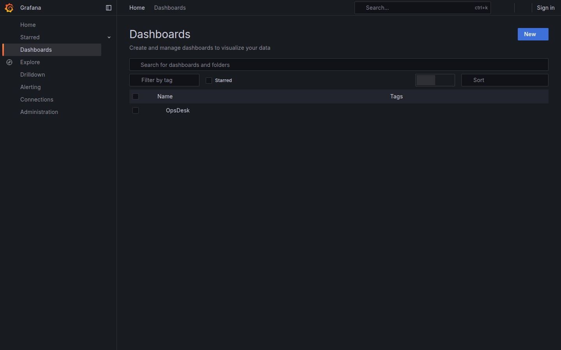
Observability & SRE Telemetry
OBSERVABILITY
Prometheus telemetry: Native /metrics endpoint exports HTTP request counters, latency histogram buckets, and CPU/RAM metrics.
Grafana SRE dashboard: Pre-configured panels track incident resolution rates, P95/P99 latency, and cluster saturation.
KEY TAKEAWAYS
Complete 9-module DevOps capstone delivered on time, documented on GitHub, and verified on live cloud infrastructure.
Grafana — OpsDesk SRE dashboard
Notes:
Observability closes the DevOps loop, providing site reliability engineers real-time visibility into production performance.

